Slide 1
WGCV-53
CalVal CONAE
Report
Thibeault, CONAE
Agenda Item #2.9
WGCV-53, Córdoba, Argentina
5th - 8th March 2024

Slide 2
Table of contents
SAOCOM CalVal activities
  SECF
  Points targets
  Distributed targets
  Higher Level products
SabiaMar CalVal activities
  Pre-launch
  Post-launch
CalVal Collaboration activities
  NASA
  JAXA

Slide 3
SECF activities
  System Engineering Calibration Facility is an
  operative system with permanent operators
  and specific tools as part of Ground Segment
  for monitoring of:
  L0 data
  L1 data
  Specific CalVal and SAR health products
RFI
Weekly and
monthly
reports
Faraday rotation map
Centroid Doppler map

Slide 4
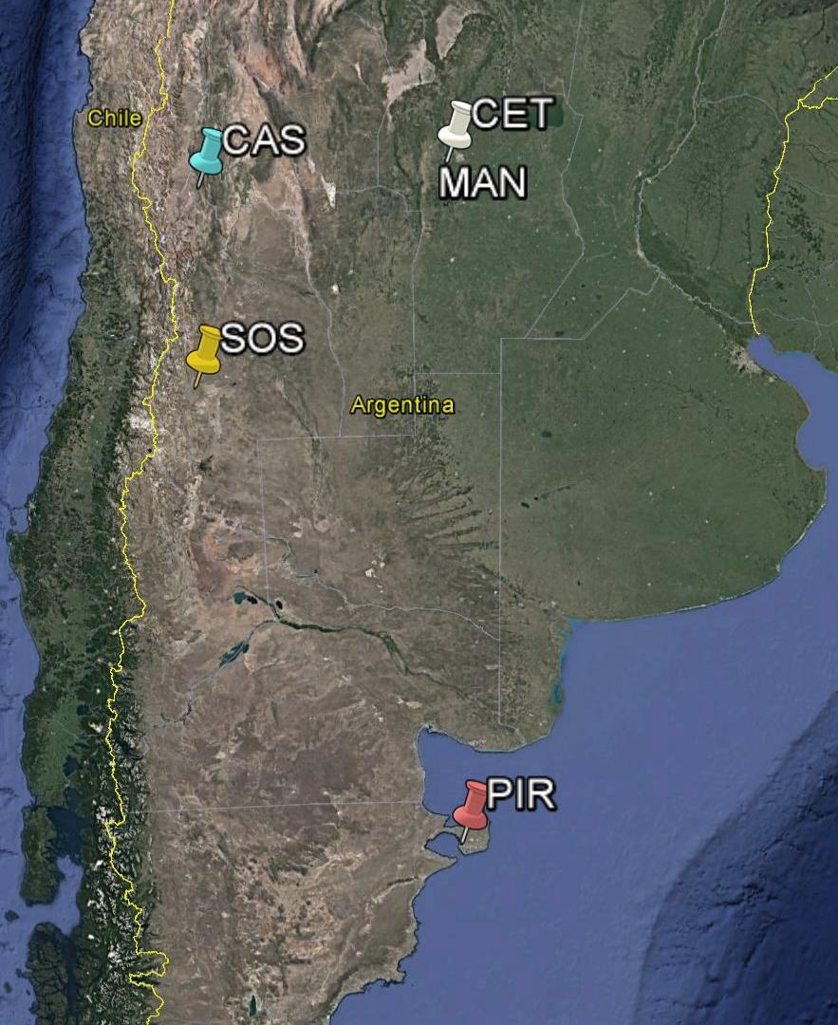
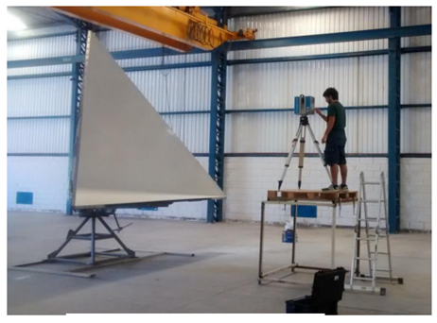
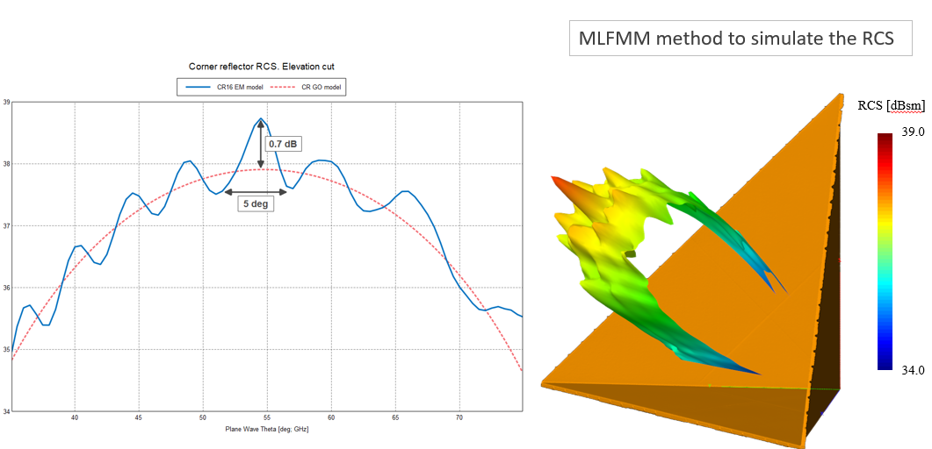
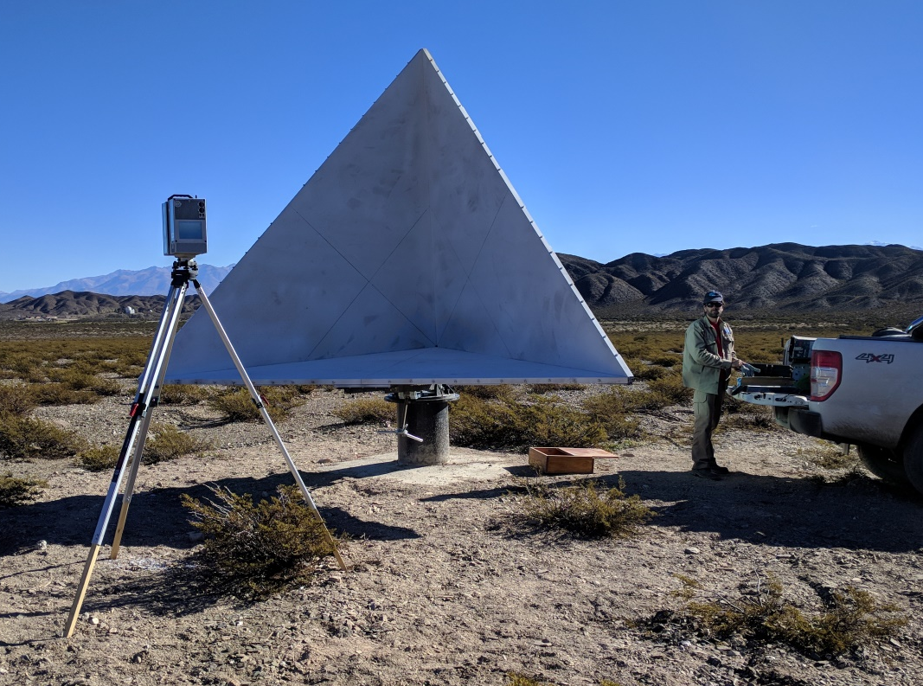
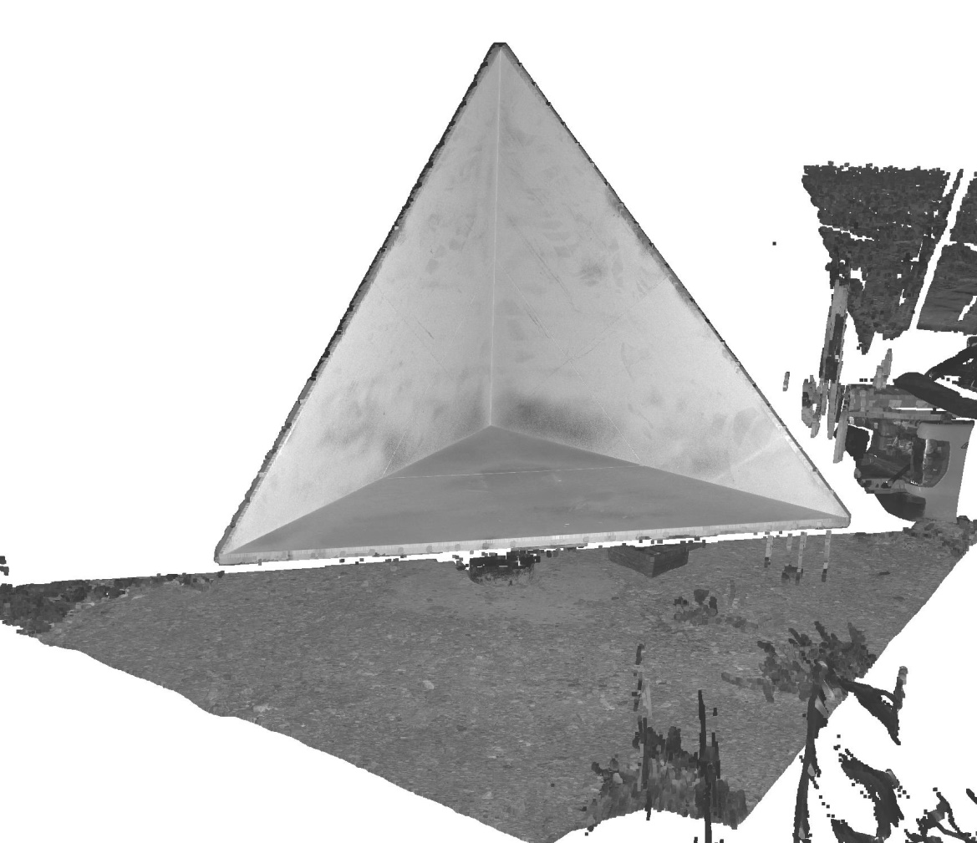
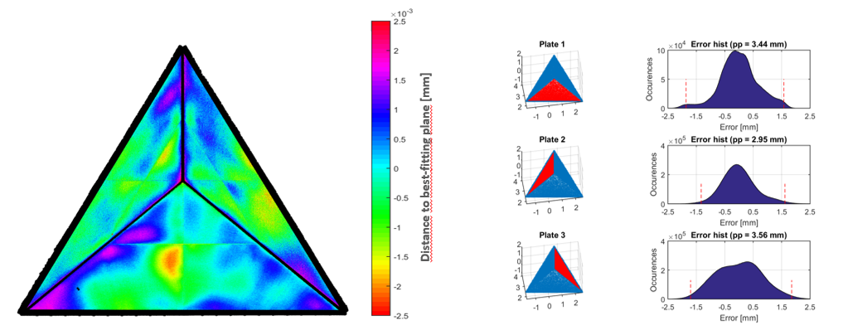
Point Targets activities
1. SOS: 14, 3m L-band ⁽¹⁾; 8, 2m C-band ⁽¹⁾; 4, 1m X-band ⁽¹⁾
2. CAS: 8, 3m L-band ⁽¹⁾
3. CET: 2, 3m L-band ⁽¹⁾, 1 L-band PARC ⁽¹⁾
MAN: 1, 3m L-band ⁽¹⁾
4. PIR: 5, 3m L-band ⁽¹⁾
⁽¹⁾ To be included in SarCalNet

Slide 5
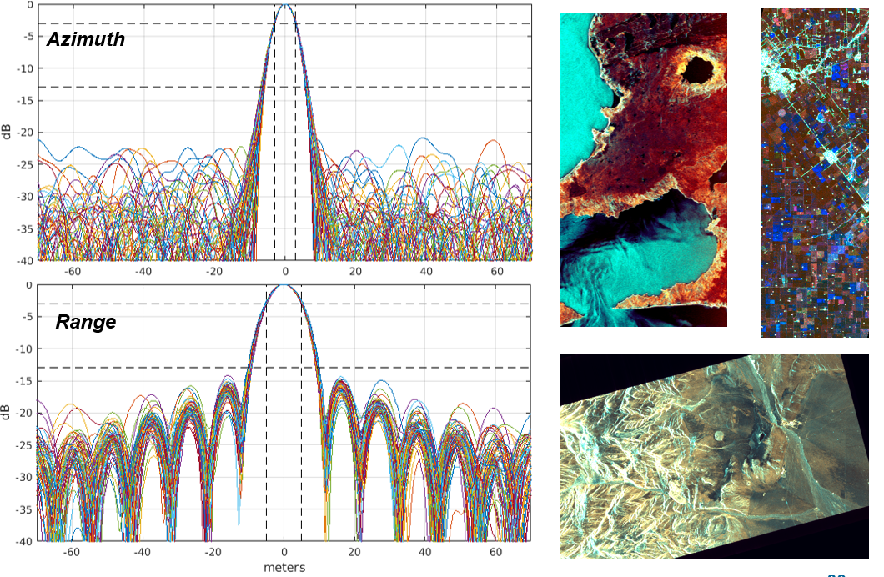
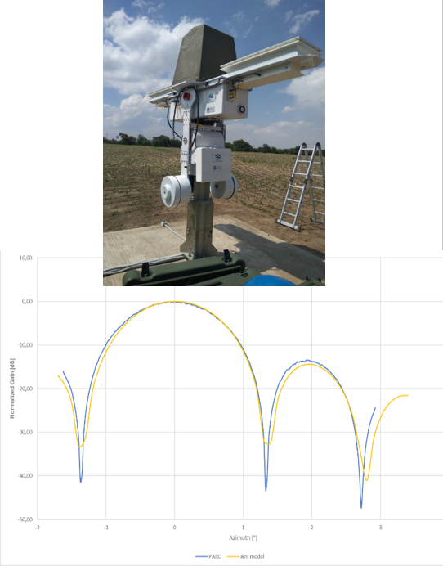
Point targets activities
L-band Polarimetric
Active Radar
Calibrator
Corner Scanning campaigns (every 2/3 year)
Sites monitoring campaigns (twice by year)

Slide 6
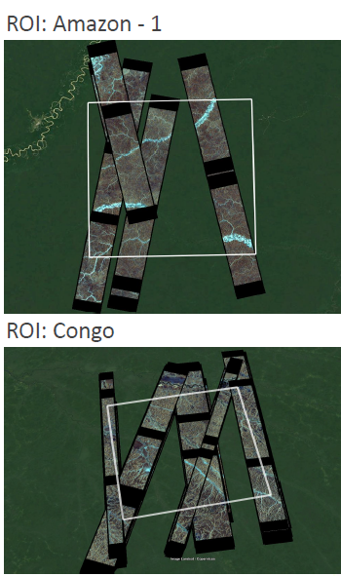
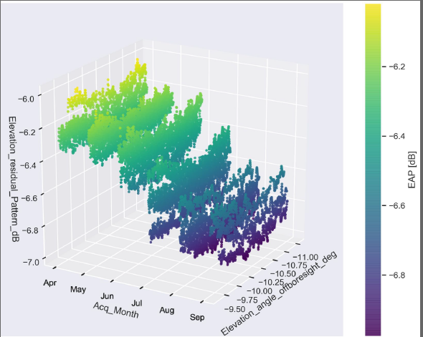
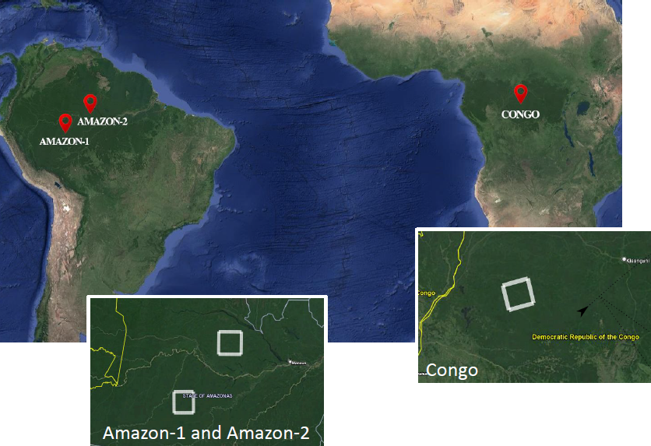
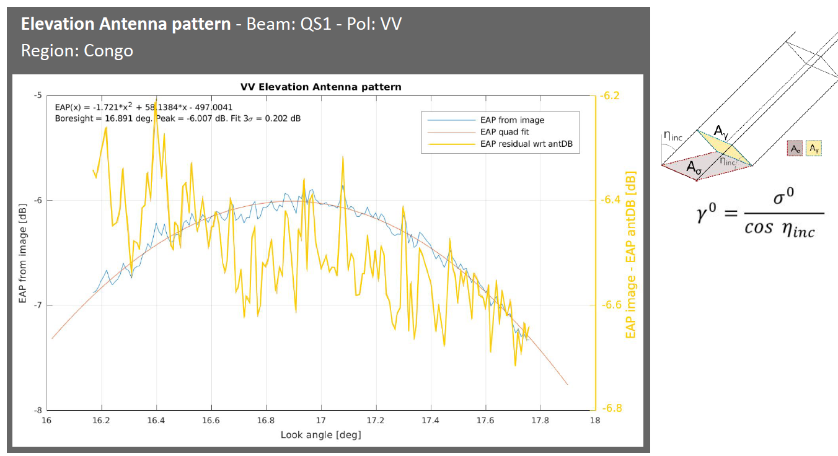
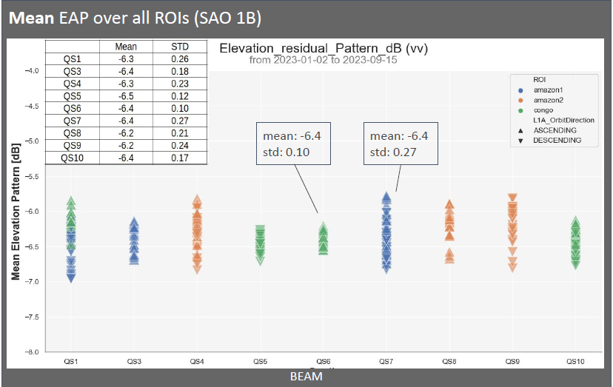
Distributed Targets activities

Slide 7
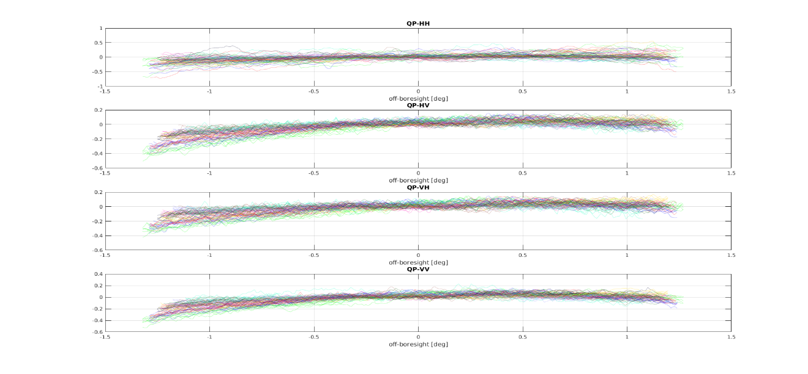
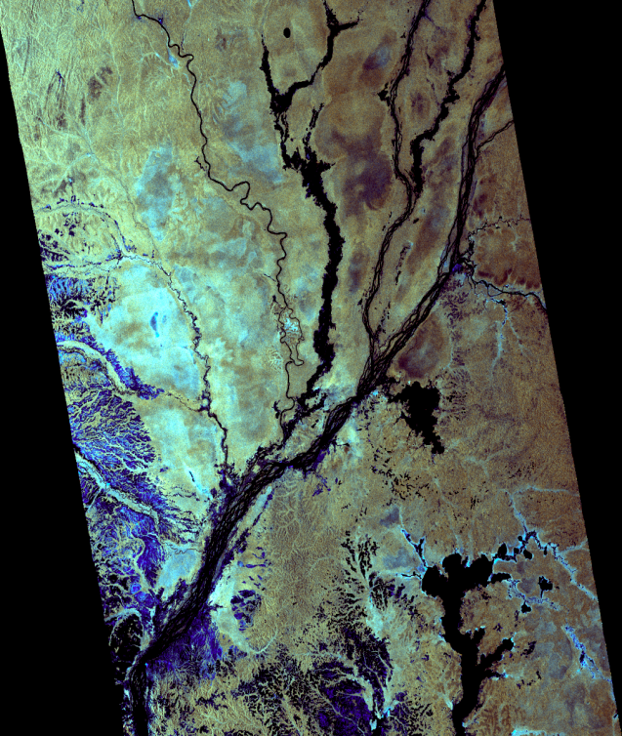
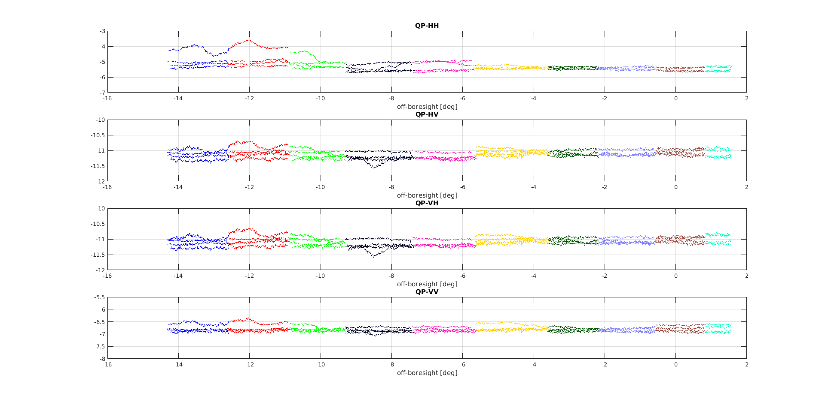
Distributed targets activities
Range Antenna Pattern and interbeams
Residual azimuth Antenna Pattern
Ratio of receive
and transmit
imbalance

Slide 8
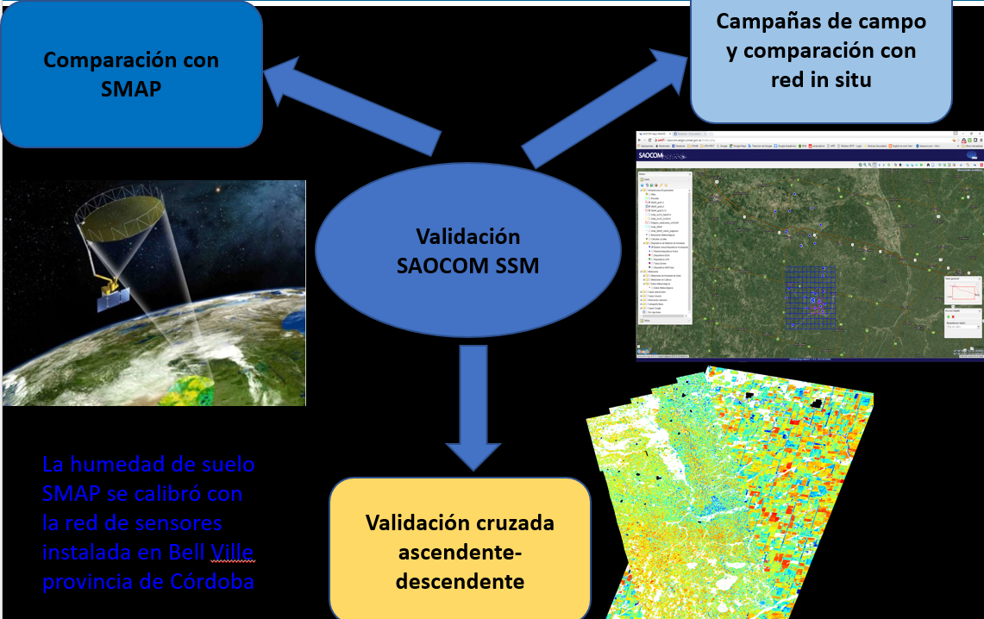
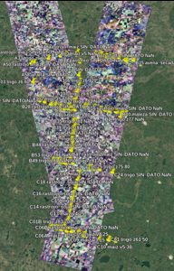
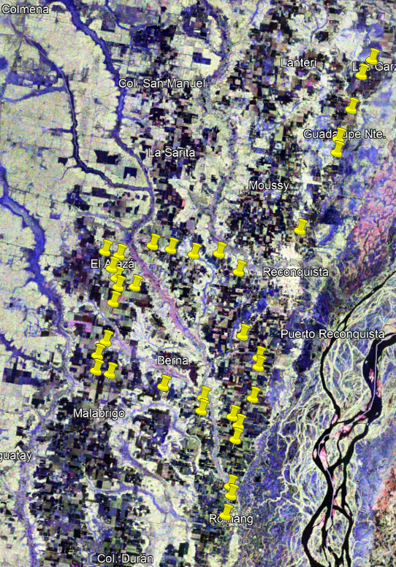
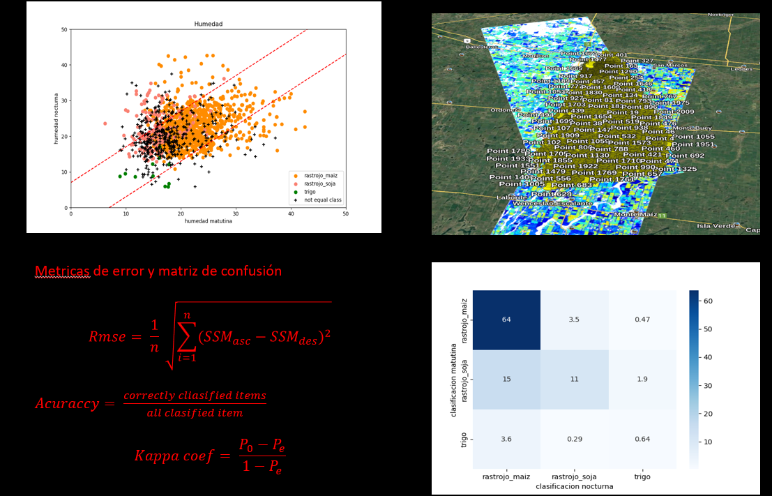
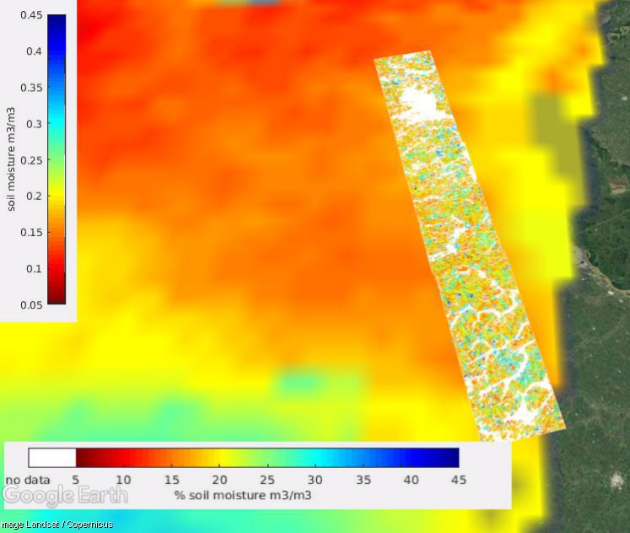
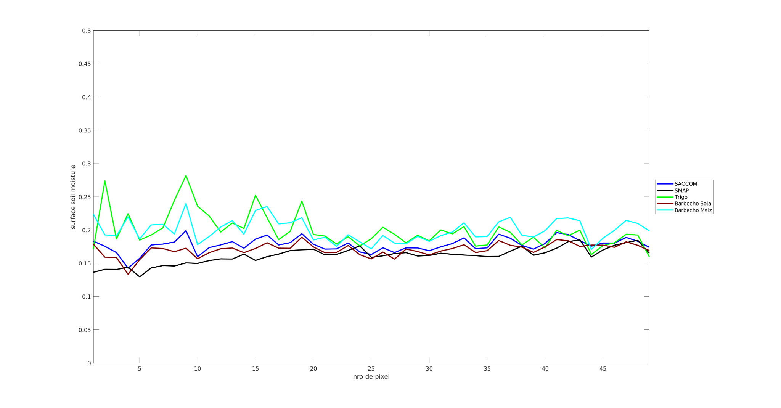
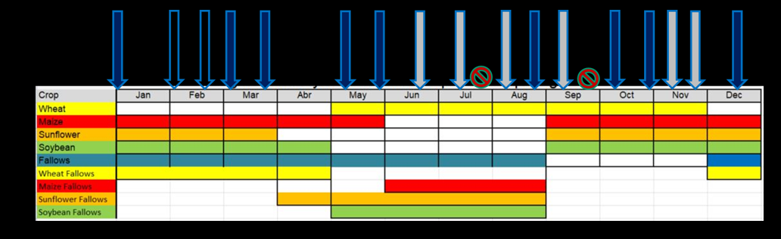
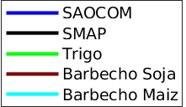
Higher products CalVal activities
Sunflower campaigns:
2021-2022
2022-2023
Core site Campaigns:
2018-2019

Slide 9
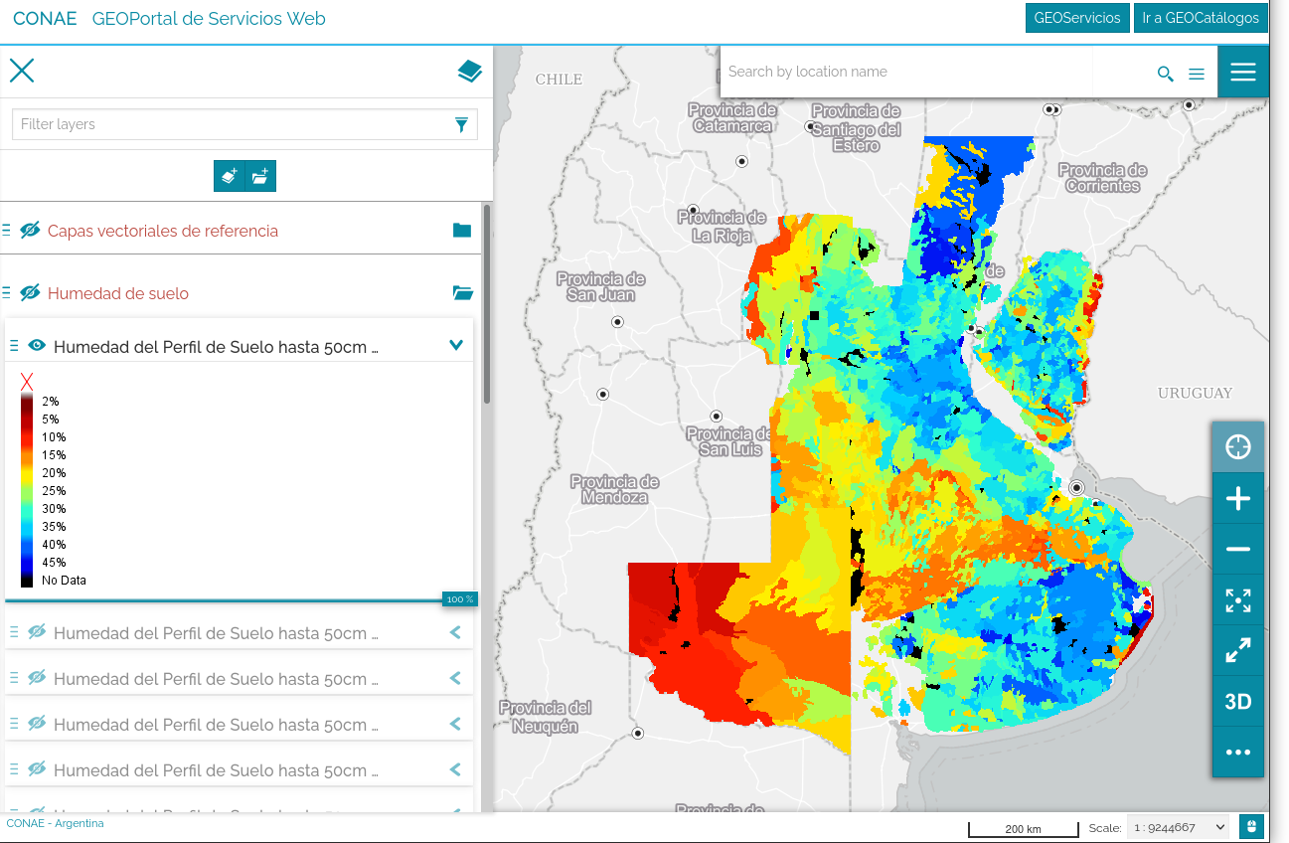
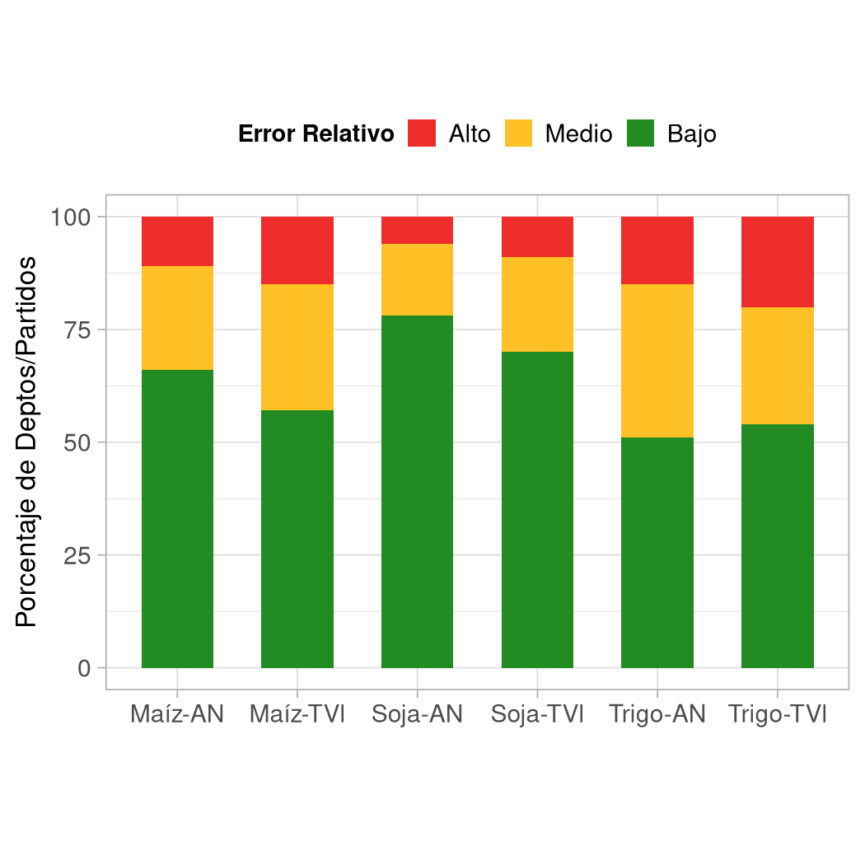
Higher products CalVal activities
  DSS Batch
It was contrasted with data from the grain exchange and others to estimate the product error.
conae_mod_mhs_dss_amz_20201025
conae_mod_mhs_dss_amz_val_20210121
conae_mod_mhs_dss_asb_20201209
conae_mod_mhs_dss_asb_val_20210121
conae_mod_mhs_dss_awh_20200804
conae_mod_mhs_dss_awh_val_20210121
conae_mod_mhs_dss_nmz_20201025
conae_mod_mhs_dss_nmz_val_20210121
conae_mod_mhs_dss_nsb_20201209
conae_mod_mhs_dss_nsb_val_20210121
conae_mod_mhs_dss_nwh_20201028
conae_mod_mhs_dss_nwh_val_20210121

Slide 10
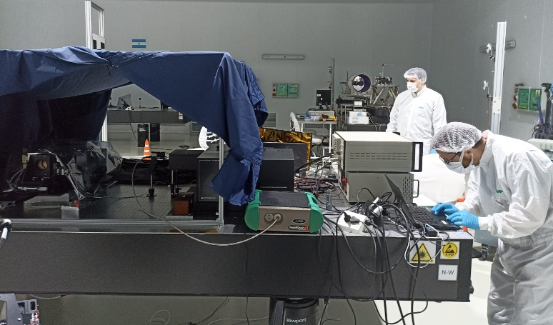
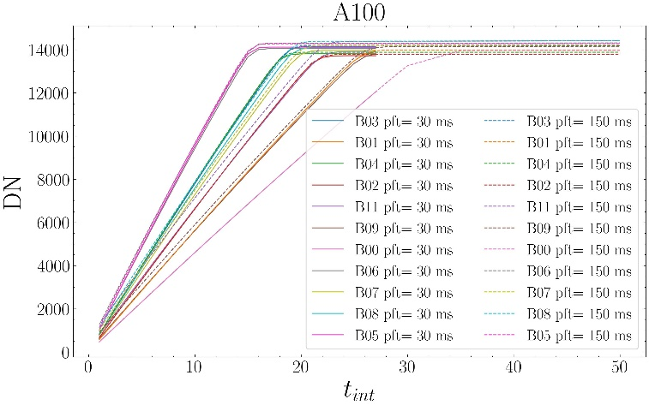
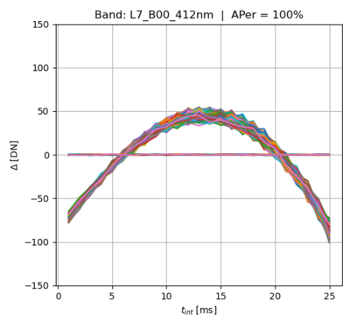
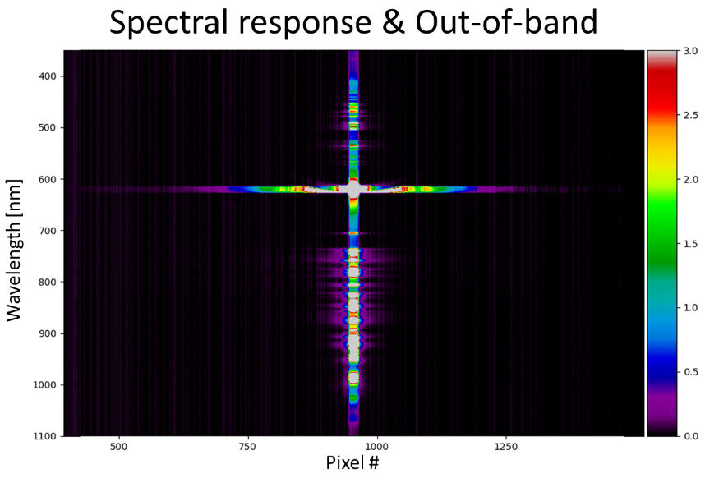
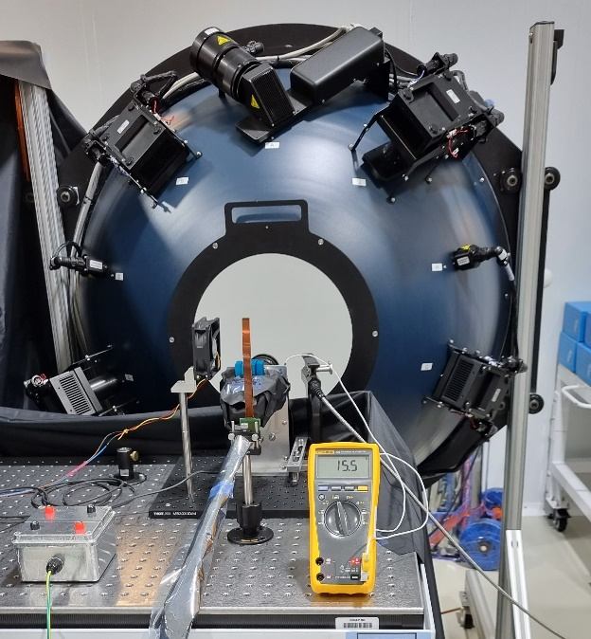
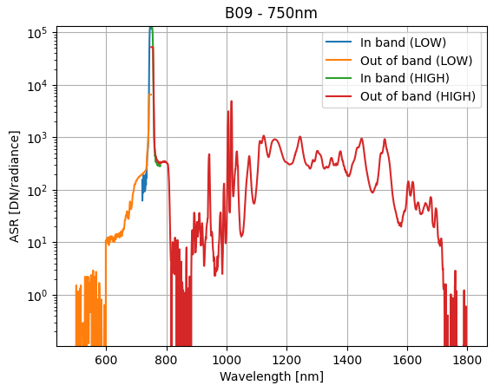
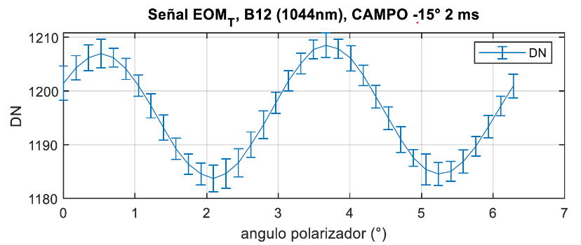
SABIA-Mar: Pre-launch
  On ground cameras characterization and calibration:
        Radiometric, spectral and geometric parameters: Absolute gain, linearity, spectral response function, polarization sensitivity, stray-light, internal temperature dependence, diffuser BRDF, line-of-sight, alignment matrix, etc.
          VIS-NIR and NIR-SWIR cameras → in progress
          HSC → latter half of 2024

Slide 11
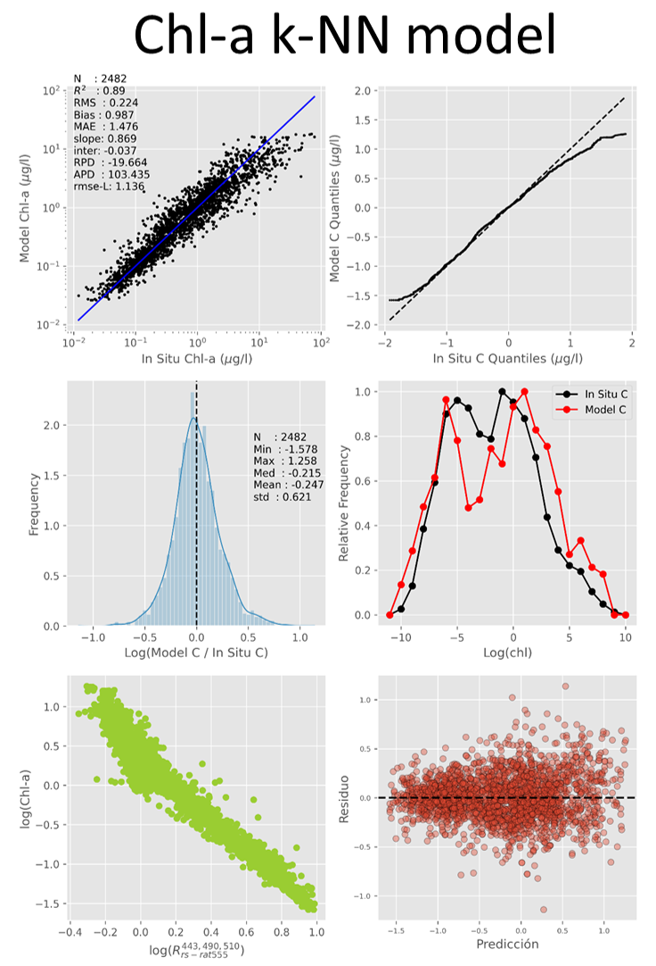
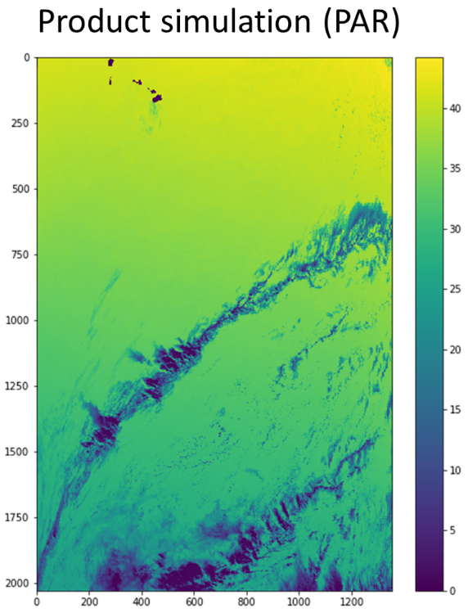
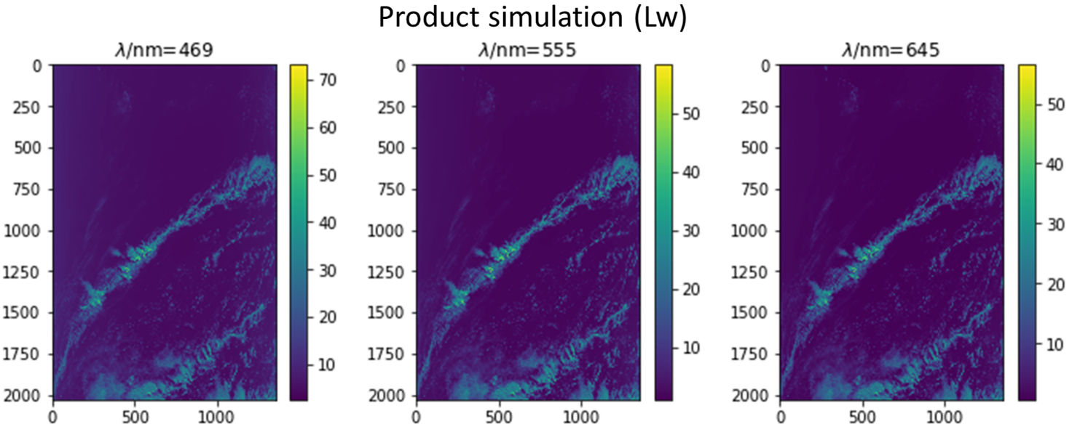
SABIA-Mar: Pre-launch
        L2 products algorithms (pre-launch version):
        L2 algorithms for normalized Water leaving radiance, Chlorophyll-a concentration, Diffuse attenuation coefficient 𝐾𝑑(490), Photosynthetically available radiation PAR, turbidity and Night boat detection → Ready
        Initial coefficients determination → in progress
        Validation using in-situ, auxiliary and simulated data → in progress

Slide 12
SABIA-Mar: Post-launch (plan)
  On-board Calibration:
    Solar (diffuser) and lunar calibration
    Deep space and side-slither calibration
    Geolocation Validation using coastlines and dams.
    Vicarious Calibration:
    Radiometric: Rayleigh scattering and Sun-glint
    Cross-calibration between VIS-NIR, NIR-SWIR and HSC.
    System vicarious calibration (SVC): Available external sites will be used (e.g.: MOBY, HyperNAV, AERONET)
        L2 and L3 Products Validation:
        In-situ data bases for Global scenario: NOMAD, SeaBASS, MOBY, AERONET-OC, HyperNet, GLORIA, AODN, CFOO, NDBC.
        In-situ permanent stations for Regional scenario in Argentina: AERONET-OC Bahía Blanca, EPEA, ROMA, REMARCO, EMAC
        Field campaigns for Regional scenario: Pampa Azul, INIDEP, EPEA, IAFE and CENPAT for coastal waters. PNA for night boats detection. INA and PROSAT II for in-land waters.

Slide 13
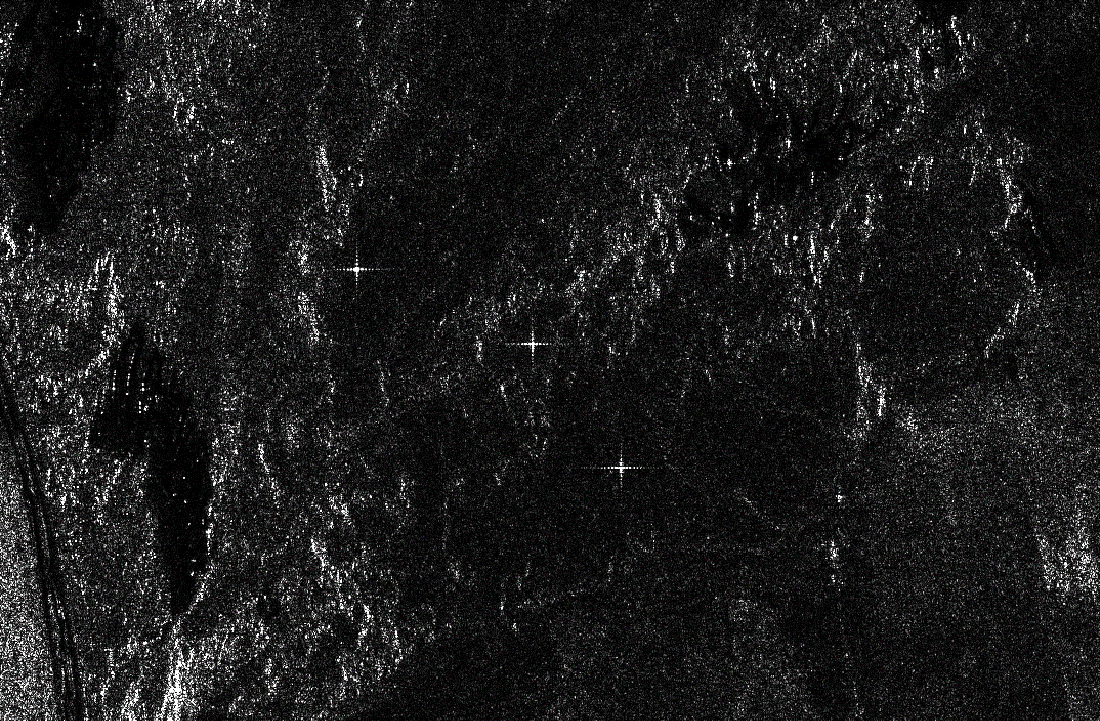
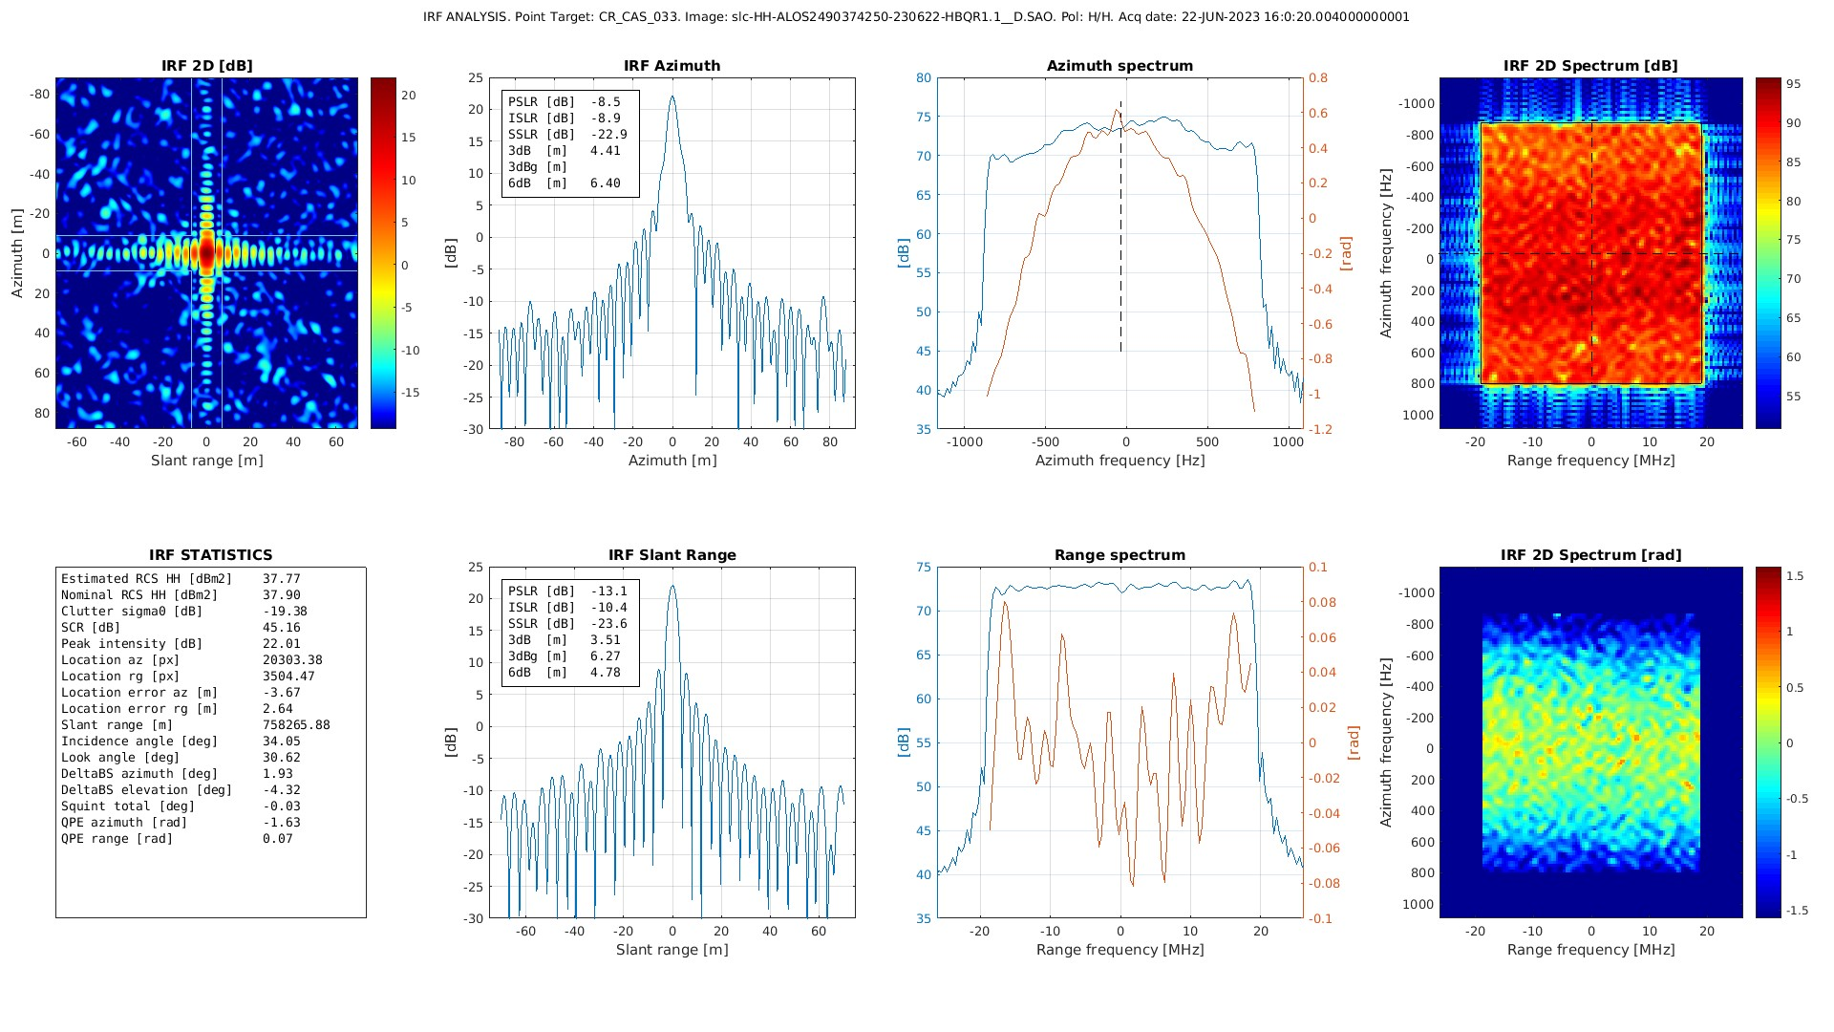
Collaboration activities (CVST,JAXA)
Over the aforementionned specific rain forest sites, there is an ongoing study comparing ALOS 2 and SAOCOM

Slide 14
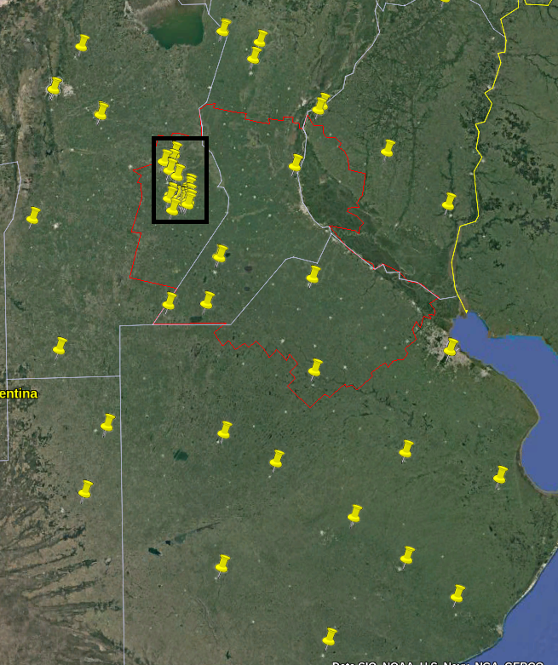
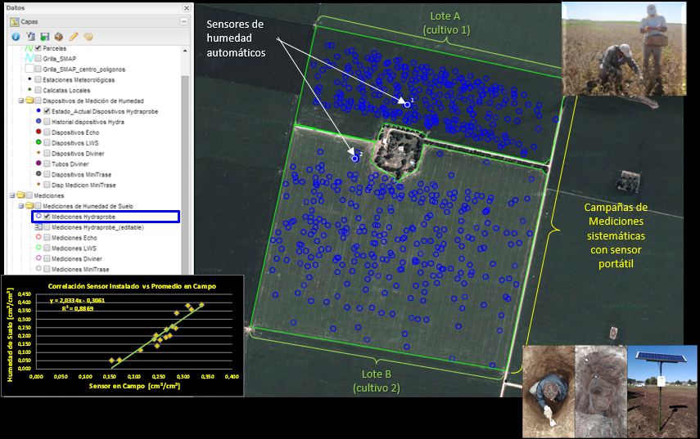
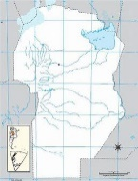
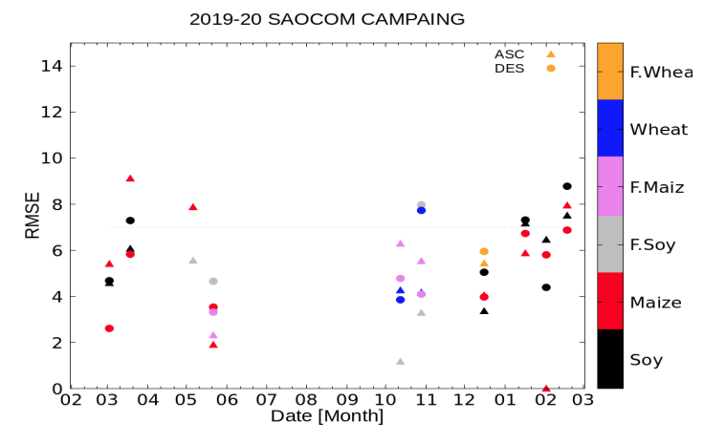
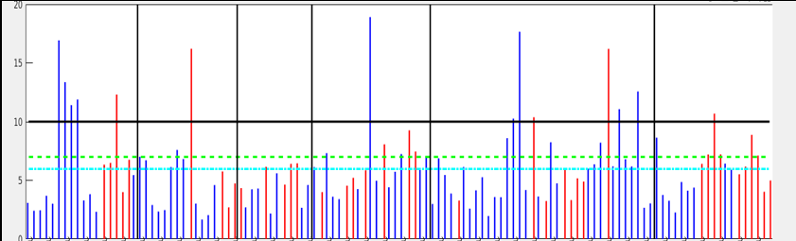

Collaboration activities (SMAP, NASA)
Rastrojo
Trigo
Measurement Protocols
Derived from USDA/SMAP collaboration
Trigo
%
Rastrojo
Maiz
Rastrojo
Soja
Maize
Maiz
Soja
Soy

Slide 15
Conclusion
Multiples, well characterized and maintained point target sites
Characterization of rain forest in full pol L-band
Crops classifications and superficial soil moisture automated products
Higher level Ag and hydrological validated products
Extensive Ground truth datasets (Crops, SM)
Date/hour | Number of leaves by plant | General condition
Plot id | Coverage | Uniformity
Crop type | Distance between rows | Weeds intensity
Phenological state | Fresh leave weight | Pest intensity
Plant height | Fresh stem weight | Illness intensity
Leaf length | Fesh reproductive organ weight | Abiotic adversities intensity
Leaf width | Total fresh plant weight | Abiotic adversity type
Leaf thickness | Dry leave weight | photosynthetically active radiation (PAR) top
Stem length | dry stem weight | photosynthetically active radiation (PAR) bottom
Stem diameter | dry reproductive organ weight | Leaf Area index
Reproductive organ length | Total dry plant weight
Reproductive organ width | observation
Plant by square meter | Lat/long
Plants by lineal meter

Slide 16
Backup slides

Slide 17
Points of contact
Marc Thibeault mthibeault@conae.gov.ar
Matías Palomeque mpalomeque@conae.gov.ar
Carolina Tauro carolina.tauro@conae.gov.ar (SabiaMar PI)

Slide 18
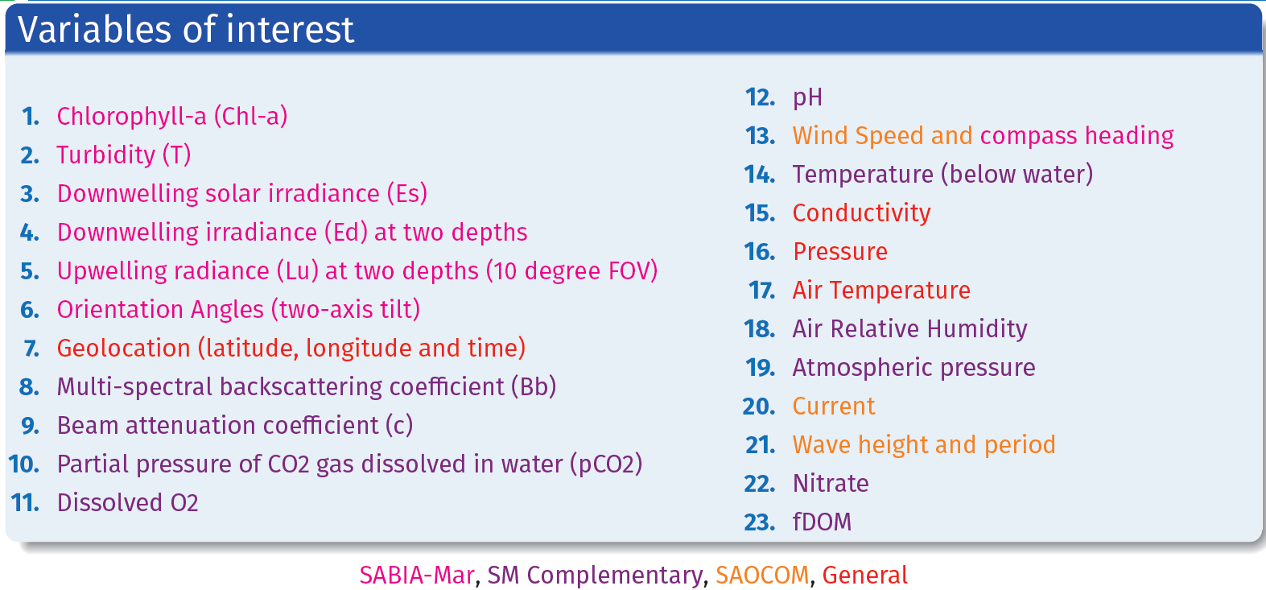
SABIA-Mar: Post-launch (plan)
        CONAE’s Buoys program: program for the development of buoys in the Argentinian Sea

