Slide 1
USGS - Space Agency Report WGCV-53
2024/03/07
Cody Anderson, ECCOE PM
USGS EROS
chanderson@usgs.gov www.usgs.gov/calval
U.S. Geological Survey (USGS) Earth Resources Observation and Science (EROS) Center, Sioux Falls, SD 57198, USA.

Slide 2
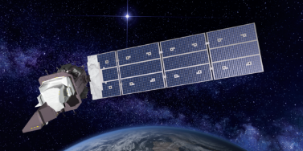
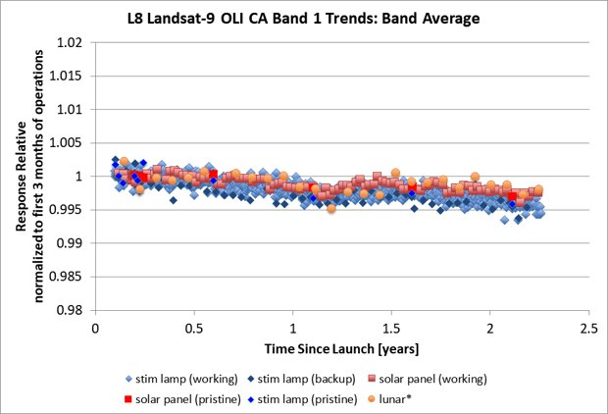
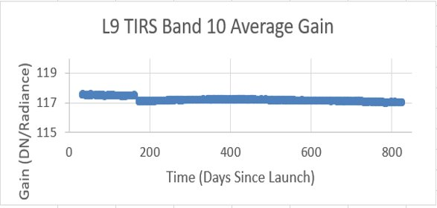
Landsat 9
Landsat 9 continues to be stable and in-line with Landsat 8 for both Reflective (Left) and Thermal (Right) Bands

Slide 3
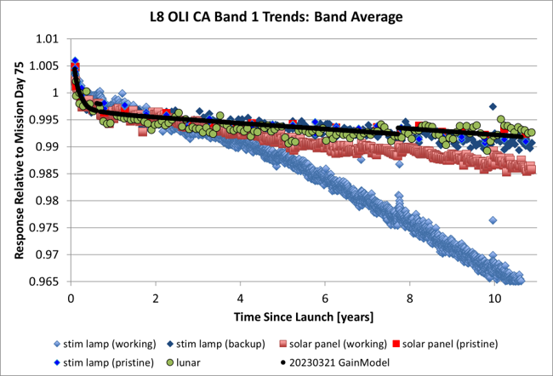
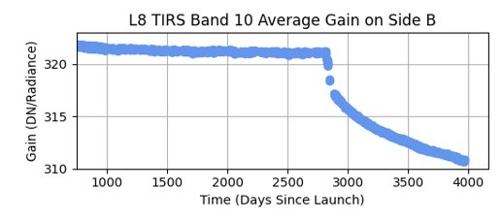
Landsat 8
10 Year Anniversary
Degradations in Reflective band plot are due to on-board calibrator degradations
Degradations in thermal band plot are due outgassing/condensation which is accounted for with calibration

Slide 4
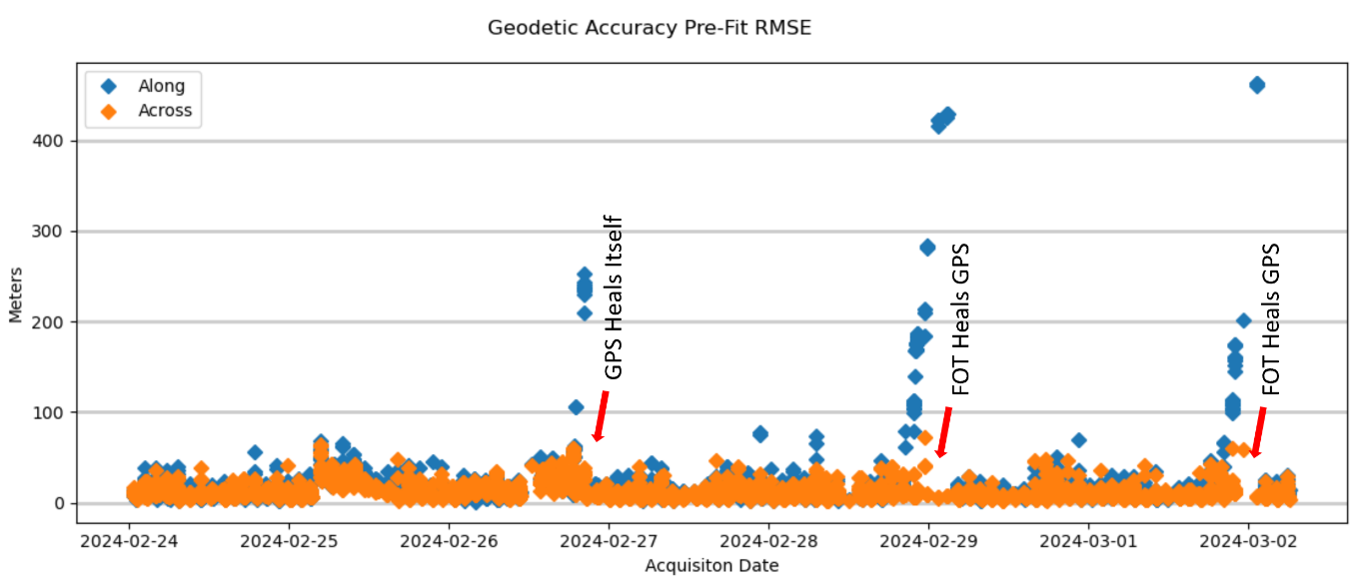
Landsat 8
One on-going issue with L8 is GPS “drop-outs” – 3 within one week in Feb.
These do not affect data quality but require extra effort to process
L9 has a different GPS unit and is not affected, similarly

Slide 5
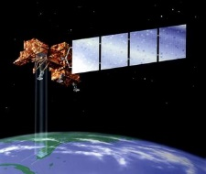
Landsat 7
Nominal Science Mission Ends: April 6, 2022 – Lowered Orbit
Landsat 7 Extended Science Mission: May 5, 2022 – Jan. 19, 2024
With cancellation of OSAM-1, L7 will cease all operations
April 15, 2024 – 25th Anniversary of mission

Slide 6
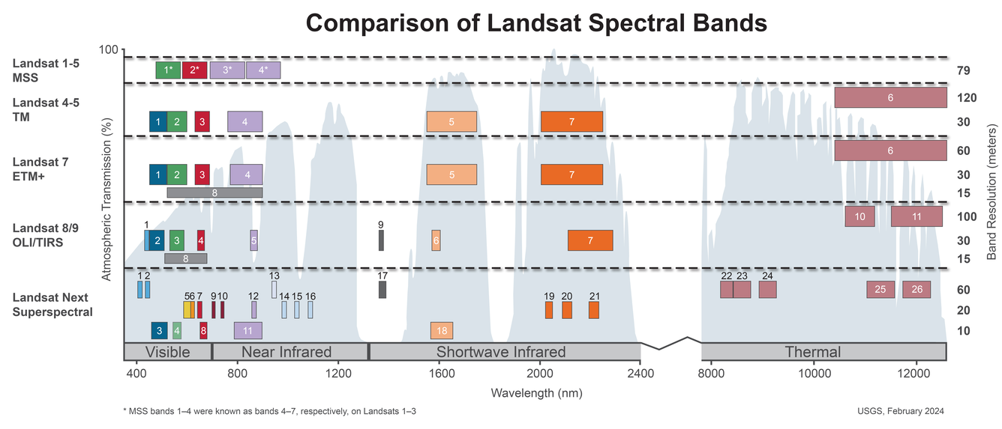
Landsat Next
Number of spectral bands: 26
Spatial resolution: 10-20 meters (VSWIR), 60 meters (atmospheric/TIR)
Triplet constellation repeat interval: 6 days
Expected launch date: Late 2030

Slide 7
Landsat Collection 3
Processing ~2028
Inclusions
Compatible with LNext
Surface Reflectance and Temperature Improvements
BRDF
Copernicus DEM
Terrain Illumination?
Global/Continental Equal Area Projection/Tiling?
Pixel Upper Left vs Center Indexing?
CEOS ARD Target Level Compliance

Slide 8
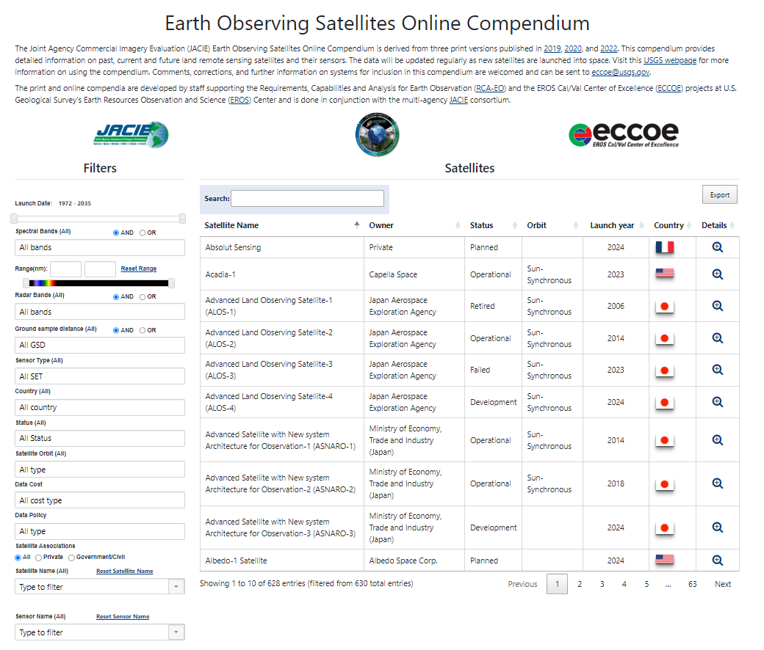
Satellite Compendium
https://calval.cr.usgs.gov/apps/compendium#

Slide 9
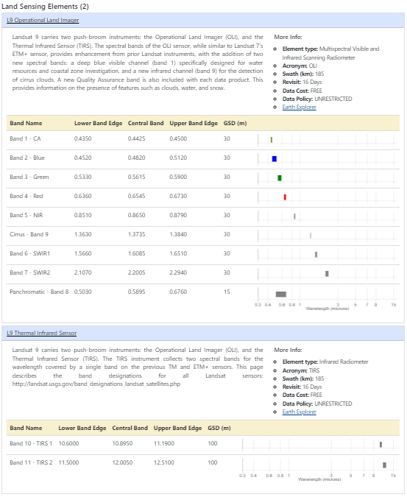
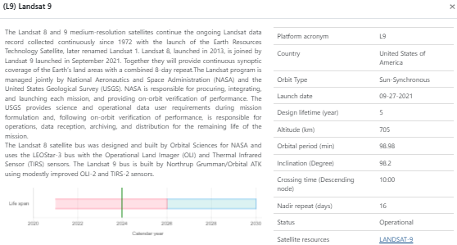
Satellite Compendium
https://calval.cr.usgs.gov/apps/compendium#

Slide 10
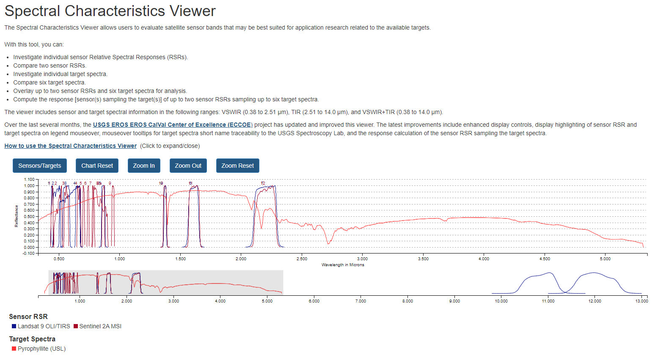
Spectral Characteristics Viewer
https://landsat.usgs.gov/spectral-characteristics-viewer

Slide 11
Spectral Characteristics Viewer
https://landsat.usgs.gov/spectral-characteristics-viewer

Slide 12
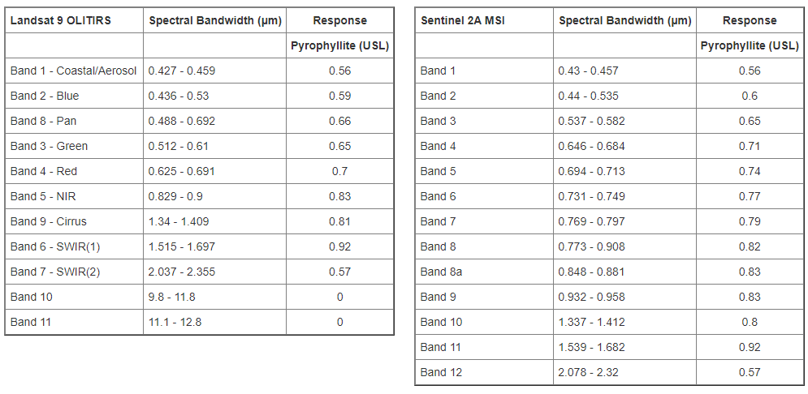
Spectral Characteristics Viewer
https://landsat.usgs.gov/spectral-characteristics-viewer

Slide 13
Land Product Characterization System (LPCS)
https://calval.cr.usgs.gov/apps/lpcs

Slide 14
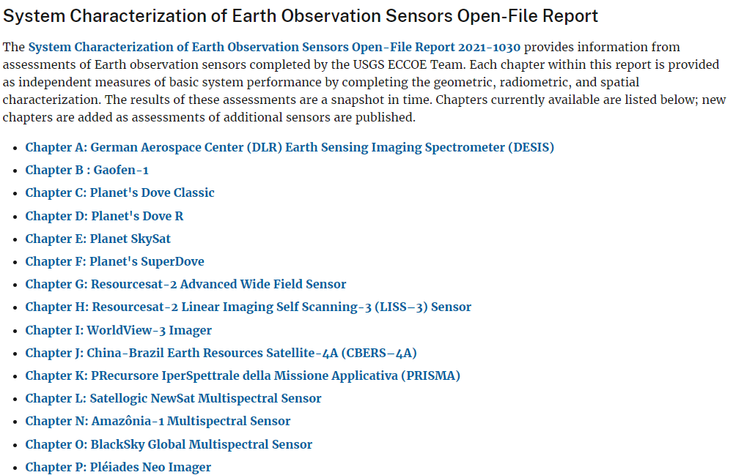
System Characterization Reports
https://www.usgs.gov/calval/data-quality-assessment

Slide 15
Summary
Landsat 8 and 9 continue nominal and stable operations
Landsat 7 is being decommissioned
LNext and Landsat Collection 3 are progressing
Check out the Satellite Compendium
https://calval.cr.usgs.gov/apps/compendium#
Check out the Spectral Characteristics Viewer
https://landsat.usgs.gov/spectral-characteristics-viewer
Check out the Land Product Characterization System
https://calval.cr.usgs.gov/apps/lpcs
Check out System Characterizations
https://www.usgs.gov/calval/data-quality-assessment

