Slide 1
WGCV-53
Cal/Val Activities in Chile
Carolina Barrientos, SAF
Agenda Item 3.9 - I
WGCV-53, Córdoba, Argentina
5th - 8th March 2024

Slide 2
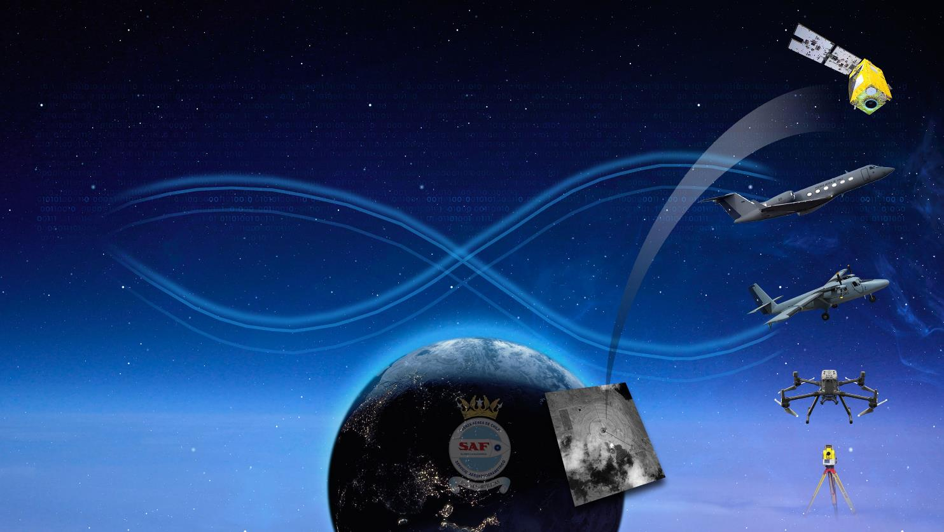
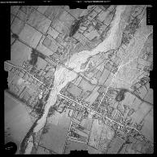
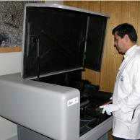
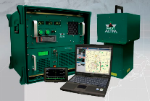
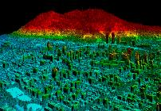
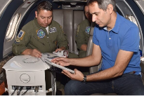
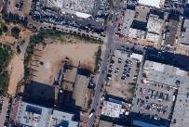
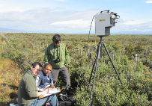
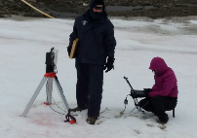
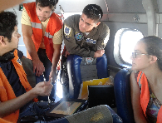
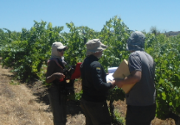
General context
FACh – Aerial Photogrammetric Service
Cooperation Agreements: ~ 30 Universities &
Research Centers: 13
Slide ‹#›

Slide 3
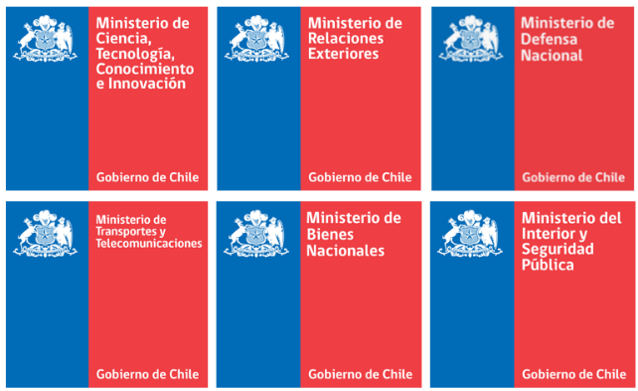
National Space Program
SUBSISTEM 1
GEOESPATIAL
INFORMATION
SUBSISTEM 2
NATIONAL SPACE DEVELOPEMENT
SUBSISTEM 3
NATIONAL SATELLITE SYSTEM
SUBSISTEM 4
SATCOM
SUBSISTEM 5
TALENT PROMOTION
Future 10 Satellites: 7 microsatellites (~ 23 kg) & 3 satellites (~ 100 kg): One built in Chile.
Advanced Mission Control: Cerrillos, Santiago.
Regional Space Centers:Antofagasta, Concepción & Punta Arenas
Slide ‹#›

Slide 4
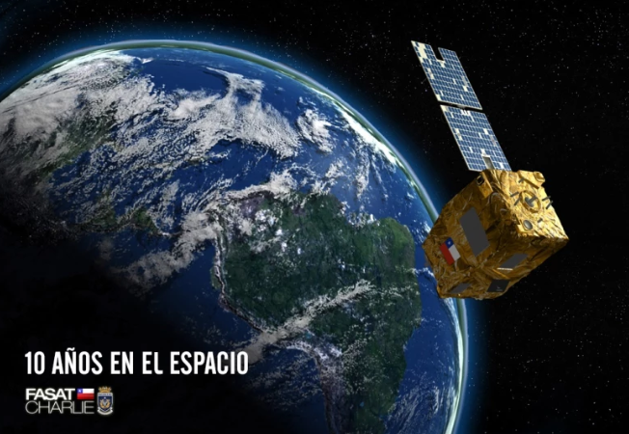
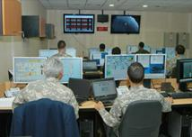
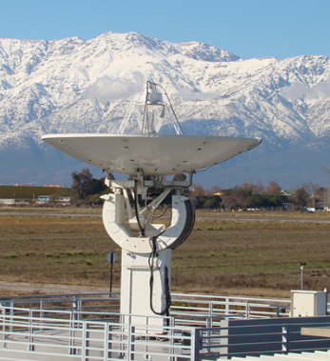
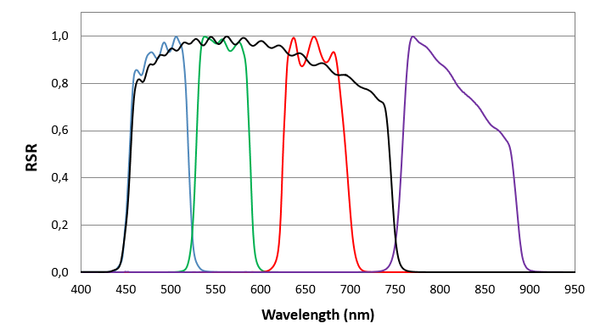
SSOT FASat-Charlie
Sistema Satelital para la Observación de la Tierra (SSOT) – FASat-Charlie
Life design: 5 years
Launched on 16 Dec. 20112

Slide 5
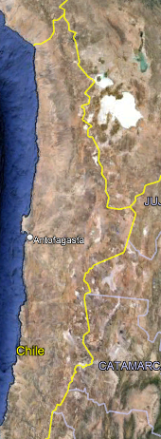
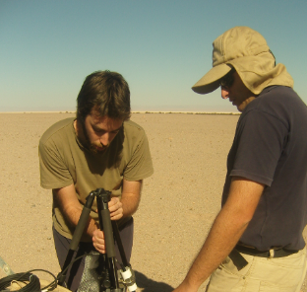
First Exploration Campaign in the Atacama Desert
National Institute for Space Research (INPE) – Laboratory for the Analysis of the Biosphere (LAB) University of Chile - SAF
El Tambillo, Región de Antofagasta
19 – 22 August 2014
Pinto et al. Spectral and Atmospheric Characterization of a Site at Atacama Desert for Earth Observation Sensor Calibration. IEEE Geoscience. Remote Sens. Letters. 2015. https://doi.org/10.1109/LGRS.2015.2460454
Mattar et al. Atacama Field Campaign: laboratory and in-situ measurements for remote sensing applications. Int. Journal of Digital Earth. 2017. https://doi.org/10.1080/17538947.2018.1450901
~ 2.400 m.a.s.l.

Slide 6
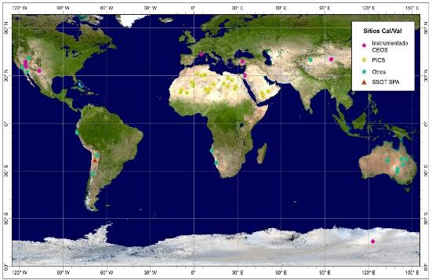
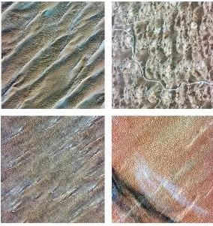
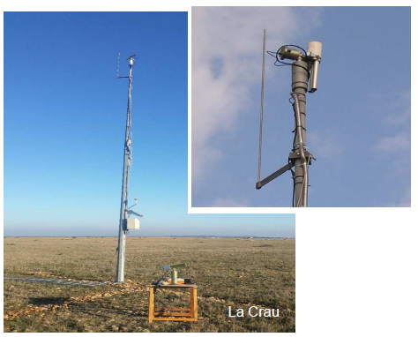
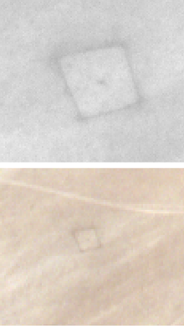
Used Cal/Val Sites
Calibration Sites Monitored for Cal/Val
CEOS-WGCV Endorsed Cal/Val Sites
PICS

Slide 7
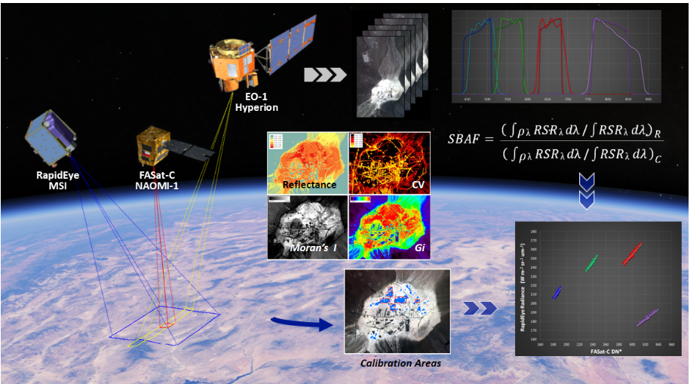
Used Cal/Val Sites
Cross Cal/Val Activities for FASat-Charlie
Radiometric Cross Calibration SNO's Approach
RapidEye and EO-1 Hyperion hyperspectral data over Frenchman Flat.
Cross Cal/Val: Sentinel-2 MSI & Landsat 8 OLI (Chile, Spain, USA, Lybia…) 🡪 SNO‘s with S2A- MSI
Barrientos, et al. Radiometric Cross-Calibration of the Chilean Satellite FASat-C Using RapidEye and EO-1 Hyperion Data and a Simultaneous Nadir Overpass Approach. Remote Sensing. 2016. https://doi.org/10.3390/rs8070612

Slide 8
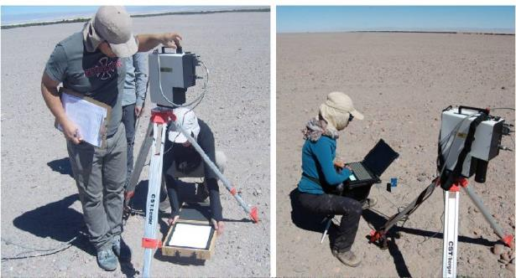
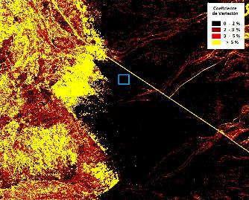
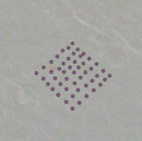
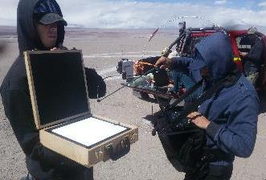
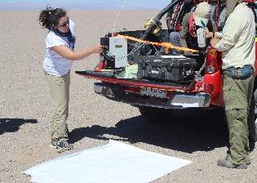
Cal/Val Campaigns in Atacama Desert
Experimental calibration campaigns: 2016 - 2021
El Tambillo Calibration Site, San Pedro de Atacama Atacama Desert
AOD₅₅₀: < 0.1 WV: < 0.5 cm
CV: <2% ρ _{surf}: ~ 0.25
Modified approach + Second Simulation of the Satellite Signal in the Solar Spectrum (6S) RTC (Vermote et al., 1997).
2020
Microtops 540 II + MODerate resolution atmospheric TRANsmission (MODTRAN) (Berk et al., 2006)

Slide 9
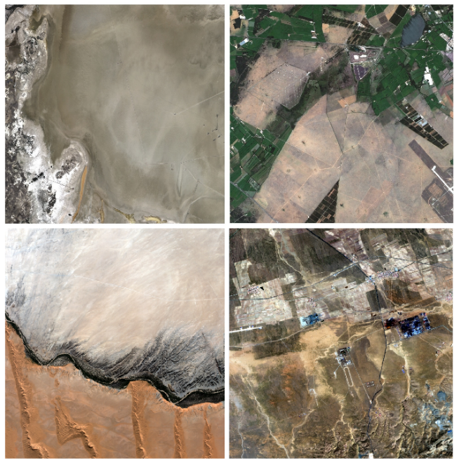
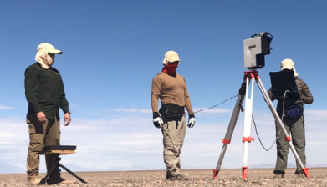
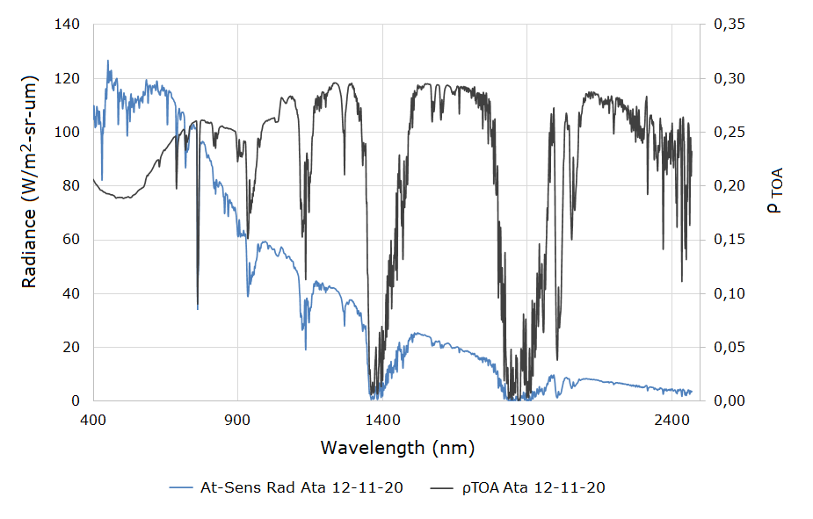
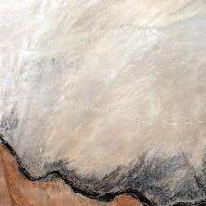
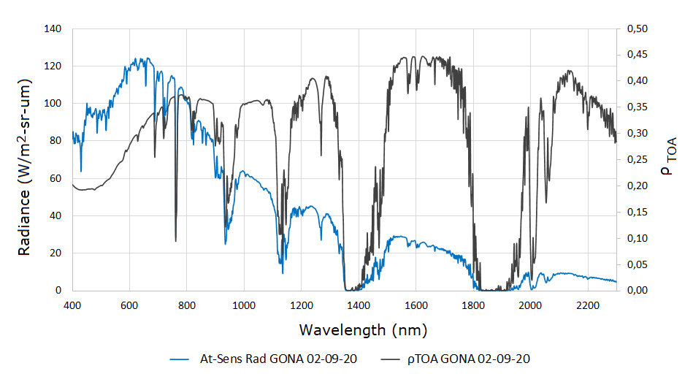
Using of RadCalNet for Cal/Val of FASat-Charlie
FASat-Charlie Calibration using acquisitions over the RadCalNet Sites
RVPN
2020
LCFR
Atacama
GONA
BTCN
GONA
Barrientos et al. Calibration of the SSOT Mission Using a Vicarious Approach Based on Observations Over the Atacama Desert and the Gobabeb Radcalnet Station. 2020. ISPRS Annals of the Photogrammetry, Remote Sensing and Spatial Information Sciences. 2020. https://doi.org/10.5194/isprs-annals-V-1-2020-133-2020

Slide 10
Using of RadCalNet for Cal/Val of FASat-Charlie
Estimation of preliminar coefficients: ρ_{BOA} and provided atmospheric retrievals and MODTRAN 6.0
RadCalNet Cal/Val at TOA level: Extraction of DN and ρTOA calculation using the Atacama coefficients.
June 2019 Calibration
November 2020 Calibration
Gains (W/m²·sr·μm)
Site | Atacama | GONA
Date | 12-11-20 | 02-09-20
Blue | 1.1233 | 1.1505
Green | 0.9591 | 1.0105
Red | 0.7675 | 0.818
NIR | 0.5573 | 0.5827
Pan | 0.4465 | 0.462
Band | ρ_{TOA-SSOT} /ρ_{TOA-RadCalNet} GONA
Dates
 | 10-05-19 | 07-07-19
Blue | 0.969 | 0.992
Green | 0.990 | 1.019
Red | 0.951 | 0.985
NIR | 1.022 | 1.061
Pan | 0.977 | 1.009
Band | ρTOA-SSOT /ρTOA-RadCalNet
Dates | 12-11-20 Atacama | 02-09-20 GONA
Blue | 0.967
Green | 0.937
Red | 0.922
NIR | 0.933
Pan | 0.940

Slide 11
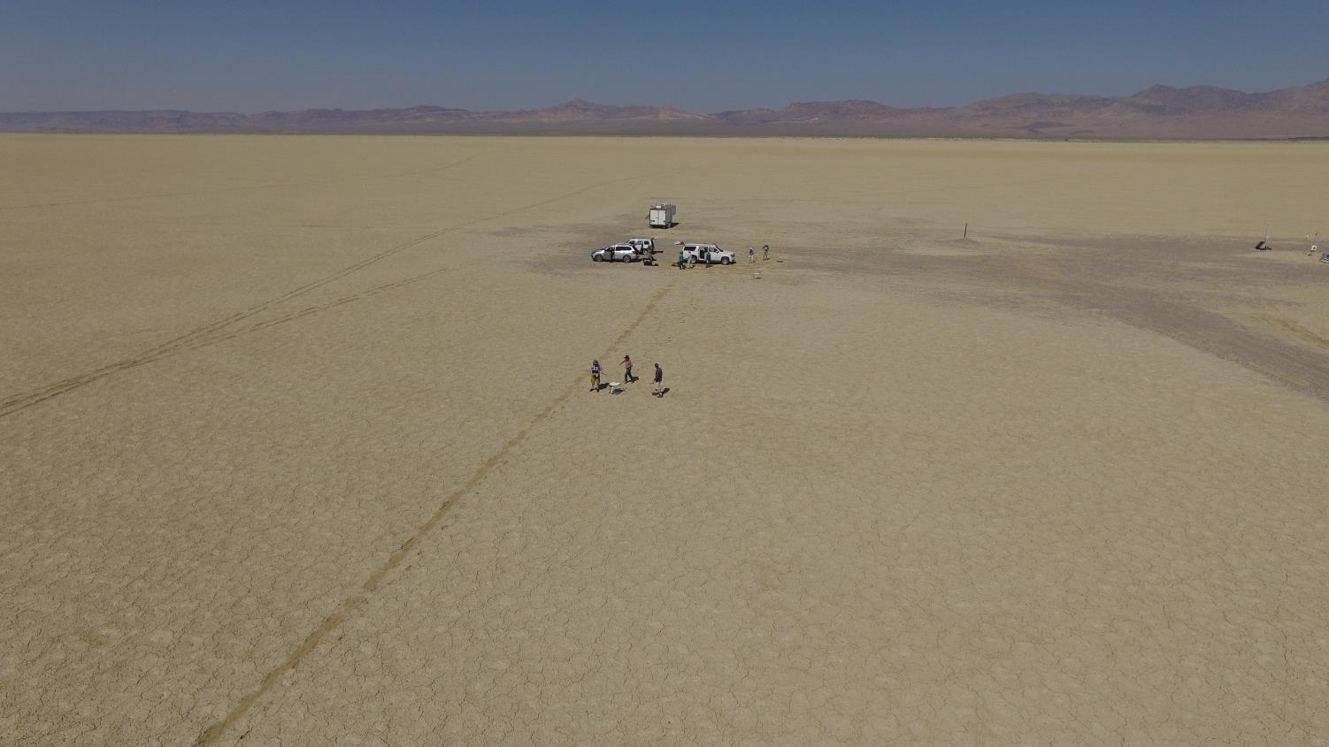
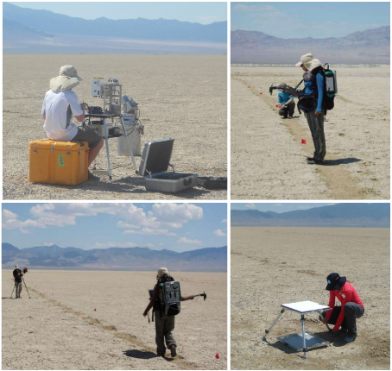
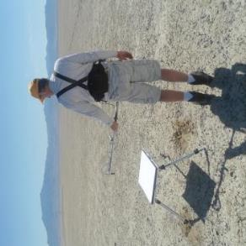
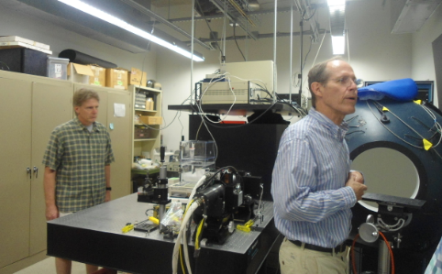
Interaction with Other Cal/Val Groups
Reflectance-based Vicarious Calibration Training at RVPN
July, 2017

Slide 12
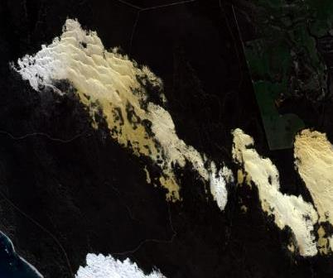
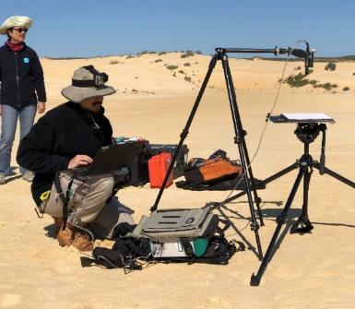
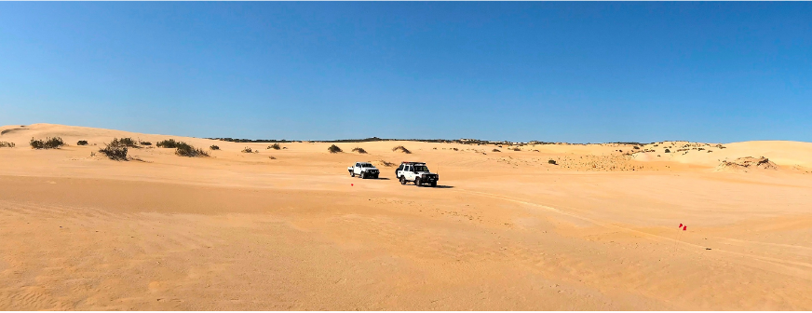
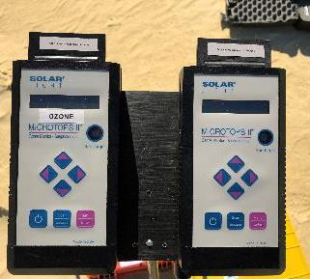
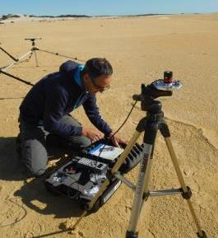
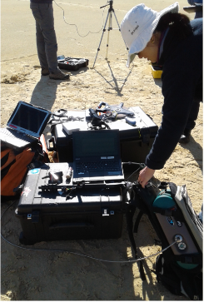
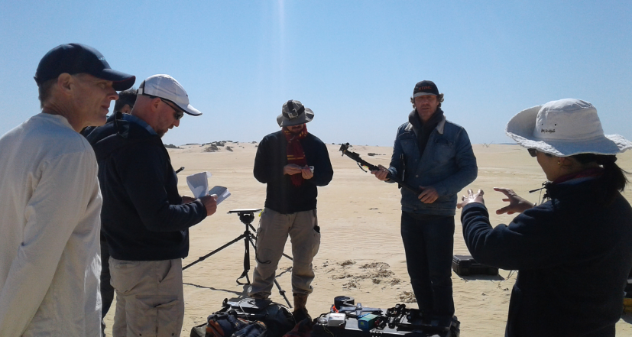
Interaction with Other Cal/Val Groups
Characterization Campaign in the Pinnacles Desert, Australia
August, 2018

Slide 13
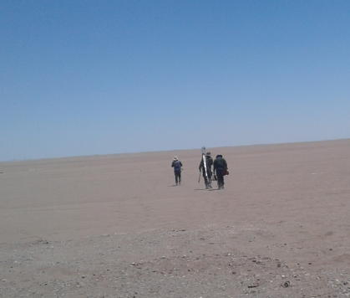
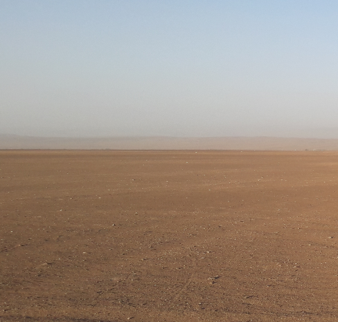
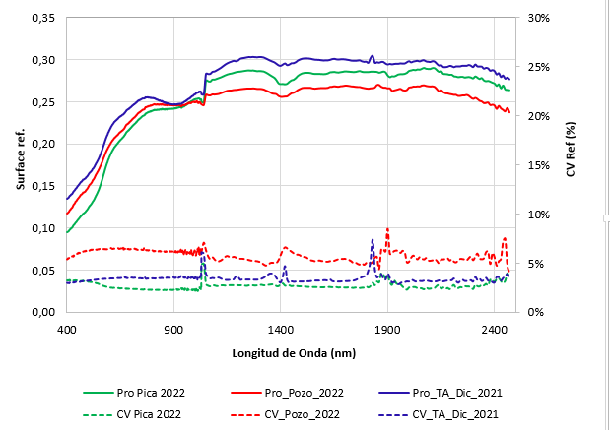
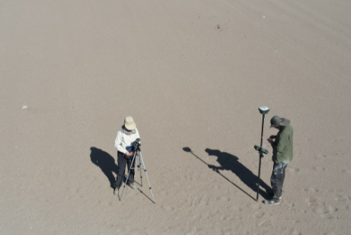
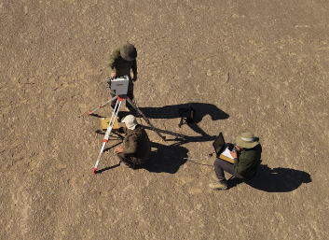
Exploration of New Cal/Val Sites
Exploration of Alternative Natural Cal/Val Sites
Field campaigns in 2021 - 2022
Pica Pozo Almonte
Stop data acquisition because of strong wind¡¡
Other candidates: unaccessible, vehicle circulation, private property, minning concessions…

Slide 14
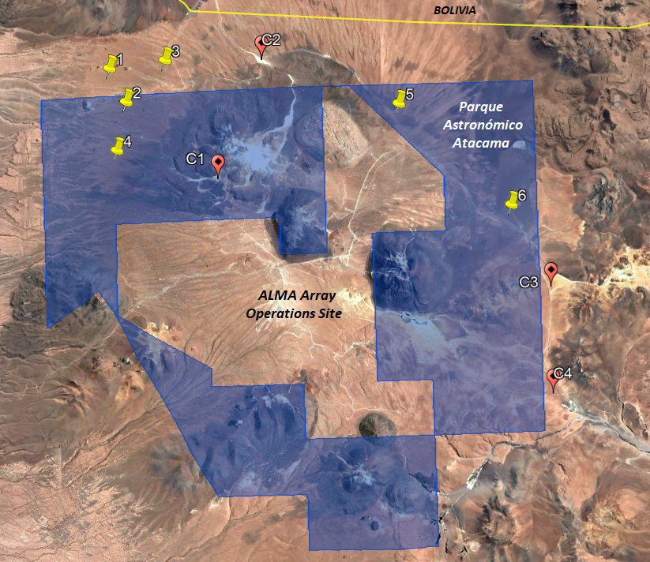
Exploration of New Cal/Val Sites
Field Campaign in the Atacama Astronomical Park (PAA)
Chajnantor Plateau, December 2023
Astronomical Observation Projects and Aerosol Robotic Network (AERONET) station.
04 – 09 DIC. 2023 with 03 days of operations in the area.
Atacama Desert, particularly Chajnantor Plateau, is the place where the highest mean surface solar irradiance is found
Rondanelli et al. 2015.The Atacama Surface Solar, Maximum. Bull. Amer. Meteor. Soc., 96, 405 – 418)
Cordero et al. The Solar Spectrum in the Atacama Desert. Sci Rep 6, 22457 (2016). https://doi.org/10.1038/srep22457
~ 4.600 – 5.200 m.a.s.l.

Slide 15
Exploration of New Cal/Val Sites
Field Campaign in the Atacama Astronomical Park (PAA)
Chajnantor Plateau, December 2023
Simultaneous acquisitions were not possible.
Some areas need to be captured
Adaptation of the team and safe operations
C1: Observatorios
C3: Amarillo
Microtops
AOD ₅₅₀: < 0.05
WV: ~ 0.07 cm
CV: 5 – 10%
GER-2600
C2: Mirador
C4: Límite

Slide 16
Exploration of New Cal/Val Sites
The sight from PAA at Chajnantor Plateau
Need for exploration, and characterization of new sites inside the PAA and in the neighborhoods
Atacama salt flats basin
El Tambillo and some other candidate sites are here ☺

Slide 17
Future Efforts
Implementation of new capabilities through collaboration:
With academia, research centers and scientific organizations
Potential collaborators: cooperation agreements (already signed and new ones)
🡪 Search and request for funding: laboratory and field instrumentation, infrastructure…
🡪 Maintenance and calibration of instruments in South America is a challenge¡
Interacting with other research groups: laboratory, processing, analysis…
Learning process: integration of calibration methodologies for other domains
Establishment of a natural and artificial site in Chile: for IVOS in the near future
Estimation of uncertainties of the calibration process

Slide 18
Cal/Val Activities in Chile
Thank you very much for your attention
carolina.barrientos@saf.cl
Slide ‹#›

