Slide 1
WGCV-53
CEOS Cal/Val Portal updates
Paolo Castracane
Rhea System for ESA/ESRIN
Agenda Item: 3.11
WGCV-53, Córdoba, Argentina
5th - 8th March 2024

Slide 2
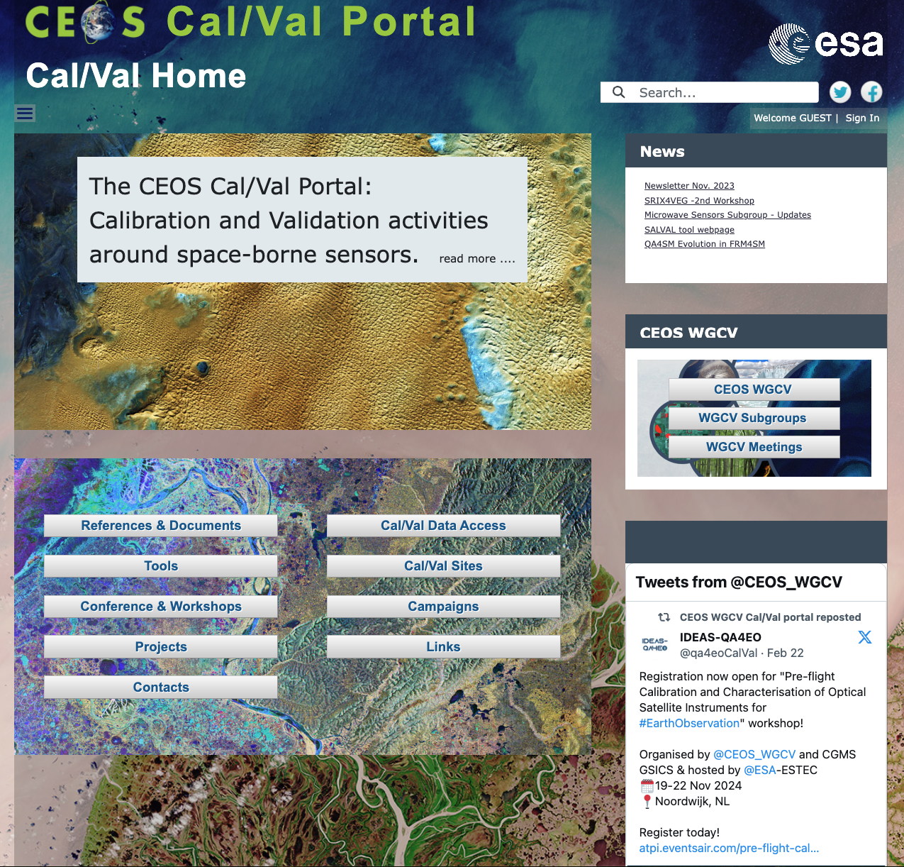
Table of Contents
CEOS Cal/Val Portal Overview
ACTIONs from WGCV-52
Content Updates
Outreach
https://calvalportal.ceos.org
Slide ‹#›

Slide 3
Overview - numbers
https://calvalportal.ceos.org
Some numbers: 1st March 2024:
Users
1233 Registered Users
154 CEOS WGCV SAR Subgroup and 3 super-users
50 MTF Members
6 Cal/Val Doc Repository (rights for editing)
21 Terms and Definitions (rights for editing)
- proposal for SITSat group user (with dedicated repository and forum – in progress)
System availability
BC uses Nagios (http://www.nagios.org/) for monitoring the IT services.
The availability of the Cal/Val Portal is close to 100%.
https://calvalportal.ceos.org
Slide ‹#›

Slide 4
Actions WGCV-52
Action | Description | Comment | Reply | Due date | Status
WGCV-52-ACT-26 | WGCV to consider any additional feedback on the hyperspectral cal/val resources page that has been published on the cal/val portal. In parallel send to Ben Poulter to complete outstanding action: WGCV-51-ACT-14. | Could you please add some details on the Hyperspectral cal/val resources document related to aquatic and ocean sites in the 'Networks' section? Also, could you please add some information on solar spectral points under the 'Guidelines and Protocol section' that Cindy has mentioned in the document? Once that's done we can go ahead and publish the document in Cal/Val portal. Let me know if it's easier for you to provide me with login credentials for the cal/val portal site and if you would like me to add the page to the portal myself. | Page available on: https://calvalportal.ceos.org/web/guest/hyperspectral-calval-resources | Sep. | CLOSED
WGCV-52-ACT-31 | Paolo Castracane and Nigel Fox to send a revised CEOS-FRM Assessment Framework following the review by the community. | We have received quite a few feedback points on the FRM Assessment Framework document: https://docs.google.com/document/d/1b5jiMvFXriDG010CXkGdz9PWrgfxQ-xD/edit I would also appreciate some guidance on the next steps for the assessment document. Regarding sharing the updated document with the WGCV list, should we aim to do so around mid-September and invite them to undertake some example self-assessments to assess the applicability of the FRM assessment framework? We could then request them to share their examples at WGCV-53. | Page available on: https://calvalportal.ceos.org/web/guest/frms-assessment-framework | Sep. | CLOSED

Slide 5
Actions WGCV-52
Action | Description | Comment | Reply | Due date | Status
WGCV-52-ACT-35 | Paolo Castracane to update the cal/val portal section on the CEOS Reference Solar Irradiance Spectrum to re-add cover note / disclaimer (ref: slide 24, IVOS presentation). | I have just created the page for the CEOS reference Solar Irradiance Spectrum on the Cal/Val Portal https://calvalportal.ceos.org/en/web/guest/solar-irrad-spectrum In this page I have included the link to the TSIS-1 HSRS dedicated page for Version 2 in preparation Note that this new entry page is also accessible from: CEOS WGCV -> IVOS -> Theme/Topic areas->Solar Irradiance Spectrum But also from: Documents-> CEOS Reference Solar Irradiance Spectrum and in the list of Methods, Guidelines and standards (see slide) |  | July | Closed pending any further input from Nigel

Slide 6
Actions WGCV-52
Action | Description | Comment | Reply | Due date | Status
WGCV-52-ACT-37 | WGCV Secretariat and Paolo Castracane to explore opportunities to better communicate IVOS (and all subgroup) outputs, starting with the SITSCOS report. Perhaps elevate this through CEOS Cal/Val portal newsletter and CEOS social media channels. |  |  |  | In progress
WGCV-52-ACT-38 | Paolo Castracane to work with WGCV Secretariat to ensure broad distribution of WGCV newsletter content - cross-posting to all CEOS mailing lists, CEOS Newsletter, CEOS social media, etc. Also consider printed formats, etc. | CEOS Cal/Val Portal Newsletter published in November 2023 and distributed over several CEOS media channels |  |  | In progress
WGCV-52-ACT-39 | WGCV Secretariat and Paolo Castracane to consider inputs for the upcoming GSICS newsletter. Send a call for inputs from WGCV and subgroup chairs. | Summary of the WGCV-52 meeting has been included in the GSICS Quarterly Newsletter Summer 2023 Issue. |  |  | CLOSED

Slide 7
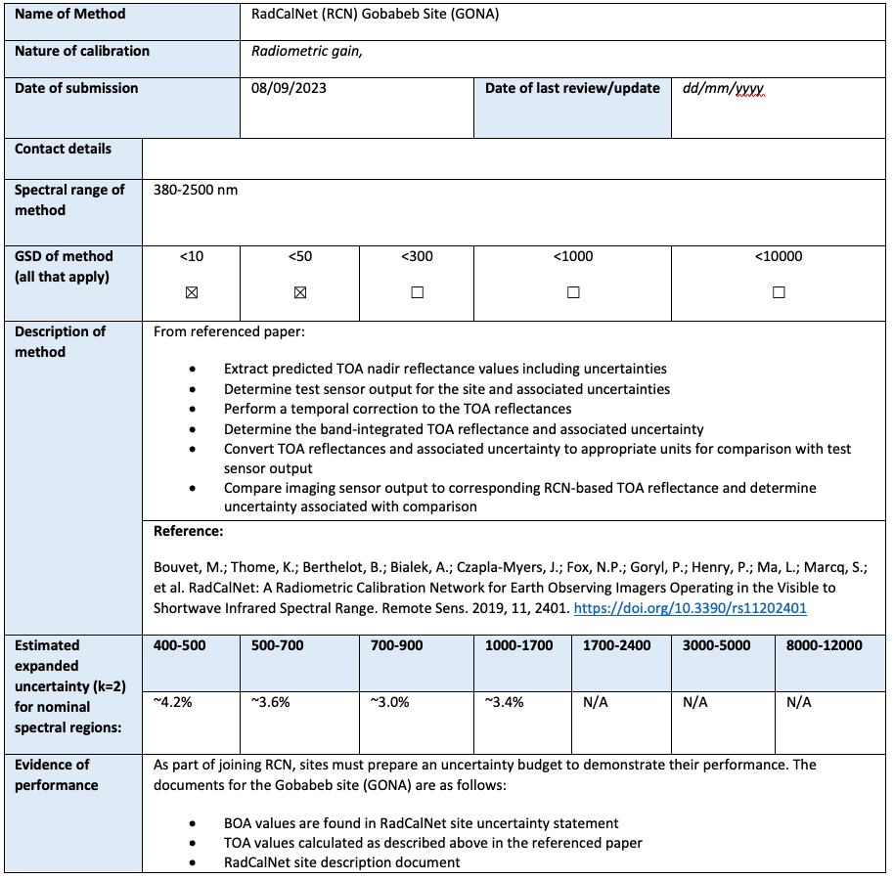
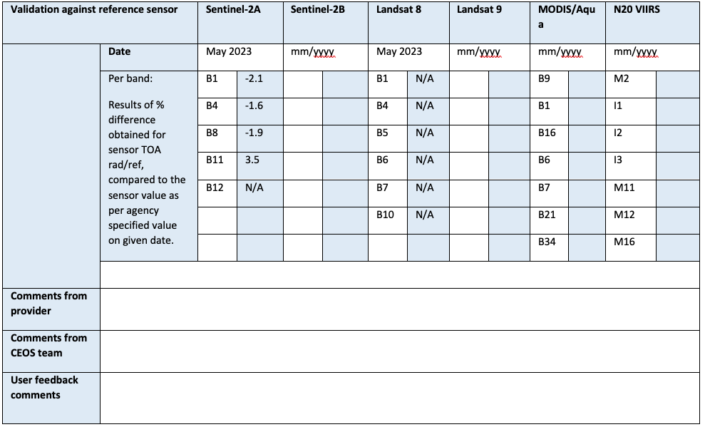
WGCV-51-ACT-10 IVOS Calibration DB
Collect information
IVOS teams will be requested to fill out a web-form or submit a formatted table containing information on a specific calibration method
This information represents one item of the Calibration Database who has the aim to collect all the calibration methods in the IVOS domain. At the first ingestion the item is flagged V=0.0 (Version 0.0) .This information is collected and kept reserved for a dedicated group (e.g. IVOS members + CEOS representative
Endorsement by CEOS
CEOS representative review the info provided. A dedicated IVOS forum can be useful to exchange opinion within the IVOS Community and support the decision. It can be requested to the provider to update the content (e.g. 0.1, 0.2). Once information are considered appropriated,the item is flagged 1.0. and is considered CEOS endorsed and public available.
Then the item can be update and version increased
Public Calibration Database
All the endorsed items (i.e. V = or > 1.0) of the Calibration Database are queryable and accessible.
Only the latest version are made available to the public (but al the history is kept in the database)

Slide 8
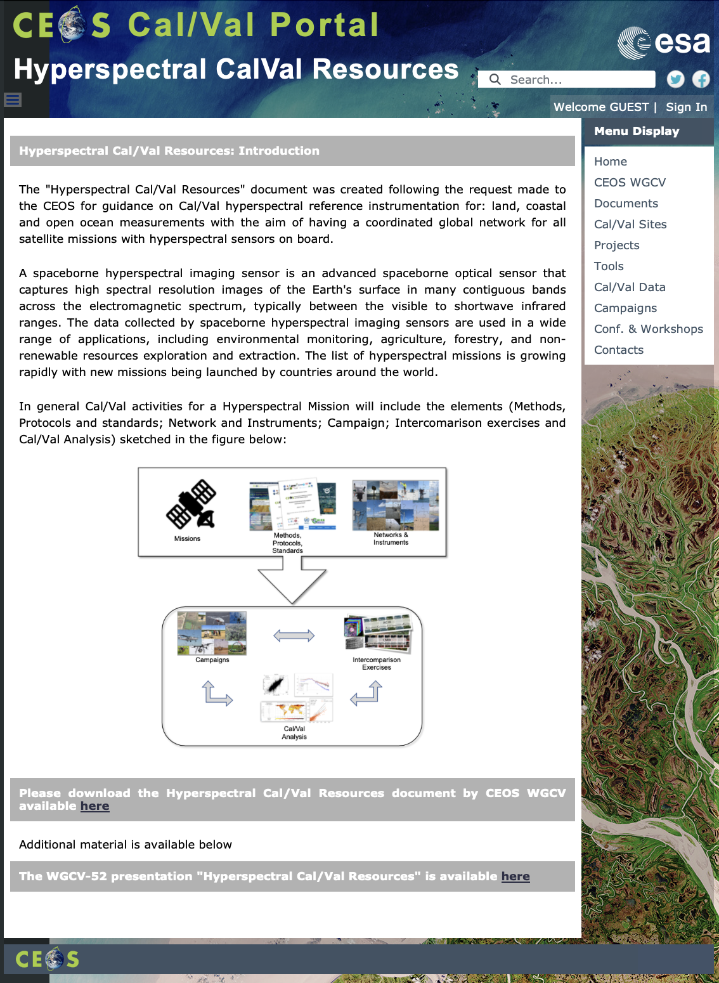
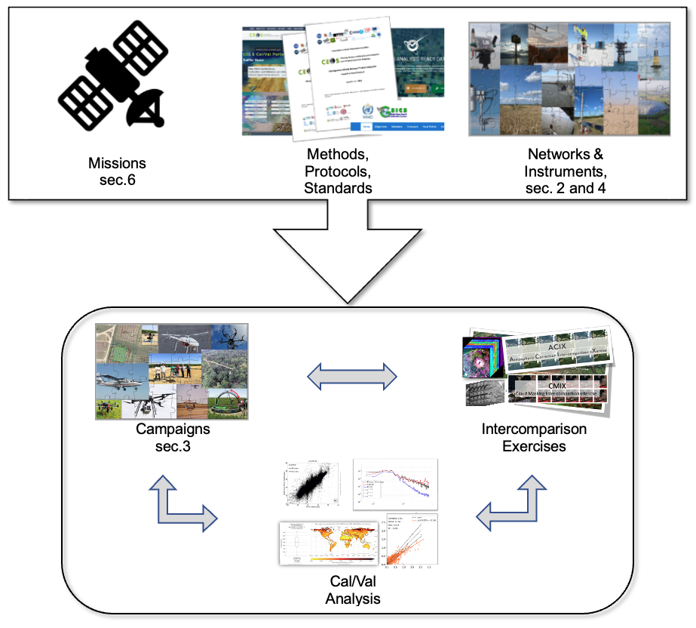
Hyperspectral Cal/Val Resources
Hyperspectral Cal/Val Resources
https://calvalportal.ceos.org/web/guest/hyperspectral-calval-resources
Introduction
Networks
Guidelines and Protocols
Campaigns and Inter-comparison Excercise
Instrumentation and Hardware
Mission-Specific Resources
In general Cal/Val activities for Hyperspectral Mission will include the elements sketched in the figure above

Slide 9
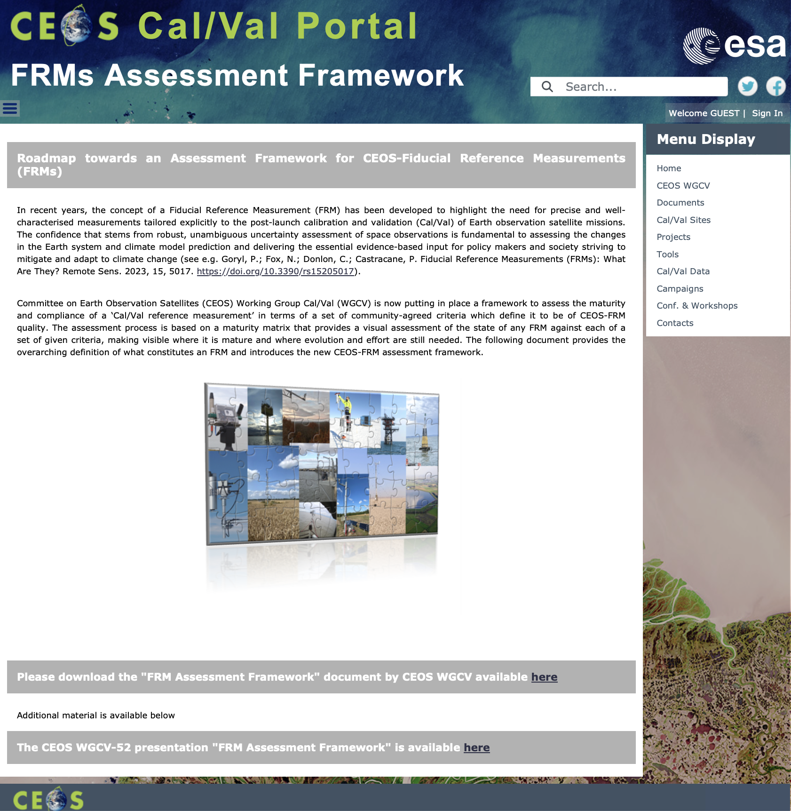
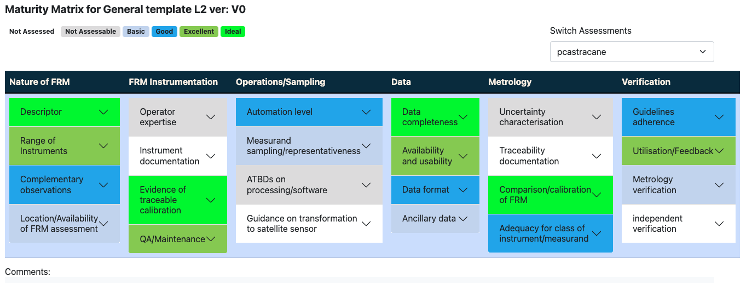
FRMs Assessment Framework
Roadmap towards an Assessment Framework for Fiducial Reference Measurements (FRM)
https://calvalportal.ceos.org/web/guest/frms-assessment-framework
The purpose of the document is to propose a roadmap towards an assessment framework to endorse a specific class of measurements as a Fiducial Reference Measurement (FRM).
Background and Objectives
FRM Definition and Principles
FRM Endorsement Process
FRM Maturity Matrix
FRM Overall Classification
CEOS FRM MM –PGN (Pandonia Global Network)
CEOS FRM MM - RadCalNet (Radiometric Calibration Network)
CEOS FRM MM –ICOS (Integrated Carbon Observation System)
CEOS FRM MM - FRM4DOAS (Ground-Based DOAS Air-Quality Observations)
CEOS FRM MM - Brewer Spectrometer Measurements
CEOS FRM MM - Hypernets
CEOS FRM MM – CSIRO (DION)
CEOS FRM MM- BAQUNIN (PREDE-POM LUNAR)
Maturity Matrix Tool
https://mmt.skytek.dev
Dedicated credentials provided for all the selected pilots
Goryl, P.; Fox, N.; Donlon, C.; Castracane, P. Fiducial Reference Measurements (FRMs): What Are They? Remote Sens. 2023, 15, 5017. https://doi.org/10.3390/rs15205017).

Slide 10
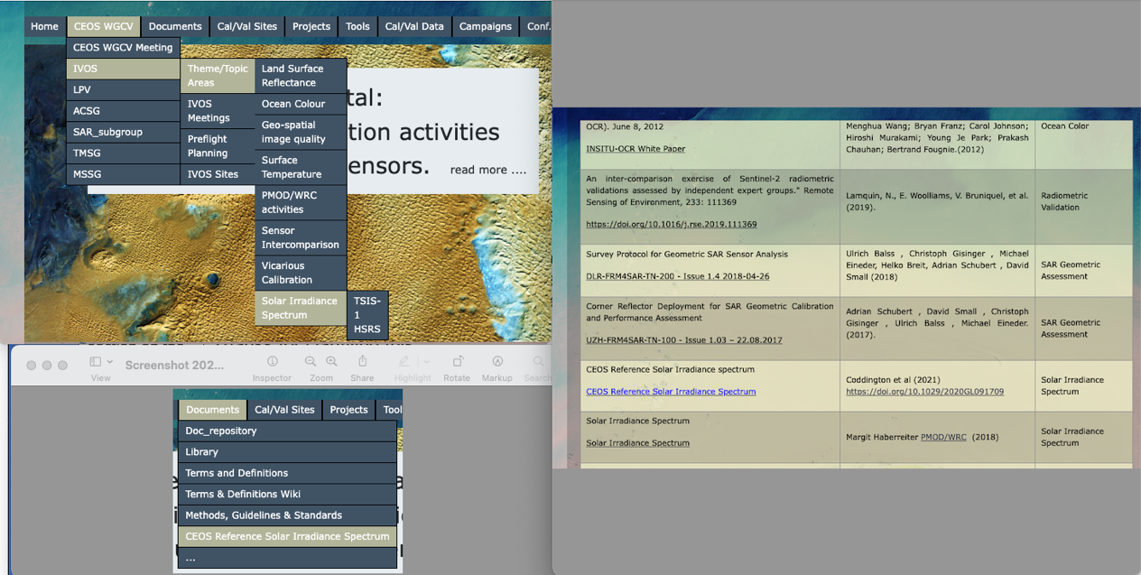
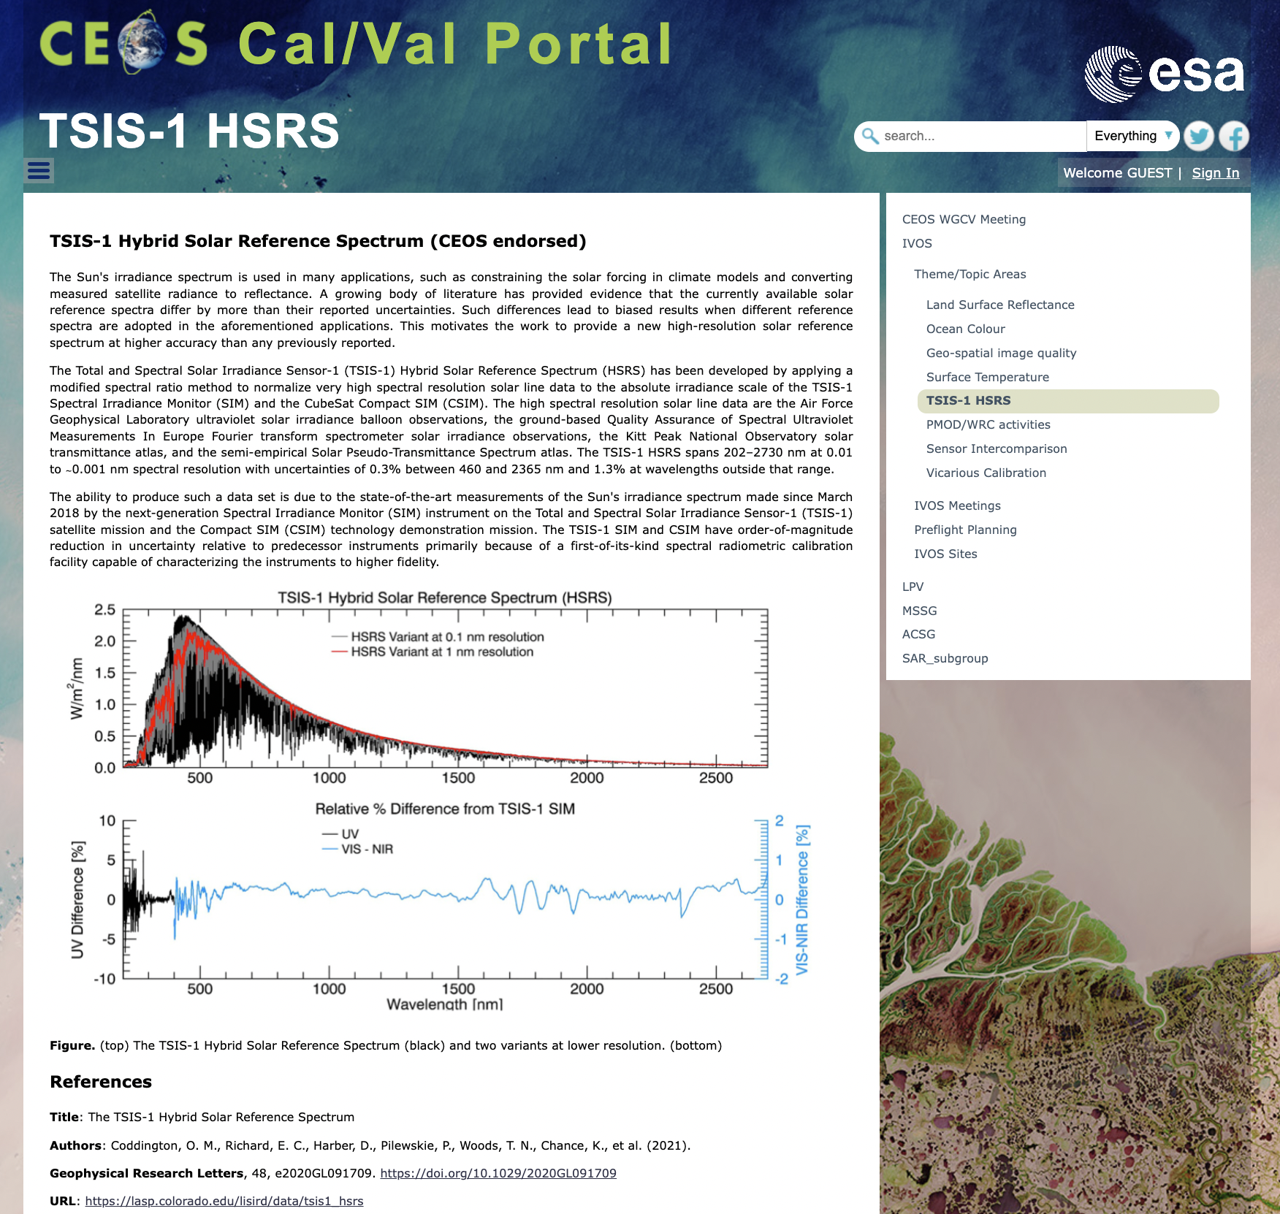
Solar Irradiance Spectrum

Slide 11
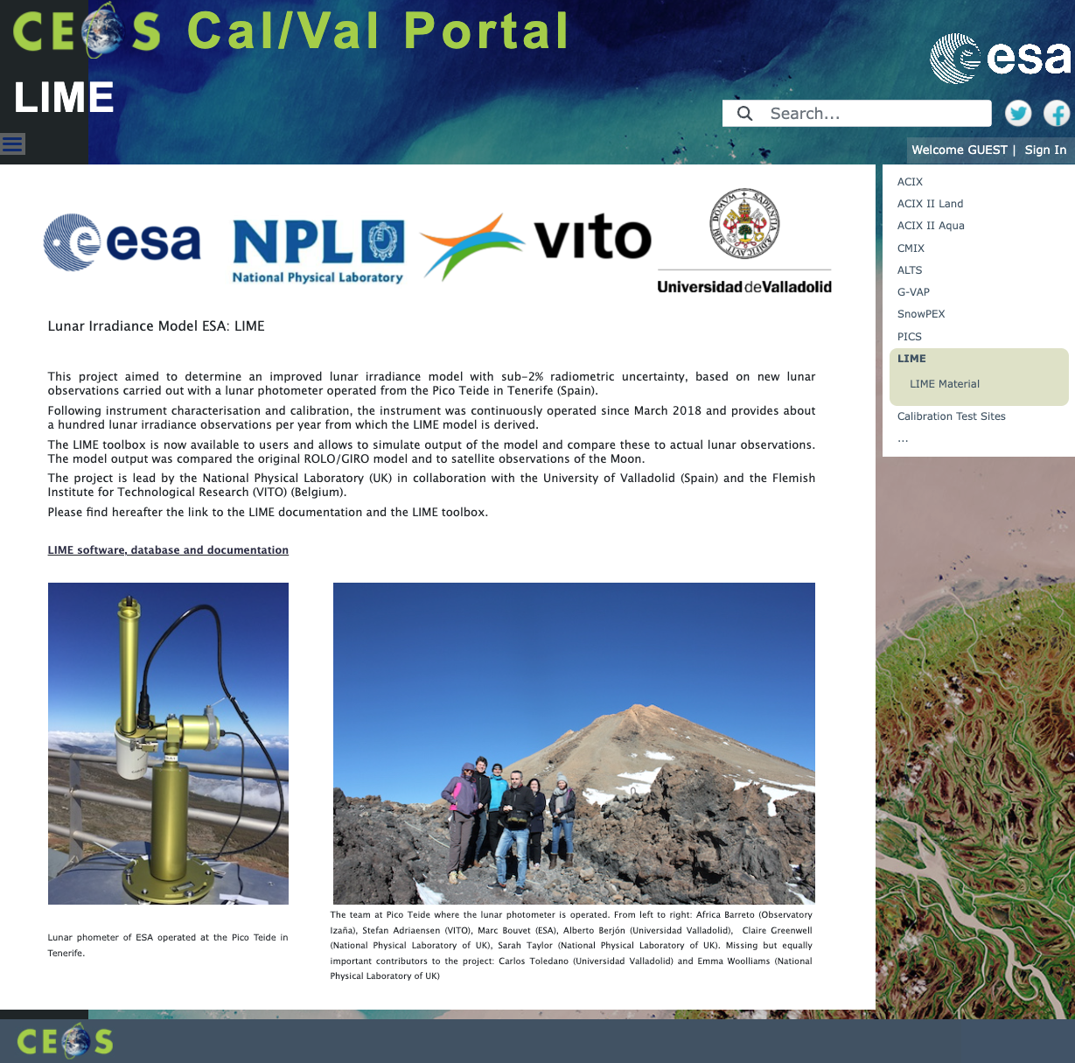
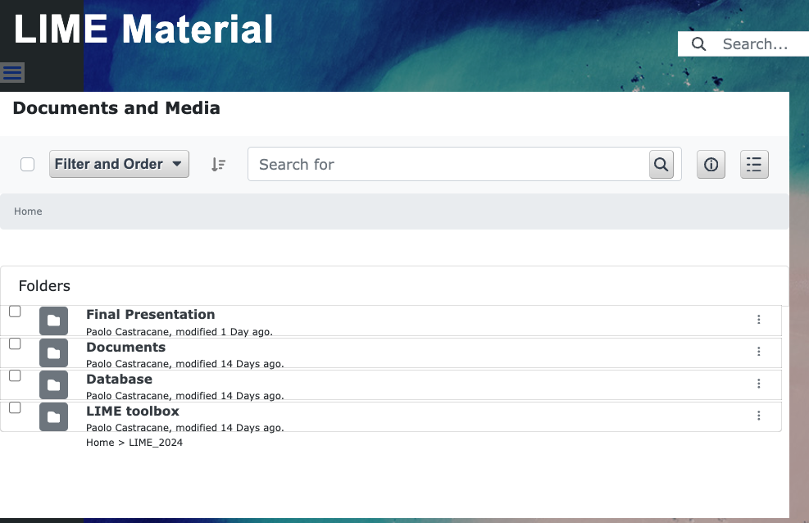
LIME update
LIME updates - feb. 2024 with:
Documents: Deliverable documents form the project;
Database;
LIME toolbox: installers for Windows, Mac, Linux and Debian (Ubuntu);
Final Presentations

Slide 12
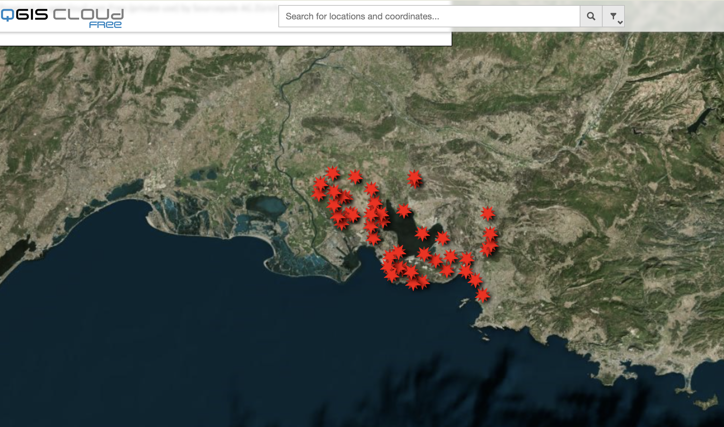
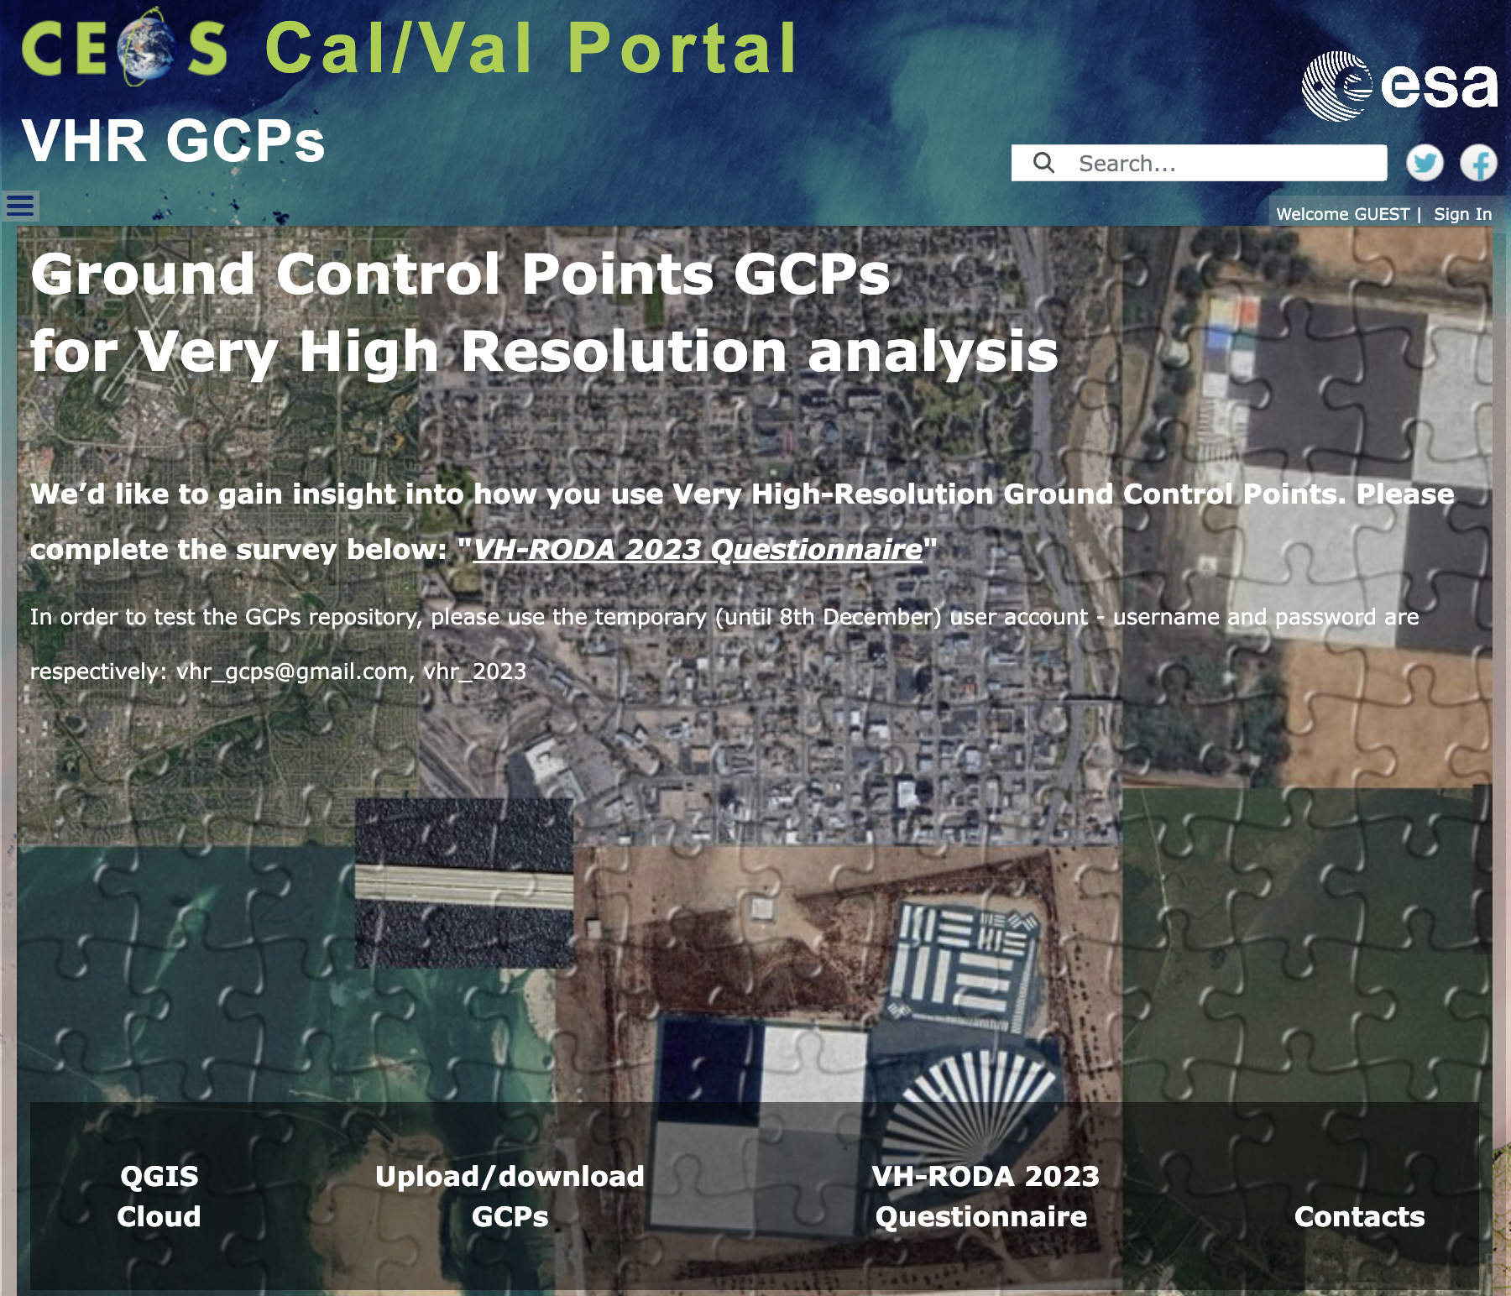
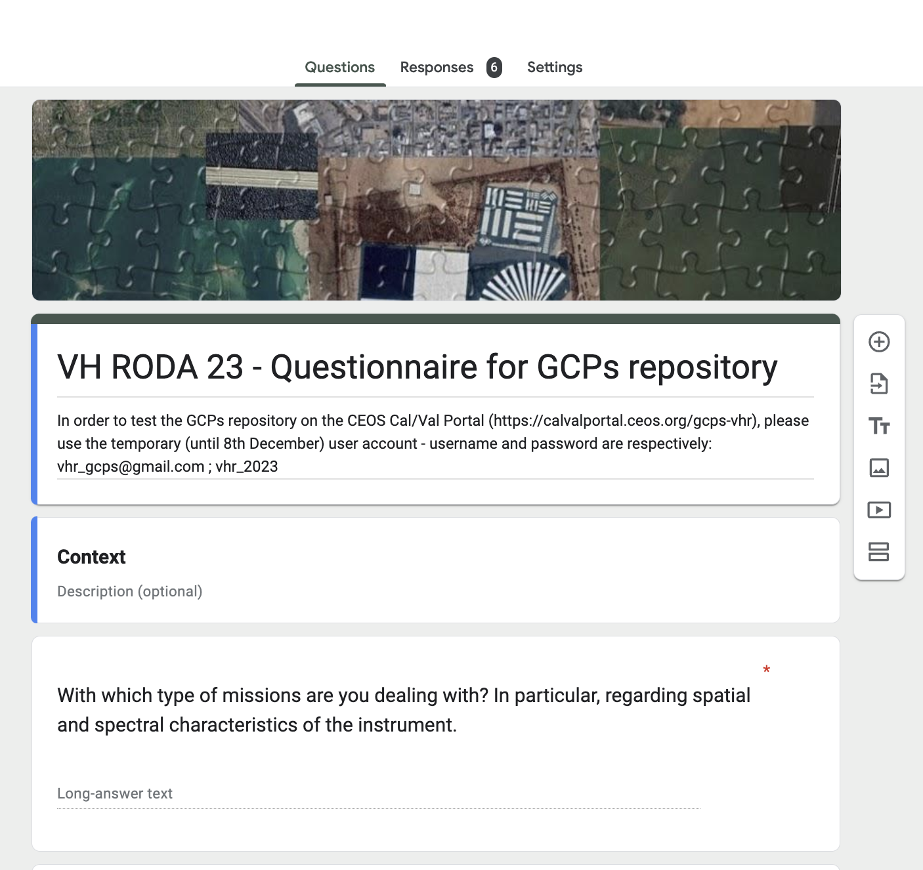
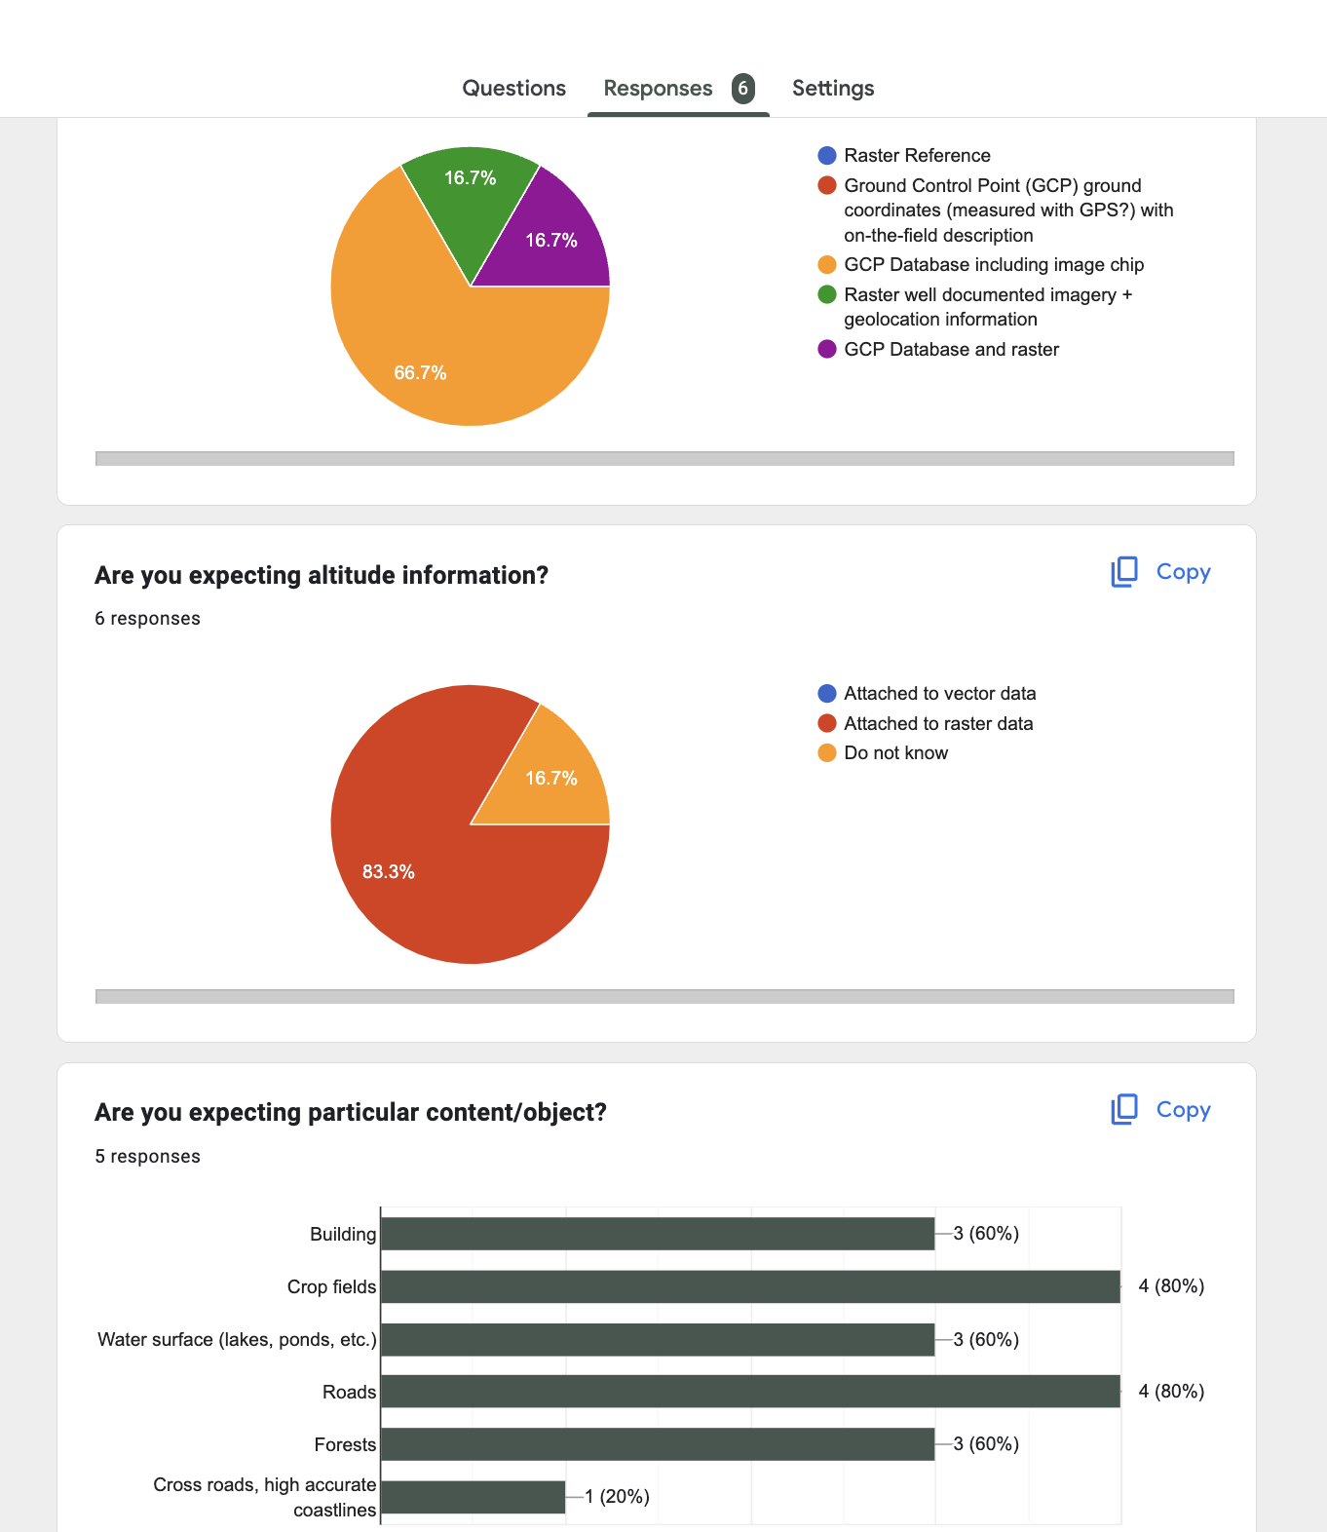
GCPs for Very High resolution analysis
Webpage for GCPs for Very High Resolution
QGIS Cloud
Upload/download GCPs
VH-RODA 2023 – Questionnaire
Nov. 2023
- Input from
Sébastien Saunier
Rosario Quirino Iannone

Slide 13
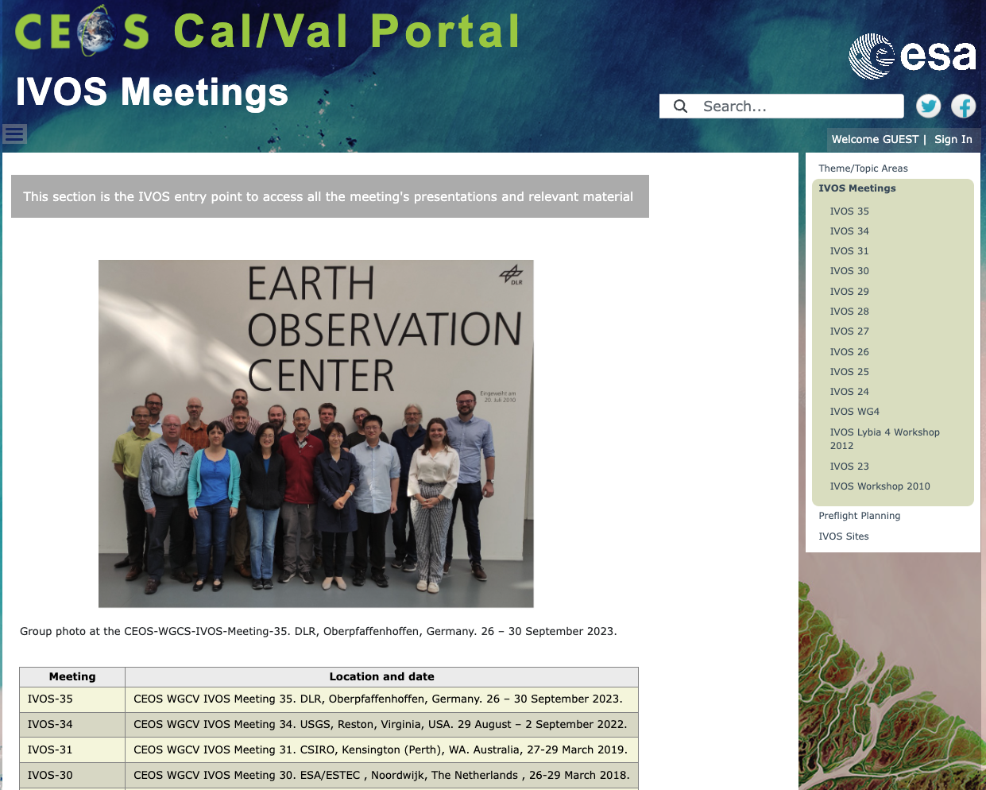
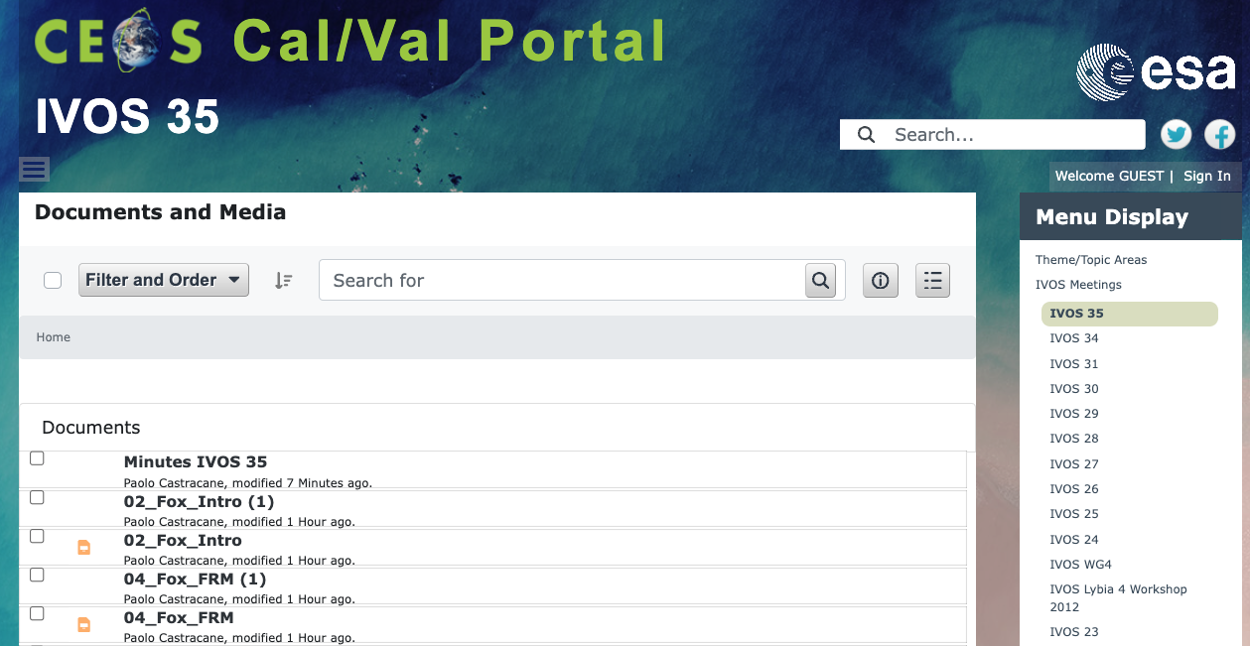
IVOS Meetings – IVOS-35
IVOS Meetings
IVOS -35
DLR, Oberpfaffenhoffen, Germany. 26 – 30 Sept. 2023
Presentations
MoM
Now available!

Slide 14
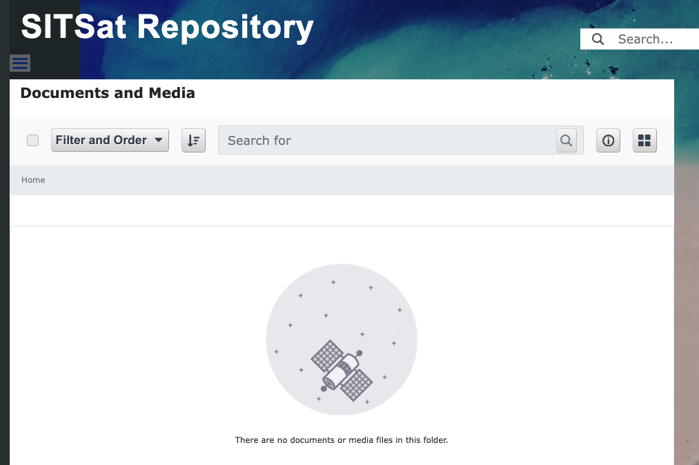
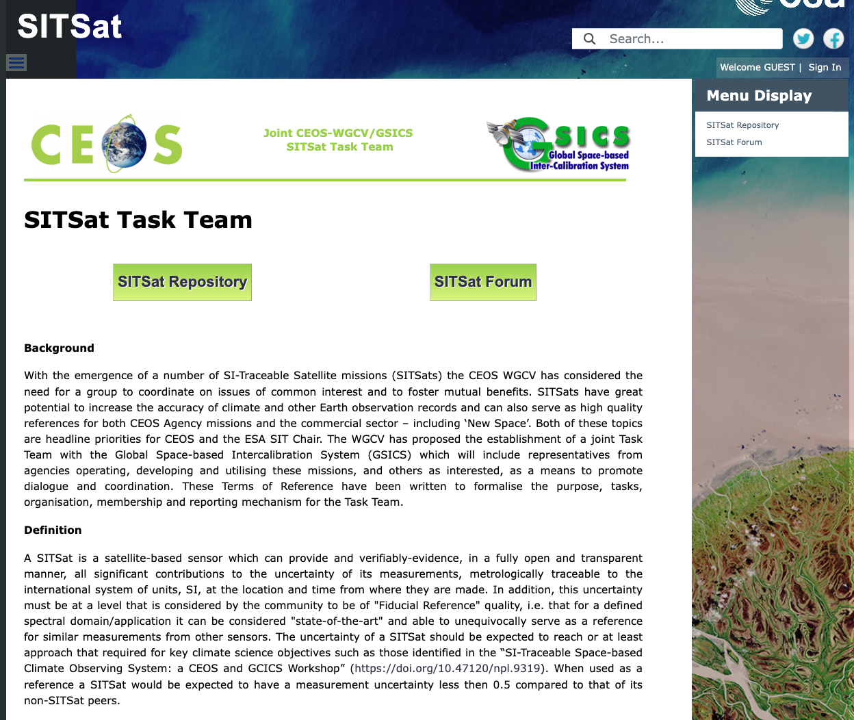
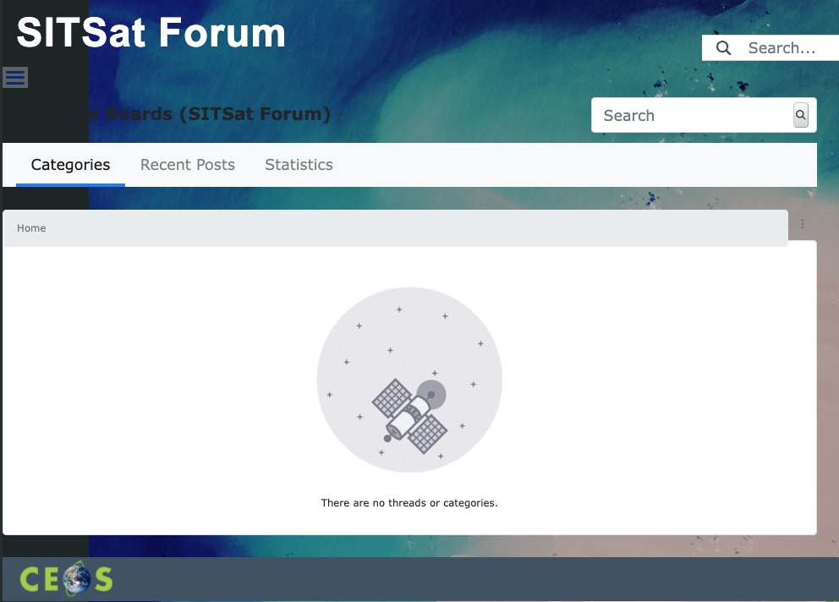
SISTSat new page - proposal
The SITSat webpage has been proposed with
Public information: Background, Definition, Objectives; Organisation and reporting and
SITSat repository
SITSat Forum
Both restricted to the SITSat members to share documents/materilas and discussions

Slide 15
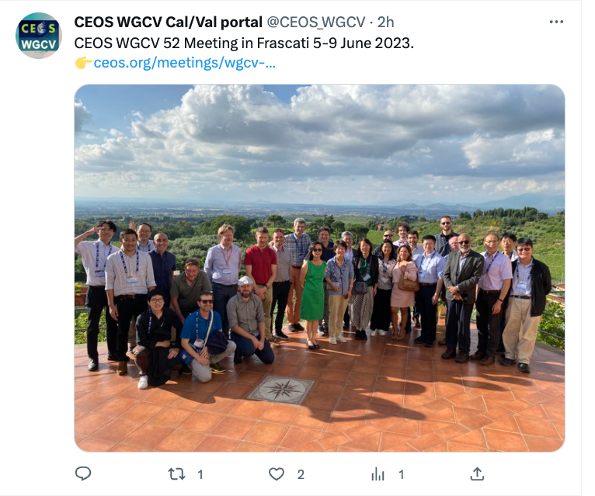
Outreach/Newsletter
Newsletter published in Nov 2023
Content Updates for each subgroups
Hyperspectral Cal/Val resouces
FRM Assessmente framwork
Outreach, video tutorials, twitter, contact and support

