Slide 1
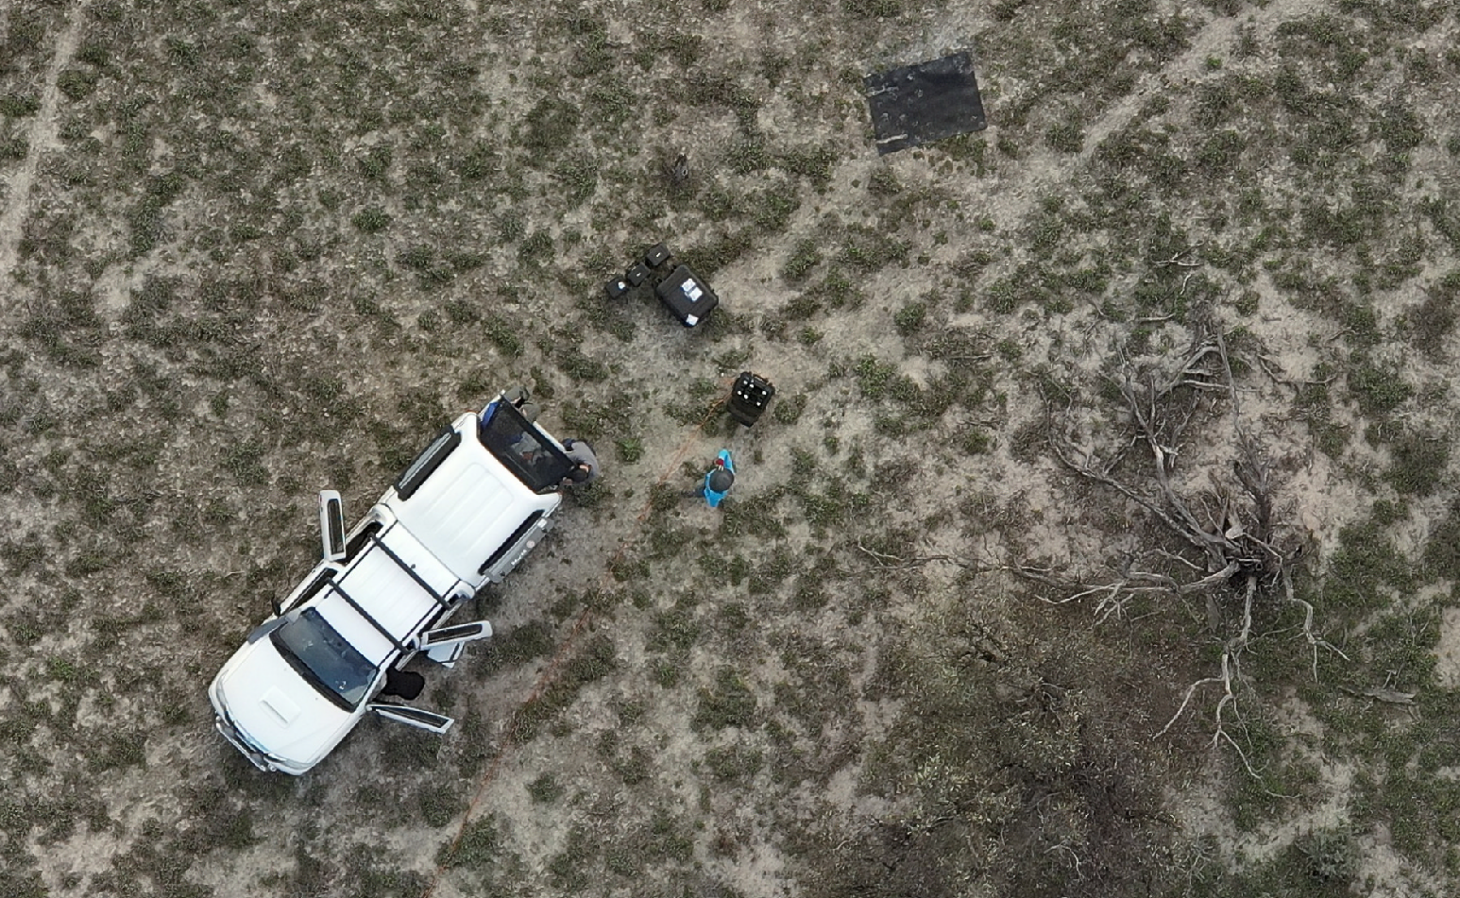
WGCV 53
SRIX4Veg-II Calperum, South Australia
Cindy Ong, CSIRO
Agenda Item 3.2
WGCV-53, Córdoba, Argentina
5th - 8th March 2024

Slide 2
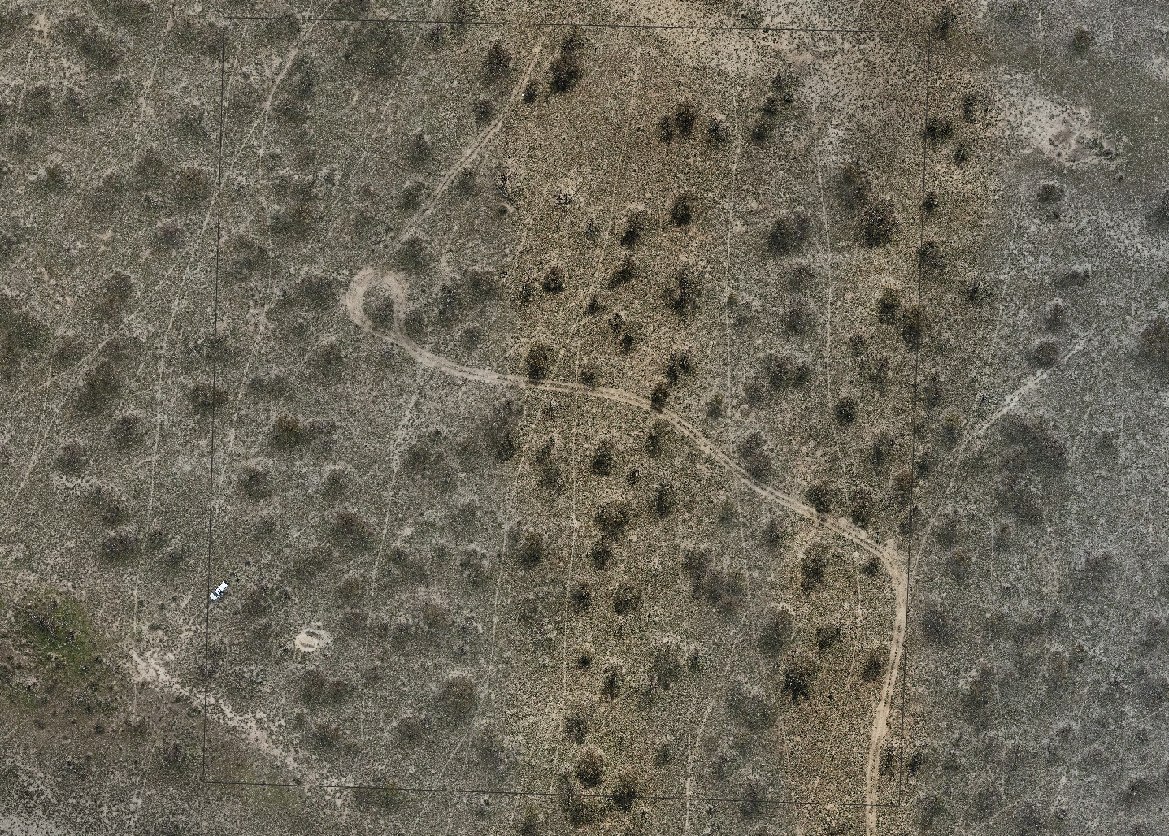
SRIX4Veg-II
11-15 March 2024 (next week)
Hosted by TERN & CSIRO
UAV teams
A: NPL/ESA
B: TERN
C: GA
D: DES
E: OSS/DCCEEW
F: MAITEC
Field measurement team
CSIRO
UAV imagery from 17 May 2022 flown by TERN/UTAS

Slide 3
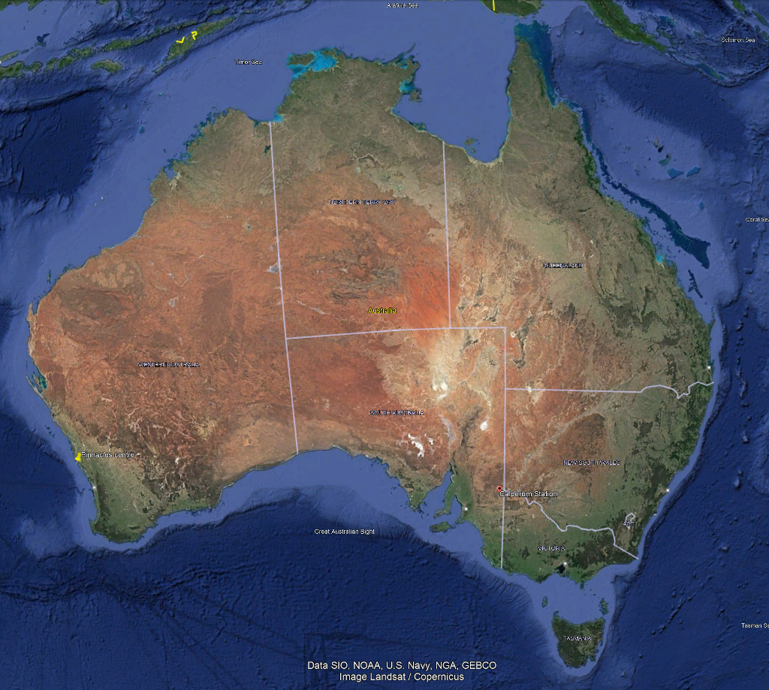
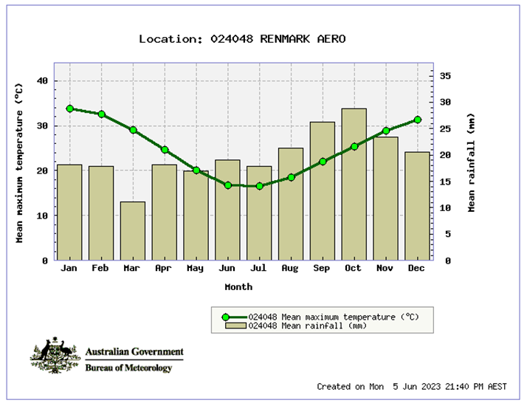
SRIX4Veg-II
Image credit: TERN
Site
TERN/LPV supersite Calperum (https://www.tern.org.au/tern-observatory/tern-ecosystem-processes/calperum-mallee-supersite/, https://www.tern.org.au/site-of-the-month-calperum-mallee-supersite/) across 9000 km² ~270 km E of Adelaide, close to Renmark;
13 years measuring fundamental carbon, water, energy and nutrient pools and fluxes;
One eddy-covariance flux tower
Soil water content, temperature and electrical conductivity probes
Phenocams
Groundwater bores with nested piezometers
18 x 1 ha Surveillance monitoring plots
Airborne LiDAR and hyperspectral imagery calibrated using SLATS star transects, leaf sampling, tree structure and LAI measurements
Mallee semi-arid ecosystem, fringing the River Murray floodplains on Calperum Station, South Australia;
Comprises undulating mallee woodlands and riverine vegetation alongside the river;
Pinnacles
Calperum
Adelaide
Slide 3

Slide 4
Pre-Fieldwork Workshop

Slide 5
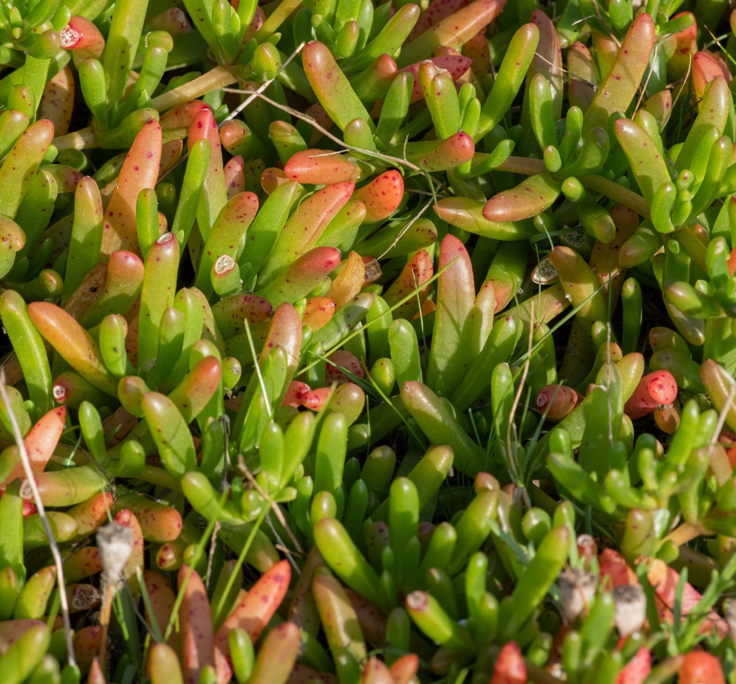
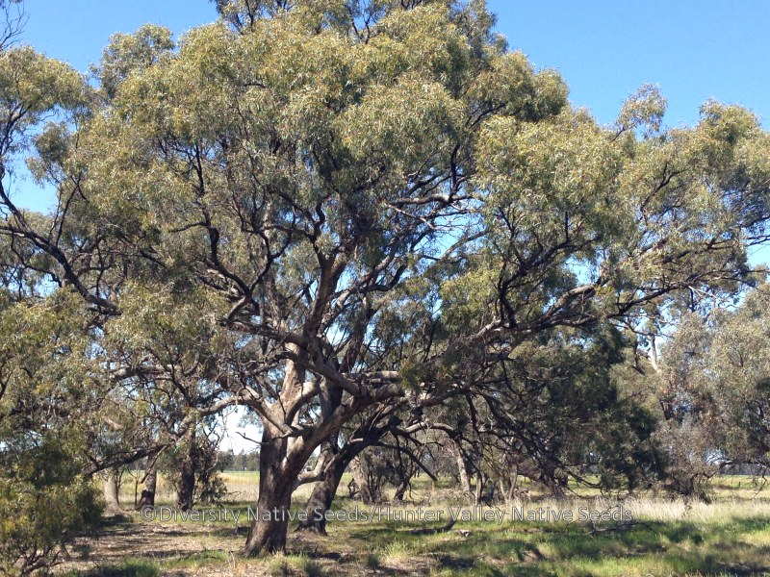
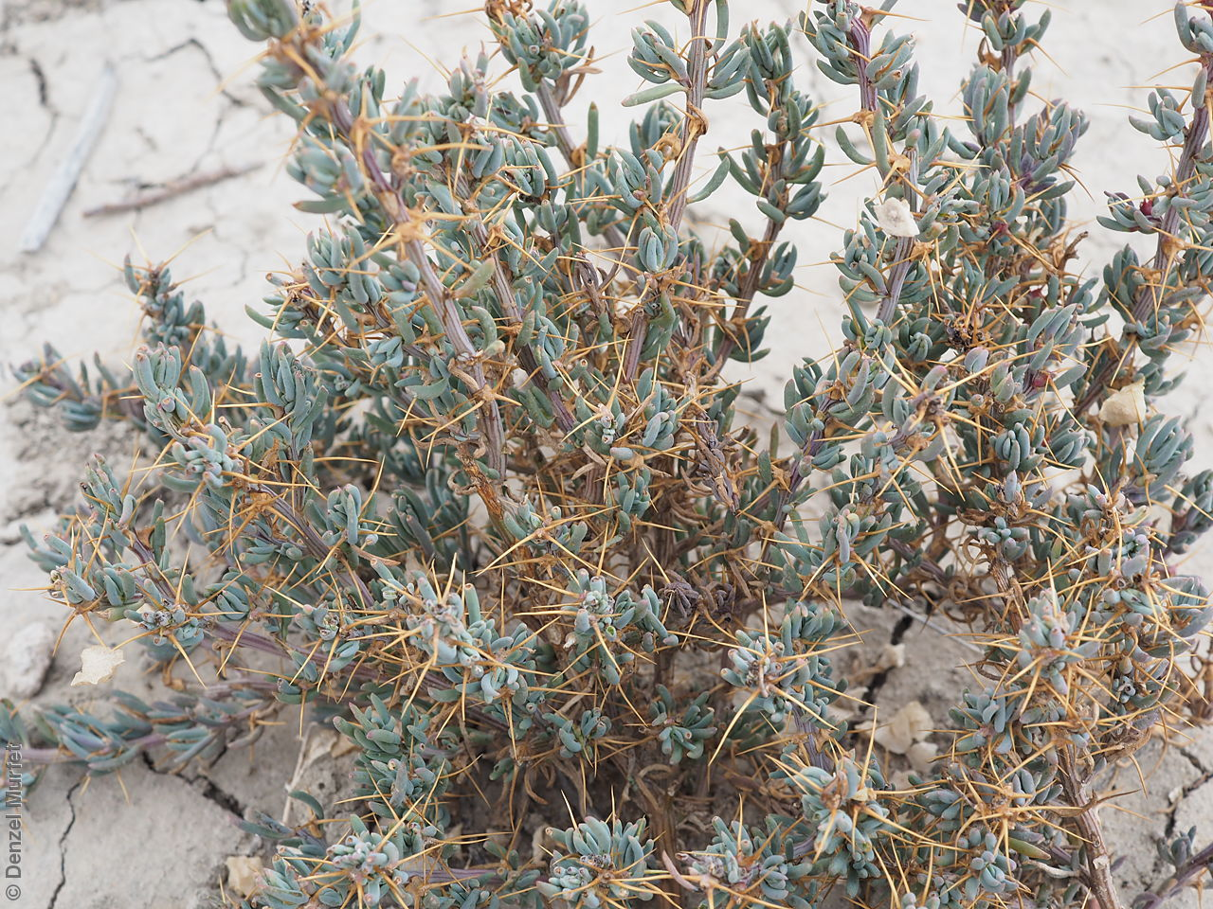
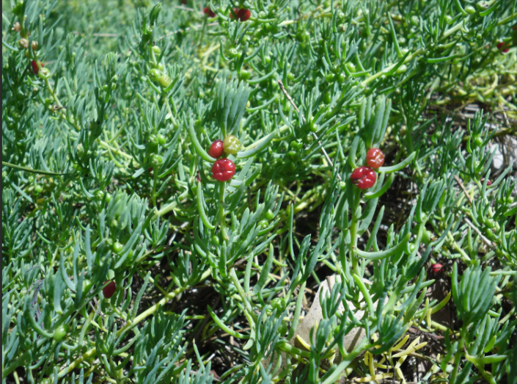
Site Characteristics
SASMDD0013 (River Gum)
Rounded Noon flower Black box Eucalyptus Slender Ice-plant Giant Red Burr Ruby Saltbush

Slide 6
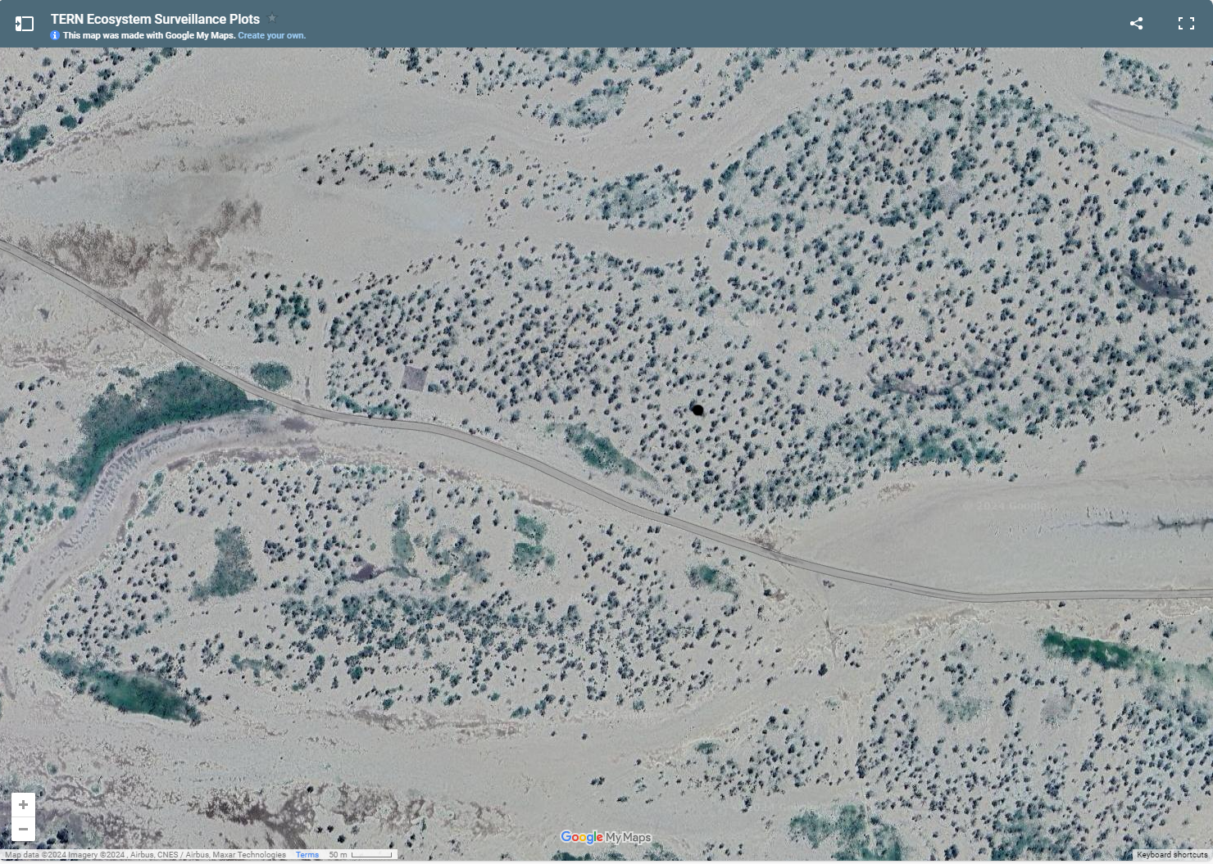
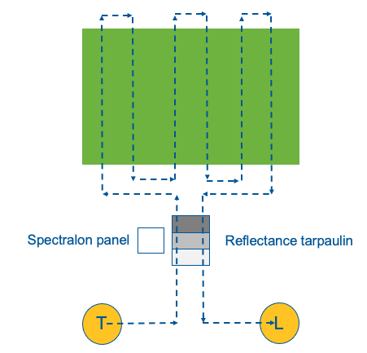
Experimental Setup
UAV acquisition area
Reference/Instrument
100 m
UAV flight path

Slide 7
Target Spaceborne Sensor
Imaging Spectroscopy VNIR-SWIR, 30 m
EnMAP, PRISMA, DESIS, CHIME, SBG
EnMAP (12 & 13 Mar), PRISMA (9 & 14 Mar) & DESIS (9 & 12 Mar) data requested
Campaign is not specifically for validation of spaceborne sensors
90x90 m or 3x3 pixel acquisition area
Similar surrounding cover type up to 150x150 m or 5x5 pixel

Slide 8
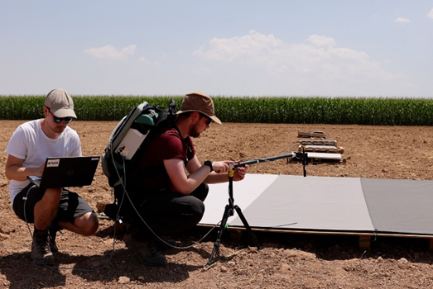
Reference & Instrumentation Set-up
sun
3x3m reflectance tarp (mounted on low platform)
Slow traverse
Slow traverse
Las Tiesas, Barrax Spain measurements of the tarp in July 2022 for SRIX4Veg I
0.5x 0.5m Permaflect (mounted on low platform)
Stop and stare
Stop and stare
Microtops
0.25 x 0.25m Spectralon (tripod)
Gazebo
Sky Camera &
Weather station
CIMEL
Safety area
LI-COR
PAR
Irradiance ASD

Slide 9
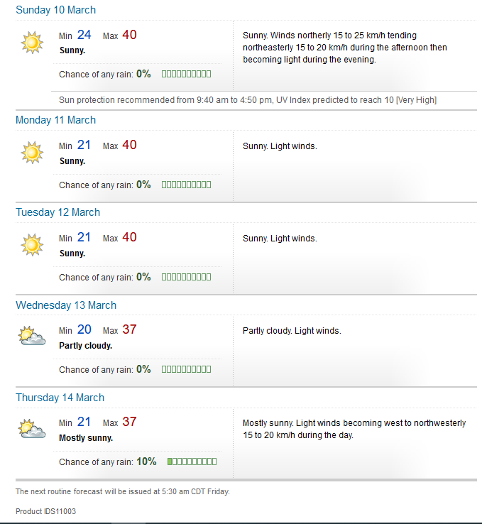
Scheduling
 |  |  |  | OWN PROTOCOL |  |  |  | Conducting SRIX4Veg protocol
Date/Time | Sun Elevation | 10 |  | 11 |  | 12 |  | 13 |  | 14 |  | 15
 |  | Sunday |  | Monday |  | TUESDAY |  | WEDNESDAY |  | THURSDAY |  | Friday
 |  | SRIX team | Set up site & practice & testing | QUEUING | FLYING | QUEUING | FLYING | QUEUING | FLYING | QUEUING | FLYING | QUEUEING | FLYING |  |  | Conducting own protocol/method
 |  |  |  |  | SETUP |  |  |  |  |  |  |  |  |  |  | Conducting SRIX4Veg protocol
8:00 |  |  |  |  |  | B,D | SETUP | A,B | SETUP | D,A | SETUP |  |  |  |  | Onsite preparing to fly
8:30 |  |  |  |  | PRACTICE
9:00 | 23.19 |  |  |  |  | F,A | B | C,D | A | E,B | D |  | CONTINGENCY |  | SRIX4Veg-II Teams:
9:30 | 29.19 |  |  |  |  |  | D |  | B |  | A |  |  |  | A: NPL/ESA
10:00 | 34.97 |  |  |  |  | C,E | F | E,F | C | F,C | E |  |  |  | B: TERN/U Tas
10:30 | 40.53 |  |  |  |  |  | A |  | D |  | B |  |  |  | C: GA
11:00 | 45.73 |  |  |  |  |  | C |  | E |  | F |  |  |  | D: DES
11:30 | 50.41 |  |  |  |  |  | E |  | F |  | C |  |  |  | E: OSS/DCCEEW
12:00 | 54.36 |  |  |  |  |  | BREAK |  | BREAK |  | CONTINGENCY |  |  |  | F: MAITEC
12:30 | 57.28
13:00 | 58.90
13:30 | 59.00 |  |  | A,B |  | D,A |  | B,D
14:00 | 57.56
14:30 | 54.78 |  |  | C,D | A | E,B | D | F,A | B |  | PACKDOWN |  | PACKDOWN
15:00 | 50.94 |  |  |  | B |  | A |  | D
15:30 | 46.34 |  |  | E,F | C | F,C | E | C,E | F
16:00 | 41.19 |  |  |  | D |  | B |  | A
16:30 | 35.67 |  |  |  | E |  | F |  | C
17:00 | 29.88 |  |  |  | F |  | C |  | E
 |  |  |  |  | PACKDOWN |  | PACKDOWN |  | PACKDOWN

Slide 10
Final Preparation & Post Inter-comparison
Final preparation meeting (7 March 2024)
Post inter-comparison workshop
Advancing Earth Observation (AEO) Forum in Adelaide, South Australia 10-12 September 2024
Interest from most teams

