Slide 1
CEOS Analysis Ready Data (CEOS-ARD)
Medhavy Thankappan Geoscience Australia
WGCV CEOS-ARD Liaison
WGCV-53
7 March 2024

Slide 2
Motivations

Slide 3
Motivations
Easing the use of satellite EO data to reach new non-expert users and increase data uptake and use
Provision of analysis-ready geophysical measurements
Reduce pre-processing burden for users
Facilitate analysis in the cloud
Reduce egress and processing
Provide a first step for interoperability
Open and transparent
Common starting point; consistency
Promote clear documentation of processing steps
Capitalise on space agency expertise and experience
Best available science and high-quality processes

Slide 4
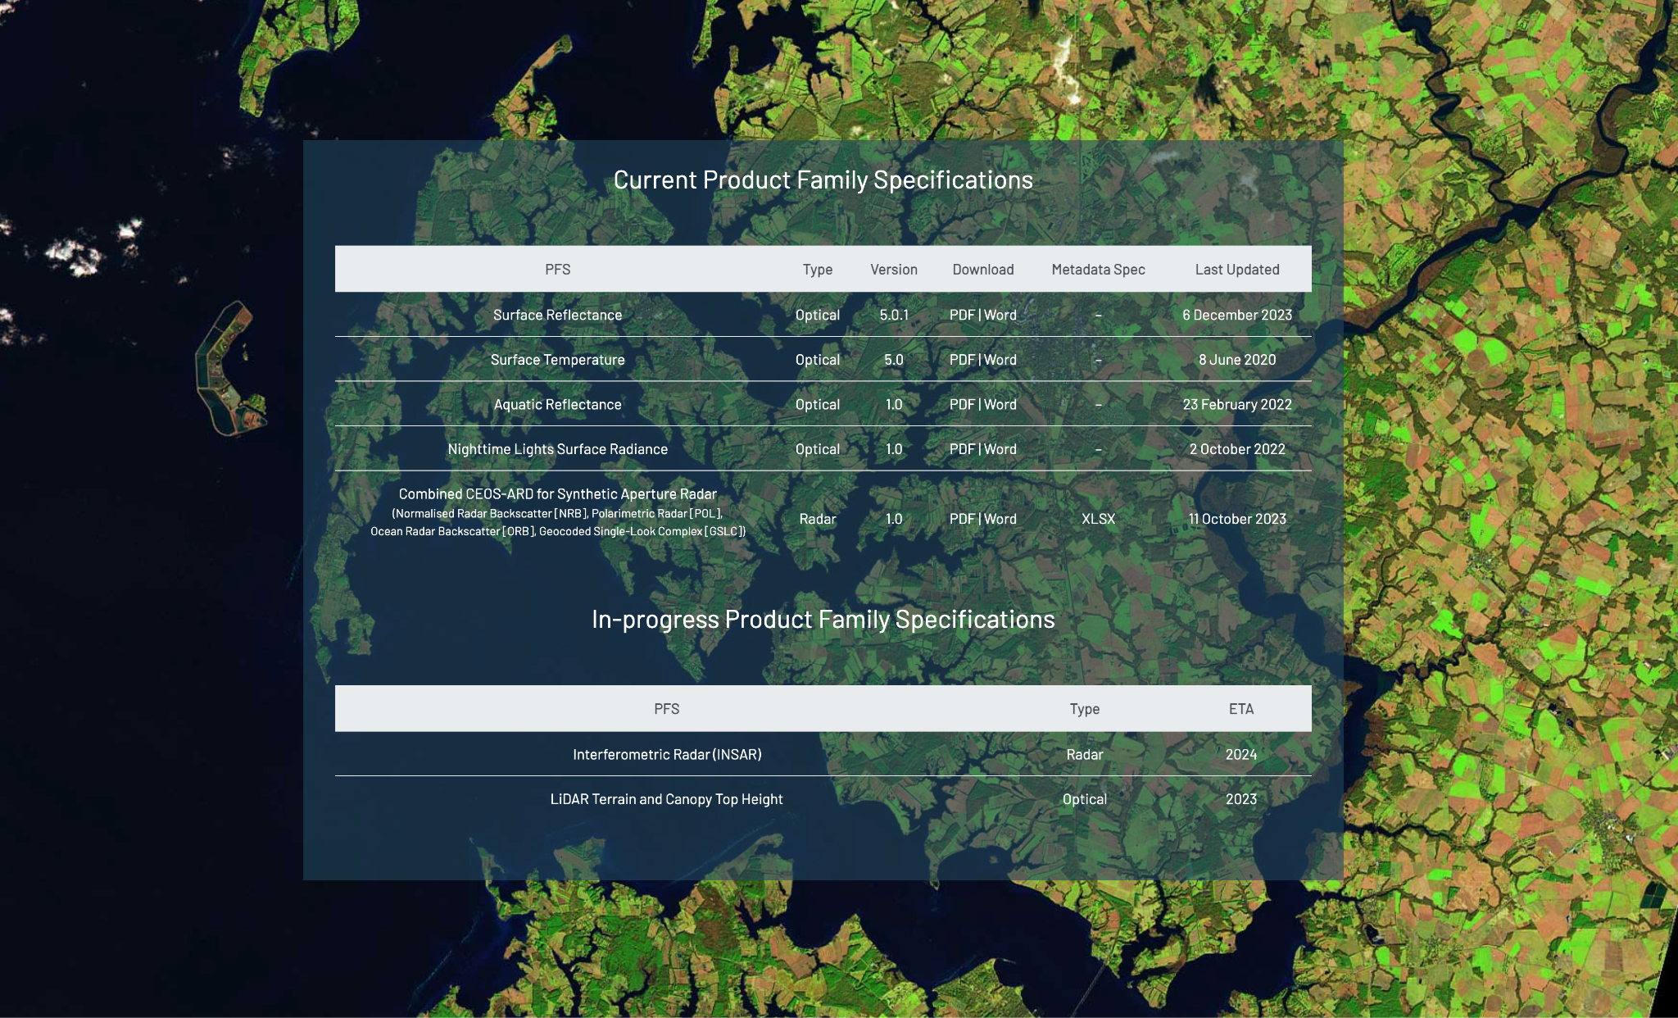
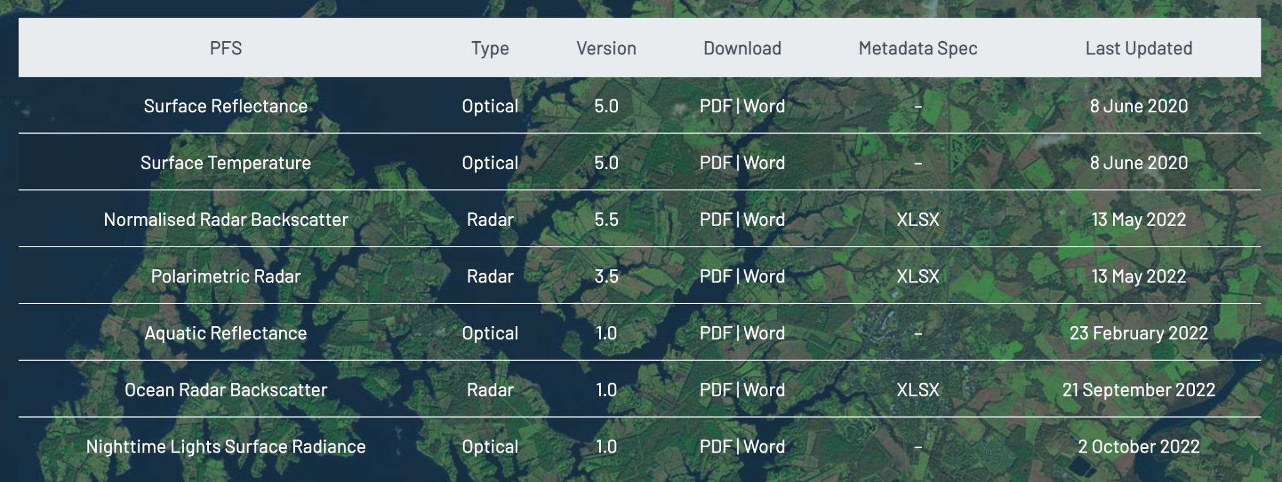
Current + In-development CEOS-ARD Specifications
Land
Inland and Coastal Waters
Oceans
Optical
Surface Reflectance
Surface Temperature
Nighttime Lights Surface Radiance
LiDAR Terrain and Canopy Top Height
Radar
Normalised Radar Backscatter
Polarimetric Radar
Geocoded Single-Look Complex (GSLC)
Interferometric Radar (INSAR)
Aquatic Reflectance
Ocean Radar Backscatter
Precipitation?
Sea Surface Temperature?
Ocean Reflectance?
Atmospheric Composition ?
http://ceos.org/ard/index.html#specs

Slide 5
CEOS-ARD Review Process
MODIFIED PROCESS
ONLY FOR TARGET LEVEL EVALUATIONS
LSI-VC Secretariat: Matt Steventon, Symbios
WGCV PoC: Medhavy Thankappan, GA
WGCV Alternate PoC: Clement Albinet, ESA
Supported by Peter Harrison, GA

Slide 6
CEOS ARD for SAR: Combined PFS
Single PFS for all CEOS ARD SAR Products – NRB, POL, ORB, GSLC
Benefits:
Ensure consistent parameter names and specifications across all SAR PFSs
Simplify PFS revisions and change tracking
Simplifying interface with ongoing external standarisation frameworks (OGC/ISO, STAC)
Elegance:
CARD4SAR PFS facilitates the generation of one, several or all of the CARD SAR products – a true combined SAR ARD product
Reduces duplication of per-pixel metadata
CEOS-ARD for SAR – one PFS to rule them all

Slide 7
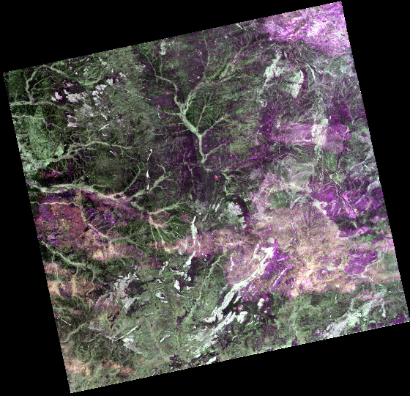
CEOS-ARD EOS-04 (RISAT-1A)
First of the SAR products to be submitted and assessed with the new CEOS-ARD SAR PFS
8 Products in total:
Quad Pol (HH HV VH VV) at 36m (CSR) and 18m (MSR) resolution
Circular Pol (RH RV) at 36m (CSR) and 18m (MSR) resolution
Dual Pol (HH HV) at 36m (CSR) and 18m (MSR) resolution
Single Pol (HH) at 36m (CSR) and 18m (MSR) resolution
Currently in the final stages of the assessment

Slide 8
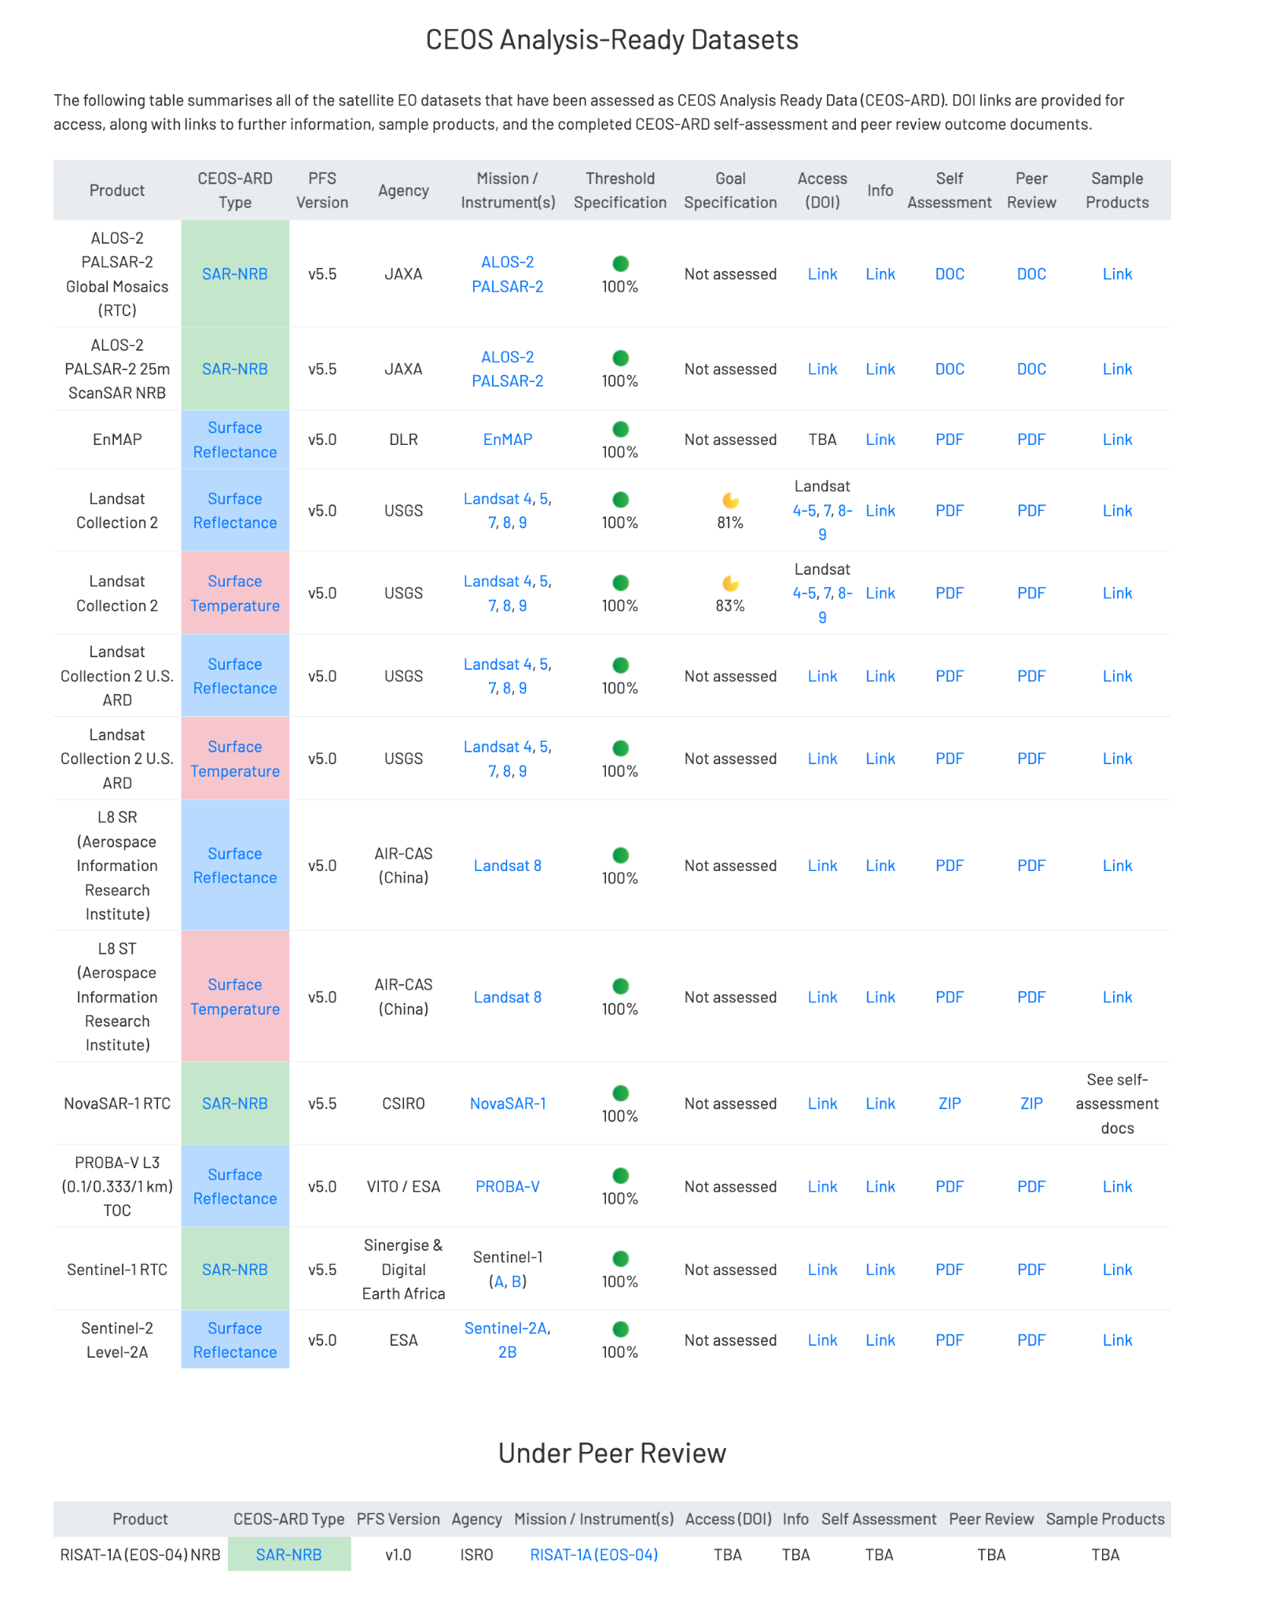
CEOS ARD Datasets
Notes:
CSIRO’s NovaSAR-1 CEOS-ARD Normalised Radar Backscatter product was recently certified as compliant with v5.5 of the Normalised Radar Backscatter PFS. NovaSAR-1 CEOS-ARD has reportedly increased the user base for NovaSAR data, both inside CSIRO and externally.
In December 2023, the Chinese AIR-CAS Landsat 8 products were also assessed as being compliant with CEOS-ARD.
ISRO’s RISAT-1A self-assessment has recently been received. This assessment has been completed using the new Combined SAR PFS, and is the first dataset to do so. The peer review is ongoing.

Slide 9
Under Development
KOMPSAT-3/3A Surface Reflectance
KOMPSAT-5 Normalised Radar Backscatter
SPOT 1-7 Surface Reflectance
RISAT-1A (EOS-04) NRB SAR
Resourcesat-2/2A
NovaSAR
SAOCOM
Gaofen-1/6 Surface Reflectance
AVHRR LST Surface Temperature
DESIS L2A Surface Reflectance
EnMAP Aquatic Reflectance
Sentinel-1
OPERA project

Slide 10
Status of ESA CEOS-ARD Products
Mission | Product | PFS | Status | Availability Date
Sentinel-2 | L2A | SR | ✅ | January 2022
PROBA-V | Collection 2 | SR | ✅ | March 2023
Sentinel-2 | L2H | SR | Under Development | 2023 (pilot product), TBD (operational product)
Sentinel-2 | L2F | SR | Under Development | 2023 (pilot product), TBD (operational product)
Sentinel-2 | L2A | AR | Under Development | TBD
Sentinel-1 | NRB / ORB | NRB / ORB | Under Development | TBD
Sentinel-3 | SYN | SR | Under Development | TBD
ERS SAR | TBC | NRB | Under Development | TBD
ERS ATSR | TBC | LST | Under Development | 2024
Envisat ASAR | TBC | NRB | Under Development | TBD
Envisat MERIS | TBC | SR | Under Development | 2024
CHIME | L2A | SR | Under Development | 2029
CHIME | L2H/L2F | SR | Under Development | 2029 (pilot product), TBD (operational product)
LSTM | L2A | ST, SR | Under Development | 2029
LSTM | L2H/L2F | ST, SR | Under Development | TBD
ROSE-L | TBD | NRB…TBC | Under Development | TBD

Slide 11
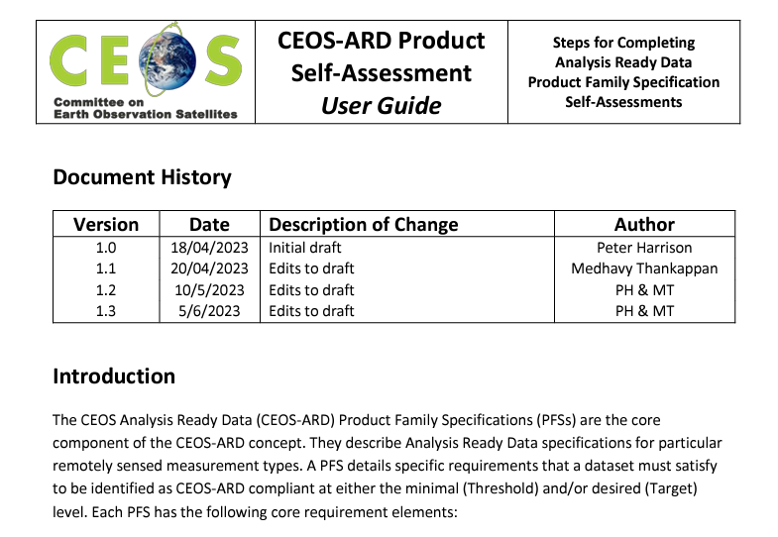
ARD Self-Assessment User Guide
The WGCV ARD assessment team has put together a guide to CEOS-ARD self-assessments
Questions regarding the self-assessment process can be sent to ard-contact@lists.ceos.org
Further information and resources related to CEOS-ARD can be found at www.ceos.org/ard

Slide 12
ARD Oversight Group and SWG
CEOS-ARD Oversight Group (ARD-OG) was established in 2022, primarily to oversee the cross-domain uptake of the CEOS-ARD concept. CEOS-ARD Oversight Group Terms of Reference was endorsed at SIT-37
Identified as a core component of the CEOS-ARD Governance Framework, acts as a forum for all matters related to CEOS-ARD, Ferran Gascon (ESA) is the ARD-OG lead
The ARD Oversight Group engaged with standards organisations IEEE and International Organization for Standardization/Open Geospatial Consortium (ISO/OGC), to understand requirements for the CEOS-ARD framework to become official, internationally recognised standards
ISO/OGC have formed the OGC ARD Standards Working Group (SWG) which is formed of both industry, academia, and CEOS Agency members
SWG is chaired by Dr. Liping Di from George Mason University and co-chaired by Patrick Quinn, NASA representative to LSI-VC

Slide 13
CEOS-ARD Strategy 2024
Update to past editions from 2019 and 2021
Reflect on the progress to date, take stock of future directions and needs, and confirm our strategy for the next few years
To achieve our stated objectives, a broad portfolio of CEOS-ARD that is easily discovered, accessed and utilised is the ultimate goal.
The Strategy activities are categorised into five broad themes:
CEOS-ARD Availability, Product Diversity, and Representation
Framework and Specification Advancement
Discovery, Access, Utilisation, and Interoperability
Community Engagement
Research, Test Cases, and Pilot Activities
WGCV input on the CEOS-ARD Strategy is welcome (DRAFT)

Slide 14
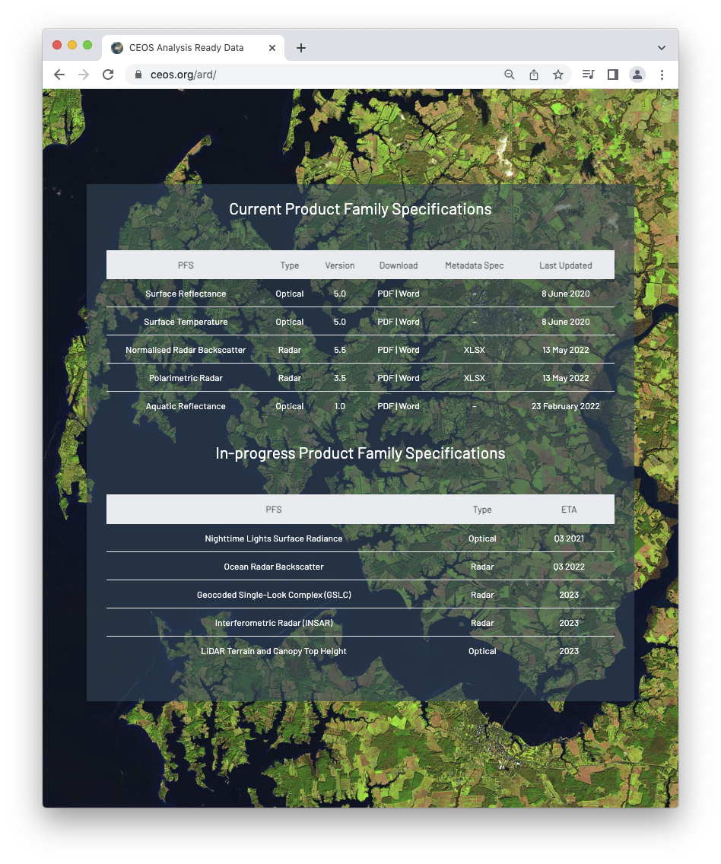
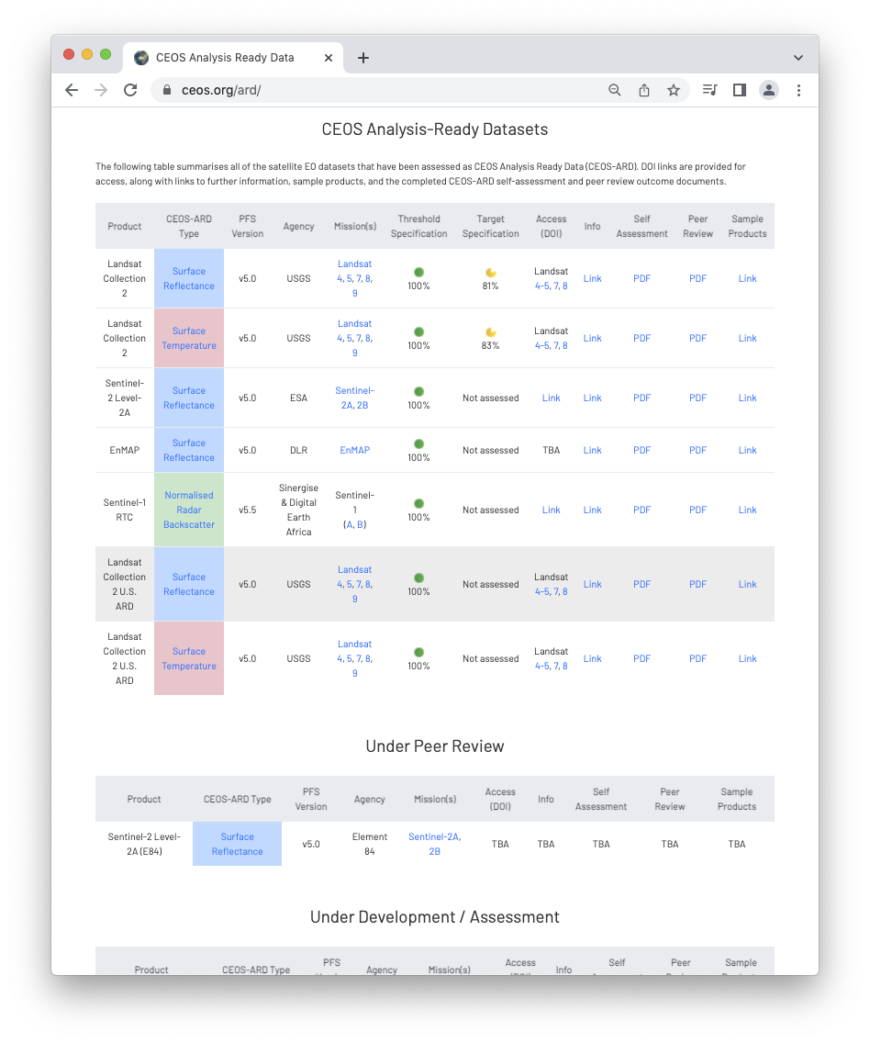
More information
ceos.org/ard
CEOS-ARD Newsletter Sign-up
Past issues: https://ceos.org/ceos-ard-newsletter/
https://twitter.com/CEOSARD
Contacts:
Ferran.Gascon@esa.int
matthew@symbioscomms.com
ard-contact@lists.ceos.org

Slide 15
Other notes for information
The need for consistency, and a recognition that a large number of parameters are shared across the optical CEOS-ARD PFS, is leading to discussion about the development of a Combined Optical CEOS-ARD PFS to match that on the SAR side
CEOS-ARD Product Family Specifications must be updated to address the issues identified with high resolution datasets and the 0.5 pixel rRMSE sub-pixel accuracy requirement of the existing Surface Reflectance PFS. LSI-VC and ARD Oversight Group are committed to resolving this issue, which will broaden the applicability of the PFS, particularly for the commercial sector and ‘New Space’ operators

Slide 16
Thank you!

Slide 17
SR Quality Consistency Equivalence
Medhavy Thankappan Geoscience Australia
WGCV CEOS-ARD Liaison
WGCV-53
7 March 2024

Slide 18
Discussion
CEOS-ARD Surface Reflectance: Quality, Consistency and Equivalence (one-page brief provided to WGCV for background)
The CEOS-ARD SR-PFS provides a good starting point for interoperability of multi-sensor SR products, but leads to different processing approaches to derive SR products with differences
The NASA Harmonised Landsat Sentinel (HLS) and ESA Sen2Like products demonstrate a need to improve the compatibility of SR products across different providers
Proposal to build on CEOS-ARD achievements and take next steps to deliver on CEOS-ARD multi-sensor interoperability objectives
Seeks to establish a set of inputs, corrections, associated parameters and tolerances for achieving SR equivalence in support of interoperability between CEOS-ARD SR products
There is need for an agreed and unambiguous definition of SR in the context of CEOS-ARD cross-sensor interoperability, potential for WGCV to provide guidance

Slide 19
Thank you!

