Slide 1
Systems Engineering Office Report
David Borges
Systems Engineering Office
Committee on Earth Observation Satellites
NASA Earth Science Division
WGCV-53 Agenda 3.4
07 March 2024

Slide 2
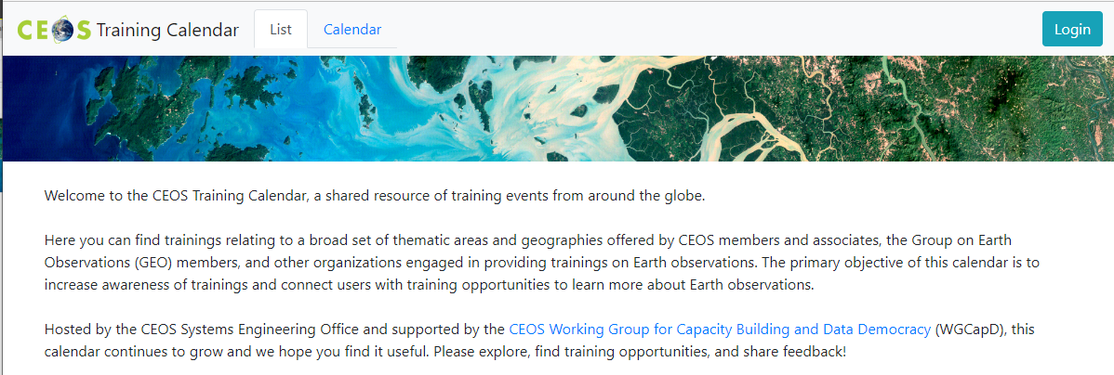
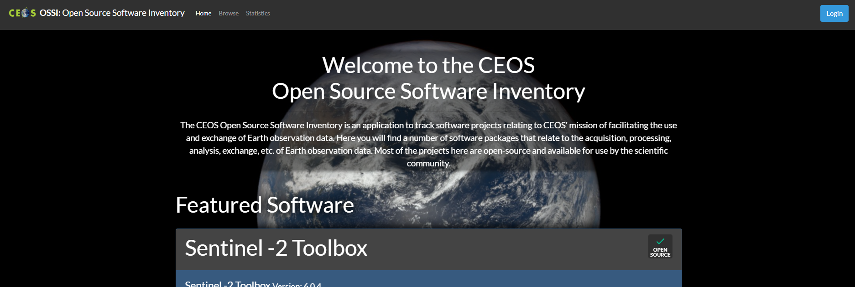
SEO Fundamentals
“Provide systems engineering leadership and support to CEOS through management and technical services and the development of tools and products that facilitate systems engineering solutions for societal benefit.”
CEOS website infrastructure
Deliverables Tracking Tool 2.0
CEOS Visualization Environment (COVE)
Open Source Software Inventory
Future Data Architectures Inventory
Training Calendar
EOTEC DevNet
Open Data Cube (ODC)
CEOS MIM Database Team support
Cloud Native Geospatial

Slide 3
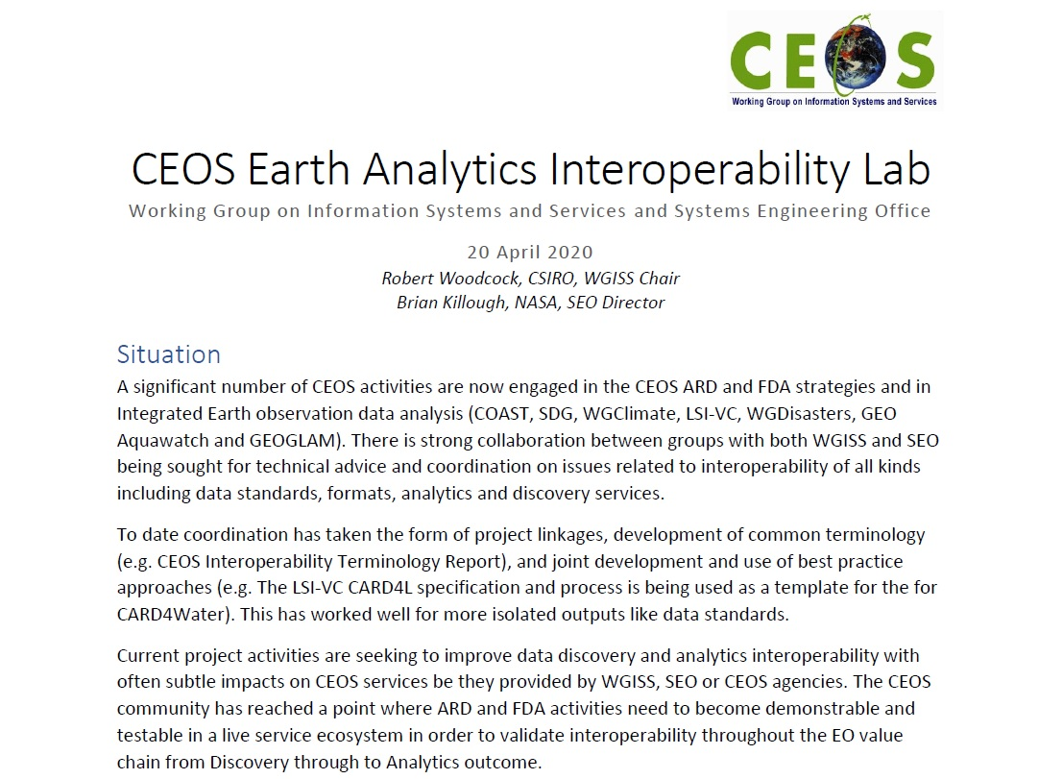
CEOS Earth Analytics Interoperability Lab

Slide 4
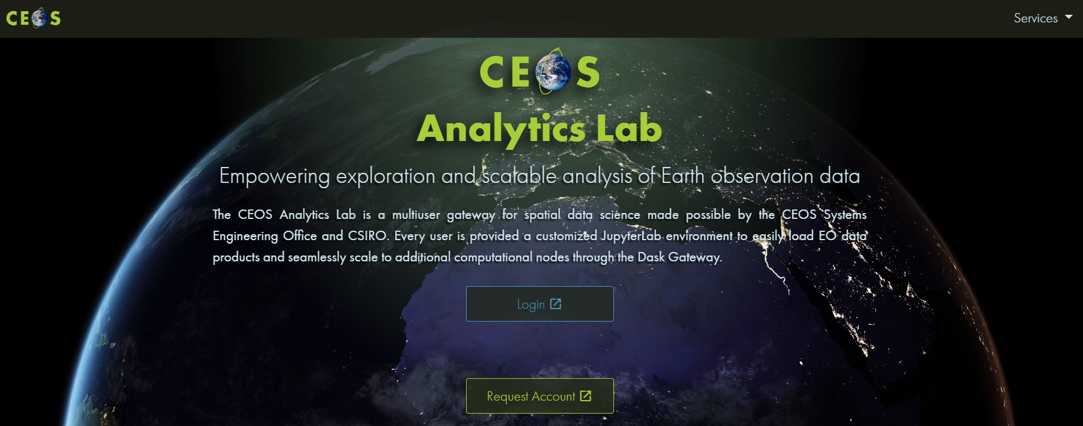
CEOS Analytics Lab
ceos.org/cal

Slide 5
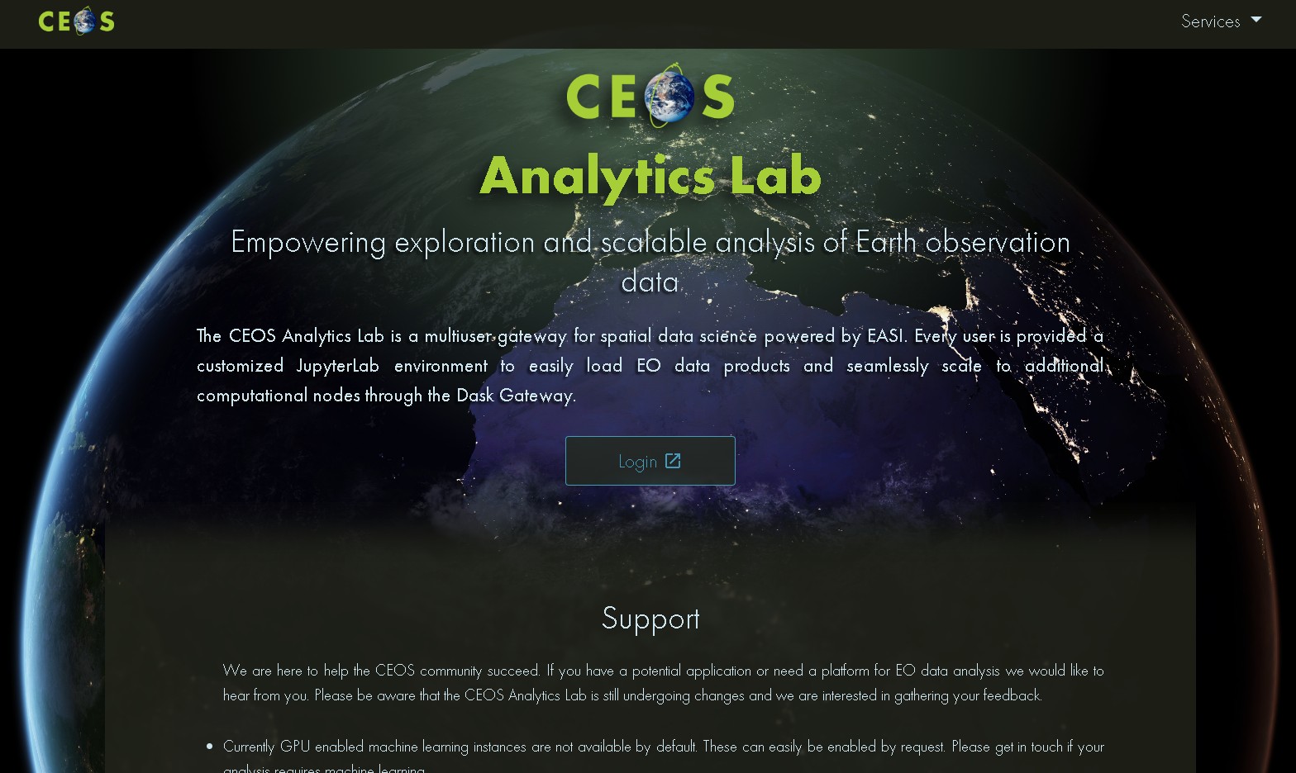
Analytics Lab Home Page
Home Page Located at:
https://ceos.org/cal/
Login Button:
Main Login for CAL
Services Tab (Upper Right)
JupyterHub
Directs to JupyterHub Homepage
Explorer
Explore Data Available in CAL
Support Request
Data Request

Slide 6
Analytics Lab Architecture
CAL is an implementation of CSIRO’s Earth Analytics Science and Innovation platform (EASI)
Combination on several open-source projects:
JupyterHub
Open Data Cube
Dask
Scales individual user environments on demand.
Analysis can scale beyond the user environment using Dask workers that are used only when the analysis is run.

Slide 7
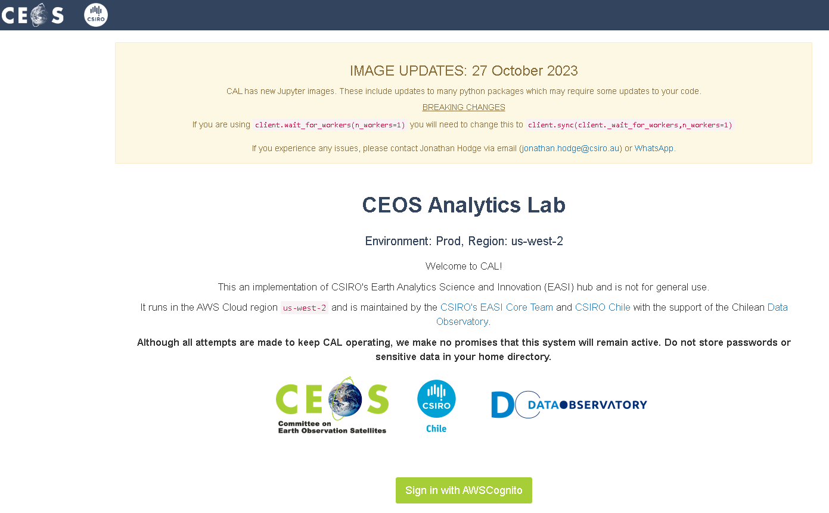
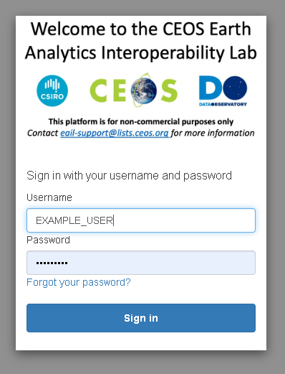
Login
Once an account has been provisioned, one can log into CAL through the main CAL homepage.
Select 'Login' on homepage -> 2. Redirects to environment page: Select 'Sign in with AWS Cognito' -> 3. Enter your Username and Password and 'Sign in'

Slide 8
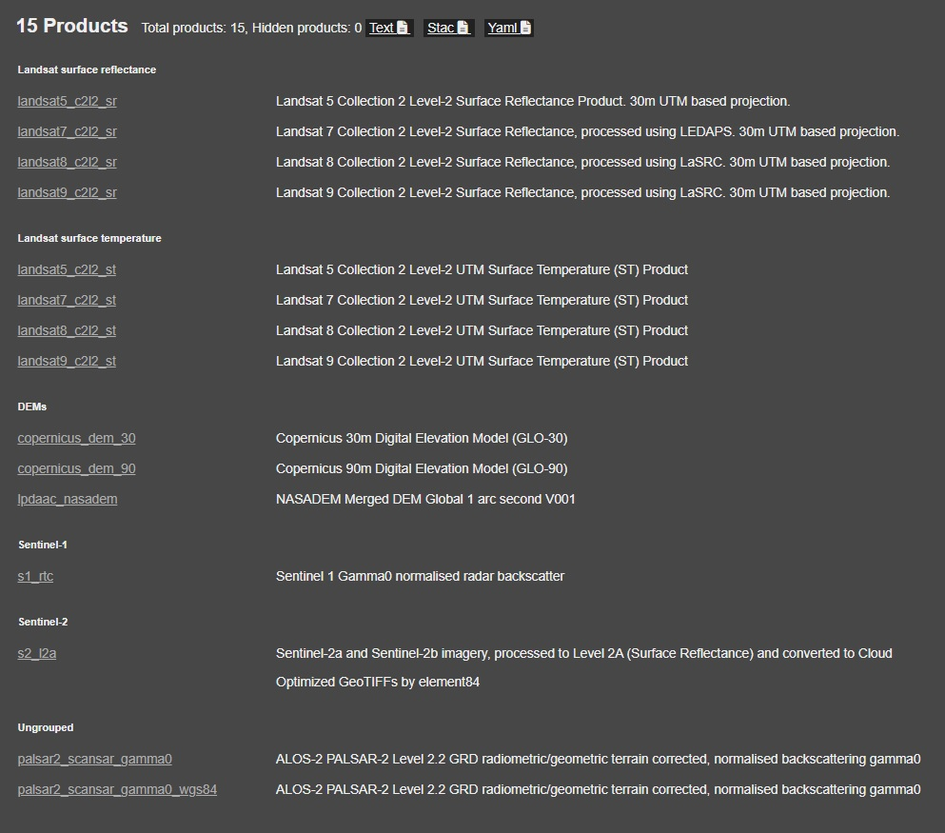
Analytics Lab: Current data
Landsat (5-9) surface reflectance
Landsat (5-9) surface temp
DEMs (Cop 30/90; nasadem)
Sentinel-1 rtc
Sentinel-2 l2a
ALOS Palsar scansar

Slide 9
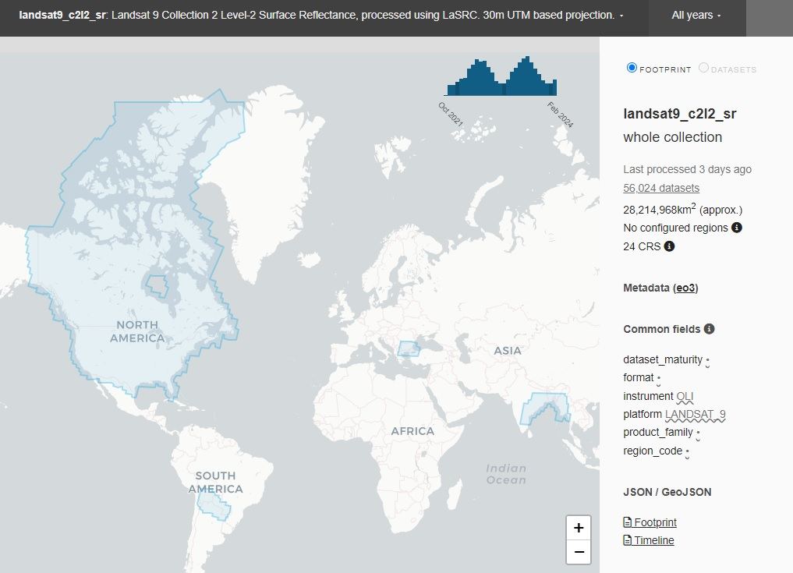
Analytics Lab: data coverage

Slide 10
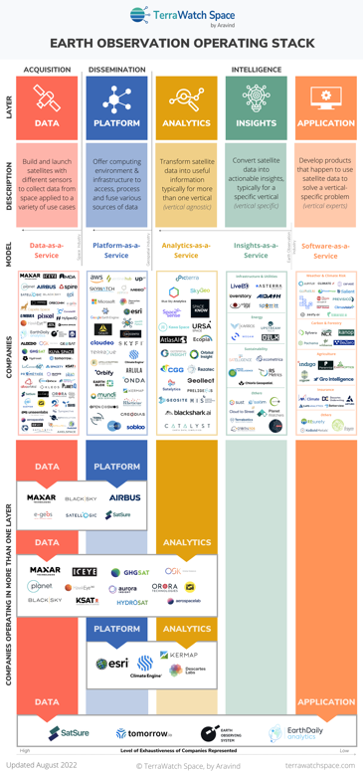
New Space Interoperability Project
CEOS New Space Task Team (NSTT) Deliverable
D5) SEO should demonstrate the integration of New Space data into CEOS Analytics Lab and evaluate its interoperability with common CEOS datasets.
Optical
Landsat 8, 9
Sentinel-2
Maxar
Planet Planetscope
DESIS
SAR
Sentinel-1
ALOS
Umbra
ICEYE
Capella

Slide 11
New Space Interoperability Project
Key Considerations and Challenges
Sensor Variation
Impacts spectral band alignment, spatial detail, signal strength
Processing Biases
Differences in atmospheric correction and vendor-specific sharpening will influence direct comparisons
Situational Factors
Slight time offsets and viewing geometry differences create irreducible limitations
Commercial data compliance with CEOS-ARD PFS

Slide 12
New Space Interoperability Project
Technical Approach
Data Access
Evaluate use of commercial providers APIs (not all include API access)
Implement APIs to access data
Data Loading
Generate ODC indexing scripts for each commercial provider
Create demo indexer notebooks
Analysis / Visualization
Build notebooks evaluating:
Pixel-by-pixel scatter plots comparing individual bands
Inherent harmonization evaluation
Resampling analysis
Band to band spectral comparison
OUT-23-05/06: NASA/ESA Mission Quality Assessment Framework Guidelines (optical & SAR)

Slide 13
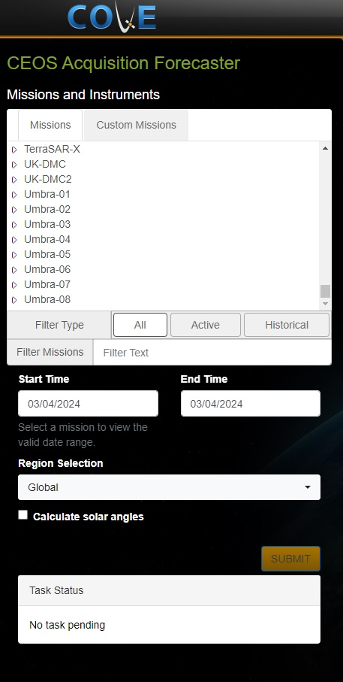
CEOS Visualization Environment (COVE)
Tool Suite
Acquisition Forecaster
Coverage Analyzer
Revisits Calculator
Coincident Calculator
Data Browser
Data Policy
Country Coverage
Utilities

Slide 14
CEOS Outreach
SatSummit 2024
Washington, D.C.
16-17 May
IGARSS 2024: CEOS Booth
Athens Greece
7-12 July

Slide 15
Discussion
CEOS COVE utilization by WGCV?
Desired improvements or mission additions?
How can this work integrate with, or support WGCV activities?
Are there other WGCV activities that could utilize Analytics Lab?

