Slide 1
WGCV-53
Greenhouse Gases Cal/Val: Networks, Resources Catalogue and IMEO WG
J.-C. Lambert (BIRA-IASB)
and Akihiko Kuze (JAXA)
Agenda Item 3.6
WGCV-53, Córdoba, Argentina
5th - 8th March 2024

Slide 2
GHG Cal/Val Networks, Resources and IMEO WG
GHG Cal/Val Networks Sustainability and Tailoring
Development of GHG Cal/Val Resources Catalogue
UNEP/IMEO Cal/Val Testing WG

Slide 3
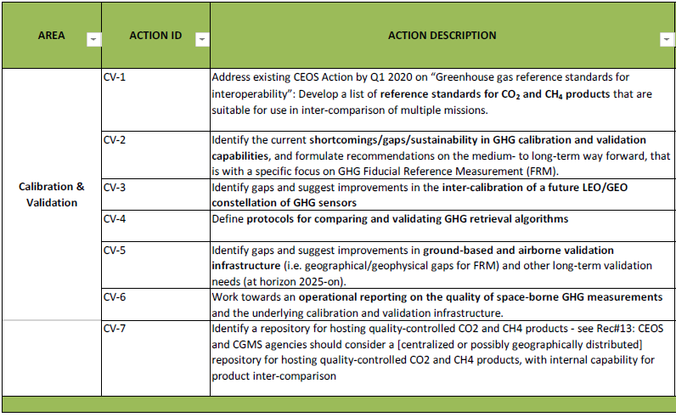
CV-2/5/6: Networks Sustainability and Tailoring
GHG constellation roadmap – Annex C: Implementations actions – Calibration & Validation
https://ceos.org/meetings/wgcv-52/

Slide 4
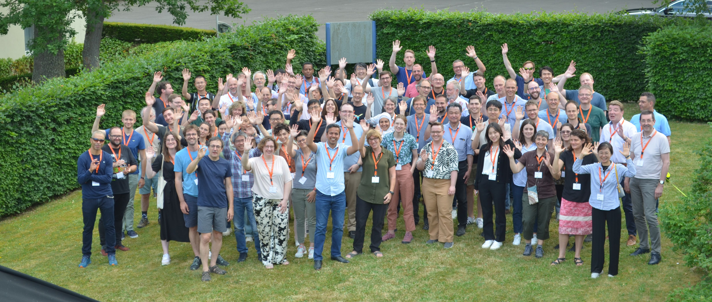
CV-2/5/6: Networks Sustainability and Tailoring
GHG Constellation Roadmap v2.3 – Annex C: Implementations actions – Calibration & Validation
CV-2 Identify the current shortcomings/gaps/sustainability in GHG calibration and validation capabilities, and formulate recommendations on the medium- to long-term way forward, that is with a specific focus on GHG Fiducial Reference Measurement (FRM).
CV-5 Identify gaps and suggest improvements in ground-based and airborne validation infrastructure (i.e. geographical / geophysical gaps for FRM) and other long-term validation needs (at horizon 2025-on)
https://events.spacepole.be/event/160/

Slide 5
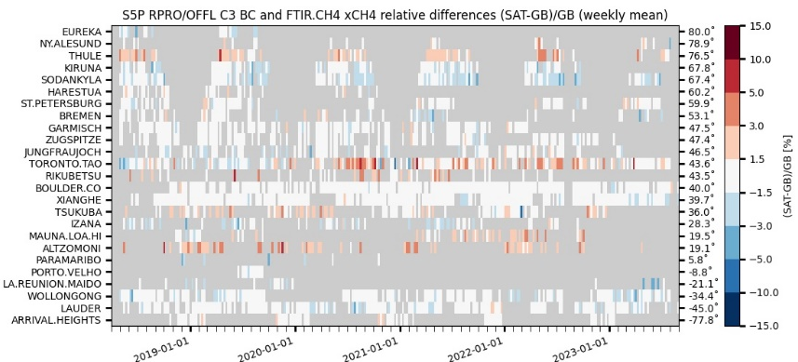
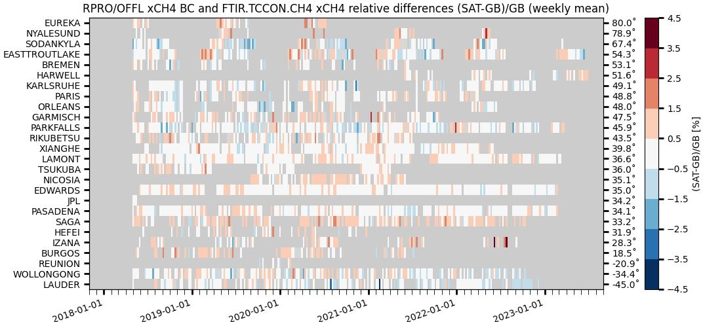
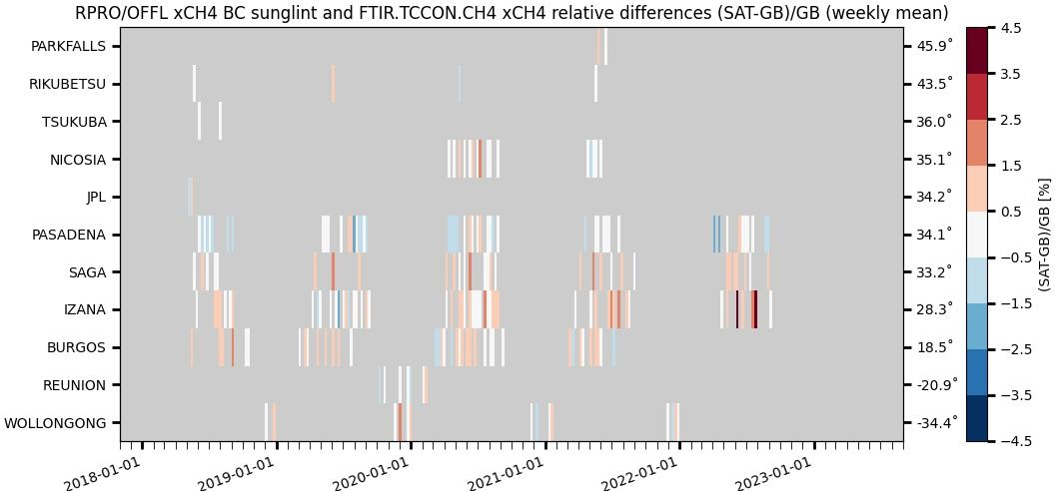
CV-2/5/6: Networks Sustainability and Tailoring
GHG Constellation Roadmap v2.3 – Annex C: Calibration & Validation
CV-6 Pathfinder: ESA/Copernicus ATM-MPC Sentinel-5P CH₄ and CO operational validation relying on the three GHG column/profile monitoring networks
NDACC FTIR : automated validation channel in ATM-MPC Automated Validation Server (https://mpc-vdaf-server.tropomi.eu).
Validation protocols based on published experience with HALOE, MOPITT, SCIAMACHY, MIPAS, ACE-FTS, IASI, GOSAT…
TCCON FTIR : manual validation channel in ATM-MPC, ESA contract for operations support to be placed; EUMETSAT FRM Roadmap and CO2M Cal/Val Studies in progress
COCCON FTIR : manual validation channel in ATM-MPC, EVDC data collection and automation in progress (ESA FRM4GHG 2023-2027)
S5P TROPOMI CH4 & CO validation updated permanently vs. NDACC FTIRs
and monthly – when and where data available – vs. TCCON & COCCON FTIRs.
Quarterly validation reports available on http://mpc-vdaf.tropomi.eu
CH₄ images courtesy M.K. Sha
ATM-MPC review October 2023
Automated collection of observations from 17
NDACC FTIR stations
through EVDC =>
automated production of S5P Quality Indicators
TCCON GGG2020 data
released 26 April 2022
No/limited data submitted
between early 2021 and the
release of new data version
GGG2020
Collection of permanent
and campaign based
observations
~17 COCCON stations
to contribute in the
future

Slide 6
CV-2/5/6: Networks Sustainability and Tailoring
Recommendations presented at CEOS SIT/GHG-TT TW 2023 for Cal/Val networks capabilities, infrastructure and operational capacity
To be incorporated in CEOS GHG Constellation Roadmap v2.3 – Annex C: Implementation Actions – Calibration & Validation
NETWORKS DESIGN AND EVOLUTION: to support gap analysis studies with a view to tailoring CO₂,CH₄ and N₂O networks deployments to Cal/Val needs of the GHG satellite constellation: background/hot spots, land/ocean, low/high albedo, full range of atmospheric temperature…
INSTRUMENT DEPLOYMENT: (i) to further develop (low-cost, light-weight, mobile) low-resolution infrared instruments; (ii) to support standardized production of enclosures for their deployment in the field; (iii) to maintain a supply of spare parts.
CALIBRATION: to support the development of and maintain mutually consistent calibration and QA/QC of the GHG Cal/Val networks – within and across networks. Key actions: (i) traceability towards internationally agreed standards; (ii) more regular and network-wide deployment of traveling standard; (iii) more regular intercomparisons within and across networks, and between in situ (AirCore…) and remote sensing (networks); (iv) facilitate AirCore deployment; (v) establish a central AirCore data archive.
DATA PROCESSING: to support GHG Cal/Val network data processing improvements needed to maintain FTIR data precision/accuracy and meet future goals: formal intercomparison exercise of the GGG and PROFFAST retrieval algorithms, development and standardization of profile retrievals, spectroscopy studies.
Notes:
- Stratospheric gliders available and demonstrated. E. g., at NOAA with AirCore onboard; by Stratodynamics company (Canada) but not yet with AirCore onboard. Proposals for embedding AirCore as payload exist but have not been funded…

Slide 7
CV-2/5/6: Networks Sustainability and Tailoring
Recommendations presented at CEOS SIT/GHG-TT TW 2023 for Cal/Val networks capabilities, infrastructure and operational capacity
To be incorporated in CEOS GHG Constellation Roadmap v2.3 – Annex C: Implementation Actions – Calibration & Validation
DATA ACCESS: to establish interoperable GHG Constellation Cal/Val Data archives and tools for tailored network data (traceable, open, metadata, co-located…) and ‘hidden’ data (e.g. campaigns), ideally coupled to New Space related matchup database(s).
TIMELINESS: to organize concertation between stakeholders and with networks data providers to support rapid and continuous availability and improved access to networks-wide GHG data.
CENTRAL PROCESSING FACILITIES (CPF): to establish central processing facilities for every network product, which will directly support harmonized calibration (3), data processing, QA/QC and tailoring (4-5) and timeliness (6).
GHG EMISSIONS AND ATTRIBUTION: to support the development of new Cal/Val protocols for satellite derived GHG emissions and fluxes, in collaboration with relevant bodies and initiatives (global stocktakes, WMO GGGW, UNEP IMEO, New Space…) Consider co-located measurements of GHG and tracers of anthropogenic/biogenic contributions for better attribution of emissions.

Slide 8
Cal/Val Resources Status and Catalogue
GHG Cal/Val in AC-VC-19 / ACSG joint meeting (2023/10, Brussels)
https://ceos.org/meetings/ac-vc-19-acsg-joint-meeting-2023/
In Greenhouse Gases session (Chairs J. Worden and Y. Meijer)
Talks on GHG Cal/Val networks, calibration, campaigns, other initiatives
Engagement with WGCV on sustainability of GHG Cal/Val networks in GHG-TT report by Y. Meijer
5 talks and general discussion on Cal/Val Status/Needs/Synergies
Agreement to elaborate on super-sites concepts and make relevant recommendations.
In Cal/Val for the Constellations session (Chairs J.-C. Lambert and H. Tanimoto)
General talk on Cal/Val needs for the Constellations (incl. GHG constellation) by J.-C. Lambert
WGCV engagement in GHG Cal/Val by A. Kuze
GHG Cal/Val talk with outlook to Copernicus Contributing Missions (NewSpace)
Panel review of the Cal/Val needs for the AC-VC constellations (incl. GHG), general discussions on way forward

Slide 9
Cal/Val Resources Status and Catalogue
Development of a guidance document on Cal/Val resources for Greenhouse Gases similar to the hyperspectral guidance document ?
Relevant discussions at AC-VC-19/ACSG joint meeting (2023/10)
Validation resources in CEOS whitepapers on GHG constellation Architecture (2018) and Roadmap (2020) succinct (not the main target), need an update.
Agreement on the principle to compile a useful catalogue of Cal/Val resources.
Key point: Scope and objectives of this document to be clarified.
Global GHG mappers first; validation of point-source emissions data not mature yet (e.g., needs identified in IMEO Cal/Val Testing WG TN).
Coordinate Cal/Val resources catalogue with update of GHG Constellation Roadmap Annex C (see next 3.7 report by J. Worden).
Coordinate with elaboration of super-sites concepts (cf. 1.7 ACSG report).

Slide 10
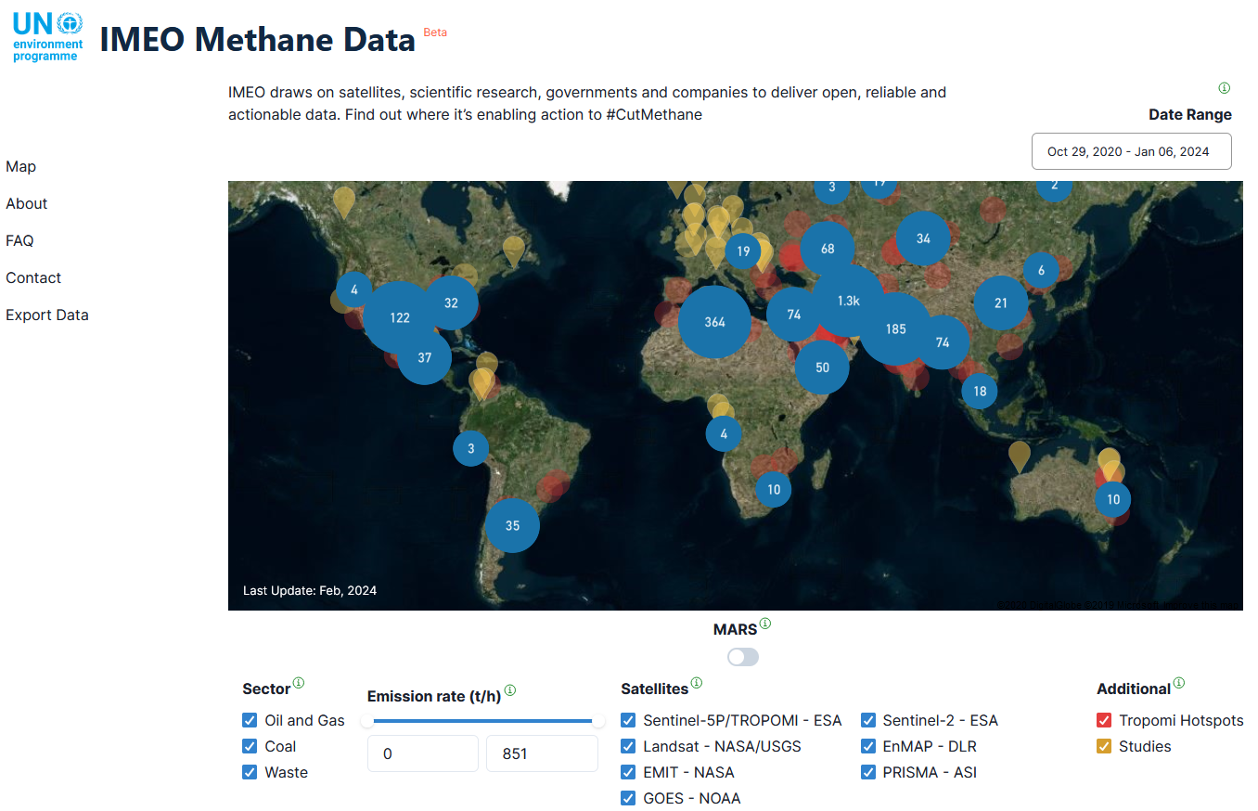
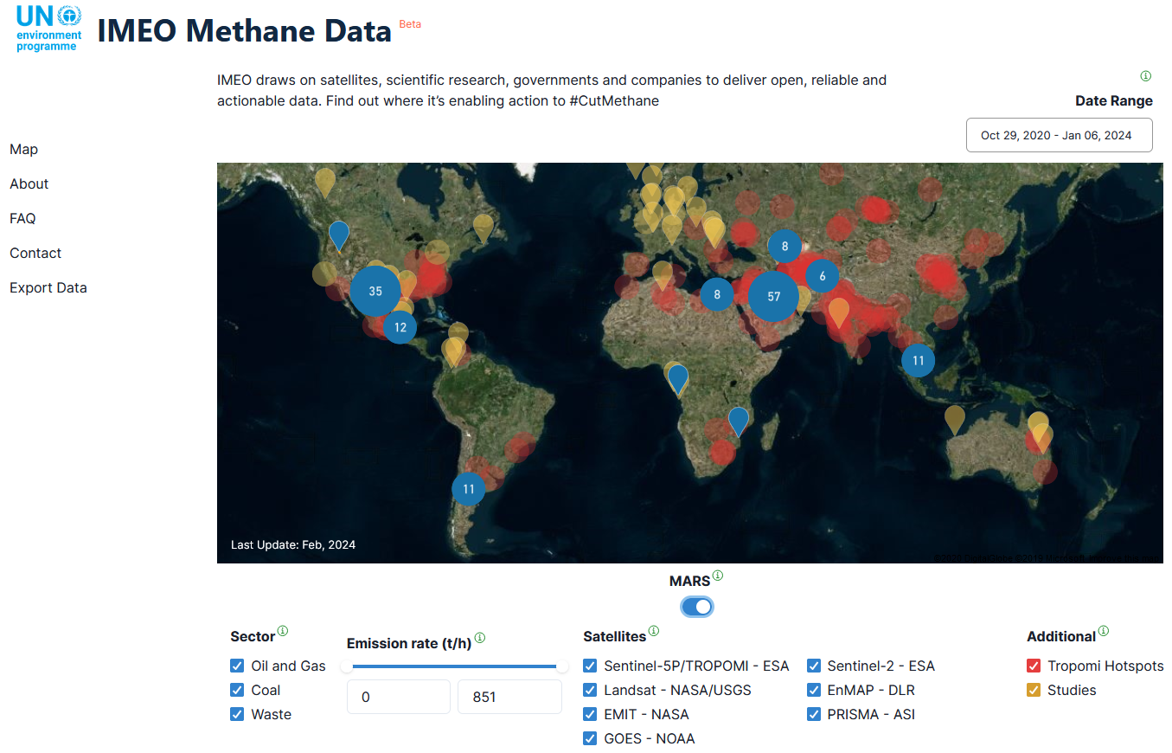
UNEP/IMEO Cal/Val Testing WG
UNEP IMEO Methane Alert and Response System (MARS): first global satellite detection and notification system providing actionable data on very large methane emissions around the world.
All UNEP IMEO’s Methane Data
MARS Satellite Data
https://methanedata.azurewebsites.net/plumemap?mars=true

Slide 11
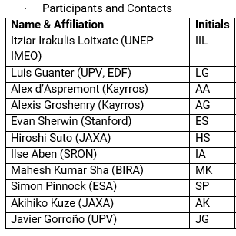
UNEP/IMEO Cal/Val Testing WG
5 thematic WGs: Observability, Use Case, Data Integration, Cal/Val/Testing, Roadmap.
Cal/Val/Testing WG – Defining testing methodologies and metrics for different patterns of emissions and scales with the intent of providing understanding of data product quality and uncertainties.
Two meetings (27 July and 11 September 2023) organized by UNEP IMEO, where a group of 11 experts gave input for the WG document.
First WG deliverable: ‘Validation of point-source methane emissions observed from space’ high-level document led by C. Randles (UNEP/IMEO) with WG contributions, to serve as input to next convening and other groups interested in same topics (e.g., CEOS)

Slide 12
UNEP/IMEO Cal/Val Testing WG
IMEO TN ‘Validation of point-source methane emissions observed from space’
(1) Need to identify specific needs for Cal/Val of detection, localization and emission quantification from point-source methane imagers.
(2) Data conventions
- Need to define critical validation components. Not only validation of CH₄ emissions, but also validation of column-mixing ratio (XCH4), localization, Probability of Detection (POD) and all associated uncertainties under various conditions.
- Need to define conventions and definitions for understanding the applicability of a given validation method: e.g., Location-blind Detection Limit, Controlled Detection Limit, Uncertainty.
(3) Validation methodologies specific for point-source methane emissions
- Controlled release experiments.
- Other methods: cross-comparisons, non-satellite observations, modeling support.
(4) Conclusions and recommendations
- To establish common definitions for key quantities needed to define how point-source methane emissions are validated.
- To define common standard conditions under which satellite data providers agree to assess their satellite’s performance.
- Multiple approaches should be taken for validation to cover as many conditions as possible.
⇨ Many links with GHG Roadmap Annex C: Prod-9, Inv-1/2/6/8/9, CV-7…

