Slide 1
Greenhouse Gas (GHG) Task Team within joint CEOS/CGMS WG Climate
Updates to Annex-C

Slide 2
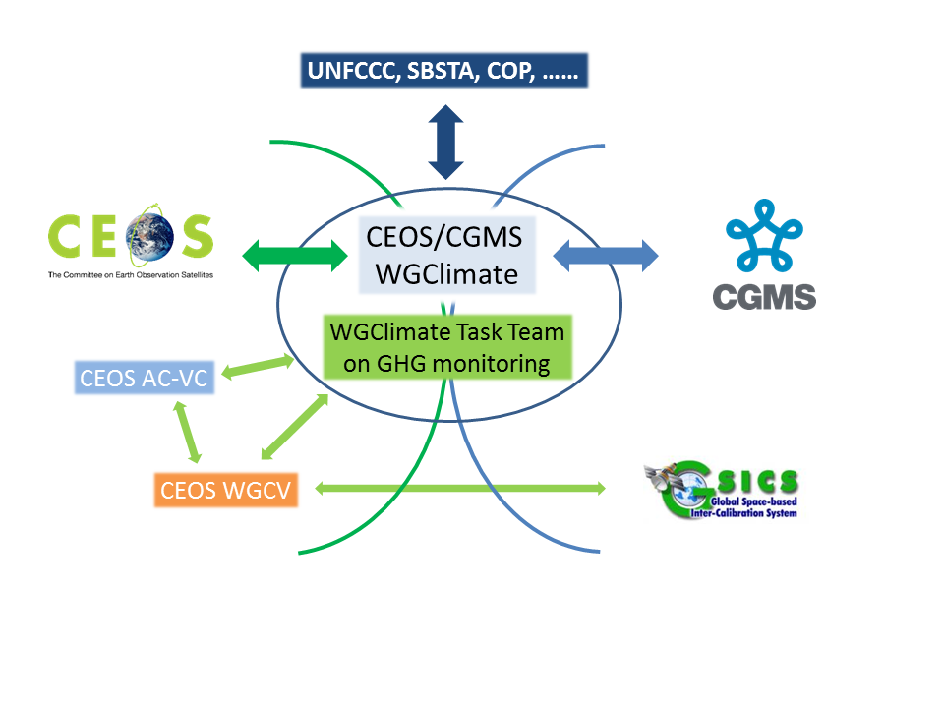
GHG Task Team – its Role
Responsible for maintaining and implementation of the GHG Roadmap and its identified Actions
Interfaces with, stimulates and monitors GHG related activities across various (CGMS &) CEOS WGs: WG-Climate, WG-CalVal, AC-VC, WG-CapD, NewSpace Task Team, etc
Actively ensure representation of CEOS and CGMS bodies by identifying Points of Contact (PoCs) for tasks to be executed by these bodies
http://ceos.org/ghg-tt

Slide 3
GHG TT – organisation
Area leads (plus deputies) have been appointed using the thematic areas of Annex C (actions) in the GHG Roadmap:
Stakeholder Engagement - Mark (John, Wenying) supports data use, requirements definition, and coordination of satellite measurements for (for example) International Methane Emissions Observatory and WMO Global Greenhouse Gas Watch; participation
System Development Facilitation – Richard (John, Kevin) Enables quantification of country-level emissions using satellite data (see ceos.org/gst to support the global Stock-Take
Sensor Development – John (AC-VC) (Yasjka) Supports coordination and evaluation of instrumentation and algorithms needed to improve accuracy of greenhouse gas measurements

Slide 4
GHG TT – organisation
Area leads (plus deputies) have been appointed using the thematic areas of Annex C (actions) in the GHG Roadmap:
Operational Preparation and Training – TT discuss Supports Supports use of operational system
L1 & L2 GHG Product Development – Ruediger & Dave Supports evaluation and development of measurements needed to support science requirements (subsequent slide)
Flux Inv. Model Development – Kevin (Frederic) Coordinates research between agencies to define requirements for estimating and
Calibration & Validation – Hiroshi (Kuze) Coordinates calibration and validation activities

Slide 5
Meetings in 2023–2024
General Meetings
02 FEB ‘23: GHG Task Team meeting #2, at WMO, Geneva
12 SEP ‘23: Leads discussion (telecon)
17 OCT ‘23: GHG Task Team meeting #3, at ESRIN
11 MAR ‘24: GHG Task Team meeting #4, virtual
09 APR ‘24: Side meeting at CEOS SIT, Tokyo
Contributions to various CEOS and CGMS (WG) meetings
Topical meetings
7-8 JUN ’23: (Joint CEOS/IMEO) International Coordination Workshop on Detection of Anthropogenic Methane Emissions from High-Resolution Satellites, Harvard Uni., USA
03 JUL ‘23: Emission Uncertainties Workshop, Paris, France

Slide 6
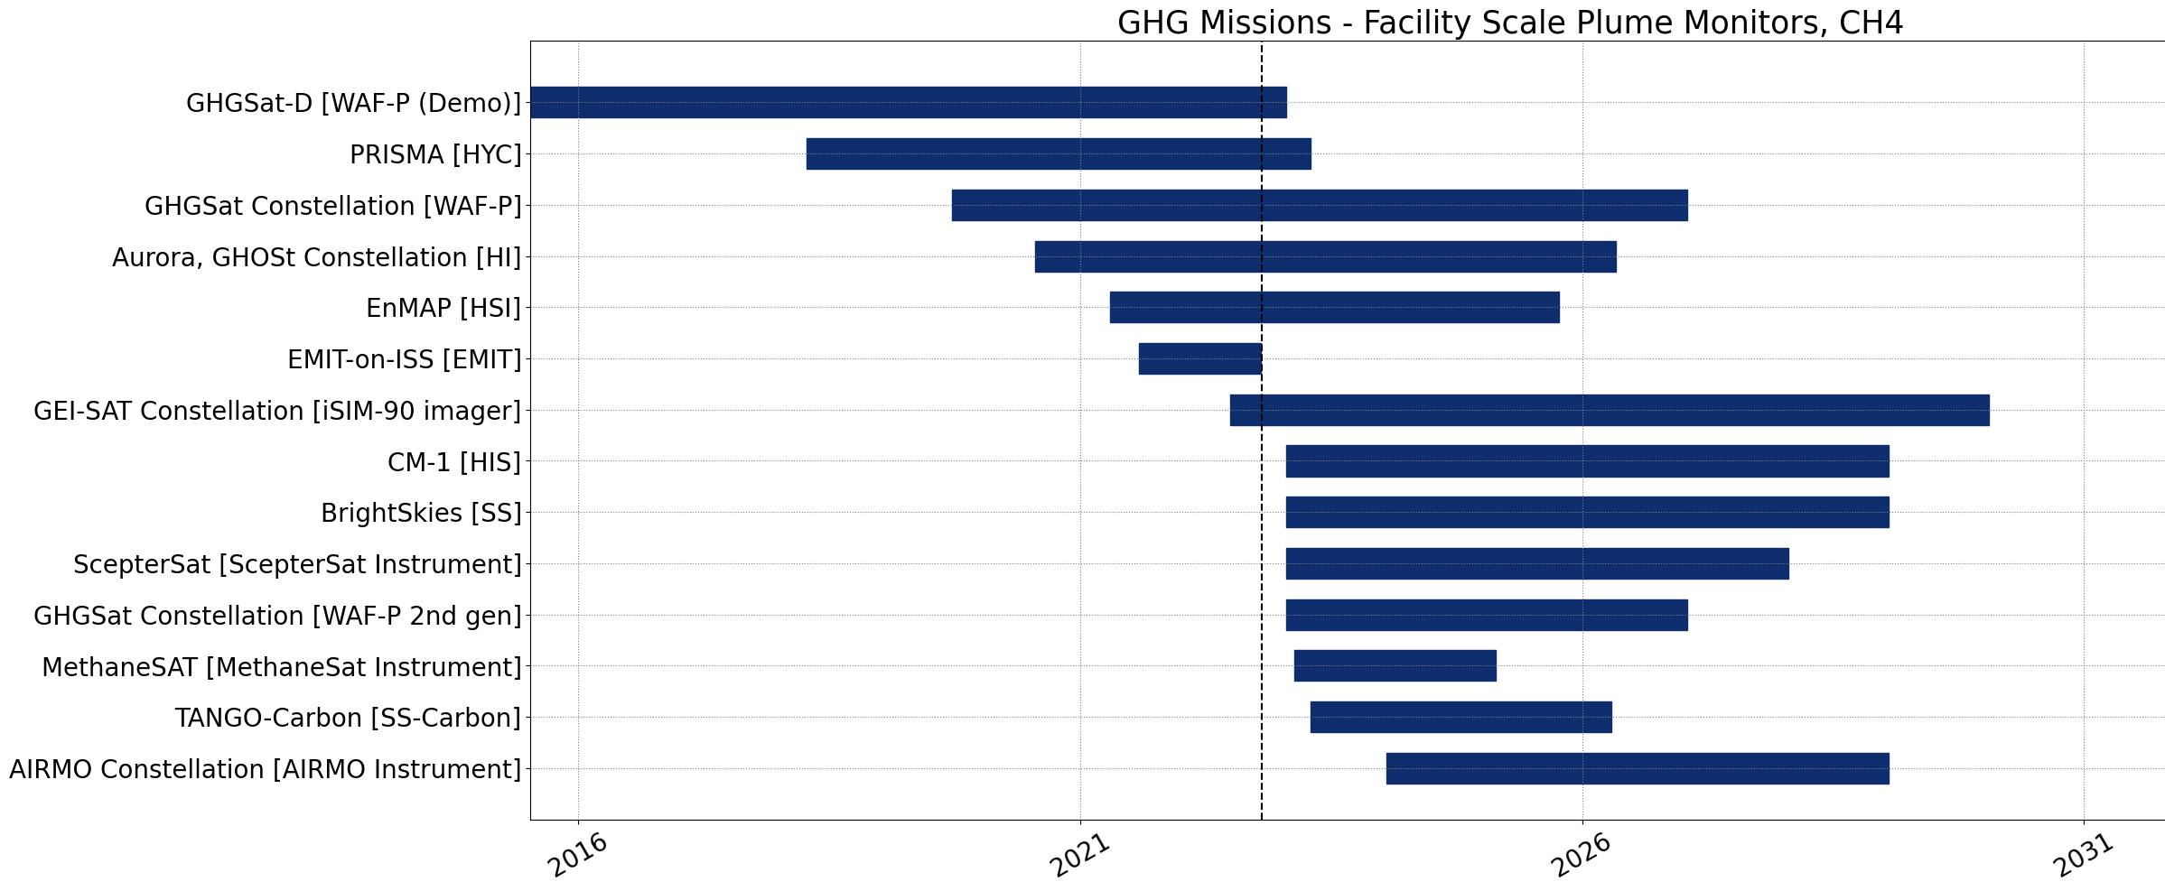
Recent Activities
International Engagement with WMO’s plans on a Global GHG Watch (G3W) and UNEP’s IMEO (with GHG TT members participating in WGs)
CEOS GHG Missions Portal; centralized overview of GHG Missions in one Portal at ceos.org/ghg
New Space
CEOS is engaged with activities to develop best practices and standards for developing/reporting emissions from “high emitters”
IMEO seeks expertise to coordinate facility scale observations , especially for ‘tip-and-cue’ and validation This is across various operators (commercial, NGOs, philanthropic, public and mixtures) → ROLE for CEOS?

Slide 7
Topic Discussions at Next GHG-TT meeting
(Cal-Val) How to support cal/val of facility scale to global CO2 and CH4 fluxes → Currently cal/val of facility scale performed on ad-hoc basis (e.g. individual projects + IMEO supporting). Need to understand project and user needs for cal-val
(Cal-Val) Support implementation of “super sites” to include ancillary measurements that can help test processes (e.g. aerosols) that affect XCO2 and XCH4 accuracy
(Sensor) CO2M plus other missions likely need joint aerosol measurements to reduce uncertainty in their XCO2 and XCH4
(System Dev, Stakeholder, Flux Inv., Operational Prep/training) Need to discuss next steps for CEOS support of global stock take
Update to GHG Roadmap in discussion to support New Space cal-val / evaluation

