Slide 1
WGCV-54 SAR Subgroup Report
Dirk Geudtner, ESA
Stephane Cote, CSA
Agenda Item 3.6
WGCV-54
16-17 October 2024
Sioux Falls, South Dakota, USA

Slide 2
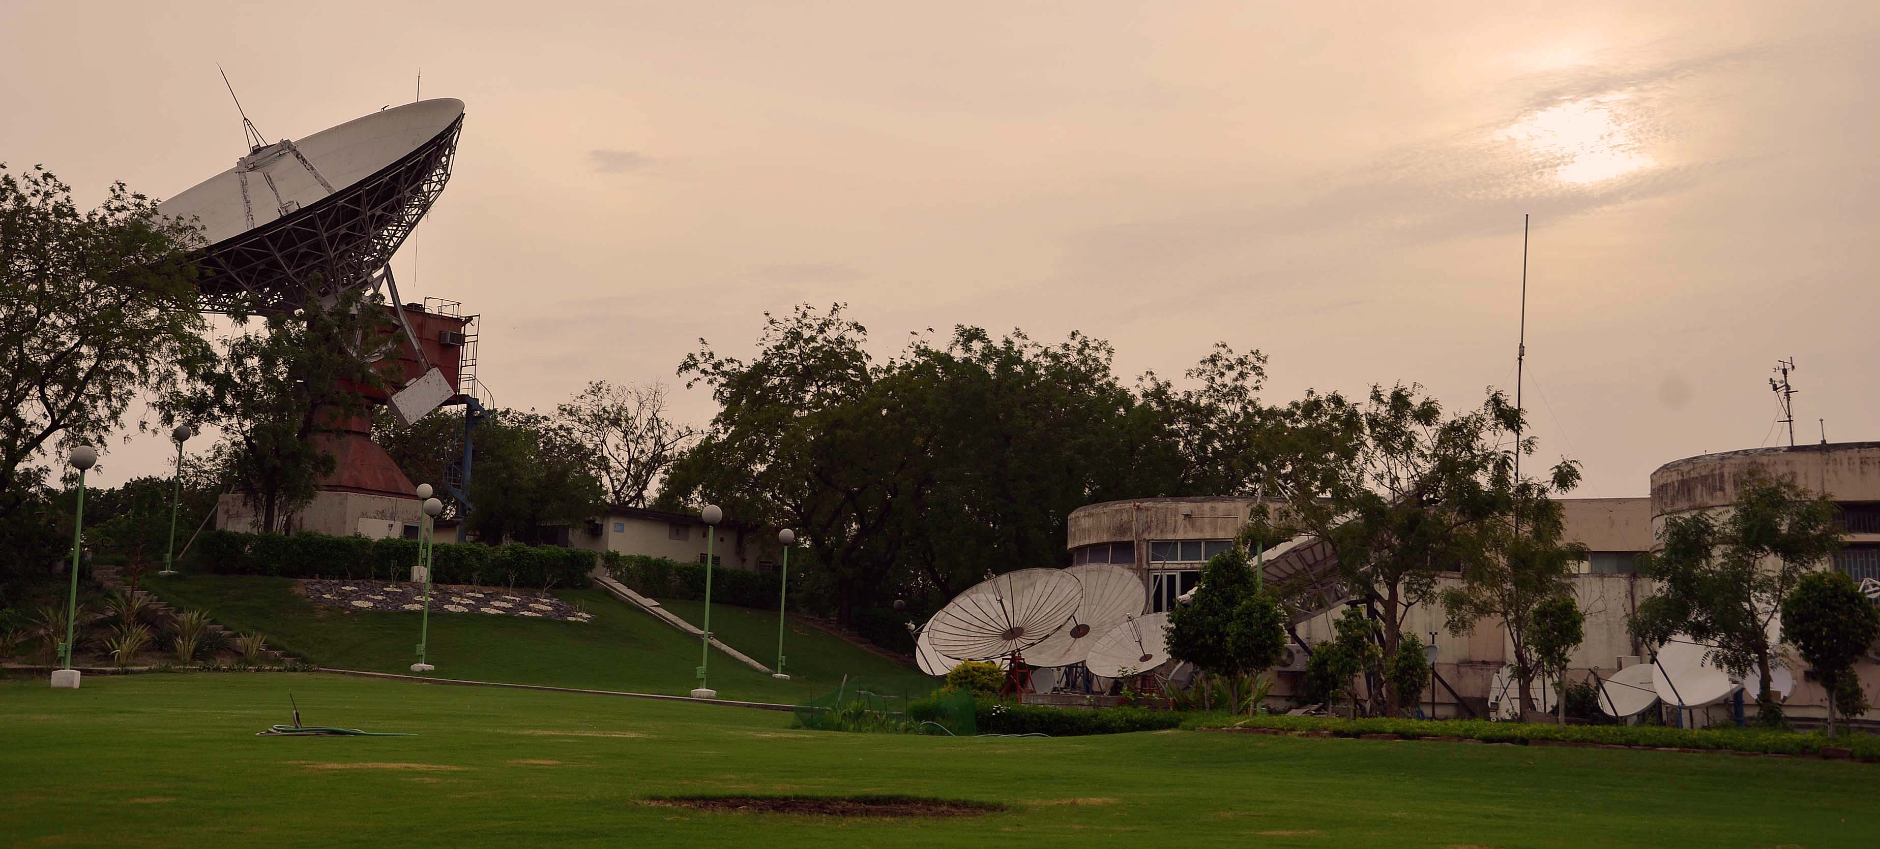
Upcoming SAR WGCV Workshop
November 12 to 15, Ahmedabad, India
Hosted by the Space Application Centre, ISRO
More than 70 abstracts submitted
A poster session will be part of the Workshop’s programme
Expected attendance of around 150 participants
Notes:
This will be the 31st SAR WGCV Workshop since 1989.
Acceptance emails were sent to all contributors/authors.
The programme is being finalized

Slide 3
Upcoming SAR WGCV Workshop
Session Topics
Calibration of Running Missions, and Future Missions
Calibration of Airborne/UAV SAR Systems
Calibration Methodology and Techniques
Calibration/Validation Targets and Sites
Calibration Requirements and Definitions
Innovative SAR Instrument Concepts
Processing Algorithms (SAR, InSAR, Polarimetry, Tomography)
InSAR Calibration and Verification
InSAR Altimetry Calibration and Validation
Polarimetry/Compact Polarimetry Calibration
Calibration of Multi-channel and DBF Systems
Cross-Calibration and Verification
Analysis Ready Data Products
Space-based and Ground-based RFIs
Use of AI for Cal/Val and SAR System Monitoring
SARCalNet
AIS-based Validation of SAR-based Vessel Detection and Velocity Estimation
Calibration of SAR System Parameters for Geophysical Applications
Notes:
Parameters for Geophysical Applications: sea surface height, radial ocean current velocity, terrain surface deformation, biomass/forest structure, soil moisture, etc.
InSAR Altimetry Cal-Val has been incorporated as a possible session topic

Slide 4
WGCV-53 Actions
WGCV-53-ACT-04: DEM mission continuity
Importance of CEOS Agencies funding missions like TanDEM-X for the provision of DEMS, in the context of TanDEM-X eventually ceasing operations, and in response to the need to secure DEM updates, including for bare surface.
On the CEOS Plenary Agenda (CEOS WGs session), Wednesday October 23.
TanDEM-X / TerraSAR-X mission information and DEM highlights are summarized on the next slide in support of the recommendation.

Slide 5
WGCV-53 Actions: DEM mission continuity
TanDEM-X Global DEM covers the entire global landmass to 99,9% (only 0.107% voids)
All heights represent the reflective surface at X-band, i.e., the global DEM is a surface model
Copernicus DEM is an edited version of the TanDEM-X’s Global DEM
Since 2017, TDX mission is in a so-called “4D Mission Phase” concentrating on observation of topographic changes, known as TanDEM-X DEM Change Maps (https://geoservice.dlr.de)
With more than 17 and 14 years in orbit, both satellites (TSX and TDX) have considerably exceeded their initial design lifetime of 5.5 years
Redundant systems are in place, but both satellites are still fully operational and continue to provide data of excellent quality
Hydrazine is currently projected to last until 2028 for TDX and until 2031 for TSX
Battery degradation is the main concern => reduced imaging capacity, reduced lengths of individual data takes, increased gaps in between data takes for battery recharge
Need for development of DEM Mission for generating bare surface DEM (L-band mission)

Slide 6
WGCV-53 Actions
WGCV-53-ACT-15: Altimetry representation in WGCV
Explore whether altimetry might be a good addition as a representation in the SAR subgroup, or in the WGCV (WGCV and SAR Subgroup Chairs)
“InSAR Altimetry Calibration and Validation” was included as a topic for presentations and discussions at the upcoming SAR Subgroup workshop at ISRO
A couple of papers were submitted on the topic

Slide 7
SARCalNet Status
To be presented by Bruce Chapman
Established SARCalNet website, database and submission templates
Reached out members to encourage submission of information (Corner Reflector sites)
Internal review of documentation issued by the SARCalNet initiative on:
Target requirements
SAR calibration and methodologies used for different type of characterization and calibration analysis, including a database of links to the relevant literature
SAR calibration and validation glossary
Links to relevant calibration resources (e.g., links to various databases including DEMs, weather models, land cover maps, etc.)
Links to relevant calibration and validation tools

