Slide 1
CEOS WGCV-55
The CEOS FRMs Assessment Framework
Paolo Castracane (STARION for ESA/ESRIN)
Nigel Fox (NPL, UK)
Philippe Goryl (ESA/ESRIN)
Jean-Christopher Lambert (IASB BIRA)
Agenda Item 1.10
WGCV-55. Hyderabad, India. 8-10 July, 2025

Slide 2
Table of Contents
Background and Objectives
FRM Definition
FRM Principles
Endorsment Process: the CEOS-FRM Maturity Matrix
Pilots for Assessment
Actions from WGCV-54
Latest updates and Summary

Slide 3
Background and Objectives
The concept of a Fiducial Reference Measurement (FRM) has been developed to highlight the need for precise and well-characterised measurements tailored explicitly to the post-launch calibration and validation (Cal/Val) of Earth Observation satellite missions [1].
Recently, this need has been enhanced with the emergence of new commercial satellite operators to ensure that users have a transparent and fair means to judge the adequacy of data products to meet their needs.
The Committee on Earth Observation Satellites (CEOS) Working Group Cal/Val (WGCV) is putting in place a framework to assess the maturity and compliance of a “Cal/Val reference measurement” in terms of a set of community-agreed criteria which define it to be of CEOS-FRM quality. The assessment process is based on a maturity matrix that provides a visual assessment of the state of any FRM against each of a set of given criteria, making visible where it is mature and where evolution and effort are still needed. General information and the last version of the guidelines are available on the CEOS Cal/Val Portal [2].
[1] Goryl, P.; Fox, N.; Donlon, C.; Castracane, P. Fiducial Reference Measurements (FRMs): What Are They?
Remote Sens. 2023, 15, 5017. https://doi.org/10.3390/rs15205017
[2] FRMs Assessment Framework on CEOS Cal/Val Portal: https://calvalportal.ceos.org/web/guest/frms-assessment-framework
Slide ‹#›

Slide 4
FRM Definition
Fiducial Reference Measurements (FRMs) are a suite of independent, fully characterised, and traceable (to a community agreed reference ideally SI) measurements, tailored specifically to address the calibration and validation needs of a class of satellite borne sensor and that follow the guidelines outlined by the GEO/CEOS Quality Assurance framework for Earth Observation (QA4EO).

Slide 5
FRM Principles
The mandatory defining characteristics for CEOS-FRMs are:
Traceability- FRMs should have documented evidence of their traceability to a community agreed reference, ideally tied to the International System of units, SI.
Independence from satellite under test- FRMs are independent from the satellite (under-comparison) geophysical retrieval process.
Uncertainty budget- A comprehensive uncertainty budget for all instruments used in deriving FRM of a particular measurand, including any transformation of the measurand to match that of the satellite product, is available and maintained.
Documented protocols- FRM protocols, procedures and community-wide quality management practices (measurement, processing, archive, documents, etc.) are defined, published and adhered to by FRM instrument deployments and usages.
Accessibility- FRM data, including metadata and documentation of processing, are accessible to other researchers allowing independent verification of processing systems. All data and information should be made available in a timely manner and in a form that is readily utilisable by a satellite operator.
Representativeness- FRM data allow the determination of the on-orbit uncertainty characteristics of satellite geophysical measurements via independent validation activities. It thus requires that the degree of representativeness of the FRM to that of the satellite observation and/or associated retrieval as well as the satellite vs FRM comparison process needs to be documented and the uncertainty assessed.
Adequacy of uncertainty- The uncertainty of the FRM measurements, including the comparison process, must be commensurate with the requirements of the class of satellite/instrument/measurand they are specified to support.
Utility (Return on Investment)- FRM data are designed to apply to a class of satellite missions (several). They should not be mission-specific.

Slide 6
FRM Endorsement process
The proposed framework takes a pragmatic approach relying on self-assessment and transparency/accessibility of evidence against a set of criteria which are subject to peer review through a board of experts led by CEOS WGCV
In order to be flexible, maximise inclusivity and encourage the development and evolution of FRM from new or existing teams compliance with criteria will be based on a gradation scaling rather than a simple pass/fail
The degree of compliance and associated gradation is presented in a Maturity Matrix model - to allow intended users of the FRM to assess suitability for their application and indeed funders to decide on where and what aspects to focus any investment. The matrix model provides a visual “simple” assessment of the state of any FRM for all given criteria making visible where it is mature and where evolution and effort needs to be expended.
In addition to this broad-based summary an overall classification of the degree of compliance will be provided based on meeting specific gradations for particular criteria.

Slide 7
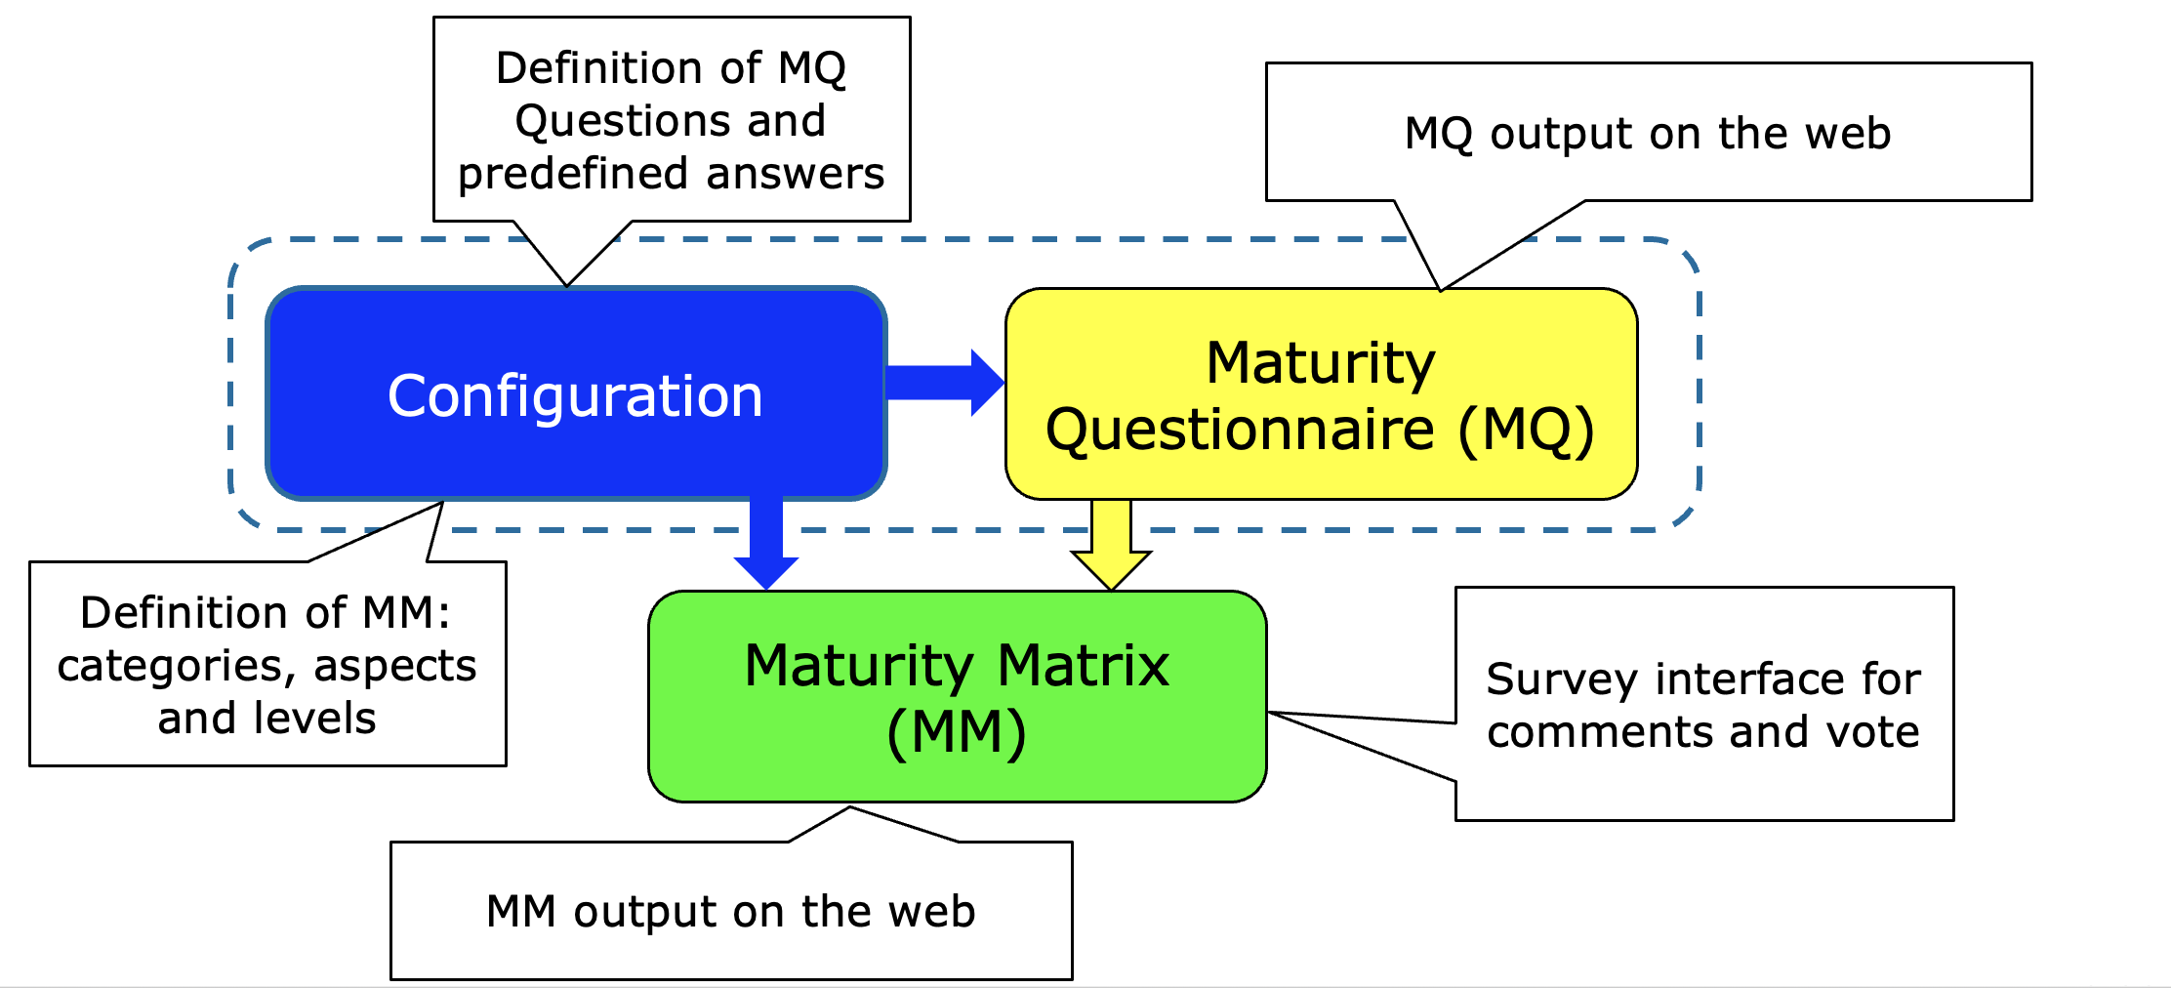
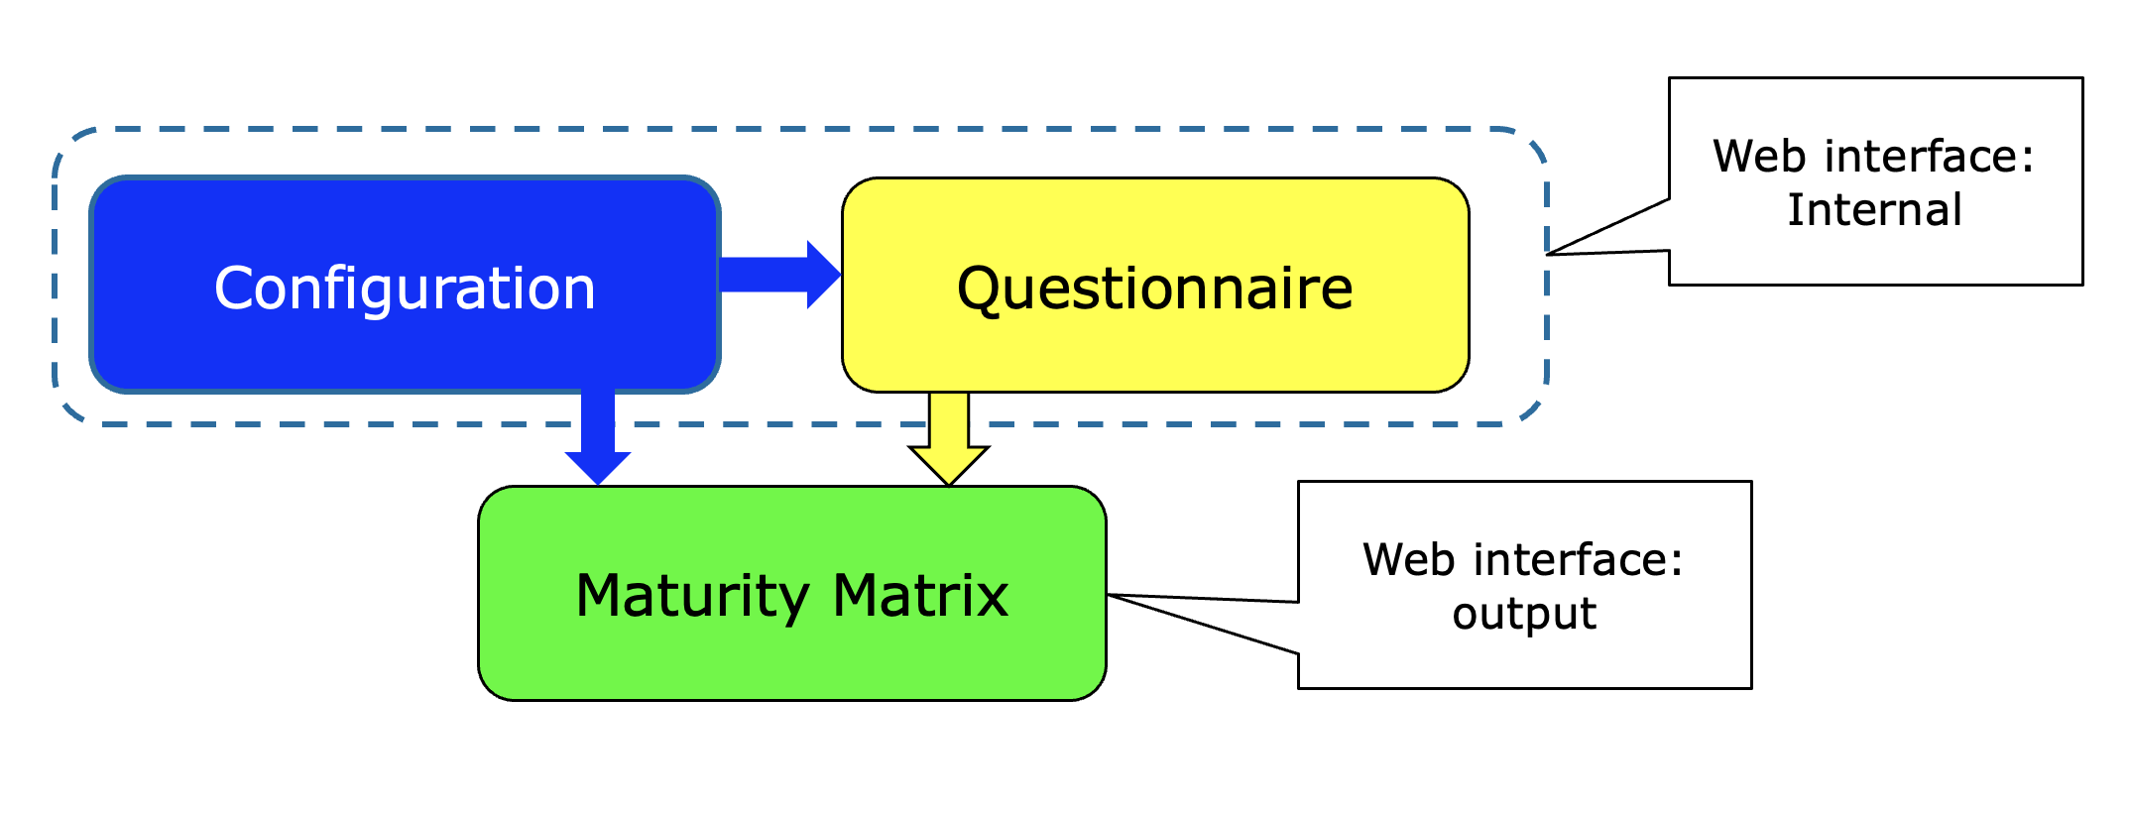
Maturity Matrix tool: Logical Overview

Slide 8
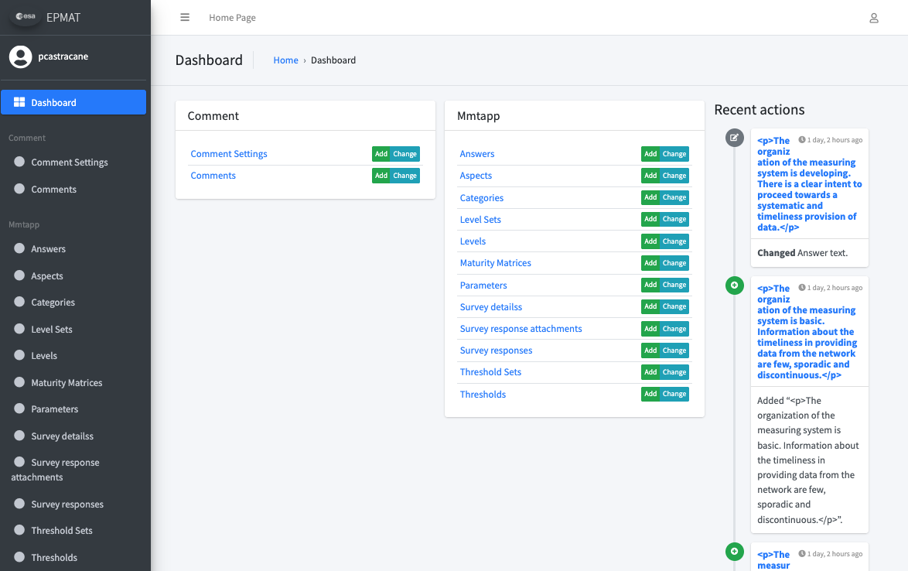
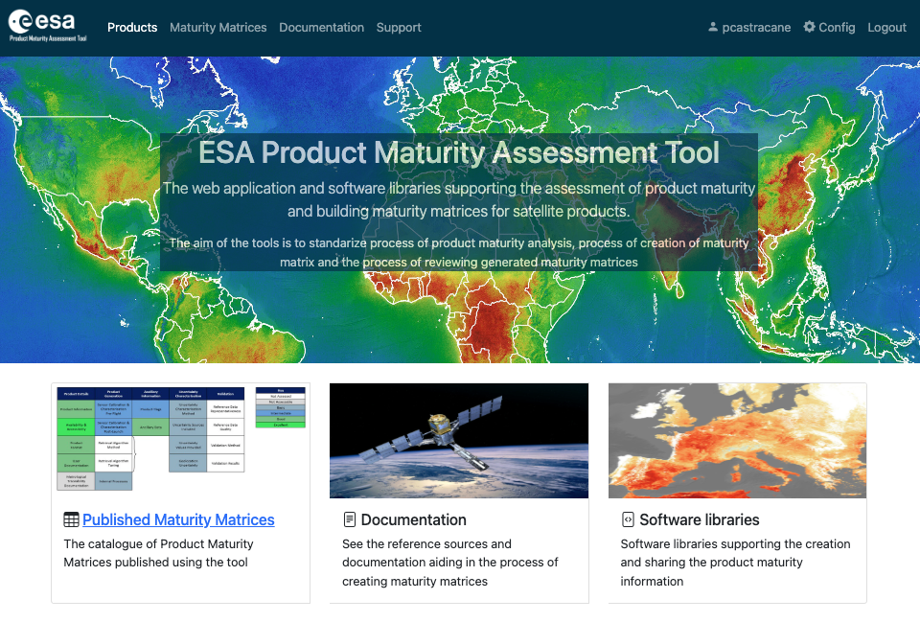
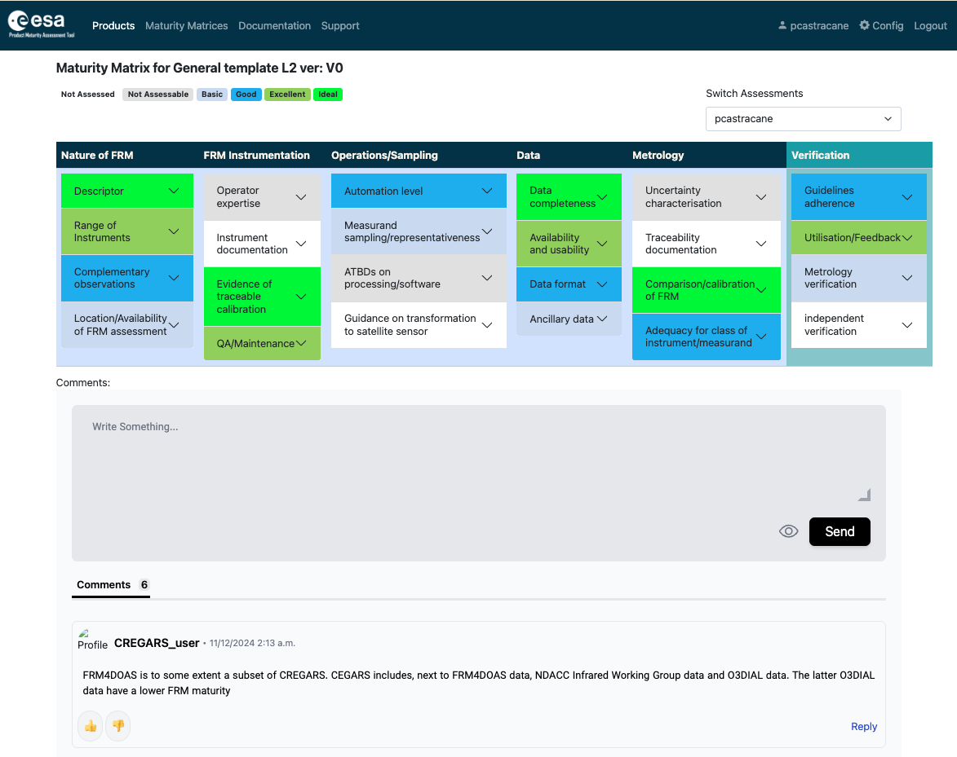
Maturity Matrix Tool

Slide 9
FRM Maturity Matrix
Self-Assessment |  |  |  |  |  | Independent Assessor
Nature of FRM | FRM Instrumentation | Operations/ Sampling (single instrument) | Data | Metrology | Completeness, coverage and distribution | Verification
Descriptor | Instrument documentation | Automation level | Data completeness | Uncertainty characterisation | Validation capacity | Guidelines adherence
Location/ availability of FRM | Evidence of traceable calibration | Measurand sampling/ representativeness | Availability and Usability | Traceability documentation | Geographical coverage | Utilisation/ Feedback
 |  |  |  |  | Temporal sampling
Range of sensors | QA Maintenance | ATBDs on processing/software | Data format | Comparison/ calibration of FRM | Centralized data, processing, quality assessment and adherence to community standards | Metrology verification
Complementary observations | Operator expertise | Guidelines on transformation to satellite sensor | Ancillary data | Adequacy for class of instrument/ measurand | Timeliness | Independent verification
FRM CLASSIFICATION |  |  |  |  |  | A B C D
Class A – Where the measurement fully meets all the criteria necessary to be considered an FRM for a particular class of instrument and measurand.
Class B – Where the measurement meets many of the key criteria and has a path towards meeting the Class A status in the near term.
Class C – Meets or has some clear path towards achieving the criteria needed to reach a higher class and provides some clear value to the validation of a class of satellite instruments/measurands.
Class D – Is a relatively basic adherence to the FRM criteria but there is a strategy and aspiration to progress towards a higher class. This can be considered an entry level class for those starting out on developing an FRM.
Grade
Not Assessed
Not Assessable
Basic
Good
Excellent
Ideal
Not Public

Slide 10
Pilots for CEOS FRMs Maturity Matrix Assessment:
PGN (Pandonia Global Network) - Stefano Casadio (Serco)
RadCalNet (Radiometric Calibration Network) - Marc Bouvet (ESA/ESTEC)
ICOS (Integrated Carbon Observation System – Ecosystem Component) - Fabrizio Niro (Serco)
FRM4DOAS (Ground-Based DOAS Air-Quality Observations) - Michel Van Roozendael and Jean-Christopher Lambert (BIRA)
BAQUNIN (PREDE-POM LUNAR) – Stefano Casadio (Serco)
CSIRO (DION) –Janet Anstee and Matt Garthwaite (CSIRO)
Brewer Spectrometer - NO2 Vertical Column Densities (VCDs) Measurements - Henri Diémoz (ARPA Valle d’Aosta) – BAQUNIN project
FRM4GHG 2.0 project –COCCON (EM27/SUN) XCO₂, XCH₄, and XCO data. – Mahesh Kumar Sha (BIRA) - FRM4GHG team. [Sha, M.K.; De Mazière, M.; Notholt, J.; Blumenstock, T.; Bogaert, P.; Cardoen, P.; Chen, H.; Desmet, F.; García, O.; Griffith, D.W.T.; et al. Fiducial Reference Measurement for Greenhouse Gases (FRM4GHG). Remote Sens. 2024, 16, 3525. https://doi.org/10.3390/rs16183525]
Tropical Centre for reactive trace gas remote sensing (CREGARS) in ACTRIS – Martine De Mazière (BIRA)
Maturity Matrix Tool
https://mmt.skytek.dev
Support provided by Jarek Dobrzanski (Skytek, Ireland https://skytek.com/)
Dedicated credentials provided for all the selected users

Slide 11
“Completeness, coverage and distribution” aspects and assessment criteria
The “Completeness, coverage and distribution” category concerns criteria assessing the properties of the measuring system intended as a set of coordinated instruments deployed as network and/or in a context of a campaign. This new category includes the following aspects :
Validation Capacity
Geographical coverage
Temporal sampling
Centralized data, processing, quality assessment and adherence to community standards
Timeliness
For each aspects assessment framework grades are provided

Slide 12
Actions from WGCV-54
ID | Description | Due Date | Status
WGCV-54-05 | Paolo and Nigel to make updates to the FRM Assessment Framework documentation to: Make clear that the assessment is relative to the intended purpose of the site. Remove subjectivity in parameters by incorporating clarifications present in the accompanying documentation, but which have to date been left out of the Matrix description. Clarify that verification should be undertaken by independent people from CEOS, not the person filling in the template (i.e., self-assessment followed by independent review). Make the Validation column a different colour. Consider inclusion of additional links to reference materials, mechanisms to allow assessors to provide feedback, etc. | Q4 2024 | Tool development completed and under test. New template (with additional column) configured
WGCV-54-06 | Paolo, Nigel and Kuze-san, to work with Jean-Christopher Lambert on the issues with the FRM Assessment Framework specific to the atmospheric domain. | Q4 2024 | Guidelines V2 published
WGCV-54-12 | Paolo Castracane to organise a second FRM Assessment Framework exercise to include PGN, FRM4DOAS, and RadCalNet as a minimum. Updates will be reported at WGCV-55. | 1 June 2025 | In progress: proposal for RadCalNet, PGN, FRM4DOAS and FRM4SM
WGCV-54-13 | WGCV to confirm the readiness of operationalisation and conduct a pre-launch review of the FRM Assessment Framework, and to define candidates for operational usage e.g. HYPERNETS. | WGCV-55 | To be started

Slide 13
Input for the Maturity Matrix Tool from WGCV-53 and WGCV-54
ID Title | Description | Status
1) Intro panel for each assessment | It has been requested to have, before of the first question, an introductive text panel where the assessor can specify and describe the intended purpose of the assessment | Done
2) Additional info for Configuration of Parameter (Question) and Answer | To better explain the possible answers, especially for data providers, which are not familiar with uncertainty tree diagrams and other metrological concepts. It could be useful have the possibility to add, links, or documentation during configuration of both parameters (Questions) and answers. | Done
3) Supporting Documents/References | We should find ways to encourage the assessor to provide evidence of his assessment, e.g.: references, papers, links, reports, sample data, etc. to verify the FRM assessment. When compiling the matrix, for each question, under the “Comments” textbox, it could be added an item called “Supporting documents/references” allowing to attach documents/materials. | Done
4) Verification (last column) for independent assessor | The last column named “Verification” of the FRM MM (but it is also valid for EDAP MM) shall be compiled by an independent assessor (i.e. different from the ones who filled the first part of the MM). To highlight this difference, it has been requested to change the colour of the column. The Verification column must always be the rightmost one in the matrix. | In progress
5) Automatic CEOS FRM classification | The idea is to provide the resulting CEOS-FRM overall classification directly from the tool. The classification: Class A, B, C or D is based on score of matrix cells according to the criteria defined in the reference Guideline. The result should be included in the MM | Open
6) Assessment report | It would be useful to generate an assessment report in pdf at the end of the process, collecting the maturity matrix together with the detailed answers to all questions and eventually links to supporting material provided. | Open
7) Improvement for the compare functionality | In the compare functionality, to add the aspect as first column and use the assessment colour for the entire row. | New
8) User rights to handle different version of the same MM template | User must have rights to handle different versions of the same MM template to trace the achived progress. | New
A second FRM Assessment Framework exercise to include PGN, FRM4DOAS, and RadCalNet

Slide 14
Summary
The CEOS WGCV has implemented a framework to assess the maturity and compliance of a “Cal/Val reference measurement” in terms of a set of community-agreed criteria which define it to be of CEOS-FRM quality.
Information and Guidelines are available on CEOS Cal/Val Portal https://calvalportal.ceos.org/web/guest/frms-assessment-framework
The assessment process is based on a Maturity Matrix (MM) approach that provides a visual assessment of the state of any FRM against each of a set of given criteria. A tool has been developed to fill the MM according to a configurable questionnaire.
A first exercise was conducted by several selected pilots. It has led to improvements in both the approach (guidelines) and in the MM tool.
A second phase of exercises is planned involving RadCalNet, PGN and FRM4DOAS (user and verifier for each case)

