Slide 1
WGCV-55
Infrared Visible and Optical Sensors (IVOS) subgroup: #36
(largely reminder)
Nigel Fox, NPL/UKSA
Agenda Item:1.11
WGCV-55,
Hyderabad, India
8th - 12th Jul 2025

Slide 2
Mission Statement
Mission
“To ensure high quality calibration and validation of infrared and visible optical data from Earth observation satellites and validation of higher level products”

Slide 3
Terms of Reference
Promote international and national collaboration in the calibration and validation of all IVOS member sensors, Level 1.
Address all sensors (ground based, airborne, and satellite) for which there is a direct link to the calibration and validation of satellite sensors;
Identify and agree on calibration and validation requirements and standard specifications for IVOS members;
Identify test sites and encourage continuing observations and inter-comparison of data from these sites;
Encourage the preservation, unencumbered and timely release of data relating to calibration and validation activities including details of pre-launch and in flight parameters.
In the context of calibration and validation encourage the full consideration of “traceability” in all activities involved in the end-to-end development of an EO product including appropriate models and algorithms.

Slide 4
IVOS: Vision
To facilitate the provision of ‘fit for purpose’ information through enabling data interoperability and performance assessment through an ‘operational’ CEOS coordinated & internationally harmonised Cal/Val infrastructure consistent with QA4EO principles.
Pre-flight characterisation & calibration
Test – sites
Comparisons
Agreed methodologies
Community Good Practises
Interchangeable/readable formats
Results/metadata - databases
Shared learning
Recommendations as appropriate
Key Infrastructure to be established and maintained independent of sensor specific projects and/or agencies

Slide 5
Work plan
Structured into themes and led by ‘champions’ (Plus specific projects)
Land surface reflectance - Czapler Myers (U of Arizona USA)
Ocean colour (link to IOCCG, VC-OCR etc) - Murakami (JAXA JPN)
Surface Temperature (link to VC-SST, GHRSST) - Corlett (Eumetsat)
Geo spatial image quality! - +USGS to propose topics to explore interest
- CNES cautious of Geolocation due to ITAR
PROJECTS
PICSCAR P Henry (CNES) TBA
RadCalNet M Bouvet (ESA)
SST & OC Comparisons N Fox (NPL)
Vocabulary E Woolliams (NPL)
Sensor pre-flight workshop N Fox (NPL)
Uncertainty/traceability S Hunt (NPL)

Slide 6
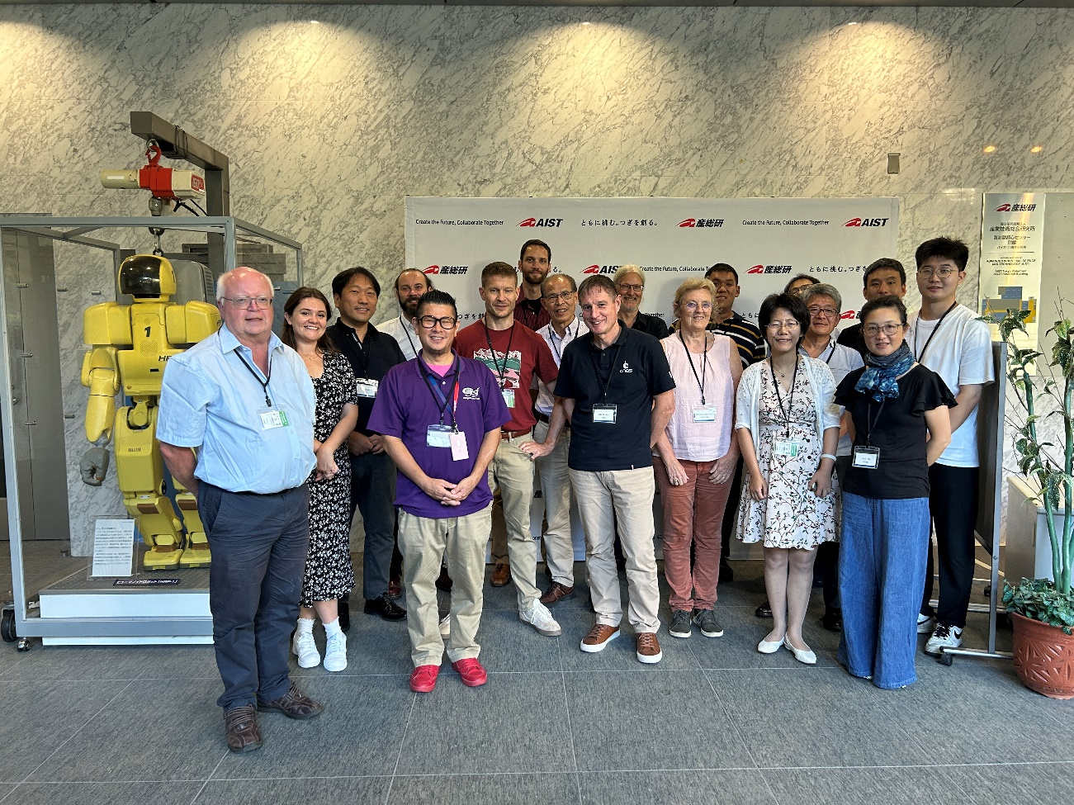
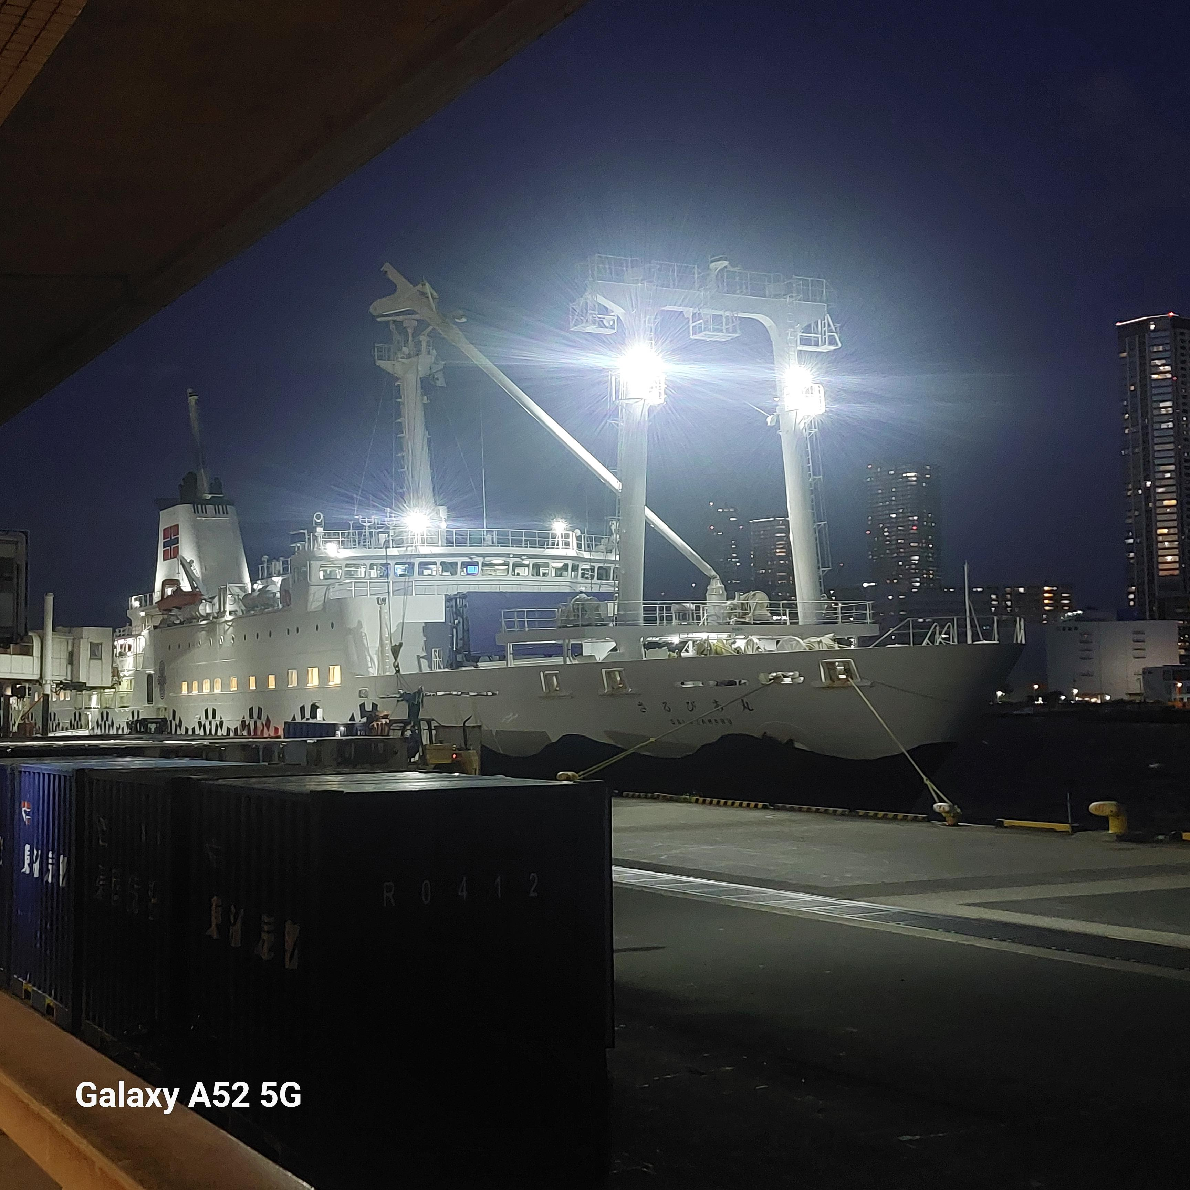
Summary of activities
IVOS 36 @ Tokyo, Japan
hosted by AIST & JAXA Sep 2024
(next meeting Tucson Arizona 1-5 Sep 2025)
20 agency/orgs represented
22 attendees + 13 on-line
Most themes and topics (work-plan
discussed or summarised)
  mett
Special Projects/Activities:
FRM4…
VH-RHODA & JACIE interfaces
    Newspace support (uncertainty)
Pre-flight Cal workshop
Lunar workshop (GSICS Led)
Special Projects/Activities:
RadCalNet team met Sep 24
Regular telecons
Terminology task team linked with WGCV
FRM4Veg Comparison (LPV) SRIX

Slide 7
IVOS 36 Topics
Comparison tools
QA initiatives (VH-Rhoda & Jacie)
Cal/Val methods/Services (RadCalNet, Hypernets, Vicalops, RT-Code, global)
Impact of Solar Irradiance spectrum change
‘Test-sites’ + Moon
Sensor performance assessment and status (particularly JAXA missions)
GHG (JAXA special session)
Hyperspectral sensors
Uncertainty, Traceability, interoperability: what and how
CEOS WGCV projects/Actions: - SITSats, FRM (QA), Pre-flight,
TIRCalNet
Communications

Slide 8
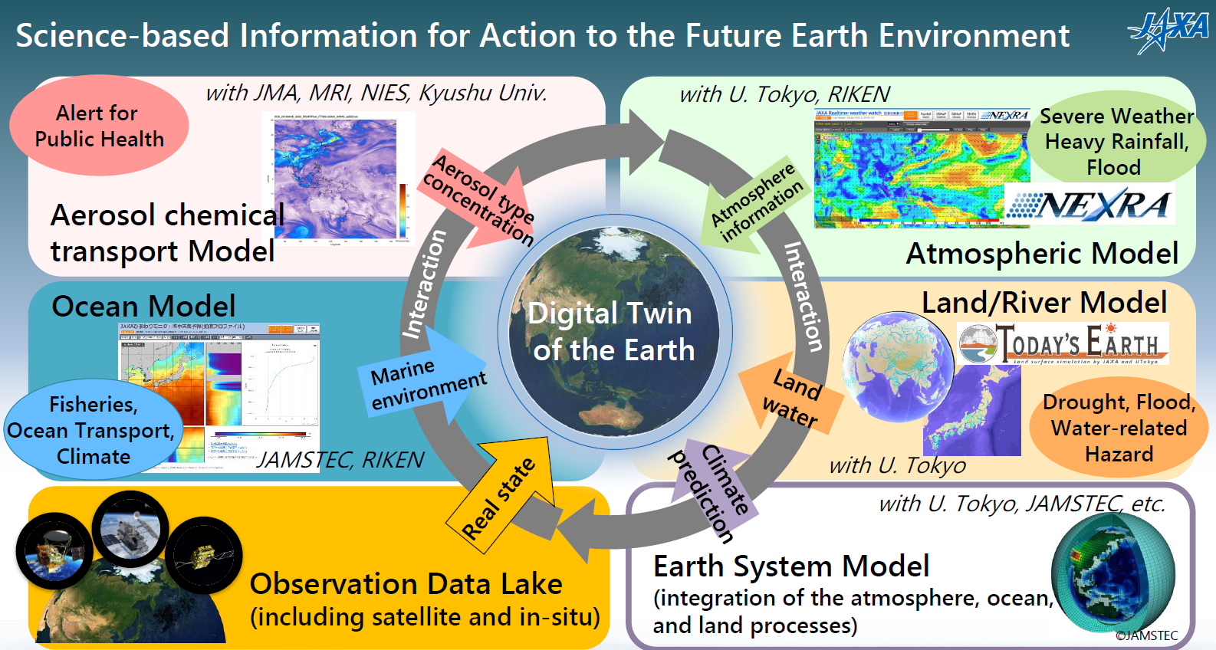
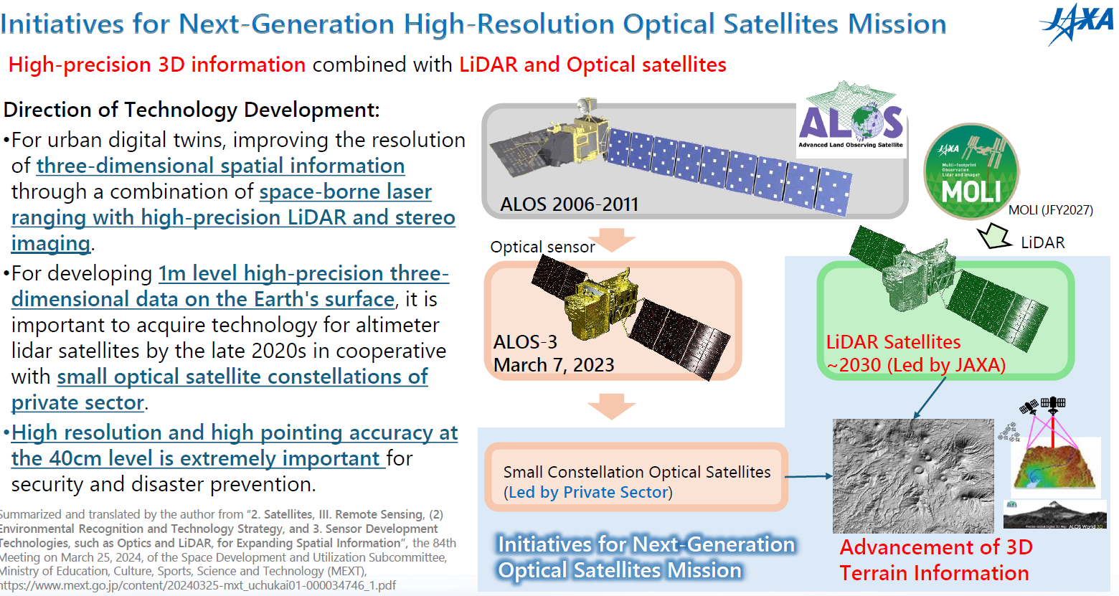
JAXA future initiatives (Murakami)
Next generation LIDAR (on ISS then satellites
Private sector led constellation Hi res sensors
Integrated program to support Digital Earth Twin

Slide 9
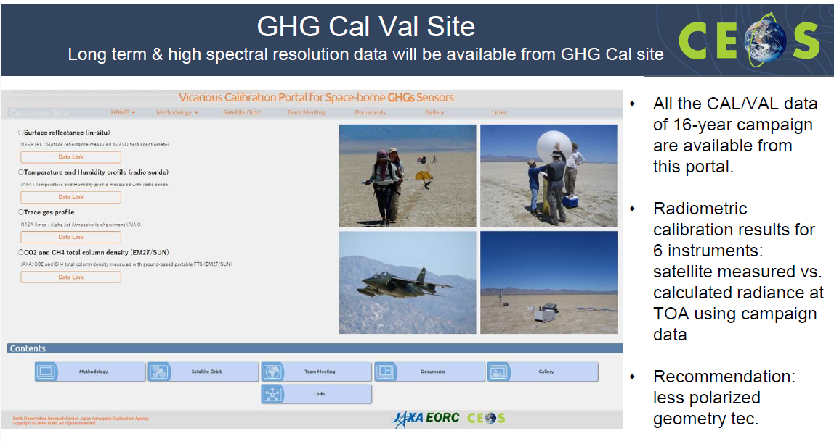
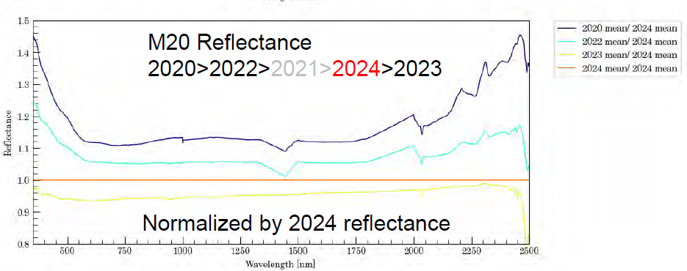
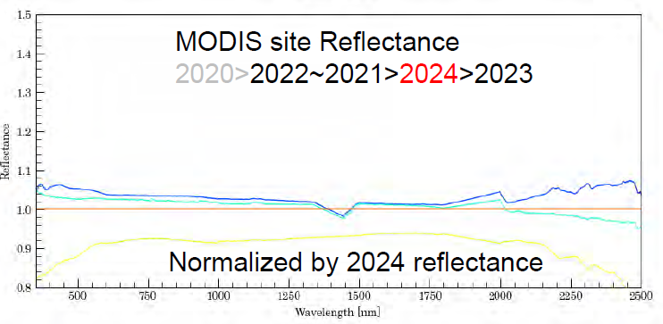
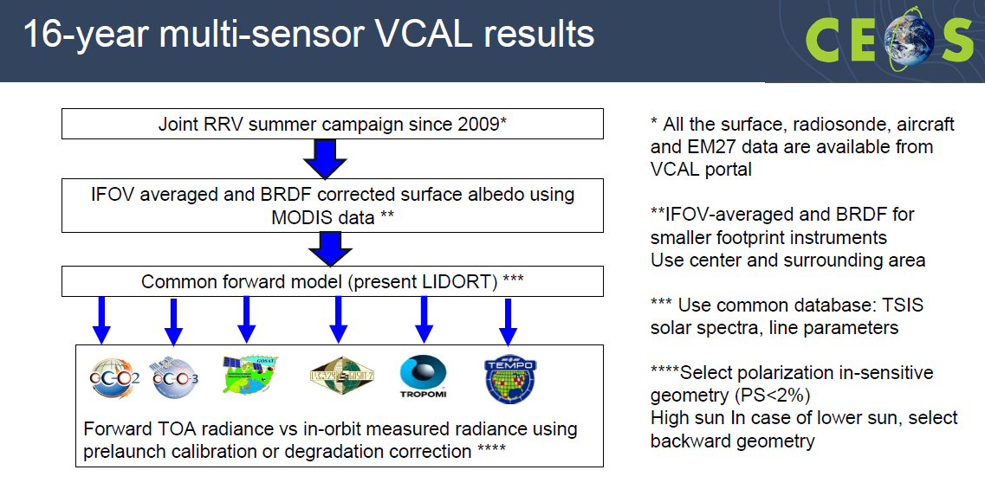
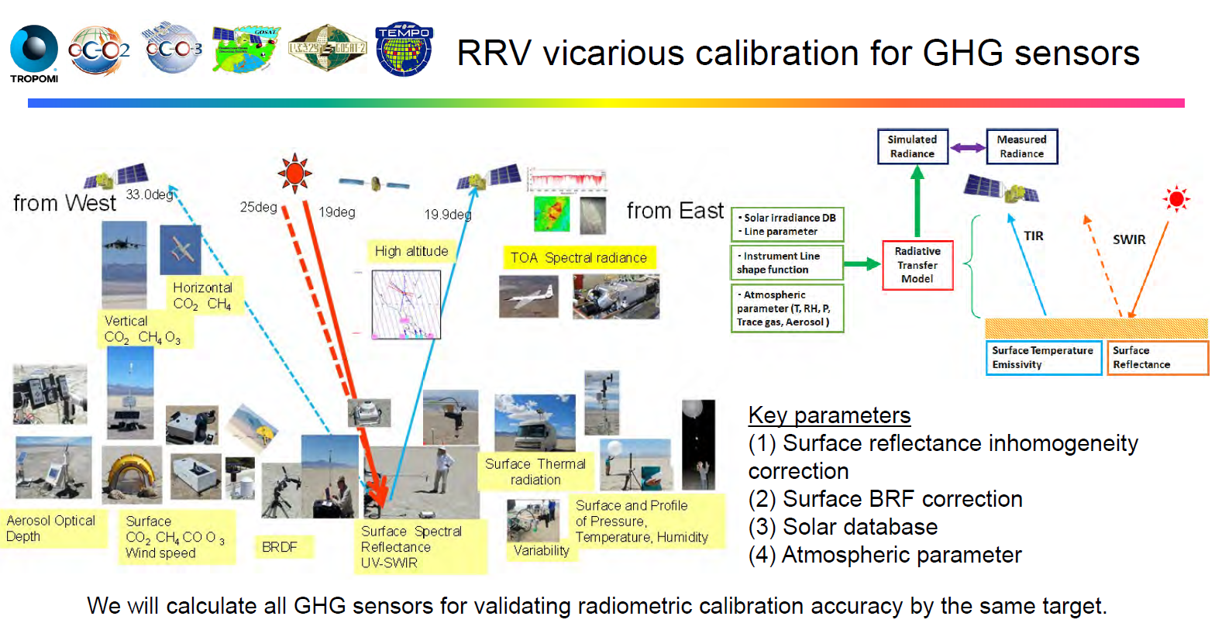
CEOS WGCV-GHG (JAXA special session)
(Kuze & Shiomi)
Overview of WGCV GHG program (see Kuze)
Comprehensive Vicarious @ RRV near RadCalNet site)
Multi-sensor common protocol, RT code etc
Interested to see if RadCalNet observed similar variation in surface reflectance

Slide 10
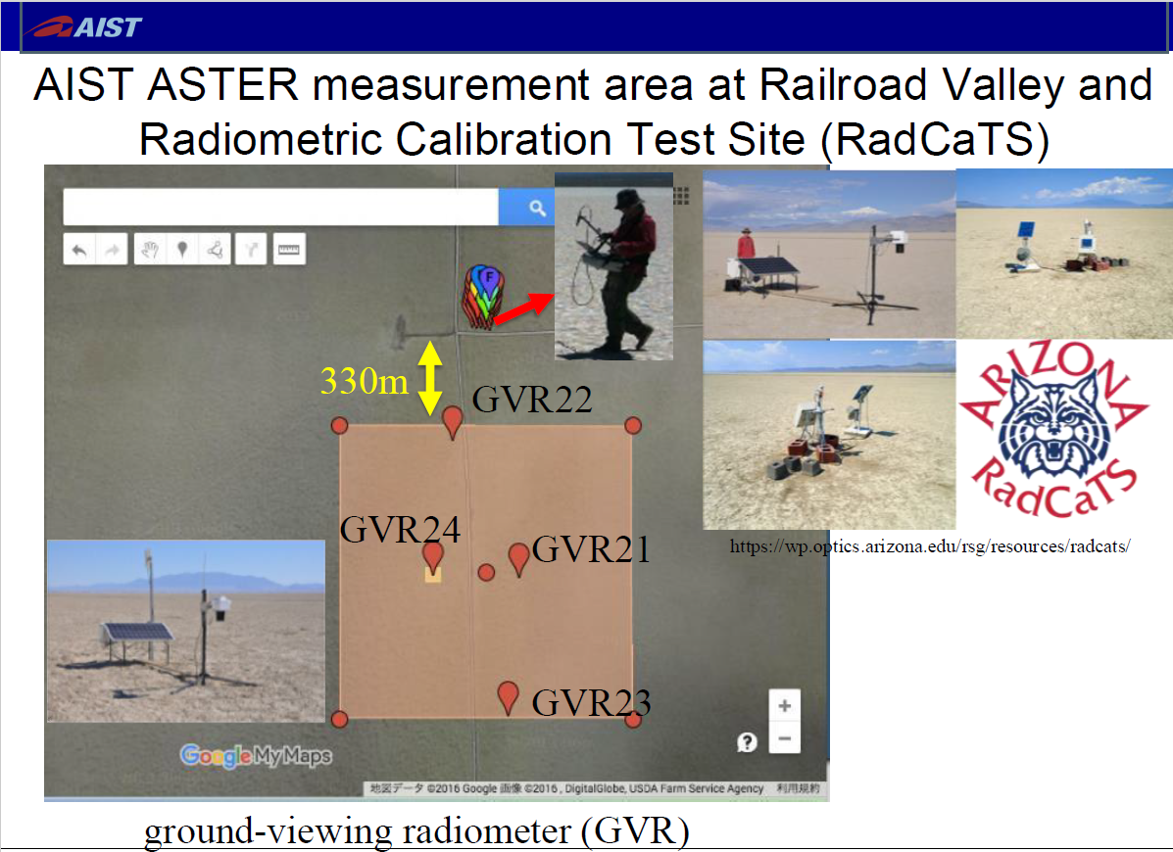
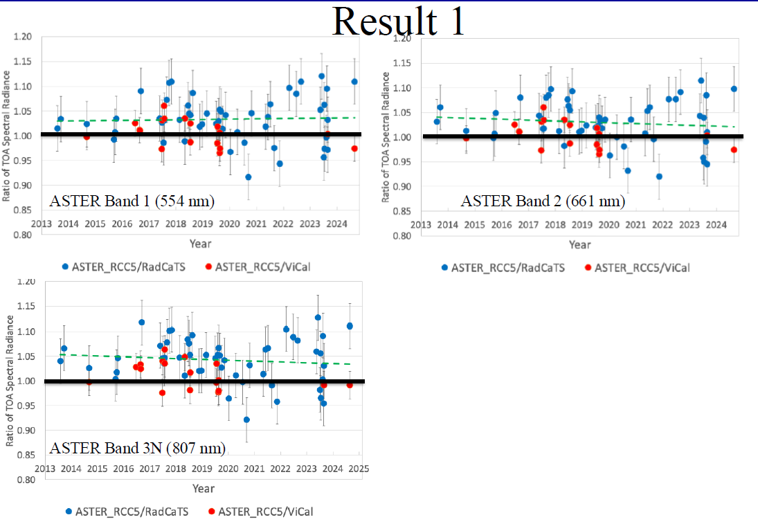
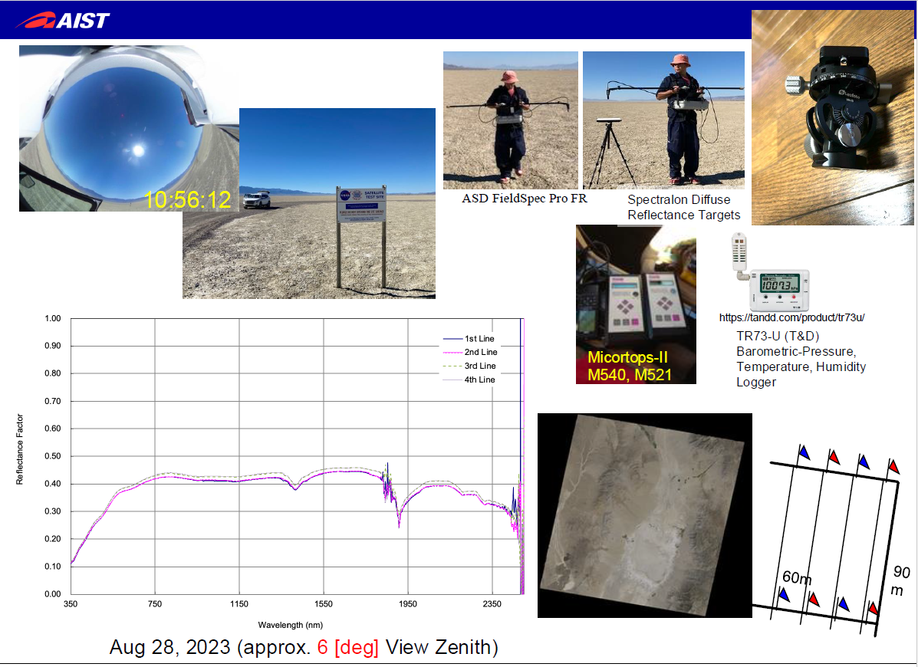
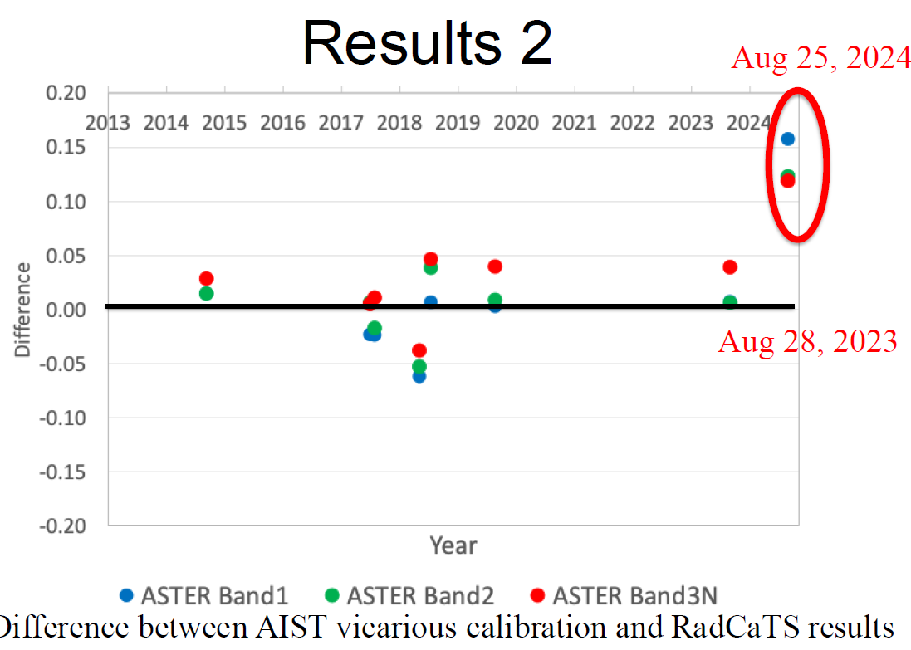
AIST: ASTER/RadCaTS

Slide 11
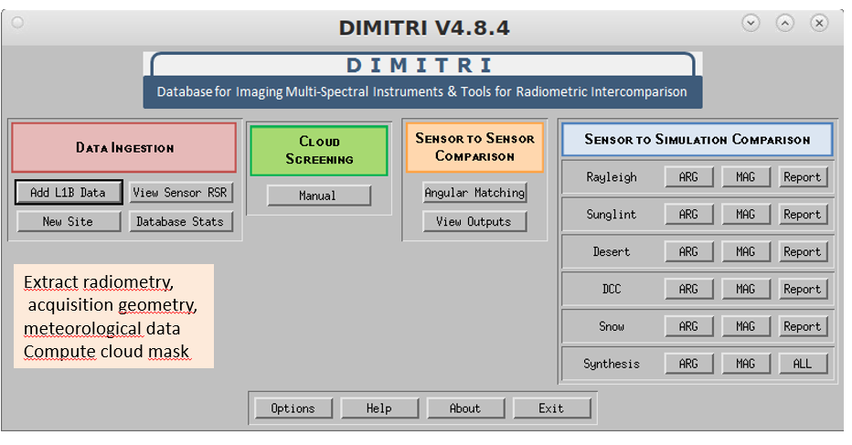

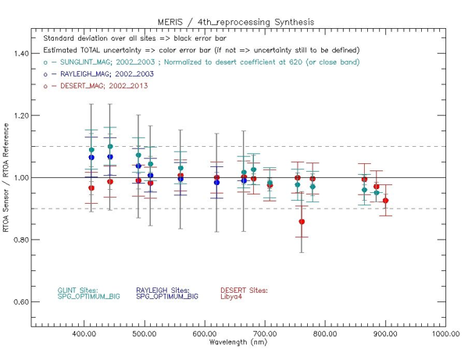
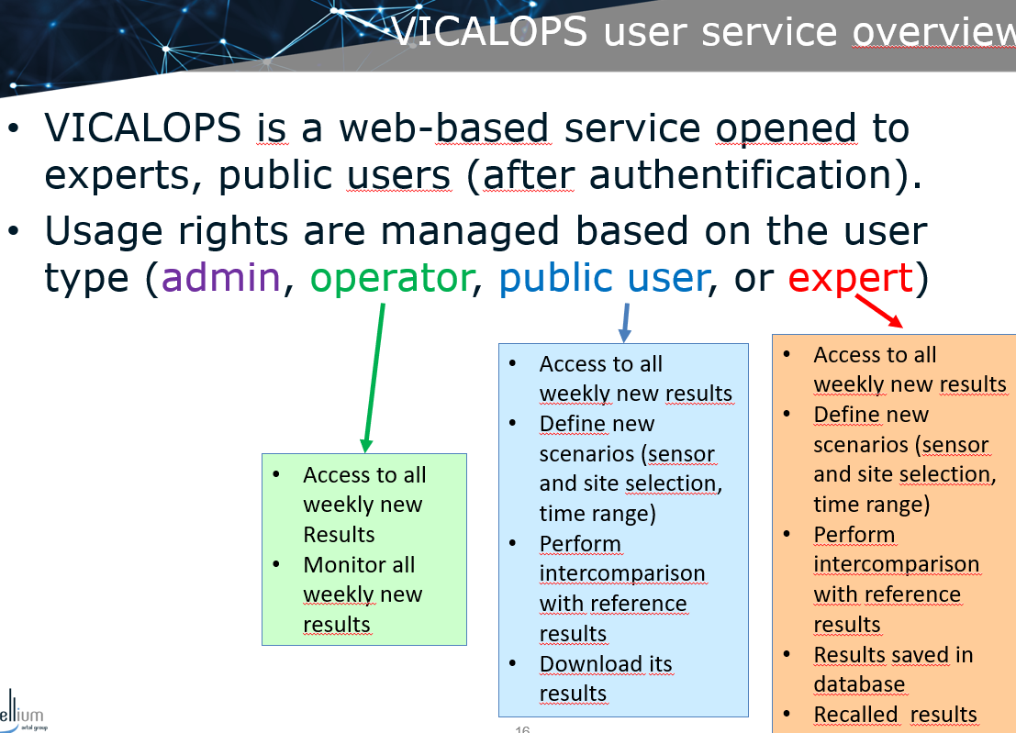
Comparison tools
VICALOPS – ESA provided free and open service with Beta testing spring 2025
NASA (Mehran Yarahmadi) novel method comparing Landsat 8 & 9 over ALL sites globally including cloud to obtain an average mean
Indicated good results in agreement with others methods
Looking at generalisation for spectral band differences and overpass time differences and potential oversampling bias from poles.

Slide 12
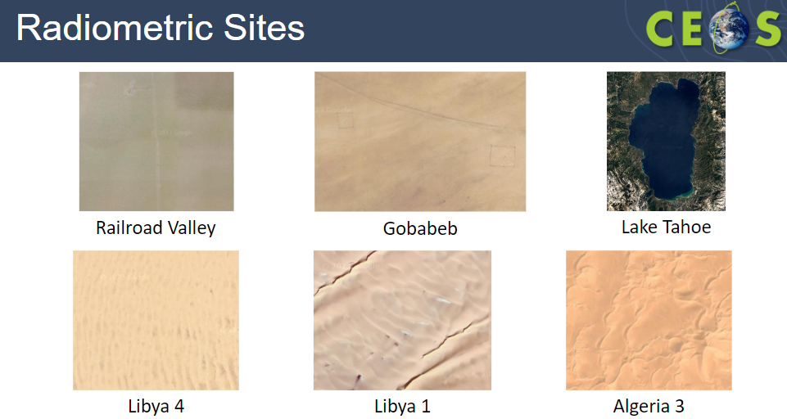
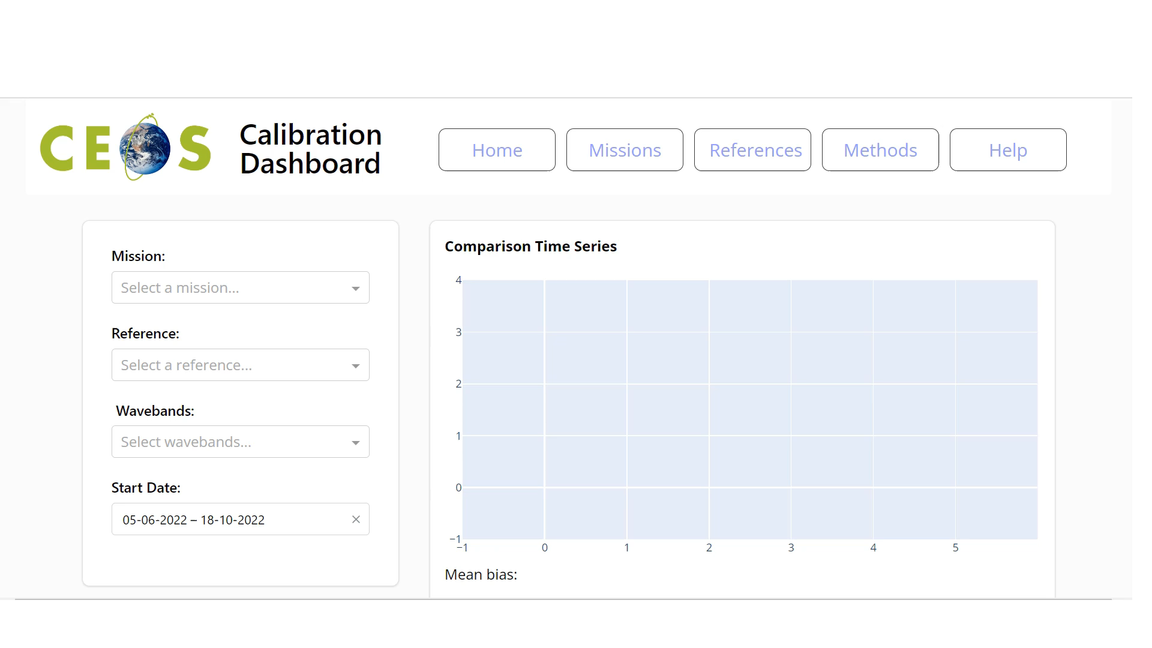
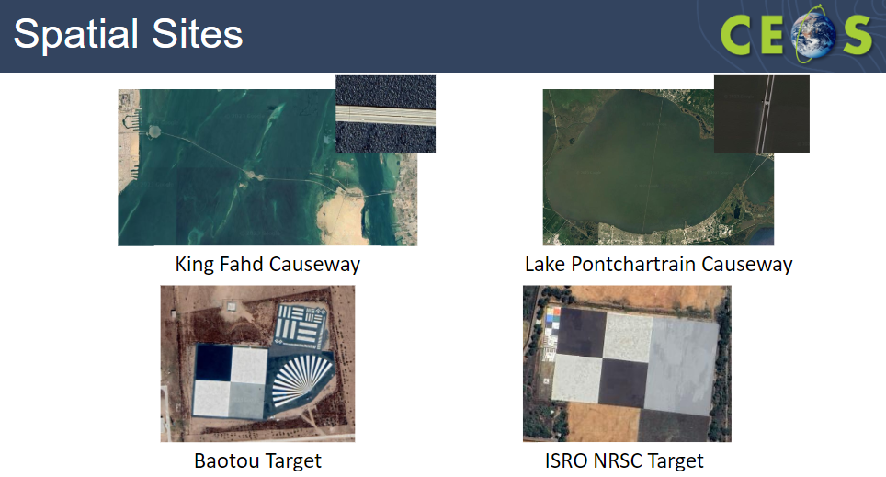
Comparison tools: Level 1 (now PVP)
Recommendation proposed and agreed at last WGCV subject to drafting has now been endorsed by WGCV and SIT

Slide 13

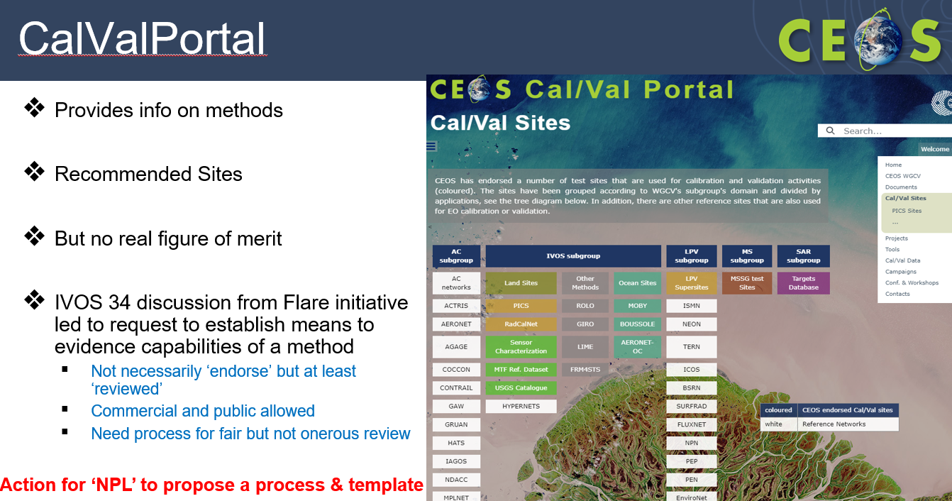
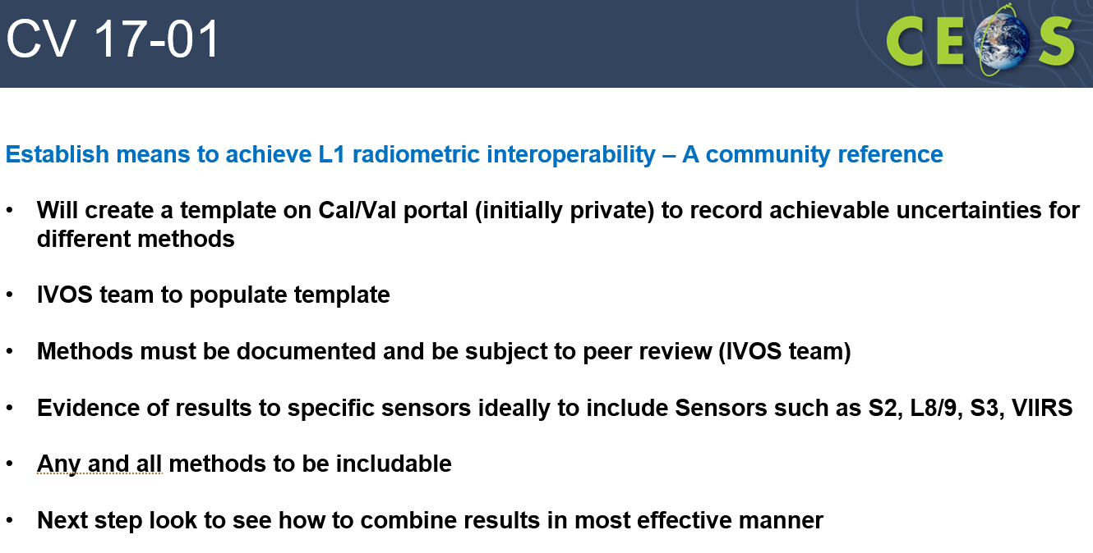
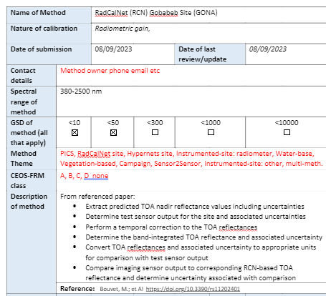
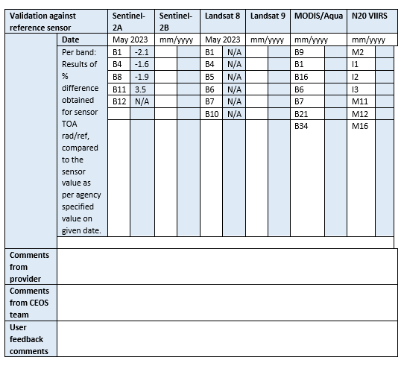
Database of Cal/Val infrastructure
Proposed last WGCV
Reconfirmed interest at IVOS 36
ACTION - Need to work with Paolo (ESA) to establish on Cal/Val portal

Slide 14
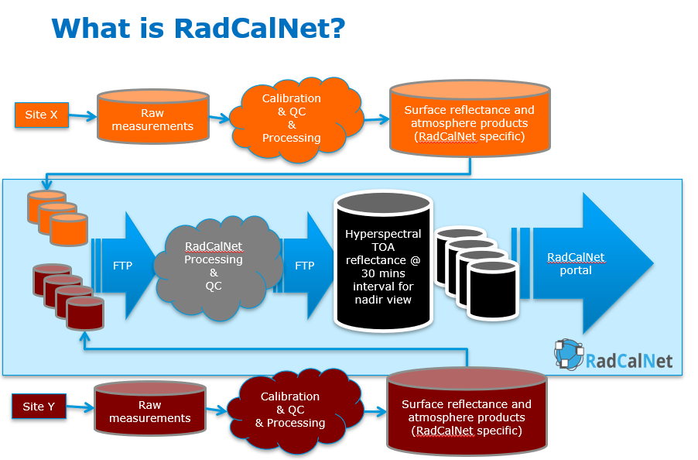
RadCalNet: Reminder

Slide 15
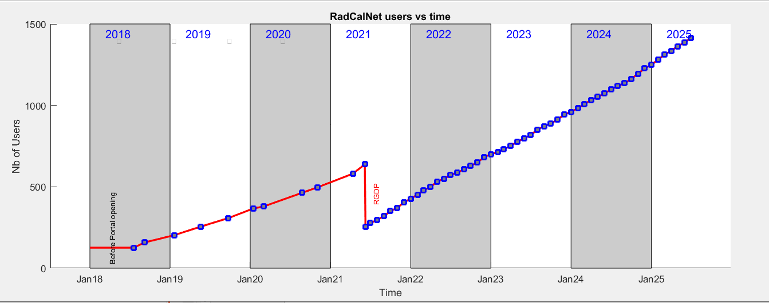
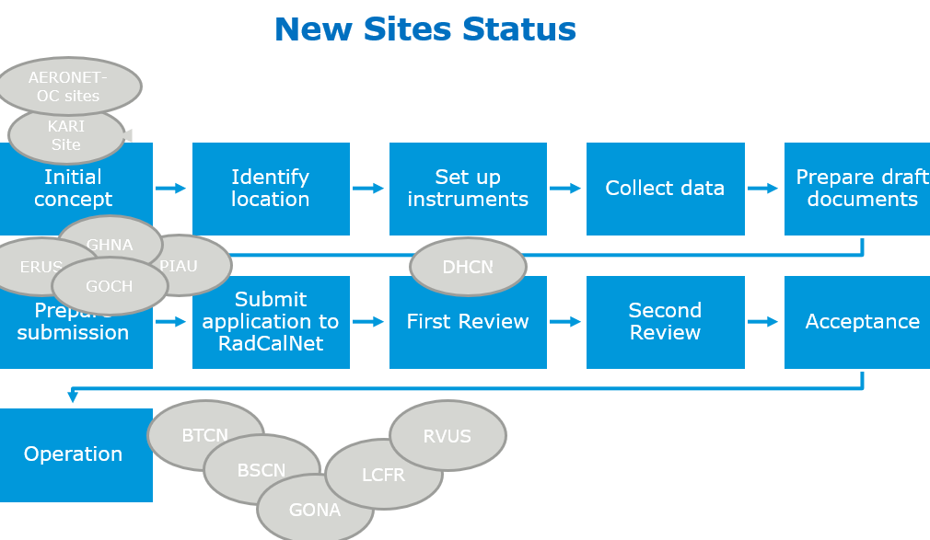
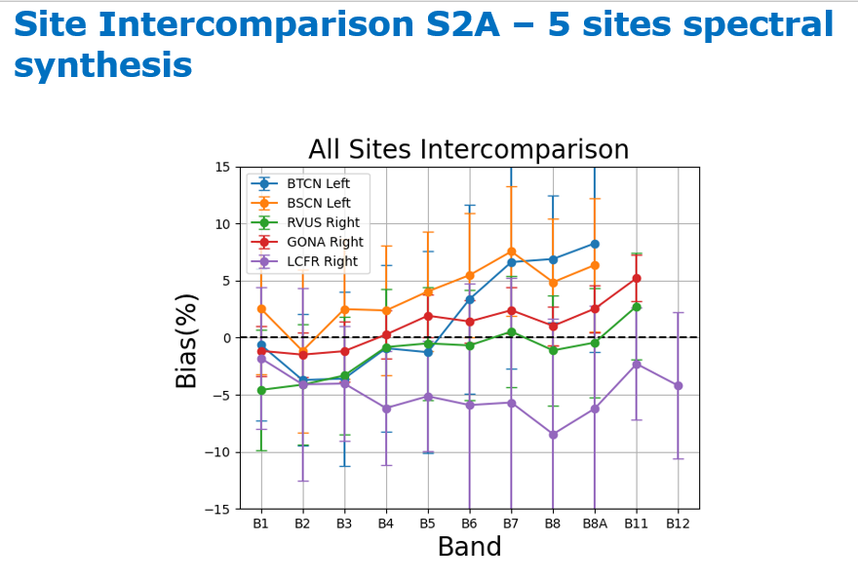
RadCalNet
More than half of users are active (downloading at least 1 data set)
On average 90 daily data downloads a week
GHNA
GOCN
ERUS
7 years of operation
Noted that at JACIE significant interest from Newspace
QA/QC continues to improve
Collection 2024 Released July 2024 (full reprocessing of Archive)

Slide 16
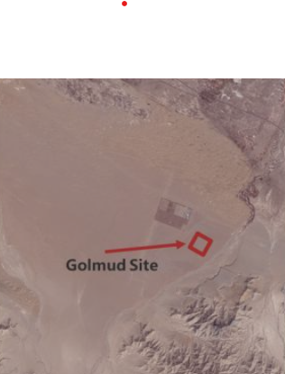
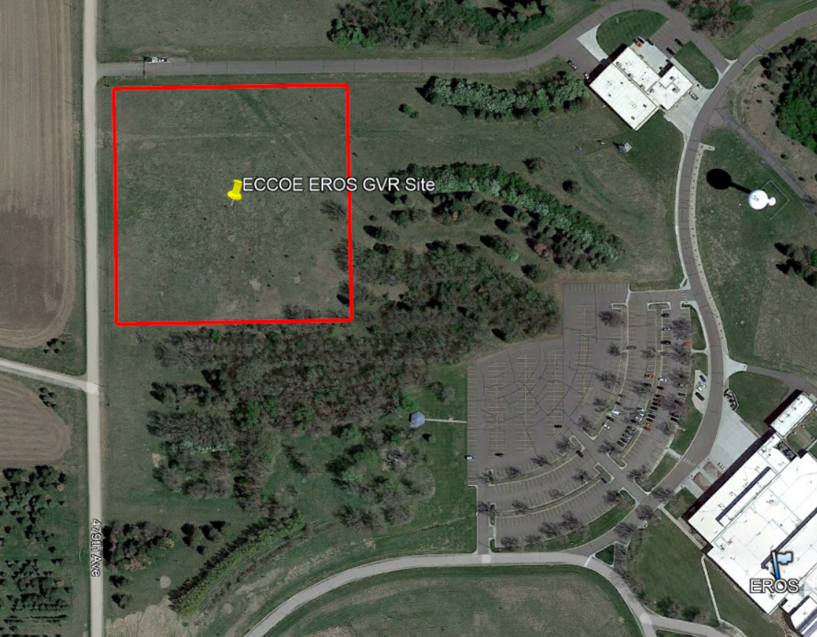
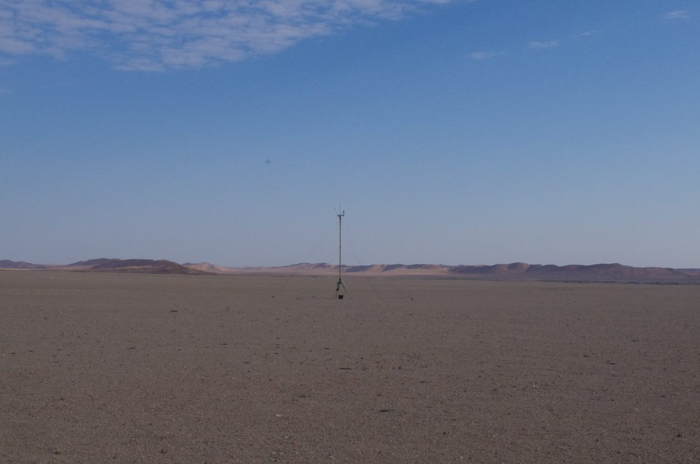
New Sites now under review
ERUS (South Dakota)
GHNA (Hypernets Gobabeb)
GOCN (Gobi Desert)
Pinnacles Australia progressing
Exploring Aeronet OC (water sites)

Slide 17
RadCalNet: But
Noted importance of gaining new sites but also to ensure long term sustainability of existing and emerging
Were there mechanisms to charge users for RadCalNet?
Various organisations e.g. Chile, without major space agencies, keen to develop sites but seek help on how to do it and also to help with instrumentation!
Propose a recommendation for consideration:
Noting the importance to mainstream agencies and new space of common long-term infrastructure to support Cal/Val and interoperability of satellite data CEOS encourages agencies to build into their long term strategies the need to continue to support the maintenance and development of existing sites e.g. RadCalNet and support the identification and establishment of new sites where there is clear interest in sustained maintenance into the future. CEOS WGCV IVOS asks if CEOS capacity building WG has resource it can channel to support developments in smaller agencies in regions where such sites may exist

Slide 18
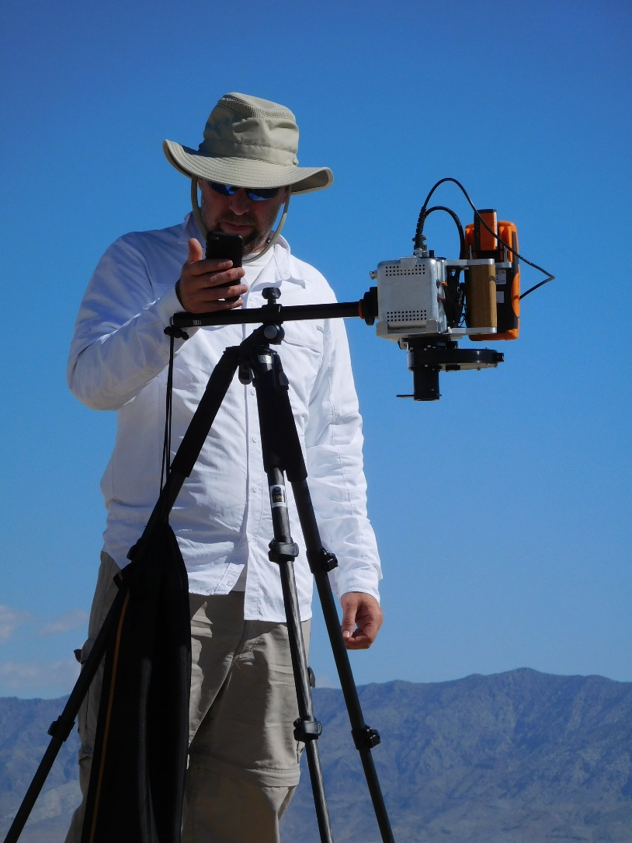
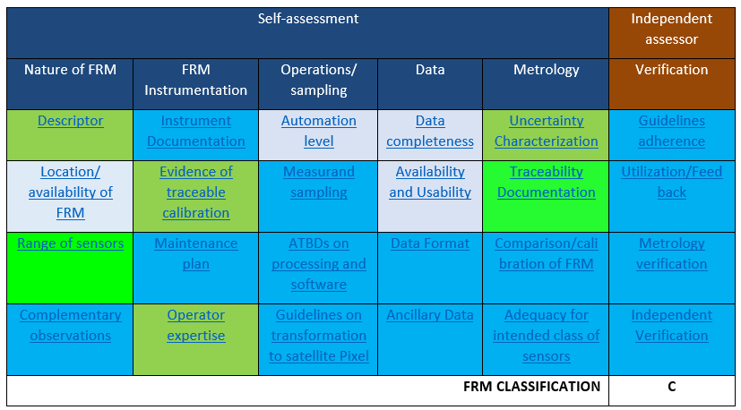
FRM QA framework
Lessons learnt from:
Calibration and Test Site SI-Traceable Transfer Radiometer (CaTSSITTR)
RadCalNet
Assessment can be subjective/pessimistic and make assumptions based on how the person thinks the context is
Should be done to reflect what is claimed to be done in descriptor
Ideally needs to be done early in a projects development cycle to get quick feedback into priorities of what needs to be done.
Assessing for a network and for other users can have different criteria some NA
  New network category and NA do not necessarily
  need to count to overall assessment (%)
  Who does verification column? And their independence
  Will be very valuable when number of assessed products increases
  Valuable for mission managers to specify class of FRM they need

Slide 19

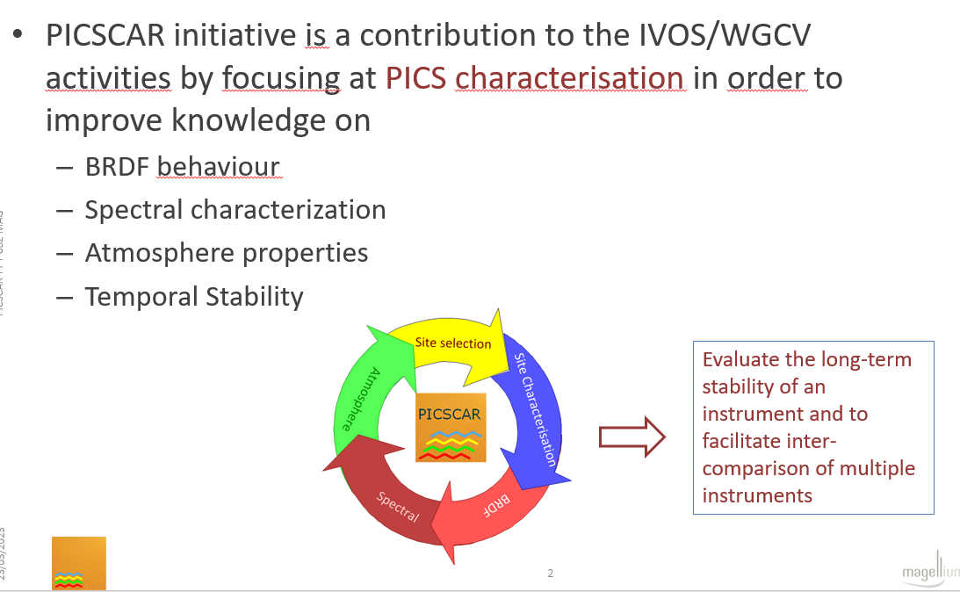
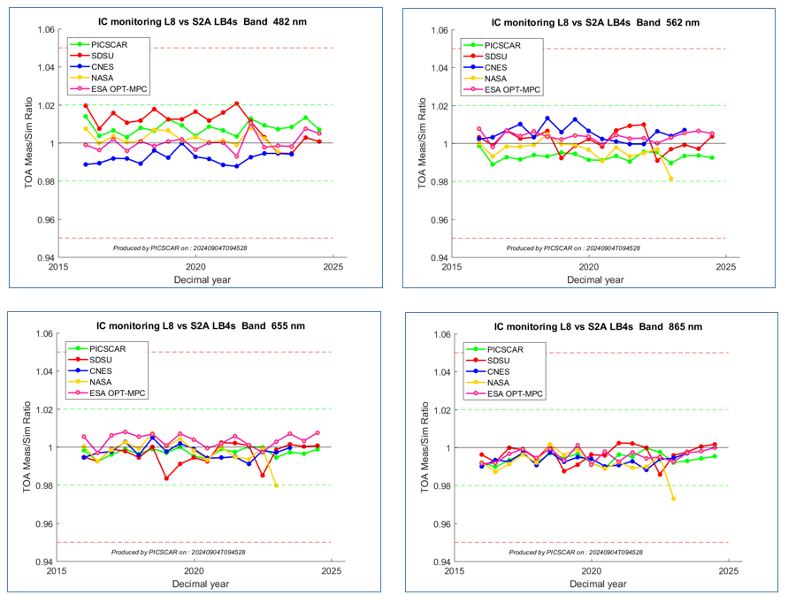
PICSCAR
Landsat 8 / Sentinel 2 for Libya 4 small site
Own methods
Consistent trend – Agreement improves

Slide 20
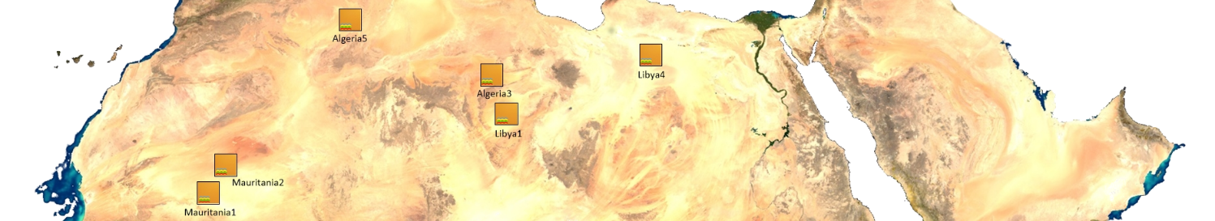
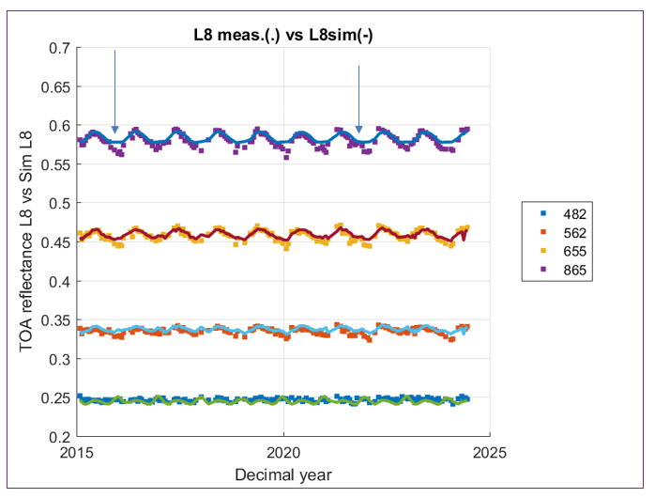
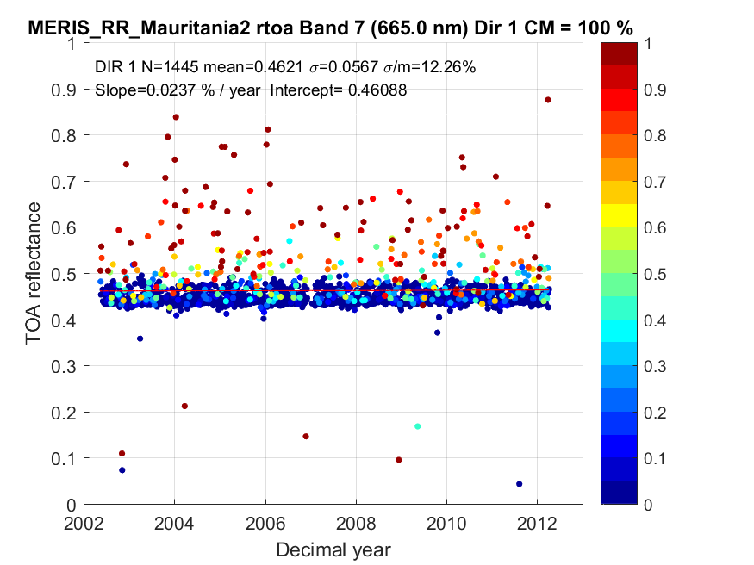
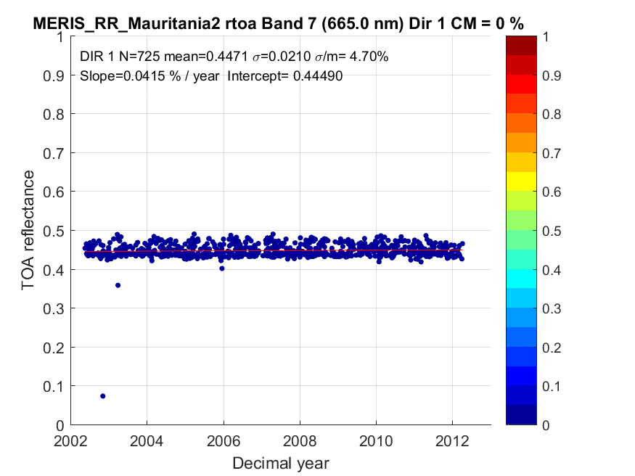
PICSCAR
Extend stability studies beyond Libya 4
First step improved cloud mask
Some residual error particularly in winter months

Slide 21
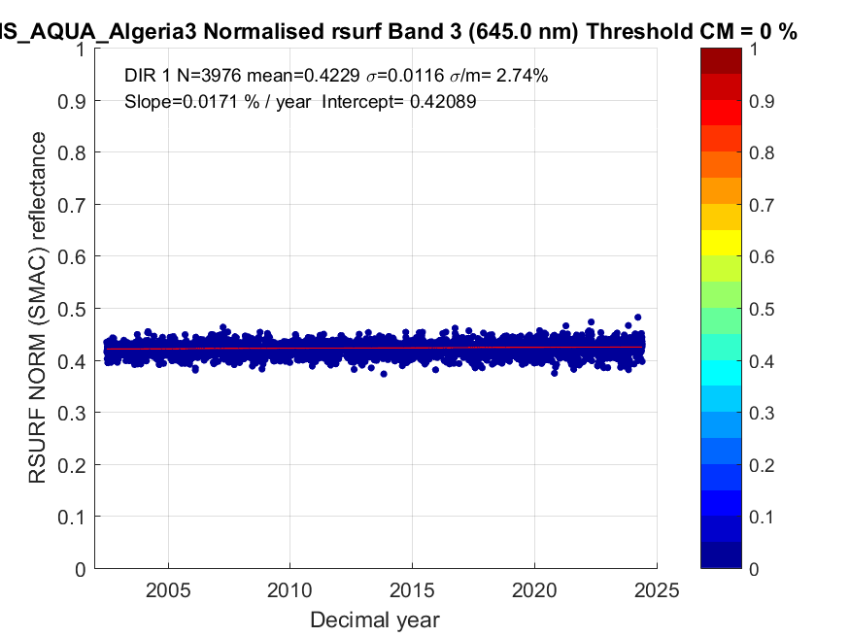
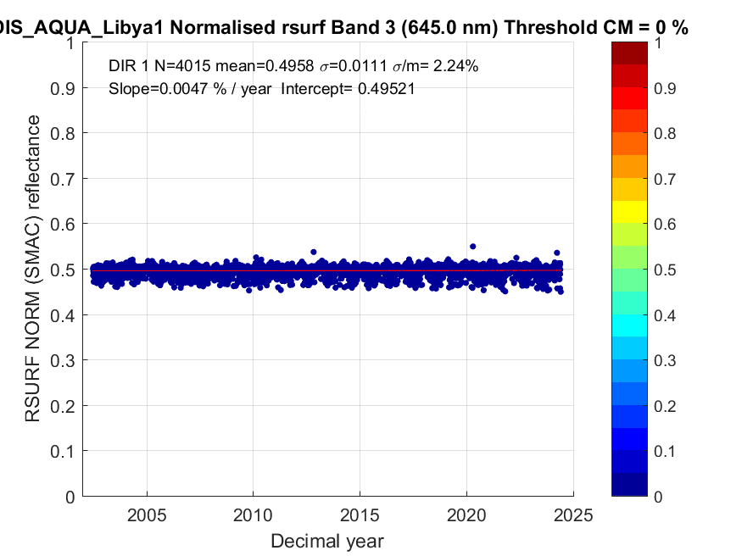
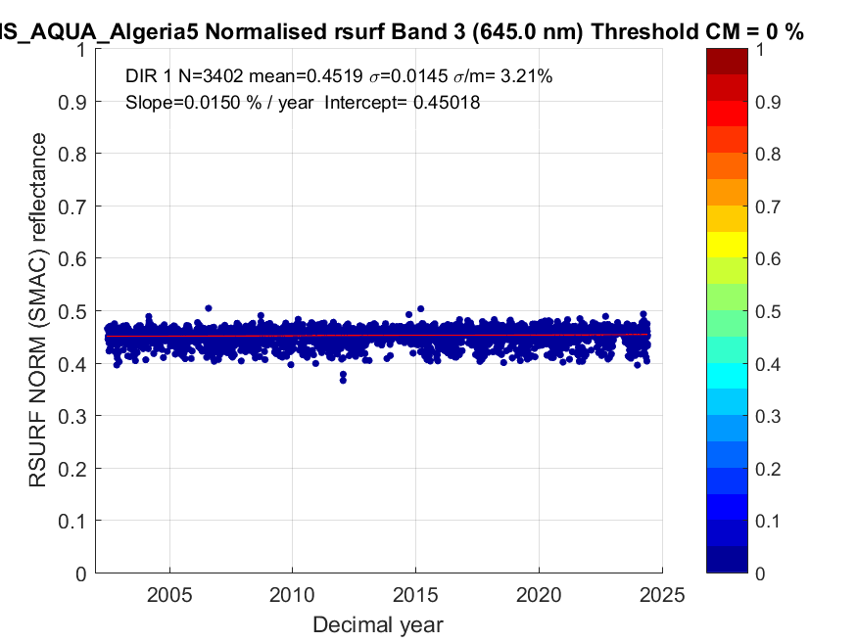
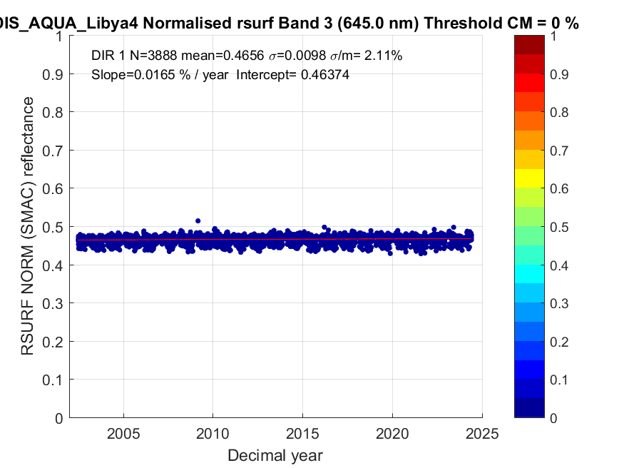
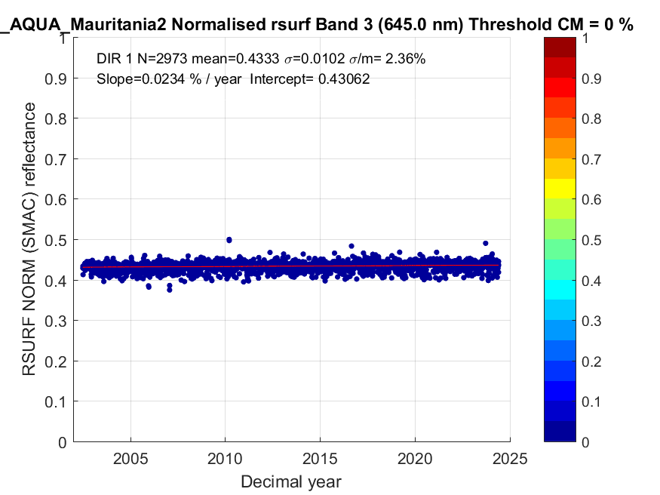
Site stability after first pass
Libya4
Band | Npt | mean | std | cv (%) | Slope %/year | ao | rmse | r
555 | 3888 | 0.329 | 0.0082 | 2.494 | 0.011 | 0.328 | 0.008 | 0.082
645 | 3888 | 0.466 | 0.0098 | 2.111 | 0.017 | 0.464 | 0.010 | 0.105
858.5 | 3888 | 0.568 | 0.0095 | 1.680 | 0.016 | 0.566 | 0.009 | 0.107
Algeria3
Bande | Npt | mean | std | cv (%) | Slope %/year | ao | rmse | r
555 | 3976 | 0.232 | 0.0105 | 4.528 | 0.010 | 0.231 | 0.010 | 0.061
645 | 3976 | 0.423 | 0.0116 | 2.735 | 0.017 | 0.421 | 0.012 | 0.092
858.5 | 3976 | 0.529 | 0.0110 | 2.076 | 0.022 | 0.527 | 0.011 | 0.126
Algeria5
Bande | Npt | mean | std | cv (%) | Slope %/year | ao | rmse | r
555 | 3402 | 0.232 | 0.0117 | 5.021 | 0.005 | 0.232 | 0.012 | 0.029
645 | 3402 | 0.452 | 0.0145 | 3.215 | 0.015 | 0.450 | 0.014 | 0.065
858.5 | 3402 | 0.563 | 0.0153 | 2.724 | 0.014 | 0.561 | 0.015 | 0.057
Libya1
Bande | Npt | mean | std | cv (%) | Slope %/year | ao | rmse | r
555 | 4015 | 0.290 | 0.0090 | 3.090 | 0.004 | 0.289 | 0.009 | 0.029
645 | 4015 | 0.496 | 0.0111 | 2.236 | 0.005 | 0.495 | 0.011 | 0.027
858.5 | 4015 | 0.605 | 0.0086 | 1.419 | 0.007 | 0.604 | 0.009 | 0.049
Mauritania2
Bande | Npt | mean | std | cv (%) | Slope %/year | ao | rmse | r
555 | 2973 | 0.245 | 0.0119 | 4.863 | 0.018 | 0.242 | 0.012 | 0.097
645 | 2973 | 0.433 | 0.0102 | 2.355 | 0.023 | 0.431 | 0.010 | 0.144
858.5 | 2973 | 0.539 | 0.0098 | 1.822 | 0.027 | 0.536 | 0.010 | 0.174
Algeria3
Libya1
Algeria5
Libya4
Statistics confirm the excellent sensor calibration and indicate that the sites have not evolved over this 22-year period.
Libya1 and Algeria5 sites highlight virtually no variation.
Mauritania2

Slide 22
PICSCAR
Next phase before releasing data for community study
improve BRDF model using latest Parasol data
Improve cloud screening
Hold review meeting with GSICS to consolidate activities

Slide 23
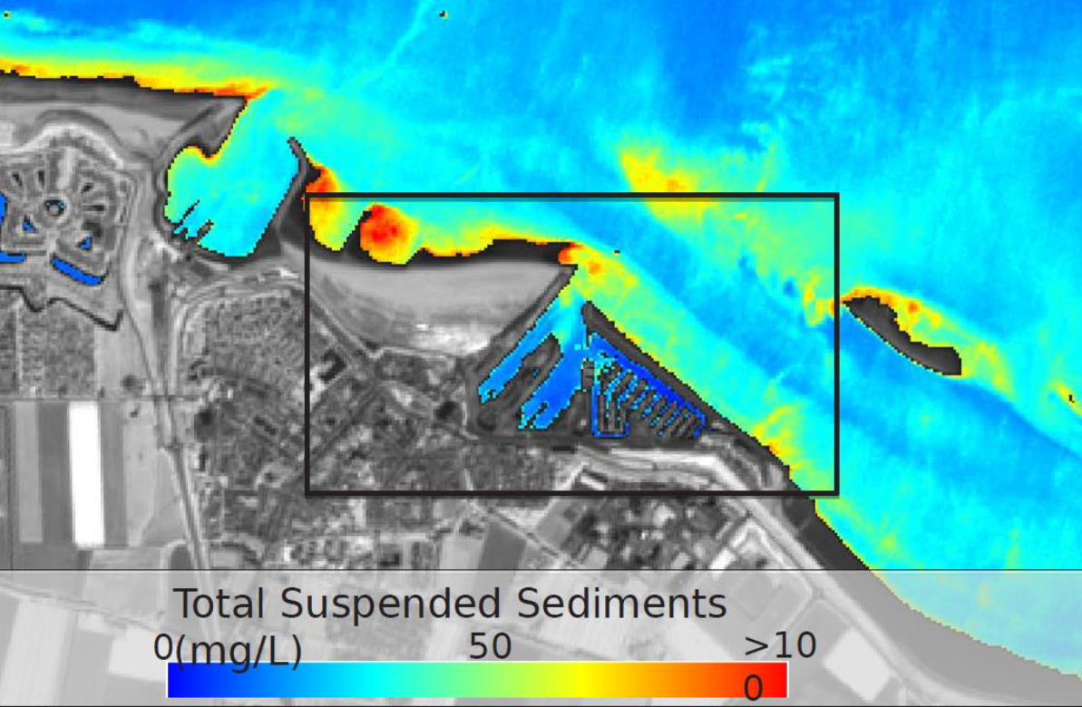
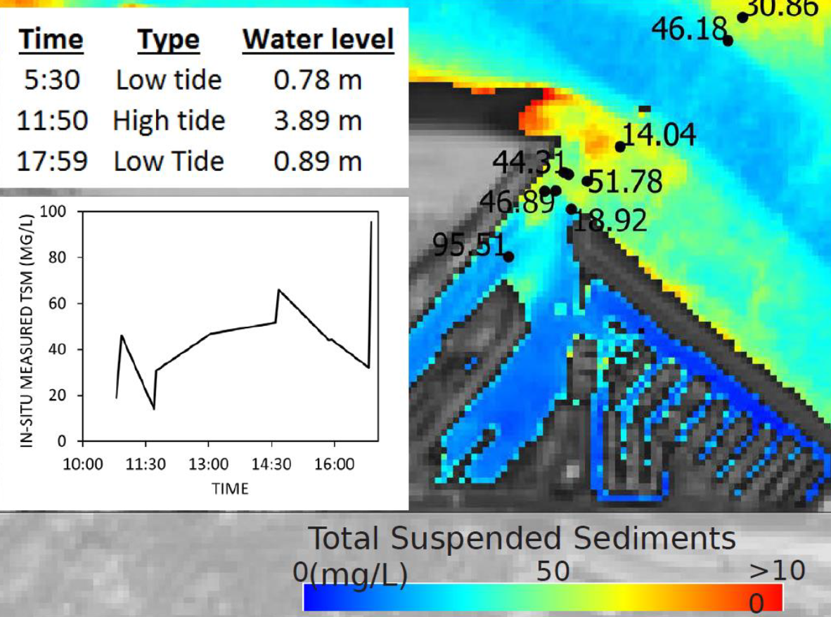
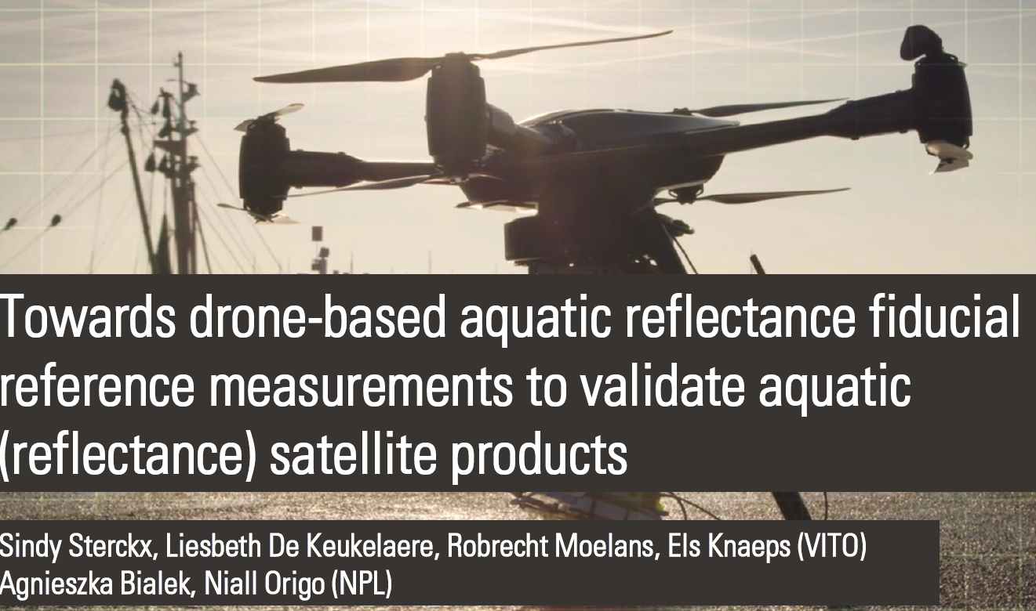
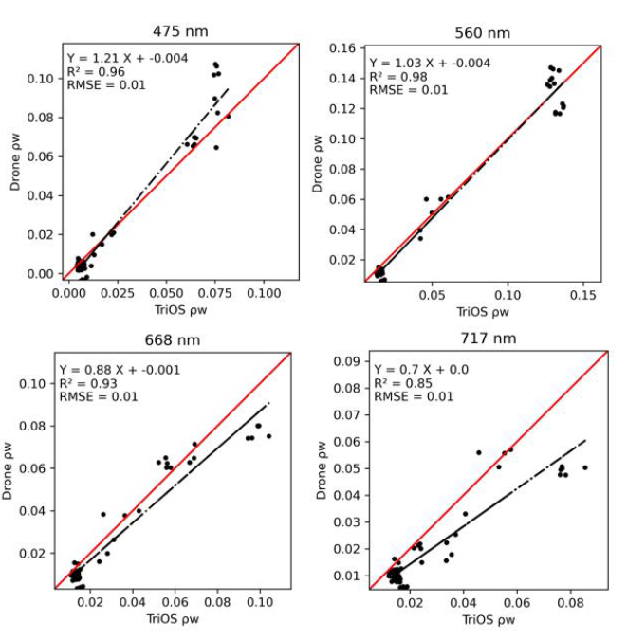
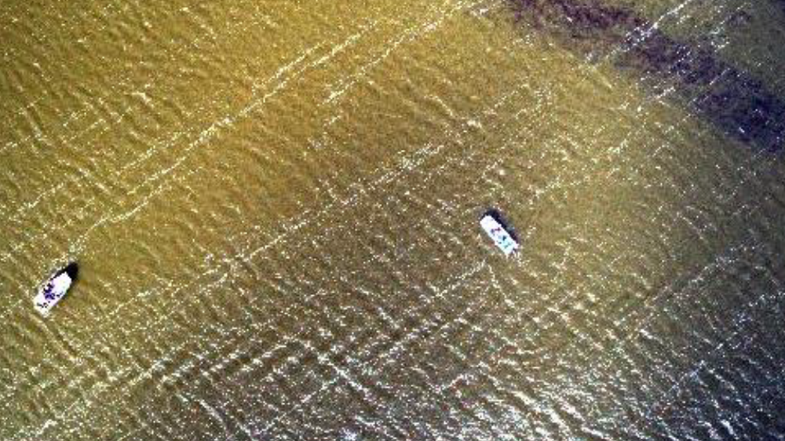
dDrones for water quality validation: Sterck (Vito)
Sentinel 2
Drones increasingly used for validation of water observations
Many challenges: some similar to land
Need to work towards FRM Project now funded by ESA
Need Protocol like Land Drones. Do we need something like LPV for water?
Obvious challenges in
visual image

Slide 24
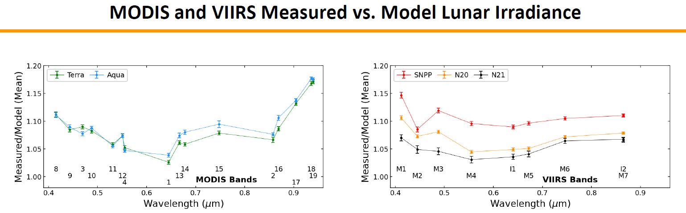
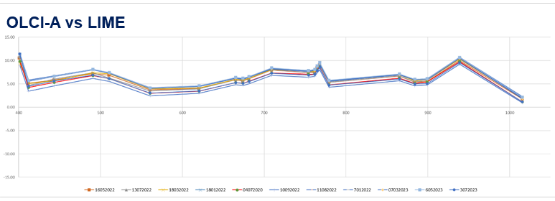




Sensor status and performance
Air-Lusi Vs LIME
EnMAP

Slide 25



Solar Spectral Irradiance evolutions
CEOS Solar Irradiance spectrum being used
Reprocessing to it underway see S3-OLCI
Sensors making comparisons of difference
New sensors looking to adopt
Need to promote more to New space
OLCI now reprocessed to TSIS no impact on L2

Slide 26





RT code assessment 4 high accuracy
For Ozone

Slide 27

RT code: conclusions
In moving to improved uncertainty regime need to better account for atmospheric composition (e.g. use CAMS not scaled values)
Need Comparisons suitable to assess < 1% accuracy
16-17 Oct 2025
ESA ESRIN

Slide 28


Uncertainty, Traceability and QA
Drivers: ARD, Per pixel Uc, Climate, New space -
What IS Traceability?
What do we have to evidence?
What is enough in terms of Uncertainty?
Started to scope a ‘minimum requirements for newspace’
    What to do pre-flight ?
    what to do post-launch ?
    What information needs to be provided ?
    Need to have evidence as to why it is needed?
    Undertake studies to evidence need e.g spectral response ideally linked to applications
    A potentially major activity for IVOS going forwards
Comprehensive workshop at JACIE:
Starting point
Discussion at IVOS

Slide 29








Metrology 4 Earth Observation (Met4EO) ESA funded NPL program
AI for sensor to sensor intercomparisons: Identifying optimum target sites and also emulators for rapid atmospheric correction
Enabling metrology practices: tools, training and consultancy for EO
- Uncertainty evaluation, case studies, Use of Drones for surface characterisation, Hands on Courses for EO uncertainty
Metrology for land classification
Uncertainty framework for categorical quantities and also validation of them
CEOS PVP and RadVal comparison Tool
Professionalise software
Improve Uncertainty analysis and references
Consoloidate ‘virtual reference

Slide 30
TIRCALNet
TIR Top-of-Atmosphere Calibration Network
CEOS IVOS Meeting Tokyo 9-13th September 2024
Steffen Dransfeld, ESA
Morgane Chapelier, Sébastien Marcq, Arthur Dick, Emilie Delogu, Aimé Meygret CNES
Darren Ghent, Jasdeep Anand, Mike Perry University of Leicester
Frank Goettsche, Lluis Perez-Planells KIT
Dave Smith RAL

Slide 31




TIRCalNet/IR

Slide 32




TIRCalNet progress

Slide 33




TIRCalNet conclusions
0.2 – 0.5 K
0.1 – 0.3 K

Slide 34





TIRCalNet site assessment protocol:
Morgane Chapellier et al CNES
Atmosphere correction

Slide 35





TIRCalNet: La Crau: Sebastien Marcq et al CNES

Slide 36
Summary
Looking for a volunteer (s) to take leadership of ‘image quality/geometric’ focus group
      - USGS to provide a questionnaire to solicit interest and priority topics
Interoperability (radiometric) L1
      - Sub-set of sites identified for ‘encouraged collect by Newspace and agencies
      - Match-up platform to assess/report consistency with ‘CEOS reference’
– strategy to build a database for users to assess suitability for their application as first step – now live
Uncertainties, Traceability, QA – lot of interest further workshops include new space
      - Develop guidance recommendations (agency buyers guide) of what needs to be done to evidence QA
      - CEOS to establish case studies (Sensitivity) to demonstrate why we need information
      - more workshops including in Europe
  LST ToA brightness temperature project (TIRCalNet) started with view to future operational network noting RadCalNet has seven yrs of operation and >500 active users
      - Encouraged to start ‘network thinking’ early
  Solar Irradiance Spectrum
    – Community is utilising and reprocessing to new spectrum need to add to CalVal portal
    -
  RT codes (parameterisation/function) may need to improve as we move to SITSat era

