Slide 1
Committee on Earth Observation Satellites
Viewing Earth
Serving Society
CEOS Overview and CEO Update
Steven Ramage, WGCV-55
July 2025

Slide 2
CEOS Mission & Primary Objectives
Primary Objectives:
To optimise global societal benefit from space-based Earth observation missions
To serve as the focal point for sustained international coordination among space-based Earth observation programs, remote sensing experts, and activities
To promote complementarity and compatibility for the benefit of data user communities worldwide

Slide 3
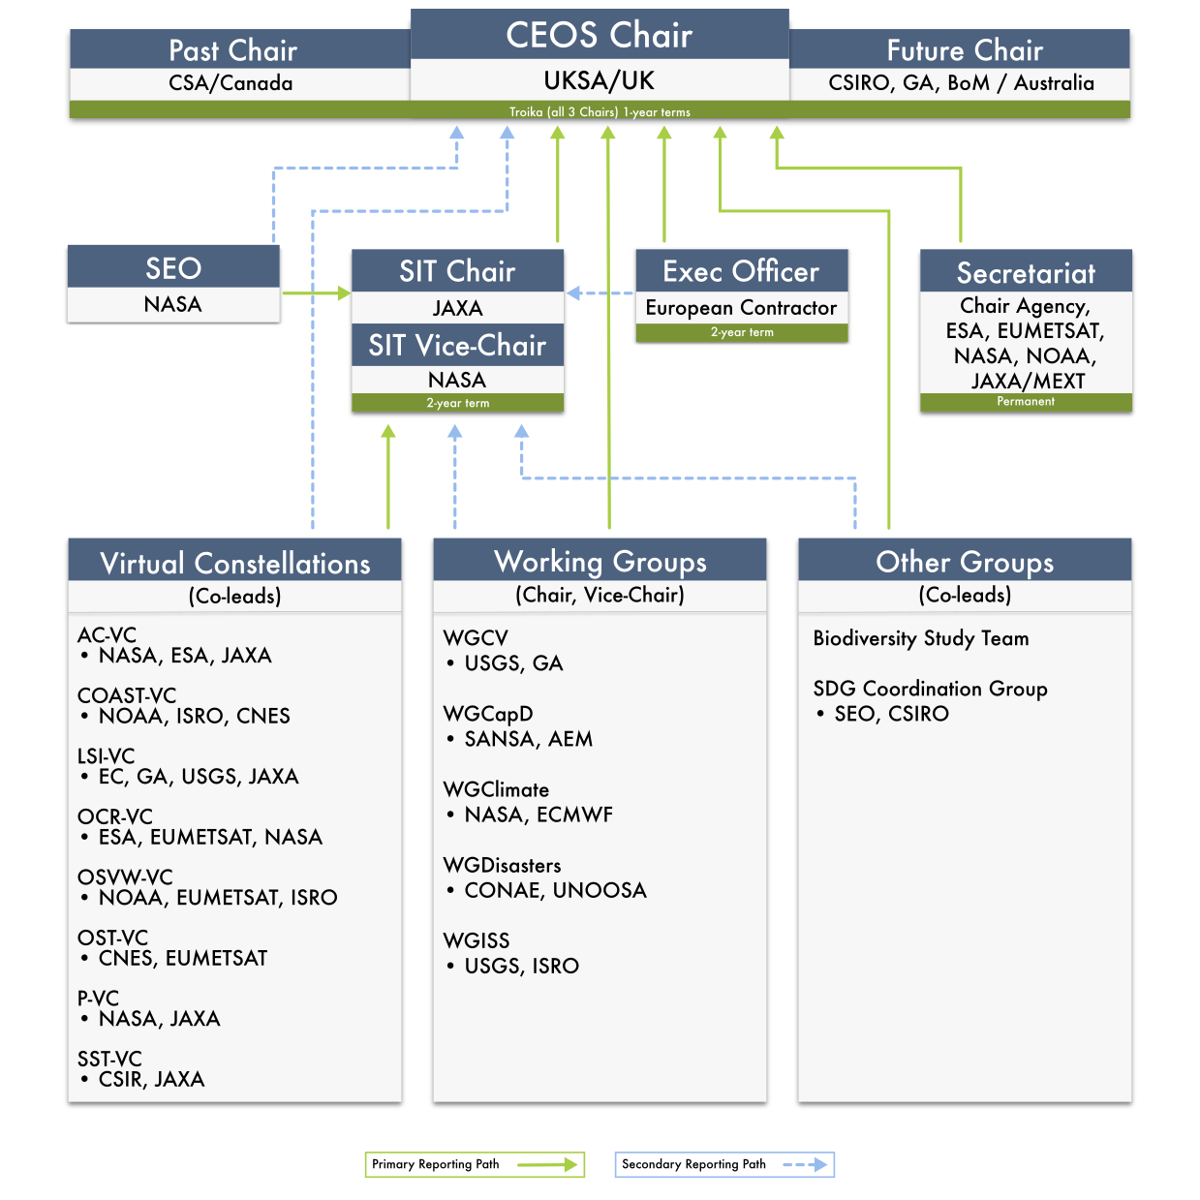
CEOS Organisational Structure
This organogram depicts the CEOS organisational structure, including the paths by which each CEOS entity reports to leadership.
Secondary reporting paths reflect augmented leadership arrangements that are normally put in place at the discretion of the entity charged with primary leadership responsibility.
SEO is the Systems Engineering Office, and the SIT is the Strategic Implementation Team
https://ceos.org/ourwork/

Slide 4
CEOS Long-term Priorities
Ensure that climate observation requirements identified by the Global Climate Observing System (GCOS) – and implications of the Paris Climate Agreement – are addressed.
Ensure, in the context of the Sendai Framework for Disaster Risk Reduction 2015-2030, that CEOS Agency data are made available in support of disaster risk reduction and that CEOS continues engagement with UN agencies and authorities.
Ensure that space-based Earth observation data and products are integral to the success of the next decade of the Group on Earth Observations (GEO), and that CEOS contributions to, and engagement in, GEO governance and leadership are further enhanced.
Systematically engage in and contribute to global efforts on the critical challenges that face humanity in support of the UN 2030 Agenda for Sustainable Development.

Slide 5
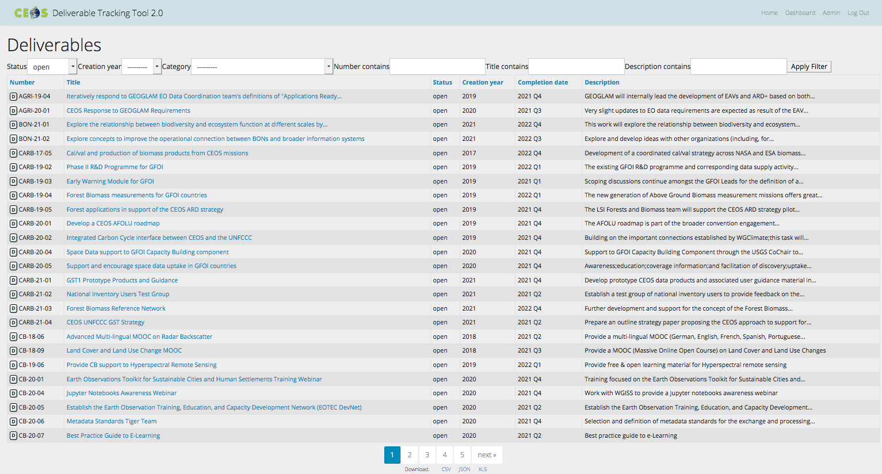
CEOS Work Plan
3-year plan re-evaluated and updated annually by all CEOS entities and presented for formal endorsement in Q1 of each calendar year.
CEOS undertakes rigorous work planning, monitoring and implementation of its activities, all of which ensure CEOS’s internal accountability and external credibility.
The Work Plan informs the spectrum of deliverables that CEOS membership agree to undertake.
CEOS deliverables are reconciled and tracked with a dedicated CEOS deliverable tracking tool.
The CEOS 2024-2026 Work Plan defines more than 120 deliverables.
http://deliverables.ceos.org/

Slide 6
CEOS Work Plan: Expected Outcomes
The CEOS Work Plan’s Expected Outcomes reflect ongoing and emerging priorities as characterised by internal decision making & external commitments (focusing on improved EO systems coordination and enhanced data access for key global programmes and initiatives) in the following areas:
CEOS and the ‘New Space’ agenda
Climate Monitoring, Research, and Services
Carbon Observations in Support of Climate Science and Policy
Observations in Support of the Global Stocktake of the UNFCCC
Data Discovery, Access, Preservation, Quality, Usability & Exploitation
Capacity Building and Data Democracy
Observations for Disasters
Observations for Water and Oceans
Observations for Land
Observations in Support of the United Nations Sustainable Development Goals
Advancement of the CEOS Virtual Constellations

Slide 7
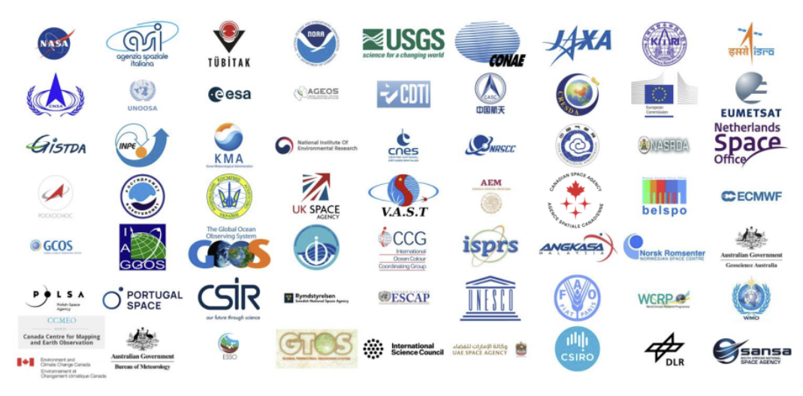
CEOS Membership
The Committee on Earth Observation Satellites (CEOS) was stablished in 1984 under aegis of the G7 Economic Summit of Industrial Nations Working Group on Growth, Technology, and Employment
Now in its fourth decade,
CEOS comprises
34 Members
(Space Agencies) and
30 Associates
(UN Agencies, Phase A programmes or supporting ground facility programmes)
All of whom contribute to CEOS on a ‘best efforts’ and voluntary basis.

Slide 8
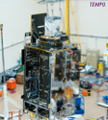
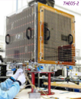
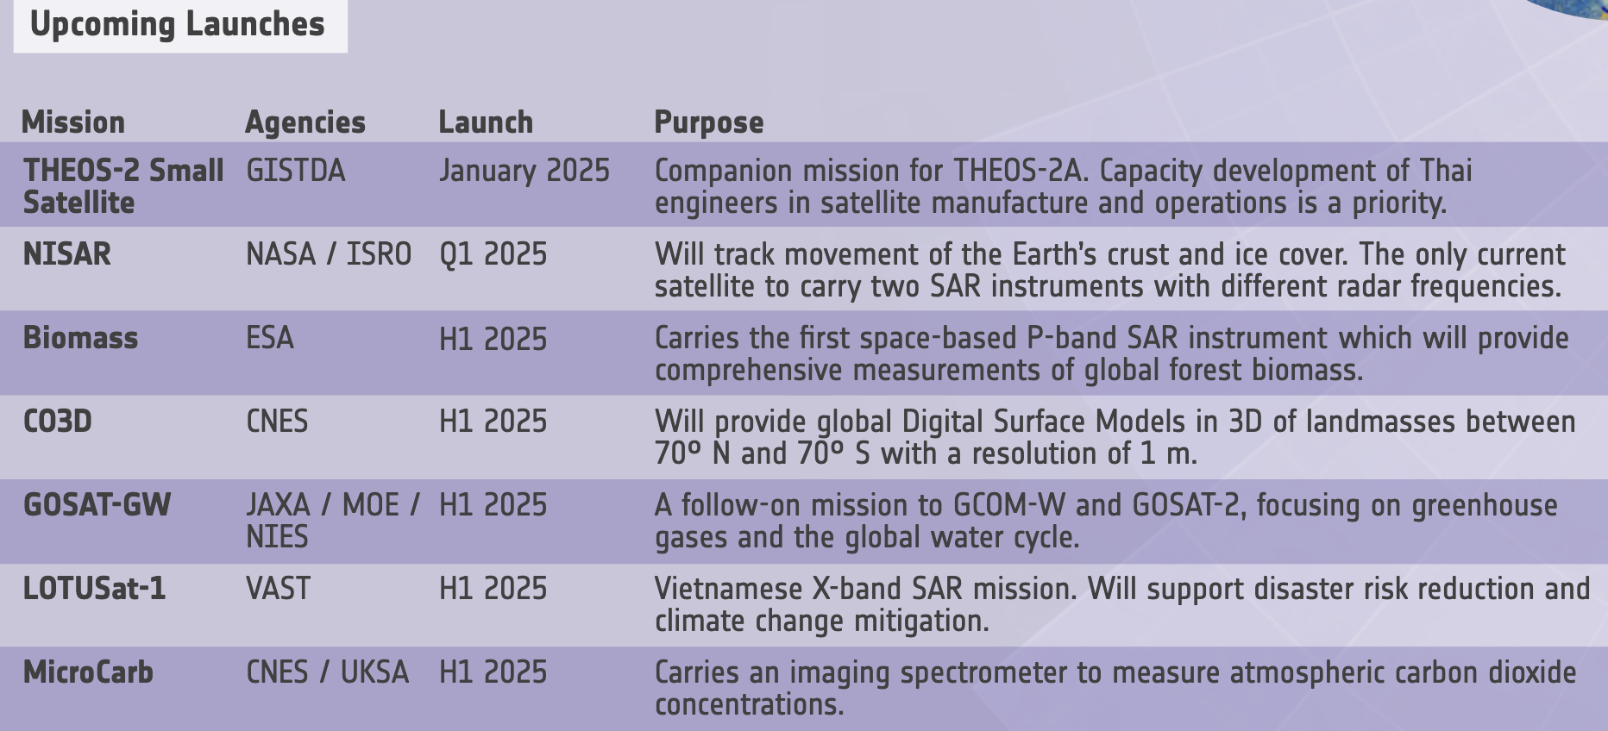
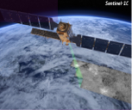
CEOS Agency Missions
CEOS Database Quarterly Reports
Key Mission activities example from Q4 2024
Biomass, CO3D, GOSAT-GW, Ionosphera-M N1, Ionosphera-M N2, Kondor-FKA N2, LOTUSat-1, MicroCarb, NISAR, NORSAT-4, Resurs-P, Sentinel-1, Sentinel-1B, Sentinel-1C, THEOS-2A

Slide 9
CEOS Plenaries
Plenary | Year | Venue | Host |  | Plenary | Year | Venue | Host
1st | 1984 | Washington DC, USA | NOAA |  | 20th | 2006 | Buenos Aires, Argentina | CONAE
2nd | 1986 | Frascati, Italy | ESA |  | 21st | 2007 | Kona, Hawaii, USA | USGS
3rd | 1988 | Ottawa, Canada | CSA |  | 22nd | 2008 | George, South Africa | CSIR
4th | 1990 | Sao Jose dos Campos, Brazil | INPE |  | 23rd | 2009 | Phuket, Thailand | GISTDA
5th | 1991 | Washington DC, USA | NASA/NOAA |  | 24th | 2010 | Rio de Janeiro, Brazil | INPE
6th | 1992 | London, UK | BNSC |  | 25th | 2011 | Lucca, Italy | ASI
7th | 1993 | Tsukuba, Japan | MEXT/NASDA |  | 26th | 2012 | Bangalore, India | ISRO
8th | 1994 | Berlin, Germany | DARA |  | 27th | 2013 | Montreal, Canada | CSA
9th | 1995 | Montreal, Canada | CSA |  | 28th | 2014 | Trömso, Norway | EUMETSAT
10th | 1996 | Canberra, Australia | CSIRO |  | 29th | 2015 | Kyoto, Japan | JAXA
11th | 1997 | Toulouse, France | CNES |  | 30th | 2016 | Brisbane, Australia | CSIRO
12th | 1998 | Bangalore, India | ISRO |  | 31st | 2017 | Rapid City, USA | USGS
13th | 1999 | Stockholm, Sweden | EUMETSAT |  | 32nd | 2018 | Brussels, Belgium | EC
14th | 2000 | Rio de Janeiro, Brazil | INPE |  | 33rd | 2019 | Hanoi, Vietnam | VAST/VNSC
15th | 2001 | Kyoto, Japan | MEXT/NASDA |  | 34th | 2020 | Virtual | ISRO
16th | 2002 | Frascati, Italy | ESA |  | 35th | 2021 | Virtual | NASA
17th | 2003 | Colorado Springs, USA | NOAA |  | 36th | 2022 | Biarritz, France | CNES
18th | 2004 | Beijing, China | NRSCC |  | 37th | 2023 | Chiang Rai, Thailand | GISTDA
19th | 2005 | London, UK | BNSC |  | 38th | 2024 | Montreal, Canada | CSA

Slide 10
Updates from SIT-40
The CEOS 2025–2027 Work Plan was virtually endorsed by CEOS Principals in May 2025 and is now available online
The UK Space Agency, as the 2025 CEOS Chair, is advancing the theme “Unlocking Earth Observation (EO) for Society”, and a joint CEOS Chair and SIT Chair side event was hosted alongside SIT-40 to discuss CEOS Agency interactions with UNFCCC COP delegates. A side event is planned for SIT Technical Workshop 2025 to discuss CEOS Agency initiatives for increasing the use of EO for public service.
The GHG Task Team continues to develop the Best Practices for Remote Sensing-based Estimates of Facility-scale Methane Emissions. The document was shared for CEOS-CGMS review in June and the final version will be released in July 2025.
The SIT Chair Team is working with the GHG Task Team on engagement with the International Methane Emissions Observatory (IMEO), notably with the Use Case Working Group, on the establishment of a database of controlled release experiments and ensuring access to CEOS Agency data.

Slide 11
Updates from SIT-40
The JAXA SIT Chair Team will lead the development of the CEOS GST Strategy Issue 2 and oversee its implementation. The CEOS community is invited to nominate representatives to assist with the development of the document, which will be presented for endorsement at CEOS Plenary 2025.
The Space Agency Response to the 2022 Global Climate Observing System (GCOS) Implementation Plan was endorsed by SIT-40. This provided responses to 48 activities identified by GCOS.
SIT-40 endorsed the Lessons Learned and Recommendations from Space Agency Support for the First Global Stocktake produced by the CEOS/CGMS WGClimate.
The IPCC Task Force on Inventories (TFI) Database is a potential mechanism through which EO data can improve national inventories, through the validation and enhancement of the default emission factors.
WGClimate has an activity to expand the use of the Climate Data Records (CDR) Inventory to address emerging priorities and invites participants to help with application/stakeholder typologies.
A UNFCCC COP Tiger Team under WGClimate has been established to coordinate CEOS and CGMS inputs to the annual UNFCCC COP meetings. WGClimate and UNFCCC held a joint, virtual workshop in April 2025, to inform and engage division focal points and define follow-up activities.
Notes:
A national emissions estimates session was held at WGClimate-22, where several national inventory teams from around Europe presented their approaches and challenges using EO data. Feedback from national inventory teams highlighted the need for better guidance on how to find and use EO datasets, as well as clearer resources for seeking help with EO data.

Slide 12
Updates from SIT-40
The Aquatic Carbon Roadmap development continues, with a first draft shared for discussion. A consolidated draft is expected by CEOS Plenary, with endorsement planned in early 2026.
The CEOS AFOLU Roadmap team defined 30+ actions to follow the Roadmap’s recommendations. The LSI-VC Forests and Biomass Subgroup will monitor and track the progress of these actions.
The Biodiversity Study Team (BST) has been running a consultation across the CEOS community to assess the potential to address biodiversity needs. A recommendation for sustainable CEOS support for biodiversity, along with the associated documentation, will be brought to CEOS Plenary 20
WGCV has developed the CEOS Product Validation Platform (PVP), which includes a database for image comparisons, as well as a tool for radiometric and validation analytics. The CEOS community is invited to engage with the initiative and provide imagery from their own sensors, and encourage other satellite operators, including commercial operators, to do the same.
WGDisasters has established a subgroup to support the UN’s Early Warning for All (EW4All) initiative. The next steps regarding engagement are currently being developed.

Slide 13
Updates from SIT-40
WGISS presented the first draft of the CEOS Interoperability Handbook 2.0. The Handbook includes recommendations for data providers to improve the interoperability of their data and services. It is open for community comment, and a final version will go to CEOS Plenary for endorsement.
SST-VC presented a statement regarding extended observation coverage from new ultra-high-resolution thermal infrared instruments.
The CEOS Executive Officer participated in the 14th Global Ocean Observing System (GOOS) Steering Committee (SC14) in Paris, France, in February 2025, on behalf of COAST-VC. GOOS expressed interest in partnering with CEOS on critical ocean observation infrastructure.
The LSI-VC GEOGLAM Subgroup asked CEOS Agencies to review their Terms of Reference and provide a response to GEOGLAM Points of Contact for any revisions, as well as nominations to join the Subgroup. A workshop was held in May 2025 to discuss the Essential Agriculture Variables (EAVs).
LSI-VC’s management of thematic areas for CEOS will be updated to ensure consistent and robust oversight, and better integration of thematic work.

Slide 14
Updates from SIT-40
The SDG Coordination Group is now led by the CEO and has provided technical contributions to the UN Global Geospatial Information Management (GGIM), Working Group on Geospatial Information (WGGI) paper, which highlights the value and role of Earth observation data in global development.
A formal letter of cooperation was received from UNCCD, which included several specific requests. A response was sent to UNCCD in June 2025 by the CEOS Executive Officer and it’s linked to SDG CG work.
CNES is leading the establishment of the Space4Ocean Alliance. The UN Ocean Conference, held in Nice, France, in June 2025, will be a key opportunity to join the alliance and contribute.
The SIT Technical Workshop 2025 will be hosted by EUMETSAT in Darmstadt, Germany, from 9-11 September 2025.
The CEOS Plenary 2025 will be hosted by UKSA in Bath, UK, from 4-6 November 2025.

Slide 15
Engage with CEOS
https://ceos.org
@ceosdotorg
@socialceos
www.linkedin.com/ company/ceosdotorg

Slide 16
executive_officer@lists.ceos.org

