Slide 1
CSIRO Agency Report
Cindy Ong, CSIRO
Agenda Item 1.8
WGCV-55
Hyderabad, India
8-10 July, 2025

Slide 2
Acknowledgement of Country
I would like to begin by acknowledging the traditional custodians of the Noongar lands and waters where I grew up, live and work, in particular the Yuet peoples, the custodians of the Pinnacles area who have so generously shared their knowledge and allowed us to conduct our research on their lands.
I offer my respect to their elders past, present and emerging as we work together towards a just, equitable and reconciled Australia, and one where we recognise and build our shared knowledge and experiences. I hope that together, we will achieve outputs that allow us to manage the lands into the future sustainably.

Slide 3
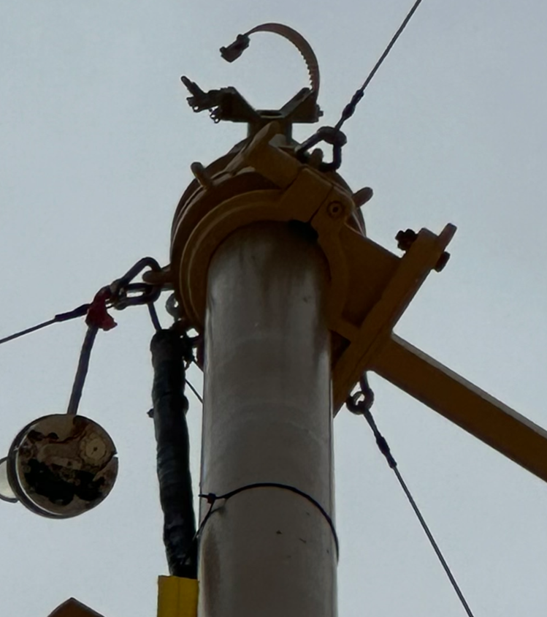
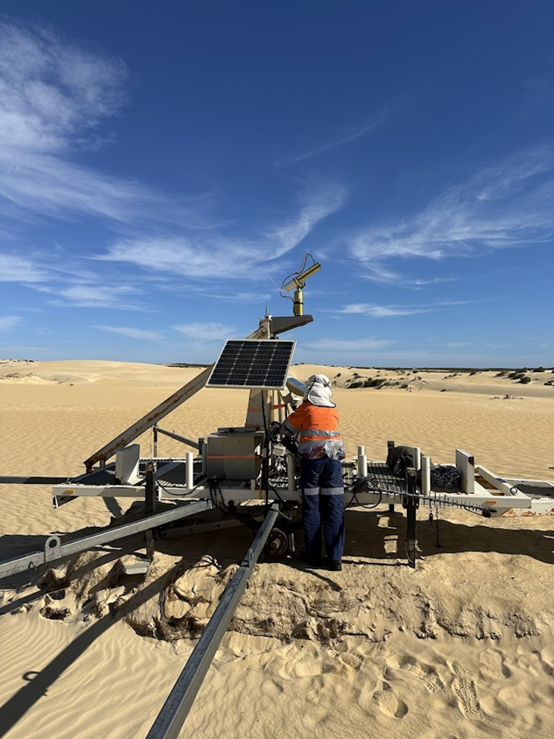
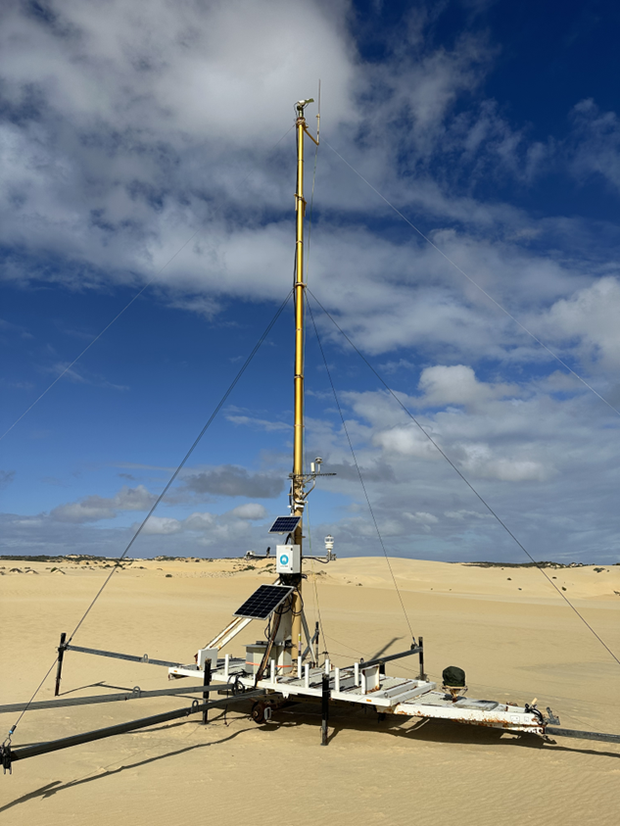
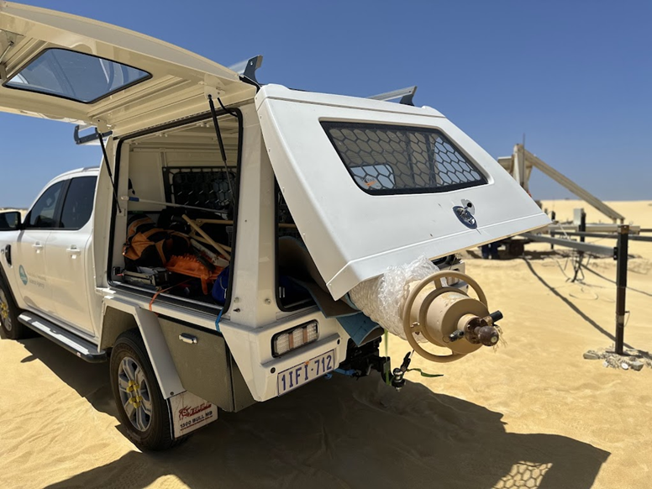
Pinnacles (PIAU)
Major instrument failure in November 2024
CIMEL head strap unclasped and head dangled from photometer cable, head cover lost from impacts against mast;
Mast was very difficult to retract;
CIMEL was removed and sent to NASA GSFC for repair/recalibration
A CIMEL was reinstalled on the platform at 3m 18 March 2025;
Replaced CIMEL wet sensor with an optical one;
Sky camera and weather station were working;
Mast was removed and sent for service in Perth
New mast arrived from UK in May and was installed 22 May 2025;
Problems with robot on installing on mast, spare robot installed 8 June 2025 and mast raised.
AOD data 18 March 2024 onwards, no BRDF data from the 6 November 2024 to 8 June 2025, BRDF reestablished 8 June 2025 to present
Notes:
Photometer head strap unclasped and head dangled from photometer cable, hitting the side of the mast for 2 days before visiting the site to repair
Found the head to have lost its cover from impacts against the mast
Mast was very difficult to retract at that time

Slide 4
Processing of ROSAS data (20/06/2024 – 21/11/2024)
More data required – only 6 clear days and 5 partially cloudy days;
Encouraging results for the irradiance and radiance calibration of the photometer;
Adjacency effects due to the strong contrast of the surrounding environment (dark veg) and very bright dunes need further investigation and characterisation;
Further investigation required to understand the uniformity of the site WRT wavelength and season.

Slide 5
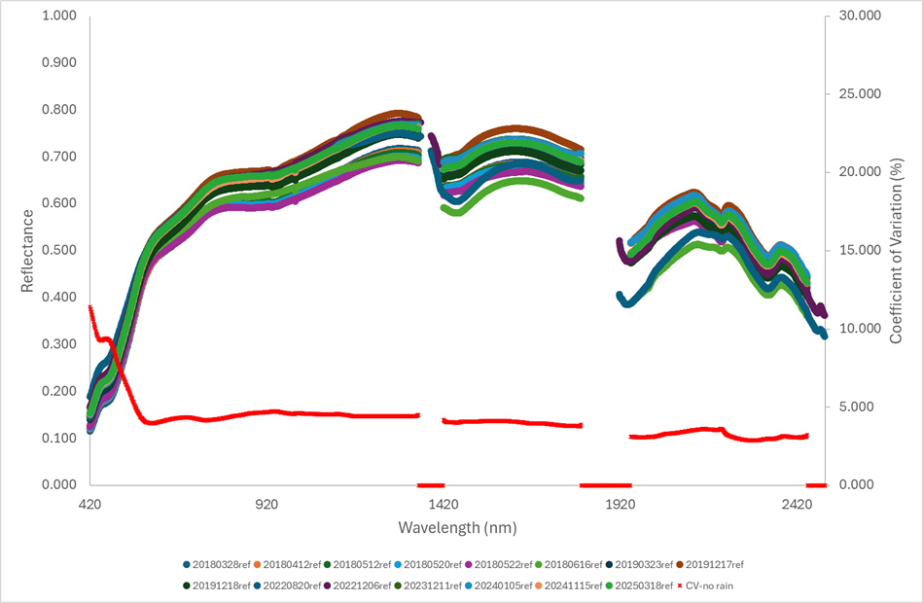
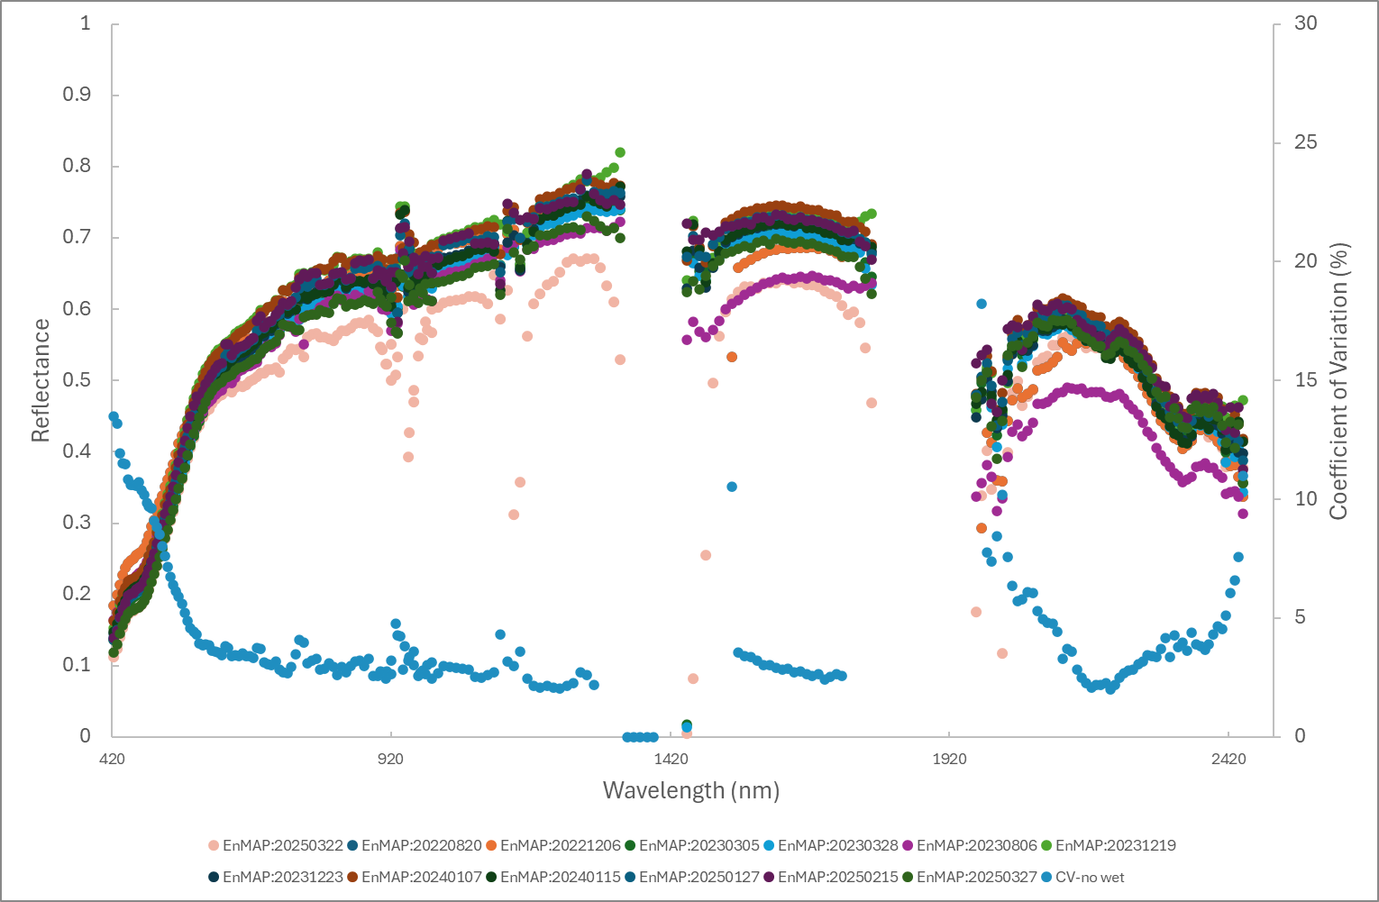
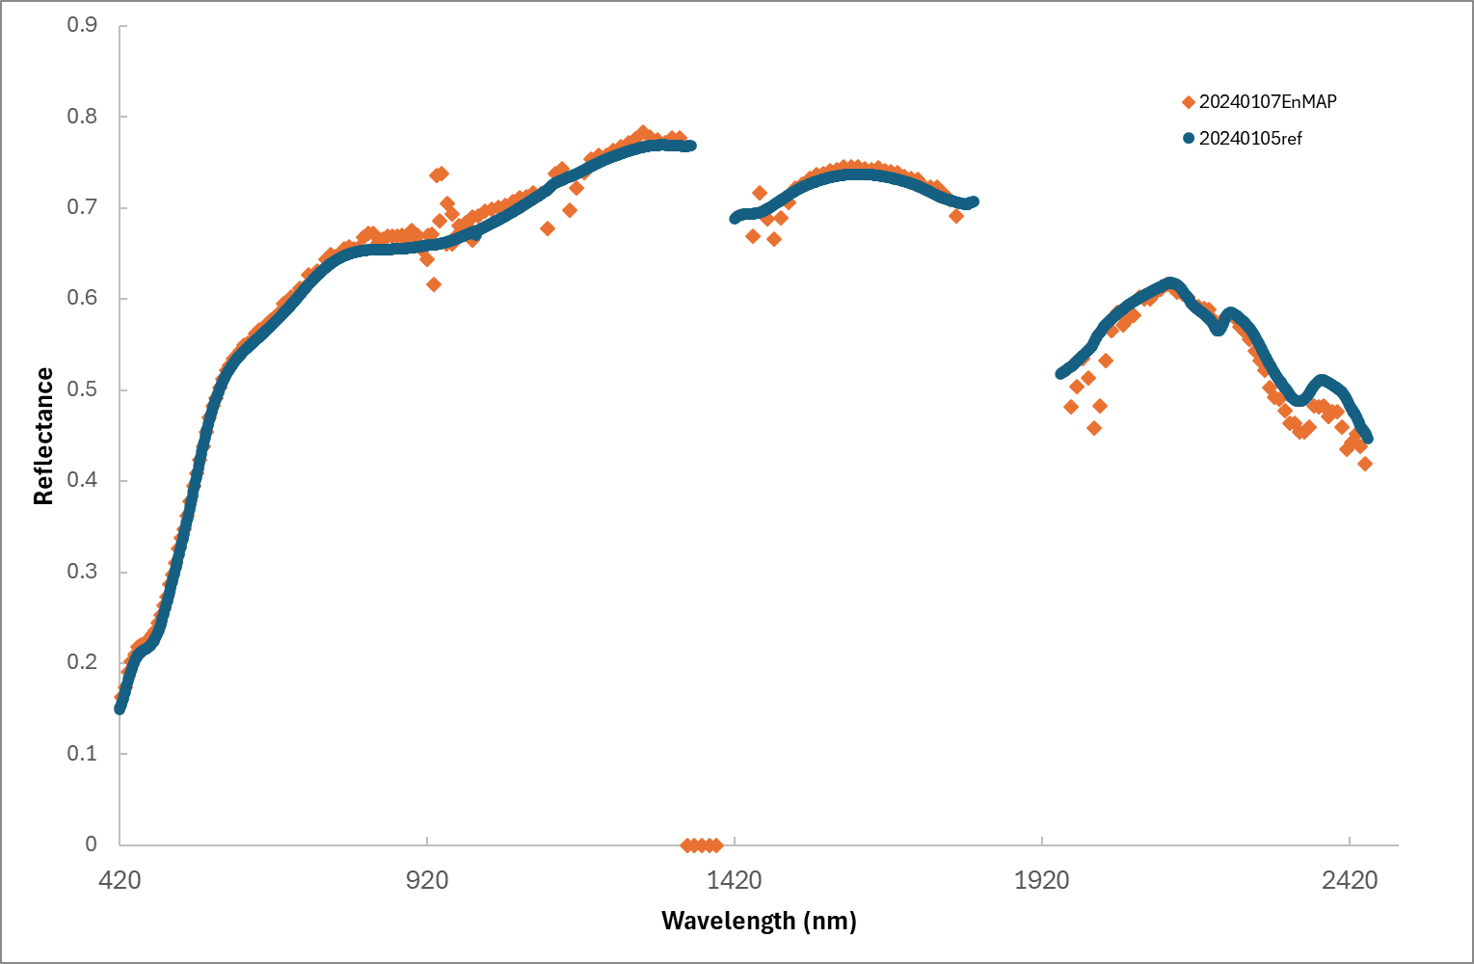
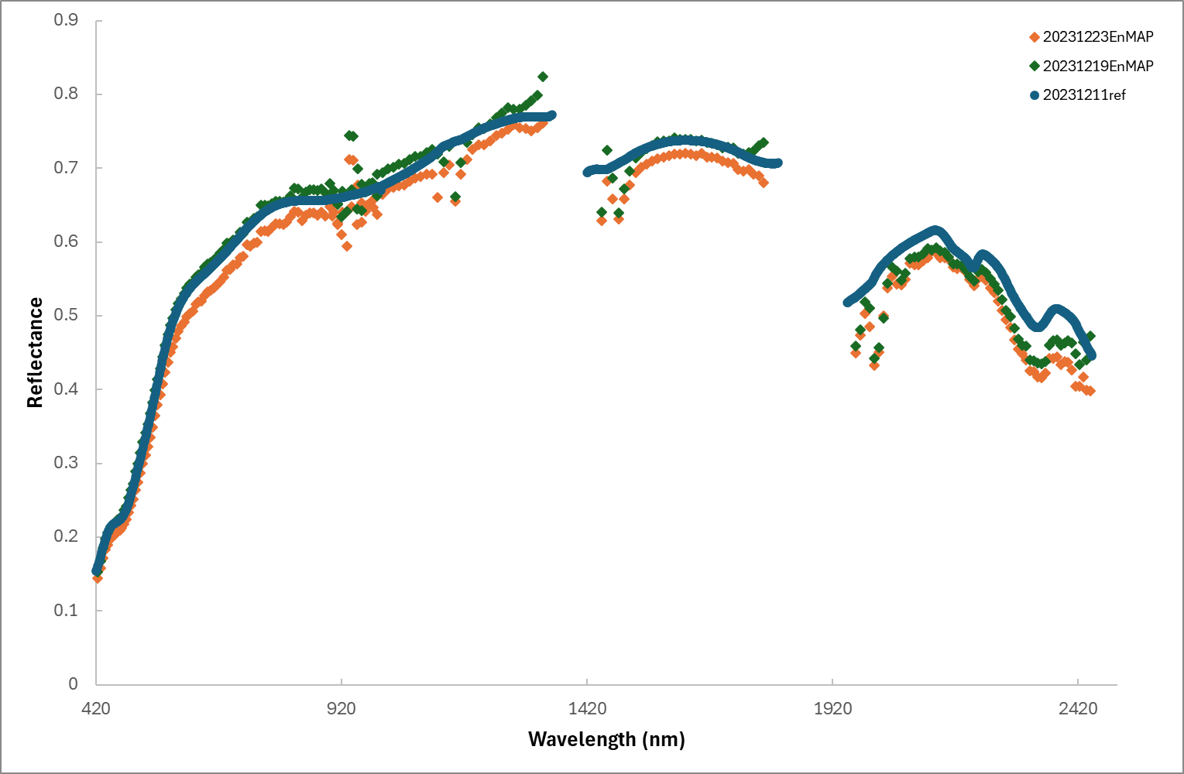
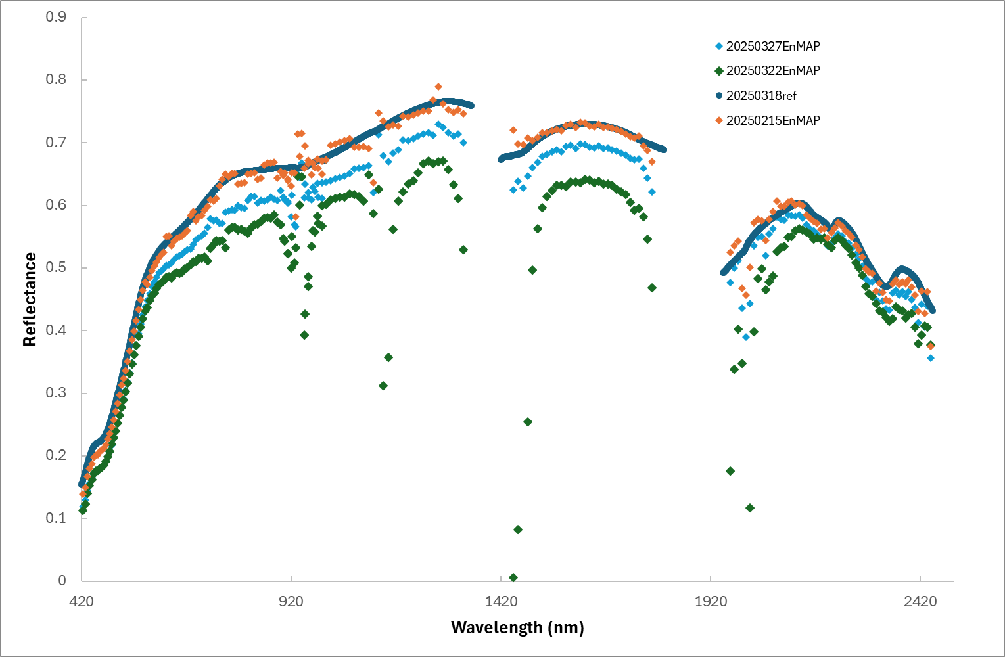
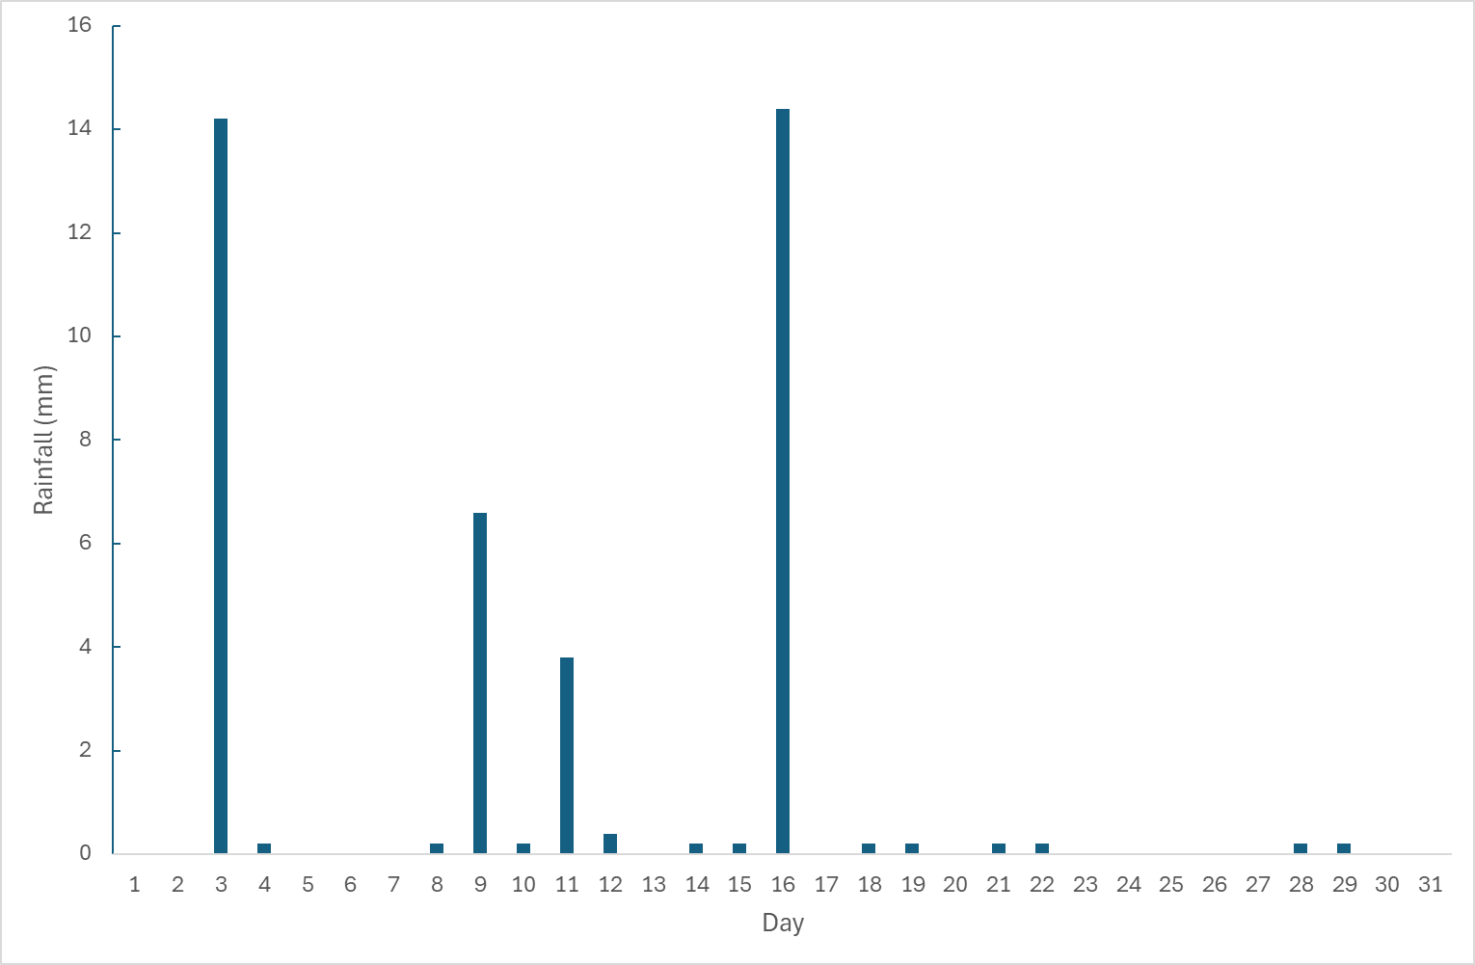
Temporal variations from field campaigns & EnMAP
ASD Field measurements
EnMap
Wet sand
Rainfall
Overpass/field

Slide 6
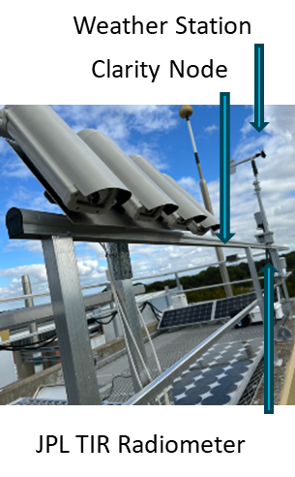
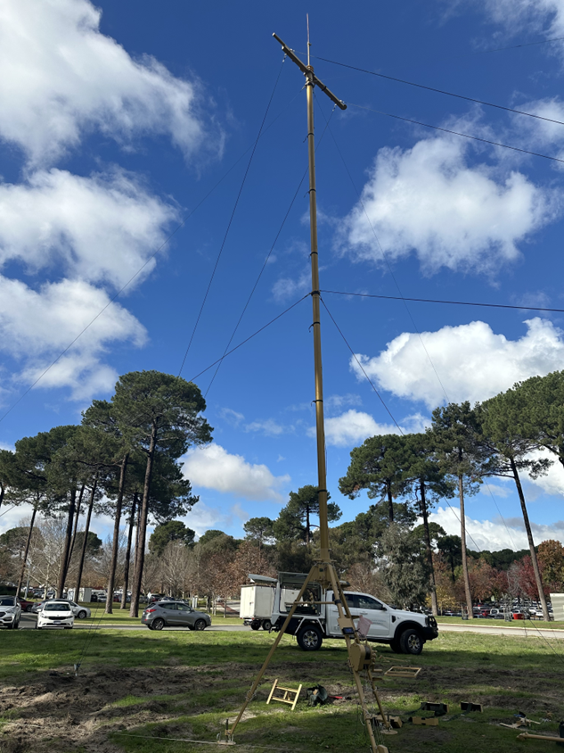
Hyperspectral & TIR
Heitronics & NASA JPL radiometer testing at CSIRO, Kensington, Western Australia.
New mast arrived for HYPSTAR® and JPL TIR radiometer in May 2025. Training completed in June 2025;
Awaiting platform for mast and HYPSTAR® instrument from NPL;
Considering installing JPL TIR radiometer and 4x Heitronics instruments on the existing mast in the meantime.

Slide 7
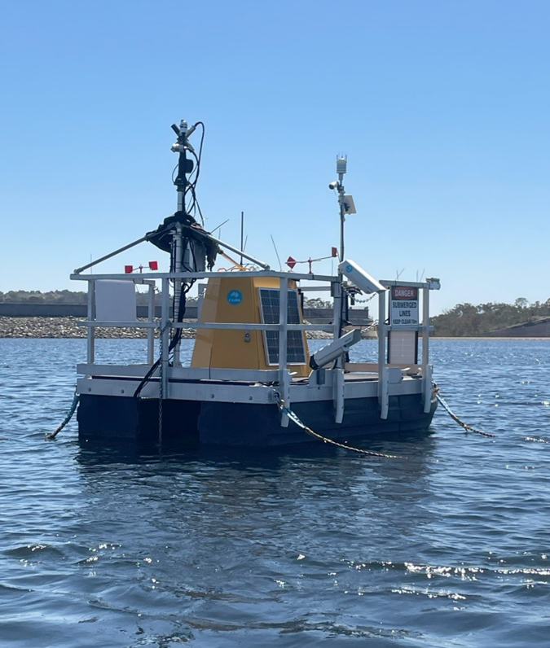
DION status & updates (June 2025)
Operational since Sept 2024.
Autonomous water surface measurements (every 15 minutes) with regular in-water observations.
Building a comprehensive database for water quality modelling and forecasting.
Operational Grafana dashboard monitoring for instrument performance.
Current modification of HyperCP code for instrument customisation and automation.
Workflow development for AquaWatch Data Service portal.
Documented System Engineering Design of DION.
Current instruments
Continuous operations with 3 sets of each TriOS Ramses E_{d}, L_{sky} and L_{w} (each sensor set characterised by Tartu Uni)
Pan/tilt unit
Weather station
Cameras horizontal and forward-looking
Water temperature (depths: 0.2, 3, 6, 9 & 12m)
Heitronics KT15.82 thermal radiometers
Autonomous power and communications
YSI EXO2 with WQ sensors (est. to be operational by October 2025)
CSIRO | DION Project Team | Janet Anstee, Gemma Kerrisk, James Taylor, Darius Culvenor*, David Benn, Albertina Diaz

Slide 8
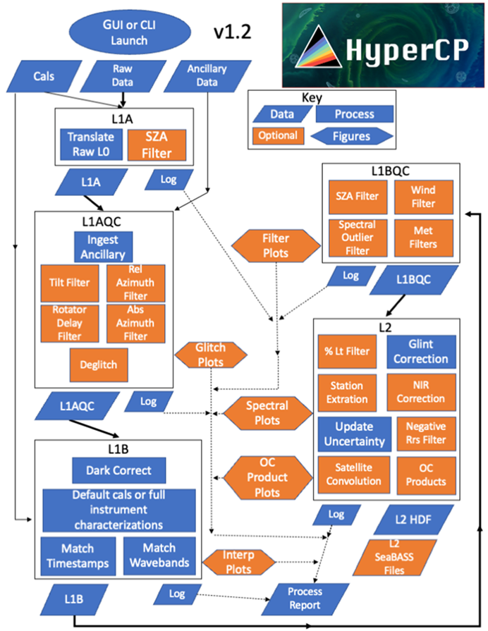
HyperInSPACE Community Processor (HyperCP)
Processes raw radiometric data using the cal/char files (from Tartu) to derive:
Remote-sensing reflectance, normalised water-leaving radiance, and uncertainty budgets following metrological standards.
CSIRO DION Team current work includes:
Debugging code, modifying code for DION instrumentation, error handling and automation.
Refining the DION2HyperCP workflow into Argo workspace.
Defining data delivery output formats and platforms, aligning with external databases (eg AODN, SeaBASS) and AquaWatch Data Portal.

Slide 9
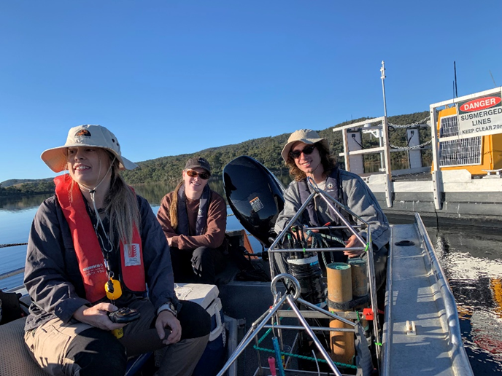
Next steps for deployment & operations
Finalise and test HyperCP automation.
Implement the FRM4STS protocols and data workflows for thermal radiometers.
Publish and maintain bio-optical database linked with surface reflectance, temperature and discrete measurements.
Third triplet of radiometers (Trios RAMSES) sent 10 June for Tartu Uni characterisation and calibration.
Deploy YSI EXO2 and implement workflow.
Gemma Kerrisk (CSIRO) attending the FRM4SOC workshop at Acqua Alta Tower, San Servolo, Italy 6-20 July 2025 https://frm4soc2.eumetsat.int/post/copernicus-frm4soc-2025-training-above-water-radiometry
gemma.kerrisk@csiro.au

Slide 10
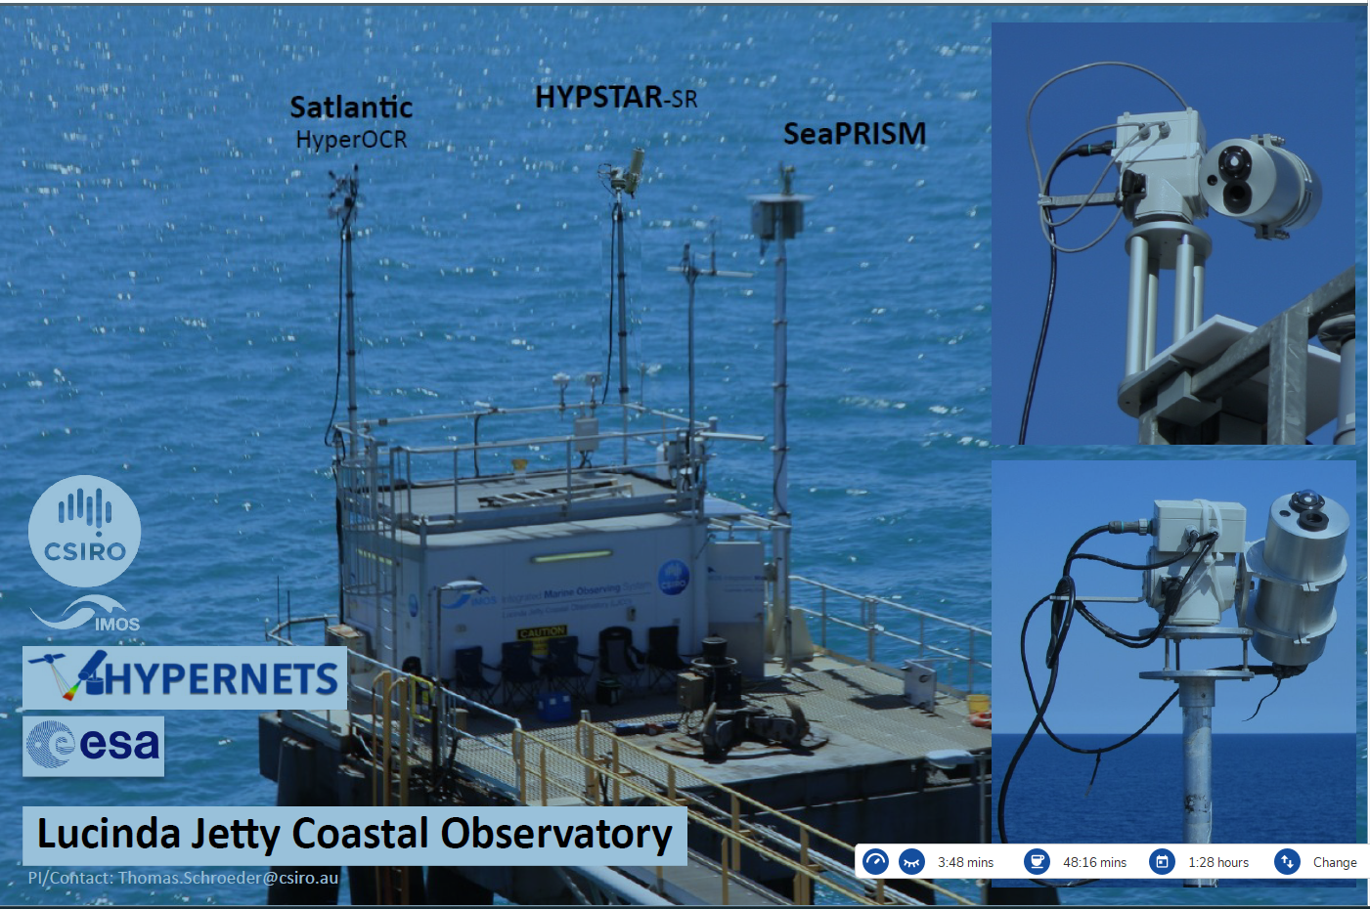
Lucinda Jetty Upgrades 2025
HYPSTAR-SR hyper-spectral radiometer funded by ESA
Cimel/SeaPRISM upgrade to T-model
Thomas.schroeder@csiro.au

Slide 11
Lucinda Jetty Upgrades 2025
HYPSTAR® - why another hyperspectral radiometer system?
Improved consistency checks and QC using 3 radiometer systems
HYPSTAR® will allow evaluation of different sky glint corrections – due to programmable viewing directions – also relevant for correction of HyperOCR
HYPSTAR® will allow evaluation/inter-comparison of uncertainty products (HyperOCR and satellite e.g. Sentinel-3 OLCI)
Synergy with USGS Landsat Next Project (Phase 1 – 2025-27)
Explore HyperCP for processing Lucinda HyperOCR – adding uncertainties
Compare HYPSTAR® uncertainties with HyperCP uncertainties
Evaluate consistency of HyperCP processing with SeaPRISM observations
Two new SeaPRISM radiometers – upgrade to T-model ($250K)
Additional IMOS funding to support HYPERNETS
0.2 FTE p/a + $12K (mast, shipments) until May 2027
To support installation, maintenance and data exploitation
Thomas.schroeder@csiro.au

Slide 12
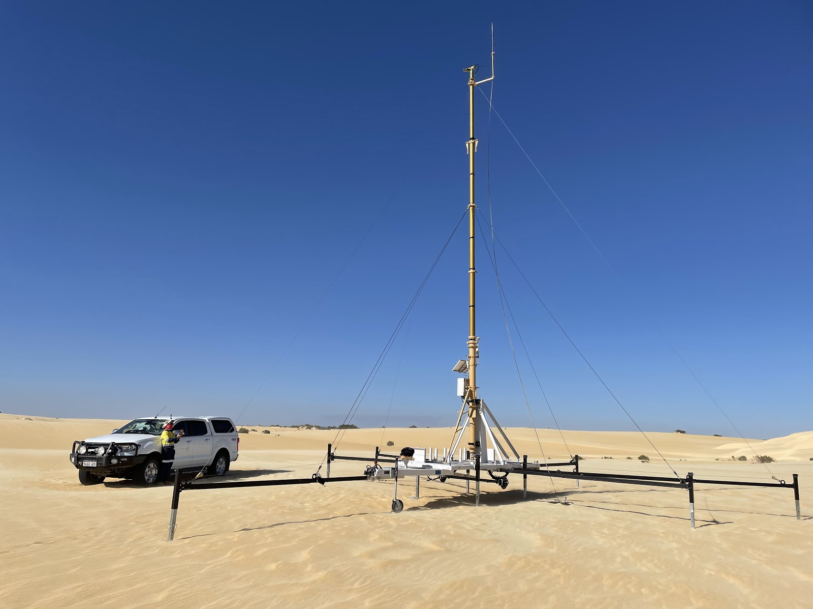
Operationalising Cal/Val Data
As part of Australia’s support of the USGS Landsat Next Mission, CSIRO is working with Geoscience Australia to “operationalise” collection of in-situ data from 3 existing permanent cal/val sites.
Currently putting systems, processes and personnel in place to:
maintain a high duty cycle of openly available data collection
minimise down time due to system issues or scheduled maintenance
align to CEOS best practice protocols and standards (RadCalNet and FRM4SOC).
Googong Dark-water Inland Observatory Network (DION)
Lucinda Jetty Coastal Observatory (LJCO)
Pinnacles Desert Optical Vicarious Calibration Site (PIAU)
Matt.Garthwaite@csiro.au

Slide 13
Pinnacles Desert Optical Vicarious Calibration Site (PIAU)
Cindy Ong Principal Research Scientist
t +61 8 6436 8677
e cindy.ong@csiro.au
w www.csiro.au
Lucinda Jetty Coastal
Observatory (LJCO)
Thomas Schroeder Senior Research Scientist
t +61 7 3833 5581
e Thomas.schroeder@csiro.au
w www.csiro.au
Googong Dark-water Inland Observatory Network (DION)
Janet Anstee
Group Leader
t +61 2 6246 5714
e janet.astee@csiro.au
w www.csiro.au
AusCalVal
Matt Garthwaite
Team Leader
t +61 492 166 671
e matt.Garthwaite@csiro.au
w www.csiro.au

