Slide 1

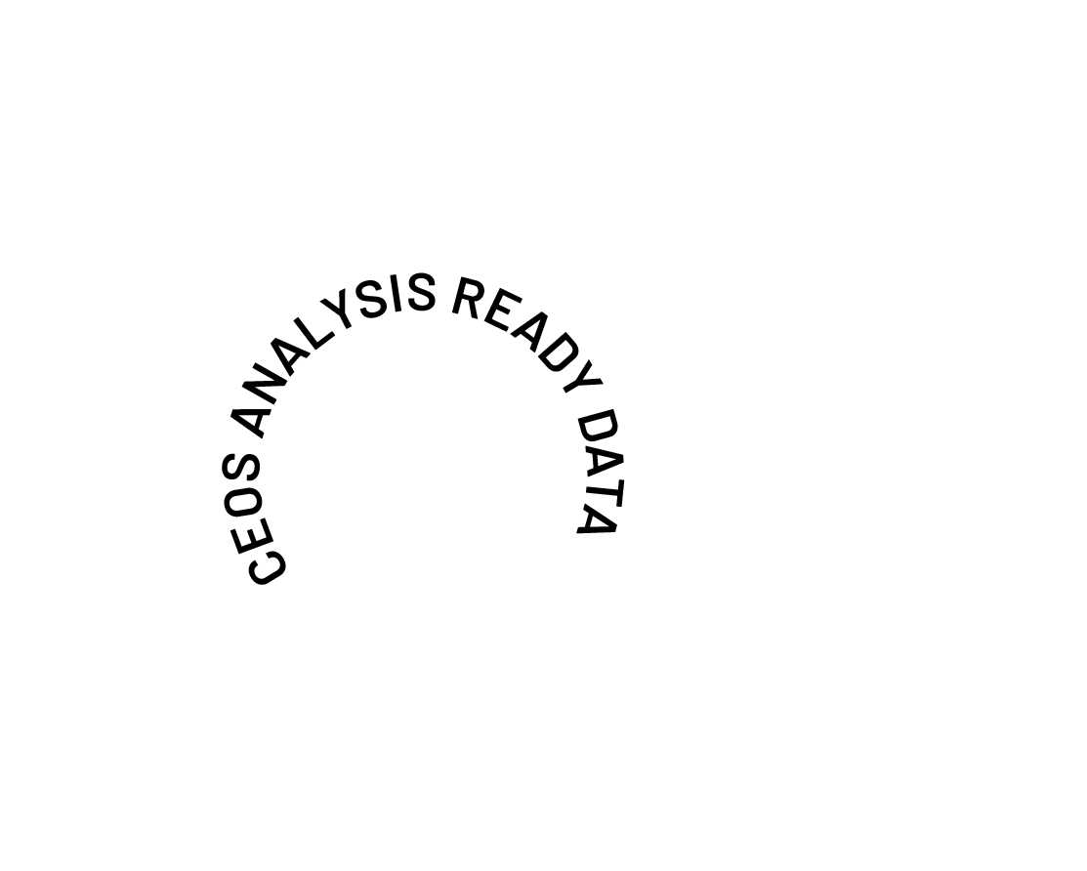
Surface Reflectance Quality and Consistency for CEOS ARD
Medhavy Thankappan
Simon Oliver
Josh Sixsmith
Geoscience Australia
LPS 2025 | Help shape the future of CEOS-ARD
ESA Living Planet Symposium 2025
Notes:
Hi and welcome to this presentation on Surface Reflectance Quality and Consistency for CEOS ARD.

Slide 2
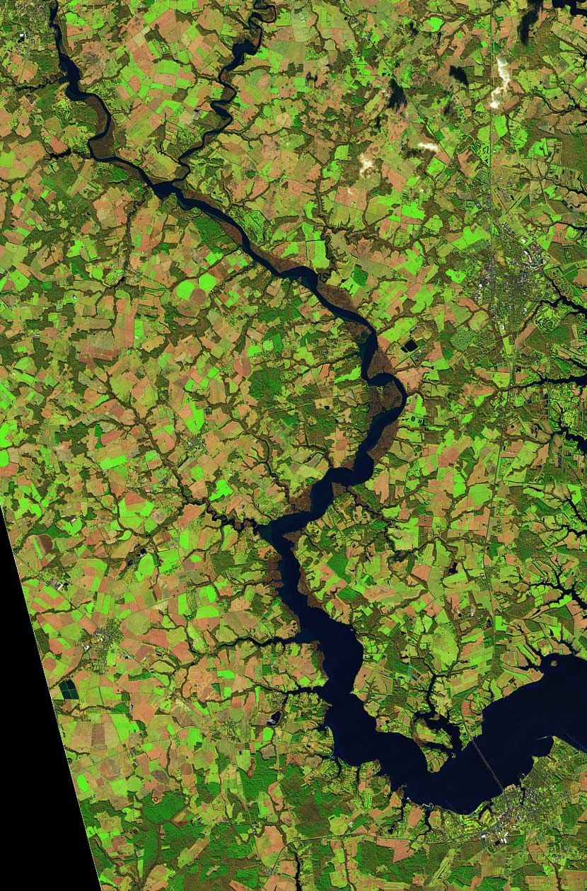
Background
The CEOS-Analysis Ready Data Product Family Specification (PFS) provides a strong basis for interoperability.
However, it tolerates different approaches for deriving the ARD, Surface Reflectance (SR) in particular. This affects the harmonisation of multi-sensor products, limiting their utility for applications requiring time-series data from several sources.
There is a need to continue building on the CEOS-ARD effort and developing approaches to achieve better harmonisation of multi-sensor data.
This proposal is about taking the next steps to support better harmonisation of CEOS-ARD Surface Reflectance products from multiple sources.
This is a status update on what is being done within CEOS – work in progress.
ESA Living Planet Symposium 2025
Notes:
To date, the CEOS Analysis Ready Data Product Family Specifications provides a strong basis for interoperability.
But tolerances for different approaches in deriving ARD can affect the harmonisation of multi-sensor products.
CEOS-ARD needs to evolve to answer the challenges faced by users today, and those of tomorrow.
This proposal is about how we better support harmonisation of CEOS-ARD surface reflectance products produced from multiple sources.

Slide 3
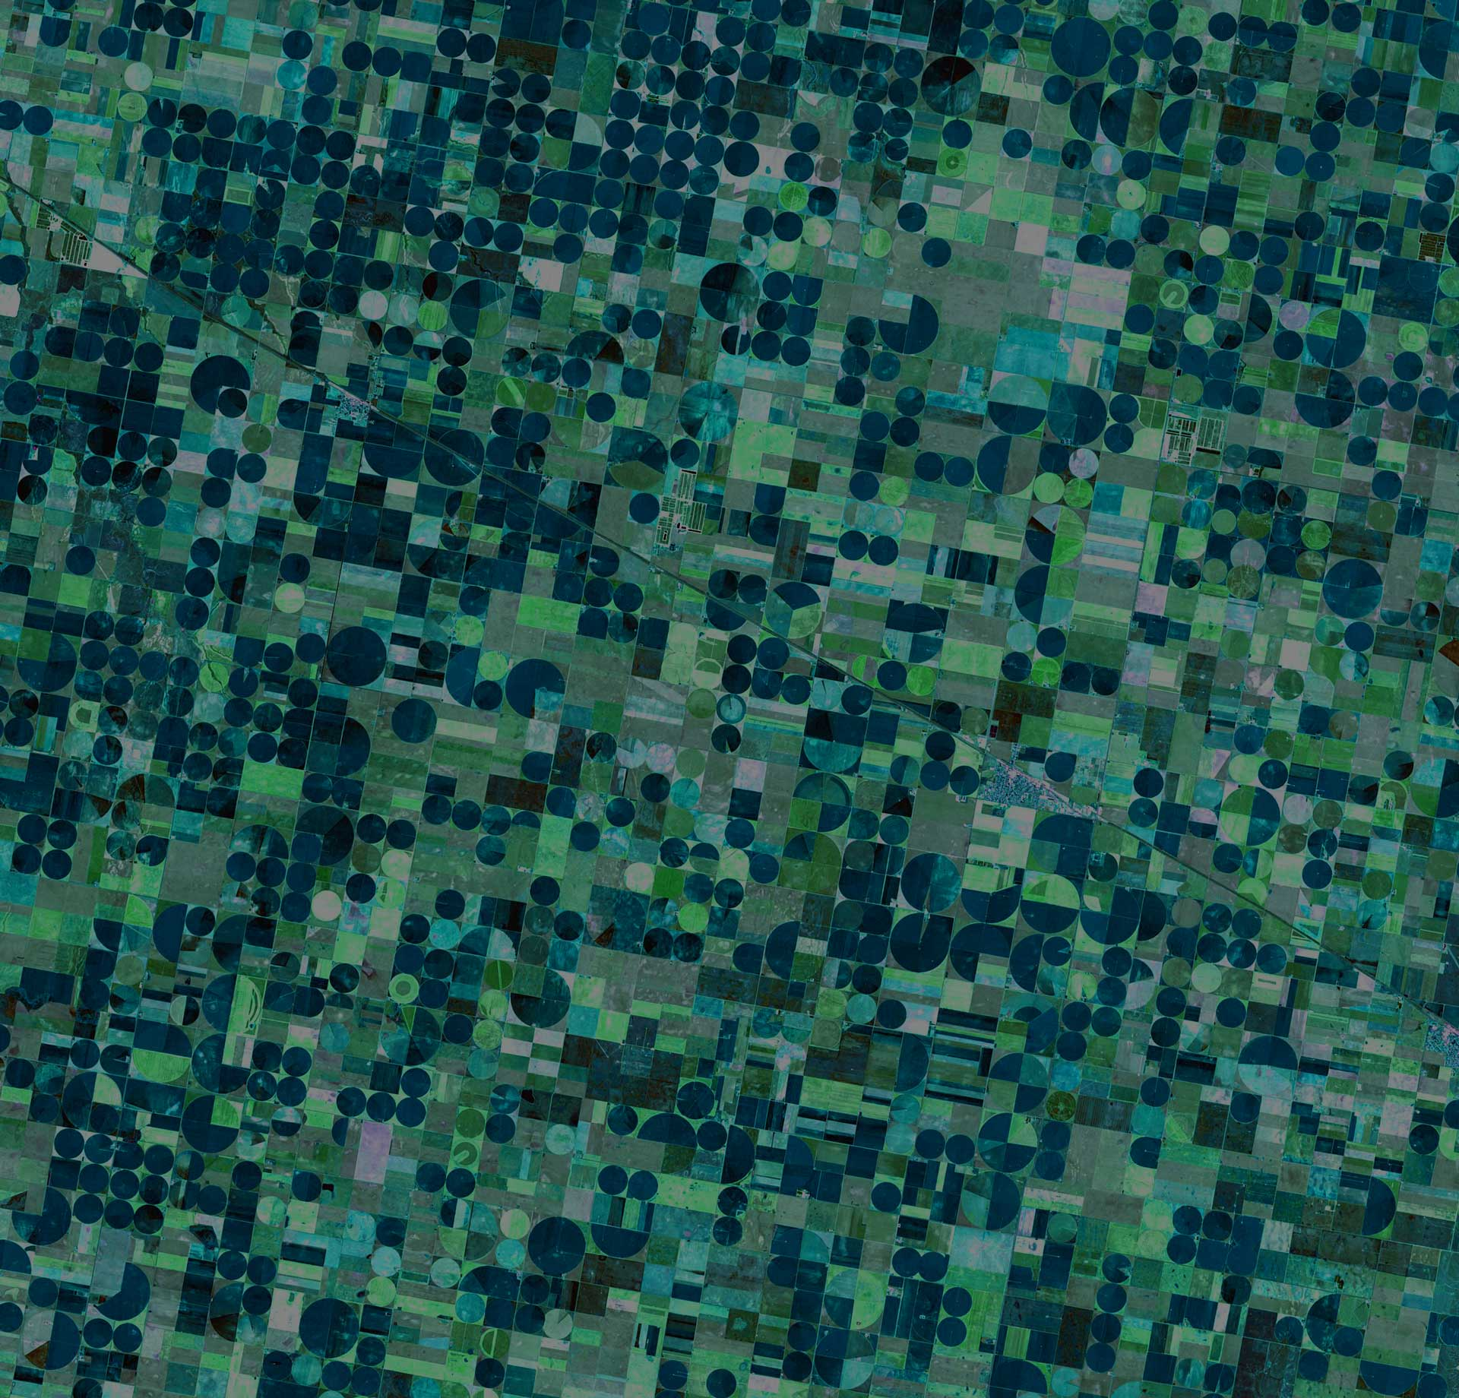
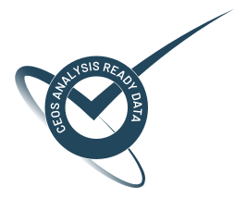

Title
Correction and Inputs | ESA S2 L2A Sen2Cor | USGS L2 LASRC | GA Lambertian | GA NBAR | GA NBART
BRDF Model | - | - | - | Ross Thick, Li Sparse
BRDF Parameters | - | - | - | MCD43A1 / VNP43
BRDF: solar angle | - | - | - | ✓ | ✓
BRDF: view angle | - | - | - | ✓ | ✓
Atmospheric: solar angle view angle | - | ✓ ✓ | ✓ ✓ | ✓ ✓ | ✓ ✓
Terrain illumination (slope/aspect/shadowing) | ✓ | - | - | - | ✓
Adjacency | ✓ | - | - | - | -
Pressure | default | Internal based on DEM | MODTRAN default atmospheric profile - DEM altitude adjusted
ESA Living Planet Symposium 2025
Notes:
This table is not extensive. There are many more rows describing the additional correction processes, and many more columns describing the different collective workflows or algorithms for producing surface reflectance.
But one thing is clear. All these methods produce something that is called surface reflectance, but they’re not necessarily interoperable.
Some apply viewing and solar geometry corrections, some do not. Same goes for terrain illumination correction and even adjacency correction.
I ask the users of CEOS ARD in the room, do you know what corrections are applied to the surface reflectance you’re using.
Over the past few days, I’ve seen a lot of talks mentioning time-series analysis of surface reflectance data, and I think to myself, “does the base surface reflectance model include a correction for the”solar zenith angle”. This correction alone is important for producing a stationary process, an important aspect when undertaking timeseries analysis. Stationarity is also a fundamental assumption of many statistical models such as an autoregressive model. Which in this day and age a lot of these statistical models are bundled under the banner of machine learning. So user beware.

Slide 4
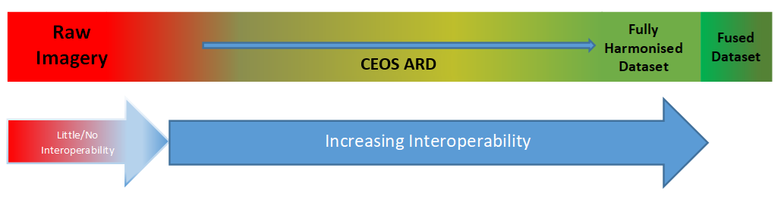
Why do we care?
Inconsistency in surface reflectance products from different providers limits combined use of multi-sensor data, performing impactful analyses and gaining deeper insights.
CEOS agencies' efforts in producing NASA HLS and ESA Sen2Like demonstrate the need to improve the compatibility of SR measurements across providers.
Planned major Collection upgrades (e.g. USGS – Landsat C3) provide an opportunity for input in support of better alignment and harmonisation of SR products.
CEOS-ARD is only the first step in the ‘interoperability continuum’, we need to plan the next steps to advance CEOS interoperability objectives.
ESA Living Planet Symposium 2025
Notes:
Why do we care?
Differences in surface reflectance products from different providers can impact users wanting to undertake multi-sensor analysis.
Algorithms like NASA’s HLS and ESA’s Sen2Like demonstrate the need for compatibility of surface reflectance across providers.
Also, USGS is planning a Collection-3 upgrade of the Landsat archive, and here’s an opportunity to input and help shape harmonisation of surface reflectance products.
In order to advance CEOS interoperability objectives, we need to plan the evolutionary phases of CEOS-ARD.
A key point to note, we’re not targetting a homogenised or fused product. We’re setting our targets at the harmonisation level.

Slide 5
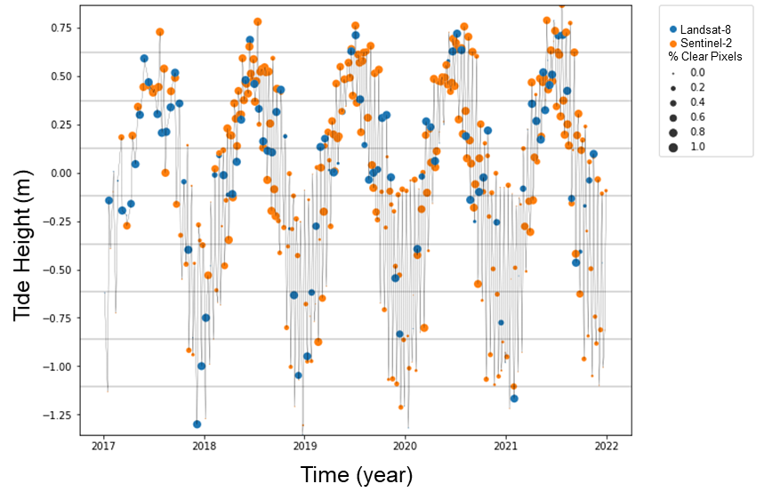
Harmonisation:synergies
By combining Landsat (blue) and Sentinel-2 (orange) data processed through the same workflow, a set of observations that best represent the tidal range in coastal northern Australia was achieved.
Credit: Robbi-Bishop Taylor,
Geoscience Australia
ESA Living Planet Symposium 2025
Notes:
This is an example of how Landsat and Sentinel compliment one another in analysing tidal ranges in coastal northern Australia. In this situation Landsat was able to acquire more clearer observations at low tide, while Sentinel-2 provided more clearer observations at high tide.
And together, they provide a denser time series of observations to better characterise both the high and low tides, and provide more reliable insights into monitoring the complex coastal dynamics of Australia presented yesterday by Stephen Sagar.

Slide 6
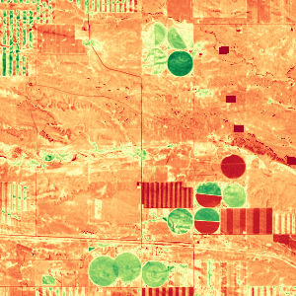
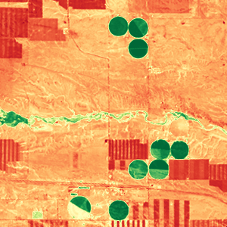
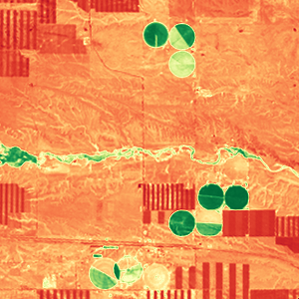
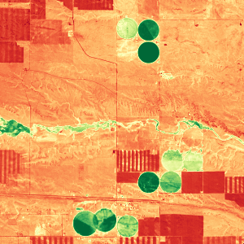
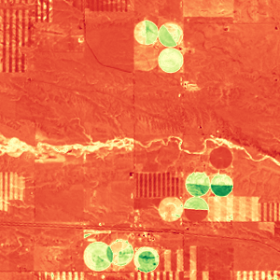

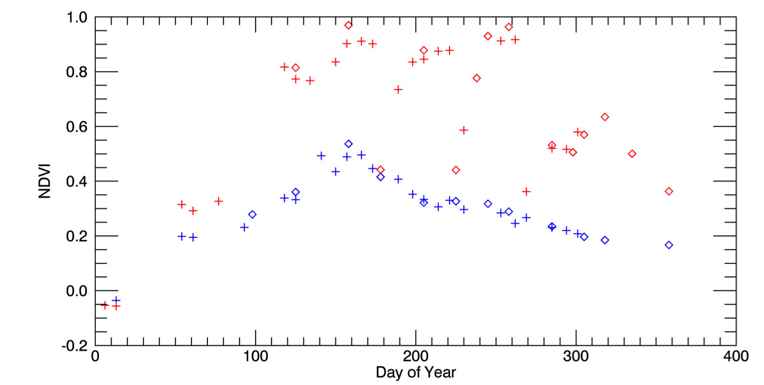
Harmonisation: better insights
Better insights into seasonal phenology could be achieved from Harmonised Landsat / Sentinel-2 data with high temporal density of observations.
May 4, 2016 (S2)
Aug 8 (L8)
Aug 17 (L8)
Sep 1 (S2)
Oct 20 (L8)
3km
0.1 NDVI 0.9
Example from the US: Seasonal phenology (greening) for natural grassland (blue line) and irrigated alfalfa fields (red line) near Cheyenne Wyoming observed from Harmonized Landsat/Sentinel-2 data products. The high temporal density of observations allows individual mowing events to be detected within alfalfa fields. HLS Products available from https://hls.gsfc.nasa.gov
Credit: Jeff Masek, NASA
Sentinel-2
Landsat-8
+
Alfalfa
NDVI
mowing
Grassland
ESA Living Planet Symposium 2025
Notes:
This example comes from HLS, and there was a great presentation this week on HLS 2.0. And fundamentally what it demonstrates is that by utilising multiple sensors, that have undergone both a harmonisation and homogenisation or fusion process, a denser time-series is achievable. Not only that, but key mowing or cutting events of the alfalfa were observed, whereas with one sensor alone such insights would be more difficult to identify, or even completely missed.

Slide 7
Proposal
Build on CEOS-ARD achievements so far, take next steps to achieve multi-sensor interoperability.
Unambiguous characterisation of the SR measurand in the context of CEOS-ARD products.
Identify a set of corrections for achieving better SR consistency in support of harmonised CEOS-ARD SR products.
ESA Living Planet Symposium 2025
Notes:
The proposal put forward was to build upon the existing CEOS-ARD and achieve multi-sensor interoperability.
What was needed was to characterise the surface reflectance measurand and identify a set of necessary corrections for achieving surface reflectance consistency

Slide 8
Benefits
Consistent time-series across sensors, steps towards enhanced harmonisation amongst CEOS-ARD SR products.
Focused effort on value-adding with a common foundational measurand, improved results from multi-sensor analyses, and better insights.
Reduced duplication of effort, cost savings, increased global applicability of algorithms, higher return on investment.
ESA Living Planet Symposium 2025
Notes:
By ensuring a common foundational measurand, users are provided with greater assurance that they can get to down to business quicker and uncover more insights in their data.
Through global efforts, common problems can be resolved thereby reducing the replication of effort. Ultimately, this can provide major cost savings to data providers which in turn enables them to continue to provide ever more data from more satellites and sensors.

Slide 9
Key objective
Describe a surface reflectance measurand (in the CEOS-ARD context), for achieving consistent quality, and generating harmonised surface reflectance products from different sensors with like bands.
ESA Living Planet Symposium 2025
Notes:
The main objective of this group is to describe a surface reflectance measurand that enables producers to generate harmonised surface relectance products that interoperate with different sensors, whilst still ensuring the highest level of qualiity and consistency.

Slide 10



Conceptual model (current)
Illumination conditions
A
B
A
Datasets A and B
Reflectance
B
A B
Atmospheric correction
BRDF correction
Terrain Illumination correction
Adjacency correction
Solar angle normalization
Target characteristics
Time
Surface Reflectance Profiles
ESA Living Planet Symposium 2025
Notes:
To give a pictorial representation of what we’re talking about, here is a conceptual model of the current situtation. We have multiple datasets produced from differing sensors, comprising of different correction methodologies, under different viewing and illumination angles. Now for some applications this might be fine, but for other applications, the resulting measurements are too different to be interoperable thus posing another problem that a user needs to solve before they can undertake their analysis.

Slide 11
Conceptual model (desired)
Reflectance
A+B
Harmonised datasets
A B
Atmospheric correction
BRDF correction
Terrain Illumination correction
Adjacency correction
Solar angle normalization
Time
Surface Reflectance Profile
ESA Living Planet Symposium 2025
Notes:
This is the conceptual model for the desired future. Datasets from different sensors, under different lighting and viewing conditions are now more interoperable. Therby enabling users to get more out of their data with less effort, and derive insights not only quicker but also more reliably.

Slide 12
Review of activities
Original concept first presented at ARD23 Workshop, exposure document of the concept presented at WGCV-52 in June 2023, then at LSI-VC 14 in October 2023, revised concept paper presented at WGCV-53 in March 2024.
Following feedback, engaged the expert community after a call for ‘Expressions of Interest’ to participate in the Surface Reflectance Quality, and Consistency initiative.
Fortnightly meetings of the expert group continue, initial discussions focussed on terminology to enable shared understanding of objectives for the work.
Subsequent effort to document the discussions that could support interoperability initiatives within CEOS (Interoperability Framework, Handbook 2.0, led by WGISS).
Presentation at VH-RODA 2024 followed by workshop in January 2025, adoption of the initiative as a part of the CEOS Work Plan
A guidance document on the SR quality and consistency initiative is in development
ESA Living Planet Symposium 2025
Notes:
(Revide of activities)
The original concept was first presented at the ARD23 workshop.
Following feddback from the Working Group on Calibration and Validation sessions 52 and 53, and Land Surface Imaging – Virtual Constellation session 14, expressions of interest were sought from the expert community with initial discussions focussed on terminology to both clarify and understand the objectives.
Post the January 2025 workshop there was addoption of this initiative as part of the CEOS Work Plan.
Still in development, is the guidance document from the surface reflectance quality and consistency initiative.

Slide 13

Plan of action
Publish
Develop guidance
Identify / address gaps & sensitivities
Review literature
Engage experts
ESA Living Planet Symposium 2025
Notes:
(Plan of Action)
Where are we right now. We’ve sought expressions of interests from a community of experts across diverse fields.
In reviewing the literature; we’re asking ourselves “what is that users are doing to data right now to overcome inherent problems in order to undertake the analysis they wanted to do in the first place”. The findings from the literature review will input to the demonstrable evidence that ultimately support the decisions made by the group.
Next is to further identify potential gaps and sensitivities with the proposed solutions. This includes informing users of both the benefits and the implications of such a product.
After which, we develop the guidance document for achieving quality and consistency in surface reflectance.
And finally, publish.

Slide 14
Literature themes
Theme | Description
Introduction and Definitions | Overview of surface reflectance, its significance for remote sensing applications, and key foundational terms.
Atmospheric Correction Algorithms and Inter-Comparisons | Studies on atmospheric correction methods, comparative evaluations of algorithms, and assessments of correction accuracy.
BRDF Normalisation and Topographic Correction | Research on bidirectional reflectance distribution function (BRDF) normalisation and terrain/topographic correction to mitigate angular and elevation-related effects.
Traditional Inter-Sensor Harmonisation (Landsat–Sentinel-2) | Literature on physics-based methods for harmonising surface reflectance between different satellite platforms, particularly Landsat and Sentinel-2.
Surface Reflectance Product Evaluations and Datasets | Analyses of global and regional SR products, including validation studies and assessments of consistency, reliability, and temporal coverage.
Validation and Uncertainty Quantification | Research focused on validating SR data using ground-truth (in situ) measurements and approaches for quantifying uncertainty in reflectance estimates.
Machine Learning and AI-Based Harmonisation | Studies leveraging machine learning and artificial intelligence to harmonise reflectance across satellite sensors, with a focus on non-physics-based techniques.
Other Topics (not covered above) | Additional or emerging topics in surface reflectance not covered in the above categories.
ESA Living Planet Symposium 2025
Notes:
As part of the literature review, we’re also grouping the findings into different themes suchs as ML and AI, BRDF normalisation and topographic corrections, atmospheric corrections and inter-comparisons, validation and uncertainty quantification.
This gives the group an idea of the common problems that users today are having to overcome in order to undertake the analysis that they’re wanting to focus on.

Slide 15
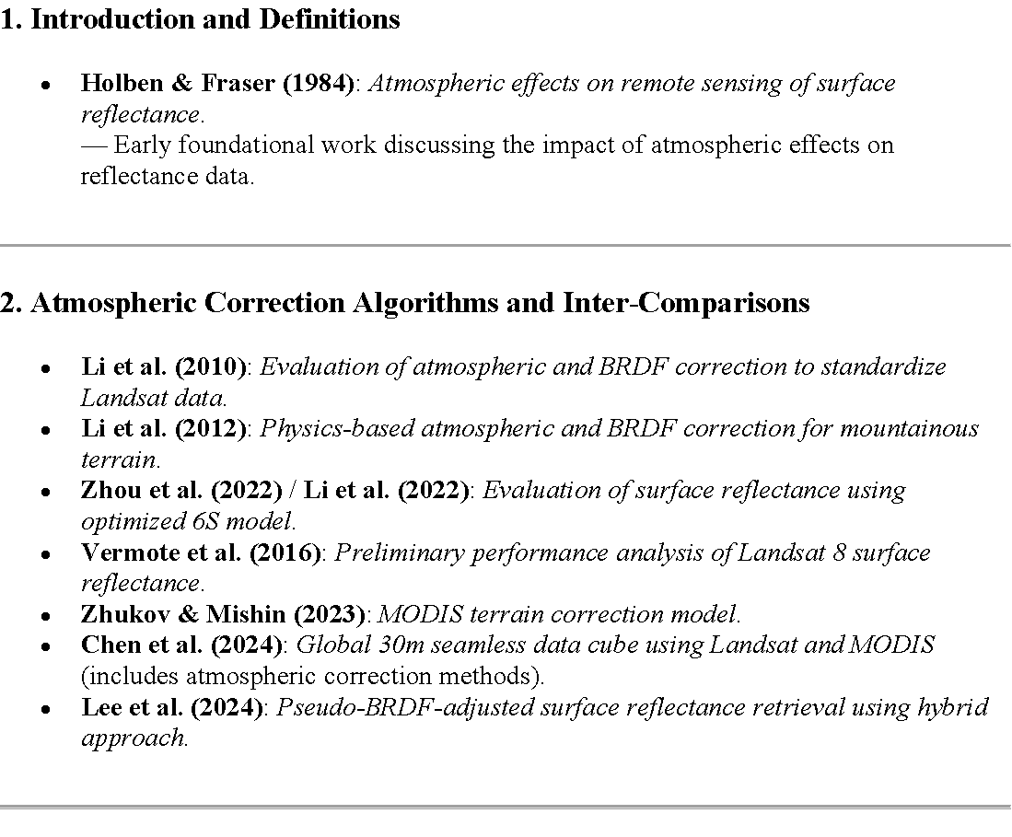
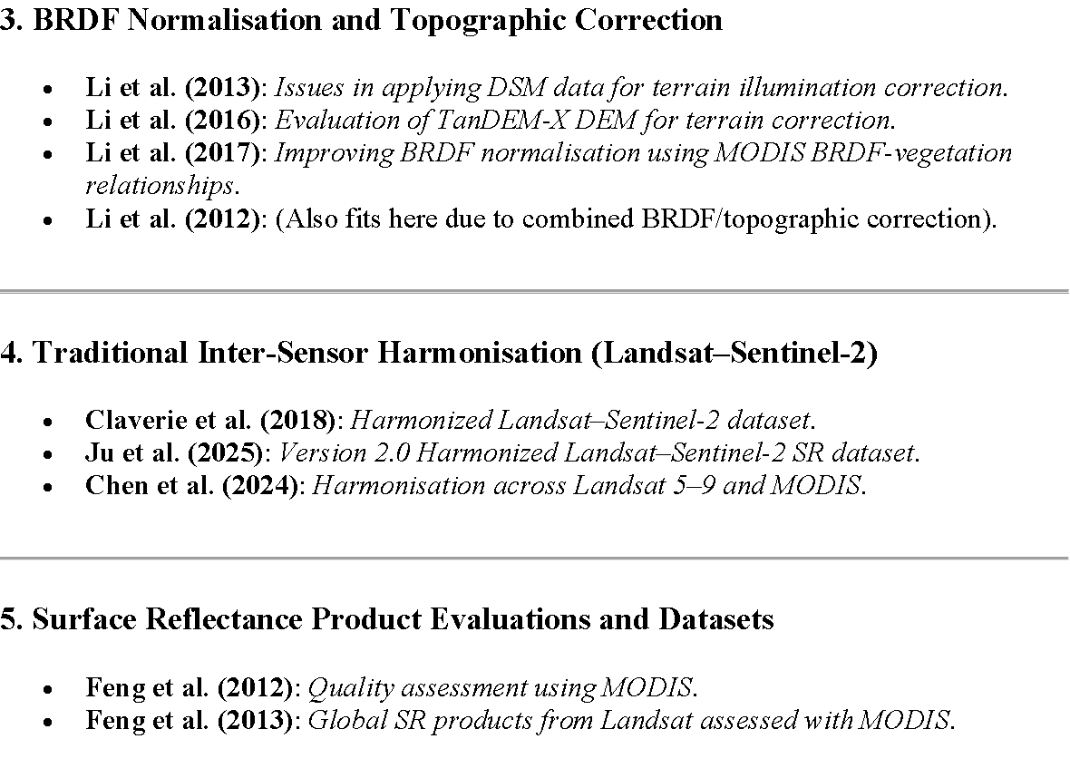
Literature grouping
ESA Living Planet Symposium 2025
Notes:
Here’s a small sample of the literature gathered to date, and how they’ve been grouped into different themes.
Through this grouping exercise, we expect to undertake a basic frequency analysis of these themes, which may offer additional insights into the problems that users face. But more importantly, help form the basis of what corrections are required for a harmonised state of surface reflectance.

Slide 16
Expert community
Contributor | Organisation
Eric Vermote | NASA
Martin Bachmann | DLR
Peter Strobl | EC
Robert (Bob) Ryan | I2R
Mary Pagnutti | I2R
Raquel de Los Reyes | DLR
Simon Oliver | GA
Medhavy Thankappan | GA
Dani Schläpfer | ReSe
Contributor | Organisation
Rudolf Richter | DLR
Fuqin Li | GA
David Jupp | CSIRO
Cody Anderson | USGS
Sebastien Saunier | Telespazio
Steve Covington | USGS
Fabrizio Niro | ESA
Danika Wellington | USGS
Nimrod Carmon | NASA-JPL
Contributor | Organisation
Crystal Schaaf | U Mass Boston
Grit Kirches | Brockmann
Angela Erb | U Mass Boston
Nigel Fox | NPL
Josh Sixsmith | GA
ESA Living Planet Symposium 2025
Notes:
Here’s a list to date of the people who’re involved in this surface reflectance quality and consistency group to ultimately define a surface reflectance measurand.

Slide 17














Contributor affiliations
ESA Living Planet Symposium 2025
Notes:
And their affiliations

Slide 18
Summary
Characterise SR measurand for producers to build against
Multi-sensor data is complimentary
Richer/denser time-series
Enable a range of future users of EO SR data
ESA Living Planet Symposium 2025
Notes:
(Summary)
More data; but also more data that is interoperable with one another. Who wouldn’t want that?
Denser time series opens up more analytical opportunities to discover new insights.
Satellites/sensors from different providers can complement one another, so we needed constrain ourselves to just one sensor or mission. Having more observations over an area is a bit like crowdsourcing a solution to solve real environmental problems. But potentially also providing more assurance for derived applications or products.
And finally, enable a range of future users of earth observation surface reflectance data to discover new insights.

Slide 19
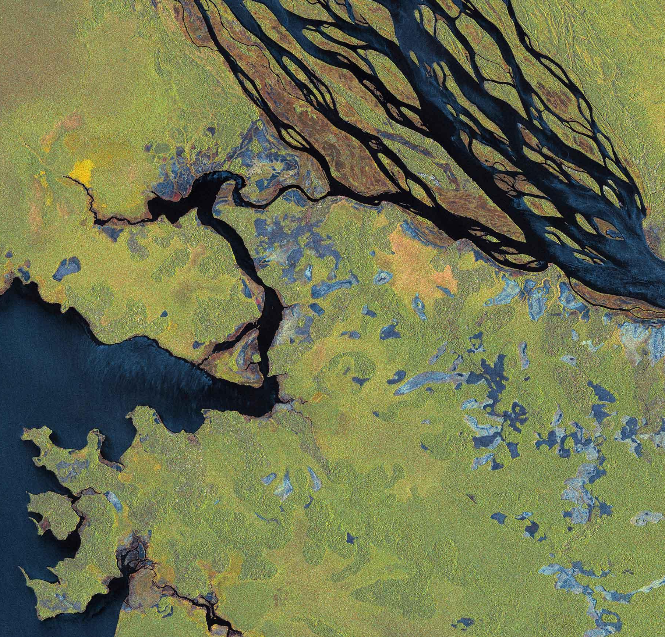
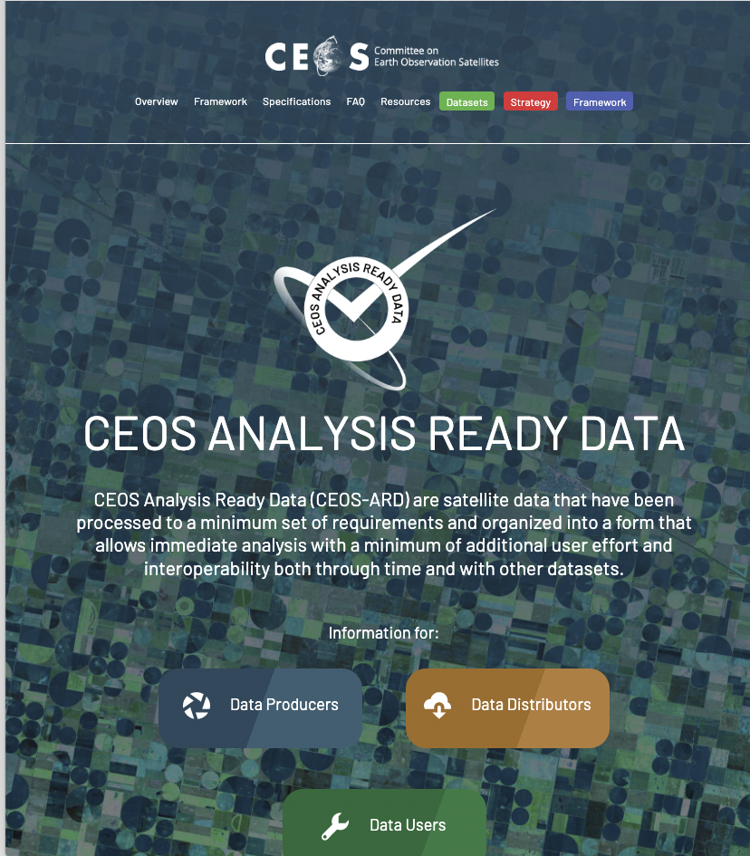
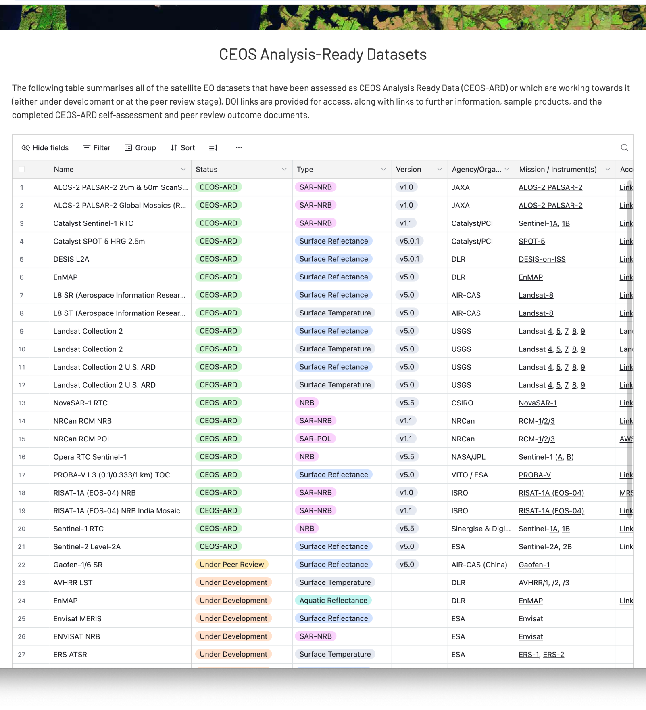
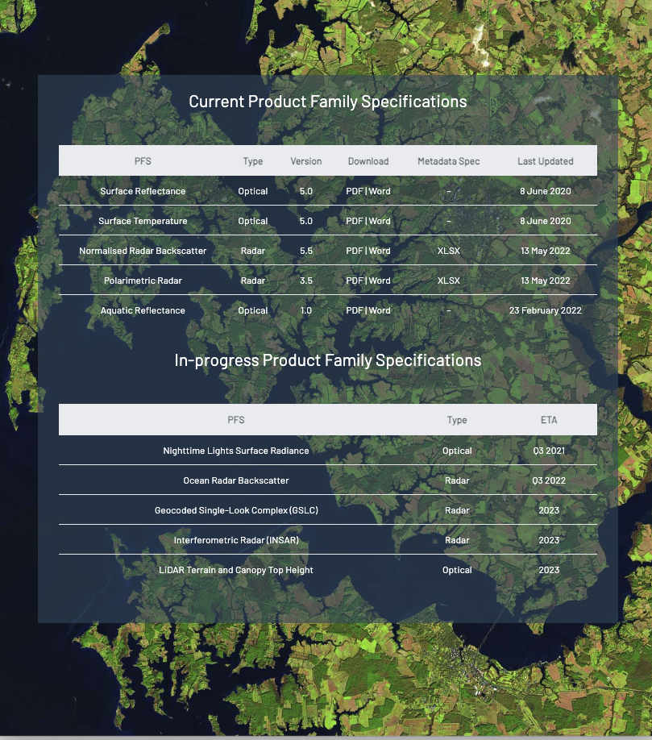

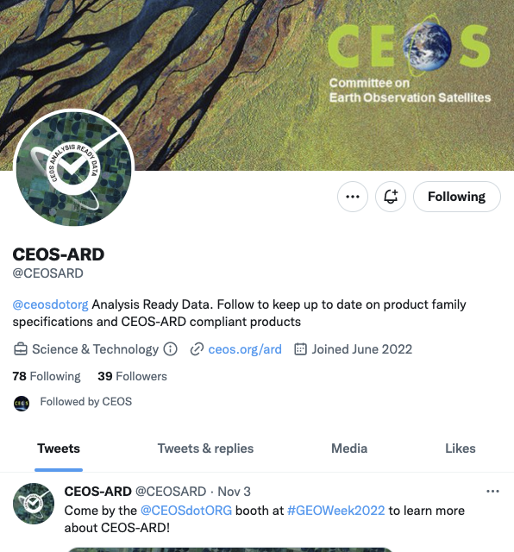
Connect & Learn More
CEOS-ARD Website
CEOS-ARD GitHub
CEOS-ARD Newsletter Sign-up
CEOS-ARD Newsletter Archive
Social Media
LinkedIn
Facebook
X
👉 Contact us to get involved or explore collaboration opportunities
Ferran.Gascon@esa.int and matthew@symbioscomms.com
ESA Living Planet Symposium 2025
Notes:
Please get in touch to connect and learn more. There’s the CEOS-ARD website, GitHub, newsletter, and various social medias, and of course email.

Slide 20

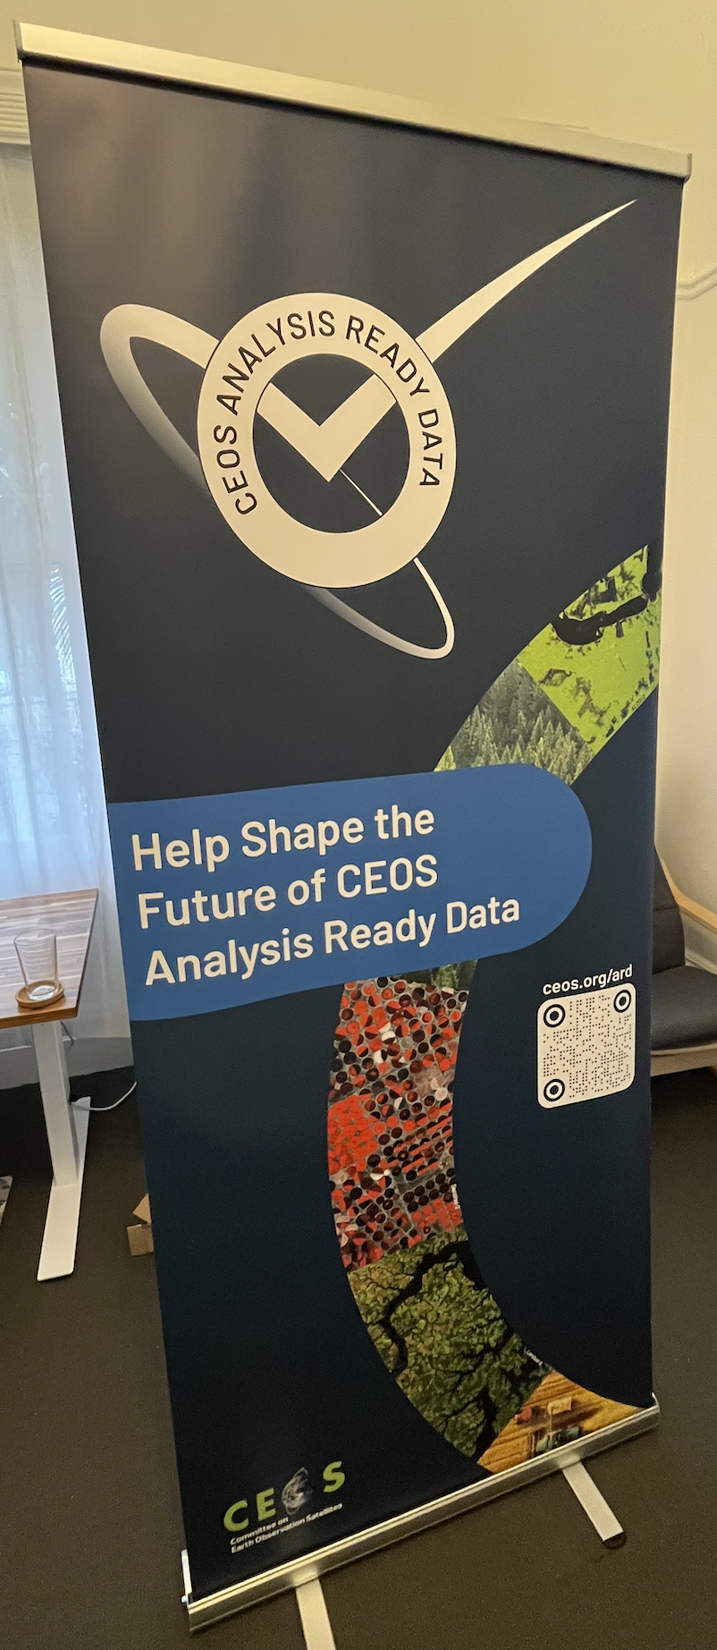
Join the Conversation — Help Shape the Future of CEOS-ARD
✅ Complete the Future of
CEOS-ARD Questionnaire
📍 Visit us at the
CEOS Booth
ESA Living Planet Symposium 2025
Notes:
We encourage everyone to get involved; CEOS needs your input to know what you want and what you expect of your data. Please fill out the questionnaire to help drive what the Future of CEOS-ARD will be. And come visit the booth located on Level-1 to learn more about CEOS, the other CEOS initiatives and working groups.
Thank you for your time.

