Slide 1
WGCV-55 Report from ESA WS on Surface Reflectance Characterisation and Validation
Fabrizio Niro (Serco/ESA), Nigel Fox (NPL)
Agenda Item 2.11, WGCV-55
Hyderabad, India, 8-10 July 2025

Slide 2
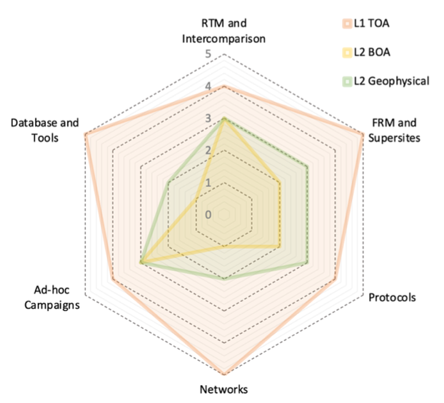
Background and Context
SR is a common product of all satellite optical imaging sensors and a key input for a wide range of applications.
Harmonizing SR products across missions is hence essential to ensure interoperability and consistency.
Despite of that, inconsistencies remain:
Lack of consensus on terminology
Disparities in algorithms and Ca/Val practices
Scarcity of reference datasets.
Niro et al., 2021
Readiness level of a generic validation framework for satellite optical imaging sensors when considering various products level: L1 TOA, L2A BOA and L2B geophysical products.

Slide 3
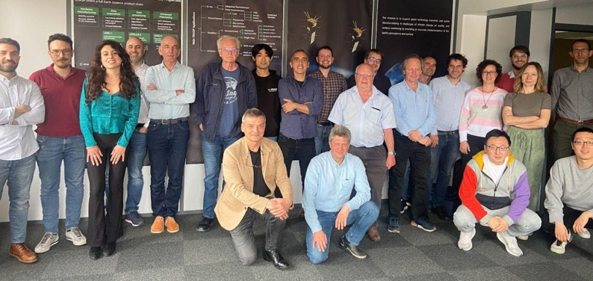
Workshop objectives
To move forward, ESA organized a WS in Lille gathering experts involved in current ESA projects on SR retrieval / validation
Objectives
Review current SR retrieval methods and reference datasets
Identify gaps and limitations, e.g., for CHIME and S-2/3 NG Cal/Val
Recommendations and roadmap for ESA’s strategy for SR validation.
GRASP, Lille, France (21–22 May 2025)

Slide 4
Agenda
Agenda included contributions from:
GROSAT: build set of reference data over AERONET sites using the GRASP algorithm
Eradiate: develop new open-source 3D RTM to support Cal/Val applications
3DREAMS: study effect of surface heterogeneity and 3D effects on surface/aerosol retrievals
FRM4VEG: working towards community practices for SR, LAI, fAPAR validation
HYPERNETS: establish a hyperspectral ground-based network for SR validation
Reports/feedback from RadCalNet (M. Bouvet, ESTEC) and AERONET (Elena Lind, NASA)

Slide 5
Discussion topics
The discussion revolved around the following main topics:
Definitions and terminology
Retrieval algorithms and models
Validation Methods
Reference datasets

Slide 6
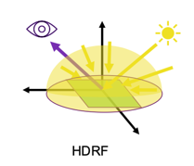
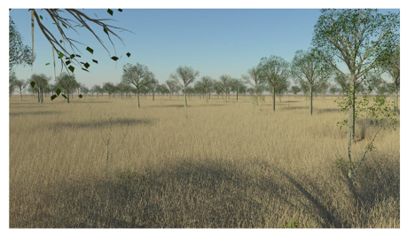
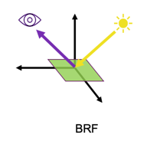
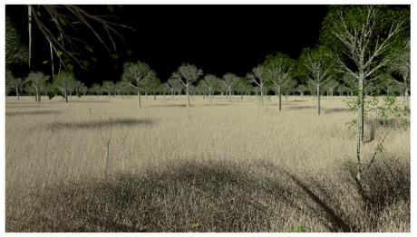
Definitions and Terminology
Consensus on two basic SR quantities:
HDRF only measurable quantity, though not an intrinsic surface property, as it depends on illumination / environmental conditions.
BRF surface-inherent property, but not directly measurable in the field, it can be derived by fitting a set of HDRF measurements + BRDF model
Recommendations:
Ground-based data: HDRF + atmospheric state + tools to derive BRF → Rationale: HDRF unchanged, BRF can improve as modelling evolves
Satellite data: ideally both HDRF and BRF, as a minimum HDRF + a toolbox to derive BRF

Slide 7
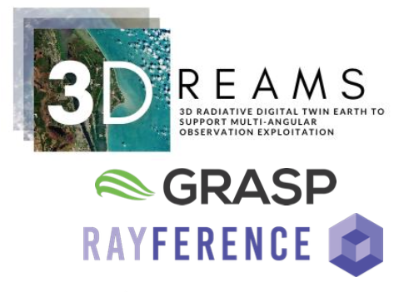
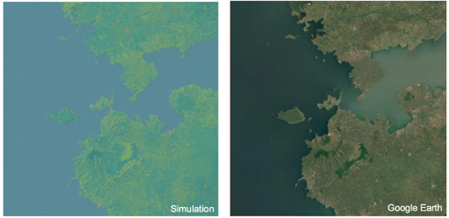
Retrieval algorithms and models
Joint retrieval essential to resolve surface/aerosol radiative coupling, limitations :
Legacy BRDF models (e.g., RPV, RTLS), developed for coarse resolution, e.g., AVHRR, MODIS.
Underlying assumptions (1D, uniformity), break down at 10m under strict uncertainty requirements (<3%).
Demonstrated impact of 3D effects in retrieving surface / aerosol properties at high resolution.
Recommended to perform 3D RTM simulations for better characterising adjacency effects over RadCalNet, HYPERNETS, Cal/Val Park

Slide 8
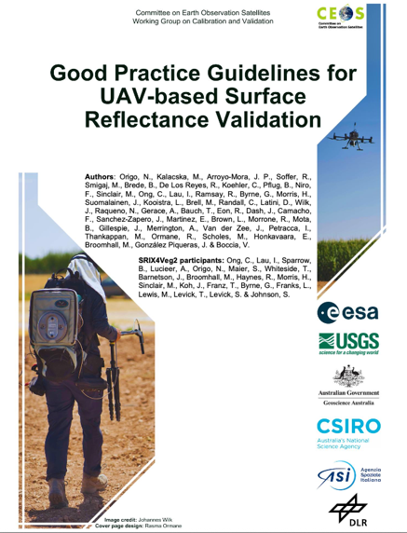
Validation Methods
Challenge of spatial upscaling.
Uncertainty associated to transformation of FRM to the satellite pixel not fully characterised and often driving the overall budget
Drones high spatial-temporal sampling, bridging gap point measurement to satellite pixel.
Recommend to address this issue with modelling approaches, and UAV, with a focus on RadCalNet, HYPERNETS sites.
Goal is the detailed characterisation of spatial mismatch uncertainty
Origo et al., 2025
Bialek et al., 2025: FRM Maturity of HYPERNETS Land

Slide 9
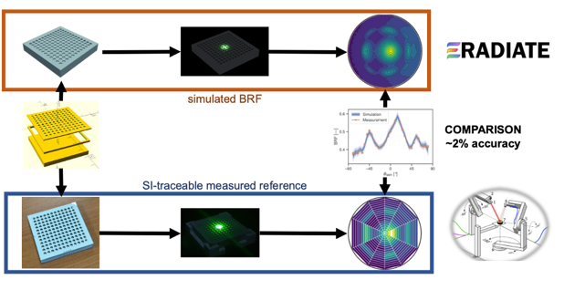
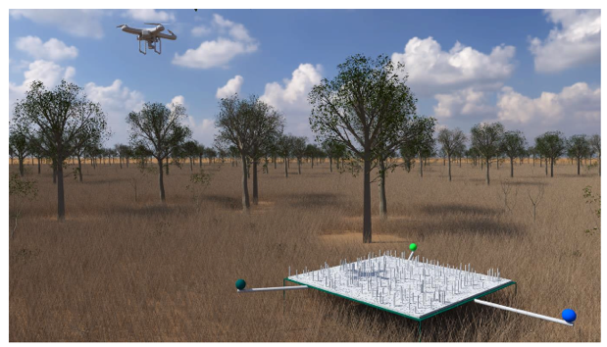
Proposed BRF Validation protocol
Building on a protocol initially defined for a laboratory experiment:
Artificial target (5mx5m) mimic vegetation reflectance pattern, i.e. hot spot
From dimensional specs and optical properties simulate BRF using 3D RTM
Measure the target (HDRF) in the field with UAV-based spectrometer survey
From measured HDRF retrieve BRF and compare it to the simulated BRF
Traceable uncertainty budget for BRF validation under controlled conditions
Leroy et al., 2025

Slide 10
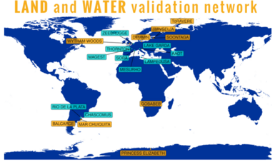
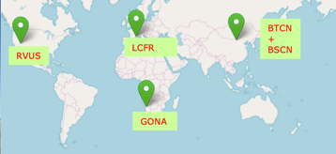
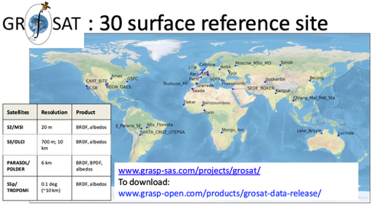
Reference datasets and networks
Two main networks:
HYPERNETS, designed for BOA, need expand spatial and spectral coverage, notably in the SWIR for land sites, to meet users’ needs (CHIME).
RadCalNet, designed for TOA, few sites, mostly in bright/arid homogeneous sites, ideal for radiometric Cal/Val, less for evaluating performances of AC
Recommended to ensure sustained funding to networks, while expanding geographical coverage with focus on vegetated sites
RTM-based datasets (GROSAT): uncertainty needs to be more thoroughly characterized.

Slide 11
Way forward
Develop an ESA project (FRM4SR) in the medium term.
Goal: to enhance FRM maturity of SR products validation.
The pragmatic approach is to build on the efforts from past and on-going ESA projects, exploiting synergies across them.
Continued engagement with networks is essential and should be facilitated through a dedicated WG that meets regularly.
Raise international awareness about the inititative
Work towards endorsement at CEOS-WGCV level, similarly to what was done in the frame of SRIX4VEG
Liaison and synergy to the CEOS ad-hoc group on SR quality should be established to ensure commonality of strategies

Slide 12
Thank You!

