Slide 1
WGCV-55
Land Product Validation (LPV) sub-group report
Fabrizio Niro (Serco/ESA)
Agenda Item 2.2, WGCV-55
Hyderabad, India, 8-10 July 2025

Slide 2

Outline
LPV internal structure and team
ECVs and EBVs requirements
LPV Validation Framework
LPV protocols, datasets and tools
LPV Supersites Update
Reports from LPV Focus Areas
Summary and Outlook

Slide 3
LPV Structure and Team
 | First Name | Last Name | Institution | Country | End of Term
Admin | Fabrizio | Niro | ESA | Italy | Apr 2028
 | Vacant
 | Jaime | Nickeson | GSFC | USA
Land Cover | Alexandra | Tyukavina | University of Maryland | USA | Mar 2027 (2nd term)
 | Nandika | Tsendbazar | Wageningen University | Netherlands | April 2027 (1st term)
 | Sophie | Bontemps | Université Catholique de Louvain | Belgium | ex-officio
Biophysical | Richard | Fernandes | Natural Resources Canada | Canada | Apr 2027 (one term)
 | Hao | Teng | University of Maryland | USA | April 2027 (1st term)
 | Luke | Brown | University of Salford | UK | Jan 2026 (1st term)
Fire/Burn Area | Louis | Giglio | University of Maryland | USA | Sep 2026 (2nd term)
 | Bernardo | Mota | National Physical Lab | UK | Jan 2026 (1st term)
Surface Rad | Zhuosen | Wang | GSFC | USA | ex-officio
 | Angela | Erb | Leidos | USA | Jan 2026 (1st term)
 | Jorge | Sanchez-Zapero | EOLab | Spain | Jan 2026 (1st term)
Soil Moisture | John | Bolten | NASA GSFC | USA | Apr 2026 (2nd term)
 | Alexander | Gruber | TU Wien | Austria | Oct 2026 (1st term)
LST | Thomas | Holmes | NASA/GSFC | USA | Dec 2028 (1st term)
 | Lluis | Perez Planells | Karlsruhe Institute of Technology | Germany | Sept 2026 (1st term)
Phenology | Joshua | Gray | North Carolina State University | USA | Jan 2025 (2nd term)
 | Victor | Rodríguez-Galiano | University of Seville | Spain | Aug 2025 (2nd term)
Snow Cover | Carrie | Vuyovich | NASA GSFC | USA | Jan 2026 (1st term)
 | Juha | Lemmetyinen | Finnish Meteorologial Inst. | Finland | Sep 2026 (1st term)
Veg Index | Tomoaki | Miura | University of Hawai'i | USA | ex-officio
 | Simon | Kraatz | USDA | USA | Apr 2027 (1st term)
 | Vacant
Biomass | Laura | Duncanson | UMD/GSFC | USA | ex-officio
 | Kim | Calders | Ghent University | Belgium | Feb 2026 (1st term)
 | Neha | Hunka | ESA/ESRIN | Italy | Feb 2026 (1st term)
ET | Yun | Yang | Cornell University | USA | Jan 2027 (1st term)
 | Carmelo | Cammalleri | Politecnico di Milano | Italy | Jan 2027 (1st term)
GPP/NPP | Arthur | Endsley | University of Montana | USA | Sept 2027 (1st term)
 | Álvaro | Moreno | University of Valencia | Spain | Nov 2027 (1st term)
New
ex-officio
end of term approaching
Vacant or beyond end of term

Slide 4
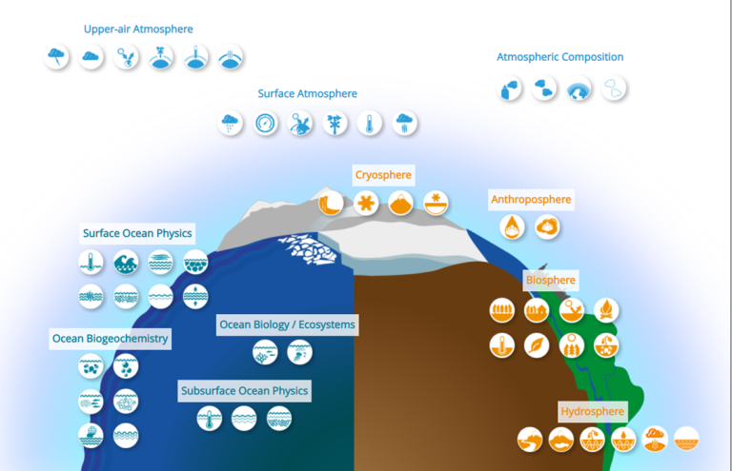











ECVs addressed by LPV
Snow (SCE, SWE)
Biomass (AGB)
Albedo
Fire (FRP, BA)
fAPAR
Land Cover
LST
Leaf Area Index
Land Evaporation
Soil Moisture

Slide 5
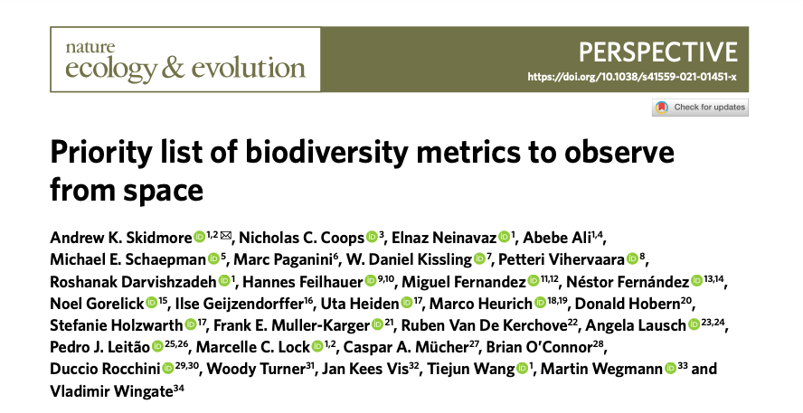
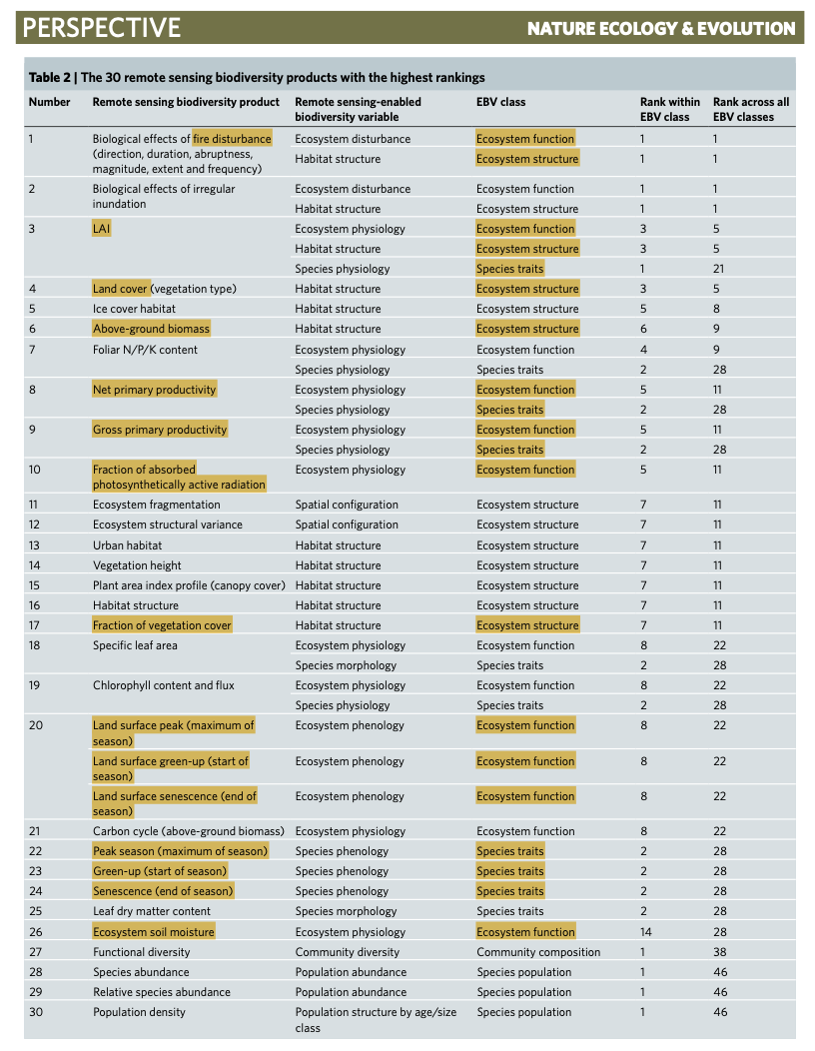
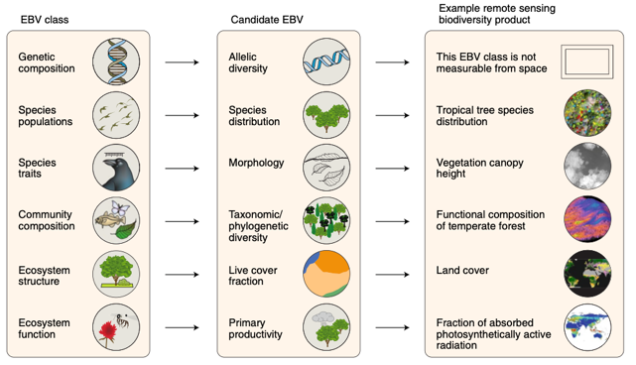
Biodiversity metrics covered by LPV
AGB
Fire
fAPAR
Land Cover
Leaf Area Index
Soil Moisture
Fraction Vegetation Cover
Phenology
Net Primary Production
Gross Primary Production
Skidmore et al 2021, Nature ecology and evolution

Slide 6
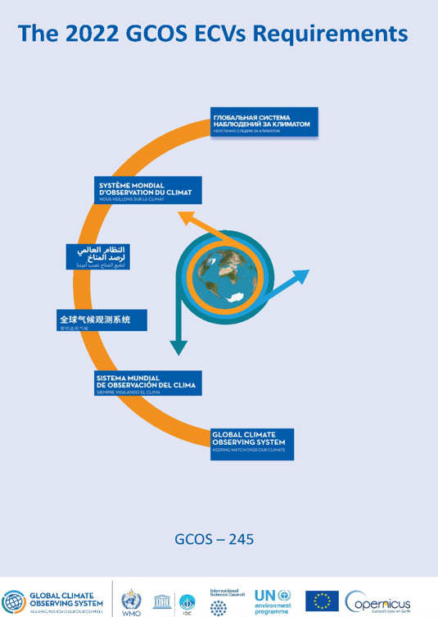
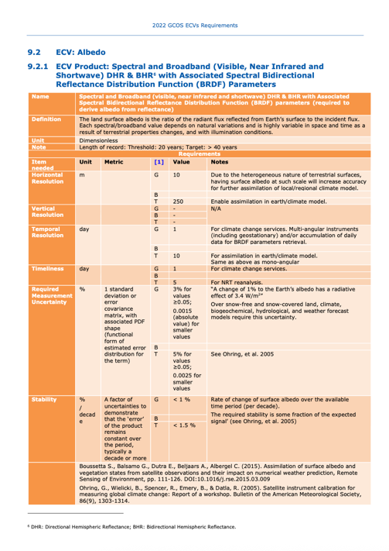
ECVs and EBVs requirements
GCOS ECVs requirements, e.g., temporal and spatial resolution, stability and uncertainty
More stringent requirements in 2022 edition for several ECVs
These are the main drivers for developing LPV protocols
No mature requirements yet for biodiversity metrics, work is ongoing to fill this gap

Slide 7
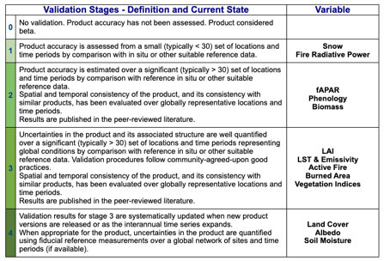
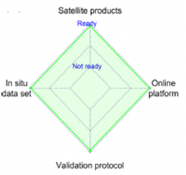
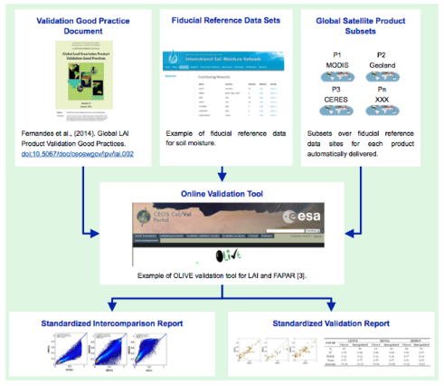
LPV Validation Framework
LPV maturity concept / framework to ensure common approaches to the validation of terrestrial ECVs
LPV framework basic elements:
  Fiducial Reference Data
  Validation Good Practices
  Reference satellite products
  On-line validation tools
Availability of on-line validation tool prerequisite to reach Stage “4”
Bayat et al. 2020

Slide 8



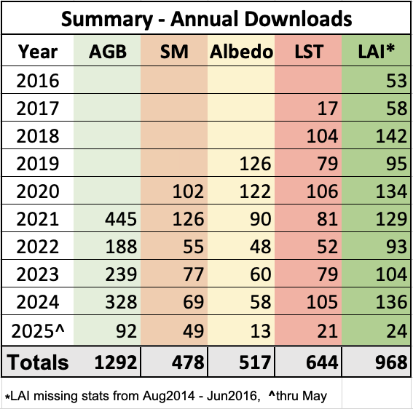



LPV Protocols
LC protocol being finalised to be endorsed at WGCV / CEOS level !
LAI protocol review: adding fCover, fAPAR, higher resolution data (<100m), RSE paper
First draft VI protocol
2014 - LAI
2018 - LST
2019 - Albedo
2020 - SM
2021 - AGB
2025 - LC

Slide 9
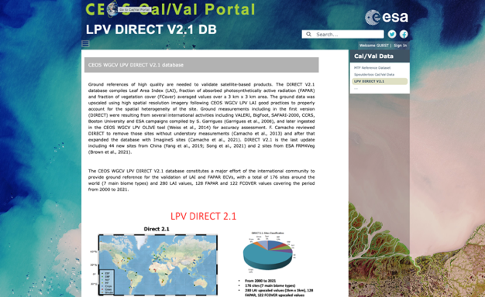
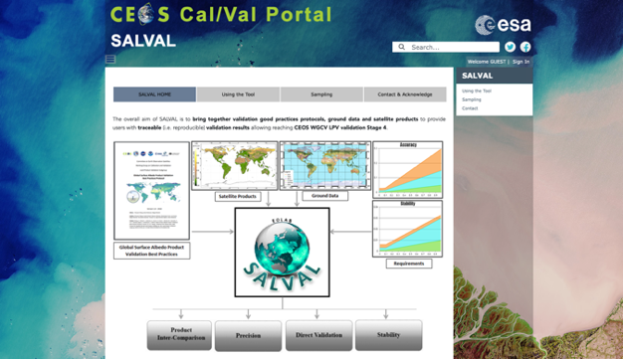

LPV Datasets and Tools
Available in Cal/Val portal:
  LPV Direct 2.1 dataset for LAI, fAPAR, fCover coarse resolution
  SALVAL Tool for broadband albedo coarse resolution using ground-based data and reference satellite products
  OLIVE Tool for LAI/fAPAR outdated, long-standing open action → ESA project to update this tool, start 2026 (TBC)

Slide 10

LPV communications
Annual Newsletters (email)
Quarterly telecons (Web)
Yearly tag up meetings with each FA (VI/Phenology and ET already done)
Up-to-date Web / list of products / key references
Workshops or special sessions per variable (every 2-3 years)
Plenary LPV meeting (every 1 or 2 years)
https://lpvs.gsfc.nasa.gov/

Slide 11
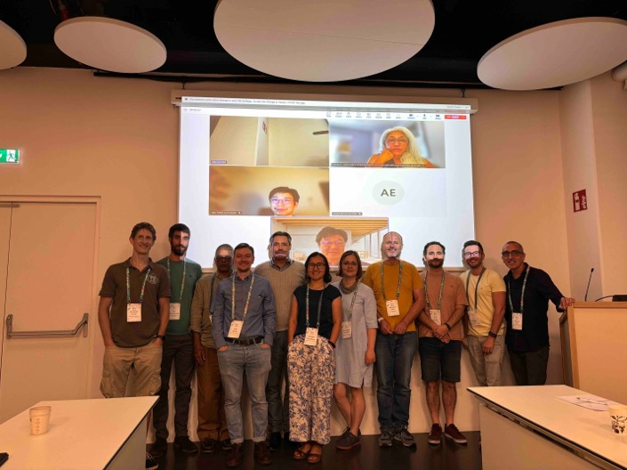
LPV Plenary 2025
Half-day LPV plenary organised during the LPS25 week
Reports from all FA leads covering all variables
Large number of input and recommendations gathered
Basis for LPV Action Plan for the 2025-28 period
Content in this presentation extracted from the plenary

Slide 12
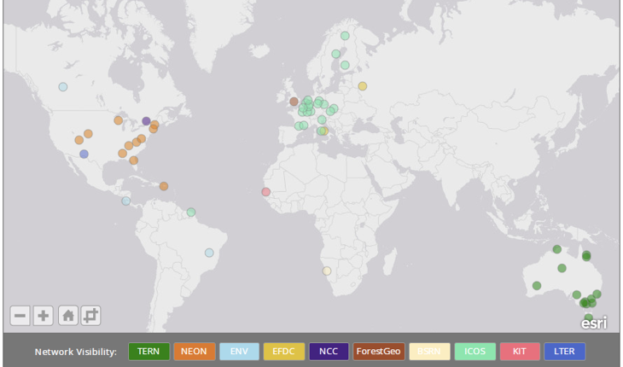
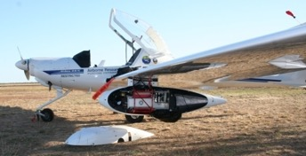
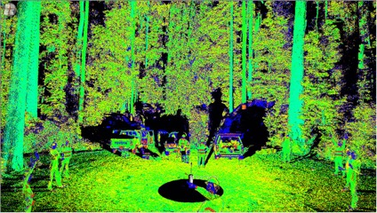
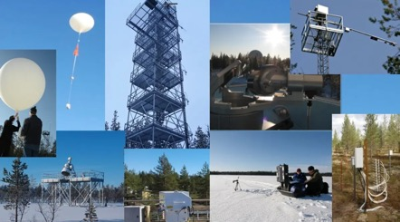
LPV Supersites
In 2016, LPV supersites (55) defined to address CEOS CV-12 action :
  Well characterised site canopy structure for RTM-based validation
  Useful for validating at least 3 ECVs
  Long term operations, part of established networks (e.g., ICOS, NEON, TERN)
  Community-agreed protocols
  Ideally supported by airborne / Lidar
Since 2016, landscape evolved:
  New sites/networks, new variables, advanced sensors (UAV), new missions

Slide 13


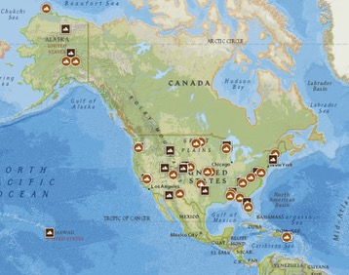



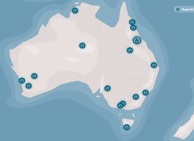
LPV Supersites update
Review definition
  Expand variables: SR, ET, GPP/NPP, SIF
  For validation of at least 3 FA groups
  Assess spatial representativeness
  Adherence (ideal) to CEOS-FRM concept
  Adding UAV-LiDAR as ideal component
Sites selection (220+ candidate)
  Review ecosystem networks for recent protocol updates (e.g., ICOS fAPAR)
  Include recent networks /sites
  Ranking: ancillary data, priority to under-sampled biomes/regions
  List (Q4 2025) for WGCV endorsement

Slide 14
FA status report
Protocol Ready
Update on going
Biophysical
Fires
Phenology
Vegetation Index
Land Cover
Snow
Surface Radiation
Soil Moisture
LST / LSE
Biomass
Evapotranspiration
GPP/NPP
Draft ready
Draft on going

Slide 15
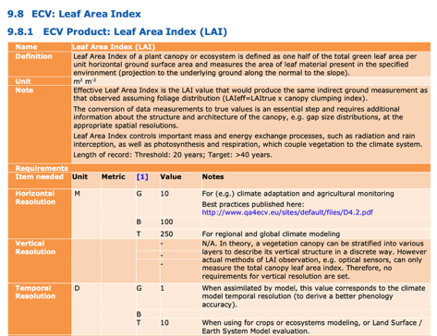

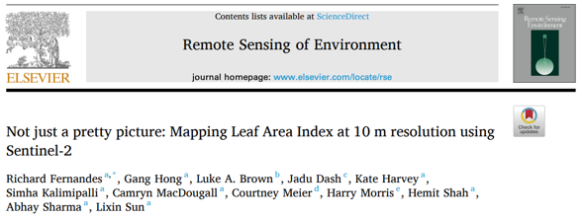
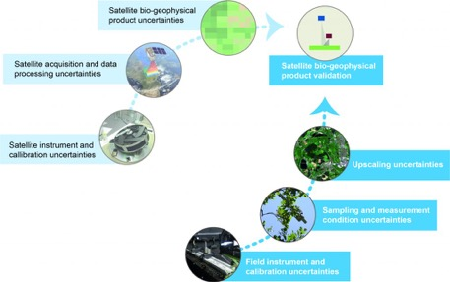

Biophysical
LAI 2014 protocol revision
  More stringent GCOS requirements
  Add new variable: FCover, fAPAR
  High-resolution products (<100 m)
  Focus on uncertainty (FRM4VEG)
  Technological advances (automated sensors, UAV-based)
Status of protocol update
  RSE paper (draft) as initial step
  First call to community gathering sent
Fernandes et al. 2025

Slide 16
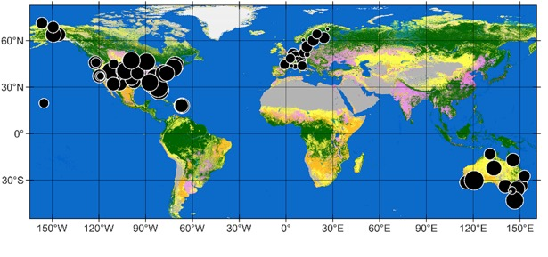
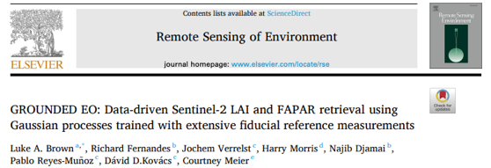
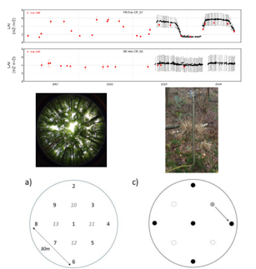

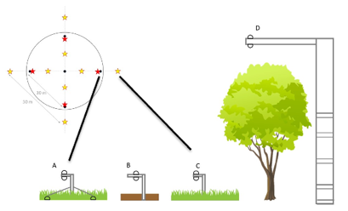
Biophysical
GROUNDED EO database
  81 NEON, ICOS & TERN sites (2013-2022)
  > 16,000 FRM (LAI, FAPAR, FCOVER)
  Provided at ESU scale (10 m to 100 m)
  Uncertainties following FRM4VEG
  Available on Zenodo, Cal/Val portal
Recent updates
  ICOS LAI/fAPAR protocols being updated align to FRM4VEG and LPV protocols
  Tackling long standing action: improving use of ICOS for Cal/Val (NUBICOS EU)
Brown et al. 2025

Slide 17
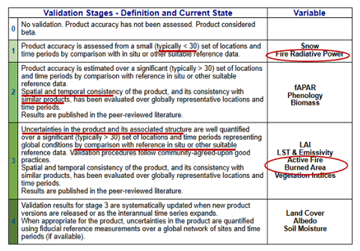
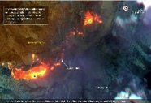
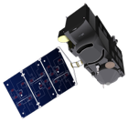
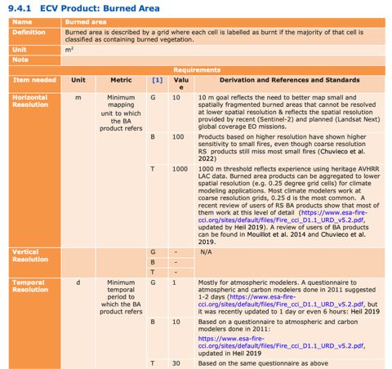


Fires
Gaps / challenges (BA, AF, FRP)
  Lack of community protocols
  Focus on higher resolution (<100m)
  Lack of uncertainties / traceability (BA)
  Ephemerality of the phenomenon (FRP): challenges in spatiotemporal comparison
  Scarcity of field campaigns data
Yet, growing interest
  Emerging commercial data providers
  Relevance for biodiversity monitoring, climate adaptation and mitigation

Slide 18
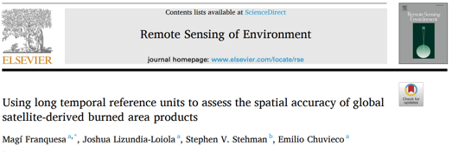
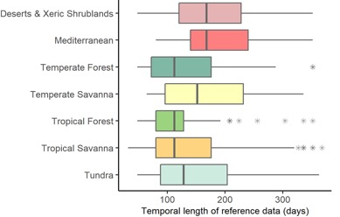
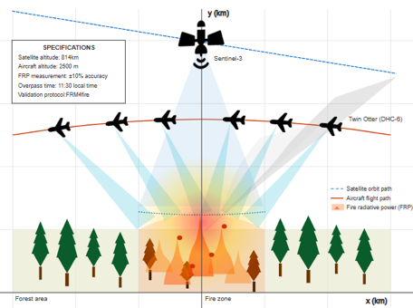


Fires
BA
  Draft being prepared (Q4 2025)
  Still some disagreement for sample sizes, metrics and collocation criteria
  Final discussion at upcoming GOFC
FRP
  Relying on airborne campaigns: limit to stage 2 (< 30 sites): review LPV stage ?
  FRP airborne Vs satellite comparison challenge: temporal and spatial scale
  FRM4Fire traceability chain/uncertainty for FRP → Protocol draft (2026)
Franquesa et al. 2022

Slide 19
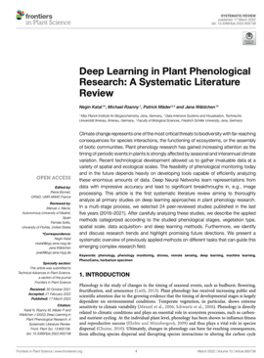
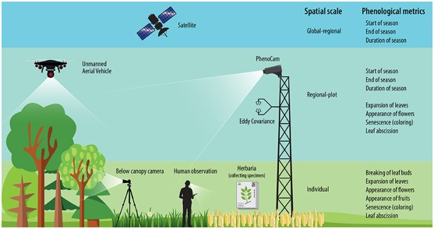
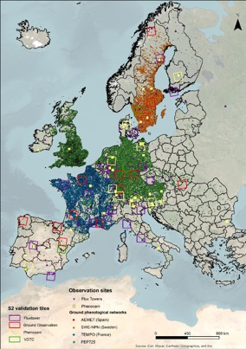
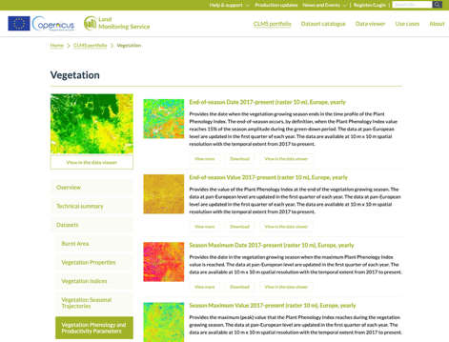
Phenology and VI
LSP protocol being drafted
  Large variety of Cal/Val sources different spatiotemporal scale
  Emerging use of UAV: review paper being prepared
  Focus on HR, Copernicus HR-VPP Phenology products (10m)
  Ground-based networks (PhenoCam, national networks, Flux Towers)
VI draft protocol under revision, Q4 2025 for release
Katal et al. 2022

Slide 20
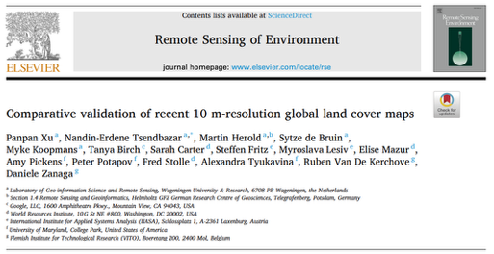
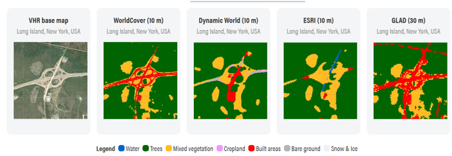
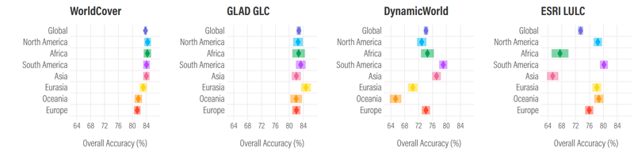
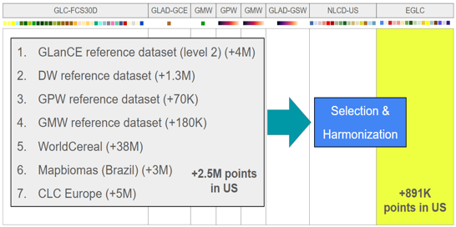
Land Cover
Status and Challenges
  Ever increasing number of HR maps
  Accuracy estimate not comparable
  HR not always more spatial details
  Accuracy vary per continent
Way forward
  Ensemble validation datasets to ease comparability
  Need community protocol for producers, users, and agencies
Xu et al. 2024

Slide 21

Land Cover
LC Protocol
  V0.1 comments from 12 reviewers: Europe (6), USA (4), China (1), Brazil (1)
  Overall feedback overwhelmingly positive, strong interest
  New sections on Definitions, GCOS requirements and FRM concept
  V1.0 Q3 2025 for endorsement at WGCV and CEOS level
  Reference guidelines for current and upcoming new HR LC maps

Slide 22
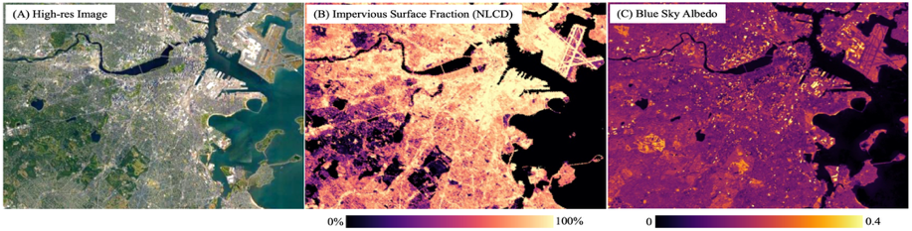
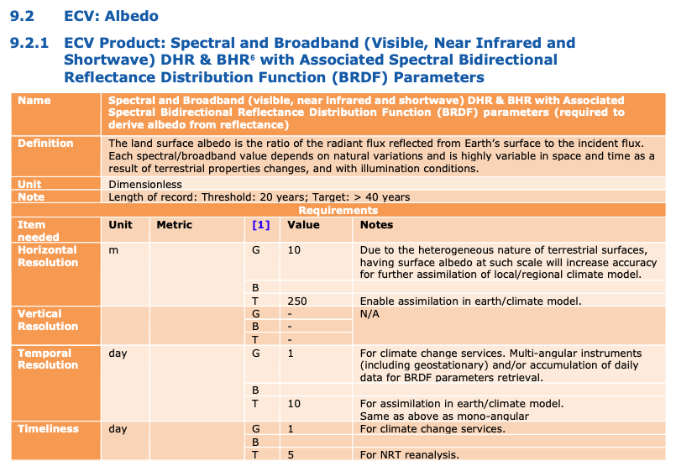
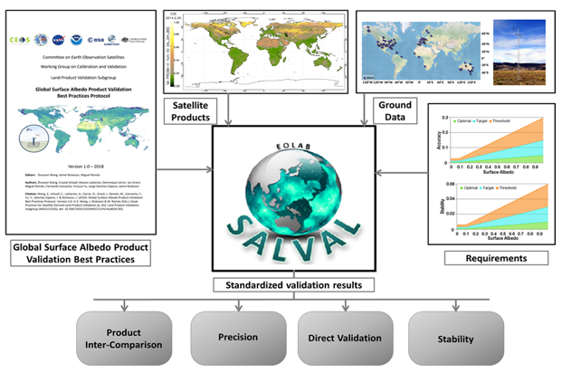
Surface Radiation
Emerging focus on HR data (<100m) for urban climate
GCOS 2022 updates
  Higher spatiotemporal resolution
  Added BRDF parameters, spectral albedo (DHR, BHR)
Status within LPV
  Existing protocol / tool focus on coarse resolution broadband using tower-based + intercomparison
  Need practices / reference for BRDF and spectral albedo validation
https://eolab.es/salval/

Slide 23
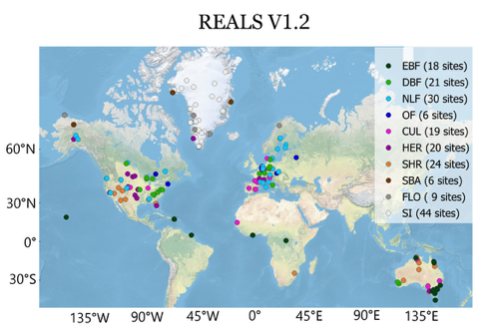
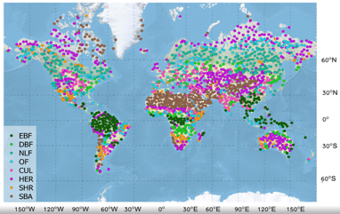
Surface Radiation
Update of protocol:
  Response to GCOS updates
  Best practices for BRDF and spectral albedo validation
  Finalize Global Downward Radiation Protocol (draft)
SALVAL tool update
  Annual maintenance
  Expand REALS tower-based data from 99 to ~200 sites
  Improve sampling LANDVAL V2
Representativeness-Evaluated ALbedo Stations (REALS)
A unique high quality-controlled sub-set of in situ measurements selected from tower-based stations (e.g., FLUXNET, BSRN, SURFRAD) that meet the CEOS LPV validation protocol (including spatial representativeness). Recent inclusion of PROMICE snow/ice sites in Greenland.
Snow-free
Snow
LANDVAL V2
Improve sampling scheme from LANDVAL V1 to V2 global sampling for product intercomparison → from 720 to 2000 sites

Slide 24
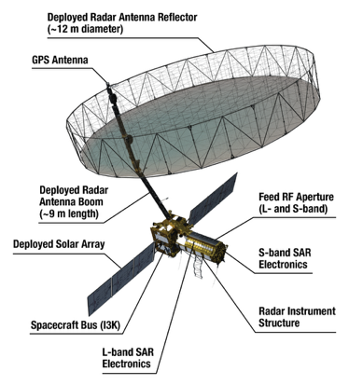
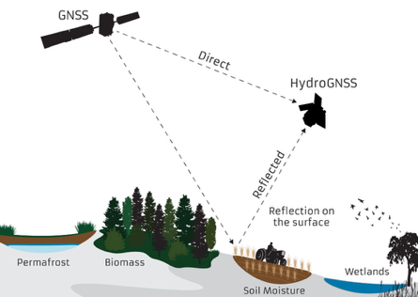

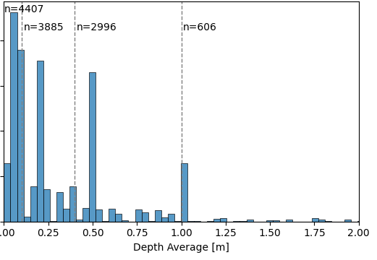
Soil Moisture
Emerging focus on HR (<1km)
  New technology (GNSS-R) and new missions (NISAR, CIMR)
  Downscaling and ML approaches
New interest for root-zone SM
  Crucial for agriculture, drought monitoring, hydrology
  Satellites provide surface SM need models for RZSM
  Reference data (ISMN) vertical resolution ill defined
https://ismn.earth/en/
ISMN measuring depths

Slide 25
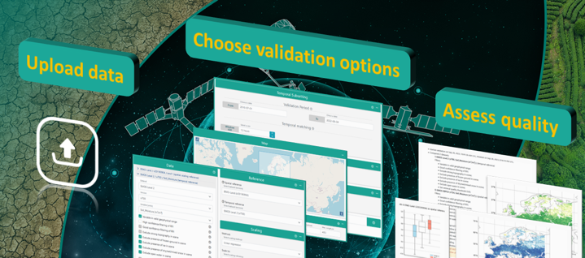


Soil Moisture
Need to update protocols, reference data and tool:
  Maintain and improve ISMN database and QA4SM tool
  Address the need for higher spatial resolution products
  Address the needs for RZSM validation
  Assess adherence to CEOS-FRM as part of ESA FRM4SM
  Aiming at first release in 2026
https://qa4sm.eu/

Slide 26



LST / LSE
Contribute to TIRCalNet
  Towards operational RadCalNet-like network for TOA radiance validation
  Cooperation ESA, CNES, JPL, Uni. Leicester, KIT, RAL
  Define instrument / algorithms, characterise uncertainties
  Radiometers installed at La Crau to perform initial testing
  Emissivity estimation remain primary source of uncertainty
  In-situ comparison of TIR radiometers (JPL and KIT) at lake Costance

Slide 27




Biomass
GEO-TREES: a Global Forest Biomass Reference System
  Stems from recommendations from the LPV AGB protocol
  Global coverage with highest sampling in the critical carbon-rich tropics
  Open data policy and long-term commitment
Long-term vision
  100 core sites (60 Tropical, 40 Temperate)
  200 supplementary, lower-cost sites
https://geo-trees.org/

Slide 28






Biomass
Multi-scale approach
  High-quality AGB at 0.25 ha plot scale with local allometric model
  Survey at 3 ha scale using TLS
  Airborne Laser Scanning of canopy height covering 100+ ha per site
GEO-TREES looking forward
  Secure resources to reach the long-term vision of BRM sites (100 / 200)
  Build links across disciplines for forest, biodiversity monitoring

Slide 29




Evapotranspiration
Status and challenges (New FA)
  Relevance for applications: agriculture, water management, …
  Growing number of ET products (institutional / commercial)
  Large variety of models / input data (e.g., satellite, meteorological)
  GCOS definition slightly differs from ET used in RS community
  Need consensus on definition, models, validation practices
https://etdata.org/

Slide 30




Evapotranspiration
Way forward
  Review existing products, group them: models, input data, coverage
  Review of existing Cal/Val practices
  Identify data and knowledge gaps
  Gather community in conferences / meeting (AGU24/ EGU25)
  Draft protocol outline (Q3 2025) and ask feedback
  Convene a WS by end of 2025
Volk et al. 2023
Volk et al. 2024
Volk et al., 2024

Slide 31


GPP / NPP
Status and challenges (new FA)
  Not yet ECV, though identified as part of biodiversity metrics
  Growing interest and availability of GPP/NPP satellite products
  Variety of models, inconsistencies across products
Way forward
  Review of existing models/products
  Gather the community (FluxNET)
  Propose protocol outline
  Discuss in a dedicated WS
NASA Global VIIRS 500m GPP/NPP for terrestrial ecosystems

Slide 32
Summary
Highlights
  LC protocol being issued: very positive feedback from community
  Review of LPV Supersites definition and list
  Updates of protocols on-going: Biophysical, Albedo, SM
  Strong interest in the upcoming ET and GPP/NPP protocol filling a well recognised data / knowledge gap
Way forward
  Compile Action Plan for next 3 years
  Work towards filling long-standing gaps: OLIVE, ICOS for Cal/Val
  Enhance readiness to upcoming missions (hyperspectral)
  Strengthen collaboration with GEO-BON, GEO-TREES, GEO-GLAM

Slide 33
WGCV-55
Intercomparison exercises: ACIX, CMIX and SRIX4VEG
Fabrizio Niro (Serco/ESA)
Agenda Item 2.2, WGCV-55
Hyderabad, India, 8-10 July 2025

Slide 34





ACIX framework
Goal → Understand strengths/limitations and enhance harmonisation of AC algorithms
Generic “X” approach
  Engage the community
  Agree on protocol, references and metrics
  Run the inter-comparison exercise
  Review/discuss the results
  Publish the paper
ACIX-I Started in 2016, 8+ years coordinated by ESA-NASA under CEOS-WGCV auspices, focus on L8/S2 → 4 highly cited papers
Since ACIX-II, 3 groups focusing on Land, Water and Cloud Mask (CMIX)

Slide 35

ACIX-III status and plans
Status
  Takeaway ACIX-I/II: use of RTM (6SV) simulations over AER may introduce biases if retrieval uses same RTM
  Priority to direct validation using SR from networks/ campaigns
  Focus on hyperspectral: EnMAP, PRISMA in preparation to CHIME
  Results now consolidated, working on 2 papers to be submitted in 2025
Future implementations
  Include synthetic scenes of different land cover and aerosol loadings,
  Include a detailed study on model agreement between RTM
 | ACIX-Land | ACIX-Aqua
# processor | 7 | 11 (7 Prisma, 4 EnMAP)
EO data | PRISMA, EnMAP | PRISMA, EnMAP
Reference | RadCalNet, HYPERNETS, ad-hoc campaigns, AERONET | AERONET-OC, HYPERNETS, ad-hoc campaigns
ACIX-III Land: APU metrics for different processors over RRV

Slide 36




CMIX-II
CMIX-I main takeaways:
  Need physically-based definition of cloud and cloud classes, e.g., thin, semi-transparent (e.g., COD)
  Inconsistencies in the reference datasets → Need to build new one tailored for S2/L8 CM validation
CMIX-II focus on S2/L8
  Improve cloud definition and reference dataset
  Number of participants reaches 23
  Include cloud shadows
Reference datasets
  PixBox S2/L8 datasets
  Multi-temporal S2/Landsat dataset
  Creation of IRIS collaborative dataset
  UMD/NASA SkyCam network (13 sites)
Results expected end of 2025

Slide 37



SRIX4VEG
Motivations
  Growing interest in UAV for Cal/Val
    Flexible and cost-effective solution
    Enhanced spatial sampling and coverage
    Survey of inaccessible sites, complement in-situ
  Yet, used protocols and procedures largely differ limiting comparability
Objectives
  Assess variability associated with different teams conducting the same validation exercise
  Move towards a community-agreed protocol
SRIX4VEG field campaigns
  Different teams, common flight plan, pairwise comparison (round-robin)

Slide 38

SRIX4VEG – Protocol
UAV SR Validation protocol published in CEOS website (Origo et al. 2025)
Protocol sensor agnostic and adaptable to future scientific/technical evolution
Recommendations for:
  UAV platform and sensor
  Environmental conditions
  Flight planning
  Ancillary data
  Post-processing scheme
https://ceos.org/document_management/Working_Groups/WGCV/GPG_UAV_SR_CEOS_version1.pdf

Slide 39
Thank You!

