Slide 1
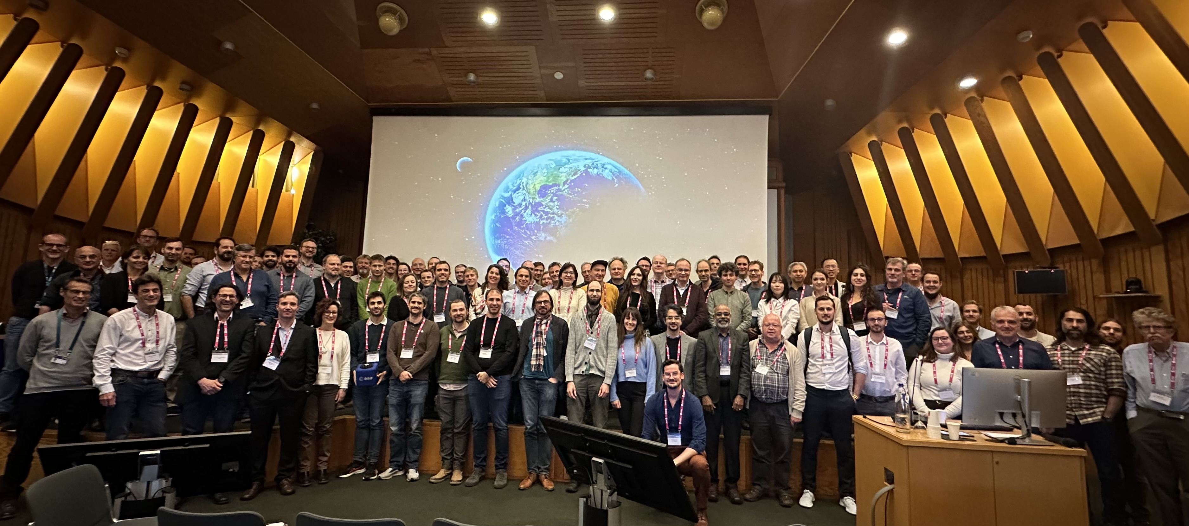
Pre-flight Calibration workshop
Nigel Fox, NPL/UKSA
XiaoXiong Xiong, NASA
Agenda Item 2.3
WGCV-55,
Hyderabad, India
8th - 12th Jul 2025

Slide 2
Pre-Flight Calibration and Characterisation of Optical Satellite Instrument for EO
19-22 November 2024
ESA-ESTEC Noordwijk
Co: chairs of Technical committee
Nigel Fox
Chair CEOS WGCV IVOS sub-group
NPL & UKSA
Xiaoxiong (Jack) Xiong
NASA

Slide 3
Objectives
Organised by the Committee on Earth Observation Satellites (CEOS) Working Group on Calibration and Validation (WGCV) and the Coordination Group for Meteorological Satellites (CGMS) Global Space-based Inter-Calibration System (GSICS)
The workshop seeks to bring together, experts from industrial and academic developers of instruments, those specifying, designing and performing calibration and characterisation as well as scientists, engineers, New Space actors, agencies and funding organisations interested in: what is and/or might be possible for a next generation instrument or future application. The workshop is organised to encourage discussion and debate on what is ‘fit for purpose’ for particular types of application.
The conclusions of the workshop will result in the publication of a CEOS WGCV and CGMS-GSICS ‘guidance document’ proposing minimal/desirable characterisation requirements and the means (methods/facilities) to achieve them for various application and instrument types. The guidance will extend to consider optimum ways to document and report calibration and characterisation information, including the associated uncertainties and traceability to SI, in a manner that facilitates transparency to all stakeholders in a standardised manner. The guidance document, to be published within a year of the workshop, will focus on the solar reflective domain but may add an appendix on the TIR.
CEOS WGCV / GSCIS Best Practise
Reference documentation

Slide 4
Programme Overview
Date/Time | Session | Chairs
Tue 10:00-11:00 | Session A: Opening Session | Nigel Fox / Jack Xiong
Tue 11:00 -13:30 | Session B: Future Calibration/Characterisation Requirements | Mounir Lekouara / Dan Scharpf
Tue 14:30 – 17:30 | Session C: Principles of Calibration / Characterisation / Traceability / Uncertainty and its Documentation / Reporting | Ralph Snel Albrecht von Bargen
Wed 8:30 -11:30 | Session C (Continued) | Arnaud Heliere/Glen Jaross
Wed 11:30 – 15:30 | Session D: Radiometric Gain / Non-Linearity / Polarisation Sensitivity | Valentina Boccia / Camille Desjardins
Wed 16:00 -17:30 | Session E Poster Session | Chengli Qi/Marc Bouvet
Thu 8:30 – 12:00 | Session F: Spectral Response Function / Bandwidth / Wavelength / Smile | Hansford Cutlip / Berit Ahlers
Thu 12:00-15:30 | Session G: Stray Light (Out-of-Field, Out-of-Band), Point Spread Function, Ghosts, Scattered | Jean-Marc Laherrere Stefan Riedl
Thu 16:00-17:30 | Session H: Discussion and Report Assignment - All themes | Nigel Fox / Jack Xiong
Fri 8:30-13:00 | Session I: Thermal Infrared | Dave Smith /Richard Wachter
Fri 14:00 -15:30 | Session J: Discussion and Report Assignment - All themes | Nigel Fox / Jack Xiong

Slide 5
Committees
Many Thanks
Scientific Committee
Berit Ahlers ESA Netherlands
Pascal Blain CLS Belgium Belgium
JaeYoung Byon KMA Korea
Yong Chen NOAA USA
Hansford Cutlip Ball Aerospace USA
Camille Desjardins CNES France
Lei Ding SITP China
Gary Fowler EUMETSAT Germany
Nigel Fox UKSA UK
Arnaud Heliere ESA Netherlands
Eric H Johnson Raytheon USAUSA
Glen Jaross NASA GSFC USA
Greg Kopp LASP USA
Toshi Kumura JAXA Japan
Stephen Maxwell NIST USA
Jean-Philippe Mur Thales France France
Thomas Pagano NASA JPL USA
Chengli Qi CMA China
Stefan Riedl Airbus Germany Germany
Dan Scharpf Labshere USA
Deron Scott SDL USA
Frank Schmülling DLR Germany
Ralph Snel TNO Netherlands
Dave Smith STFC UK UK
Christoph Straif EUMETSAT Germany
Dave Tobin Univ of Wisconsin USA
Sylvain Thomas Airbus France France
Richard Wachter OHB Germany Germany
Xiaoxiong Xiong NASA USA
Organising Committee
Nigel Fox NPL/UKSA United Kingdom
Philippe Goryl ESA/ESRIN Italy
Jean-Marc Laherrere CNES France
Mounir Lekouara EUMETSAT Germany
Albrecht von Bargen DLR Germany
Xiaoxiong Xiong NASA USA
Many Thanks to:
Paolo Castracane Starion for ESA Italy
Harvey Jones Symbios Australia
Peter Kraan ESA Conference Bureau

Slide 6
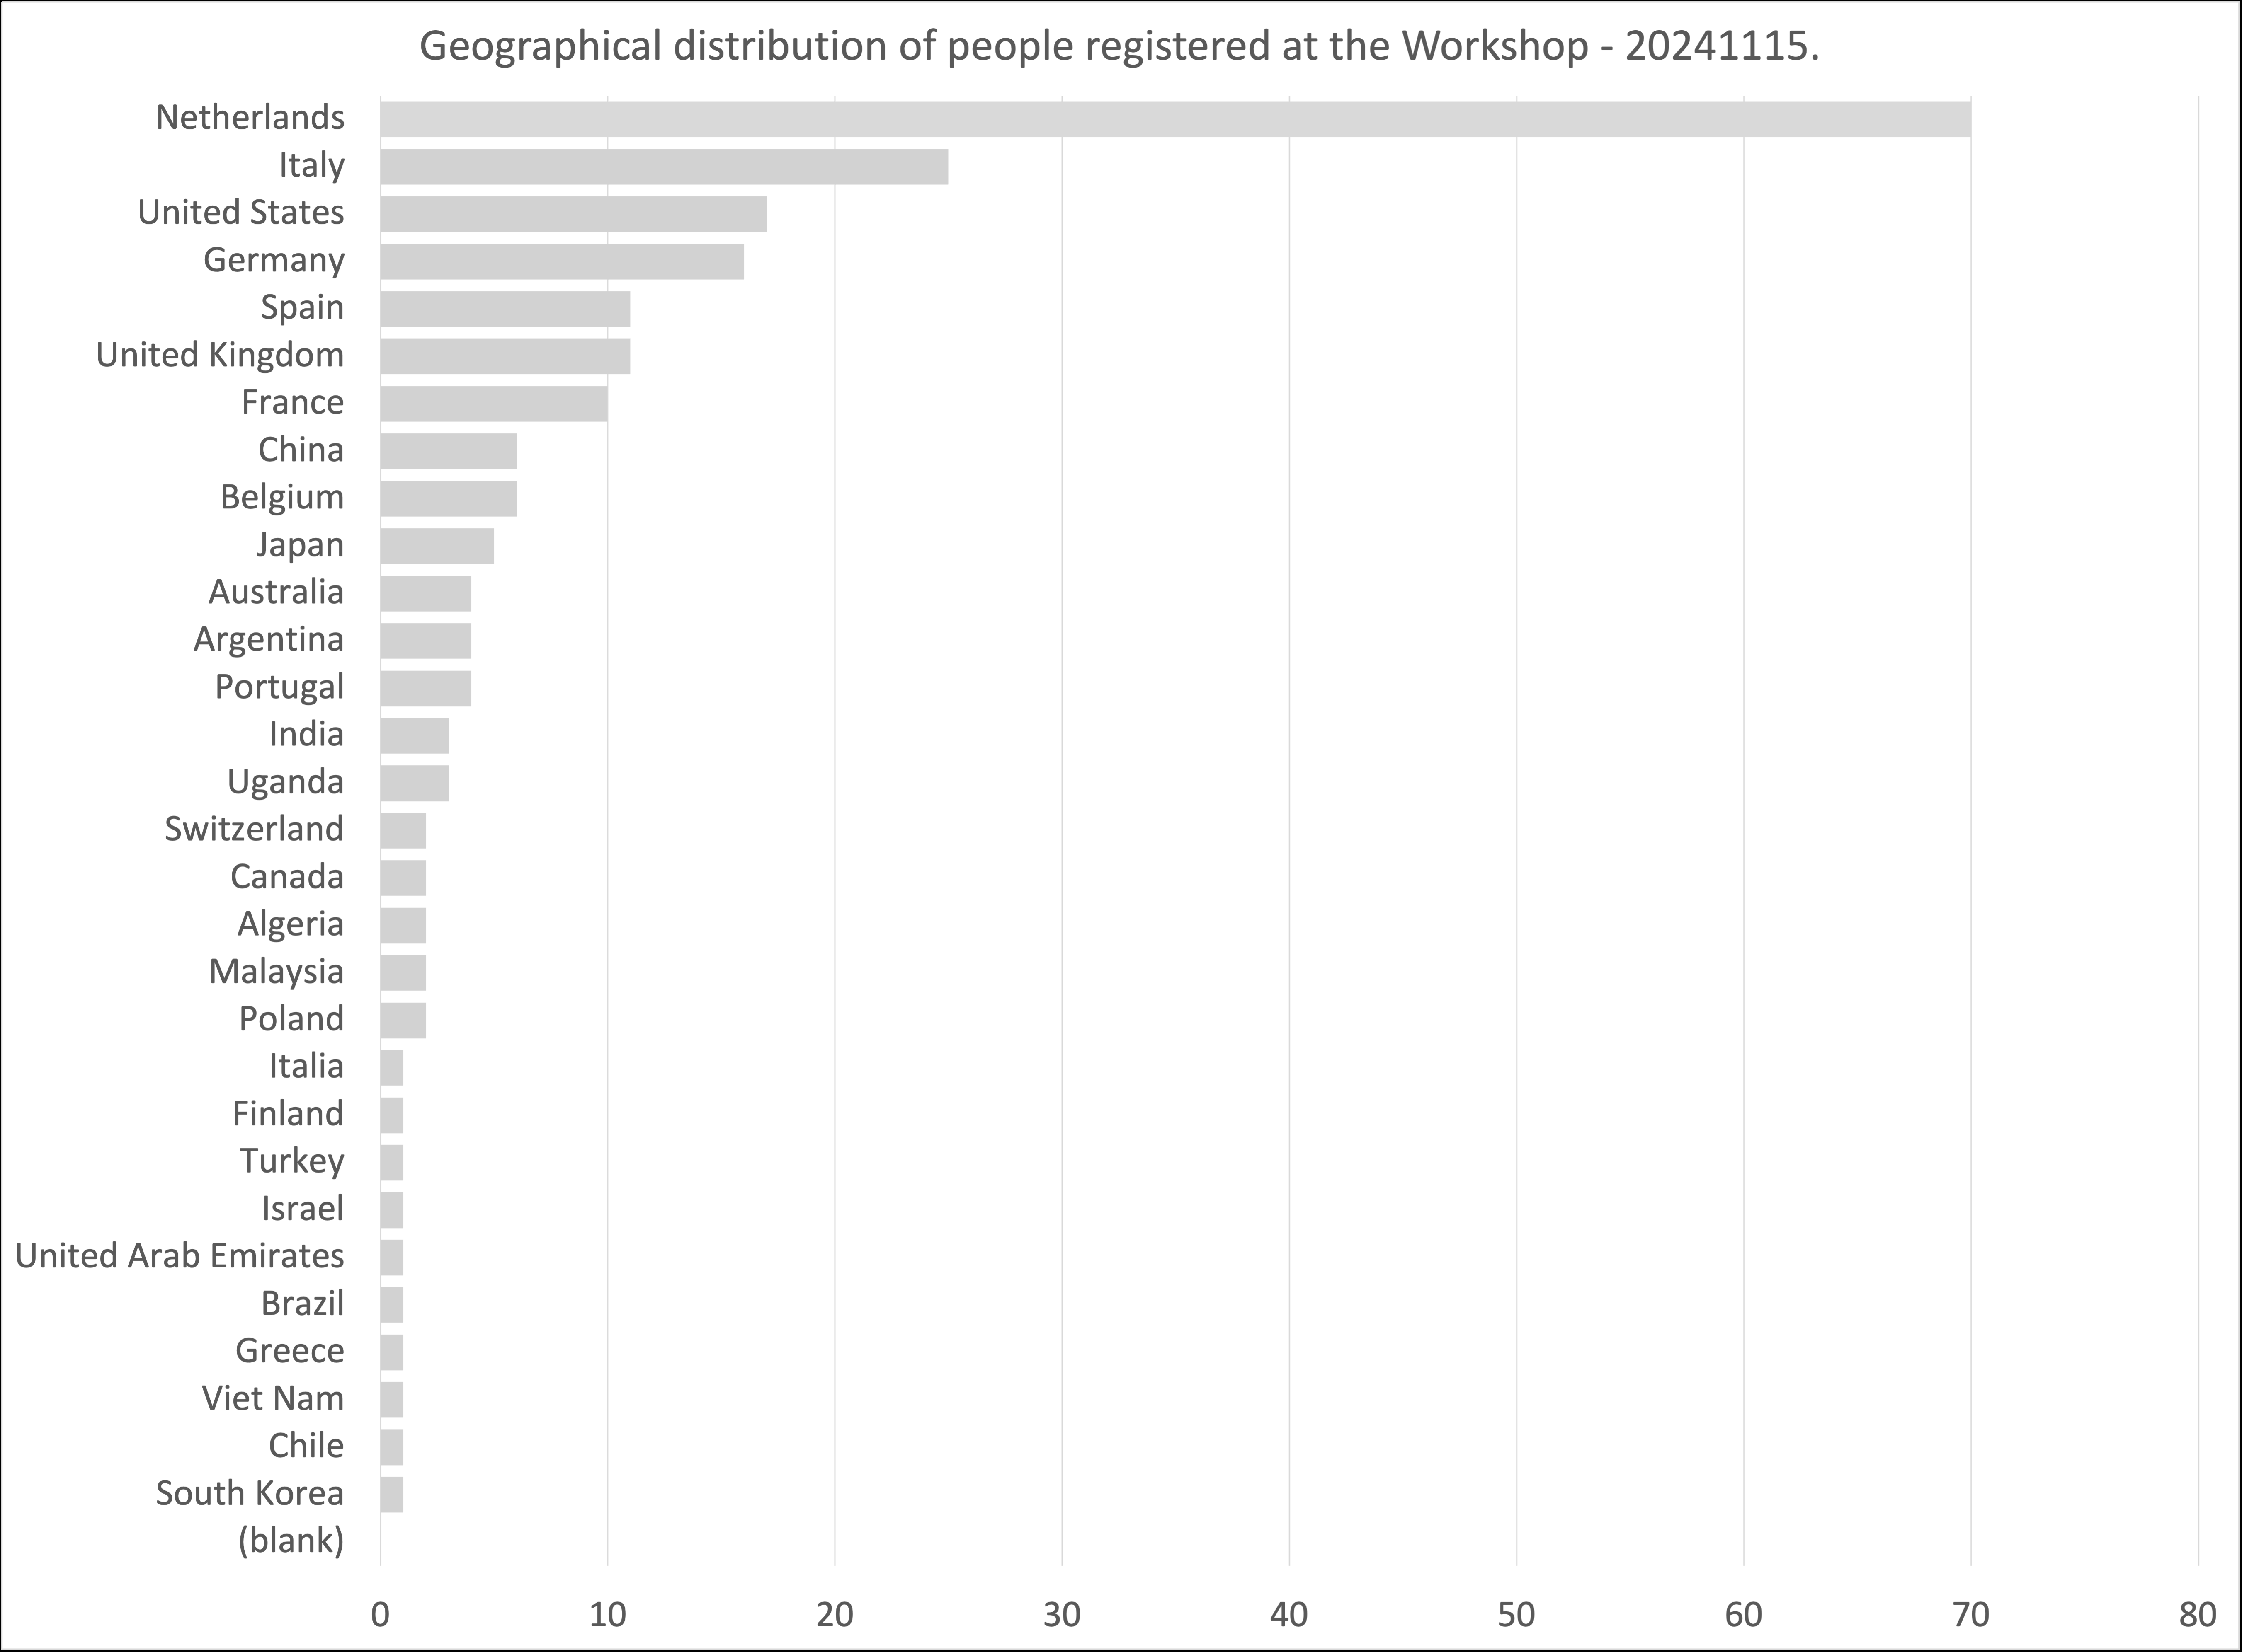
Participants
220 Participants registers !
25 Presentations
24 Posters → opportunity to present the posters during the slideshow/discussion session
DISCUSSION is important → needed to produce the document
Thanks to the chairs ! Organise the discussion/input for the final report
Presentations
Pre-Flight Calibration Workshop

Slide 7
Conclusions/recommendations
Pre-flight challenges
Unknowns
Ageing from pre-flight
Representativeness of the cal/characterisation to the sensor measurand and operational conditions/environment
Time and budget at end of development cycle
Do we need to do it in Tvac?
Cost and benefit particularly for new space but increasingly for ALL
Test beyond Lmax
Test for post-launch e.g. moon ready!
Use of heliostats beneficial
Measurement capabilities are broadly OK for current and perceived sensors
Active ? (not this workshop)
‘integrated’ sensor?
How to get costs and time to minimum is important particularly if we are to encourage ‘new space’ to undertake - need reasons why it needs to be done

Slide 8
Conclusions/recommendations
Increasing use of tuneable lasers as multi-parameter calibration tool
Agree that we need to have increased transparency of calval methods and evidence to support results
Funders need to oblige contractors
Potential value in making information available in a common structure / database?
Value in creating a document/guidance on good practises/lessons learnt
Could be a hybrid with a doi top level document with general principles and key methods under auspices of CEOS/GSICS with internal links to updatable info in ?????
Medium to longer term value in training courses on cal/val also uncertainty evaluation
More workshops??
Vacuum/ambient cal/characterisation an important but debatable issue
Cost benefit per application/mission
Can be more interactive and agile in ambient for some measurands
Some must be in TVAC
Can perhaps create a table to help provide guidance

Slide 9
Conclusions/recommendations
Detectors can have surprises!
Full testing of all characteristics – specify need to manufacturer and/or user/integrator
Potential techniques for post processing for spectral harmonisation
Create a table to show what must be done in terms of cal/val graded by classes of application! With lessons learnt as to why important
How to deal with an apparent change in cal coefficients post launch
Compare with other independent references (particularly SITSats when available)
Pre-flight consider what might be helpful post-launch for diagnostics (measurements and access to data) to make possible – also to be able to make full use of SITSats & other refs
In developing a mission consider Cal/Val from design concept phase
Establish a Cal/Val team (with cal/val, AIT , instrument team, science team) at the early phase of mission and maintain throughout operational lifetime (build a coordinated interactive team not silos) Small additional cost potential for major long-term savings
Plan an adequate cal campaign (add two months!) and try to avoid compromise!!!
Ensure preflight includes activities to meet potential needs of post launch

Slide 10
Conclusions/recommendations
Develop comprehensive Mission simulators
Evaluate the OGSE (particularly stray light) to ensure its performance
--------------------------------------------------
Community surprisingly very open / sharing ideas and information
‘New space’ recognise value but need evidence of benefit/requirement to justify some activities
Need to know necessities and ‘nice to have’
May be prepared to provide key technical info needed for Cal
Desire low cost/quick solutions
Very keen on utilisation of SITSats & noting they will need to do some pre-flight to benefit e.g. spec response functions

Slide 11
Next steps: delay due to initial issues with presentations
Develop good practise guidance - by application theme as chapters,
Purpose of cal/characterisation (theme) what is impact/benefit per application (table?) (examples of benefit)
Methods being used - relative differences (capabilities/challenges/limitations for particular applications - provide references and examples (updatable if on-line doc)
illustrate lessons learnt
Evolutions needed for future applications if any (including lower cost minimal methods)
be a hybrid like publication (reference doc with DOI + links to other locations new media etc TBD)
recommend what might be done in ambient/Tvac
recommend necessity to provide transparency of Cal/charac method and evidence of traceability/uncertainty and what is minimum needed for particular types of application and for example to allow post-launch Cal. How to provide information!
Recommend need to have Cal team integrated into mission- development to end of life

