Slide 1
CEOS WGCV-55
WGCV inputs to Interoperability Handbook 2.0
Nitant Dube
(WGISS)
Agenda Item #2.7
WGCV-55
Hyderabad, India
8-10 July, 2025

Slide 2
CEOS Interoperability Handbook V 2.0
Objective
CEOS Interoperability Handbook Version 2.0 should provide guidance to the organizations for development of Interoperable Data and Services and help them in measuring their maturity level
Interoperability Handbook
Maturity Matrix

Slide 3
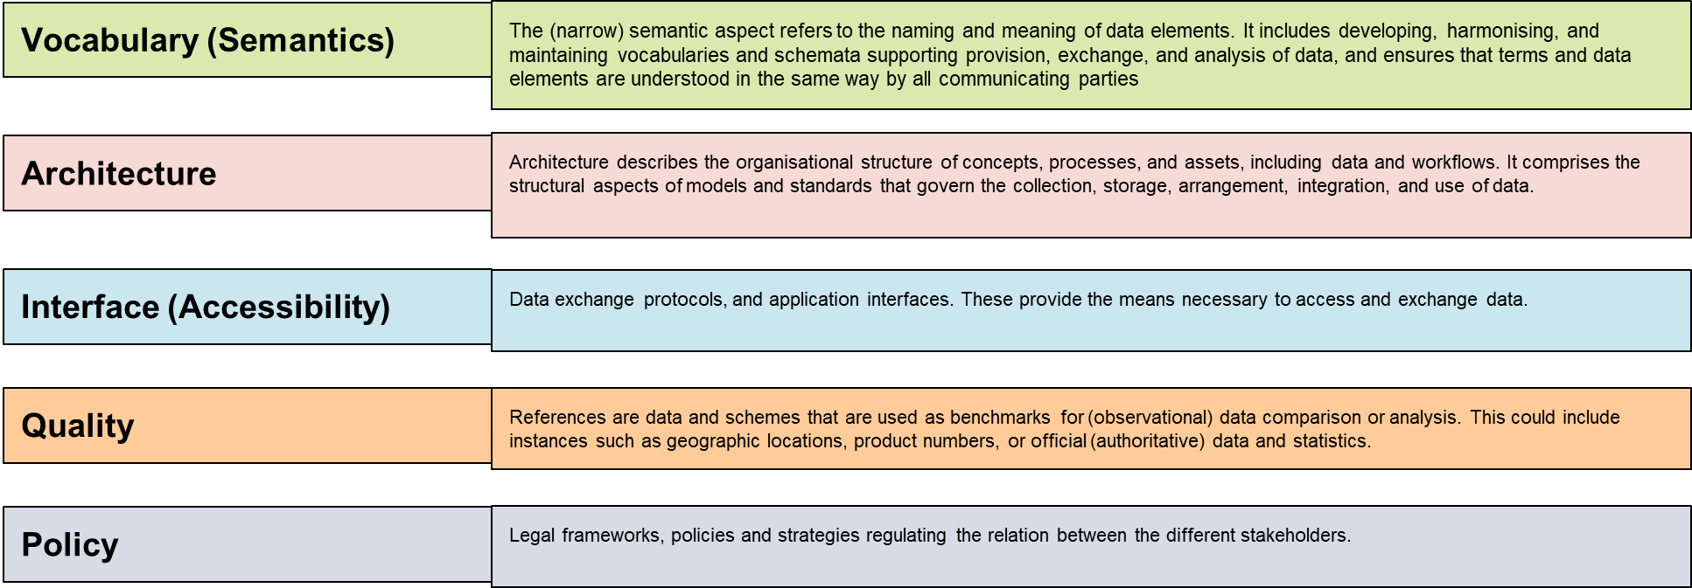
Interoperability Framework : Factors
Management
Policy
Technology
Quality
Vocabulary
Interface
Architecture

Slide 4
Handbook on github
The First Draft of Interoperability Handbook 2.0 is now available on github
https://github.com/ceos-org/interoperability-handbook

Slide 5
Handbook Chapter Layout
Chapters
Chapter-1 : Introduction
Chapter-2: Interoperability Framework
Chapter-3: Vocabulary (Semantics)
Chapter-4: Architecture
Chapter-5: Interface (Accessibility)
Chapter 6: Quality
Chapter 7: Policy

Slide 6
Recommendations

Slide 7
Quality
Major Contribution by:
Working Group on Calibration and Validation (WGCV)
Engagement with Community calibration and validation groups, Quality Indicators, CEOS Fiducial Reference, CEOS Cal/Val Sites (RAdCalNet and SARCalNet), Q4AEO, EDAP based Quality Matrix, Best Practices Document for cal/val activities, CEOS CAL/VAL Portal
Quality
Calibration & Validation ( 9)

Slide 8
Quality Recommendations
ID | Recommendations
CALVAL#1 | Data providers should engage and participate in community calibration/validation groups, such as CEOS WGCV (and its subgroups), WMO GSICS, JACIE and VH-RODA.
CALVAL#2 | The Measurand and Uncertainty of stated values should be included within all products, as they are key to communicating and understanding data quality.
CALVAL#3 | All products should have associated quality indicators, traceable to reference standards to allows users to assess usability of the data for their applications.
CALVAL#4 | Post-launch, Level-1 products should be calibrated using reference measurements, such as CEOS Fiducial Reference Measurements (CEOS-FRM).
CALVAL#5 | Community endorsed Cal/Val sites and reference network should be used for satellite cross-comparison, such as CEOS Cal/Val sites, RadCalNet and SARCalNet .
CALVAL#6 | The Quality Assurance Framework for Earth Observation QA4EO developed by Group on Earth Observations (GEO) and endorsed by CEOS should be followed to enable interoperability and quality assessment of earth observation data.
CALVAL#7 | The ESA/NASA/USGS Earth Data Assessment Project (EDAP) should be used for reporting metrics related to quality.
CALVAL#8 | The Joint Agency Commercial Imagery Evaluation (JACIE) Best Practices document should be used as a guideline for performing standard calibration and validation activities.
CALVAL#9 | CEOS CAL/VAL portal should be used as a reference site for accessing agreed good practices and CAL/VAL protocols for interoperability for Earth observation calibration and validation activities.

Slide 9
Feedback on Quality Factor by CEOS-COAST
CALVAL_SUGGETSION#1 Use of the phrase Cal/Val: Distinguish between Sensor and Product Calibration. For Product Cal (e.g., SST), hold out a portion of the in situ data exclusively for Val, not to be used in Cal. The hold-out percentage should be set by consensus within the Int. Science Team of SMEs.
CALVAL_SUGGETSION#2 Measurand and Uncertainty of stated values: Uncertainty budgets should ideally include contributions from instrument, algorithm, and environmental sources. Also, specify whether theoretical (modeled) uncertainty or estimated against ground truth. Specify precisely which Quantitative Measures: e.g. (SST): Systematic (bias), Non-systematic (uncertainty), Stability, Sensitivity, as is possible, or set by consensus within the Int. Science Team of SMEs. (cf., https://www.ghrsst.org/about-ghrsst/task-teams/task-team-on-climate-data-assessment-framework/ )

Slide 10
Feedback on Quality Factor by CEOS-COAST
CALVAL_SUGGETSION#3 Cal/Val practices should be reproducible and documented with access to datasets and code where possible.
CALVAL_SUGGETSION#4 (Rashmi Sharma) Distinguish “uncertainty” across different levels of products, e.g., L2, L3, and L4.
QUALITY SUGGESTION #5 (Jorge Vazquez) - In the handbook, suggest highlight documentation about what contributes to quality at the sensor level. Just one example: “land contamination”, “clouds”. Etc. This will be especially important to users with future hyperspectral sensors.

Slide 11
New Recommendation by OGC
Quality
Consider a new recommendation to leverage existing quality measure registers, such as the ISO 19157-3 register under finalization (https://defs-dev.opengis.net/prez-hosted/catalogs/hosted:iso-19157-3/collections/ns8:qualityMeasure)

Slide 12
Thanks nitant@sac.isro.gov.in

