Slide 1
CEOS WGCV-55
CEOS-Cal/Val Portal
Paolo Castracane
Starion for ESA/ESRIN
Agenda Item 2.8
WGCV-55
Hyderabad, India
8-11 July, 2025

Slide 2
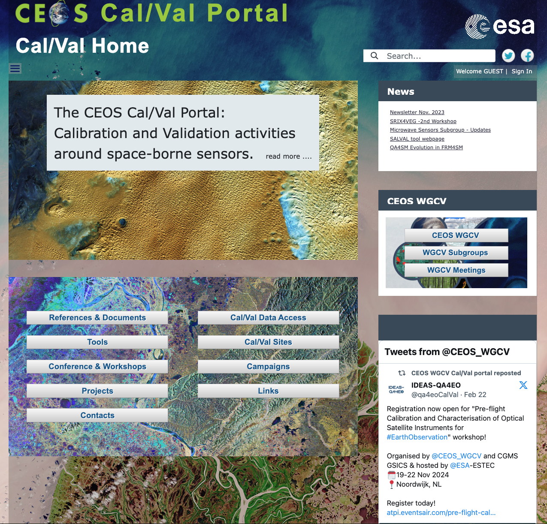
Table of Contents
CEOS Cal/Val Portal Overview
ACTIONs from WGCV-54
Content Updates
Outreach
Conclusion
https://calvalportal.ceos.org

Slide 3
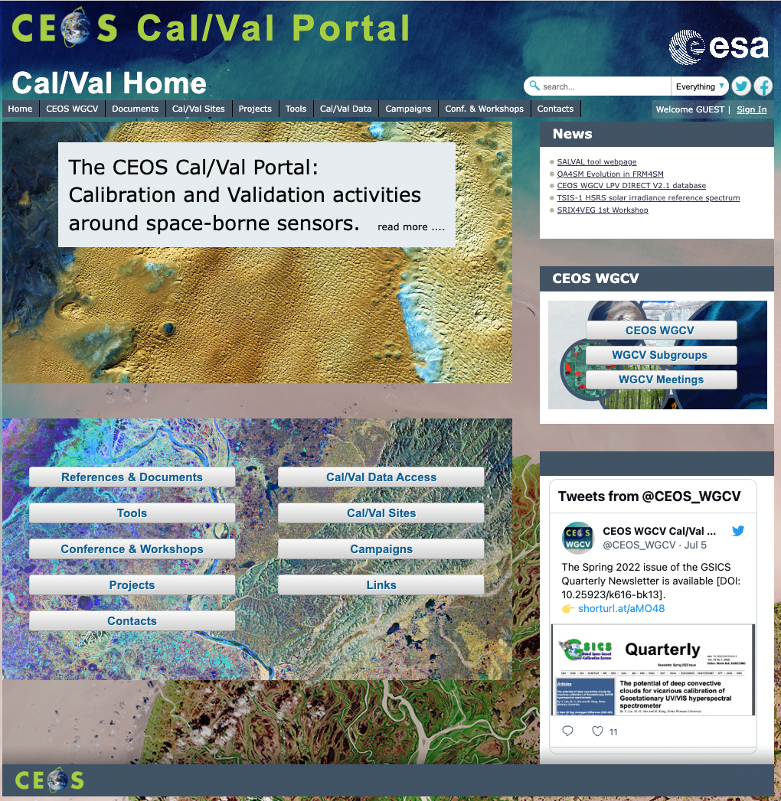
CEOS Cal/Val Portal Overview
The CEOS CalVal portal (https://calvalportal.ceos.org/) serves as the main forum for exchange and information sharing for the CEOS Working Group on Calibration and Validation.
it provides access to agreed good practices and Cal/Val protocols to the wider Earth Observation community within CEOS and beyond.
It connects users to reference data and networks and provides reliable, up-to-date and user-friendly information useful for Cal/Val tasks, facilitating data interoperability and performance assessment through an operational CEOS coordinated and internationally harmonised Cal/Val infrastructure consistent with QA4EO principles.

Slide 4
Overview - numbers
https://calvalportal.ceos.org
Some numbers: 19th June 2025:
Users
1356 Registered Users
156 CEOS WGCV SAR Subgroup and 3 super-users
59 MTF Members
23 SITSat Members
7 Cal/Val Doc Repository (rights for editing)
22 Terms and Definitions (rights for editing)
- System availability
BC uses Nagios (http://www.nagios.org/) for monitoring the IT services.
The availability of the Cal/Val Portal is close to 100%.
https://calvalportal.ceos.org

Slide 5
Actions from WGCV#54
ACTION | DESCRIPTION | DUE DATE | STATUS
WGCV-54-08 | Paolo and Jean-Christopher to update the CEOS Cal/Val Portal with details of recent activities of the Atmospheric Composition Subgroup (ACSG). | Q4 2024 | IN PROGRESS
WGCV-54-11 | Paolo Castracane to work with MSSG to update the subgroup’s Cal/Val Portal page. | Q2 2025 | TO BE STARTED
WGCV-54-15 | Nigel Fox and Paolo Castracane to collate IVOS achievements (e.g., the solar spectral irradiance spectrum work) on the Cal/Val Portal and communicate them to the CEOS Communications team for promotion. | WGCV-55 | IN PROGRESS
WGCV-54-16 | Paolo Castracane to coordinate with Patrice Henry and Beatrice Berthelot to present PICSCAR in one of the regular GSICS VIS/NIR teleconferences. | TBC | CLOSED
WGCV-54-18 | Paolo Castracane to work with Nigel Fox to establish on the Cal/Val Portal an IVOS database on radiometric calibration capabilities. | WGCV-55 | TO BE STARTED

Slide 6
Actions from WGCV-WGISS
ACTION | DESCRIPTION | DUE DATE | STATUS
WGCV-WGISS-2024-01 | The WGCV Maturity Matrix and WGISS Data Management and Stewardship Maturity Matrix teams should define their target users, and ensure their tools are fit for purpose. The Interoperability team should also consider this when developing their matrix. | Q2 2025 | TO BE STARTED
WGCV-WGISS-2024-10 | WGISS & WGCV to create a joint deliverable for the 2025-2027 CEOS Work Plan regarding the development of the CEOS/KCEO Glossary. Both working groups should ensure enough people are engaged, including from other CEOS groups, as well as from the external community. WGCV & WGISS Chairs to include this in their respective Plenary presentations, to solicit support to brand the glossary as the ‘CEOS/KCEO Glossary’. | Q4 2024 | IN PROGRESS
WGCV-WGISS-2024-11 | SEO to discuss with Paolo Castracane & Peter Strobl (and perhaps NOAA Knowledge Graph team) about transferring the current Cal/Val Portal Terms & Definition Wiki to GitHub KCEO repository, considering the appropriate format. | Q1 2025 | CLOSED

Slide 7
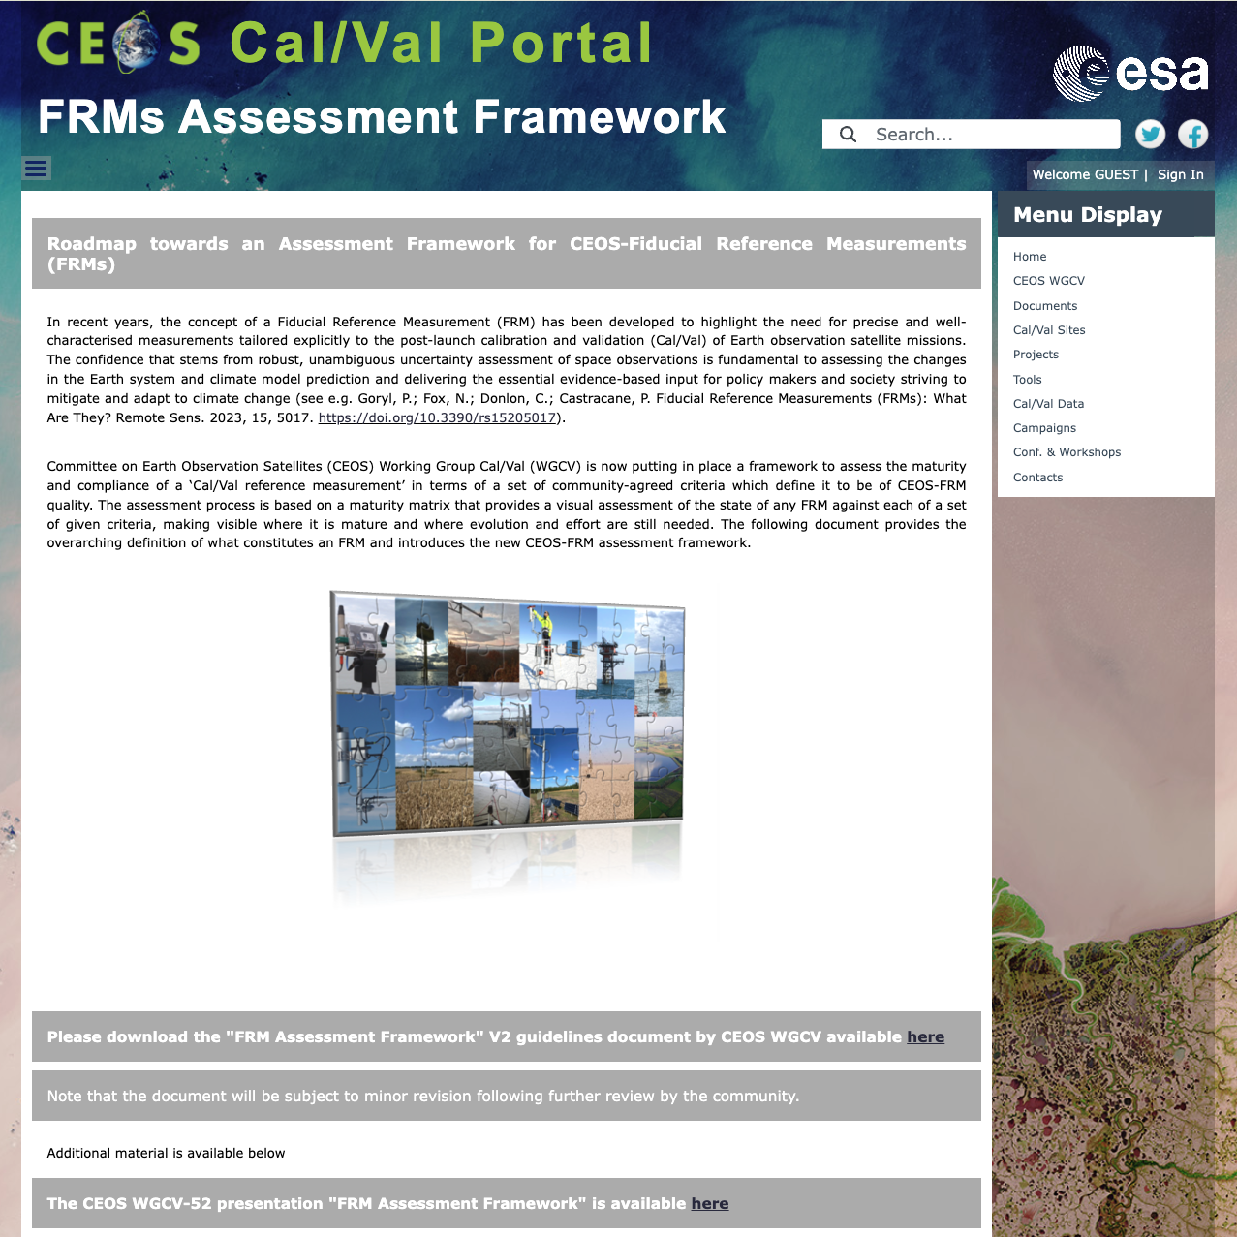
CEOS FRM Assessment Framework Guidelines document V2
CEOS Fiducial Reference Measurement Assessment Framework – Guidelines document Version 2 available on Cal/Val Portal
https://calvalportal.ceos.org/frms-assessment-framework

Slide 8
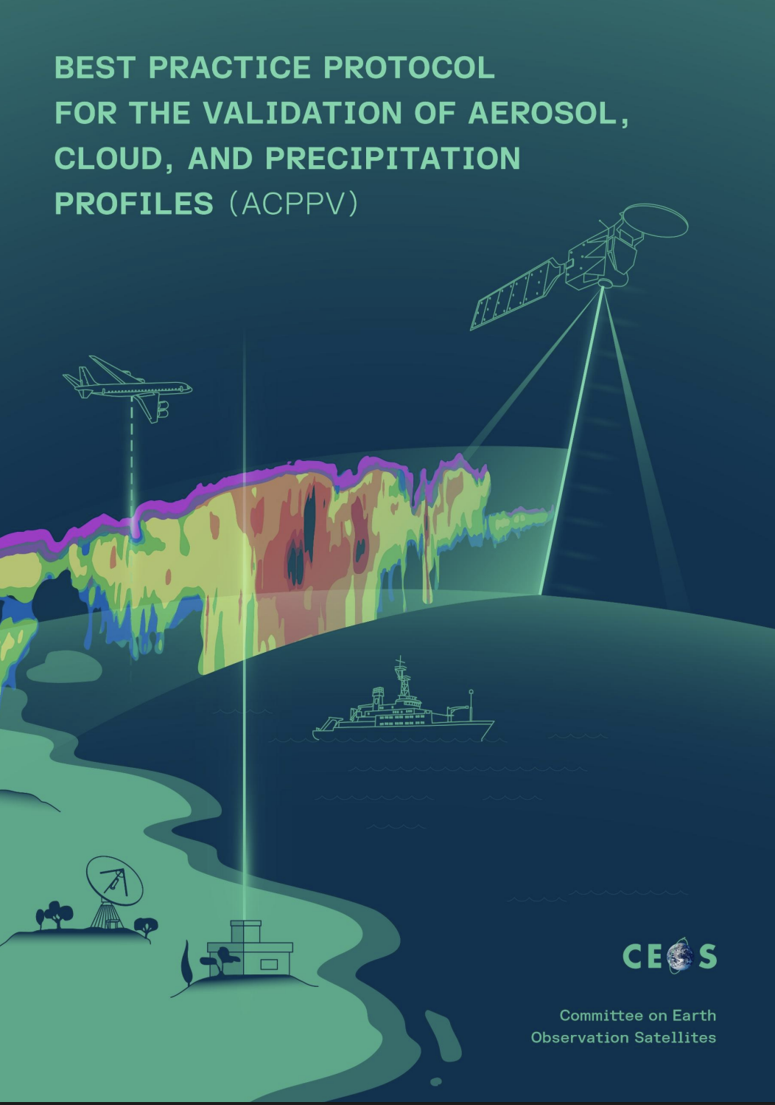
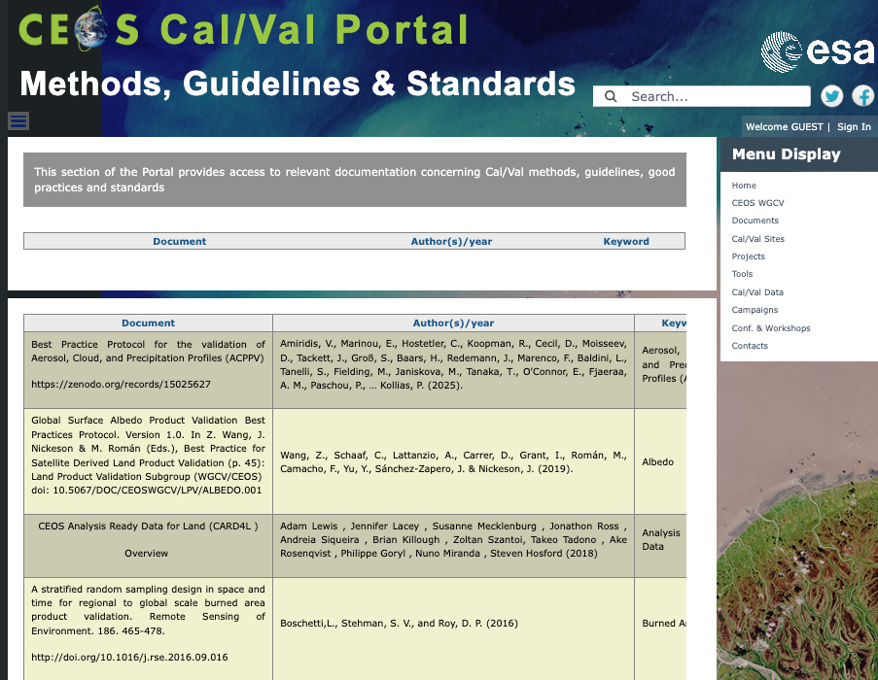
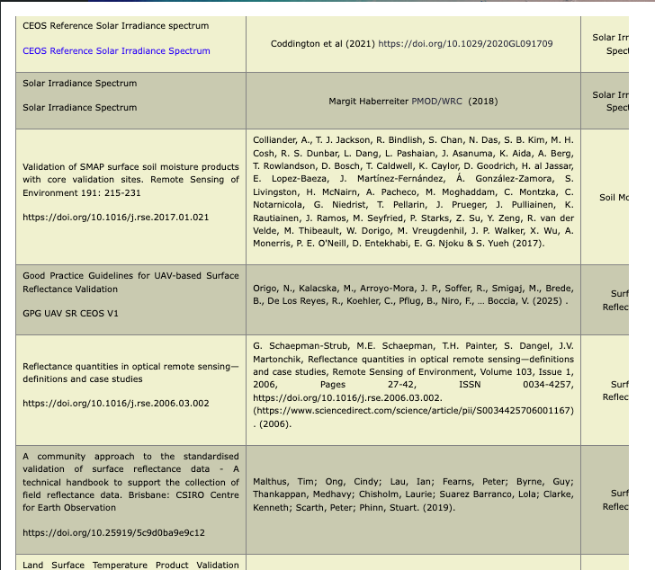
Good Practice Guidelines for UAV-based Surface Reflectance Validation
Updates on “Cal/Val methods, guidelines,
good practices and standards”
Best Practice Protocol for the Validation of Aerosol, Cloud, and Precipitation Profiles (ACPPV)

Slide 9
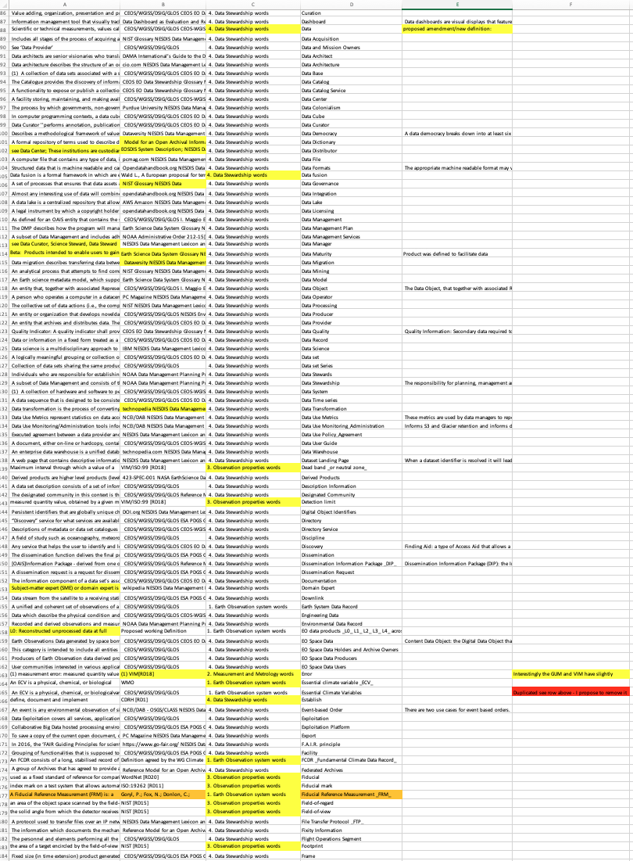
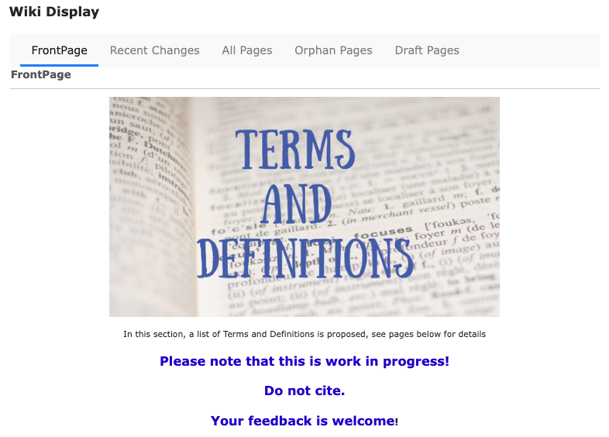
CEOS Cal/Val vocabulary to KCEO Dictionary on GitHub

Slide 10
CINDI-3 Campaigns and Workshops
https://frm4doas.aeronomie.be/index.php/cindi-3
CINDI-3 on other webpages:
https://www.actris.eu/news-events/news/cindi-3-extensive-air-pollution-measurement-campaign-cabauw
https://ruisdael-observatory.nl/cindi-3-campaign/
https://www.aeronomie.be/en/news/2024/successful-participation-cindi-3-measurement-campaign
https://ndacc.larc.nasa.gov/news/2024/07/cindi-3-intercomparison-campaign-held-cabauw-2024

Slide 11
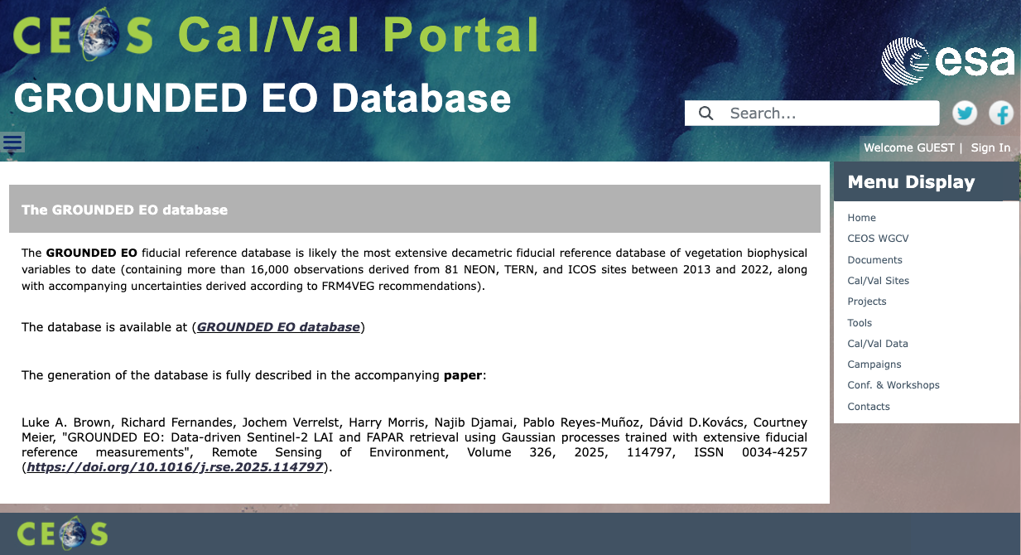
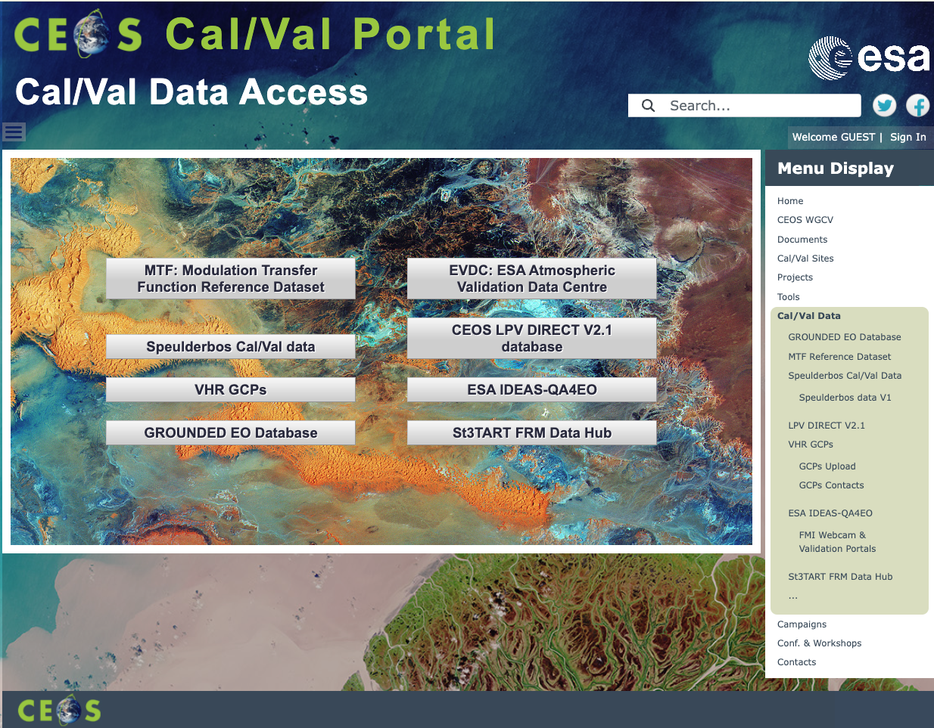
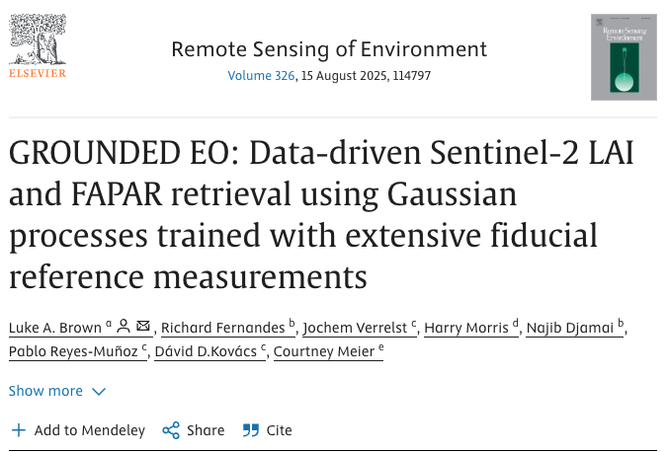
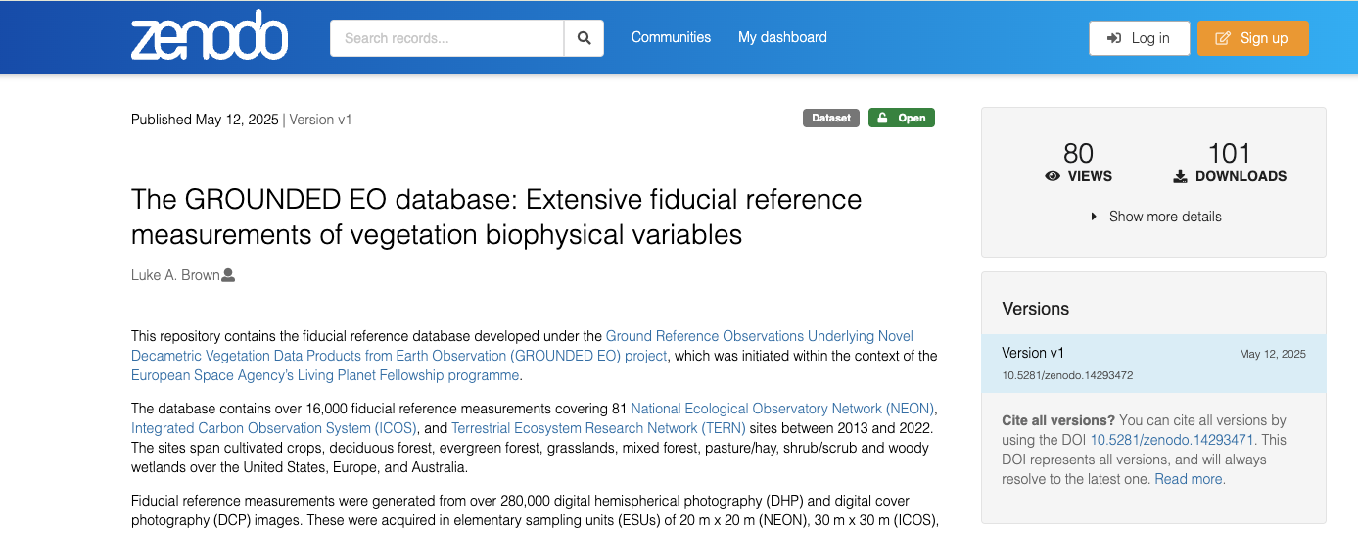
GROUNDED EO Database

Slide 12
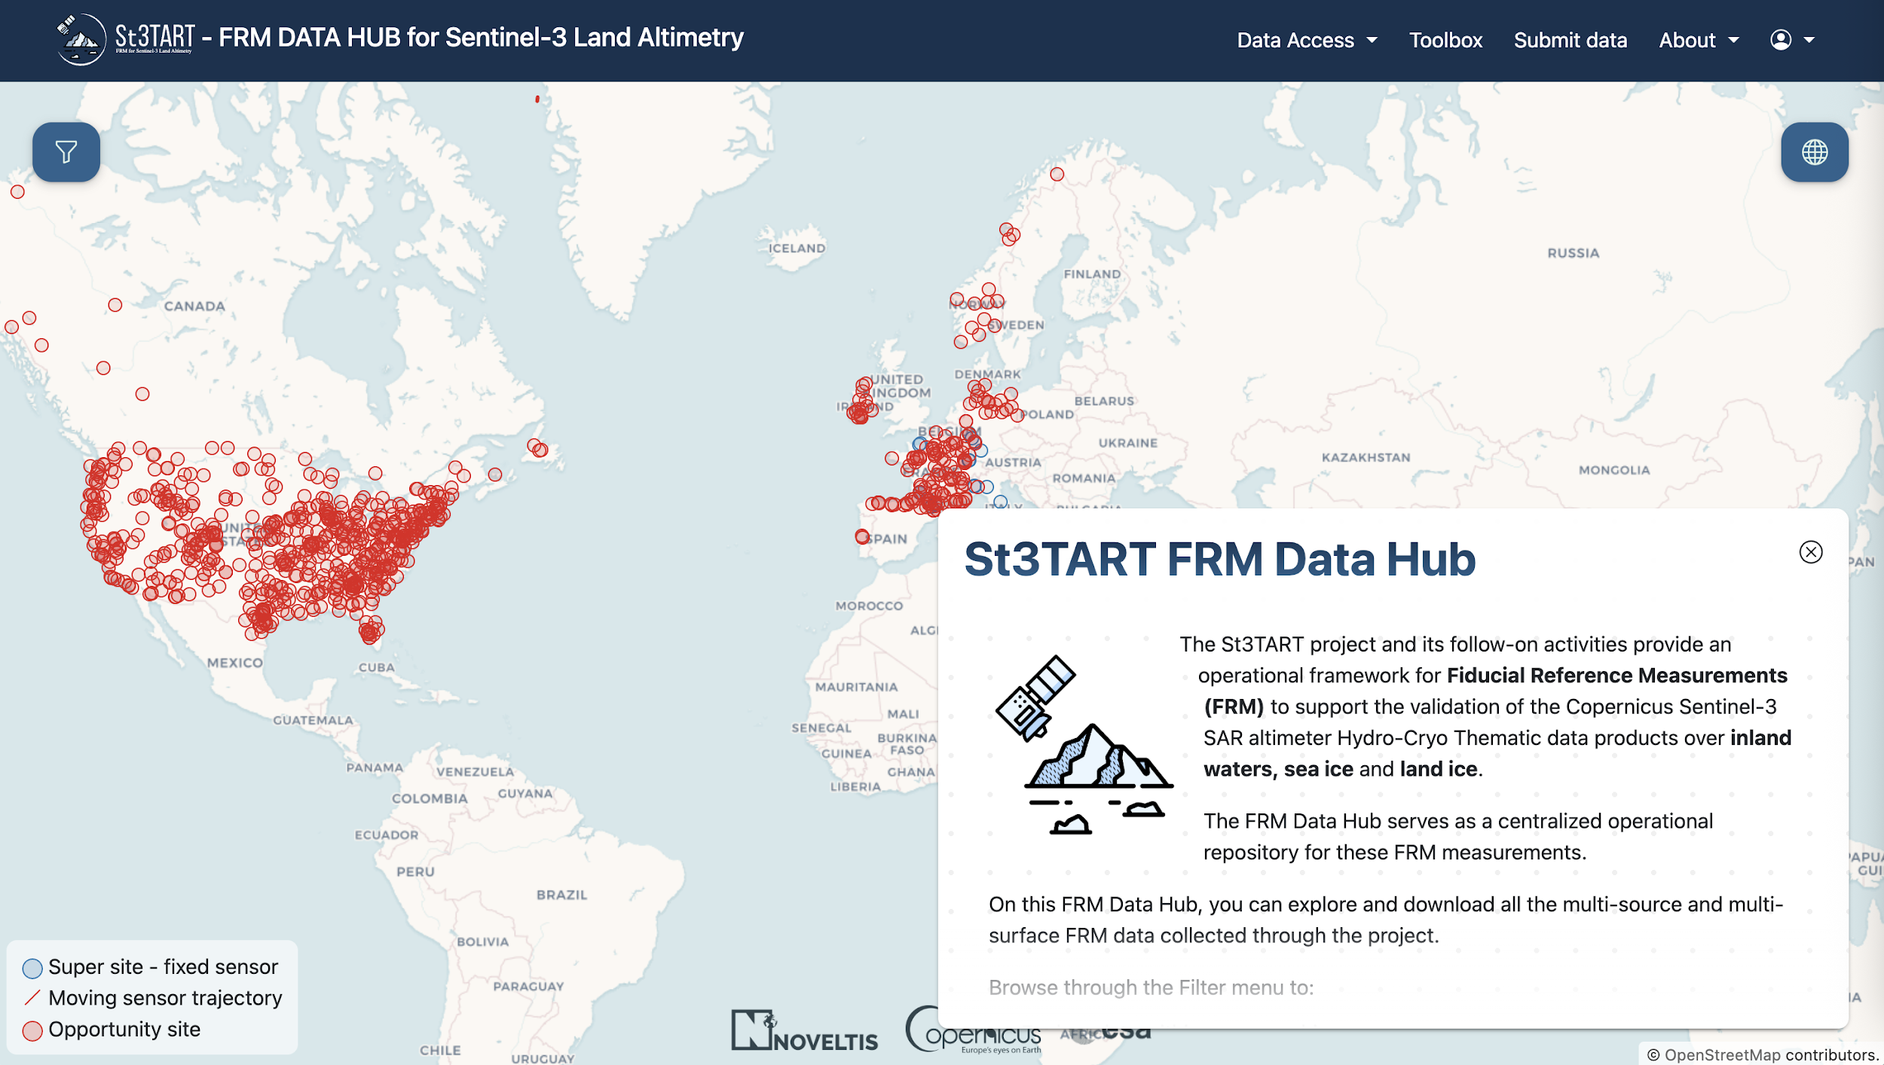
St3TART FRM Data Hub

Slide 13
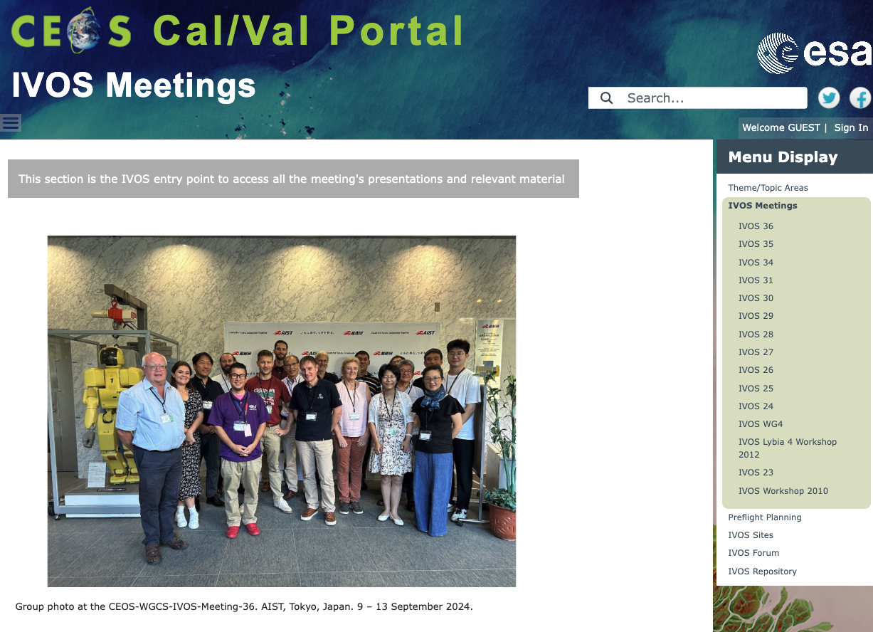
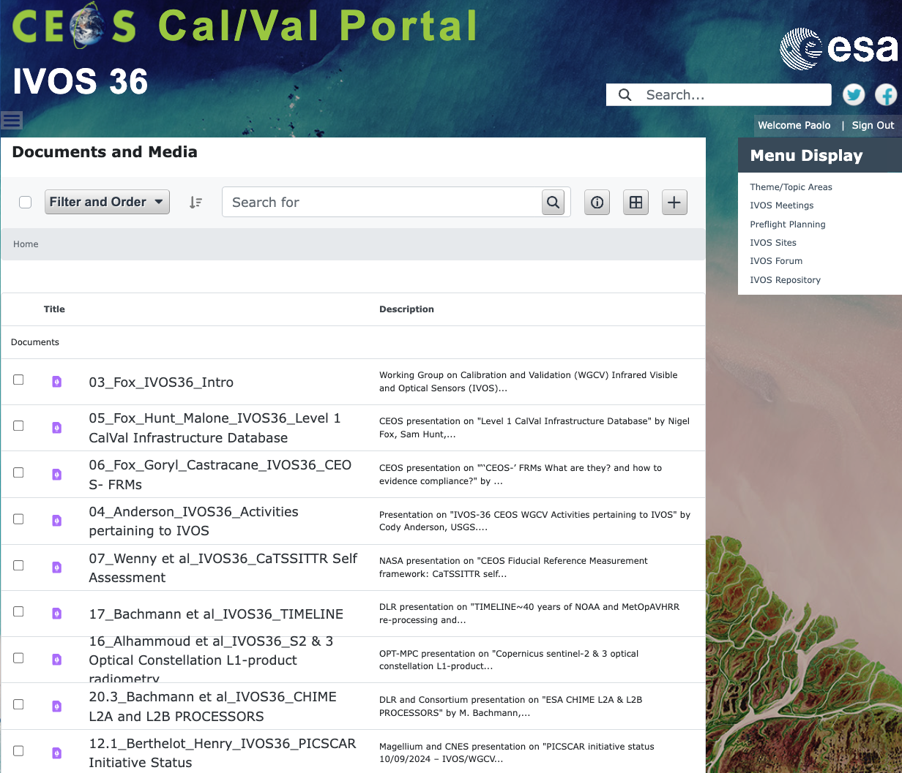
IVOS Meetings – IVOS-36
IVOS Meetings
CEOS-WGCS-IVOS-Meeting-36. AIST, Tokyo, Japan. 9 – 13 September 2024.
Presentations
MoM
Now available!

Slide 14
CEOS-SAR Cal/Val 2025
The CEOS SAR Calibration and Validation Workshop 2025 (CEOS SAR Cal & Val 2025) will be hosted by the Synthetic Aperture Radar Laboratory (SARlab) of the Simon Fraser University (SFU), in collaboration with MDA Space, Your Trusted Space Mission Partner | MDA Space.
The Workshop will be held at SFU’s Harbour Centre (Harbour Centre - Vancouver Campus - Simon Fraser University), downtown Vancouver, Canada, from 27 to 30 October, 2025.

Slide 15
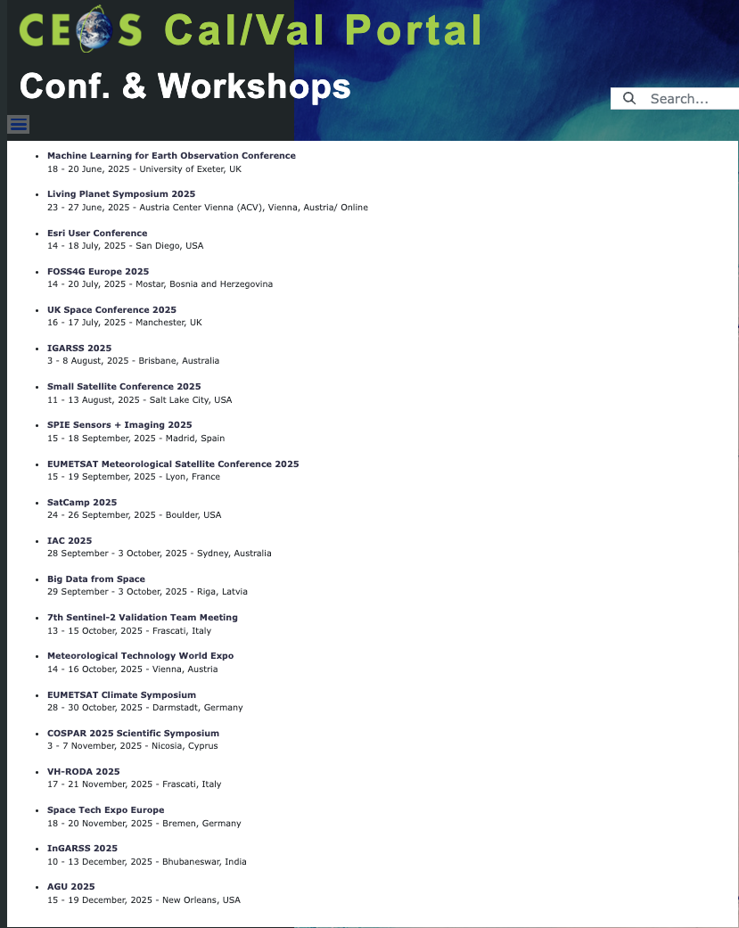
Conferences and Workshops
List of relevant Conferences and workshops maintained and updated by Claire Aitkenhead

Slide 16
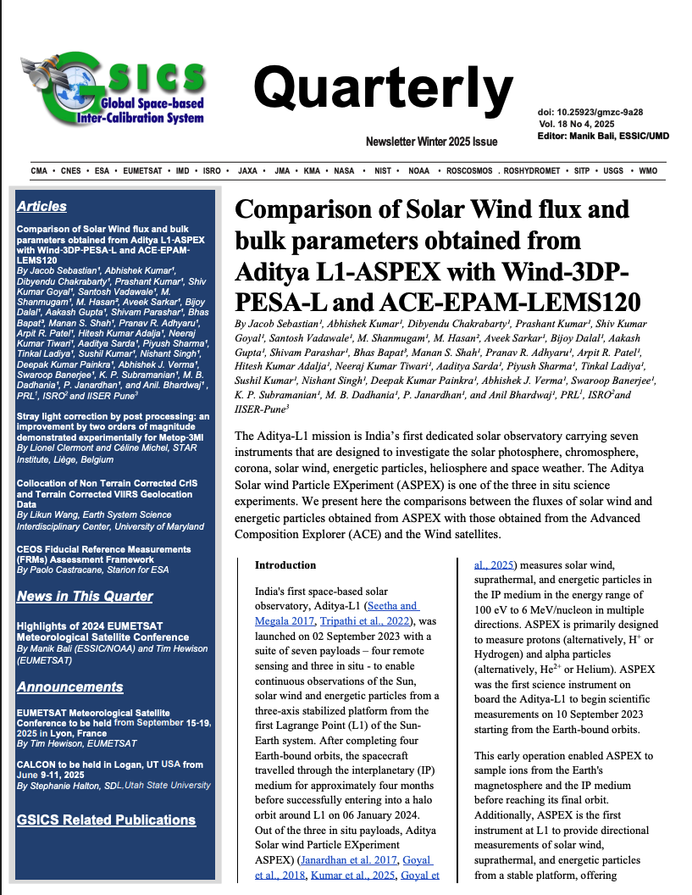
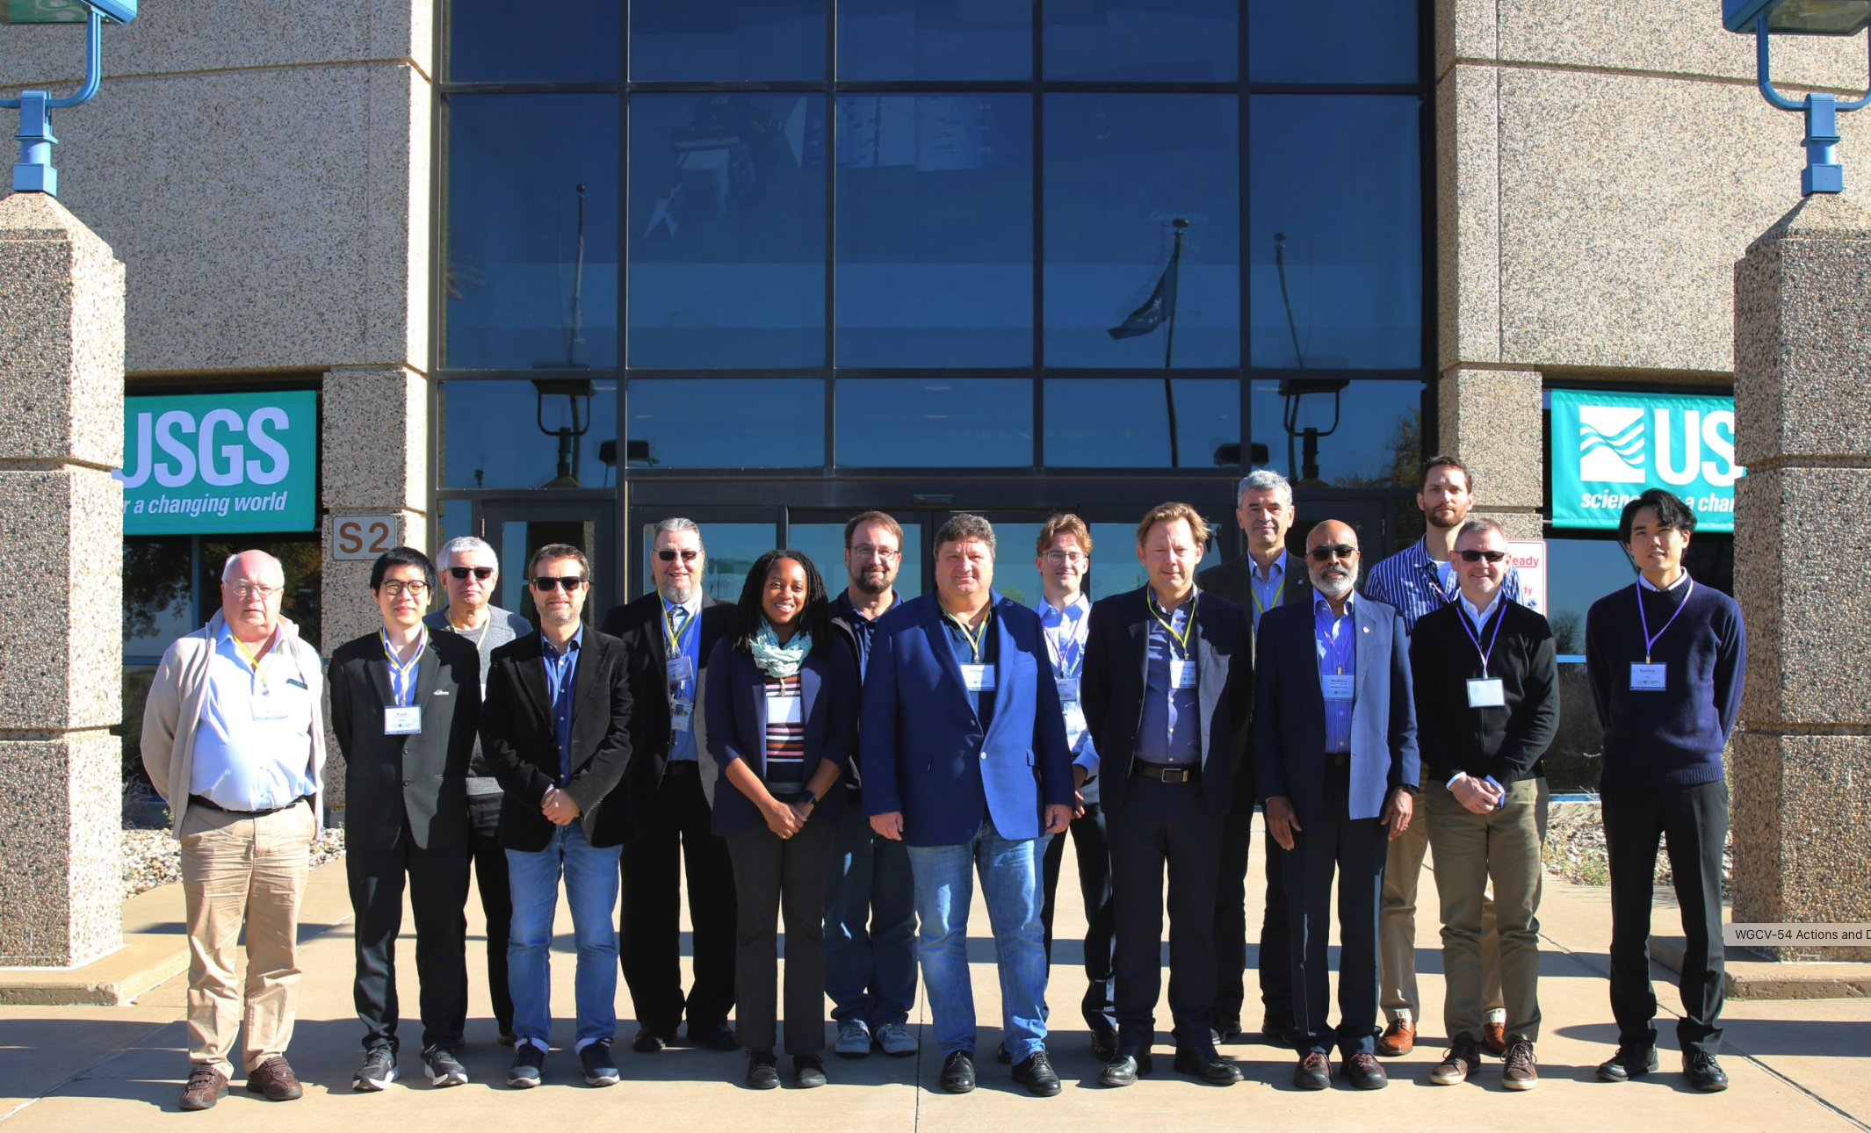
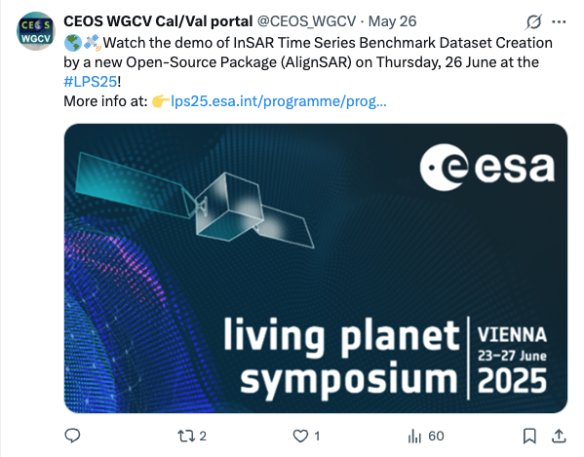
Outreach
News content updates
Outreach, video tutorials, X post, contact and support
Newsletter

Slide 17
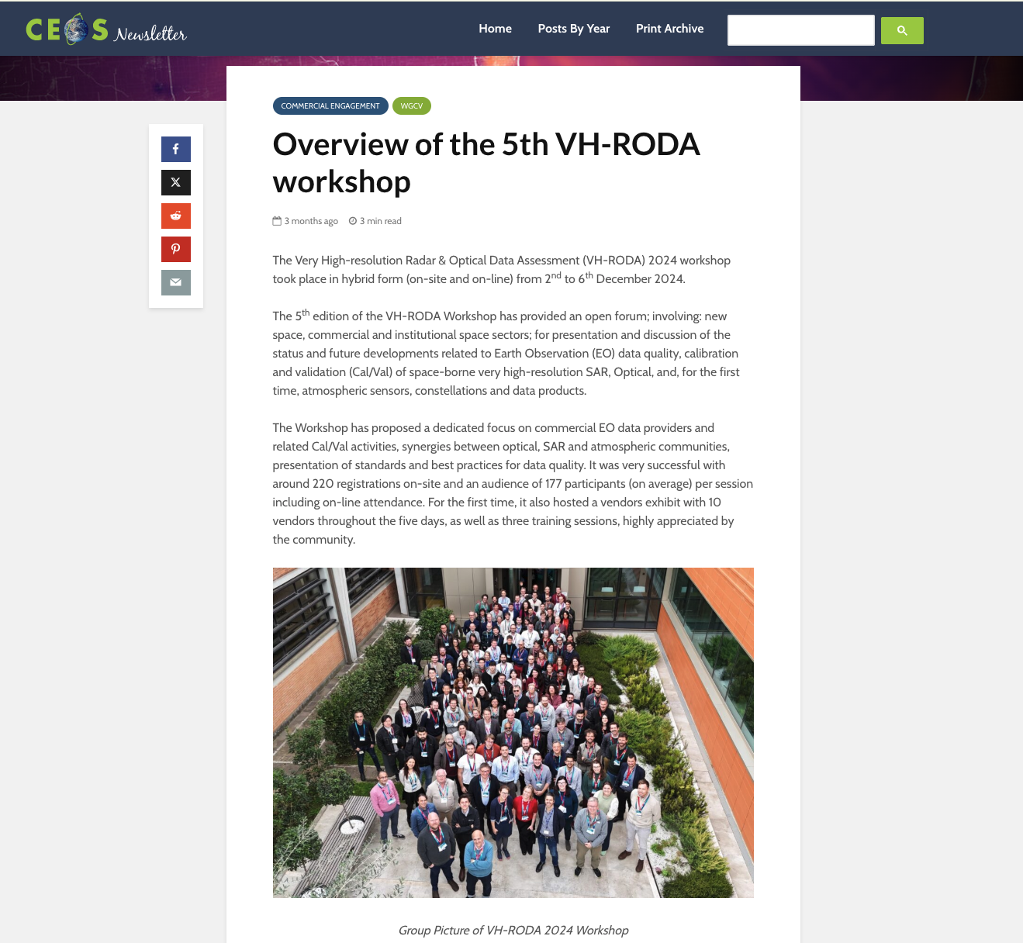
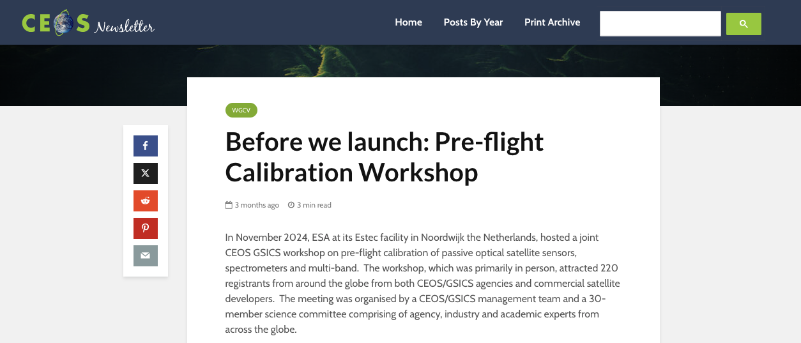
Conclusion
Several ongoing activities (e.g. FRMs Assessment Framework page, SITSat pages, Subgroups updates, Dictionary team, Cal/Val Portal Newsletter etc.)
Continue collaboration with CEOS WGISS (e.g. WGISS Data Management and Stewardship Maturity Matrix teams and the Interoperability team)
Coordinate outreach with CEOS.org team – CEOS Newsletter examples:

