Slide 1
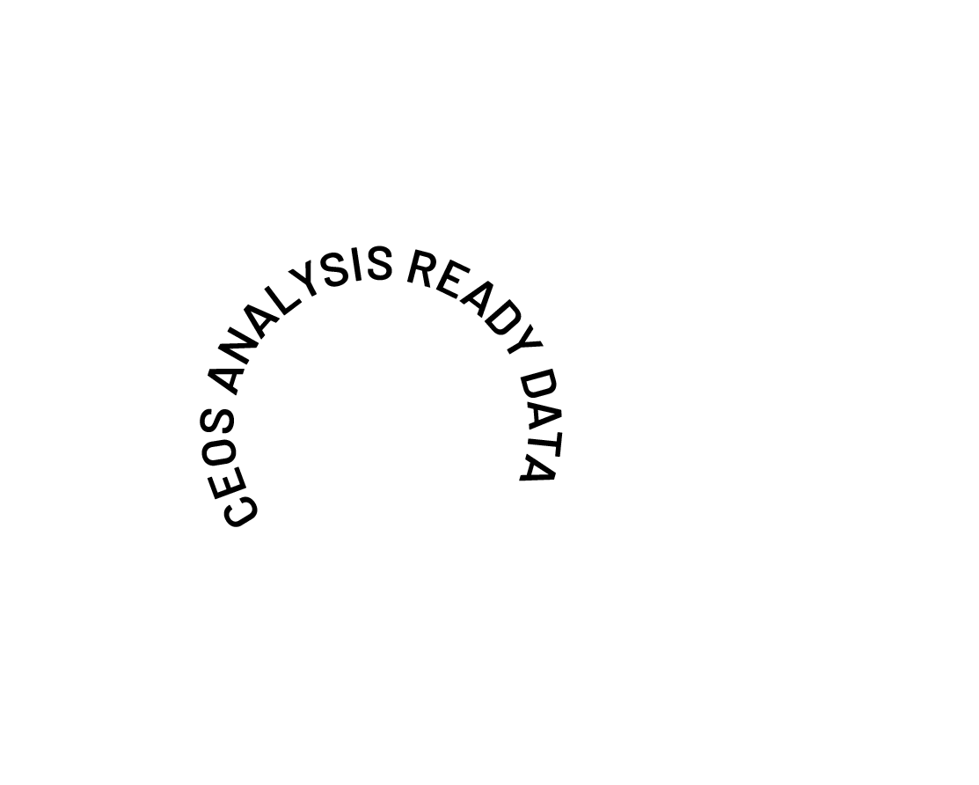
The Future of CEOS Analysis Ready Data
Matthew Steventon
CEOS-ARD Secretariat
Help shape the future of CEOS-ARD
WGCV-55, 10 July 2025

Slide 2
Presentation Overview
Goals for 2025:
Gathering community feedback on the current state of CEOS-ARD
Understanding priorities for future development
More engagement outside of CEOS
Feedback will contribute to a proposal to be presented to senior space agency and EO program leadership at the CEOS Plenary meeting later this year.
Today we will cover:
Background
Current status
Impact
Future considerations and use cases such as AI/ML
How to engage, questionnaire
We want to ensure CEOS-ARD is working for the broadest group of stakeholders – your input matters!
WGCV-55, 10 July 2025

Slide 3
Background
CEOS Analysis Ready Data (CEOS-ARD) are satellite data that have been processed to a minimum set of requirements and organized into a form that allows immediate analysis with a minimum of additional user effort and interoperability both through time and with other datasets.
Established by the Committee on Earth Observation Satellites in 2016
CEOS membership comprises the world’s major space agencies
Aims:
Reduce barriers to the uptake of EO
Enable new applications and users
Improve data interoperability across both the public and private sectors
Approach:
Require a suitable degree of pre-processing – exact methods are up to the data provider
Providing analysis-ready geophysical measurements (primarily L2)
Ensuring robust metadata and documentation
Providing an open and transparent first step for data interoperability
Everyone is welcome to participate and benefit – across both the public and private sectors!
WGCV-55, 10 July 2025

Slide 4
Why CEOS-ARD?
Data Providers | Data Users
Lower barriers to data uptake Open new user bases and markets Streamlined data procurement Increase user confidence Encourage operational uptake | Minimise data preparation overhead Improved documentation and metadata Leverage data provider expertise Increasing interoperability Data supply resilience and scalability
WGCV-55, 10 July 2025

Slide 5
Since 2016, CEOS has developed nine CEOS-ARD Product Family Specifications (PFS)
WGCV-55, 10 July 2025
* Combined SAR PFS includes: Normalised Radar Backscatter, Polarimetric Radar, Ocean Radar Backscatter, Geocoded Single-Look Complex, Interferometric Radar

Slide 6
Future PFS Vision
Recognized that CEOS-ARD PFS need modernization to scale and ensure consistency with an expanding number of specification types, products, and contributors.
Consistent requirements, terminology, definitions
Also aim to foster open collaboration, boost engagement from data providers and users, and simplify the development of new PFS through automation.
Document co-authoring and generation, self-assessments, compliance checks / peer reviews.
Build in alignment with existing metadata standards (e.g. STAC) and therefore with other software/tools.
Embrace modern, transparent collaboration practices using GitHub for discussions, issue tracking, change management, and version control.
WGCV-55, 10 July 2025

Slide 7
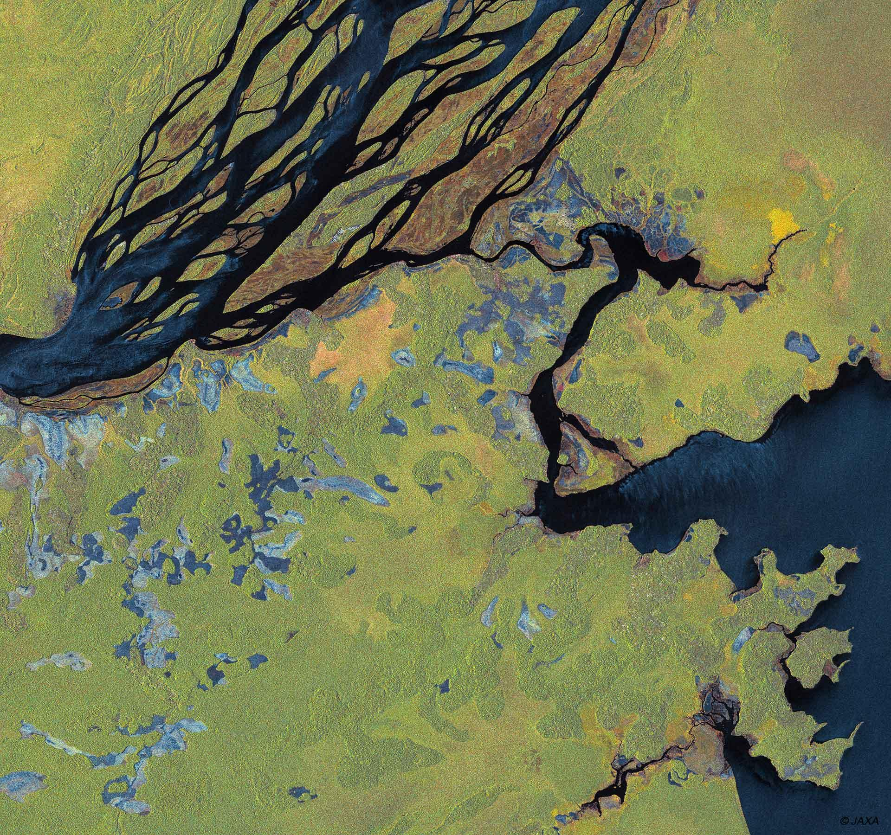
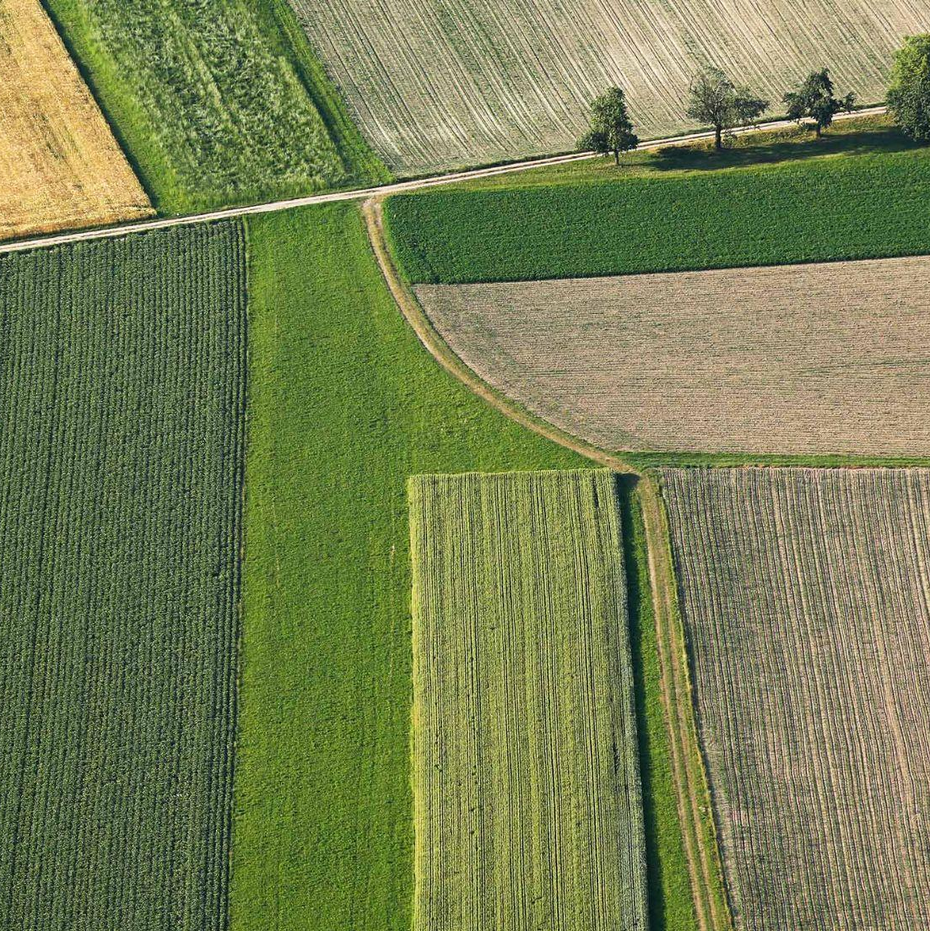
Where are we now?
CEOS-ARD Specifications have been powerful catalysts for progress:
USGS Landsat Collection 2
Copernicus Sentinel-2 Collection 1
ALOS-2 PALSAR-2 ScanSAR NRB and Global Mosaics
DLR EnMAP
ISRO RISAT-1A
And many more… See all datasets on ceos.org/ard
CEOS-ARD Product Family Specifications
Synthetic Aperture Radar
Normalised Radar Backscatter, Polarimetric Radar, Ocean Radar Backscatter, Geocoded Single-Look Complex, Interferometric Radar
Surface Reflectance
Nighttime Lights Surface Radiance
Surface Temperature
Aquatic Reflectance
WGCV-55, 10 July 2025

Slide 8
See all datasets on ceos.org/ard

Slide 9
Great Impact
For our Global Mangrove Watch (GMW) data workflow where we process thousands of images, the CEOS-ARD standard used for the JERS-1/ALOS/ALOS-2 SAR data from JAXA has simplified our processing chains with data now provided as GeoTIFFs and with standardised metadata. The specified pre-processing, including geometric rectification and radiometric terrain correction, has also been a significant help and reduced our internal data processing effort.
Dr Pete Bunting, Global Mangrove Watch Product Lead, Aberystwyth University, UK
By adopting CEOS Analysis Ready Data (CEOS-ARD) specifications, Digital Earth Africa is ensuring that satellite data is available, findable, accessible, and suitable for use by as many users as possible. Using CEOS-ARD, DE Africa is providing a rich source of information to better understand and address challenges of sustainable development in Africa. This information tells a story over time to support decision-making by governments, private sector and civil society.
Dr Adam Lewis PSM, Senior Advisor on the Global Team for Digital Earth Africa
Landsat Collection 2’s compliance with CEOS-ARD standards has been a game changer for the global Earth observation community. Users gain faster, more dependable insights for diverse applications from land cover change and agricultural monitoring to natural resource management and disaster response. CEOS-ARD compliance has truly unlocked the analytical power of the 50+ year Landsat archive, significantly enhancing USGS's contribution to our understanding and stewardship of the planet.
Dr. Christopher Barnes (KBR), Sustainable Land Imaging Partnerships, USGS EROS Center, USA
WGCV-55, 10 July 2025

Slide 10
But can we do more?
The Earth observation sector has come a long way since CEOS-ARD was first conceptualised:
Changing technology, including AI/ML, cloud-native
Evolving user base and expectations
Increasing demands for interoperability
Need to ensure we keep moving forward
Where are the opportunities to make CEOS-ARD better?
Seeking your guidance to help shape the future of CEOS Analysis Ready Data !
WGCV-55, 10 July 2025

Slide 11
Food for Thought
What characteristics make an EO dataset ‘analysis ready’?
How can we drive increased AI/ML readiness of CEOS-ARD?
Is the value proposition of CEOS-ARD clear and could it be better communicated?
The potential role of CEOS-ARD as a common benchmark for space agency / governmental data procurement processes.
Specific datasets you would like to see assessed and endorsed as CEOS-ARD?
Do we need to introduce minimum requirements for data quality? And what is the correct approach?
Can we better support users to find products that are fit for a specific purpose?
Supporting application resilience by increasing consistency and equivalence of CEOS-ARD products?
How might CEOS-ARD be made more interoperable and interchangeable? Do we need to be stricter in certain areas to drive practical interoperability?
Do we need formal standards? Or is it sufficient to embrace ‘community standards’ ?
WGCV-55, 10 July 2025

Slide 12
Continuing the dialogue
Future of CEOS-ARD Questionnaire
ceos.org/ard/survey
WGCV-55, 10 July 2025

Slide 13
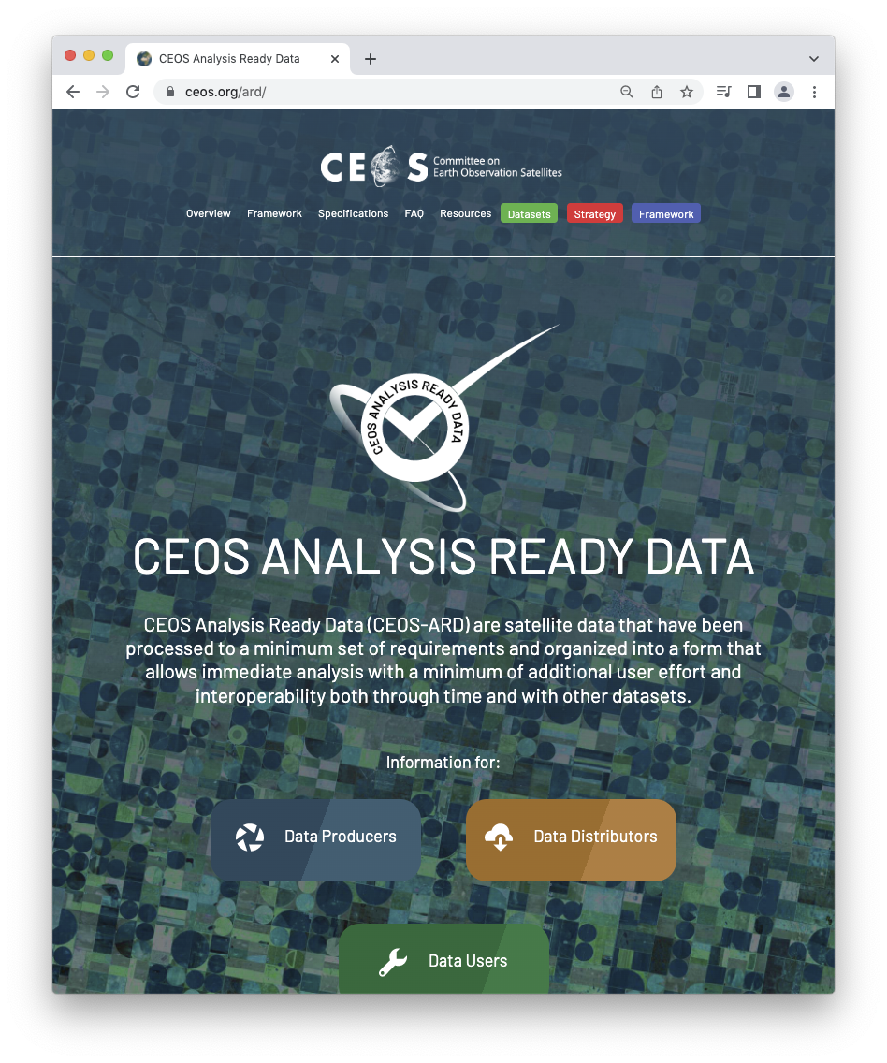
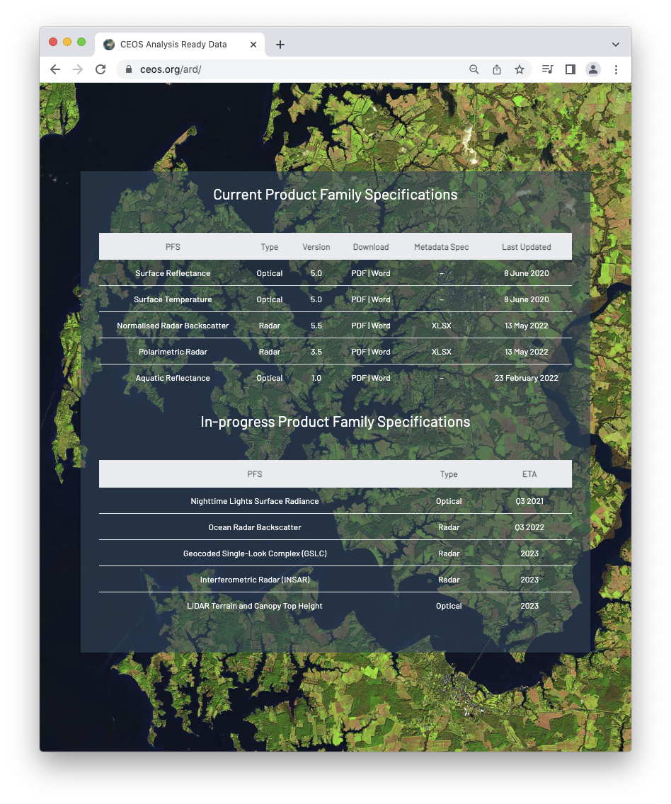
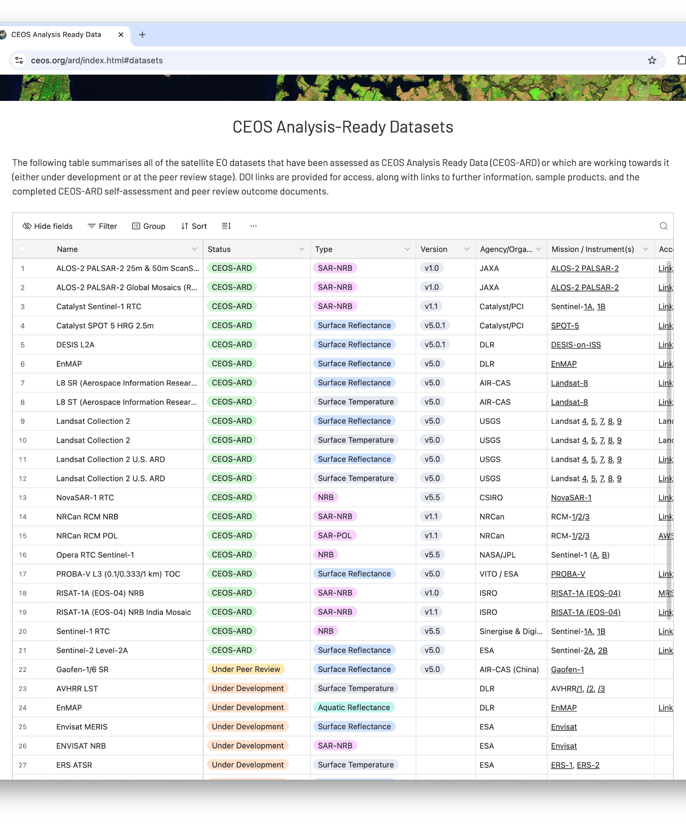
Connect
ceos.org/ard
Contact form on page
Or directly:
matthew@symbioscomms.com
Ferran.Gascon@esa.int
ESA Living Planet Symposium 2025

Slide 14
Help shape the future of CEOS Analysis Ready Data
ceos.org/ard/survey

