Slide 1
WGCV-55
GHG Cal/Val and Network Updates
Jean-Christopher Lambert,
Mahesh Kumar Sha (BIRA-IASB)
Hiroshi Suto, Kei Shiomi, Kazuhisa Tanada (JAXA)
WGCV-55 Agenda Item 3.12
Hyderabad, Telangana, India
8-11 July 2025

Slide 2
GHG Cal/Val and Networks
Roadmap Issue 2 – Annex C Action
L1B intercalibration (VICAL, RRV…) L1CAL-01/02/03
Match-up database
GHG Cal/Val networks L2VAL-03
Common practices for detecting methane emissions BP-01

Slide 3
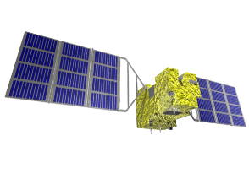
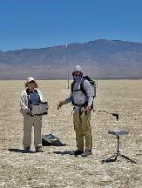
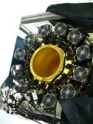
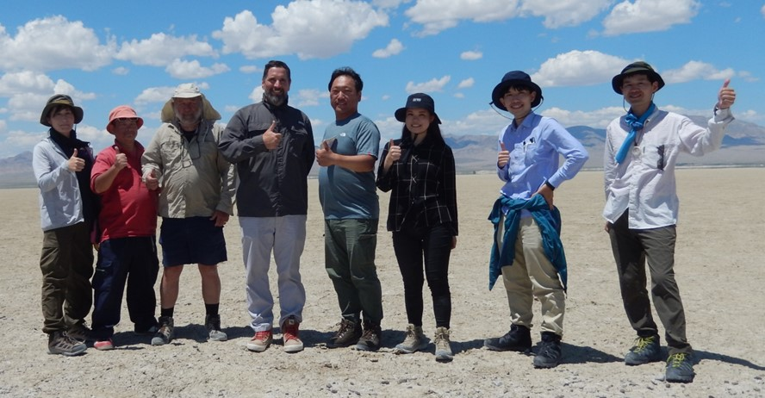
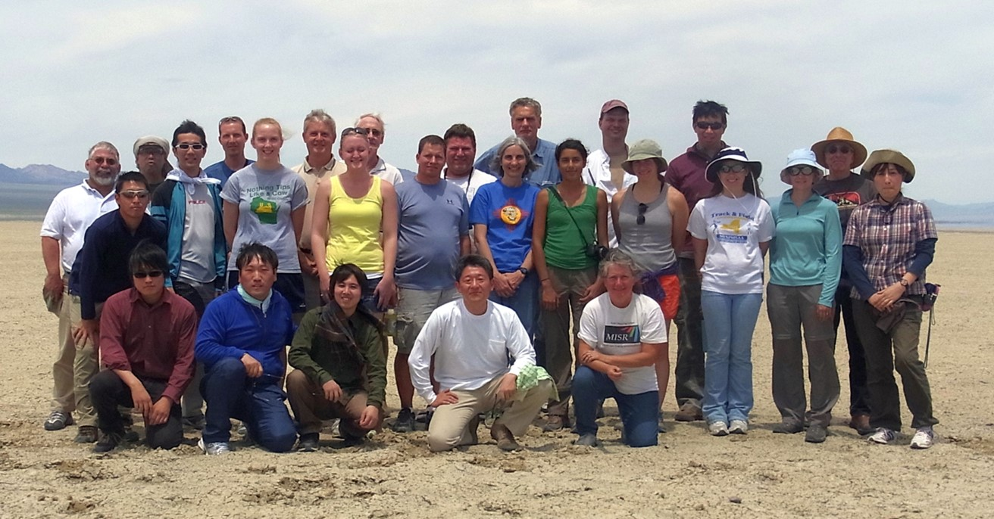
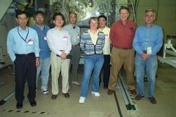
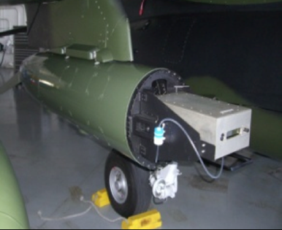
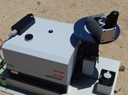
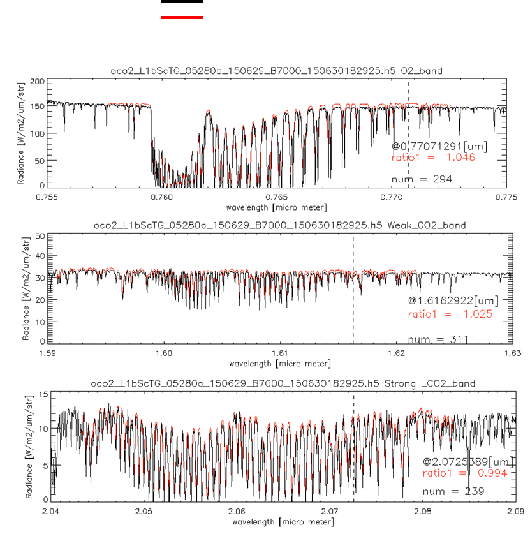
International collaboration for GHG sensors calibration
2008 09 10 11 12 13 14 15 16 17 18 19 20 21 22 23 24 25
Radiometric calibration
Prelaunch
X-CAL
Annual Vicarious Calibration at the desert playa in Nevada
CO₂ & CH₄ profile
In situ CO₂ and CH₄ on AJAX
XCO₂ & XCH₄
Column with EM-27 FTS
GOSAT OCO-2
Coincident Target
Among GHG sensors and also AQ sensors
Calibrated GOSAT and OCO-2 radiance spectra agrees within 5% for all bands.

Slide 4
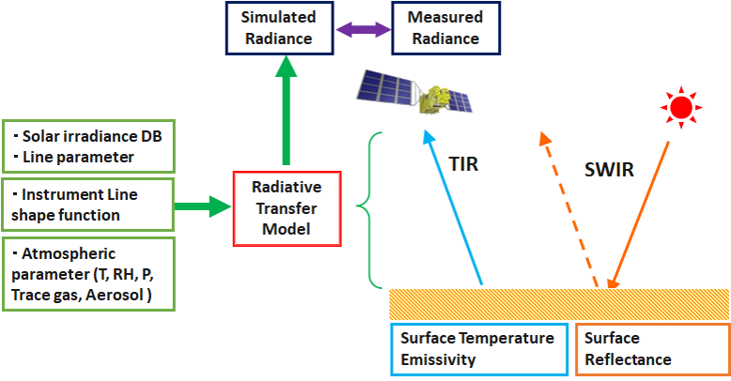
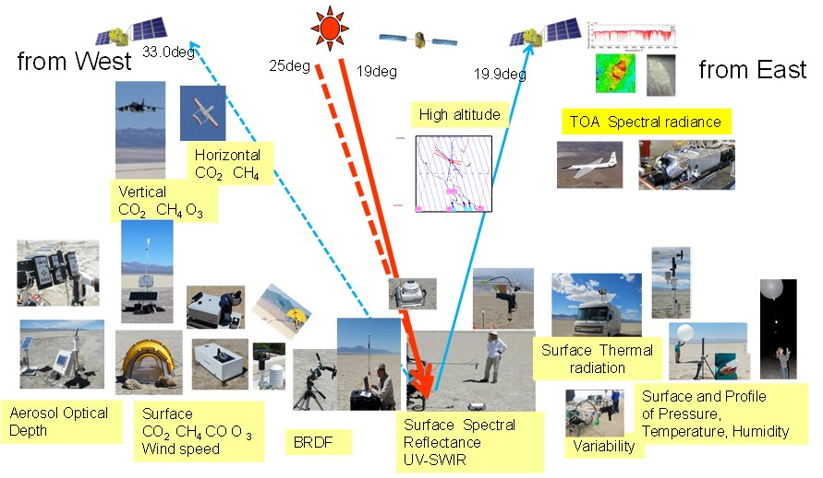
Railroad Valley vicarious calibration for GHG and AQ sensors
Key parameters
(1) Surface reflectance inhomogeneity correction
(2) Surface BRF correction
(3) Solar database
(4) Atmospheric parameter
We will calculate all sensors for validating radiometric calibration accuracy by the same target.

Slide 5
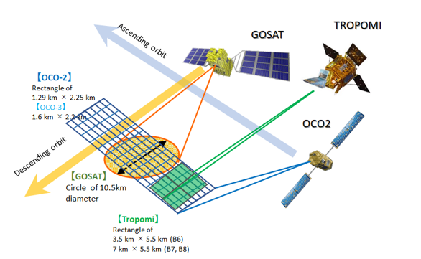
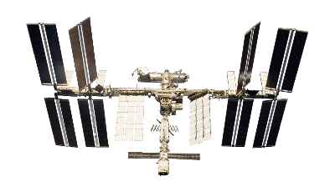
Railroad Valley target by multiple GHG and AQ sensors
GOSAT-2
RRV 2022 Summer Campaign schedule
Date | DoW | OCO-2 path | GOSAT path | GOSAT-2 path | TROPOMI InstZA [deg]
8-Jun-22 | Wed |  | no | no | 53.6 | RRV
9-Jun-22 | Thu | 138 | 36 | 72 | 8.1 | RRV
10-Jun-22 | Fri |  | 37 | 73 | 6.9 | RRV
11-Jun-22 | Sat | 136 | no | 74 | 46.3 | RRV
12-Jun-22 | Sun |  | 36 | no | 31.7 | RRV
13-Jun-22 | Mon |  | 37 | no | 46.6 | RRV
Good conditions for all sensors come every 48 days.
 | Nadir footprint size
GOSAT | Circle of 10.5km diameter
GOSAT-2 | Circle of 9.6km diameter
OCO-2 | Rectangle of 1.3 km * 2.3 km
OCO-3 | Rectangle of 1.6 km * 2.2 km
TROPOMI | Rectangle of 3.5 km * 5.5 km (B6) 7 km * 5.5 km (B7, B8)
OCO-3

Slide 6
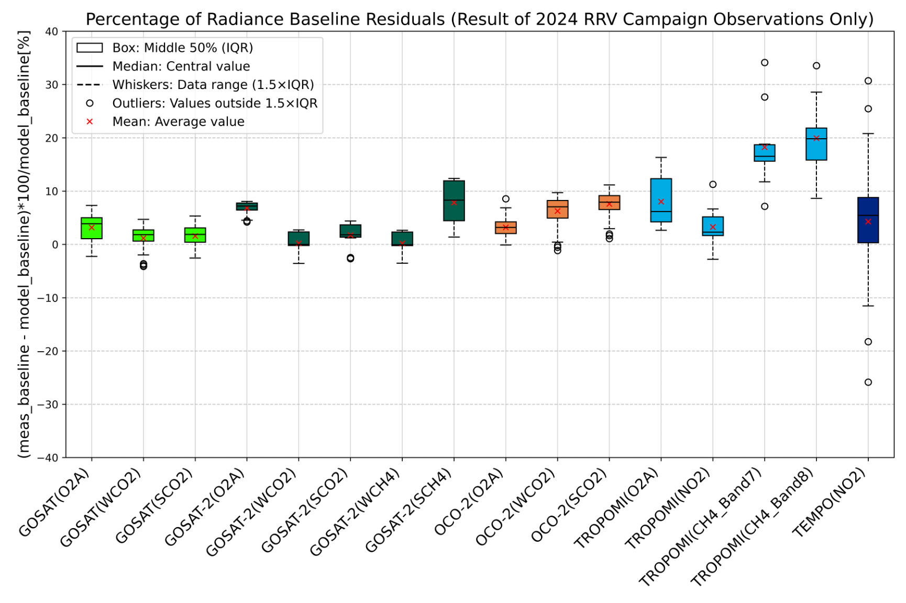
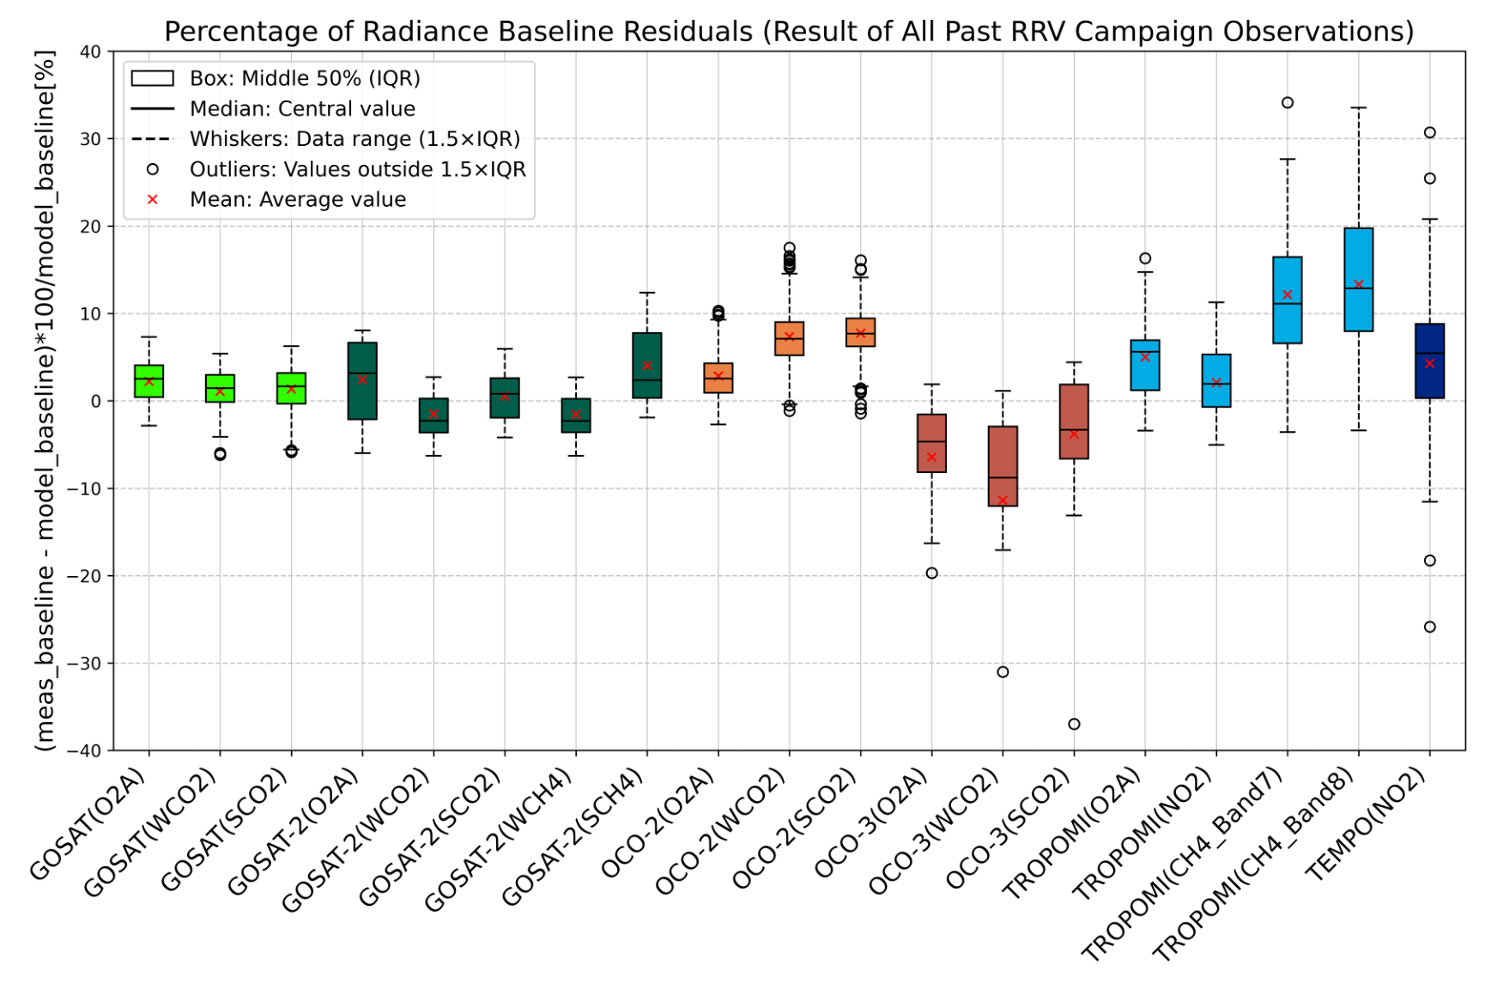
Multiple sensors VCAL results for RRV2024 and averaged all RRV campaigns
+/-5% variation
Evaluation periods:
GOSAT: 2019 – 2024 (except.2020)
OCO-2: 2019 – 2024 (except.2020)
GOSAT-2: 2019 - 2024
TROPOMI: 2021 -2024
OCO-3: 2021
TEMPO: 2024
Evaluation periods: Only use 2024
Large off-nadir conditions TROPOMI, TEMPO are challenging.
To reduce errors, good data qualifications are needed.
Ishida et al., AGU24

Slide 7
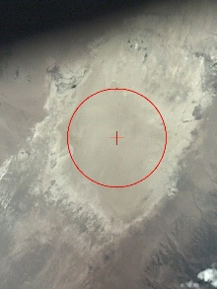
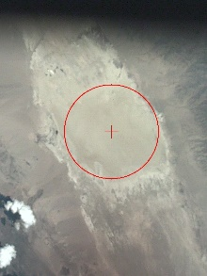
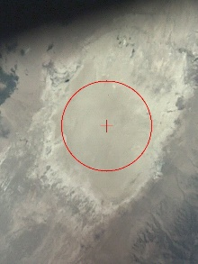
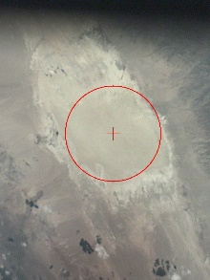
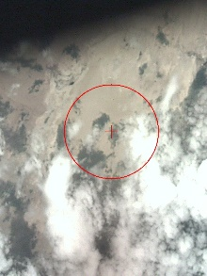
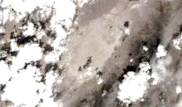
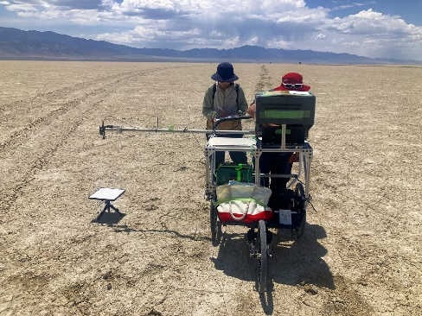
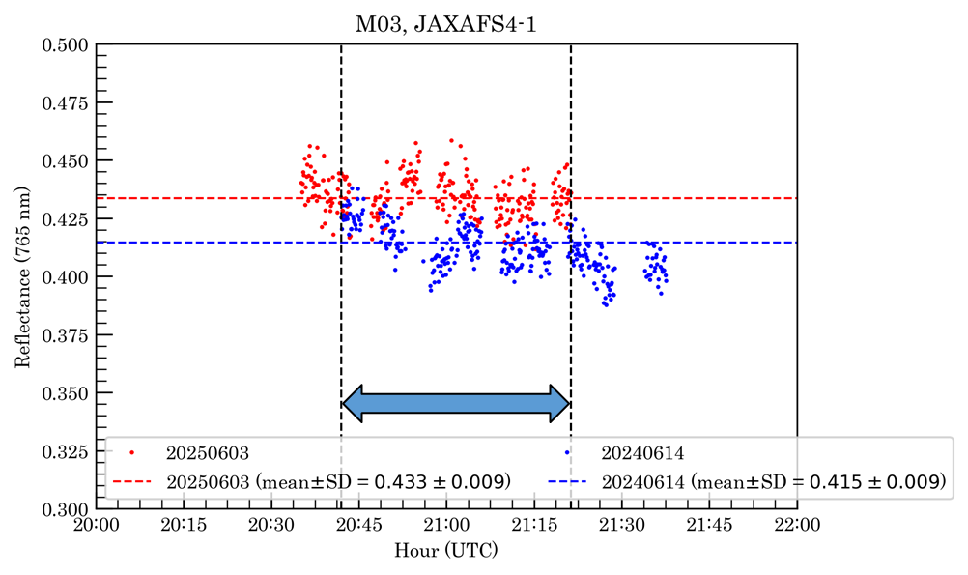
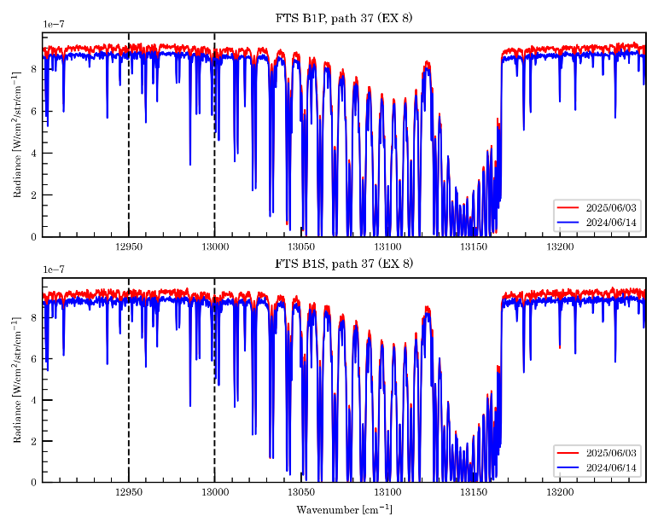
Summary of RRV2025 summer campaign Surface data collected by OCO and GOSAT teams
 | 30-May-25 | 31-May-25 | 1-Jun-25 | 2-Jun-25 | 3-Jun-25 | 4-Jun-25 | 5-Jun-25
OCO-2 path |  |  | 138 (20:53UTC) |  | 136 (20:40UTC)
GOSAT path | 36 (20:52UTC) | 37 (21:24UTC) |  | 36 (20:52UTC) | 37 (21:24UTC) | No | 36 (20:52UTC)
GOSAT-2 path | 72 (20:54UTC) | 73 (21:10UTC) | 74 (21:26UTC) |  |  | No | 72 (20:54UTC)
TROPOMI VZA[deg] | 28deg | 53.6deg | 8.1deg | 6.9deg | 46.3deg | 31.7deg | 46.6deg
OCO-3 |  |  | 19:07UTC |  |  |  | 17:35UTC
TEMPO |  | SPECICAL(21UTC) | SPECICAL(21UTC) | SPECICAL(21UTC) | SPECICAL(21UTC) |  | SPECICAL(21UTC)
GOSAT-1/-2 FOV camera 10km-FOV
Weather | Clear sky (21UTC) | Clear sky (21UTC) | Clear-up just noon Partly cloudy (21UTC) | Clear sky (21UTC) | Clear sky (21UTC) |  | Cloudy (17:35UTC) Cloudy (21UTC)
Up 3.9% in ratio
GOSAT Path37
June3-2025
June14-2024
Surface reflectance
Up 4.3% in ratio
B1P
B1S

Slide 8
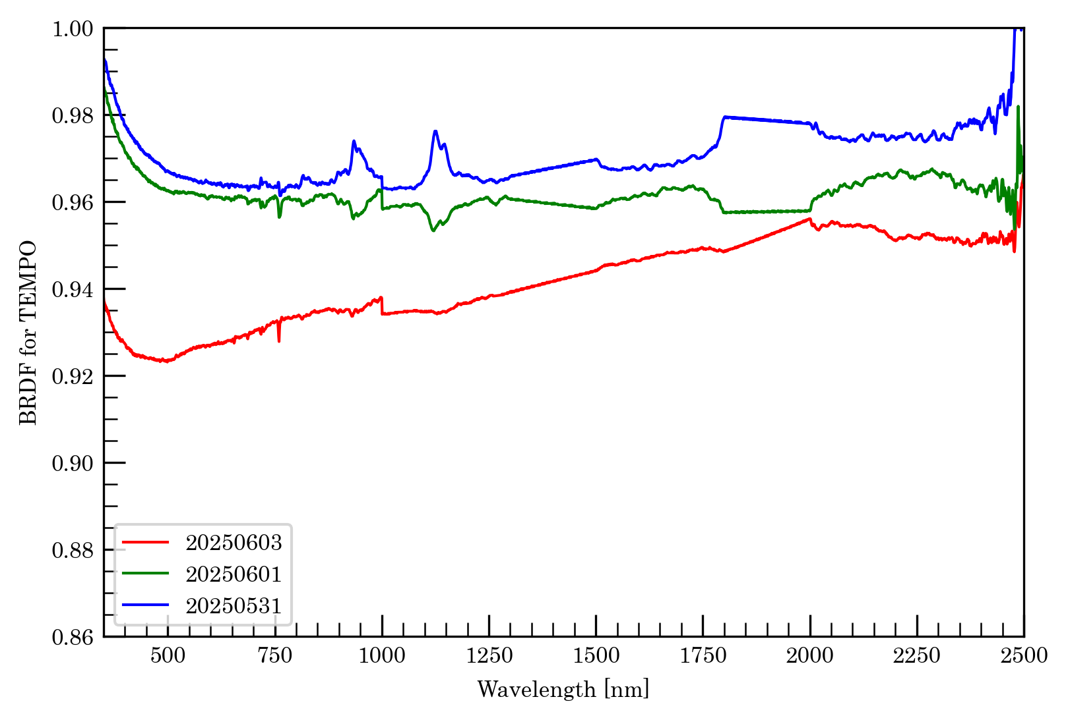
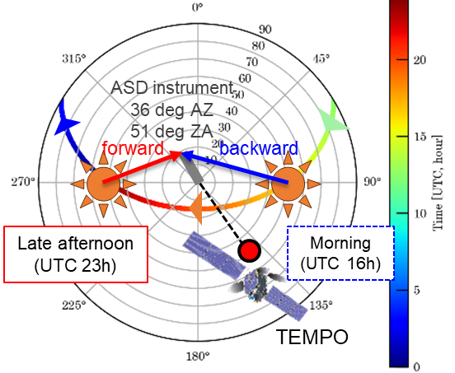
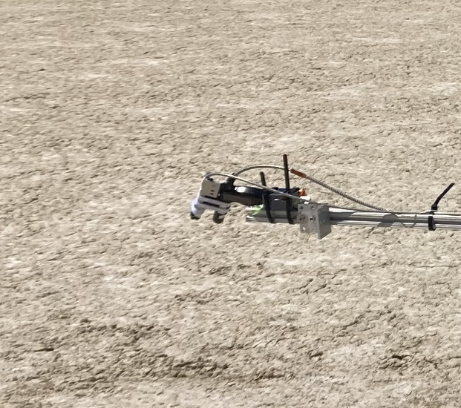
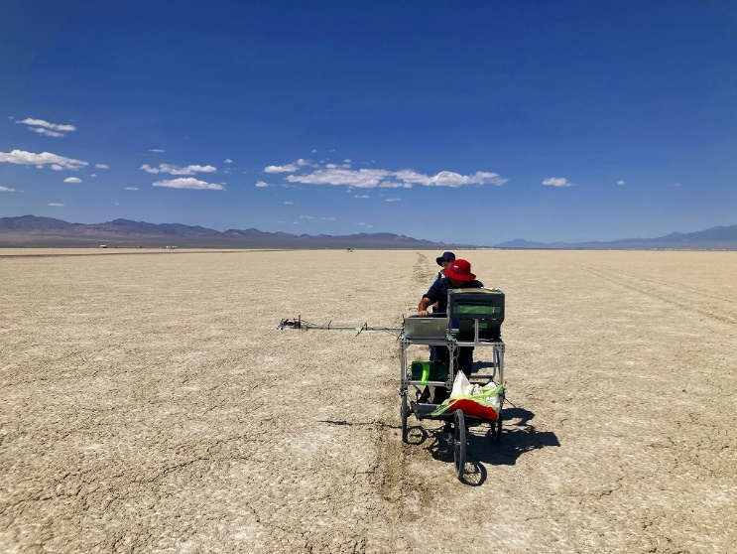
Nadir and off-nadir adjusted to the TEMPO view angle
RRV2024 TEMPO off-nadir / Nadir
RRV2025 TEMPO off-nadir / Nadir
BRDF for TEMPO measurement time:
2024/06/18 20:52 - 21:25 (UTC)
$≈$ TEMPO observation time at RRV
May31, June1 before rain
Off-nadir/ Nadir
June3 after rain
〇 MODIS BRDF product
☆ VIIRS BRDF product
South

Slide 9
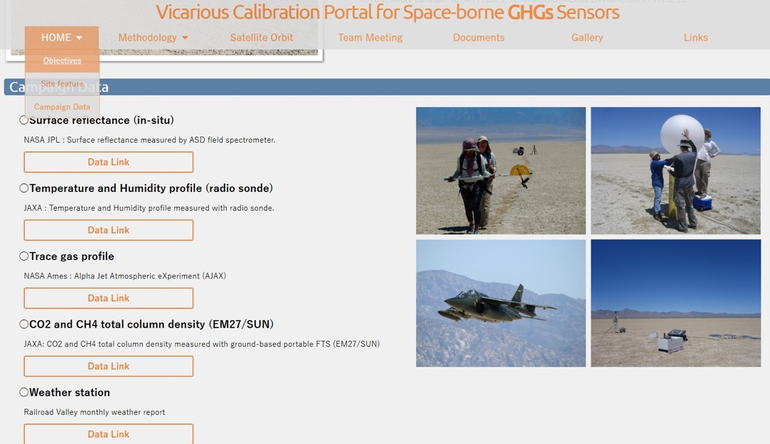
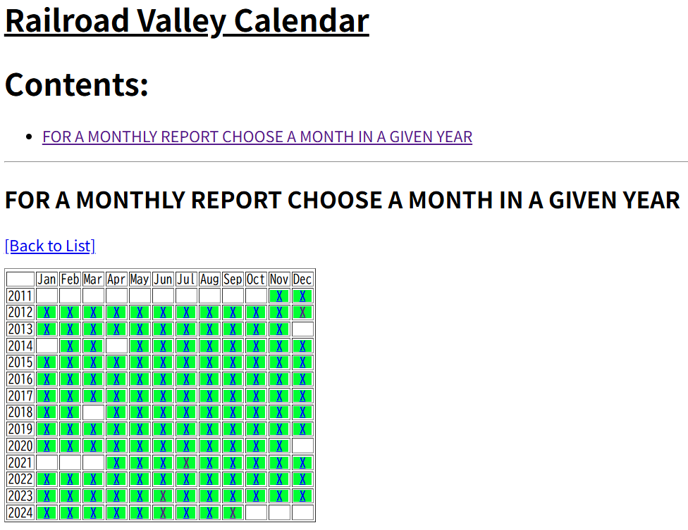
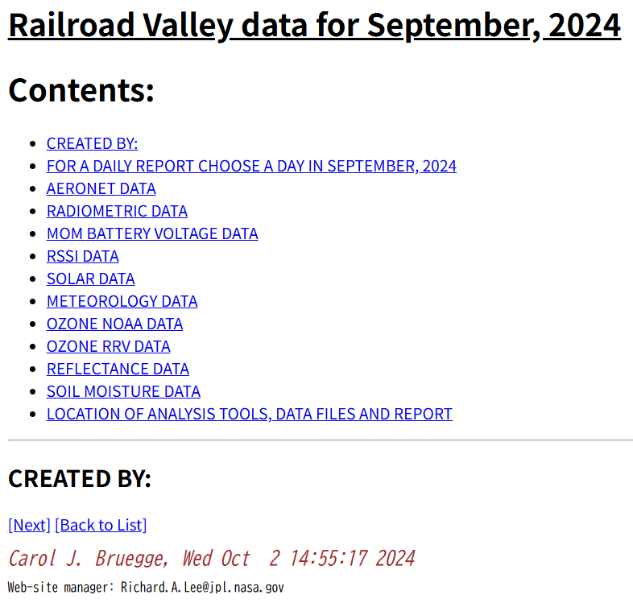
VCAL Portal site for field data access
VCAL portal site update
Weather station data at RRV collected by JPL
Update soon
New
https://www.eorc.jaxa.jp/GOSAT/GHGs_Vical/index.html
The Railroad Valley field data are available from VCAL portal site.
Next Updating the re-analysis of the surface reflectance by careful screening
Adding the weather station data collected by JPL

Slide 10
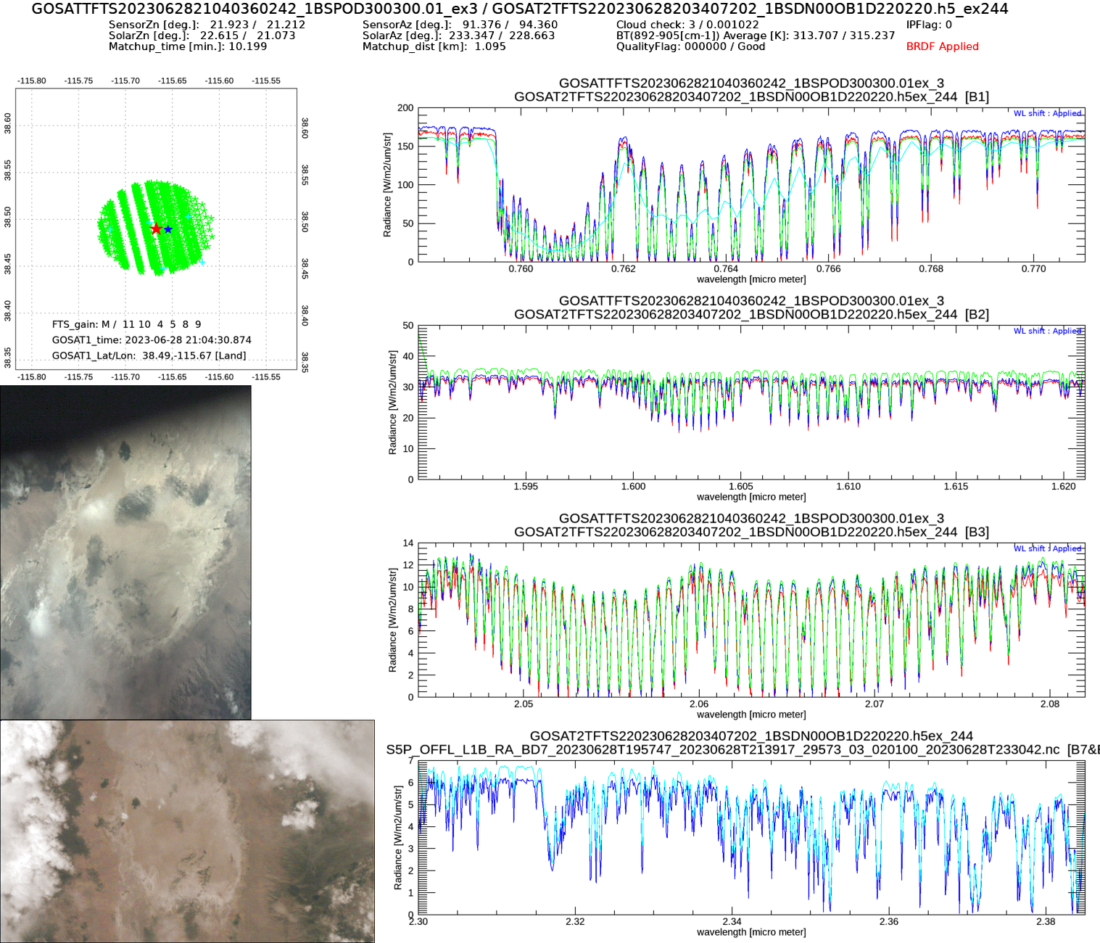
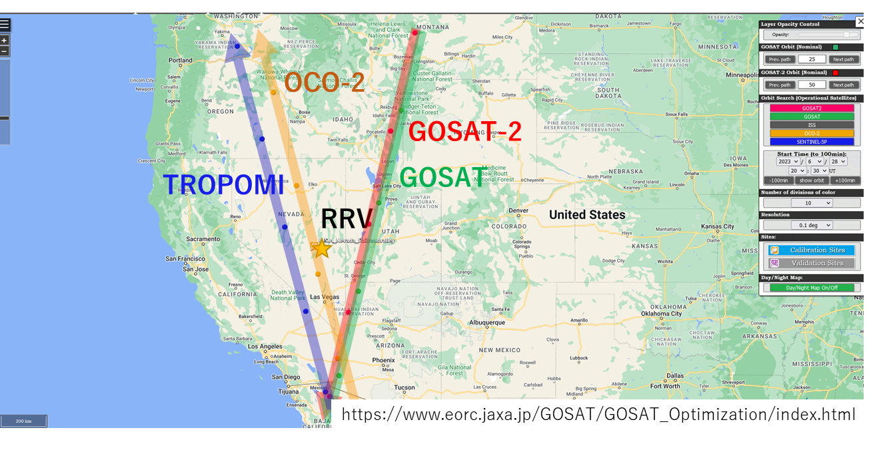
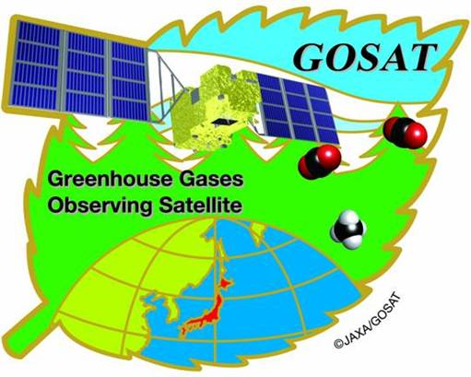
Intercomparison of GHG sensors simultaneous measurements at RRV
BRDF applied
2023/06/28
GOSAT (21:04) V300
GOSAT-2 (20:54) V200
OCO-2 (20:53) B11r
OCO-3
TROPOMI(20:51)
All sensors SatZA=20-23deg

Slide 11
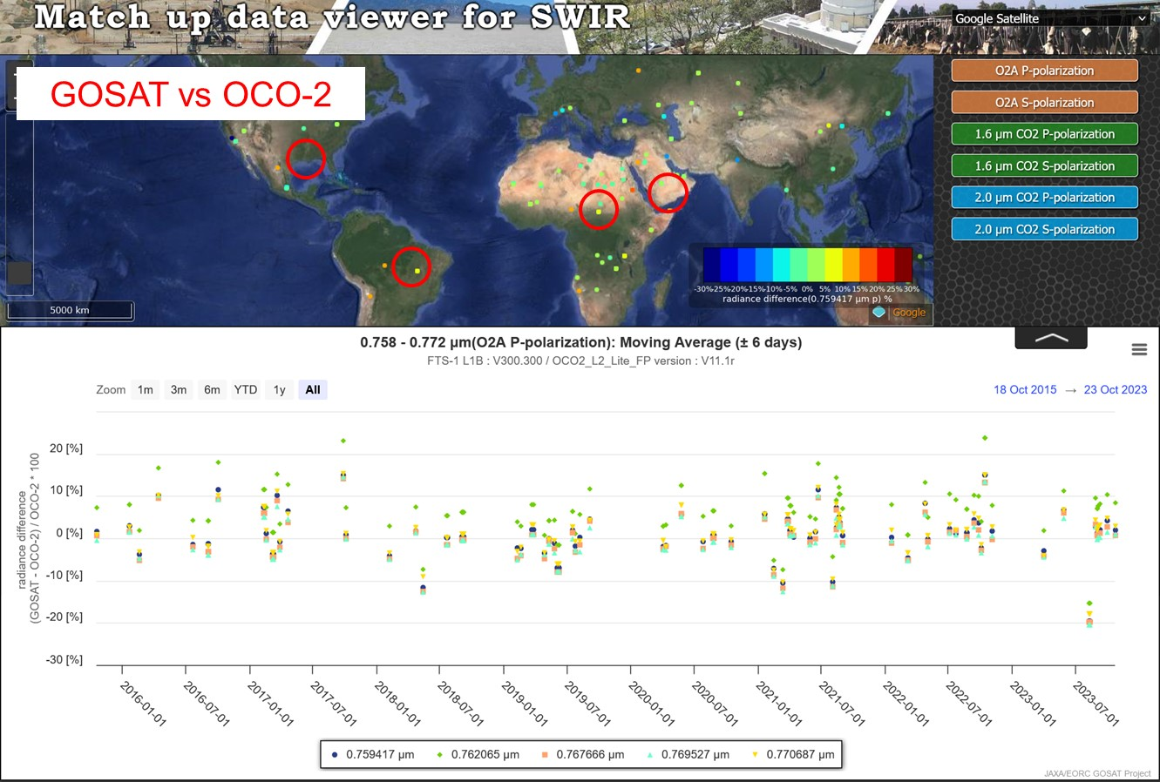
Match-up data viewer of GHG sensors L1 and L2
To harmonize the multiple GHG data, inter-comparisons of the sensor radiances or gas densities are important to confirm the biases in spatial and temporal variations.
GOSAT vs OCO-2 O2A radiance spectra
Degradation corrected
Cloud screened (successful L2)
Most of the data agree within 10% for all three bands except for over forest.
SWIR
Calibrated radiance
XCO2, XCH4, SIF, AOT
TIR
Calibrated radiance
Brightness temperature
https://www.eorc.jaxa.jp/GOSAT/Matchup_forCal/top_matchup_viewer.html

Slide 12
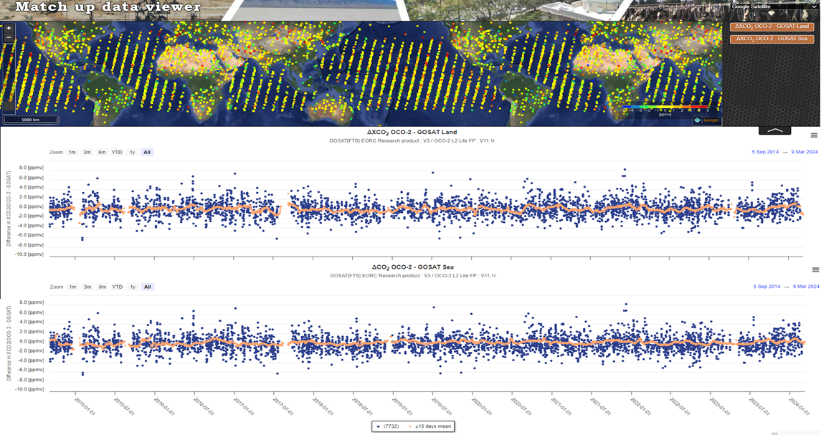
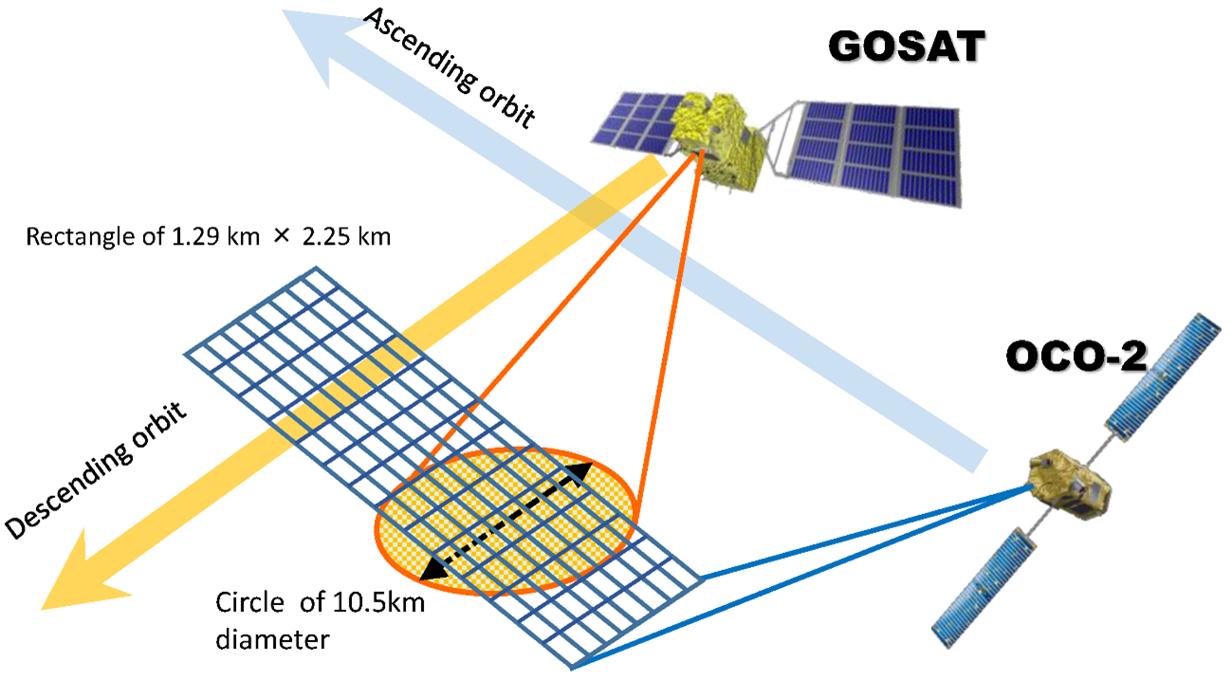
L2 XCO2 inter-comparison (OCO2-GOSAT)
OCO2-GOSAT XCO₂
-5ppm
0
+5ppm
Land
Match up data
+/-15days moving average
ΔXCO₂ (OCO2-GOSAT)
Ocean
GOSAT: JAXA GHG product V3
OCO2: OCO2_L2_Lite_FP V11.1r
Retrieved parameters are different between the L2 algorithms over Land and Ocean. Ocean glint measurement methods are slightly different between GOSAT and OCO-2. Bias might be also different.
OCO-2 and GOSAT XCO₂ are in good agreement < 0.5ppm. OCO-2 has low bias than GOSAT over forest area of Amazon and Africa.

Slide 13
Summary
VCAL campaign at Railroad Valley has conducted since 2009 over 17 years
Target by 5 GHG sensors (GOSAT, OCO-2, TROPOMI, GOSAT-2, OCO-3) + AQ (TEMPO) + New space (MethaneSAT…) + future GOSAT-GW, CO2M, MicroCarb
Validate multiple sensors radiometric accuracies by the common VCAL method
RRV2025 summer campaign was conducted successfully from May 30 to June 5.
VCAL portal site (https://www.eorc.jaxa.jp/GOSAT/GHGs_Vical/index.html)
Inter-comparison between GHG sensors
L1 radiance in both SWIR and TIR and L2 XCO₂, XCH₄, AOD
Match-up data viewer site (https://www.eorc.jaxa.jp/GOSAT/Matchup_forCal/top_matchup_viewer.html)

Slide 14
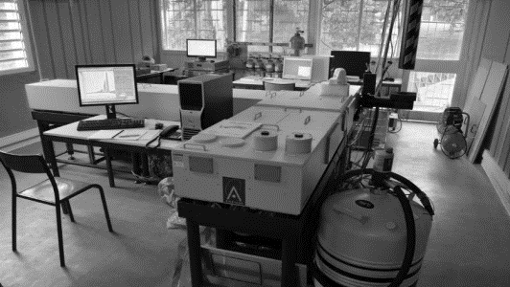
GHG Column Cal/Val Networks
NDACC FTIR
http://ndacc.org
Bruker 120HR/125HR
Resolution 0.0036 cm⁻¹
Spectral range: SWIR, MIR and TIR
Measurements every ±10’
21 stations worldwide
Targets: O₃, CH₄, N₂O, (CO₂, HCHO, SF₆, CFC, HCFC, H₂O, HDO not official), CO, HNO₃, HCl, HF, HCN, C₂H₆, ClONO₂, (C₂H₂, PAN, OCS, CH₃OH, NH₃, HCOOH, NO₂ not official)
Profile retrievals (low vertical resolution, typically tropo/strato separation)
Retrieval software: SFIT or PROFFIT
Measurement protocol (SOP), no central processing, QA/QC for selected targets in CAMS operational validation
TCCON
http://tccon.org
Bruker 125HR
Resolution 0.02 cm⁻¹
Spectral range: SWIR
Measurements every ~ 3’
28 stations worldwide
Targets: CO₂, CH₄, N₂O, H₂O, HDO, CO, HF
Profile scaling retrievals (profile retrievals in development)
Retrieval software GGG
Central QA/QC
COCCON
http://www.imk-asf.kit.edu/english/COCCON.php
Bruker EM27/SUN
Resolution 0.5 cm ⁻¹
Spectral range: SWIR
Measurements every ~ 1’
> 60 instruments worldwide (some fixed sites but mostly for campaigns)
Targets: CO₂, CH₄, CO
Profile scaling retrievals
Retrieval software PROFFAST
Central calibration & processing facility at KIT

Slide 15
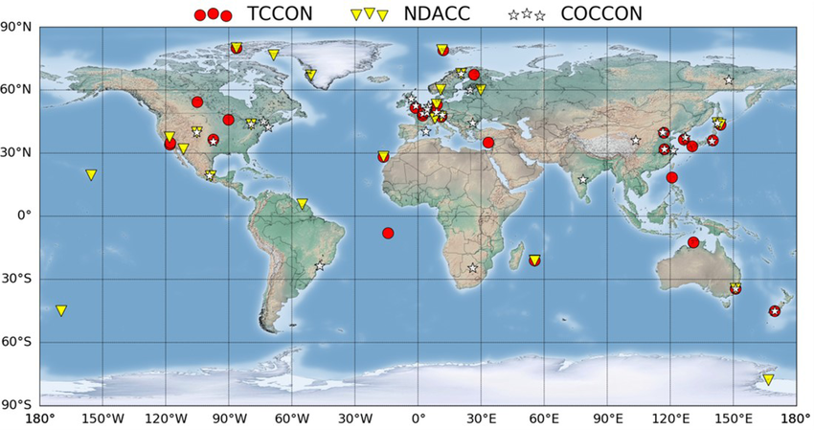
GHG Column Cal/Val Networks

Slide 16
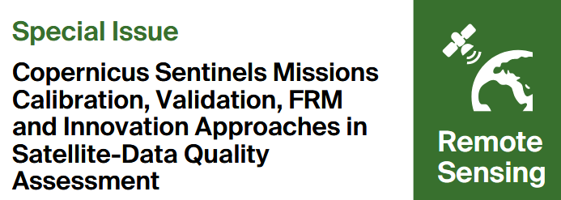
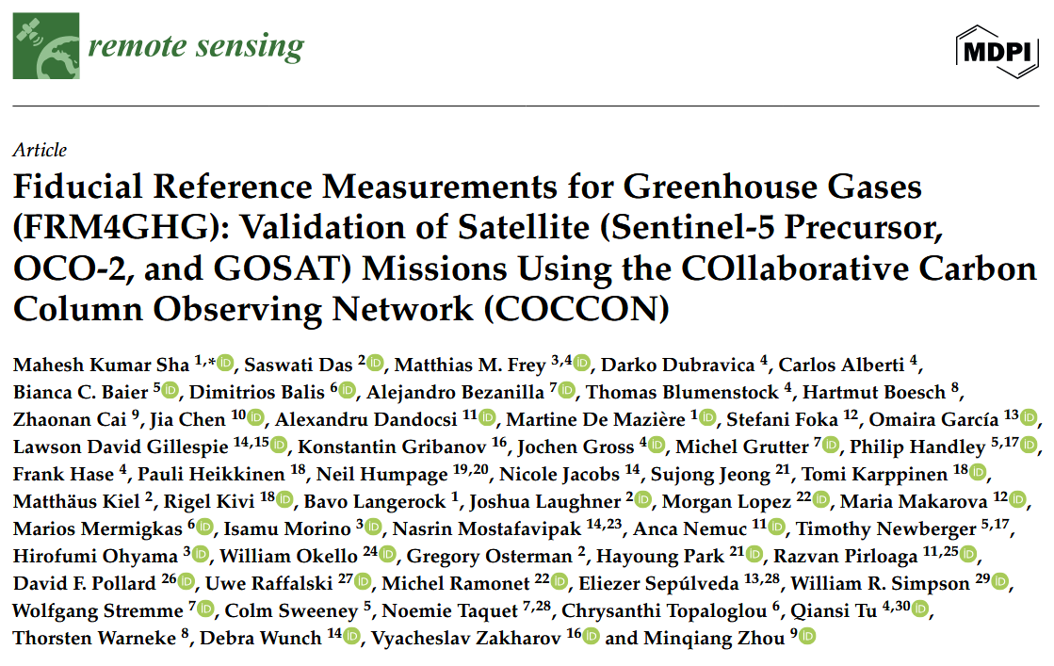
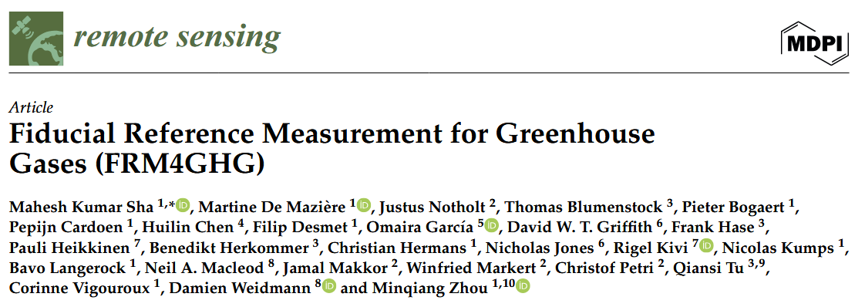
GHG Cal/Val Networks & CEOS-FRM
CEOS-FRM self-assessments of GHG column monitoring networks

Slide 17
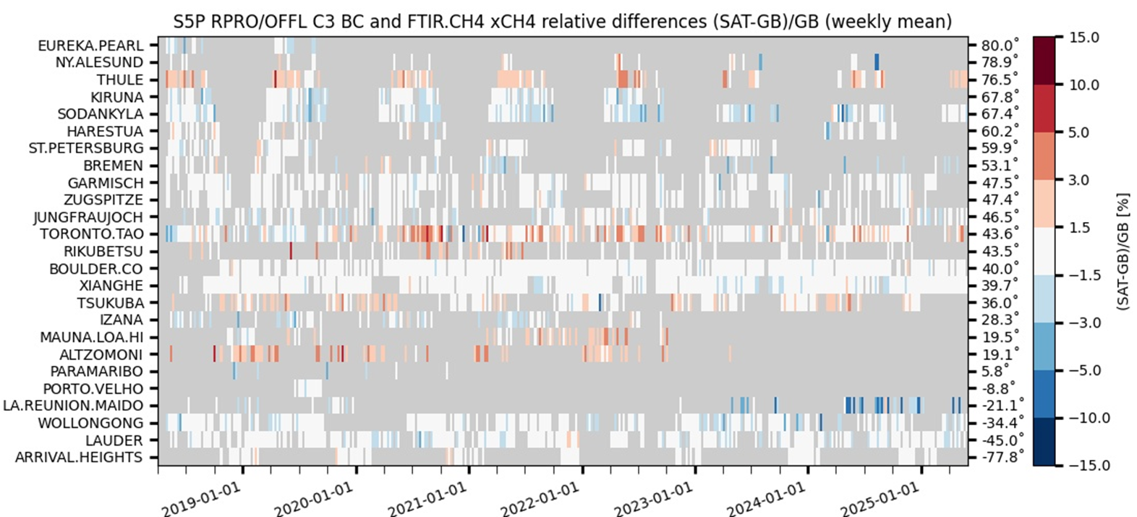
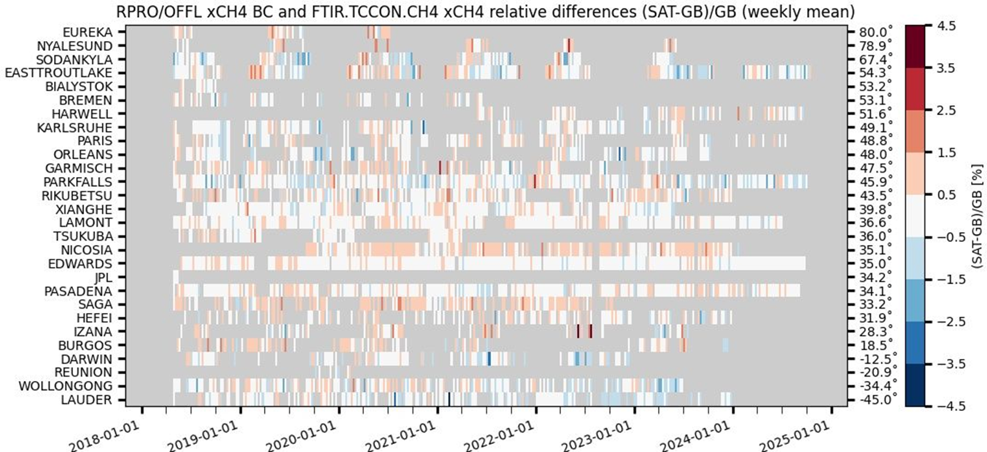
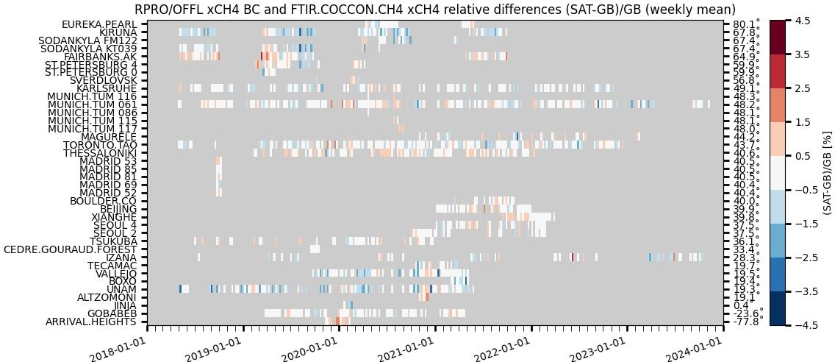
Operational Validation with GHG Networks
ESA/Copernicus ATM-MPC Sentinel-5P TROPOMI: CH₄ and CO operational validation fed by the 3 GHG column/profile monitoring networks
NDACC FTIR : automated validation channel in ATM-MPC Automated Validation Server (https://mpc-vdaf-server.tropomi.eu).
Validation protocols based on published experience with HALOE, MOPITT, SCIAMACHY, MIPAS, ACE-FTS, IASI, GOSAT…
TCCON FTIR : manual validation channel in ATM-MPC
COCCON FTIR : manual validation channel in ATM-MPC, EVDC data collection and automation in progress (ESA contract 2023-2027)
S5P TROPOMI CH4 & CO validation updated permanently vs. NDACC FTIRs
and monthly – when and where data available – vs. TCCON & COCCON FTIRs.
Quarterly validation reports available on http://mpc-vdaf.tropomi.eu
CH₄ images courtesy M.K. Sha (BIRA-IASB)
ATM-MPC June 2025
Automated collection of observations from 24
NDACC FTIR stations
through EVDC =>
automated production of S5P Quality Indicators
TCCON GGG2020 data
latency
No/limited data submitted
between early 2021 and the
release of new data version
GGG2020 in April 2022
Collection of permanent
and campaign based
Observations
Reprocessing
PROFFAST2.4
in progress

Slide 18
Tracking Gaps in GHG Cal/Val Networks
GHG Constellation Roadmap Issue 2
Cal/Val capabilities and challenges of TCCON, COCCON, NDACC & AirCore networks updated in GHG roadmap Issue 2
Annex C – Action L2VAL-03
To track L2 validation Capabilities, Evolving Needs and Gaps in the ground-based L2 validation system
To explore a more operational framework for delivering its products to support evolving GHG mission needs
Action started at AC-VC-21 / ACSG joint meeting with dedicated discussion (2025/06)

Slide 19
GHG Cal/Val Networks Updates
IWGGMS-21 and AC-VC-21 / ACSG meetings 2025 in Takamatsu (2025/06)
Evolving validation needs, gaps and challenges
GHG monitoring networks and campaigns
New Space / Facility Scale missions
Validation of emissions and fluxes;
Operational validation capacity
Harmonized data processing and infrastructures
New version of COCCON software released (PROFFAST2.4), reprocessing in progress
EUMETSAT CO2M Cal/Val support activity incl. COCCON, NDACC & TCCON processing
Cal/Val planning and ground-based network design tool https://co2m.aeronomie.be/
Developed in support to CO2M, extendable to related missions

Slide 20
GHG Cal/Val Networks Updates
New stations / instrument deployments
Number of (Low-Resolution) spectrometers growing every year. Until now, 163 EM27/SUN spectrometers checked at KIT
New LR stations encouraged to follow COCCON standard procedures
New instruments deployed and planned around city source regions, some in array – e.g., Tokyo, Madrid, Kolkata, Bhopal, Ahmedabad
Campaigns
Ship-based observations using EM27/SUN and mini-DOAS
ESA Sentinel 5p VAlidatioN and calibraTion Experiment (SVANTE): 4-year support for IR and UV-Vis airborne/ground-based campaigns dedicated to S5P validation

Slide 21
GHG Cal/Val Networks Updates
NIES and BIRA-IASB cooperation with IISER-Kolkata, IISER-Bhopal and PRL to deploy GHG FTIRs in India
Plan: GHG column measurements by high- and low- spectral resolution FTIR spectrometers complemented with air quality measurements by Pandora spectrometers
Recently 2 Pandora’s in Nainital and Haldwani
3 FTIRs planned: IISER Kolkata (VERTEX, MAX-DOAS, AWS), IISER Bhopal, PRL Ahmedabad

Slide 22
Common Practices for Methane Emissions
Developed by GHG-TT, WGCV contributions
CEOS-CGMS final review just closed
Version 1.0 to be finalized in July to get formal CEOS sign off by Plenary
SIT working with GHG-TT on engagement with UNEP International Methane Emissions Observatory (IMEO) via Use Case WG, establishment of database of controlled release experiments data, and ensuring access to CEOS agencies data

Slide 23
Thank you for your attention !

