Slide 1
CEOS WGCV-55
CGMS-GSICS and CEOS-WGCV
Paolo Castracane,
Starion for ESA/ESRIN on behalf of
Bojan Bojkov EUMETSAT/GSICS EP Chair
Agenda Item 3.12
WGCV-55
Hyderabad, India
8-10 July, 2025

Slide 2
Table of Contents
Overview from the CGMS-GSICS Annual Meeting 2025
Main outcomes and next Annual Meeting
WGCV and GSICS area of cooperation

Slide 3
GSICS Annual meeting 2025
GSICS Annual Meeting
17-23 March 2025, Changchun, Jilin Province, China
meeting page
Agenda: here
Meeting Minutes: here
Access to the actions: here

Slide 4
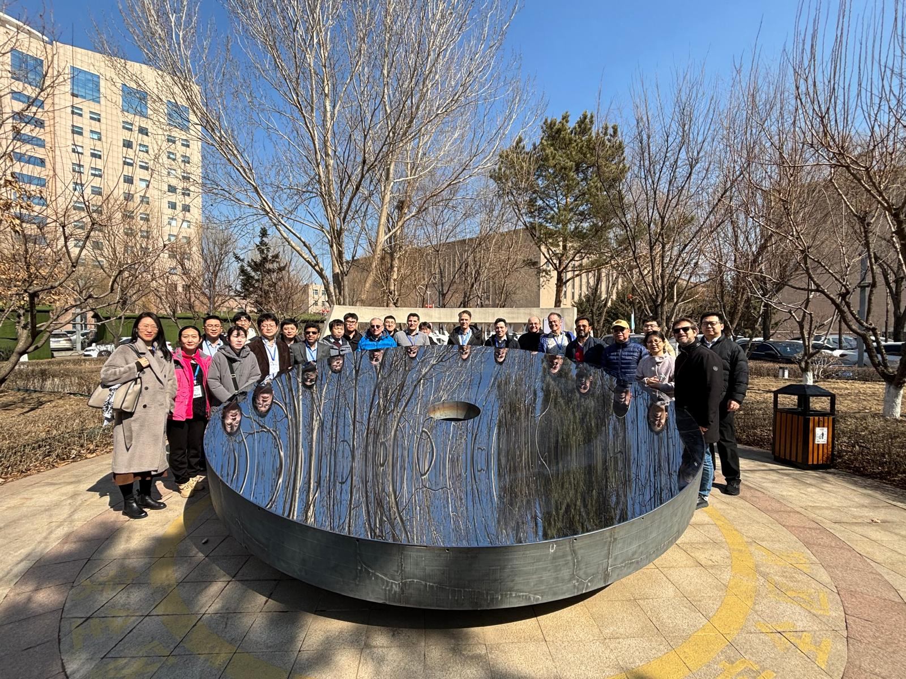
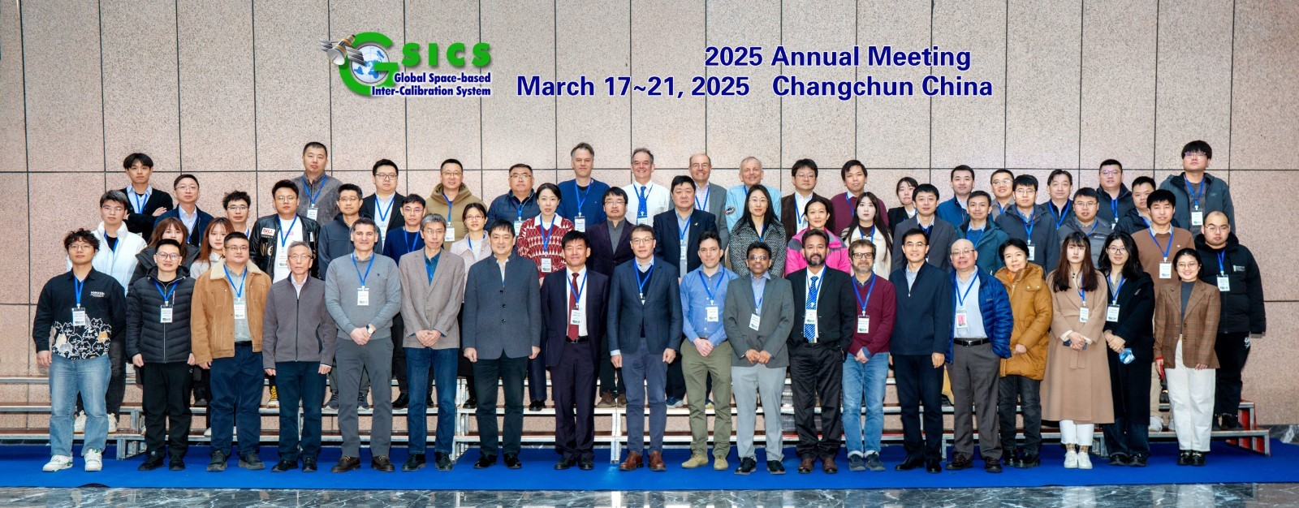
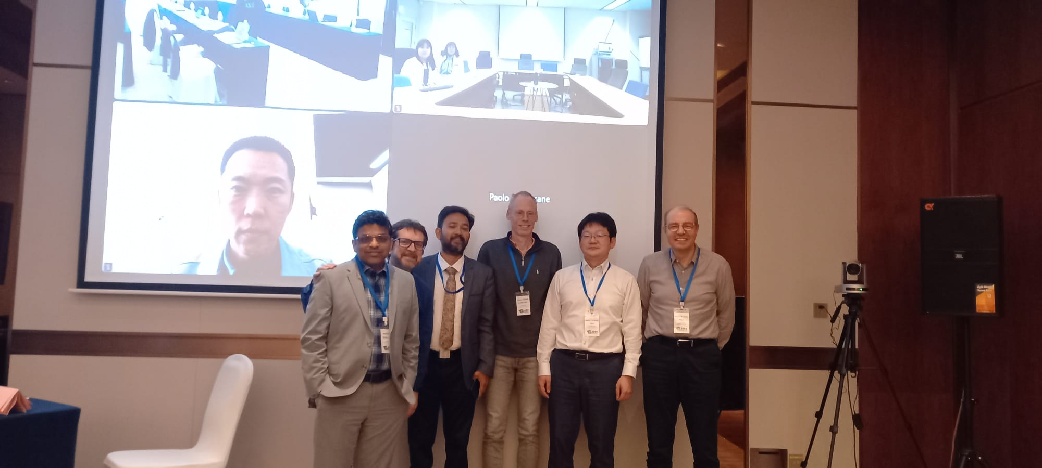
Plenary and group meetings
17
pictures from GSICS Annual Meeting, Changchun, Jilin Province, China.

Slide 5
Agenda Overview
SWs Space Weather
VIS/NIR + Lunar
IR infrared
MW Microwave
UVN-S: UV/Vis/NIR Spectrometer
GDWG: GSICS Group Data Working Group
GRWG: GSICS Research Working Group
In additions:
- CEOS WGCV Report
Outcames from the
- Pre-flight Calibration and Characterization Workshop and
- SITSat activities
Time |  | Sections
Day 1 | Morning (8:00 Start) | Mini conference
17 | Afternoon (18:00 End) | SWx | VISNIR + Lunar PM
Day 2 | Morning | VisNIR + Lunar AM
18 | Afternoon | IR PM
Day 3 | Early Morning | UVN-S AM (w US remote) | MW AM
19 | Long Lunch | CIOMP Site Visit
 | Late Afternoon | UVN-S PM (w EU remote) | MW PM
Day 4 | Morning | IR AM | GDWG
20 | Afternoon | Agency reports 10-minute pre-recorded using template in 12 minute slots
Day 5 | Morning | Cross-Cutting (WG Briefings)
21 | Afternoon | EP meeting
Notes:
The GSICS 2025 Annual meeting 17-21 March 2025, held in Changchun, Jilin Province, China and involved all the GSICS subgroups (namely: SWs Space Weather; VIS/NIR + Lunar; IR Infrared; MW Microwave; UVN-S: UV/Vis/NIR Spectrometer; GDWG: GSICS Group Data Working Group and GRWG: GSICS Research Working Group) along the following 5 days Agenda.

Slide 6
GSICS Cooperative Developments this last year
As evidenced over the last year, GSICS provides a critical framework for satellite agencies to collaborate to develop community-agreed best practices, standard procedures and tools.
The effort has been distributed across agencies to refine the calibration and inter-calibration methods of interest (e.g. desert calibration/inter-calibration, imager-hyperspectral inter-calibration) and to establish the uncertainties. It was agreed that the agencies will further seek to share relevant code and satellite data (e.g. lunar acquisitions) in support of the data quality monitoring.
26 quarterly GSICS sub-group web meetings were held in the last year, as well as the annual and Executive Panel (EP) meetings in Changchun (China) in March 2025.
Joint CEOS WGCV – CGMS GSICS pre-flight calibration WS took place in ESA/ESTEC (NL) on 19-22 November 2024.

Slide 7
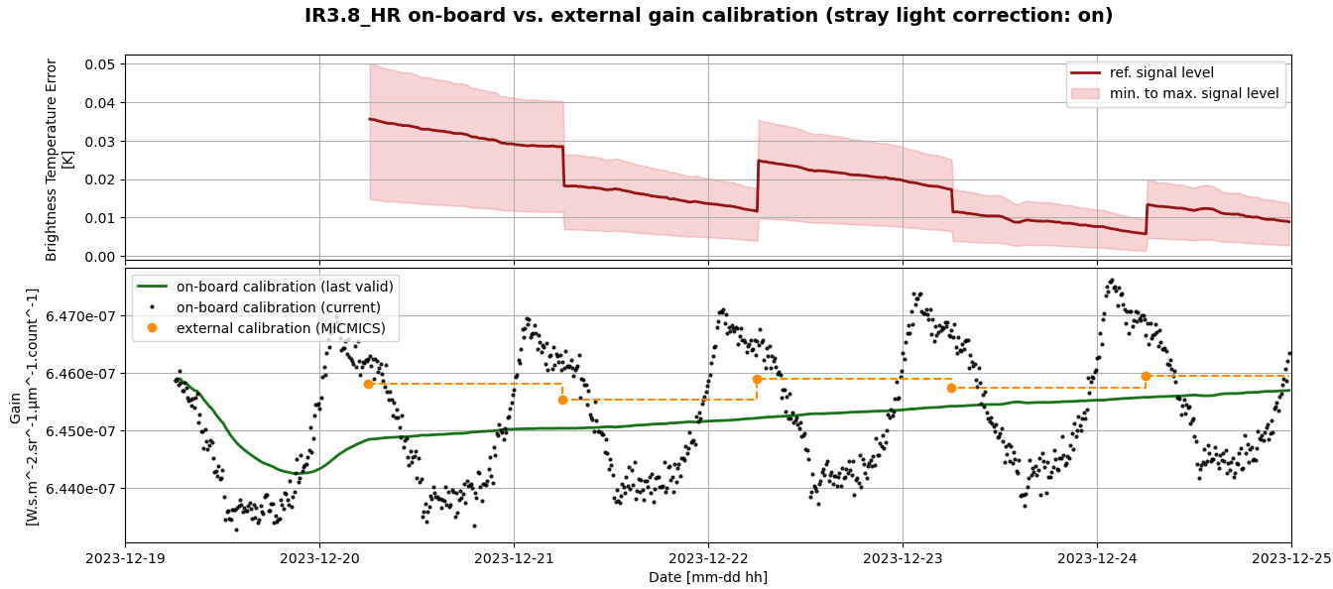
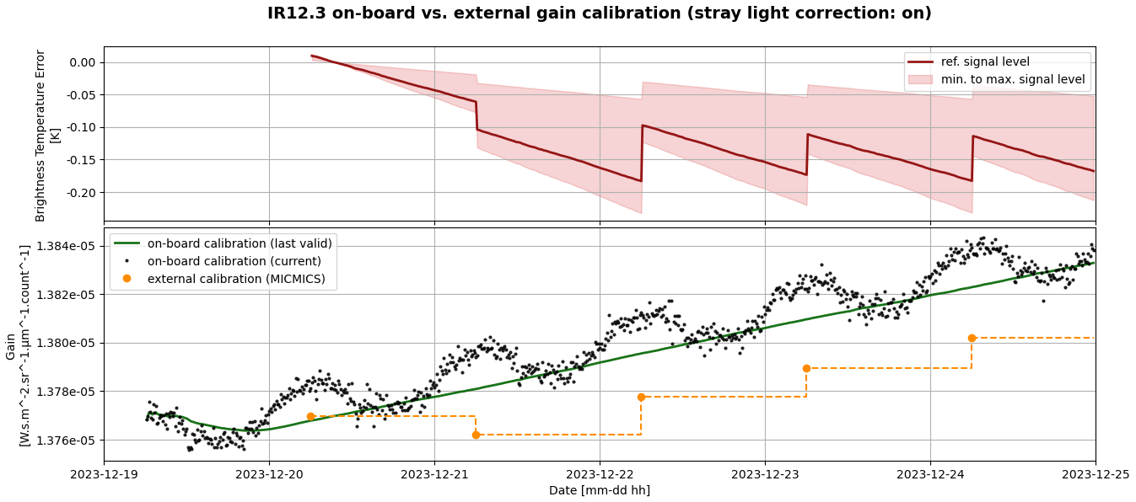
GSICS Benefits – some examples
Following a HW failure on the EUMETSAT MTG-I1 (Metop-12) FCI detected in January 2024, the instrument resumed observation mode in May 2024 without the on-board calibration acquisitions.
Since then, the anomaly is well mitigated by the use of the MICMICS implementation of the GSICS GEO-LEO (inter-calibration with Metop-B/C IASI) to estimate the FCI IR gains.
This is a clear example of the GSICS cooperation benefiting the quality and lifetime of a key operational mission.

Slide 8
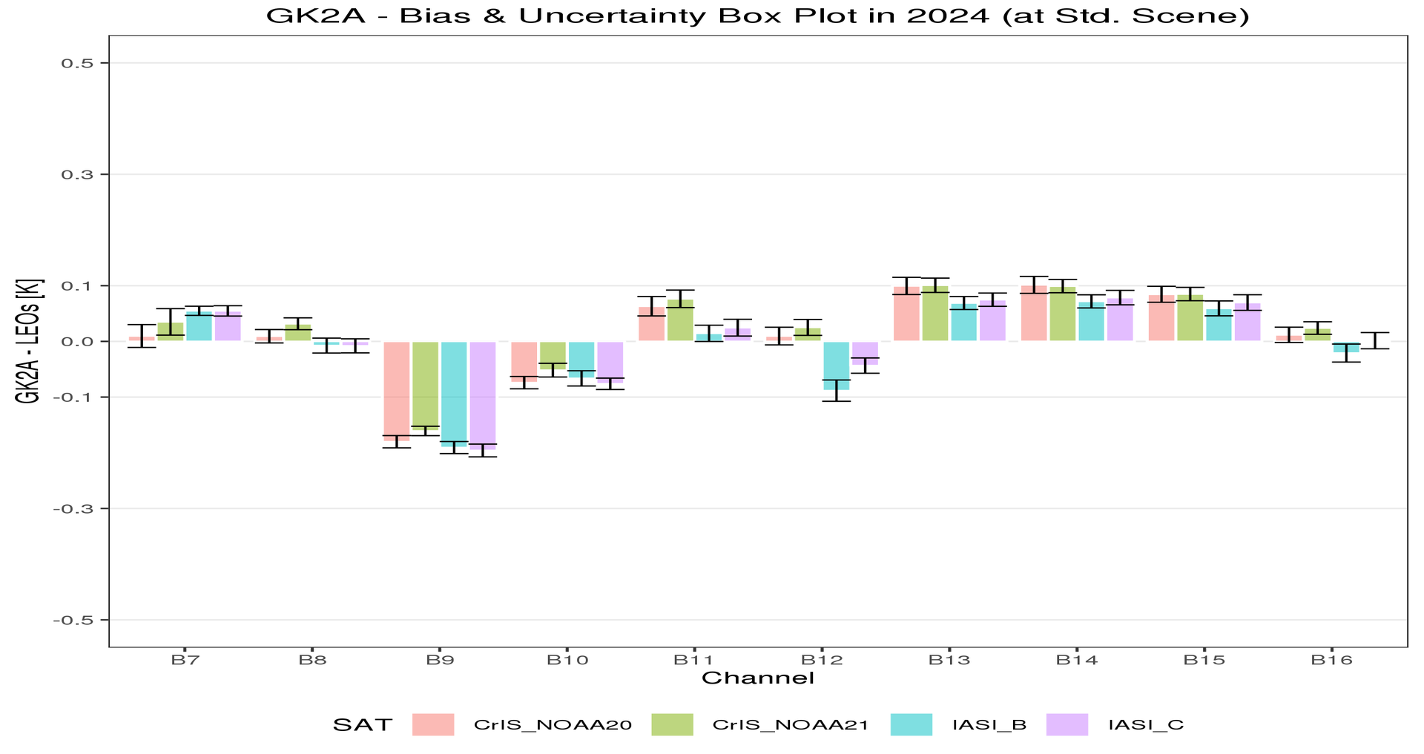
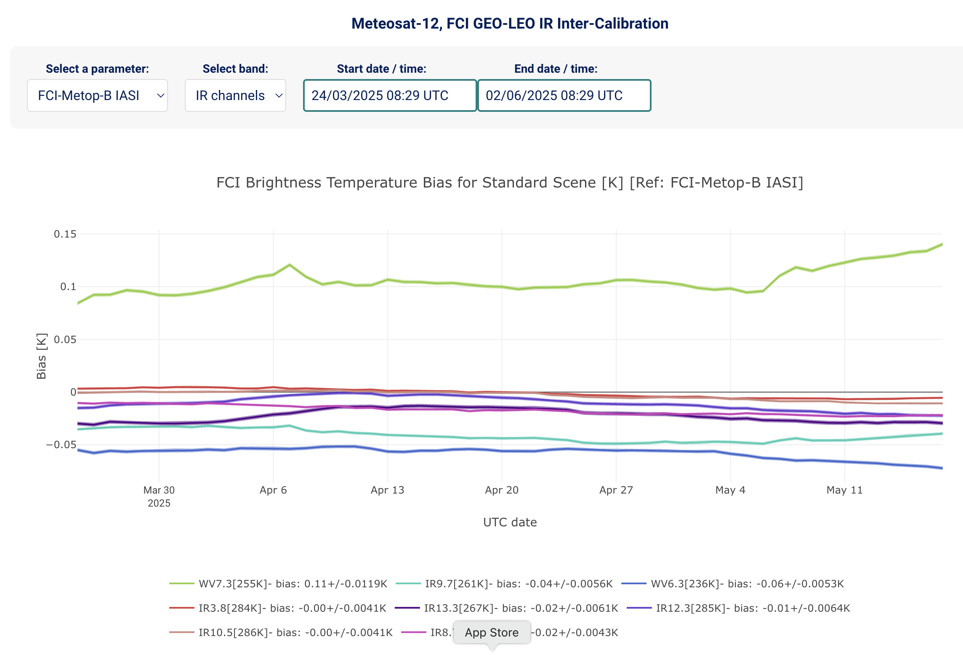
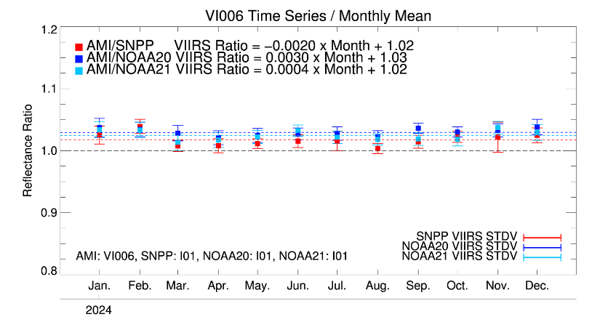
GSICS Benefits – some examples (ii)
Examples right of KMA inter-calibration monitoring of GK2A AMI with IASI/CrIS for IR and VIIRS for VIS-NIR.
All agencies are doing the same analyses and GSICS is working on the standardization of the reporting (e.g. http://matrics.eumetsat.int (below)

Slide 9
Next GSICS Annual Meeting
Next annual meeting will be hosted by the National Research Council of Canada, 23-27 March 2026, in Ottawa.
For the next annual meeting, invitations will be sent out to commercial satellite providers and to other potential users (e.g., CEOS-CGMS WG climate, CGMS WG II subgroups, CEOS VCs, etc.)

Slide 10
WGCV and GSICS area of cooperation
The collaboration between CEOS WGCV and GSICS is ever evolving. This collaboration occurs at multiple levels: the CEOS and CGMS Working group levels and GSICS Executive Panel Level.
Several areas of work between GSICS and WGCV are being actively pursued. These include methods, protocols, and organization of joint workshops (e.g. Pre-flight Calibration and Characterization Workshop).
New Space topics: WGCV and GSICS participation at initiatives and workshops as VH-RODA 2024 and JACIE 2025.
Outreach: CEOS Cal/Va Portal shares GSICS Tools (colab notebooks), Conferences, Workshops and Projects. GSICS Newsletter (Via X @CEOS_WGCV).

