Slide 1
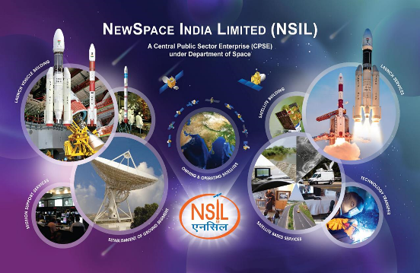

NewSpace India Limited [NSIL]
(A CPSE under Department of Space, Government of India)
An ISO 9001:2015 Certified Company
NSIL - Pioneering India’s Space Commerce

Slide 2
SPACE VALUE CHAIN
User Ground Equipment, Terminals
Launch Services
Space- based Services
Value-added Services
Consumers
Satellite Manufacturing
Manufacturer
Launch Operators
Satellite Operators
Service Providers
Up-stream
(10% of total market size)
Down-stream
(90% of total market size)

Slide 3
NSIL - INCORPORATION
During March 2019, Union Cabinet approved creation of new company “NewSpace India Limited (NSIL)” to :
  Enhance ISRO- Industry interface
  Carry out Commercialization of ISRO’s space products & services
NSIL - A wholly owned Government of India Company/ Central Public Sector Enterprise (CPSE), under the administrative control of Department of Space (DOS)
  Paid-up capital ₹ 5607.60 Cr
  Authorised share capital ₹ 7500 Cr
NSIL is the commercial arm of ISRO
NSIL [Schedule ‘A’ CPSE] has been graded as “Excellent” on Corporate Governance

Slide 4
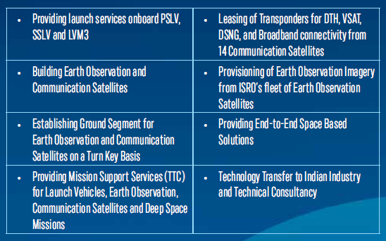
NSIL MANDATE – POST SPACE REFORM
As part of “Unlocking India’s potential in Space Sector”, Government of India announced Space Reforms during June 2020 and NSIL’s Mandate has been enhanced.
Business Activities

Slide 5

NSIL - BUSINESS VERTICALS
1
2
3
4
5
LAUNCH VEHICLE BUILDING & LAUNCH SERVICES
SATELLITE BUILDING
SATELLITE BASED SERVICES
GROUND SEGMENT & MISSION SUPPORT
TECHNOLOGY TRANSFER & TECHNICAL CONSULTANCY

Slide 6
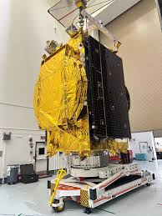
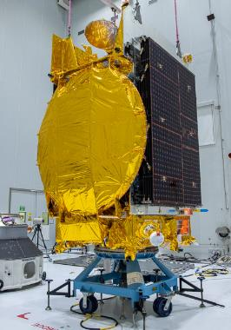
BUSINESS VERTICAL: SATELLITE BUILDING
Building satellites and launching them as per demand [“Demand Driven Mission”] / User Requirements
GSAT-N1 (GSAT-24)
GSAT-N2 (GSAT-20)
5 Future satellites on Demand Driven Mode GSAT-N3, GSAT-N4, GSAT-N5, GSAT-N6, GSAT-N7, GSAT-N8
Building Satellites as per User Requirement - Earth Observation & Communication Satellites

Slide 7
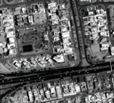
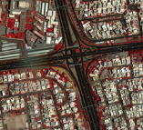
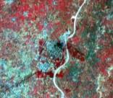
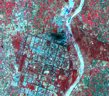
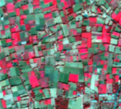
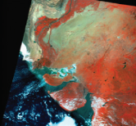

BUSINESS VERTICAL: SBS – EO DATA & VALUE ADDED PRODUCTS
Remote Sensing Data & Services: Wide range of RS data from the constellation of the IRS Satellites
CARTOSAT SERIES
High Resolution Panchromatic
Multimode Imaging
Stereo Imaging capability
RESOURCESAT SERIES
Multi-Resolution
Multi Spectral (VIS, IR, SWIR)
RISAT SERIES
Microwave – Multimode imaging
Polarimetry
OCEANSAT SERIES
Ocean Colour Monitor
Wind Vector Data
VHR Panchromatic
VHR - Multispectral
Microwave
AWiFS
LISS-III
LISS-IV
Data Dissemination through Bhoonidhi Portal
Establishing IGS Globally
OCM
DEM
Ortho-product

Slide 8
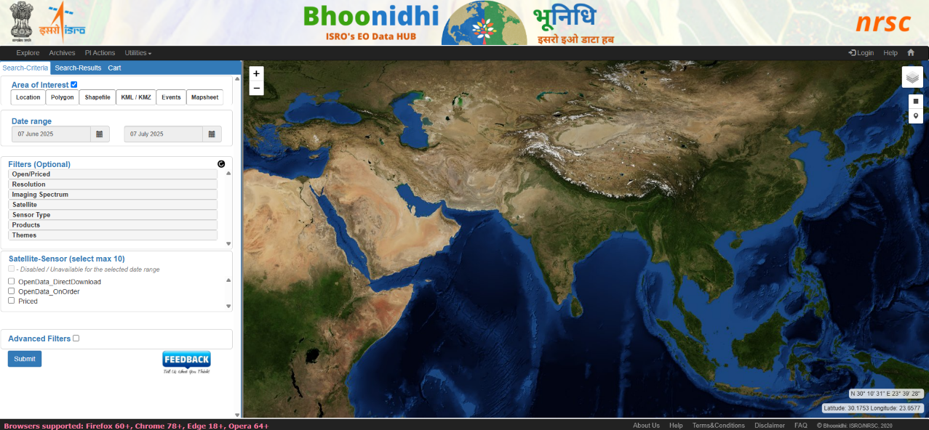
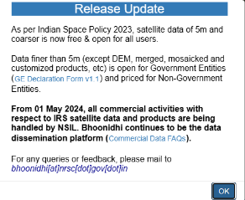
Bhoonidhi Portal of ISRO – Free & Commercial Data

Slide 9
Cal-Val
Calibration:
  Quantitatively defining a system’s response to known and controlled signal inputs
Validation:
  Assessing, by independent means, the quality of the data products derived from these system outputs
Calibration Parameters
MX/Hyperspectral Optical Data:
  Radiometric Accuracy
  Radiometric response stability on orbit phase
  Radiometric Calibration Coefficients
High Resolution Data:
  MTF & Absolute Geometric accuracy
  Resolvable Pixel size
Microwave Data:
  Geometric accuracy
  Radiometric Calibration Parameters:
    PSLR
    ISLR
    Calibration constant
    IRW

Slide 10
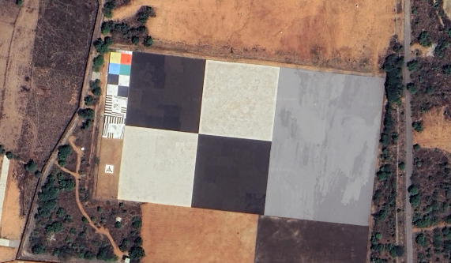
Cal-Val of Satellite Sensors
Microwave Calibration Targets:
These are corner reflectors (trihedral and dihedral) with precise dimensions and characterized Radar Cross Section (RCS) at different frequency bands and polarizations.
Natural Targets:
These targets have a range of reflectance values (8% to 70% in VNIR) and are used for radiometric calibration.
Geometric Calibration:
The site includes a 70mx70m white and black contrast edge with a 6-degree orientation for geometric calibration.
In-House Facility:
NRSC has developed an in-house goniometer for BRDF characterization of targets and an Active Radar Calibrator (ARC) for various SAR missions.
Post-Launch Evaluation:
The site is used for periodic evaluation of radiometric and geometric performance of spaceborne optical sensors
The NRSC uses a calibration/validation (Cal/Val) site for testing and validating data from spaceborne optical sensors. This site, located at Shadnagar, includes microwave calibration targets and natural targets for radiometric and geometric calibration. The microwave targets consist of corner reflectors with varying dimensions and polarization, while the natural targets have a reflectance range from 8% to 70% in the VNIR region.

Slide 11
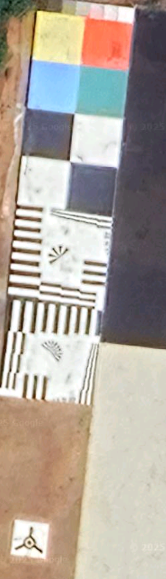
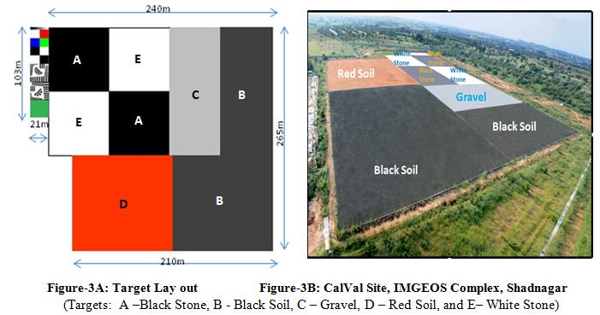
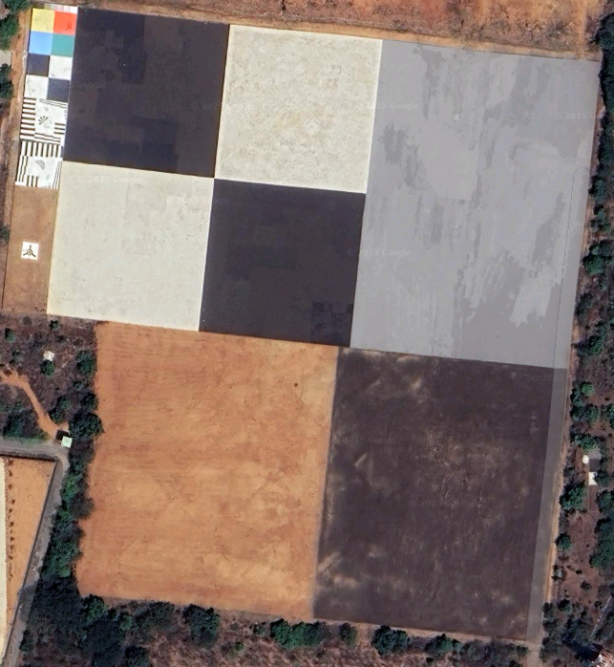
NRSC Cal-Val Site at Shadnagar
Source: NRSC Website
Recent image as viewed in Google Map

Slide 12
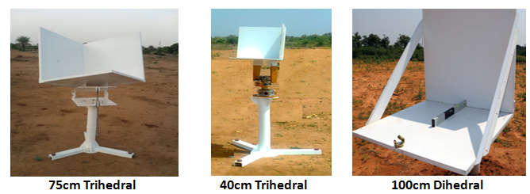
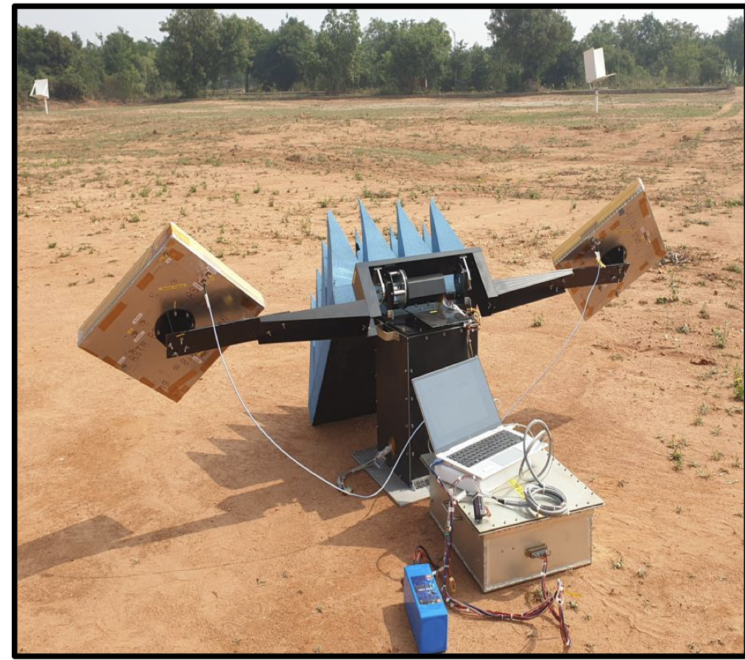
Corner Reflectors at IMGEOS,NRSC
Multiband Active RADAR Calibrator (ARC)
Source: NRSC Website

Slide 13
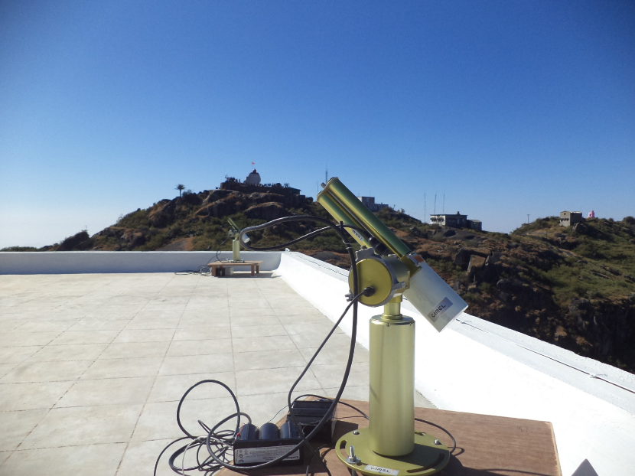
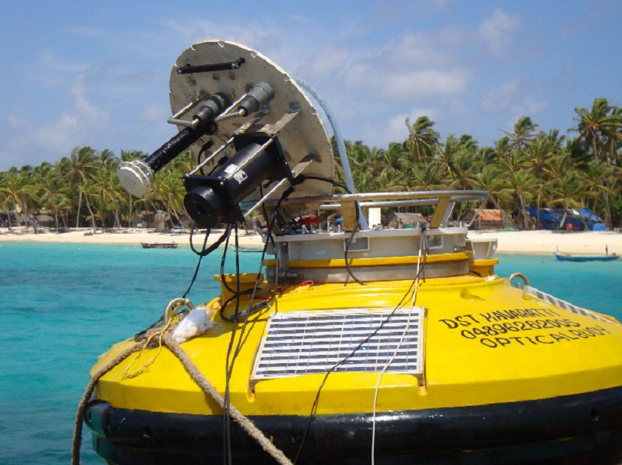
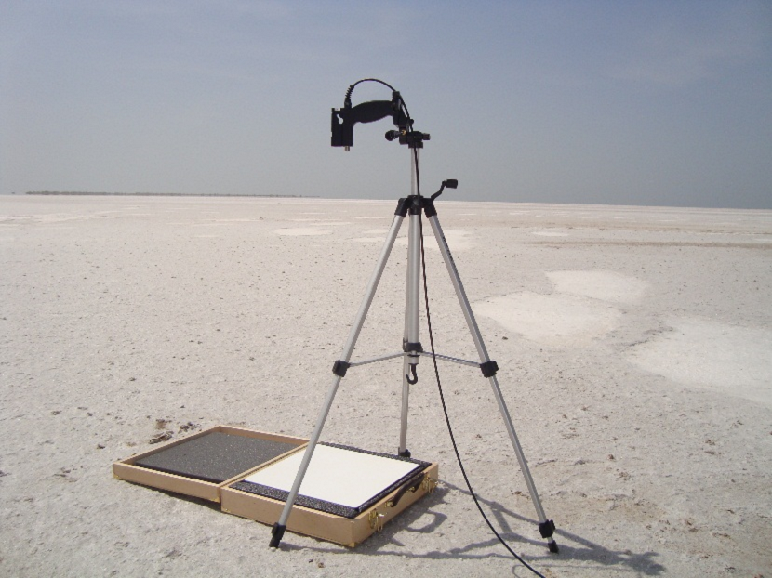
Cal-Val Activities of SAC
Sun Photometer at Mt. Abu
Optical buoy for calibration of OCEANSAT-2 at Kavaratti, Lakshwadeep Islands
Calibration measurement at Great Rann of Kutchh, Gujarat
Source: SAC Website

Slide 14

Geospatial Applications
END OF PROJECT
IMPACT EVALUATION STUDY
In the process of onboarding of Indian Geospatial Industry
Value Added Product Generation
Geospatial Applications in diversified areas
  Agriculture
  Water Resources
  Environment & Forest
  Marine Application
  Base Map and Large Scale Maps
  Planning and Development
  Large Area monitoring for change detection
  Geology & Minerals
Karnataka Watershed Development Project – II
Sujala III
Bhuvan Platform-as-a-Service

Slide 15
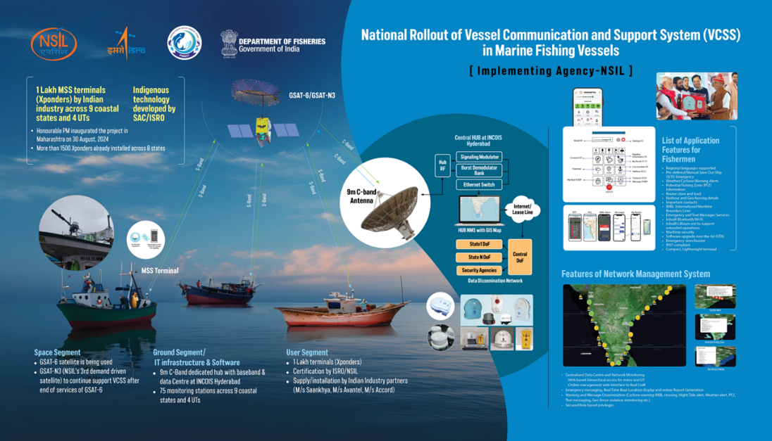
Space Based Application – End to End Solution

Slide 16

Commercial Opportunities with NSIL
Low Cost Access to Space
Earth Observation Data
International Ground Station for IRS Data
Resellers of IRS Products
Geospatial Applications
Structured Training in various disciplines
TTC & Mission Support Services
Establishing Ground Stations – Turn Key Project
Satellite Communication – End to End Solution
Transfer of Technology developed at ISRO

Slide 17
Thank You for Your Kind Attention
contact@nsilindia.co.in
eodata@nsildindia.co.in

