Slide 1




Seeing the unseen
Pixxel’s HYPERSPECTRAL satellites
Post-launch vicarious cal-val effort
55th CEOS Working Group on Calibration & Validation Plenary Meeting (WGCV-55)
Dr Rahul Raj
Principal Research Scientist
Pixxel.Space
PIXXEL SPACE TECHNOLOGIES, INC.
10th July 2025

Slide 2

THE health monitor for Planet Earth
MONITOR, DETECT & PREDICT what is happening around the world at an unprecedented level of detail.

Slide 3
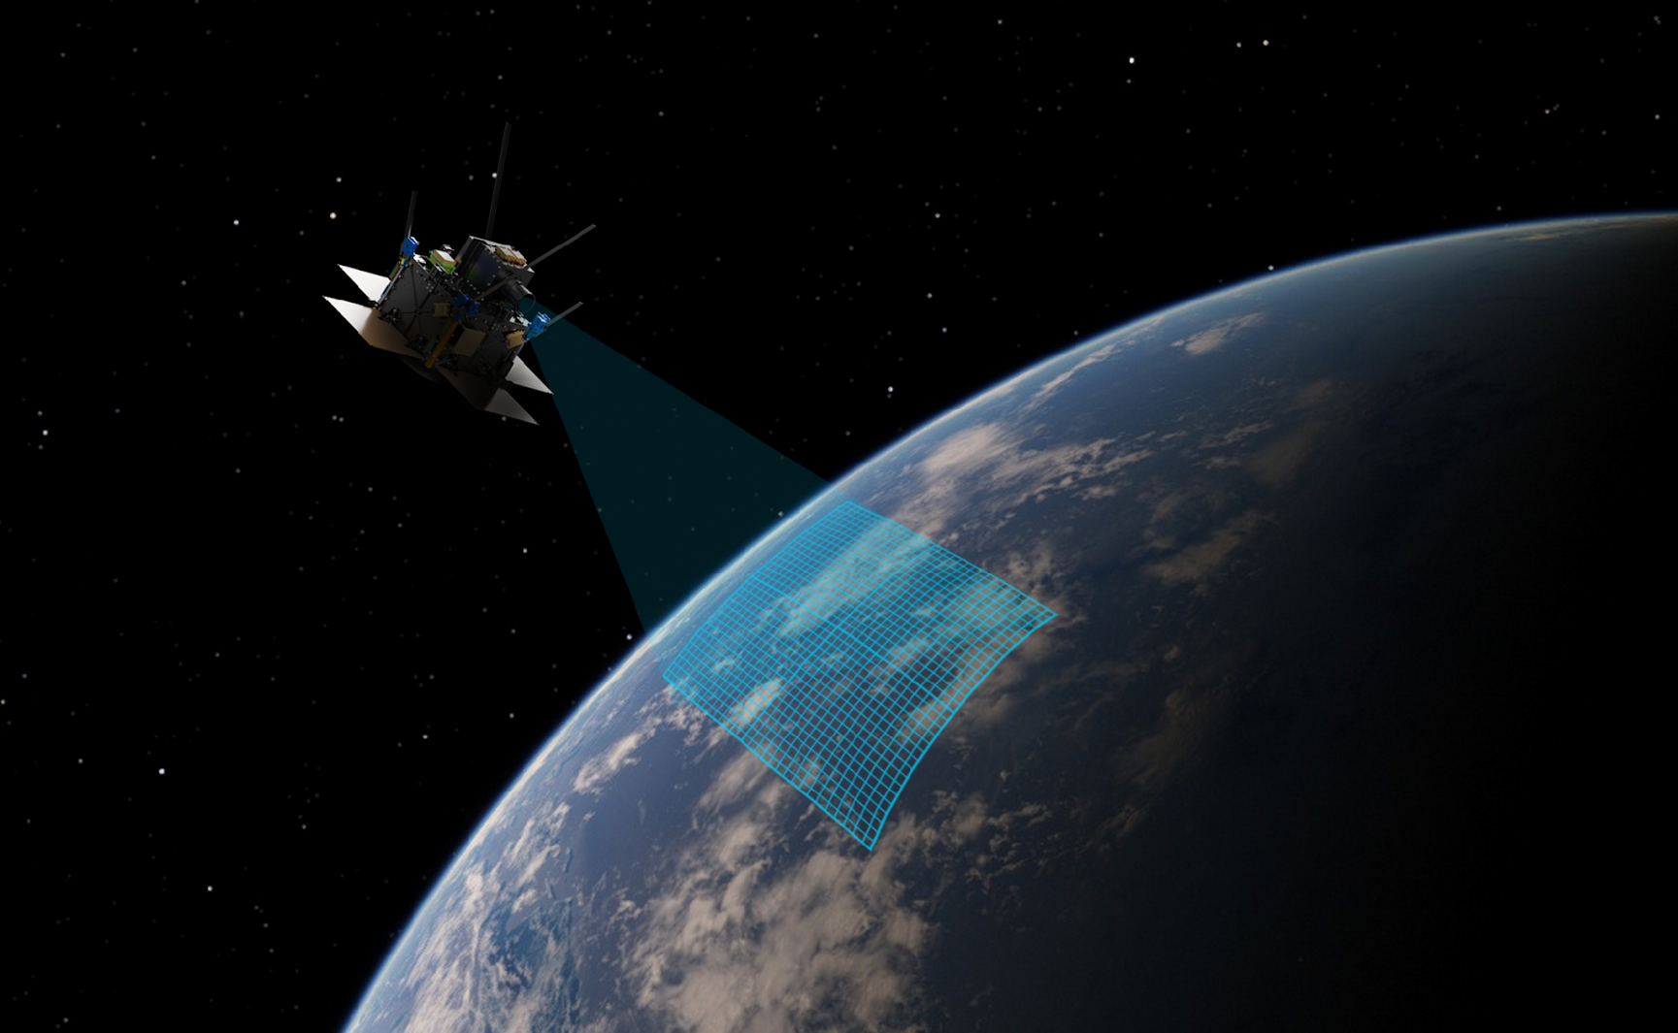
A HYPERSPECTRAL satellite Constellation
COMPACT FORM FACTOR
DAILY GLOBAL
ACCESS
50-150kg class of microsatellites
24-hour revisit anywhere on the planet
UNPRECEDENTED RESOLUTION
5M spatial resolution, 250+ bands
GLOBAL
COVERAGE
Access to every part
of the planet with 50X more information
Pixxel.Space

Slide 4
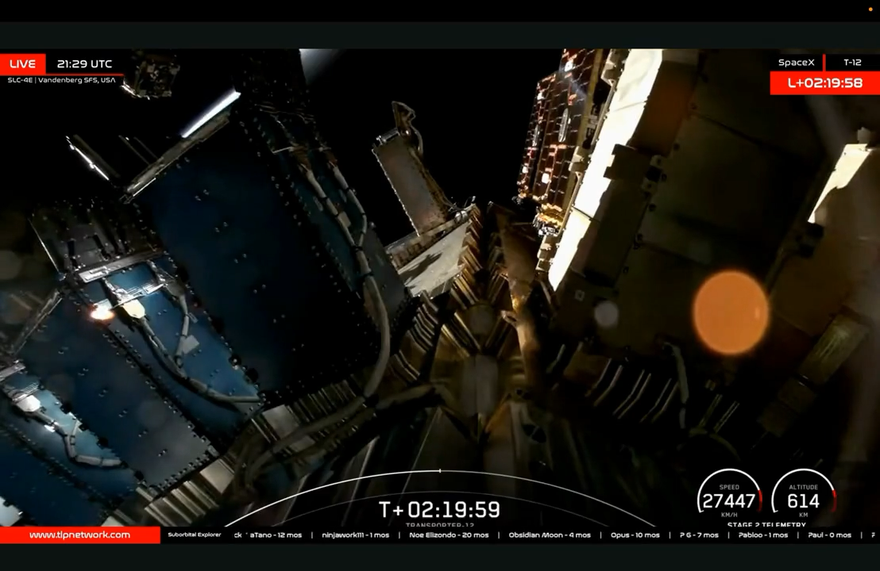
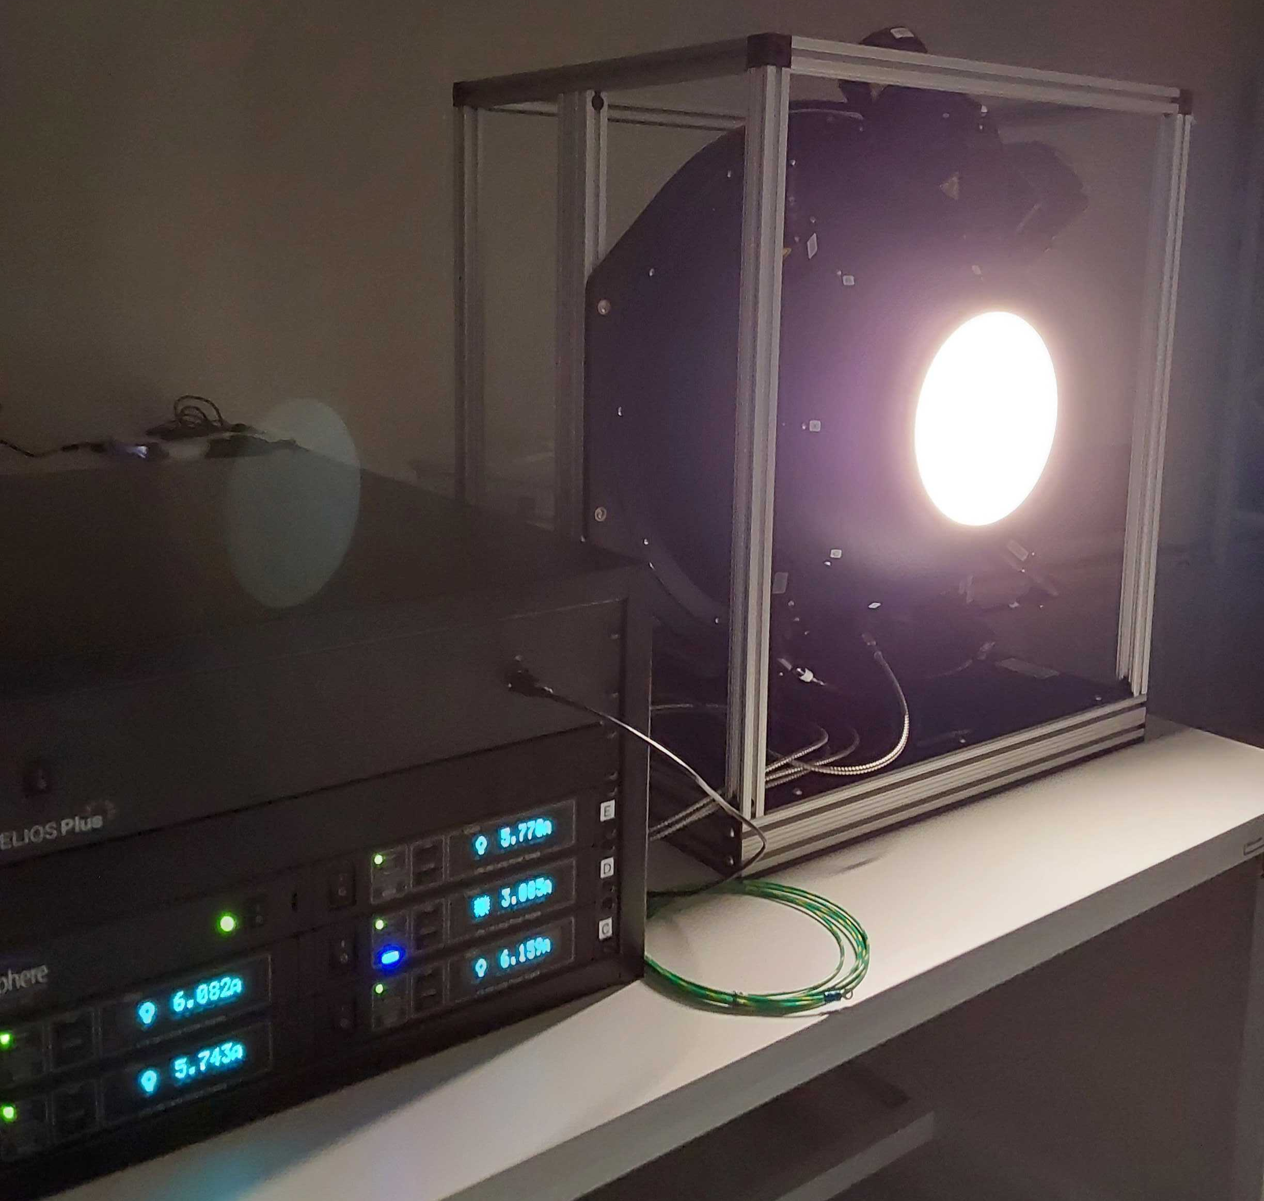
WORKING SATELLITES
ALREADY IN space
DEPLOYMENT from Falcon 9
Labsphere - USLR-D20F-NDNN-P

Slide 5
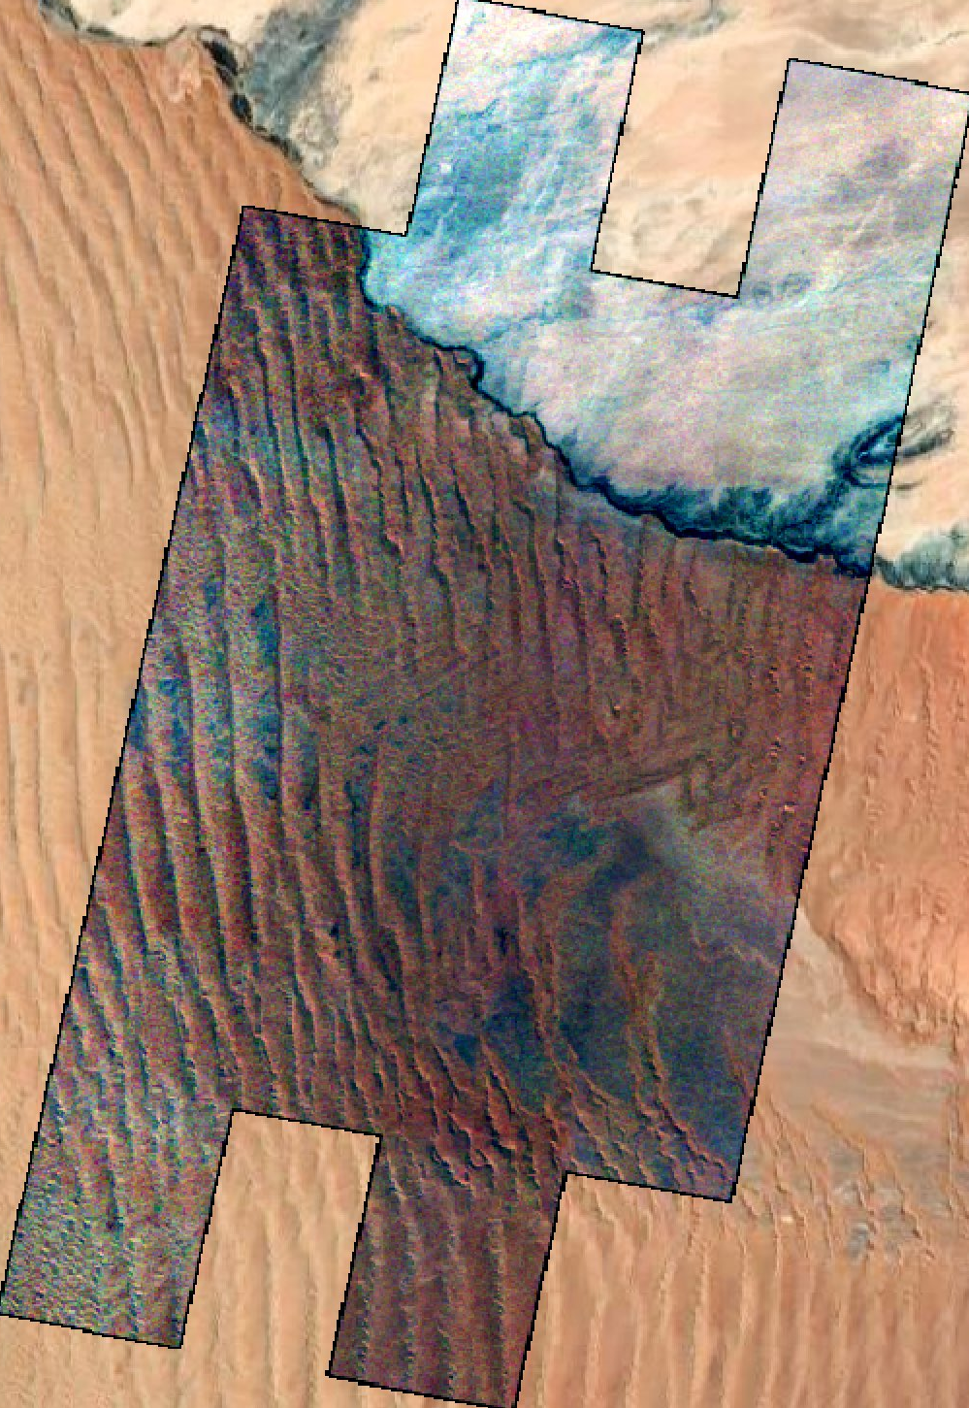
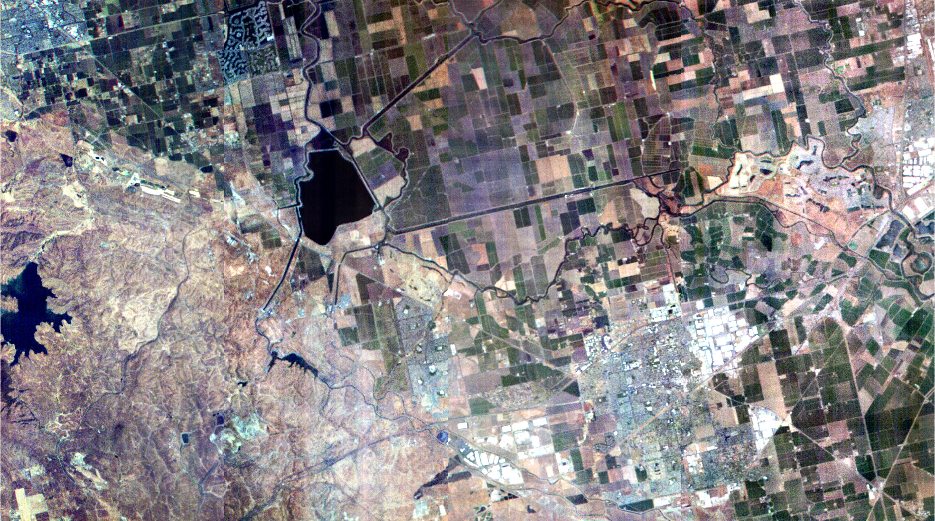
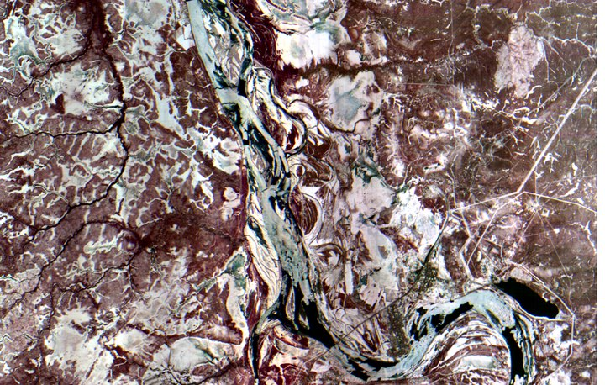
Gobabeb, Namibia
California, USA
Ganga River, Bihar, India

Slide 6
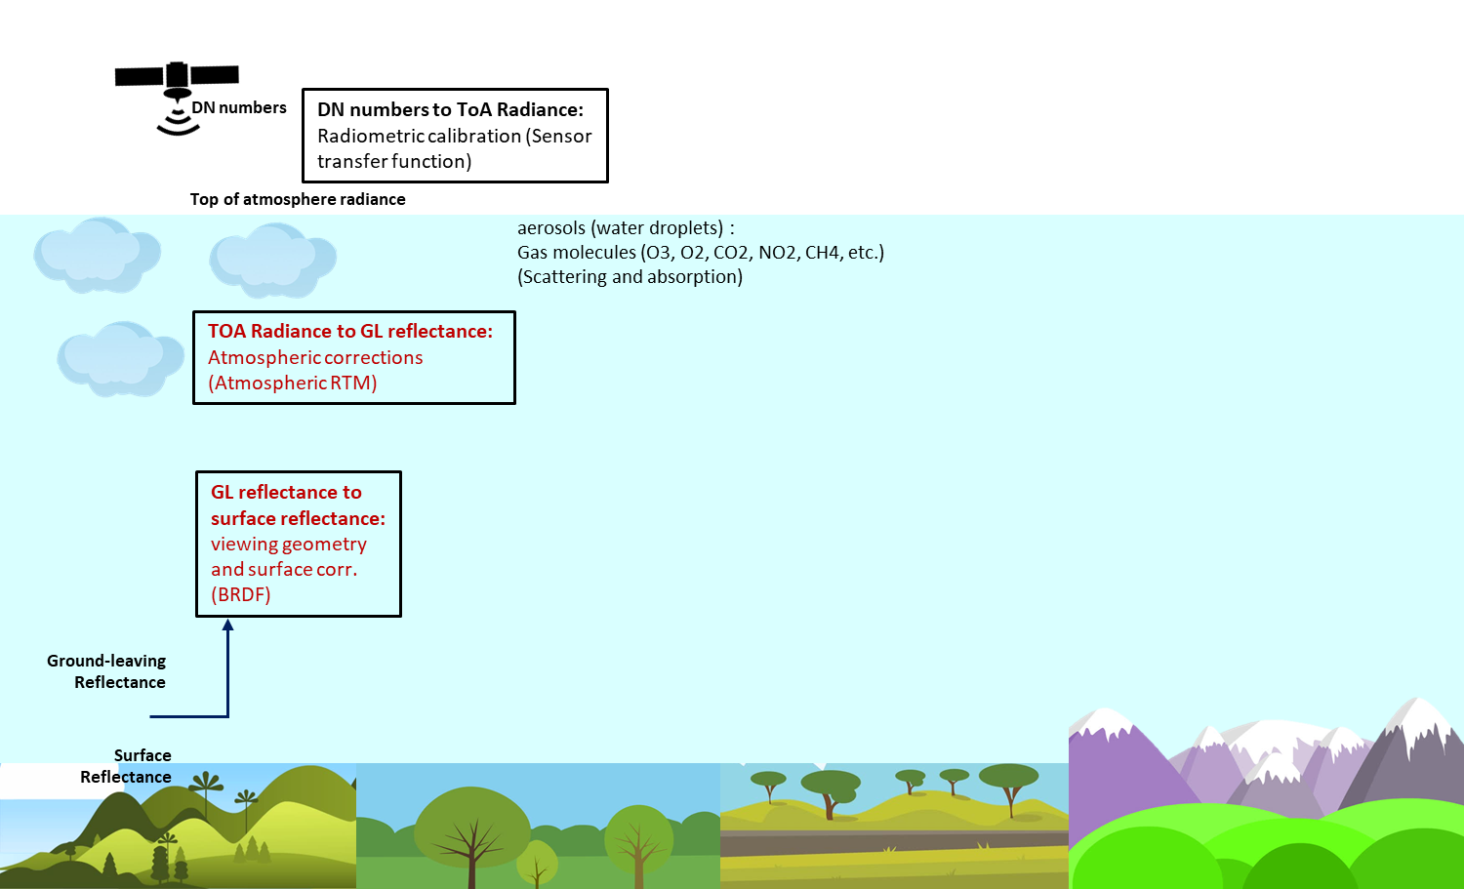

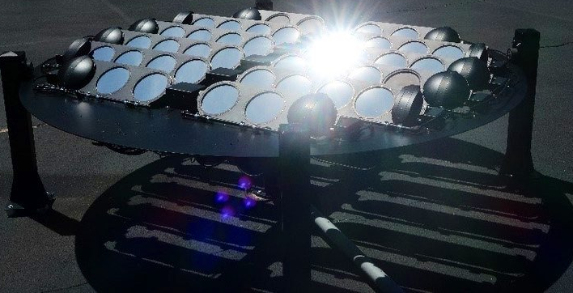

Effort needed towards data CAL-VAL
Calibration surface

Slide 7
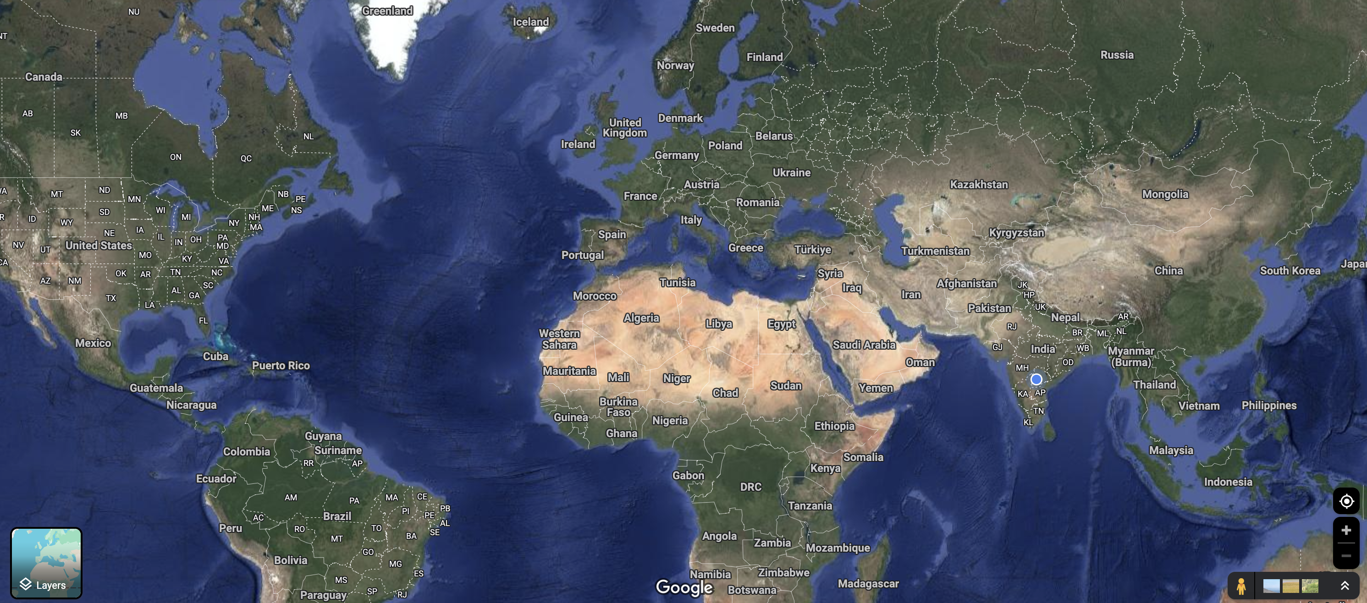
Our CAL-VAL partners
FLARE South Dakota & Japan || IIT Madras

Slide 8
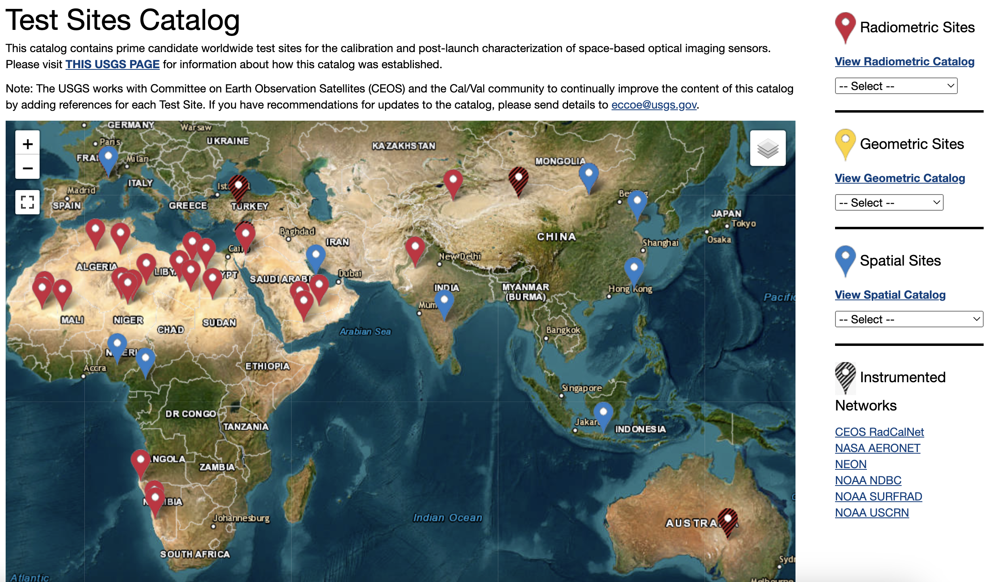
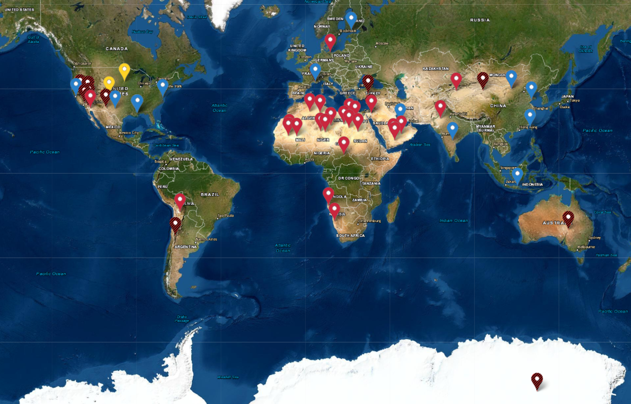

Slide 9
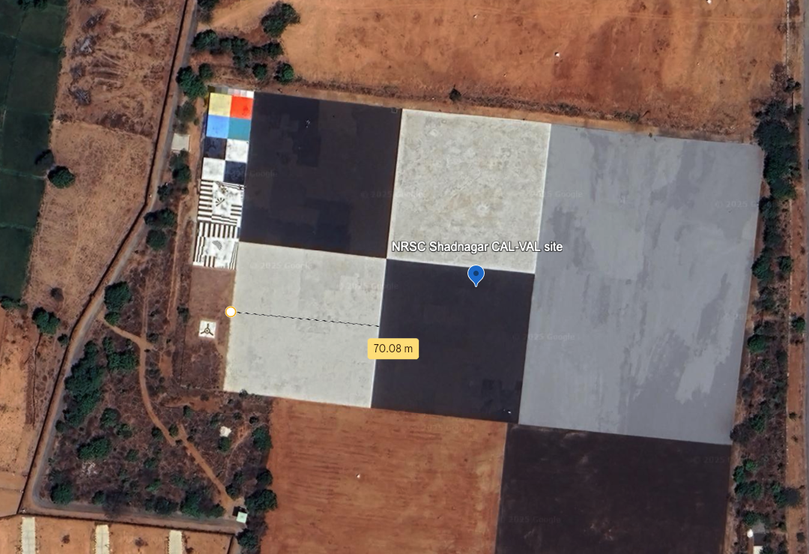
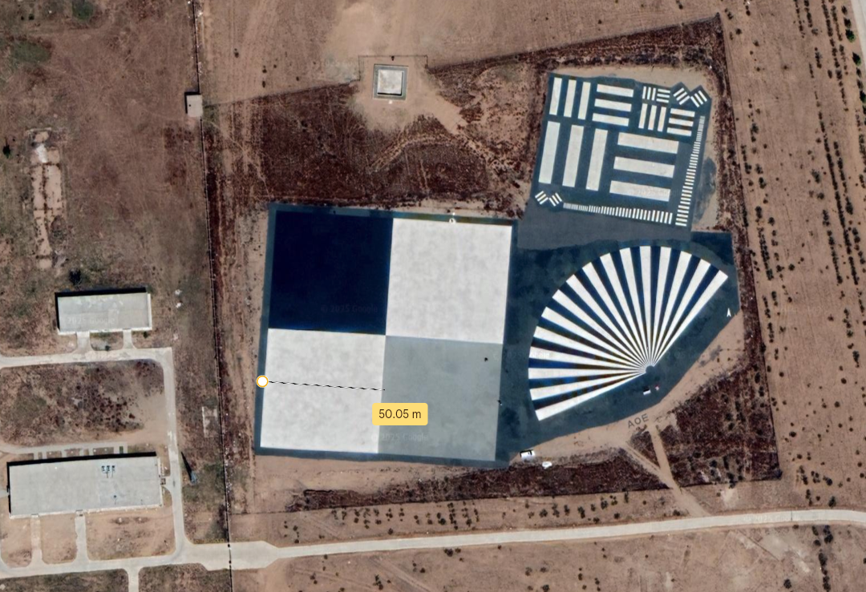
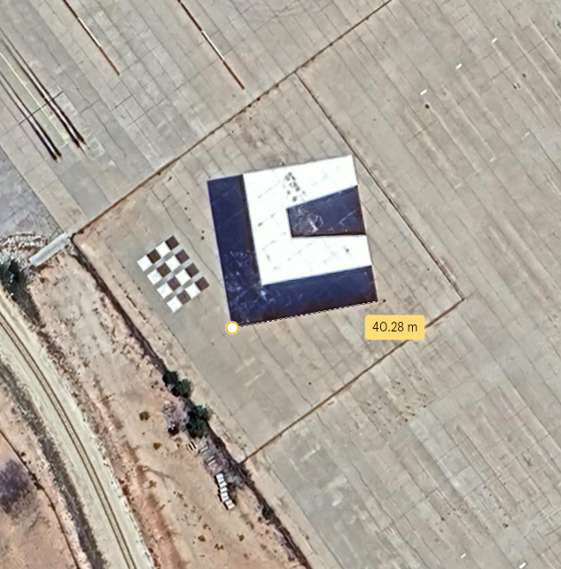
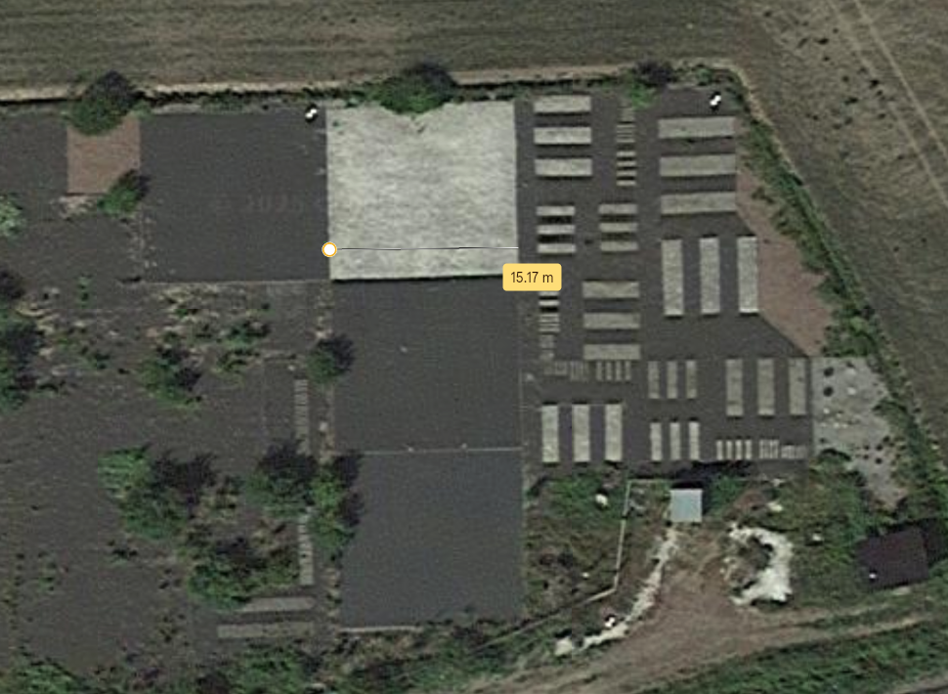
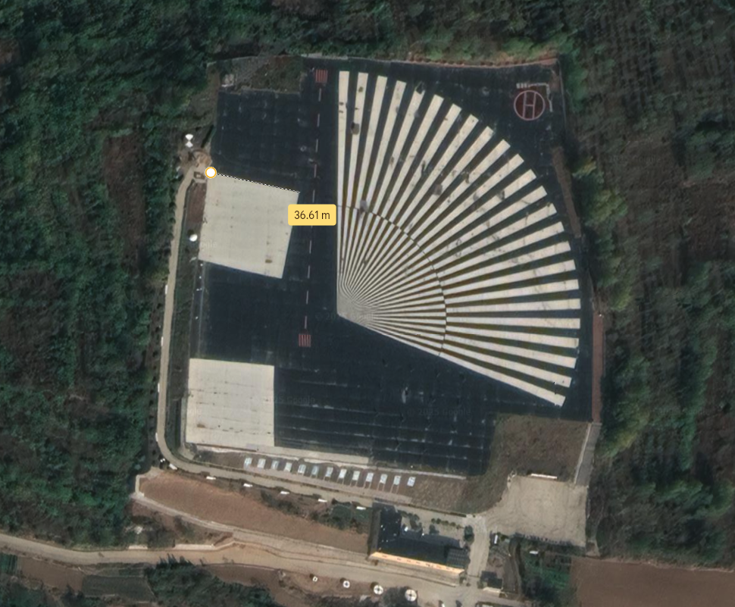
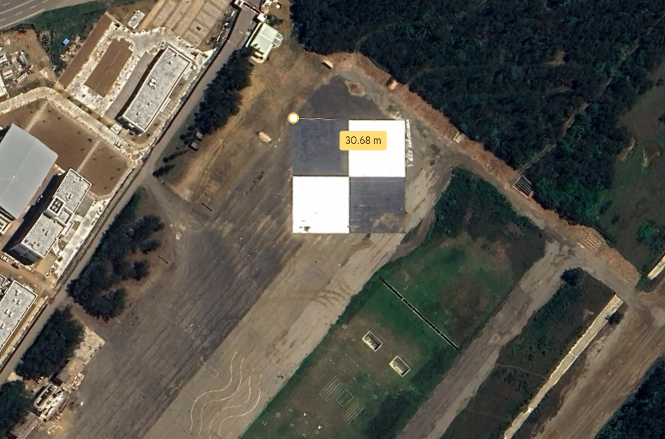
NRSC Shadnagar, Telangana
Spatial CAL sites
17.033889, 78.183333
Big Spring, Texas, USA
Inner Mongolia, China
40.851667, 109.629167
32.220499, -101.512541
Kirkkonummi, Finland
60.242177, 24.384075
Zhengzhou, Henan China
Taiwan, Penghu County, Magong City
34.535674, 113.095843
23.520005, 119.583587

Slide 10
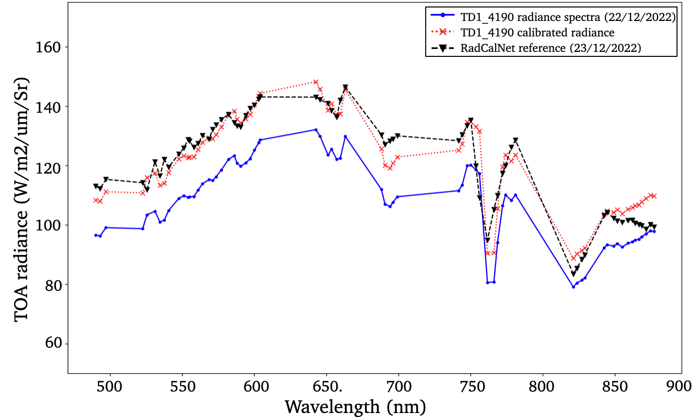
Sites are good enough to bring satellite data closer to ground truth

Slide 11
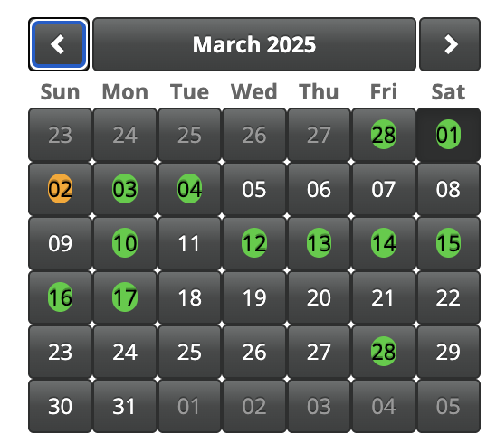
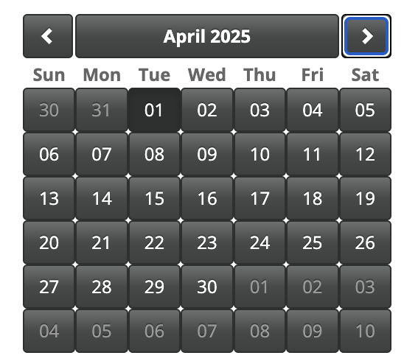
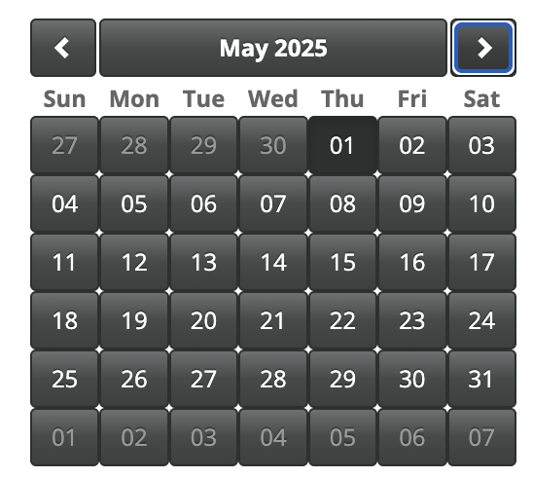
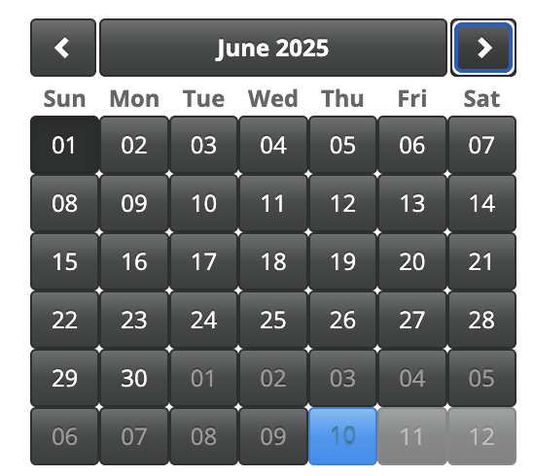
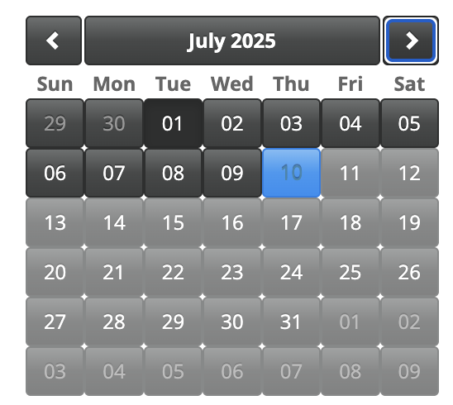
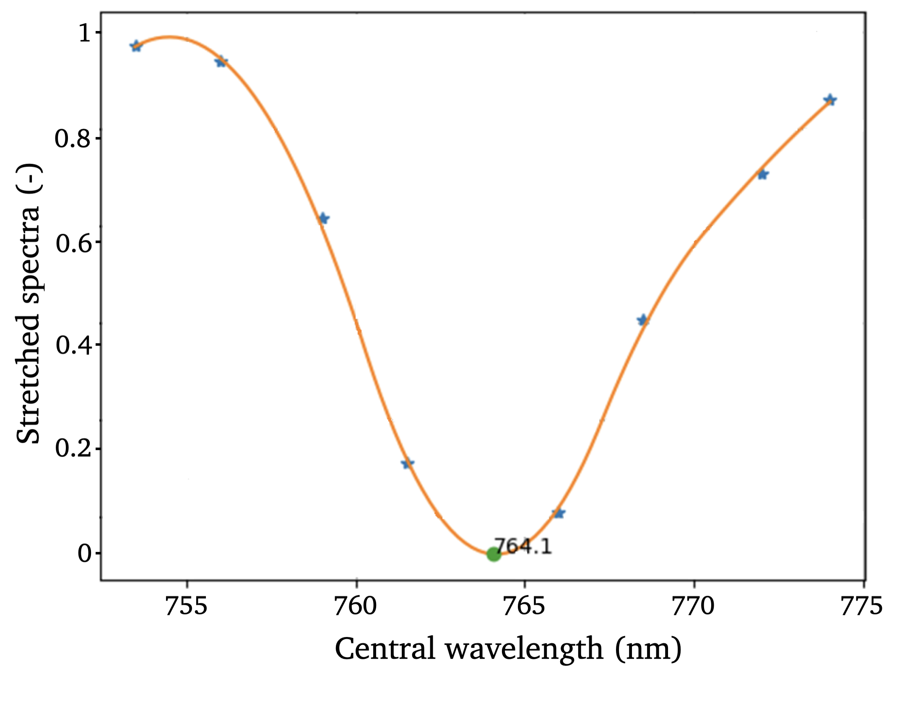
Challenges with open source CAL-VAL data
Continuous availability of the data
FWHM of the data ~10nm
Look angle is fixed

Slide 12

Thank you
Dr Rahul Raj
Principal Research Scientist
Pixxel.Space
contact@pixxel.co.in || rahulraj@pixxel.co.in

