Slide 1
CEOS Working Group on Calibration and Validation (WGCV)
Overview
Cody Anderson, USGS
Agenda Item 3.7
WGCV-55
Hyderabad, India
8-10 July, 2025

Slide 2
Who is CEOS?
34 Members
Space Agencies
30 Associates
UN Agencies, Phase A programmes or supporting ground facility programmes
Mission: CEOS ensures international coordination of civil space-based Earth observation programs and promotes exchange of data to optimize societal benefit and inform decision making for securing a prosperous and sustainable future for humankind.

Slide 3
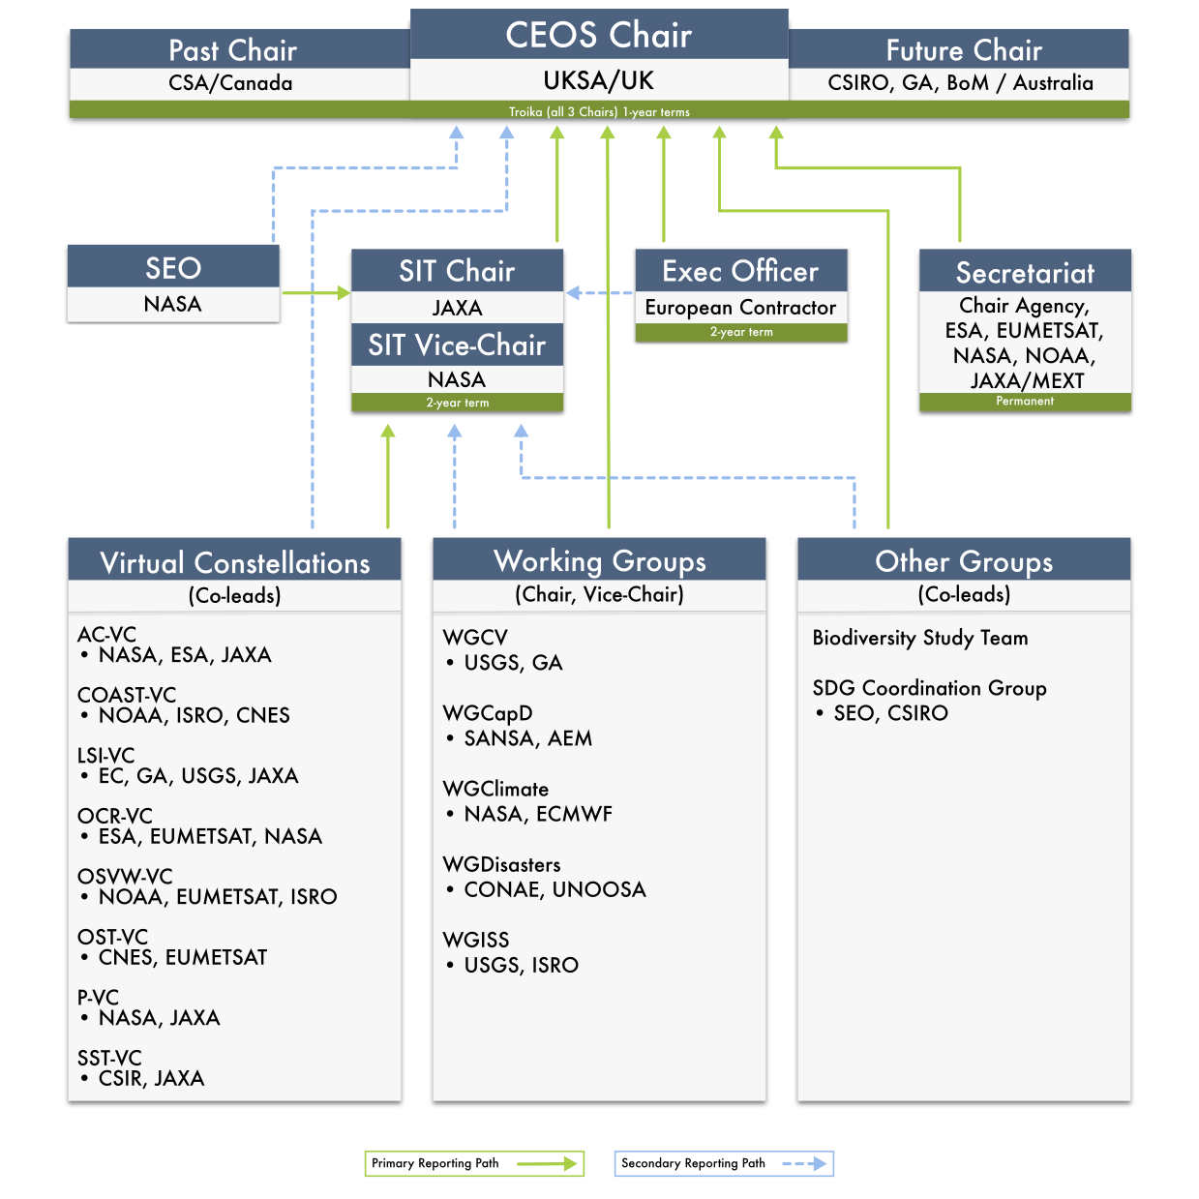
What is CEOS?
Virtual Constellations:
Atmospheric Composition
Coastal Observations Applications Services and Tools (COAST)
Land Surface Imaging
Ocean Colour Radiometry
Ocean Surface Topography
Ocean Surface Vector Wind
Precipitation
Sea Surface Temperature
Working Groups:
Calibration & Validation
Capacity Building & Data Democracy
Climate
Disasters
Information Systems & Services

Slide 4
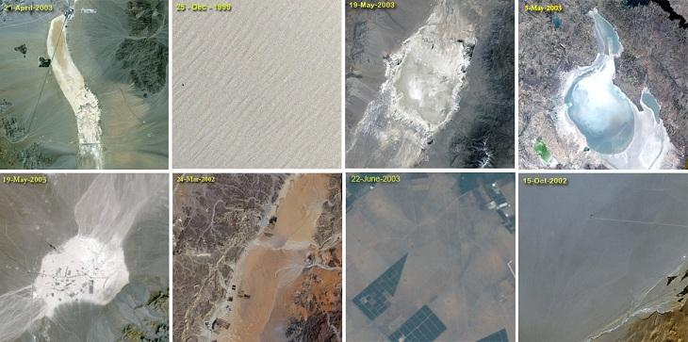
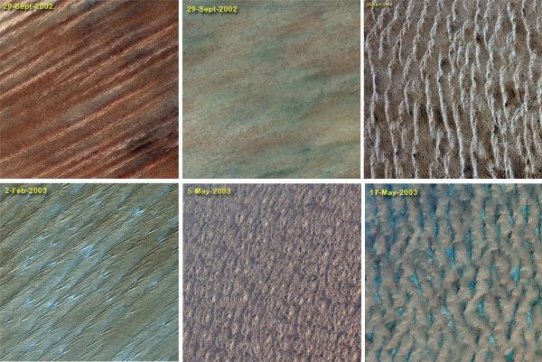
CEOS Working Group on Calibration and Validation
WGCV mission: Ensure long-term confidence in the accuracy and quality of Earth Observation data and products and to provide a forum for the exchange of information about calibration and validation, including the coordination of cooperative activities.

Slide 5
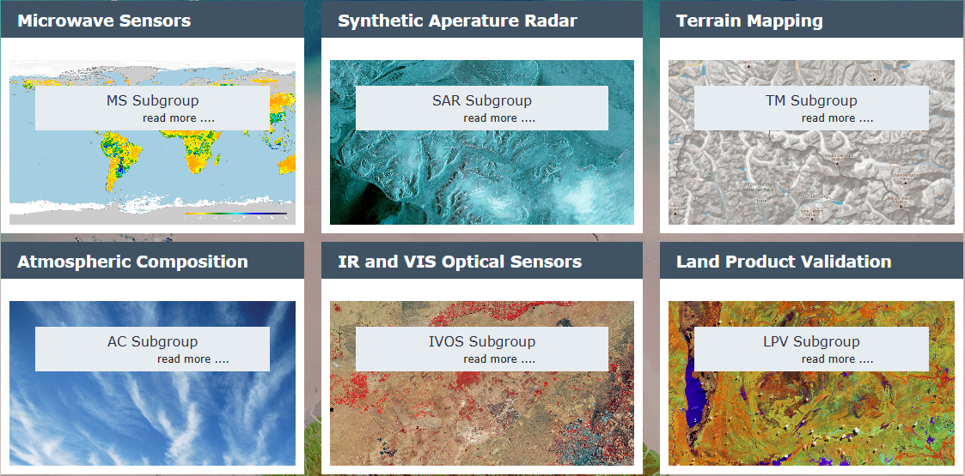
Organisation
WGCV Chair: Cody Anderson (USGS)
WGCV Vice Chair: Medhavy Thankappan (GA)
The six subgroups of WGCV aim to foster high quality Cal/Val of data from Earth Observation sensors and validation of higher level products in each domain
Credit: Cal/Val Portal (https://calvalportal.ceos.org/wgcv)

Slide 6
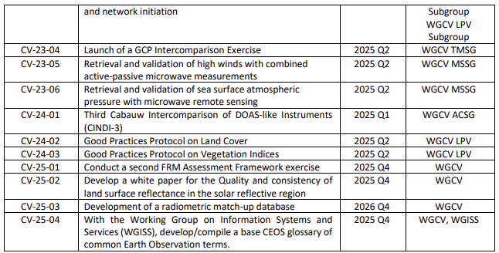
WGCV Deliverables and Work Plan
List of open WGCV deliverables in the CEOS Work Plan - to be updated after WGCV-55!
WGCV activities are described in more details in Chapter 7 of the CEOS Work Plan.

Slide 7
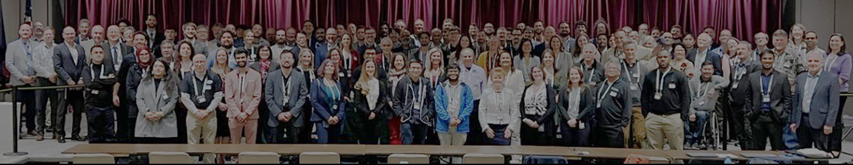
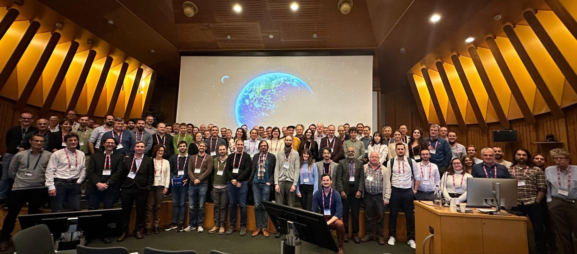
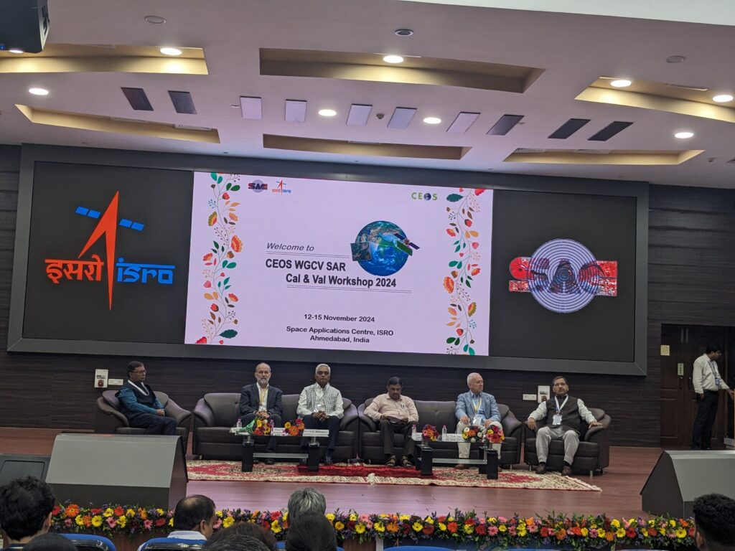
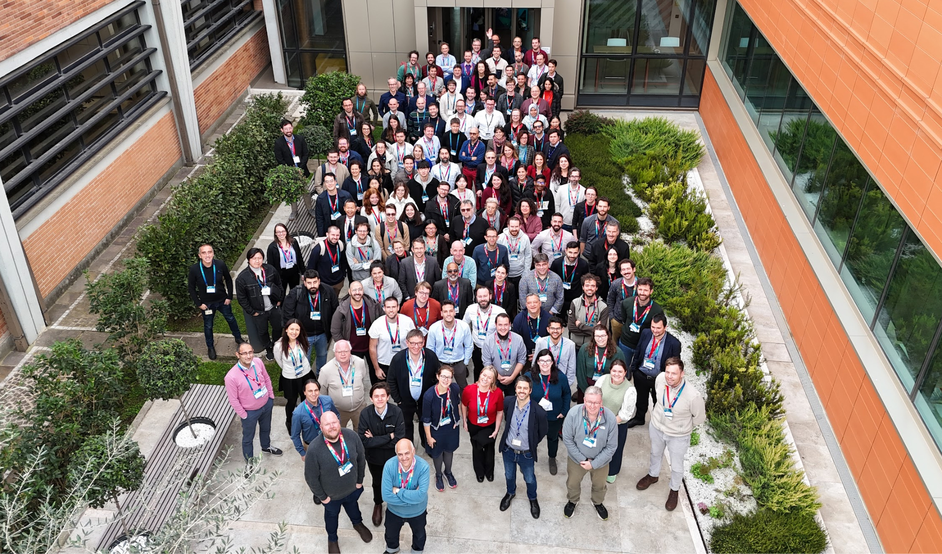
Meetings & Workshops
JACIE 2025: 7-11 April 2025, USGS Headquarters, Reston, USA
VH-RODA 2024: 2-6 December 2024, ESA ESRIN, Frascati, Italy
WGCV SAR Workshop 2024: 12-15 November 2024, ISRO SAC, Ahmedabad, India
Workshop on Pre-flight Calibration and Characterisation of Optical Sensors: 19-22 October 2024. ESA-ESTEC, Noordwijk, the Netherlands
JACIE 2025
Pre-flight Workshop
VH-RODA 2024
SAR Workshop

Slide 8
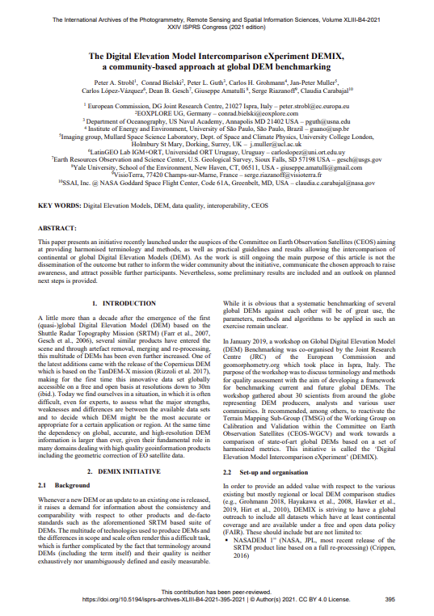
Publications
LPV Subgroup Validation Protocols: LC (2025), AGB (2021), SM (2021), Albedo (2019), LST (2018), LAI (2014)
IVOS: Good Practice Guidelines for UAV-based Surface Reflectance Validation
ACSG: Best Practice Protocol For The Validation Of Aerosol, Cloud, And Precipitation Profiles
TMSG: DEMIX Conference paper
FRM: FRM Assessment Framework guidelines V2

Slide 9
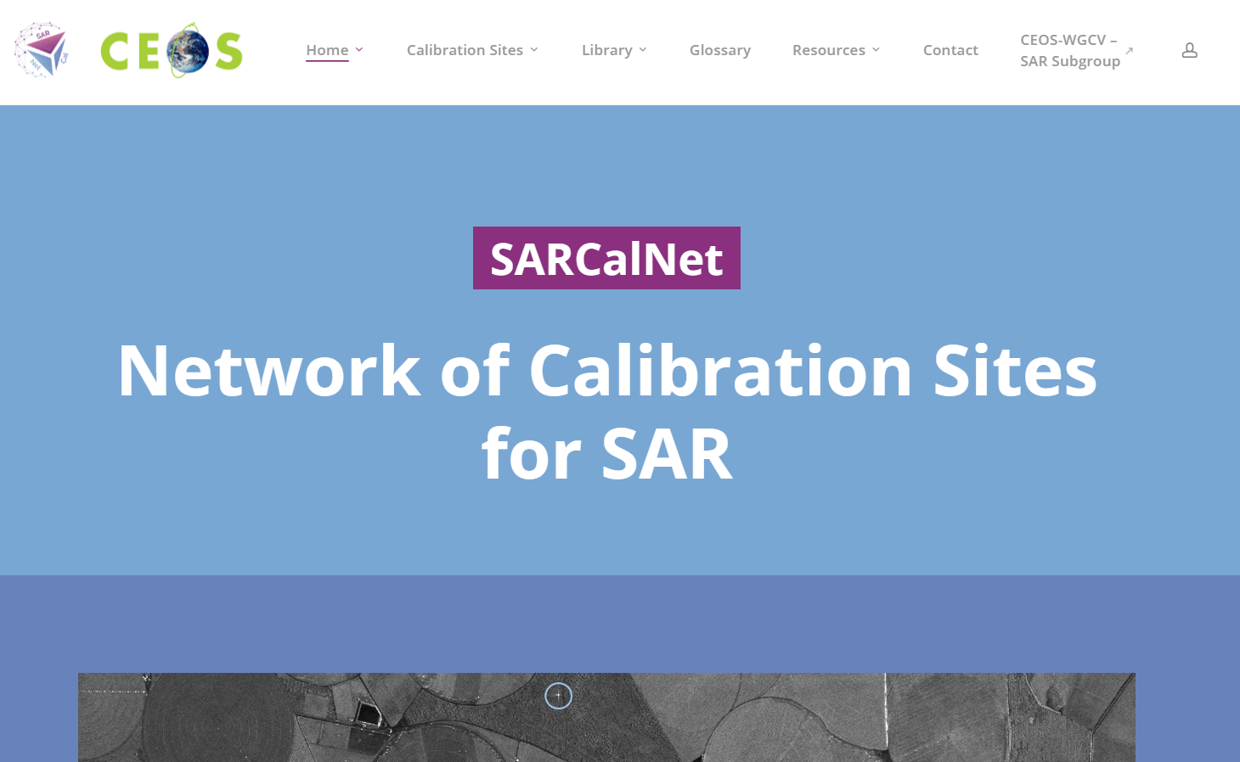
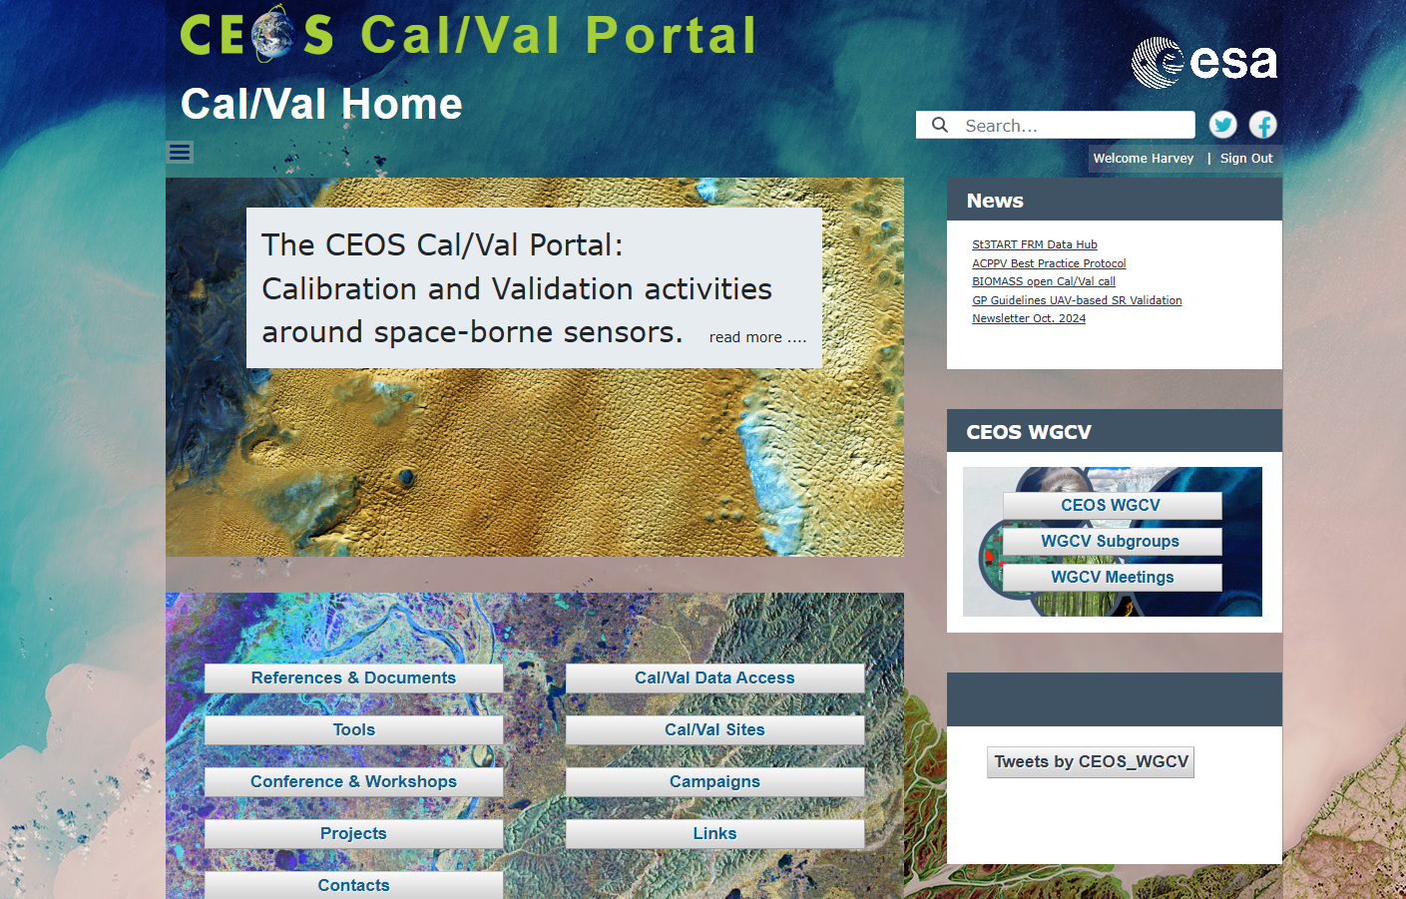
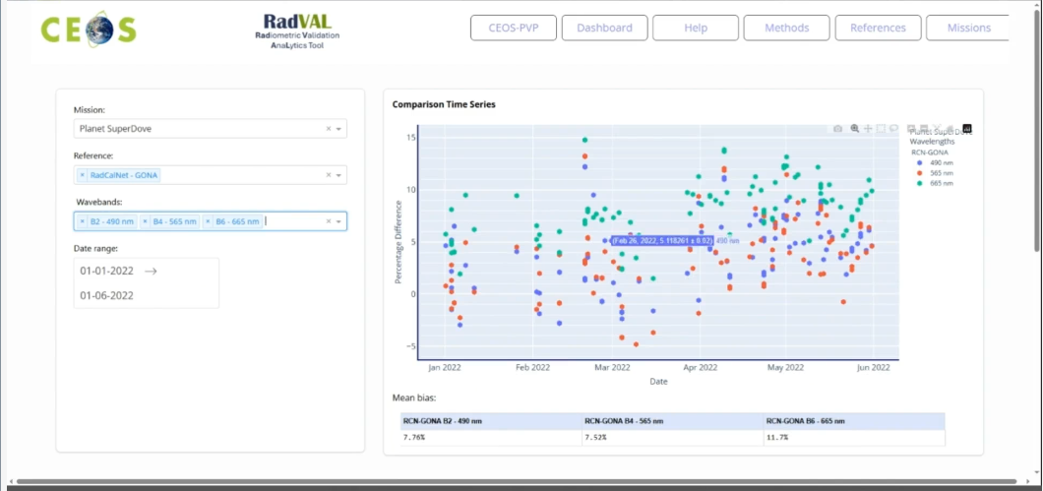
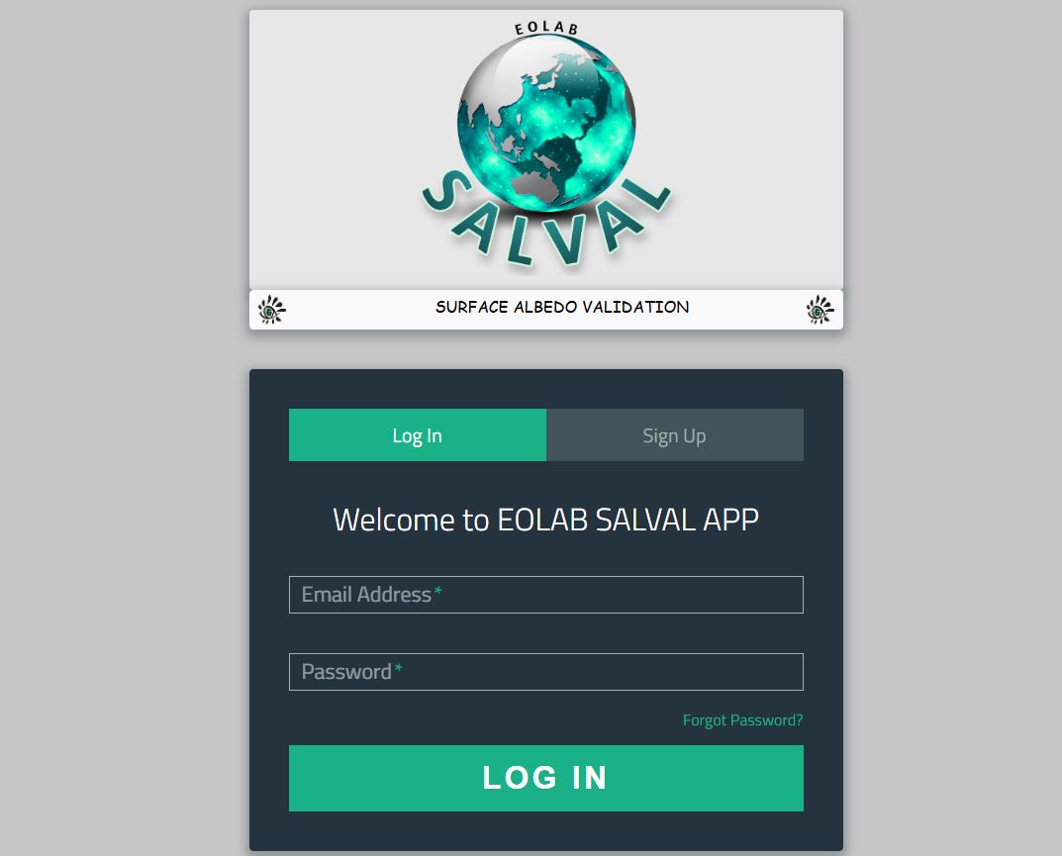
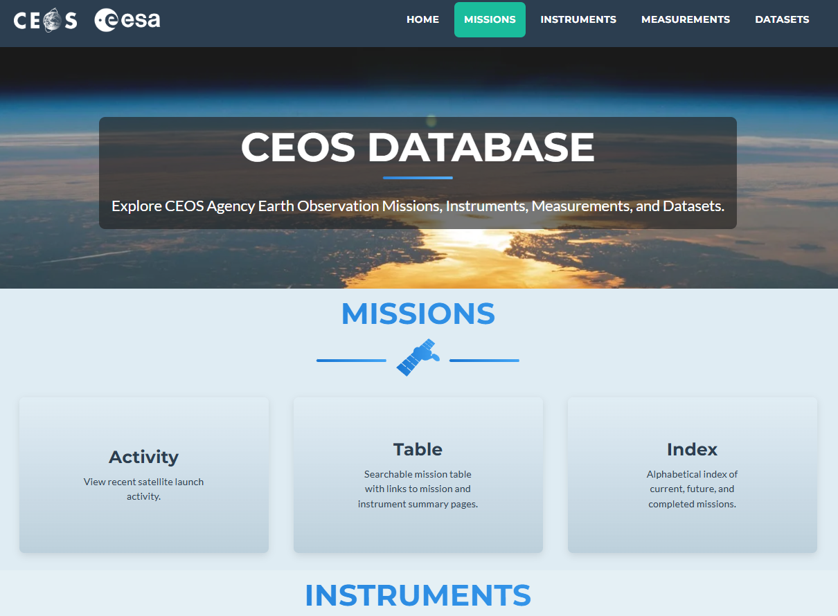
Tools & Services
Radiometric Calibration Network radcalnet.org
SAR Calibration Network sarcalnet.org
CEOS Cal/Val Portal calvalportal.ceos.org
Product Validation Platform ceos.org/pvp
Surface Albedo Validation salval.eolab.es
CEOS MIM Database database.eohandbook.com

Slide 10
Contact us
ACSG Chair: Jean-Christopher Lambert (BIRA-IASB) jean-christopher.lambert@aeronomie.be
LPV Subgroup Chair: Fabrizio Niro (ESA) fabrizio.niro@ext.esa.int
TMSG Chair: Peter Strobl (EC) peter.strobl@ec.europa.eu
IVOS Chair: Nigel Fox (NPL) nigel.fox@npl.co.uk
MSSG Chair: Xiaolong Dong (CAS) dongxiaolong@mirslab.cn
SAR Subgroup Chair: Dirk Geudtner (ESA) Dirk.Geudtner@esa.int
WGCV Chair: Cody Anderson (USGS) chanderson@usgs.gov
WGCV Vice Chair: Medhavy Thankappan (GA) medhavy.thankappan@ga.gov.au
WGCV Secretariat: Harvey Jones harvey@symbios.space

