Slide 1
CEOS WGCV CEOS-PVP incorporating CID & RadVAL
Product Validation Platform
(previously known as 'matchup Database')
(Comparison Image Database) &
(Radiometric Validation & AnaLytics tool)
Endorsed by SIT (April)
Nigel Fox, NPL
Agenda Item 3.9
WGCV-55,
Hyderabad, India
8th - 12th Jul 2025
Notes:
Full overarching name

Slide 2
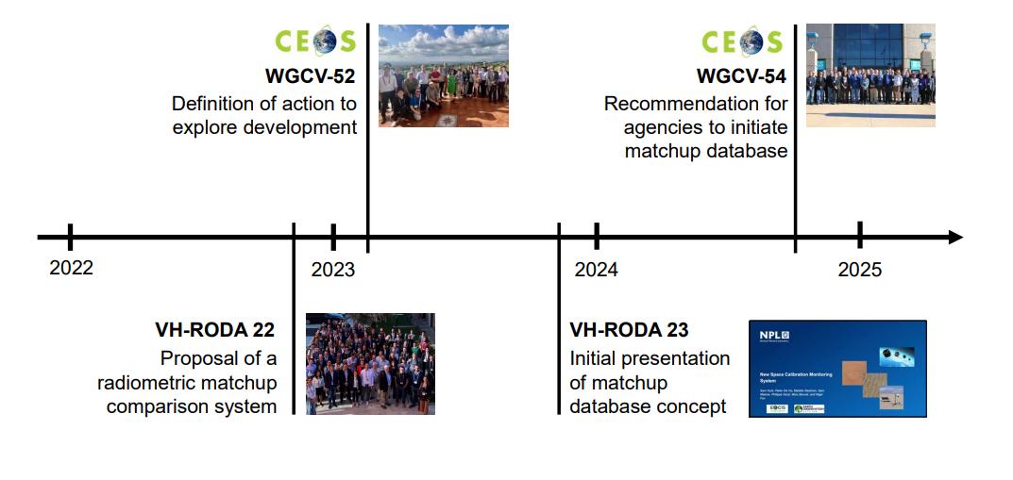
Background
Supporting the CEOS New Space Task Team white paper generally, including recommendations (R3) and deliverables (D4)
VH-RODA 2023 slides here
Noting recent CEOS Commercial Engagement guidance

Slide 3
WGCV’s recommendation
(CEOS plenary 2024)
CEOS WGCV’s recommendation to facilitate interoperable global satellite imagery for both public and commercial agencies
CEOS Agencies should regularly collect and provide free access to Level 1 satellite imagery and metadata against a common ‘CEOS reference’ (representing radiometric and spatial properties)
A combination of CEOS calibration sites will be integrated together into a virtual reference
Commercial data providers are encouraged to also provide similar imagery
Imagery should be made available through an API or a dedicated CEOS archive offered to be hosted by the UK Earth Observation Data Hub (EODH).
CEOS will provide QA feedback to support satellite operators and data users via an NPL developed web app

Slide 4
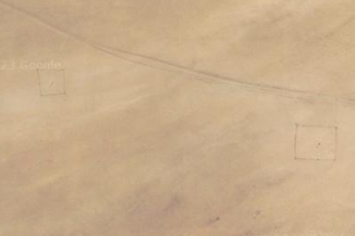
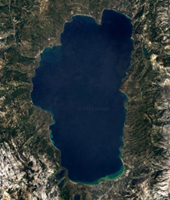
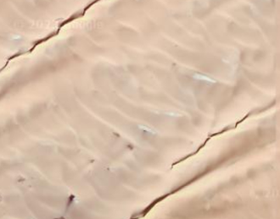
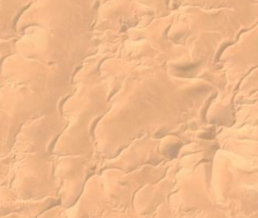
Selected: Radiometric Sites
Instrumented Sites
Railroad Valley, USA
Gobabeb, Namibia
Lake Tahoe, USA
Natural (Pseudo-Invariant Calibration Sites)
Libya 4
Libya 1
Algeria 3

Slide 5
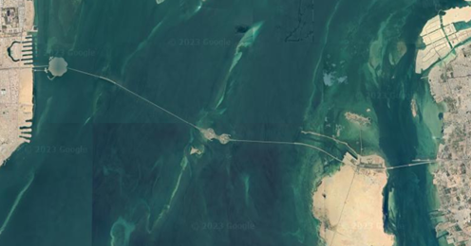
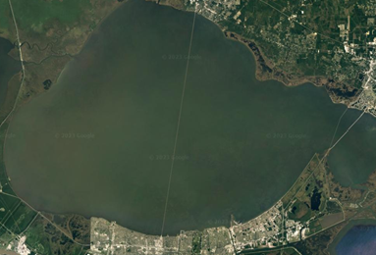
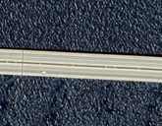
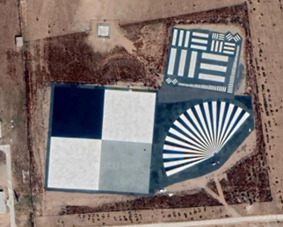
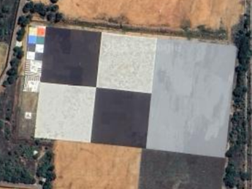
Selected: Spatial Sites
Medium resolution sensors
King Fahd Causeway, Saudi Arabia-Bahrain
Lake Pontchartrain Causeway, USA
High resolution sensors
Baotou Target, China
ISRO NRSC target, India

Slide 6
Current Progress
Creation of an overarching Product Validation Platform (PVP) new name for matchup database
Database of radiometric and spatial imagery data has been developed: (Comparison Image Database (CID)
Combination of CEOS-developed references - integrated together to form “virtual reference”
Gobabeb, RadCalNet
Railroad Valley, RadCalNet
PICS
“Virtual reference” concept to be refined in future to reduce reference uncertainty
Initial implementation built into a Radiometric Validation AnaLytics tool (RadVAL) within UK EODH, including:
Sensors: Sentinel-2, Landsat and commercial high-res: Planet SuperDove and Airbus Pléiades (as a demo)
CEOS references: Radiometric sites defined. More may be added, but aim to maintain a minimum core set of sites
Comparison Image Database (CID) to hold mission imagery over the sites now ready for inputs
Sentinel-2
Landsat 8

Slide 7
Comparison Image Database (CID)
The UK’s Earth Observation Data Hub (EODH) infrastructure hosts the archive of satellite imagery over CEOS references:
Intended to be open access
Initial mechanism of data transfer via direct contact with NPL and completing a form with the required information: Samantha.Malone@npl.co.uk
Mission/sensor details (product description/reader) and performance specification
SRFs for sensors will be needed (not necessarily publicly accessible)

Slide 8
RadVAL Comparison Dashboard
Radiometric Validation AnaLytics Tool
Built from NPL’s Cal/Val toolkit (to be open source)
Beta version, live in staging environment, including:
Sensors – Sentinel-2, Landsat, Planet SuperDove* and Airbus Pléiades* (* via EODH)
CEOS References – RCN GONA, RCN RRV, with PICS coming soon & 'virtual'
Landing page describing the activity and how to contribute
Find at: ceos.org/pvp – live by end of week! 2025 (URL agreed at SIT 40)
Allows Satellite operator to demonstrate radiometric performance and stability in a consistent manner via a range of independent references
'Virtual reference' an approximation of truth and aid to harmonisation
Can provide feedback to sensor operators

Slide 9
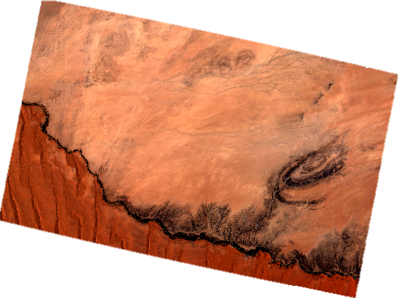
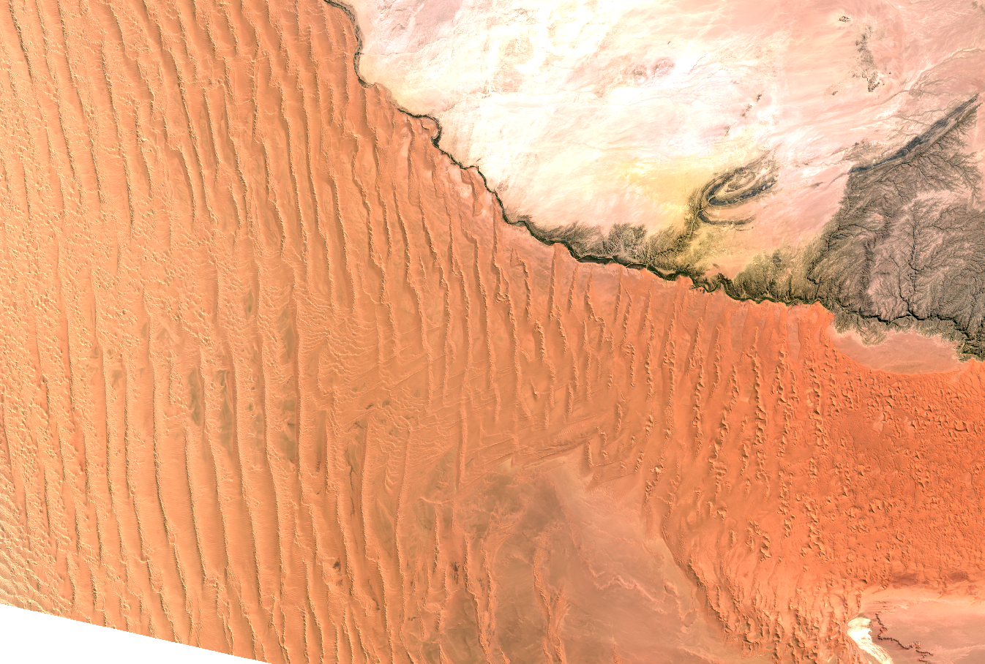
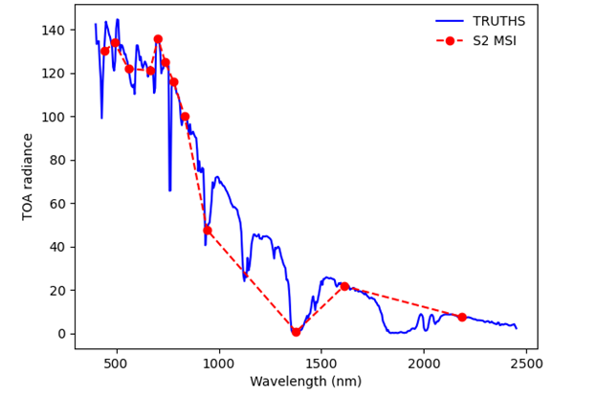
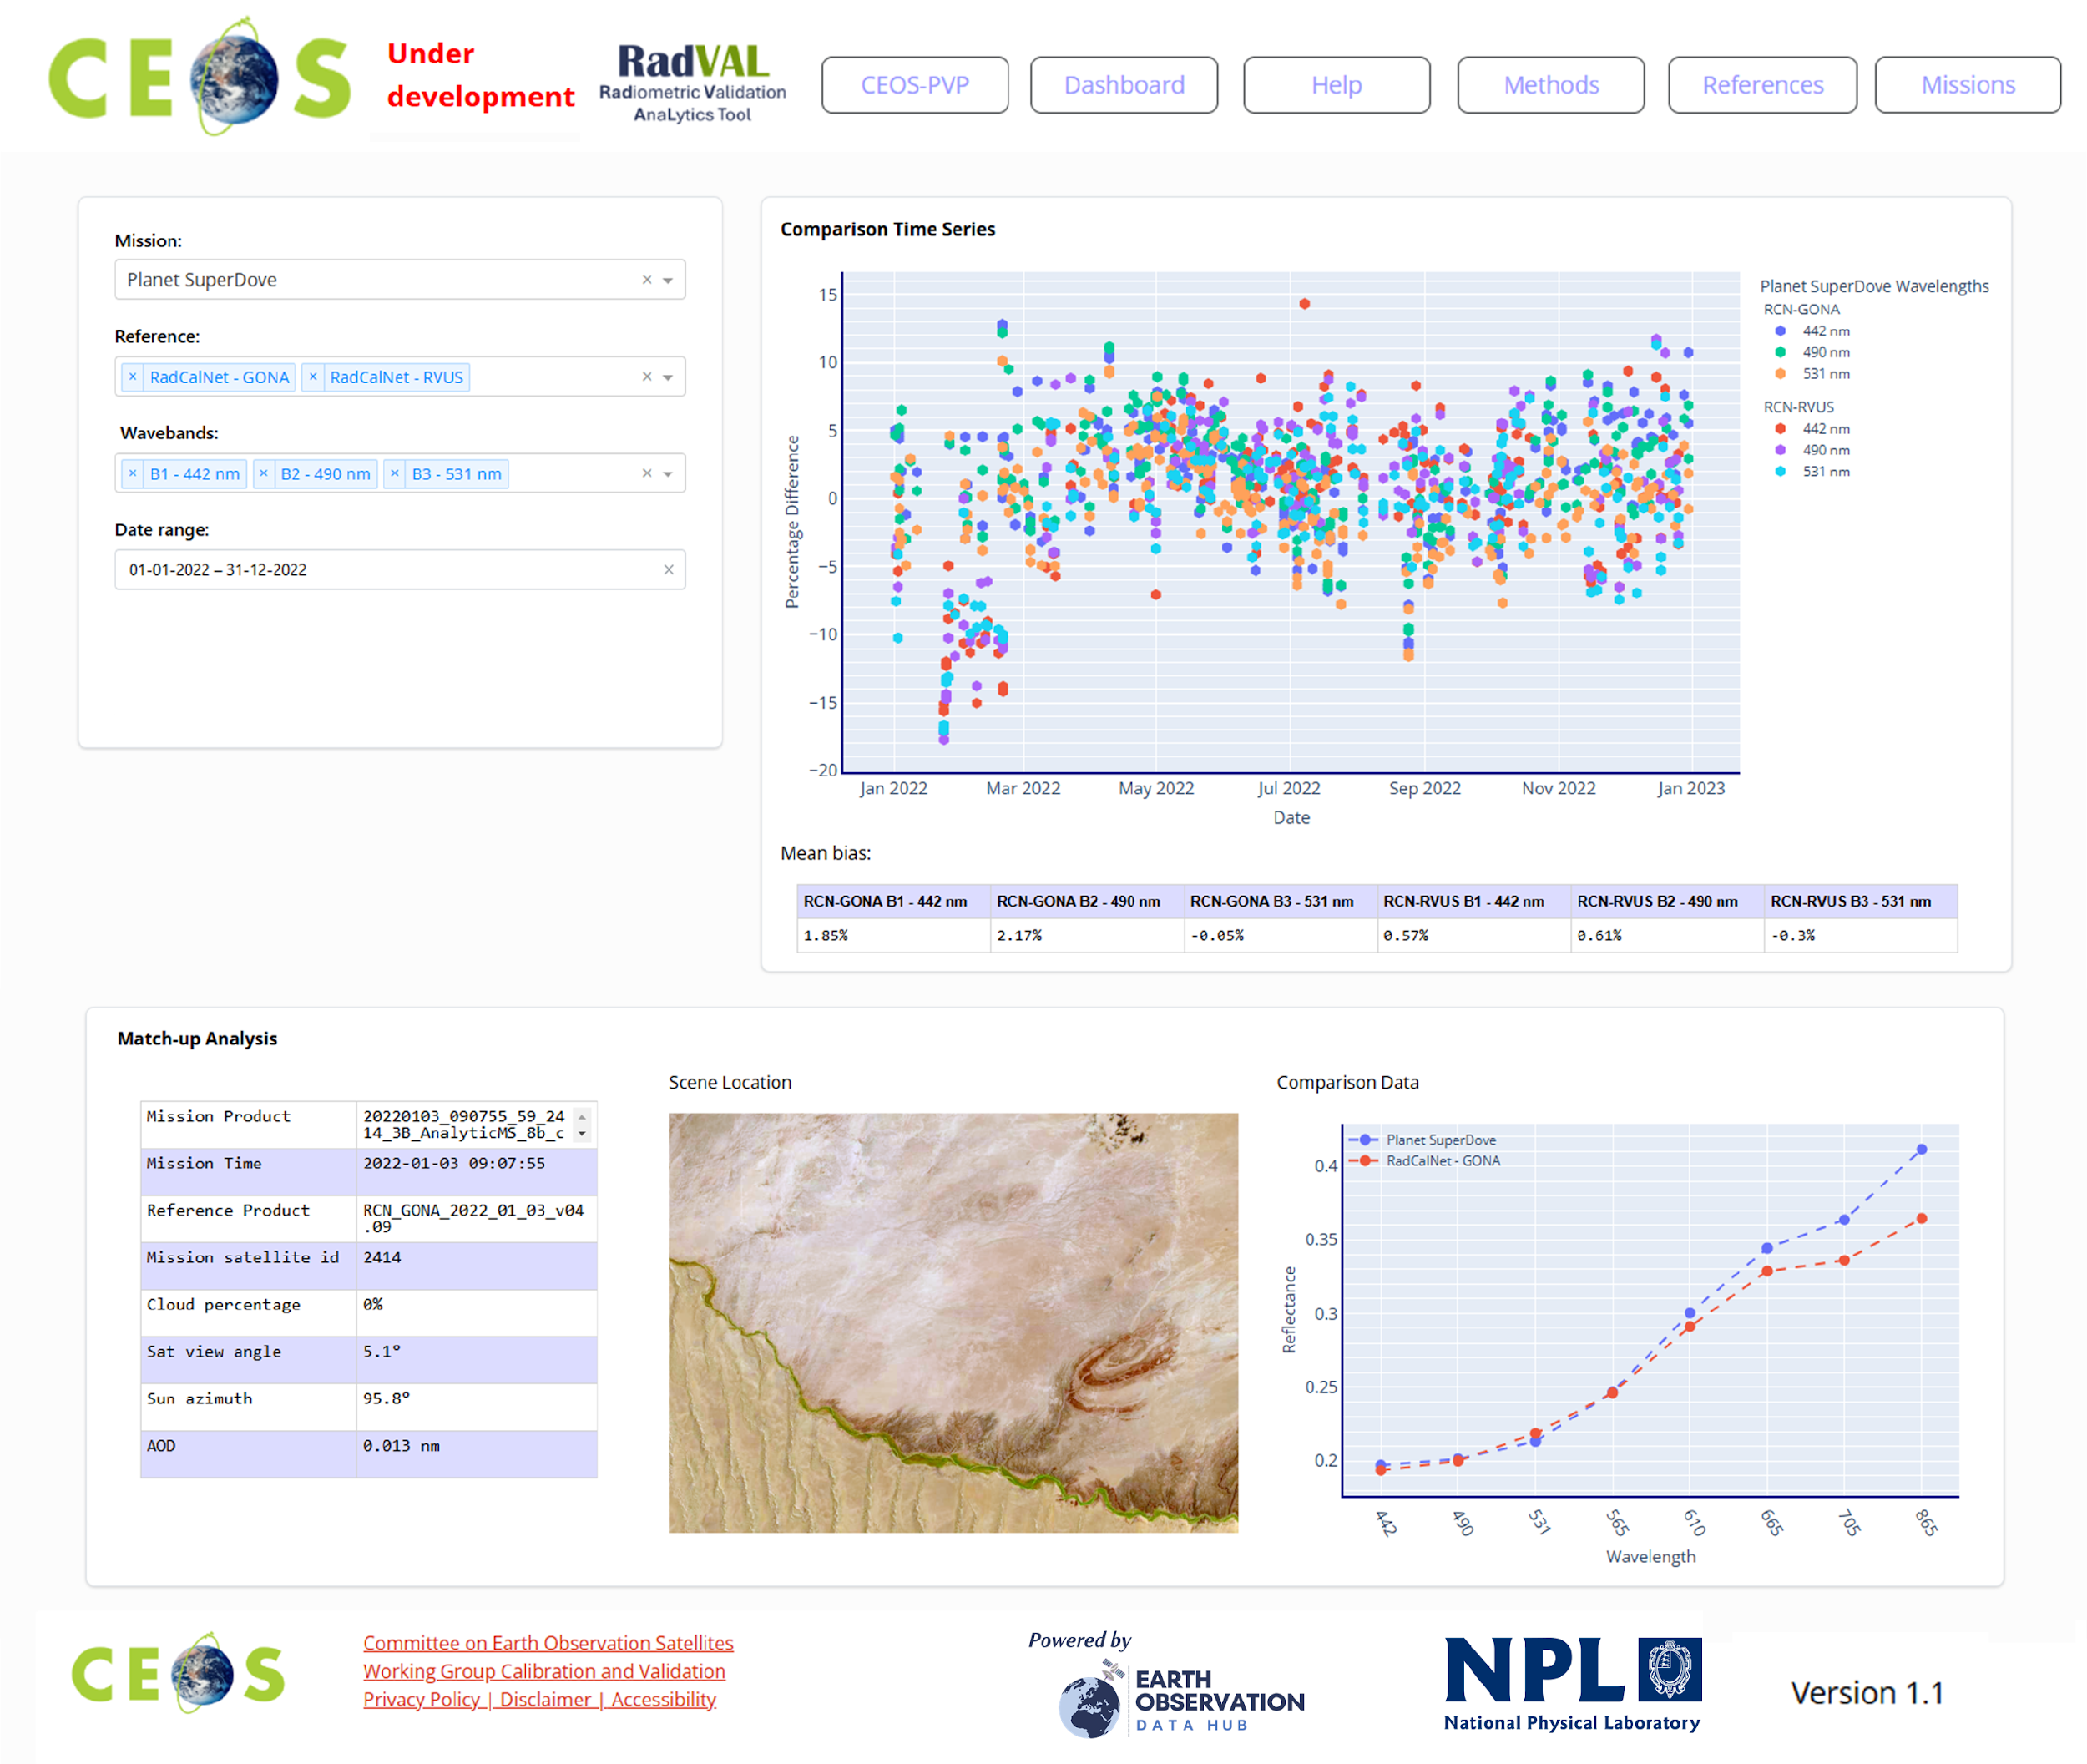
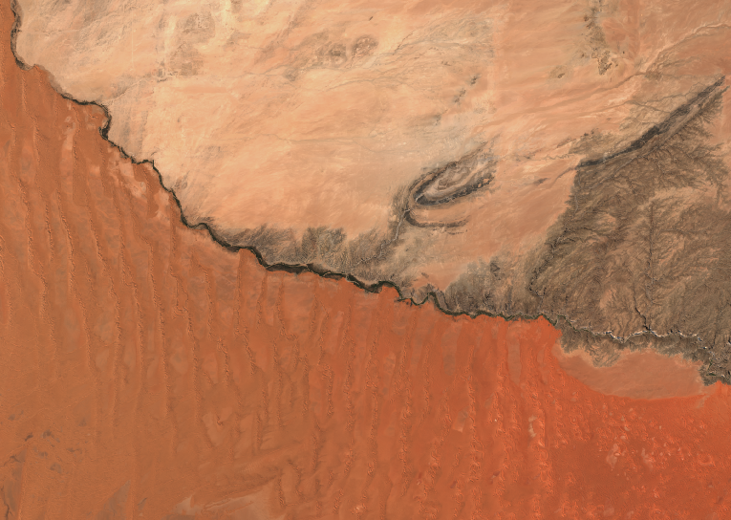
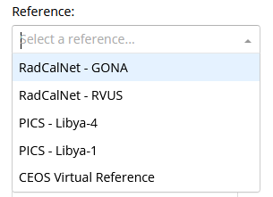
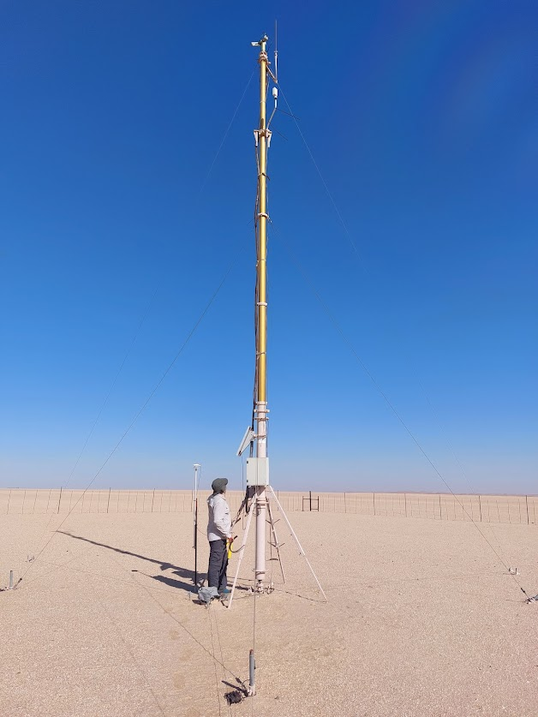
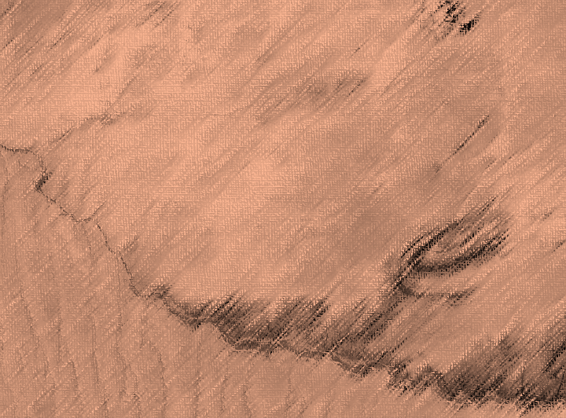
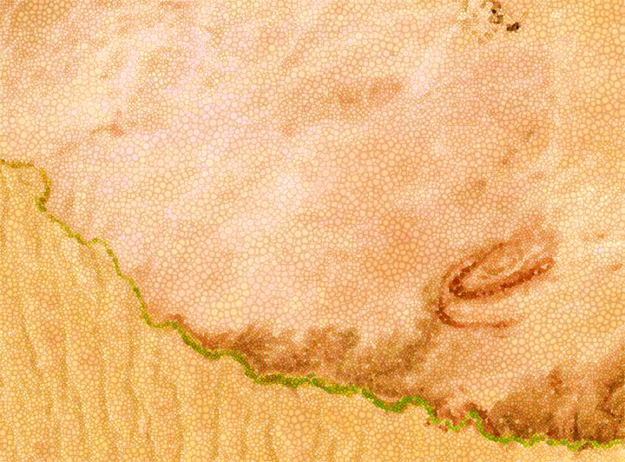
Product Validation Platform: PVP
PVP: Product Validation Platform
Data Collection
Comparison
Visualisation
Comparison Image Database (CID)
RadVAL Comparison
Database
RadVAL
Comparison
Dashboard
& future contributing missions…
Radiometric sites
Spatial
sites
RadVAL: Radiometric Validation AnaLytics Tool

Slide 10
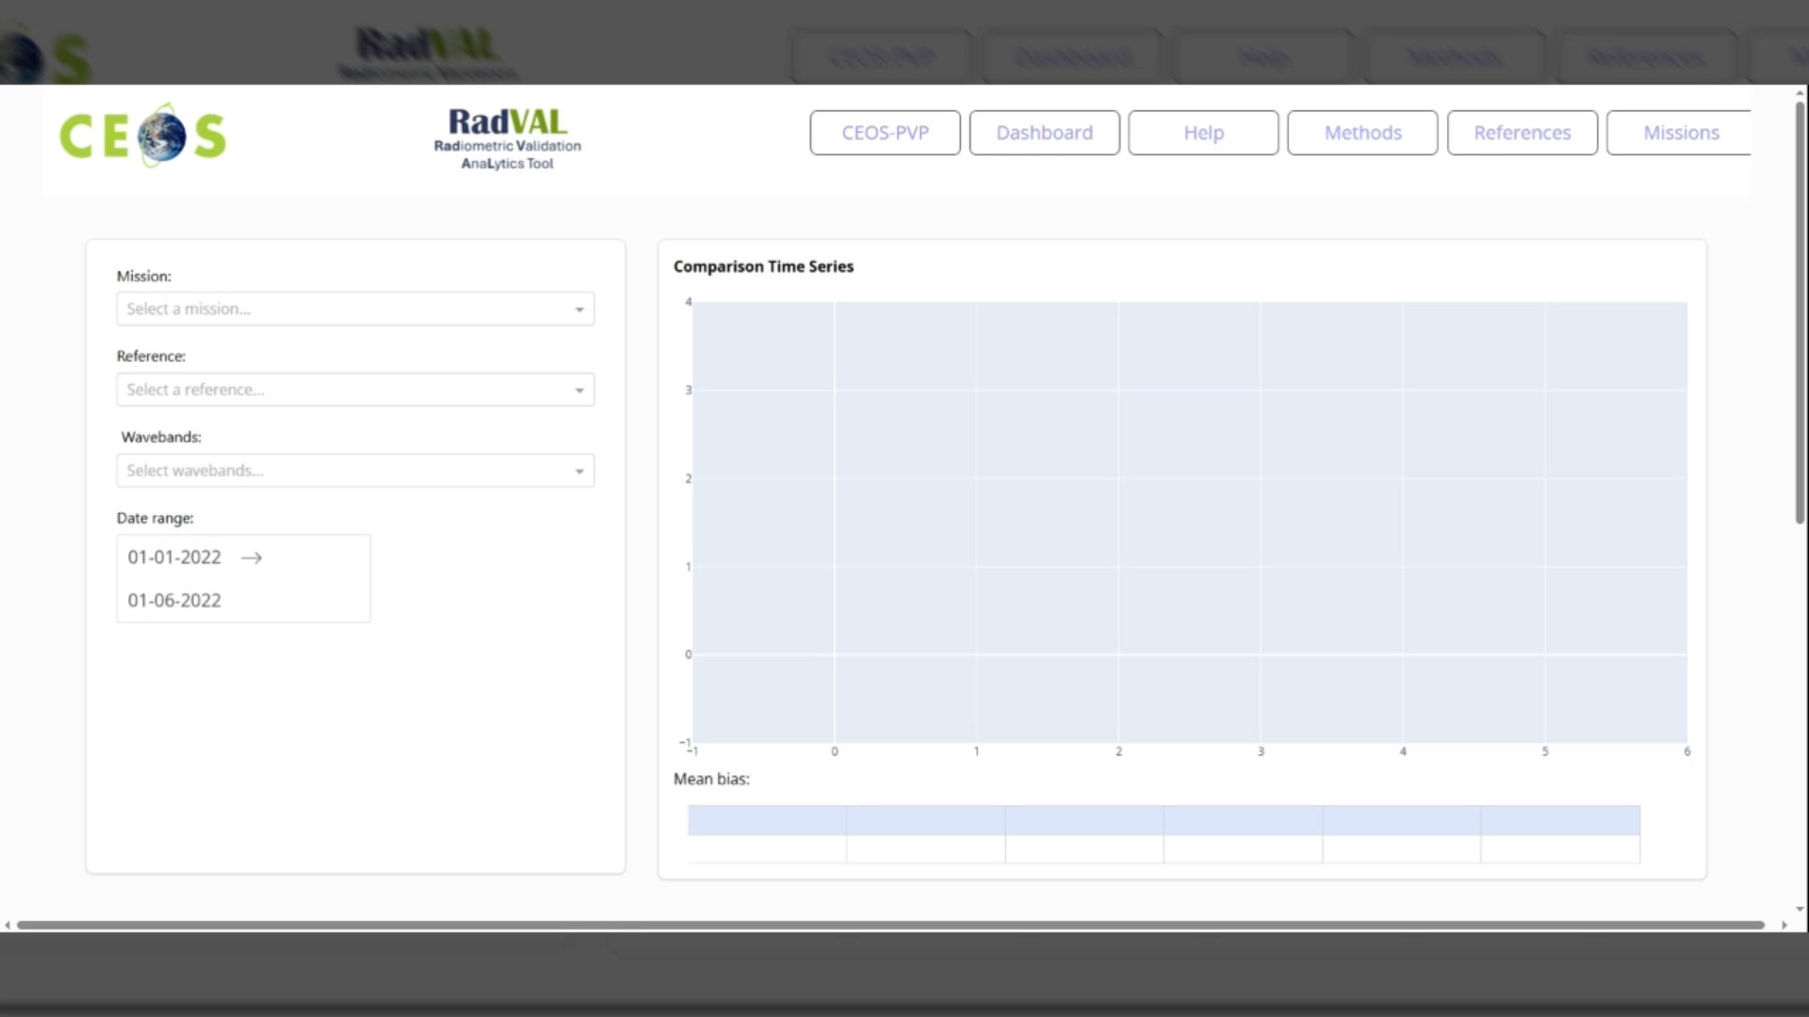
RadVAL tool demo

Slide 11
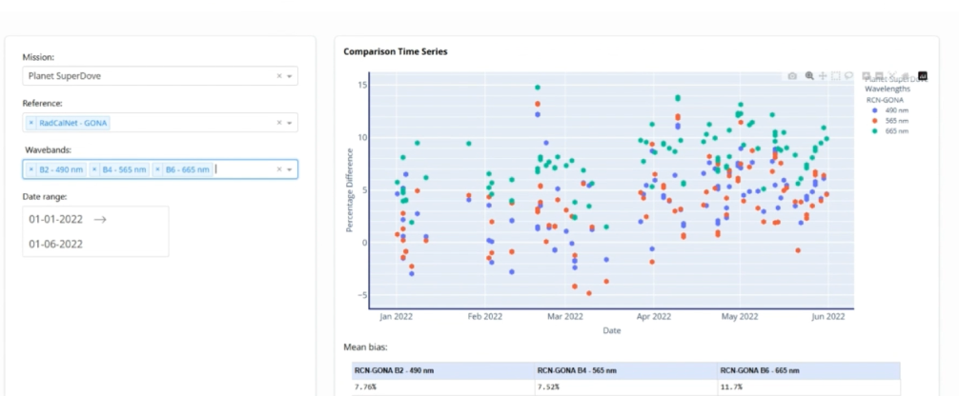
Planet superDove screen shot

Slide 12
Screenshot summary page example

Slide 13
Next Steps
Interaction with commercial missions to encourage delivery of imagery over reference sites
Release of submission form for missions to provide their data
CEOS- PVP CID & RadVAL beta launch NOW ish ceos.org/pvp
Launch CEOS Comparison Image Database (CID) on EODH
Deployment of beta RadVAL Comparison Dashboard site
Refinement of the CEOS ‘virtual reference’ concept
Populate CEOS-PVP with agency and commercial satellite imagery data.
Historic and future

Slide 14
Feedback from SIT
Very support
Suggestion to look at PVP to become landing page for other CEOS WGCV Product validation tools!!

