Slide 1

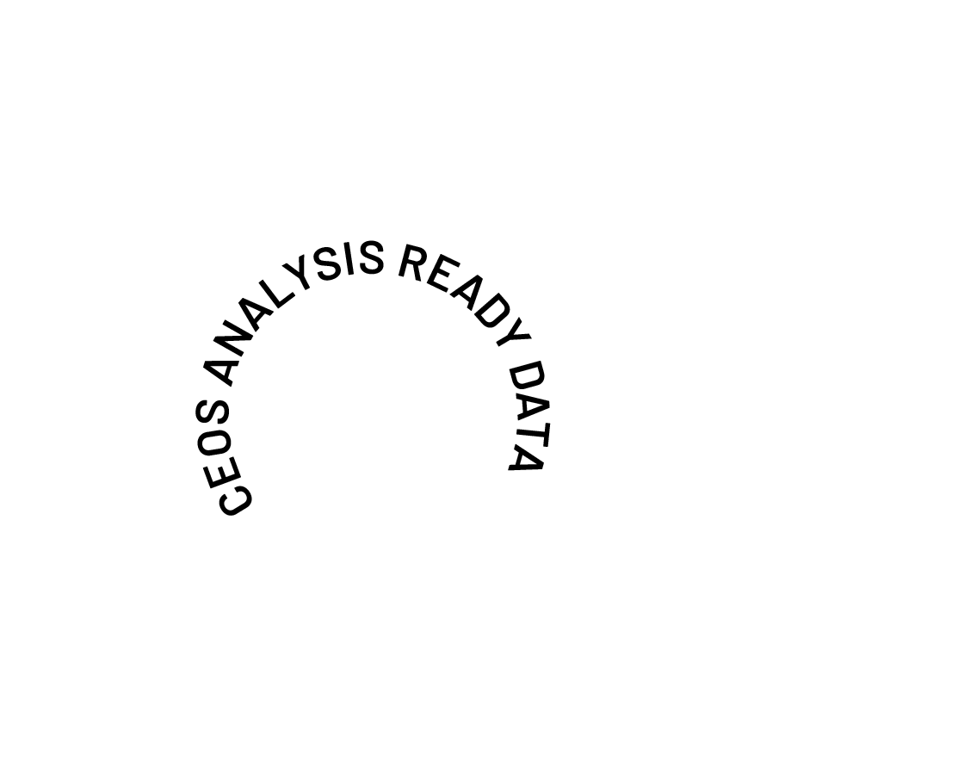
Future of CEOS-ARD Campaign
Matt Steventon
On behalf of the CEOS-ARD Oversight Group
Earth Observation for Everyone

Slide 2



In 2025 we asked: Can we do more?
The Earth observation sector has come a long way since CEOS-ARD was first conceptualised:
Changing technology
Evolving user base and expectations
Increasing demands for interoperability
Need CEOS-ARD to continue evolving
Ensure CEOS-ARD remains consistent with and relevant to the evolving user base and their expectations
Where are the opportunities to make CEOS-ARD better?

Slide 3
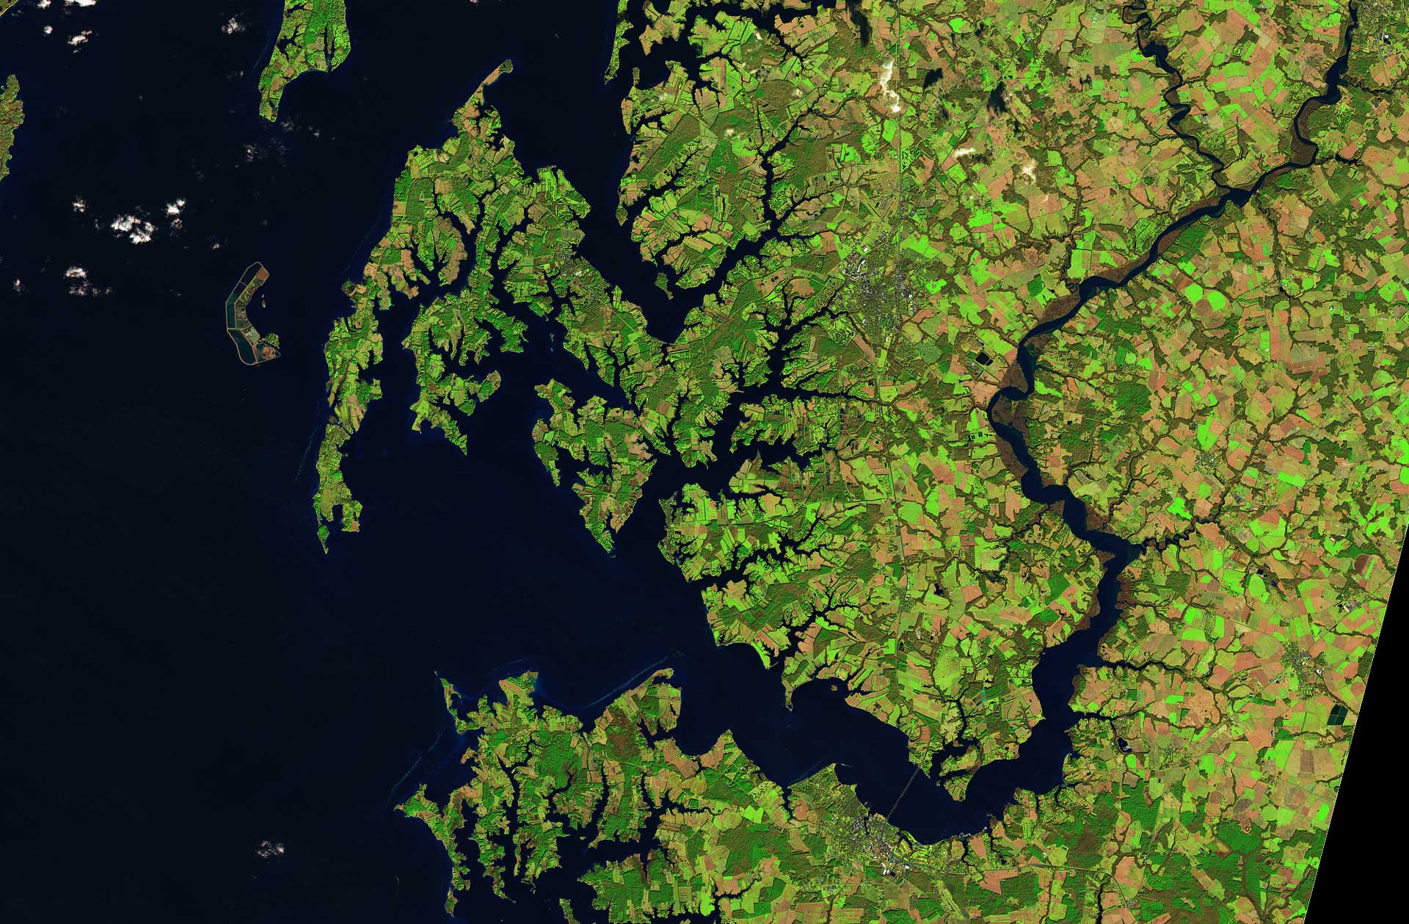

Approach
CEOS-ARD Oversight Group tasked with maintaining CEOS-ARD Strategy
  Updated every two years
In 2025 we undertook a community engagement campaign to understand needs
  Particular focus on those outside of CEOS
Understand exactly how CEOS-ARD needs to evolve
Presence at key events such as ESA’s LPS, IGARSS, IAC, WGCV-55
Survey to gather feedback to “Help Shape the Future of CEOS-ARD” ceos.org/ard/survey
Social media campaign
  LinkedIn particularly valuable

Slide 4
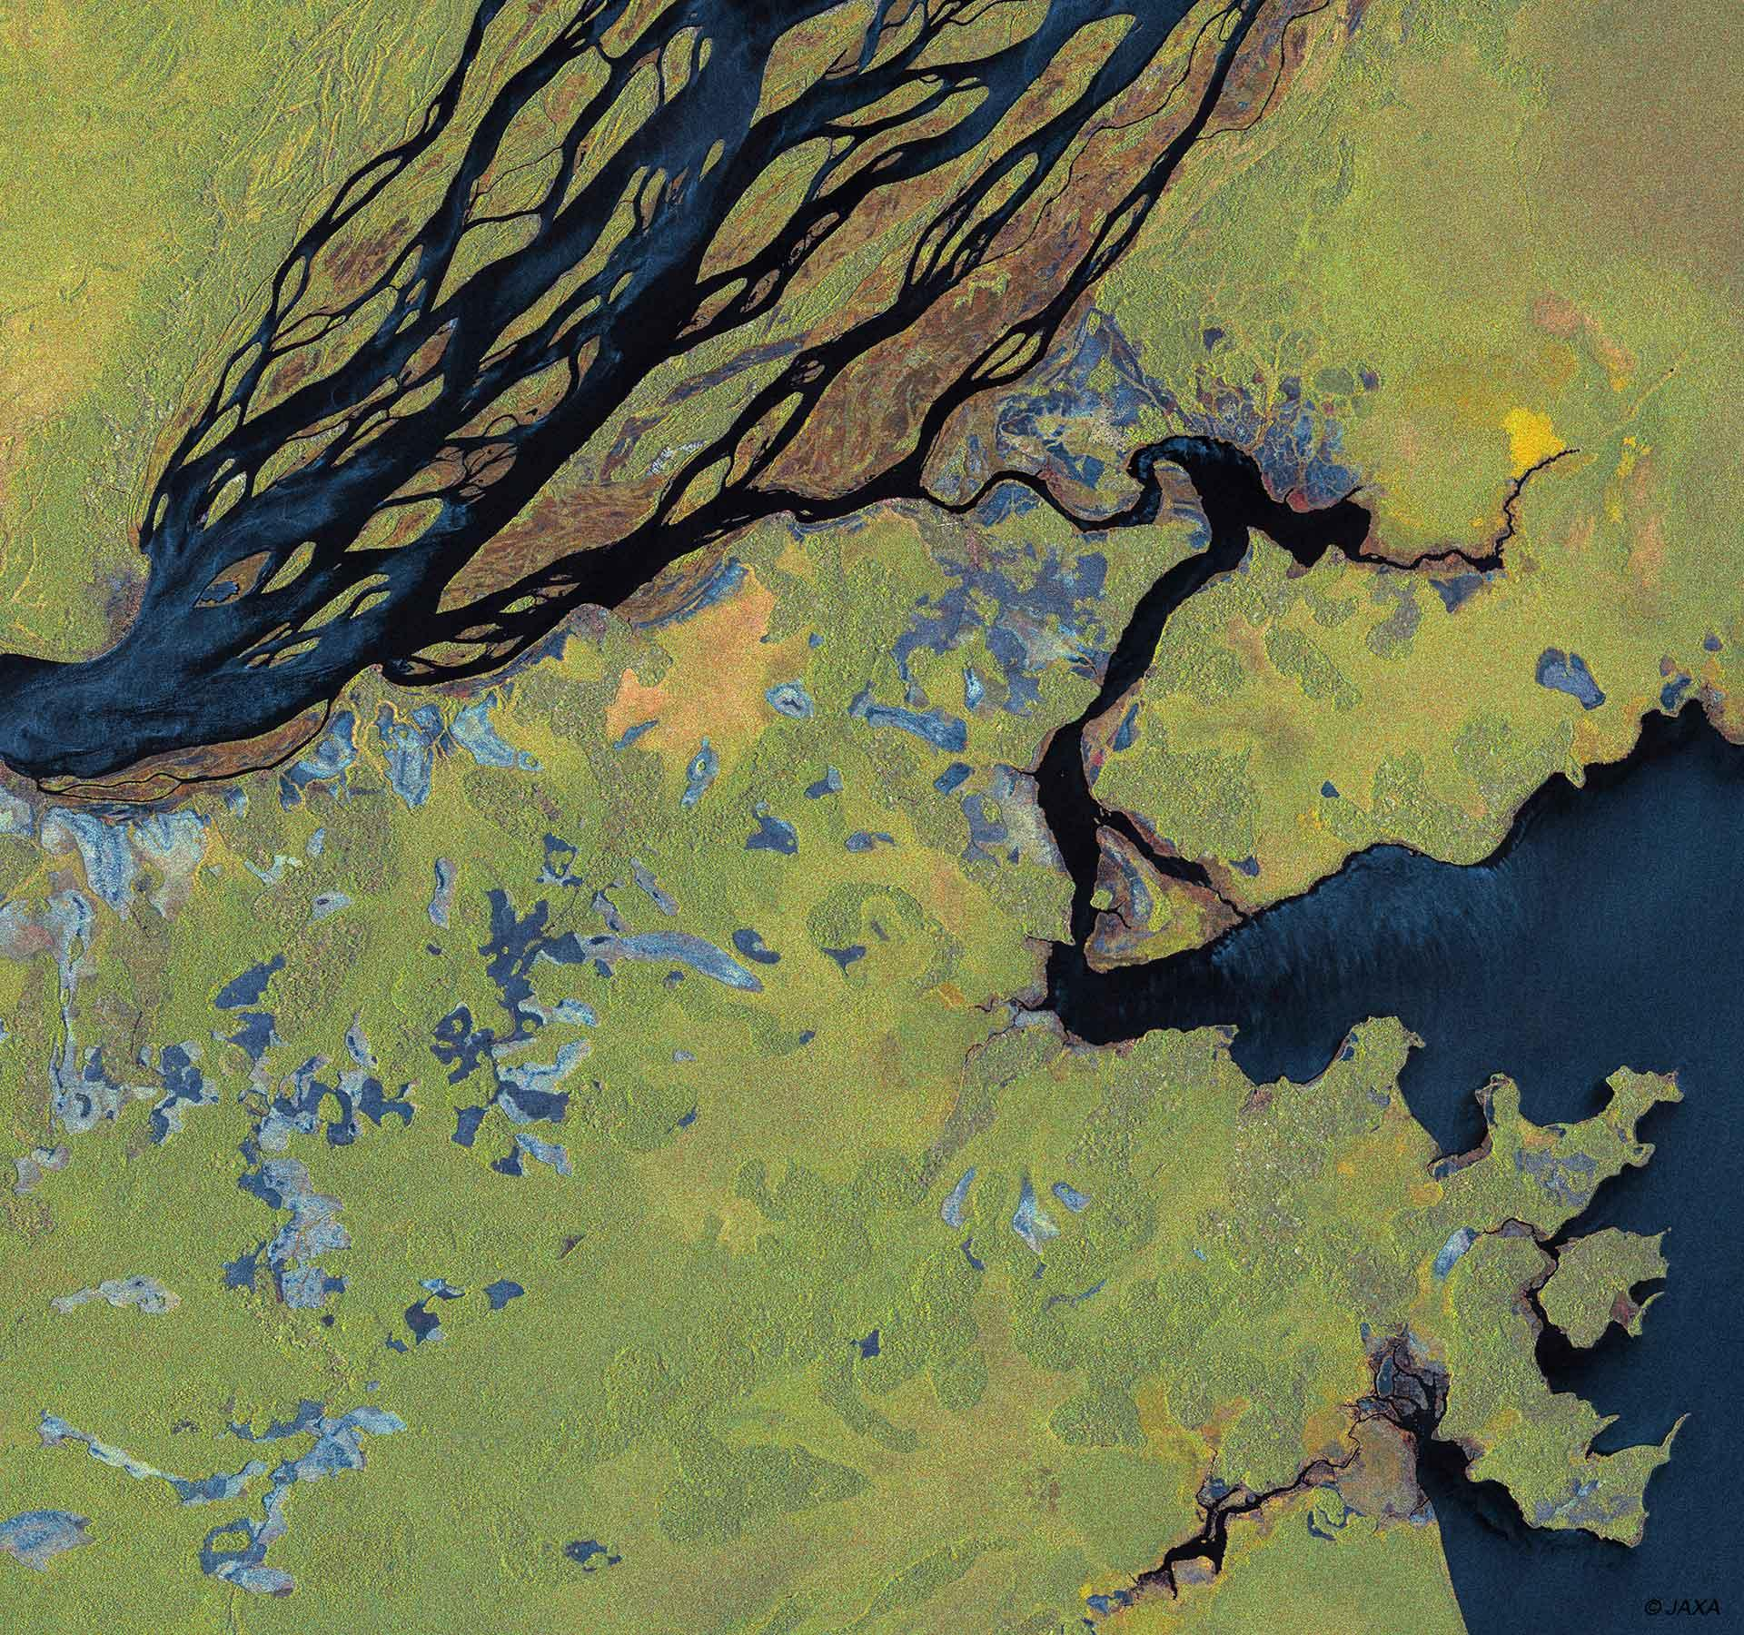
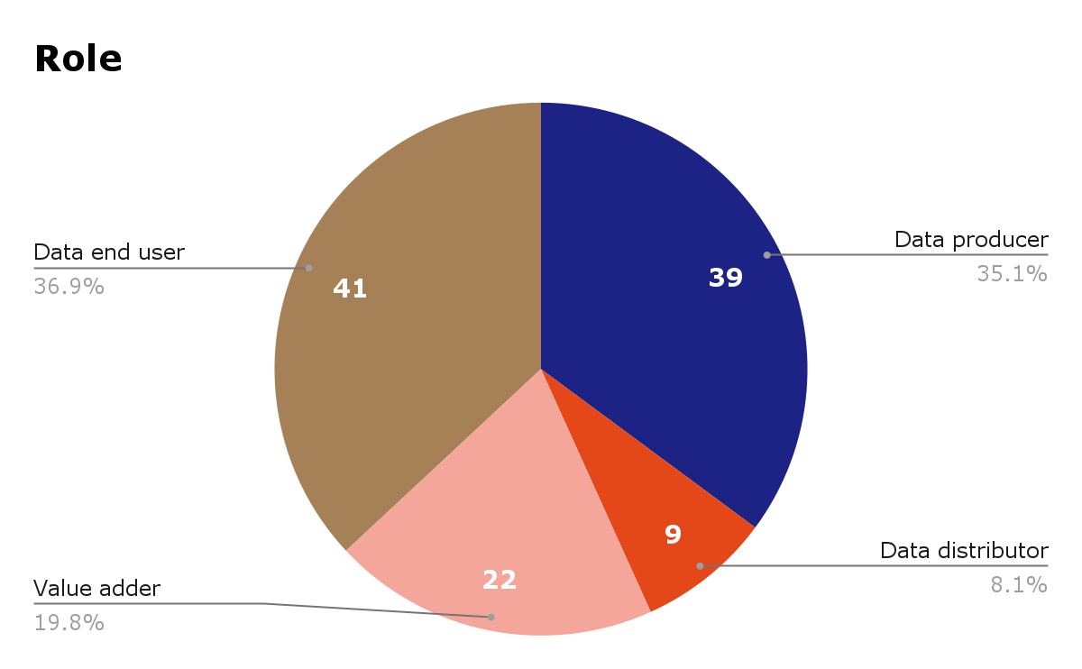
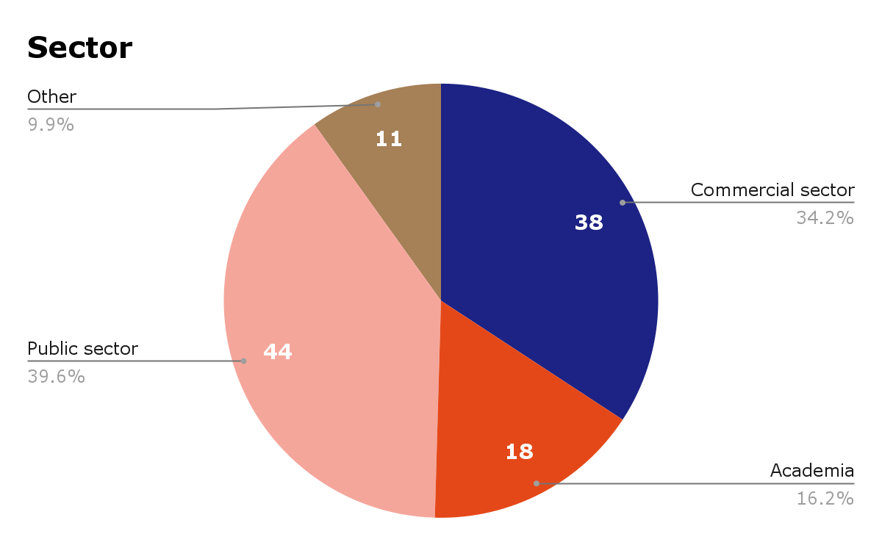
Survey Respondents
111 responses! 🎉

Slide 5
Survey responses
Commercial | Other
Airbus Defence and Space GmbH AISTECH SPACE, S.L. Arlula Pty Ltd Auspatious CATALYST (PCI Geomatics) Common Space Constellr EarthDaily ENVEO IT GmbH EOIntelligence Esri First Street GeoInsight GRASP Earth Marble Imaging AG Pixalytics Ltd Pixxel Planet Labs Riscognition GmbH Sarmap SA SatSure India Analytics Pvt Ltd SatVu Sparkgeo SpectralEO Telespazio UK USACE-AGC World from Space | Aberystwyth University Anna University Conicet Curtin University Kasetsart University KTH Royal Institute of Technology Landgate Natural Resources Canada OGC STFC Trier University UK Met Office UK Ordnance Survey Univ. Colorado, Boulder University of Maryland University of Tartu University of the Free State University of Venda
CEOS Agencies
+

Slide 6
Headline Findings 1/2
Topics that a Future CEOS-ARD Strategy Should Consider:
Consistent and Enhanced Metadata Specifications
Data and Metadata Quality
Ongoing Quality Assurance and Integrity Monitoring
Fitness for Purpose
Increased Support to Scientific Applications and Environmental Adaptation and Resilience
​​Solidifying the Business Case and Increasing Commercial Relevance

Slide 7
Headline Findings 2/2
Topics that a Future CEOS-ARD Strategy Should Consider:
Tools to Aid Compliance Assessments and Peer Reviews
​​Supporting Opportunities and Reducing Risks Related to AI / ML
Measurand Consistency and Algorithm / Application Resilience
​​Alignment with the Software Ecosystem
​​Analysis Ready Data Standards
Thematic and Higher-level ARD Products
Training and Outreach
Capturing Use and Impact

Slide 8

Findings are summarised in the paper available on ceos.org/ard
Identifies areas to develop further in CEOS-ARD Strategy 2026 and the dependencies / expertise needed
Survey remains open at: ceos.org/ard/survey

Slide 9
Progress
At the 2025 CEOS Plenary, Principals tasked the CEOS-ARD Oversight Group to develop the 2026 CEOS-ARD Strategy for delivery by the 2026 CEOS Plenary
    In collaboration with CEOS entities and external stakeholders
    Supported by the 2026 CEOS Chair team
Strategy will define the actions, resources, and commitments required to deliver the next level of ambition for CEOS-ARD and meet community expectations
Proposed vision statement: “Earth Observation for Everyone”
Decided on a two-part structure – following example of other CEOS Roadmaps
  High-level, five-year Strategy, which will set the overall vision and direction
  A more frequently updated annex of initiatives/tasks that achieve the Success Criteria and Outcome Signals of the Strategy
Potentially supplemented by a CEOS-ARD for water annex, supported by the NASA SIT Chair team.

Slide 10
2026 Timeline (1/2)
January
Initial conversations with CEOS-ARD Oversight Group in collaboration with various CEOS entities and in consultation with external stakeholders.
Agreed to develop a longer term strategy document separate to specific initiatives
March
Revised Strategy shared with an extended 100 member stakeholder list and engagement with Working Groups and Virtual Constellations has begun
February
Initial Strategy drafted and circulated to a core writing team of 53

Slide 11
2026 Timeline (2/2)
CEOS SIT-41
Submitted high-level, five-year strategy, which will set the overall vision and direction
Ask CEOS Principals to confirm overarching strategic directions
2026 SIT Technical Workshop
Near complete draft of high-level strategy and initiatives/tasks annex prepared for discussion
November
April
September
LSI-VC-19 / WGCV-56 Joint Meeting
Discuss each of the Strategic Pillars identified in the high-level Strategy and confirm initiatives and activities needed to realise the Success Criteria and Outcome Signals identified therein.
Critical milestone for data quality topics
2026 CEOS Plenary
Presentation for endorsement

Slide 12

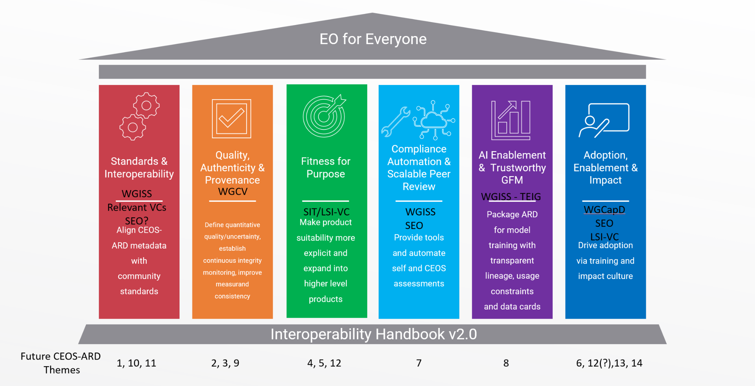
Provided at SIT-41

Slide 13
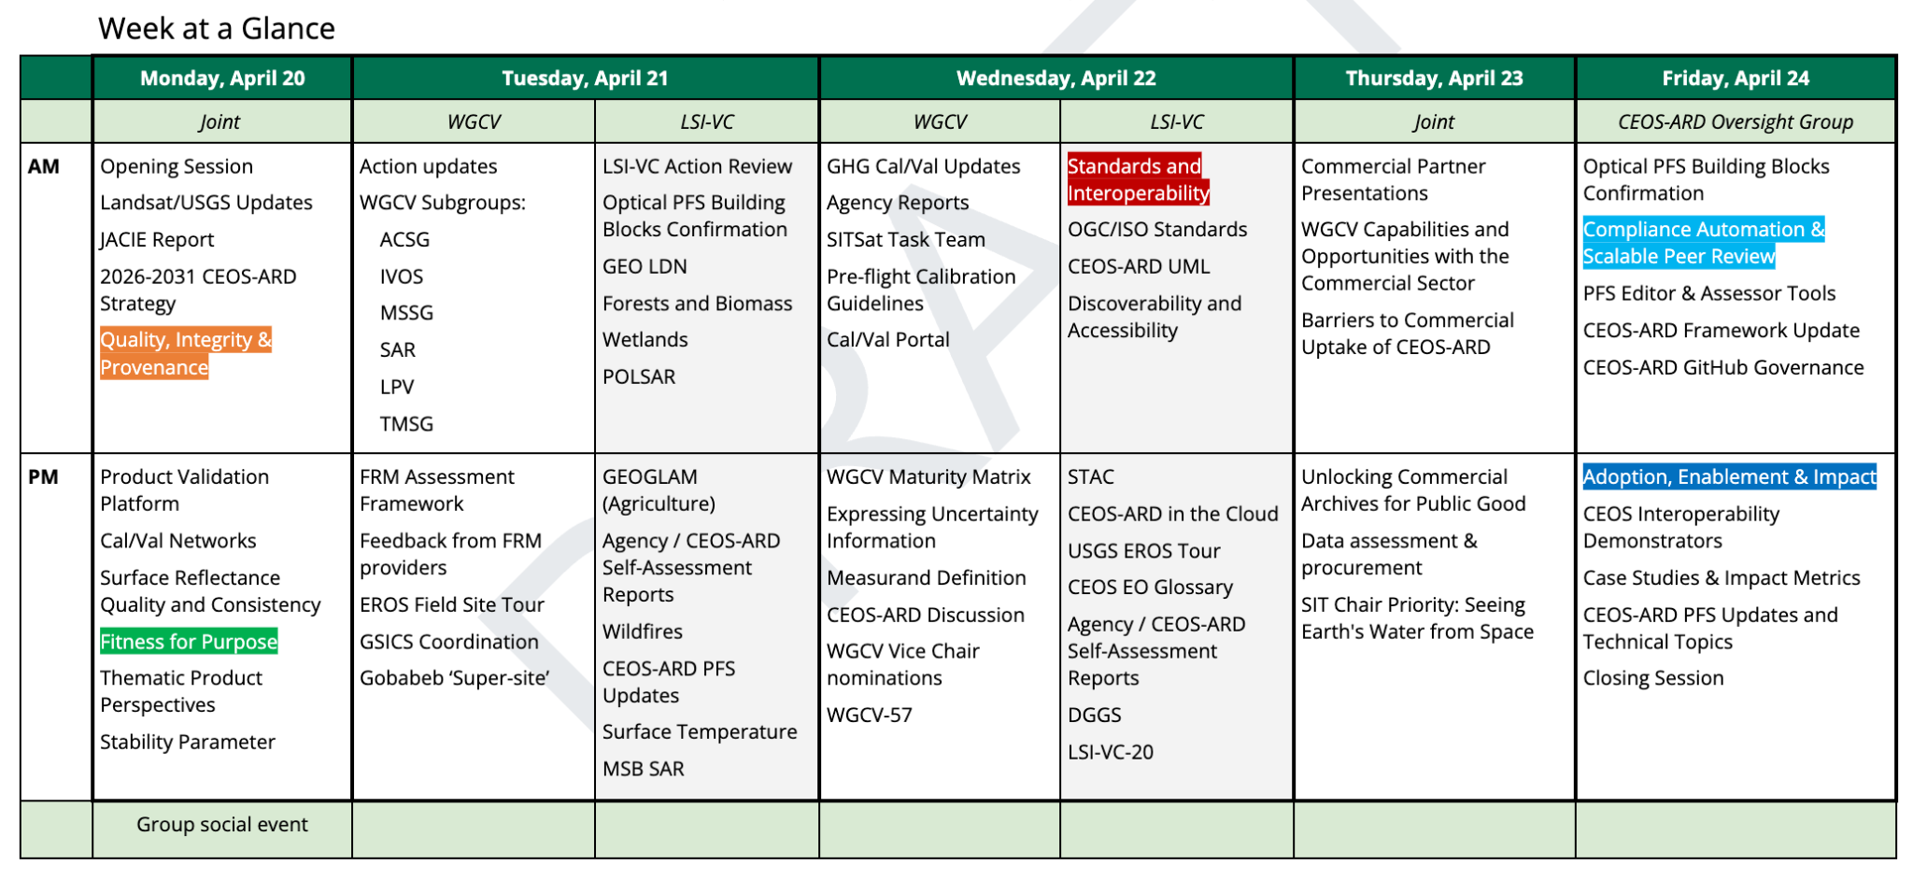

Slide 14





Shaping the future of CEOS Analysis Ready Data

Slide 15
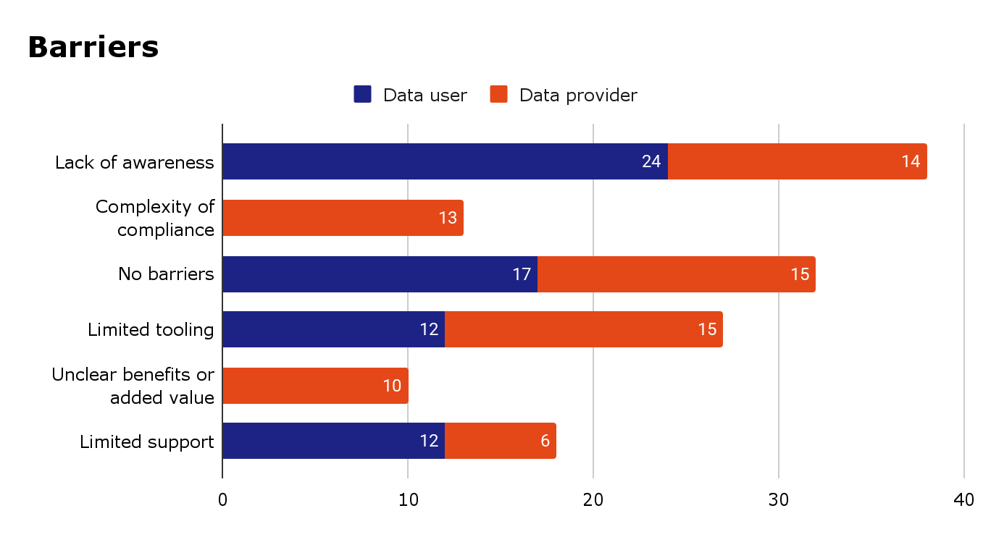
Future of CEOS-ARD

Slide 16
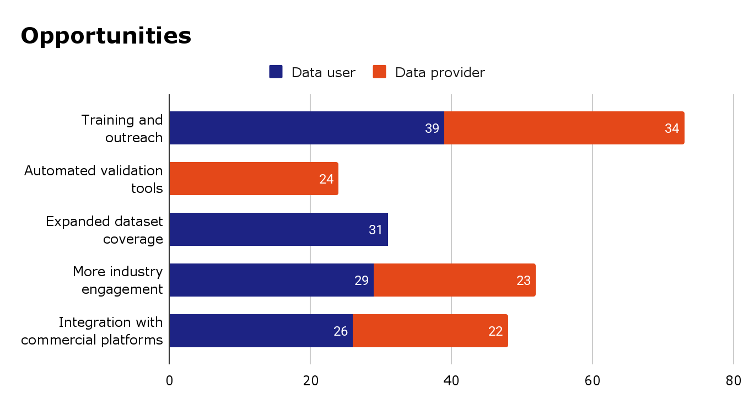
Future of CEOS-ARD

Slide 17
Top 10 Characteristics for Analysis Ready Data (multiple choice)
Rank | Characteristics sorted by ranking
1 | Consistent metadata specifications
2 | Machine-readability
3 | Interoperability through time (relative geolocation)
4 | Findable, Accessible, Interoperable, Reusable (FAIR) compliance
5 | Consistency (data has temporal and spatial consistency)
6 | Consistent terminology
7 | Accessibility
8 | Interoperability with other datasets
9 | Geometric correction using DEM (ortho-rectified)
10 | Fitness for purpose indicators (that the product fulfills the requirements of a specific application, e.g., land cover mapping, precision agriculture, etc.)
Respondents were also asked to provide additional characteristics and comments in a free text field. Feedback has been integrated into concept note.
Notably, quality characteristics were mentioned six times.

Slide 18
Top 10 Characteristics for AI/ML Ready Data (multiple choice)
Rank | Characteristics Sorted by Ranking
1 | Machine-readable formats
2 | Rich, consistent, useful and interpretable metadata
3 | Easy access via APIs or cloud providers
4 | Rigorous definition of data values/content (no ambiguities)
5 | High-quality data and continuous QA/QC
6 | Large-scale accessibility
7 | Temporal consistency
8 | Supply of training datasets that are consistently and accurately labelled
9 | Automated pre-processing
10 | Standardised acquisition parameters
Respondents were also asked to provide additional characteristics and comments in a free text field. Feedback has been integrated into concept note.

Slide 19
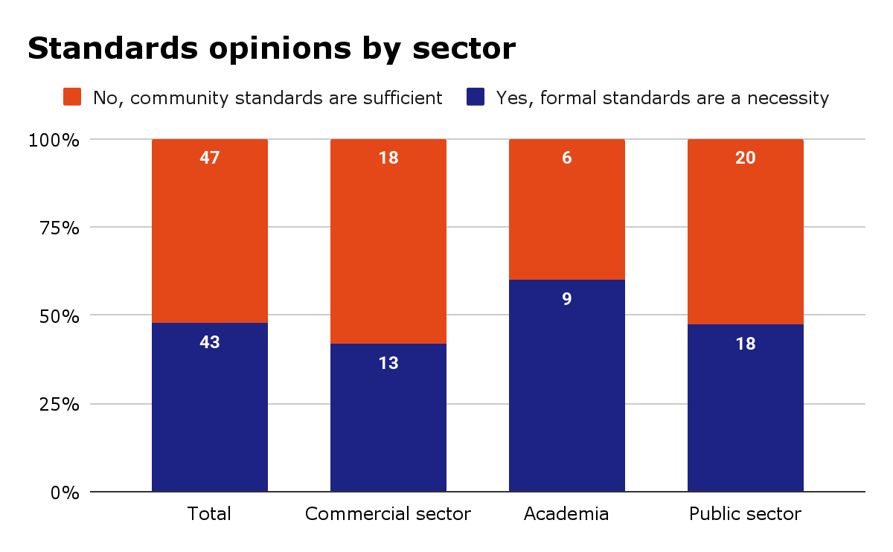
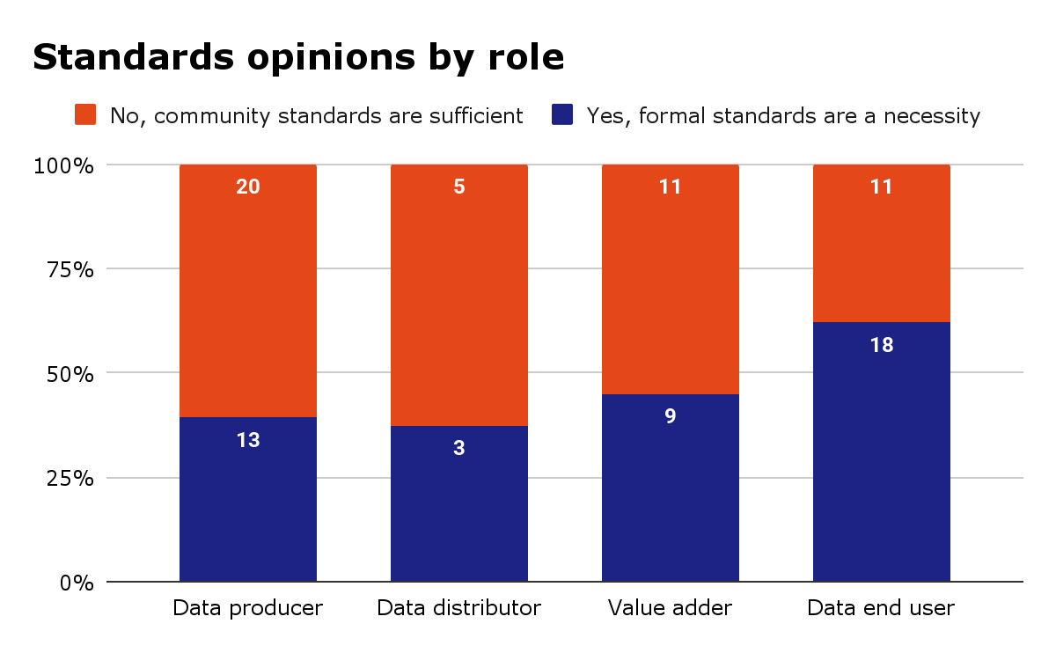
Opinions on ARD Standards
Respondents were divided on the topic of formal vs community standards
In the additional comments box, respondents advocated for free and open community standards – noting the need to be flexible

Slide 20
