Slide 1

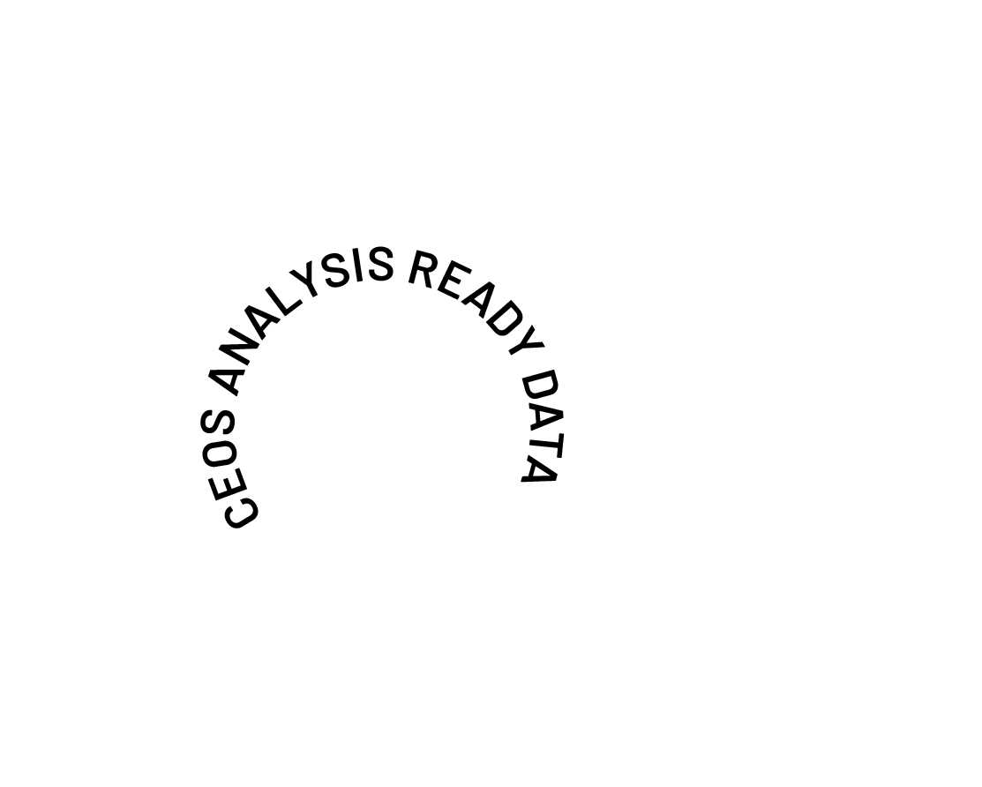
2026-2031 CEOS-ARD Strategy Introduction
Ferran Gascon
On behalf of the CEOS-ARD Oversight Group
Earth Observation for Everyone

Slide 2


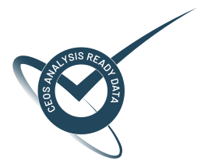
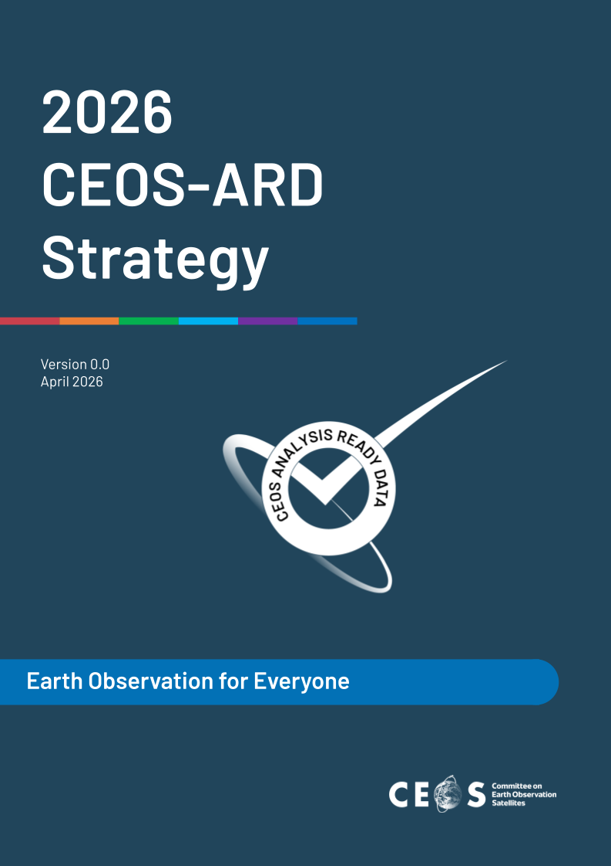
Provided at SIT-41

Slide 3
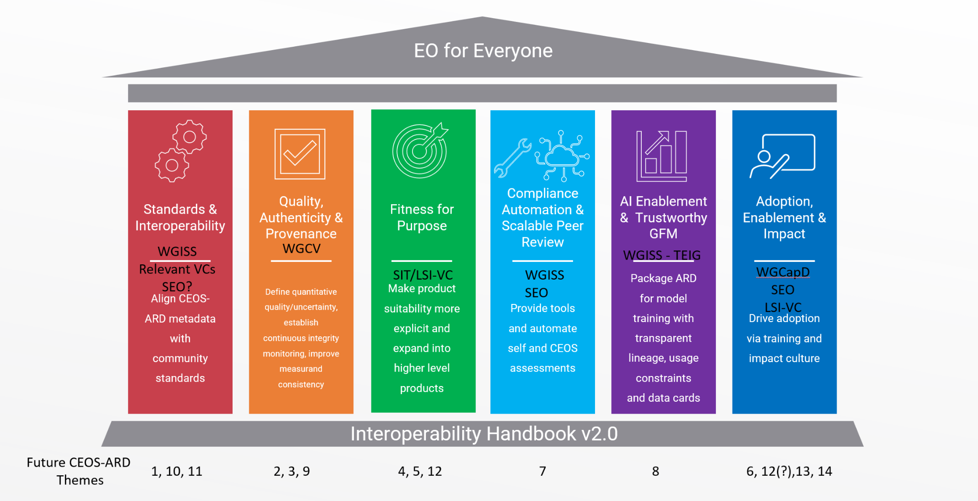
CEOS-ARD Strategy Pillars
Underpinned by CEOS Interoperability Handbook conventions

Slide 4
CEOS-ARD Strategy Pillars
1: Standards and Interoperability: Focus on ensuring CEOS-ARD metadata and data structures are interoperable across existing global standards.
2: Quality, Authenticity & Provenance: Addresses the need for measurable, transparent, and continuously verifiable data quality.
3: Fitness for Purpose: CEOS-ARD products are clearly classified for their suitability across different applications, supporting both non-expert users and scientific communities.
4: Compliance Automation & Scalable Peer Review: Reducing the burden of compliance assessments for data providers and assessors, enabling CEOS-ARD to scale across a growing number of providers.
5: AI Enablement & Trustworthy GFM: Position CEOS-ARD as the gold standard for AI applications, including Geospatial Foundation Models (GFMs).
6: Adoption, Enablement & Impact: Maximize CEOS-ARD adoption across public procurement, commercial markets, and end-user communities

Slide 5
Questions for Principals
Are these the correct strategic directions?
Are they actionable enough?
How do the pillars align with national / space agency priorities?
What can agencies and CEOS entities offer to develop and implement them?

Slide 6
SIT-41 Feedback
CEOS-ARD referenced in many presentations - strong support
Welcomed CEOS promoting complementarity between both government and commercial systems.
Providing a foundation for trust - underpins the reputation of EO, particularly in the age of AI.
High interest in how the strategy will translate into a concrete and actionable work plan.
Value of a trusted, interoperable and scalable gold standard, particularly with a focus on AI enablement and readiness.
Need to connect with and ensure alignment with geospatial standards like OGC and ISO.
AI pillar needs careful definition of the action.
Fitness for Purpose pillar may need a bit more thought on how to make it actionable, and the relevance to the higher level product traceability highlighted in the 2025 future priorities paper.
Link with users and fitness for purpose is a key element of strategy.
Links to Data services are not explicitly referred to in the document, and should be reinforced.
Need for the pillars to align with space agency priorities.
NOSA CEOS Chair priorities for 2027 lean heavily on ARD (polar, oceans, rainforests themes)
Need to manage proliferation of ‘Decision Ready Data’, ARD+, IRD, etc.

Slide 7




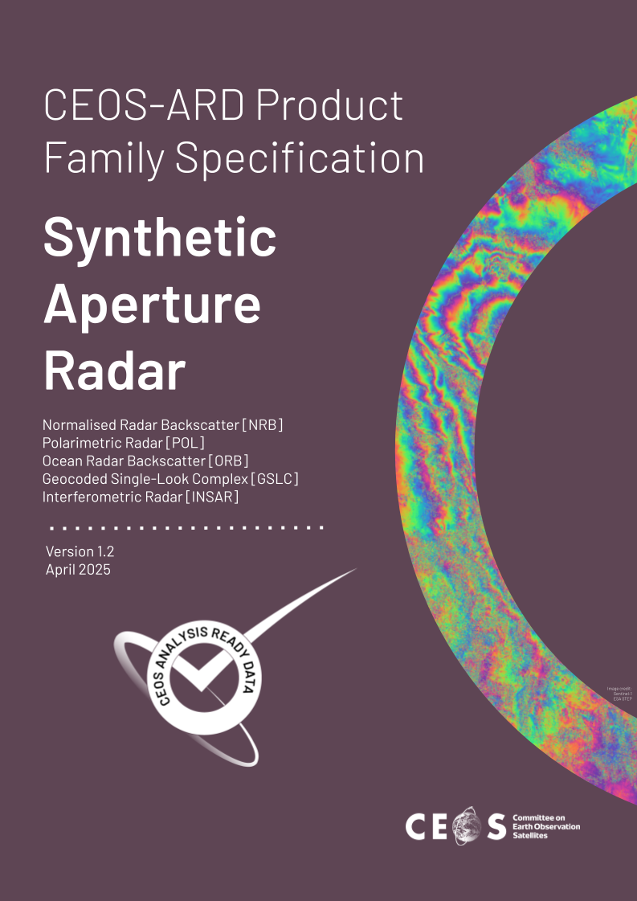
Shaping the future of CEOS Analysis Ready Data

Slide 8
Supplementary Slides for SIT-41 Side Meeting
2026 CEOS-ARD Strategy Pillar Descriptions

Slide 9
Standards & Interoperability
Success Criteria:
CEOS-ARD metadata is consistently implemented across all Product Family Specifications, with a STAC-first, machine-readable and human-interpretable specification supported by OGC/ISO crosswalks.
CEOS-ARD data and metadata are natively understood by mainstream software tools (e.g., GDAL, QGIS, ArcGIS, cloud catalogues) without custom adapters.
CEOS-ARD is recognised as the de facto global community standard for satellite Analysis Ready Data, with a clear, endorsed roadmap toward formal standardisation.
Agencies, commercial providers, and distributors treat CEOS-ARD requirements as default interoperability baselines, not bespoke CEOS artifacts.
Outcome Signal: CEOS ARD datasets work seamlessly across mainstream geospatial tools and cloud-based processing environments. This means:
CEOS-ARD metadata and data work out-of-the-box in mainstream tools and cloud workflows.
Users don’t need custom scripts or manual schema mappings to use CEOS-ARD.
CEOS-ARD is seen as ready-to-use.

Slide 10
Quality, Authenticity & Provenance
Success Criteria:
CEOS-ARD products are accompanied by quantitative, consistent, and comparable quality and uncertainty information, not just descriptive compliance statements.
Ongoing integrity monitoring and reporting is routine, enabling early detection of degradation or loss of compliance. Note: Integrity means continuous, verifiable confidence that CEOS‑ARD data remains accurate, consistent, authentic, and traceable across its entire lifecycle.
Provenance, authenticity, versioning, and lineage of data are machine-readable and human-interpretable, and traceable across all mirrors, cloud platforms, and reprocessing cycles.
If a user is building a time series or multi-mission analysis, they can swap or mix CEOS-ARD products with no hidden biases or artifacts being introduced.
The CEOS-ARD label guarantees harmonized measurands, within specified uncertainties (note: not homogenised).
Outcome Signal: Trust in the CEOS-ARD label is based on evidence.

Slide 11
Fitness for Purpose
Success Criteria:
Users can clearly identify what each CEOS-ARD product is fit for, including limitations, uncertainty bounds, and appropriate application types.
CEOS-ARD supports long-term, stable, bias-aware data records suitable for long-term scientific applications.
Fitness-for-purpose distinctions help non-expert users avoid misuse, while giving providers clear pathways to improve product maturity.
CEOS-ARD products are increasingly cited as authoritative inputs to global frameworks, indicators, and assessments.
Outcome Signal: Users can select CEOS-ARD products with confidence.

Slide 12
Compliance Automation & Scalable Peer Review
Success Criteria:
CEOS-ARD assessments are largely automated, repeatable, continuous, and embedded in provider pipelines.
Peer review scales sustainably without relying on manual document checks.
Providers experience lower effort and faster turnaround for CEOS-ARD endorsement.
CEOS-ARD governance shifts from gatekeeping to continuous assurance.
Contribute to commercial ecosystem enhancement by enabling independent third parties to undertake compliance assessments.
Outcome Signal: CEOS-ARD can scale to many more providers without slowing down and third parties emerge to provide commercial compliance services.

Slide 13
AI Enablement & Trustworthy GFM
Success Criteria:
CEOS-ARD products are widely used as trusted training and benchmarking data for geospatial AI and foundation models.
CEOS-ARD defines product specifications for GFM-derived products, including embeddings, ensuring they carry the same quality and provenance guarantees as the source data.
AI users understand dataset limitations through clear provenance, uncertainty information, and data cards.
CEOS-ARD helps reduce AI risk, by discouraging use of poorly characterised data in high-impact applications.
CEOS agencies are recognised as stewards of high-quality training data.
Outcome Signal: CEOS-ARD is referenced as a quality baseline in AI research and operational deployment.

Slide 14
Adoption, Enablement & Impact
Success Criteria:
CEOS-ARD is routinely referenced in procurement, funding calls, and operational requirements as a baseline expectation.
CEOS-ARD is recognised as community-driven, being co-developed by CEOS and the broader community.
Derivative and thematic CEOS-ARD products directly support priority user communities (e.g. agriculture, biodiversity, disasters).
Commercial providers see CEOS-ARD endorsement as a market differentiator, not a compliance burden.
Training, outreach, and documented case studies clearly demonstrate real-world impact and return on investment.
Growing number of CEOS-ARD compliant datasets and a growing annual volume of CEOS-ARD compliant datasets across common ’data distributor’ platforms based on a 2026 baseline.
Outcome Signal: CEOS-ARD success is measured by use and impact including through increased citations in the scientific and general literature.

Slide 15
What do we need from Agencies and CEOS to help develop these areas?
Headline: Engagement of agency and CEOS experts
Standards and Interoperability
Expertise in geospatial standards development
Engagement with national standards bodies
Experience with STAC implementation and discoverability and accessibility standards (WGISS)
Connection to agency staff responsible for archives, data processing, metadata definition, etc.
Connections to software and tool developers including in private sector
Adoption of CEOS-ARD as an interoperability baseline
Pilot studies to demonstrate CEOS-ARD facilitation of interoperability
Quality, Authenticity & Provenance
Close engagement of WGCV experts and resourcing of agency experts to engage with CEOS-ARD
Implementation of the CEOS Interoperability Handbook Quality Chapter
Alignment of agency quality assessment frameworks with CEOS-ARD
Support to WGCV cal/val networks and Product Validation Platform
Connection to agency experts working on issues of data provenance and quality assurance

Slide 16
What do we need from Agencies and CEOS to help develop these areas?
Headline: Engagement of agency and CEOS experts
Fitness for Purpose
Application area experts to assess suitability of CEOS-ARD specifications and products
Engagement of thematic CEOS groups in areas such as biodiversity, forests and biomass, agriculture, disasters, etc.
Alignment with WGCV LPV protocols
Compliance Automation & Scalable Peer Review
Software and tool developers
Integration of CEOS-ARD assessments directly into production pipelines
Guidance, templates, and examples that support new providers in meeting requirements
AI Enablement & Trustworthy GFM
Advocacy for CEOS-ARD to be the gold standard for AI applications, including Geospatial Foundation Models (GFMs)
Engagement with AI research communities and platform providers to promote adoption and best practices

Slide 17
What do we need from Agencies and CEOS to help develop these areas?
Headline: Engagement of agency and CEOS experts
Adoption, Enablement & Impact
Capturing and documenting case studies and impact metrics that demonstrate CEOS-ARD’s value to funders and policymakers
Connections to end users (LSI-VC Forests and Biomass, GFOI, GEOGLAM)
conducting and developing training and outreach programs, supported by multilingual documentation to build capacity and awareness globally (WGCapD?)
Pilot projects that utilise CEOS-ARD and help refine specifications through feedback (WGDisasters?)
Positioning CEOS-ARD as a procurement baseline to reduce duplication and risk for agencies and vendors.
Expanding CEOS-ARD to thematic and higher-level products to meet evolving user needs in areas like agriculture, biodiversity, and atmospheric monitoring
Commercial sector engagement

