Slide 1


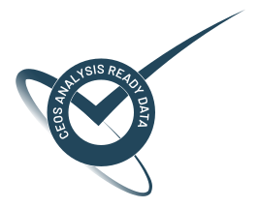
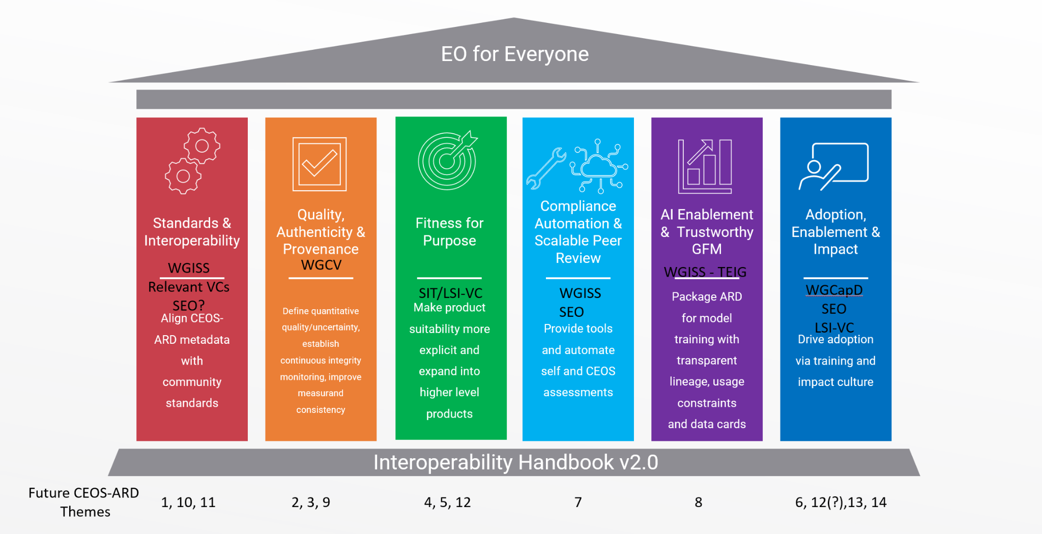
CEOS-ARD Strategy Pillars
Underpinned by CEOS Interoperability Handbook conventions

Slide 2
Quality, Authenticity & Provenance
Addresses the need for measurable, transparent, and continuously verifiable data quality.
Success Criteria:
CEOS-ARD products are accompanied by quantitative, consistent, and comparable quality and uncertainty information, not just descriptive compliance statements.
Ongoing integrity monitoring and reporting is routine, enabling early detection of degradation or loss of compliance. Note: Integrity means continuous, verifiable confidence that CEOS‑ARD data remains accurate, consistent, authentic, and traceable across its entire lifecycle.
Provenance, authenticity, versioning, and lineage of data are machine-readable and human-interpretable, and traceable across all mirrors, cloud platforms, and reprocessing cycles.
If a user is building a time series or multi-mission analysis, they can swap or mix CEOS-ARD products with no hidden biases or artifacts being introduced.
The CEOS-ARD label guarantees harmonized measurands, within specified uncertainties (note: not homogenised).
Outcome Signal: Trust in the CEOS-ARD label is evidence-based.

Slide 3
Initiatives under this pillar could include
Defining quantitative specifications thresholds for uncertainty/accuracy/precision and completeness across CEOS-ARD product families (e.g. building off of EDAP+).
Developing provenance and lineage specifications to capture version history, processing steps, and chain-of-custody information to build trust and reproducibility.
Integration with WGCV validation platforms and Cal/Val networks (such as RadCalNet and Hypernets) to support quality assurance and continuous verification.
WGCV Surface Reflectance Quality and Consistency project to contribute in refining the specifications.
Continuous integrity monitoring replacing one-off ARD assessments, leveraging automated pipelines and dashboards to track compliance and performance over time.

Slide 4
What is needed from Agencies and CEOS to help develop this pillar?
Headline: Engagement of agency and CEOS experts
Quality, Authenticity & Provenance
Close engagement of WGCV experts and resourcing of agency experts to engage with CEOS-ARD.
Implementation of the CEOS Interoperability Handbook Quality Chapter.
Alignment of agency quality assessment frameworks with CEOS-ARD.
Support to WGCV Product Validation Platform and cal/val activities.
Connection to agency experts working on issues of data provenance and quality assurance.

Slide 5
Observations - 1
In an underpinning document (Interoperability Handbook) there are recommendations that could be progressed in the context of this Pillar.
Growing use of EDAP Framework (ESA, NASA, USGS, GISTDA)
Mission vs. Quality measurements (or both?)
Multiclass CEOS-ARD proposal (along lines of Maturity Matrix classes including a potential additional class)
What about higher level products from thermal?
Allowing for STAC encoding is essential (refer Red pillar conversations)
Is BRDF/Terrain illumination correction the best way to go to get to surface reflectance?

Slide 6
Observations - 2
Provenance and traceability/authenticity are important
Provision of ground truth data references - guidelines and requirement to use specific calibration sites and networks - build into the CEOS-ARD specs/framework (this was requested by commercials at JACIE)
  Enable access to reference datasets, shared global networks (satellite data AND CalNets. Build distributed collaborative cal/val networks
CEOS-PVP provides radiometric and geometric comparisons with some global calibration networks. Extensible

Slide 7
Discussion
Discussion objective: Identify Quality, Authenticity & Provenance initiatives and activities we can add to CEOS-ARD Strategy work plan for 2027-2031
Discussion/Objective: Defining what we mean by ‘quality’ (confirm the scope).
Generic architecture and hierarchy, along with a list of essential quality, authenticity, and provenance specifications for CEOS‑ARD PFSs, to enable the assessment of datasets.
Requirements to actively monitor and calibrate CEOS-ARD datasets, verified instrument performance, SRFs, etc.
Leveraging frameworks and networks that enable the quality and authenticity monitoring.
Implementation in practice.
What pieces currently exist, what needs further development, where do we have capacity?
Relevance of activities such as CMIX or ACIX for optical imaging sensors?
Should CEOS-ARD require the collection of data over designated cal/val networks or sites?
Confirm: Quality, Authenticity & Provenance initiatives and activities we can add to CEOS-ARD Strategy work plan for 2027-2031

Slide 8
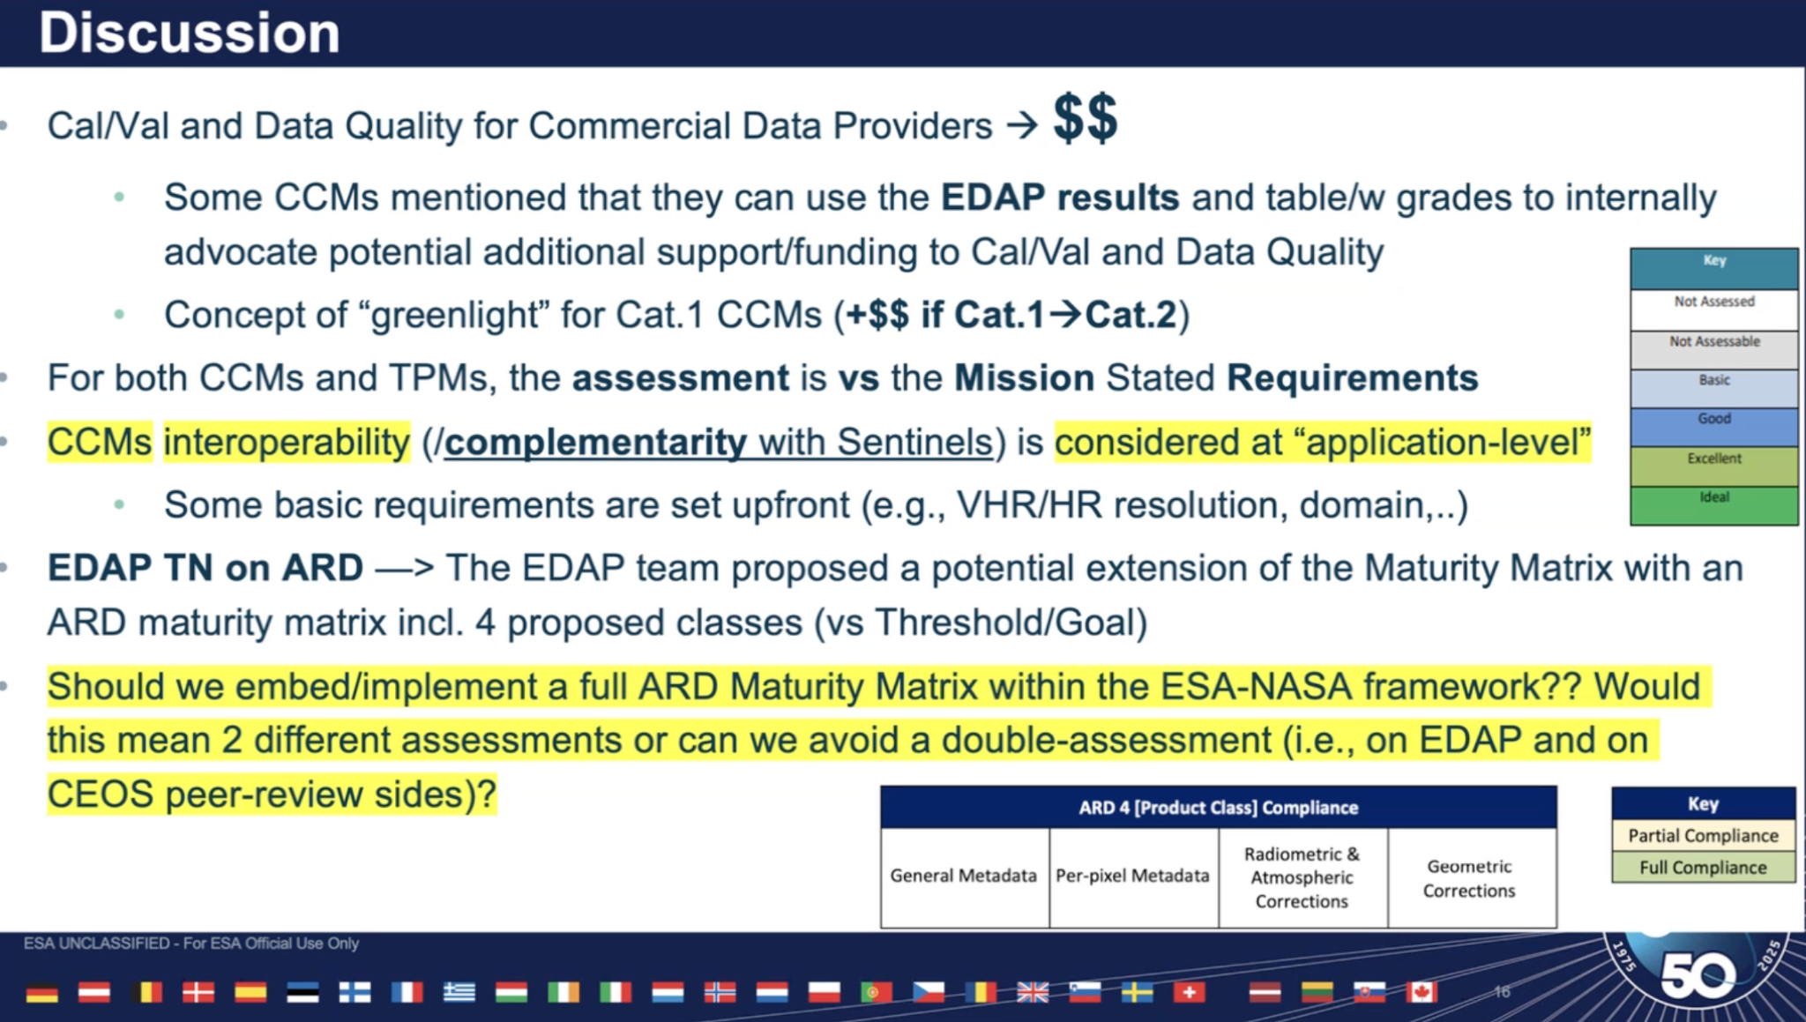

Slide 9
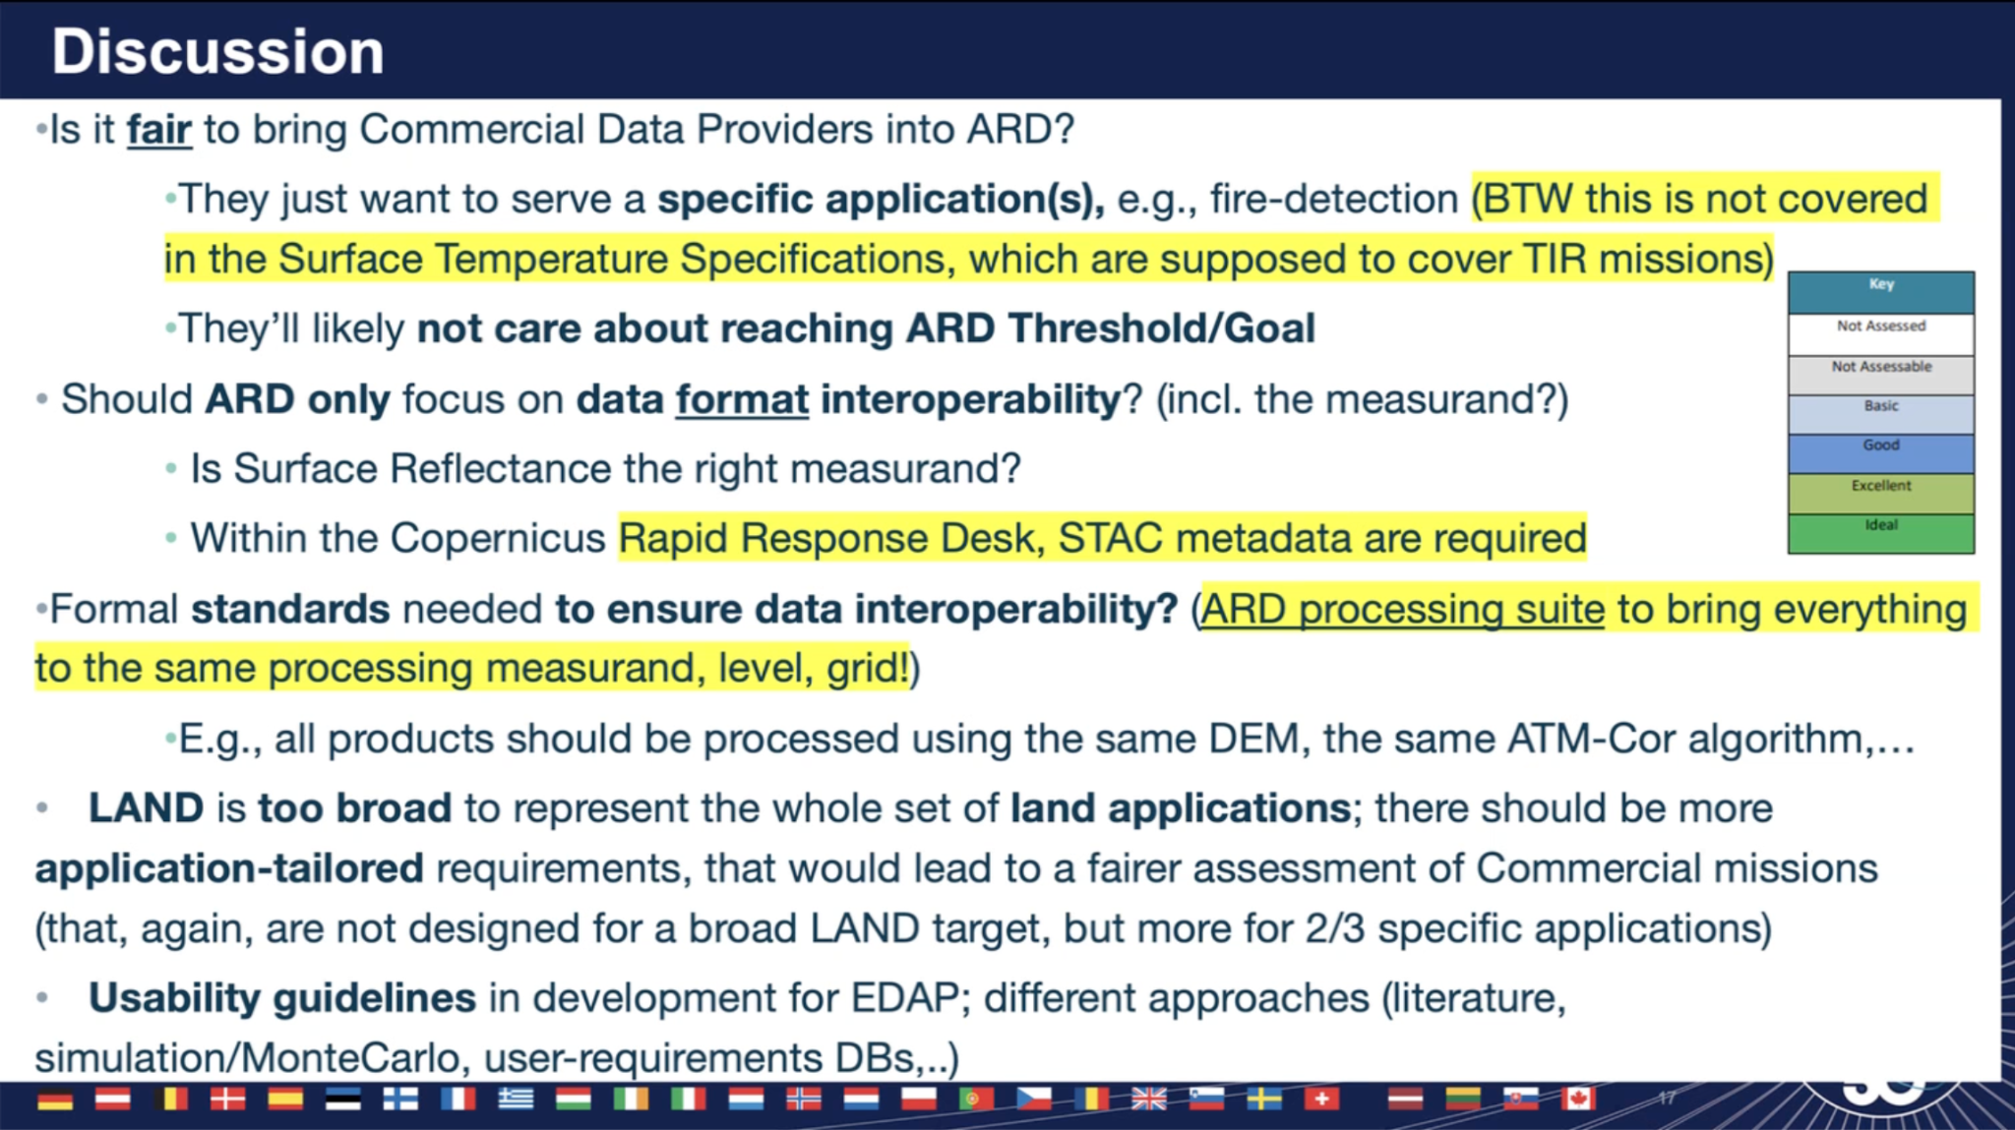

Slide 10
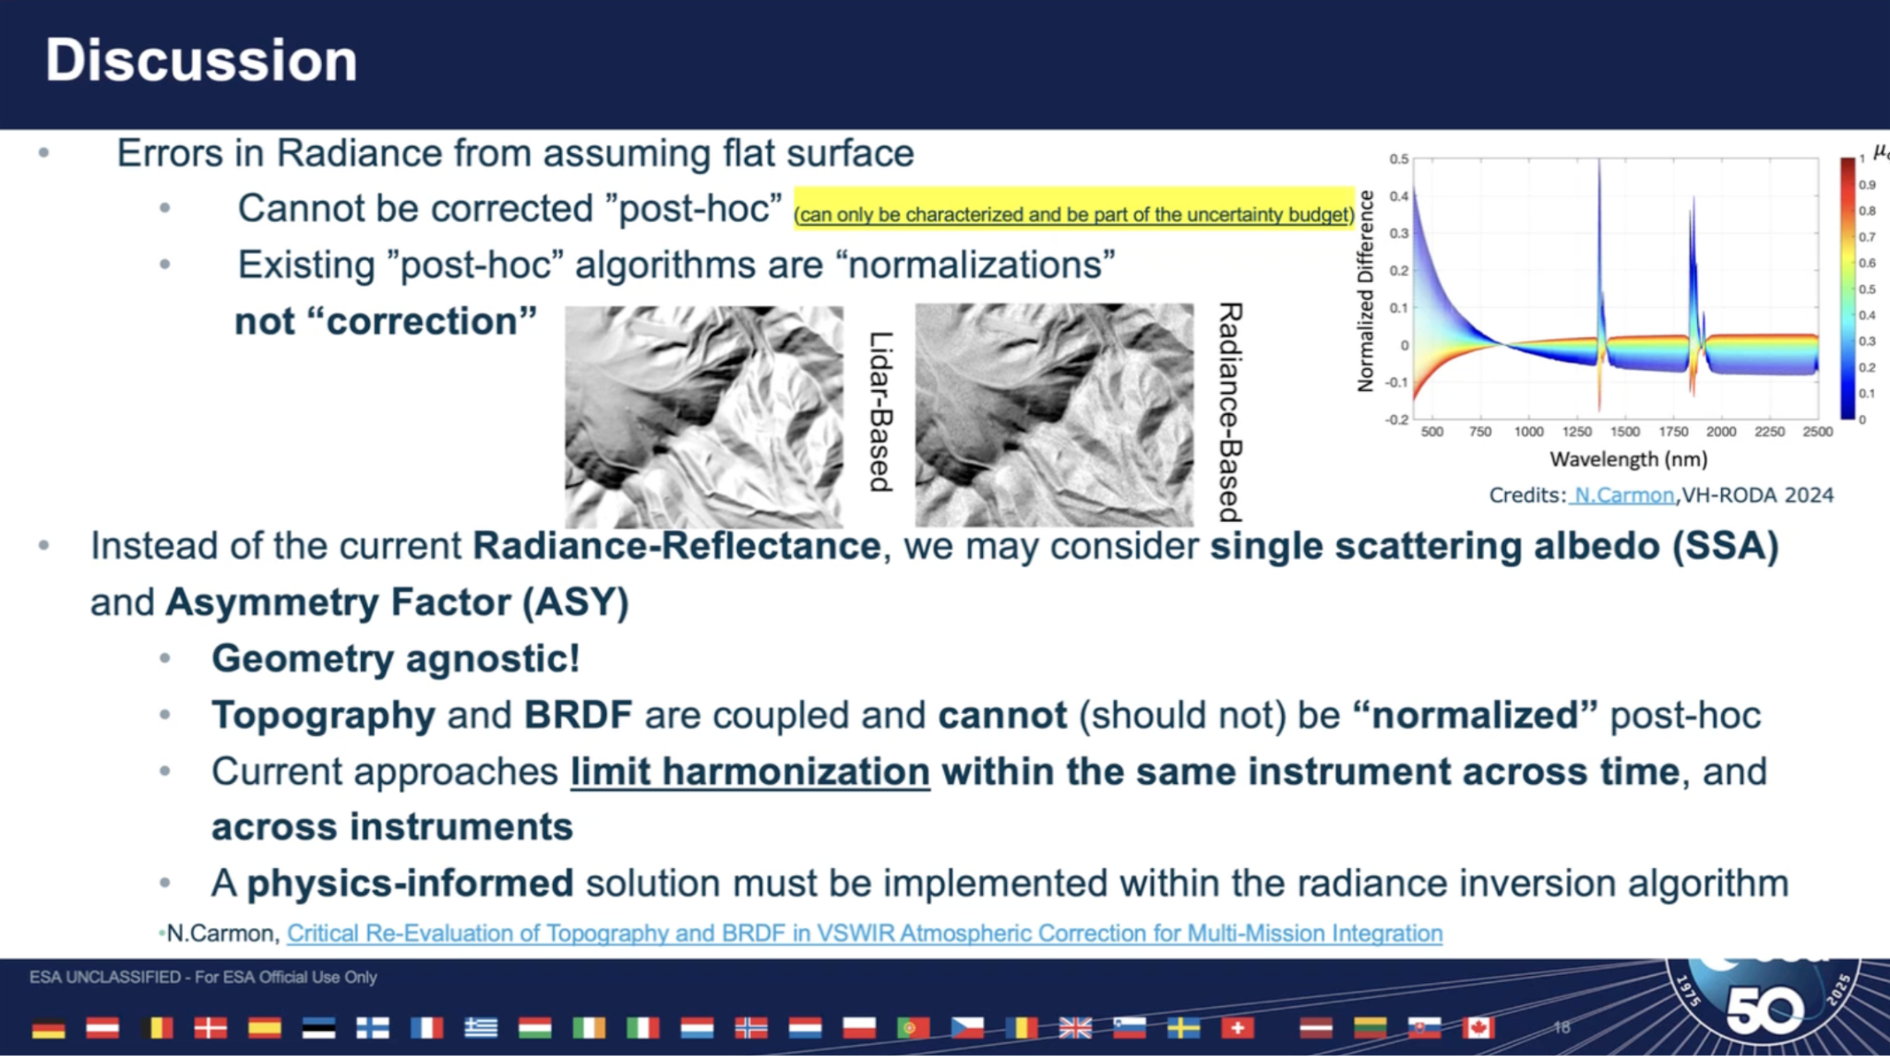

Slide 11
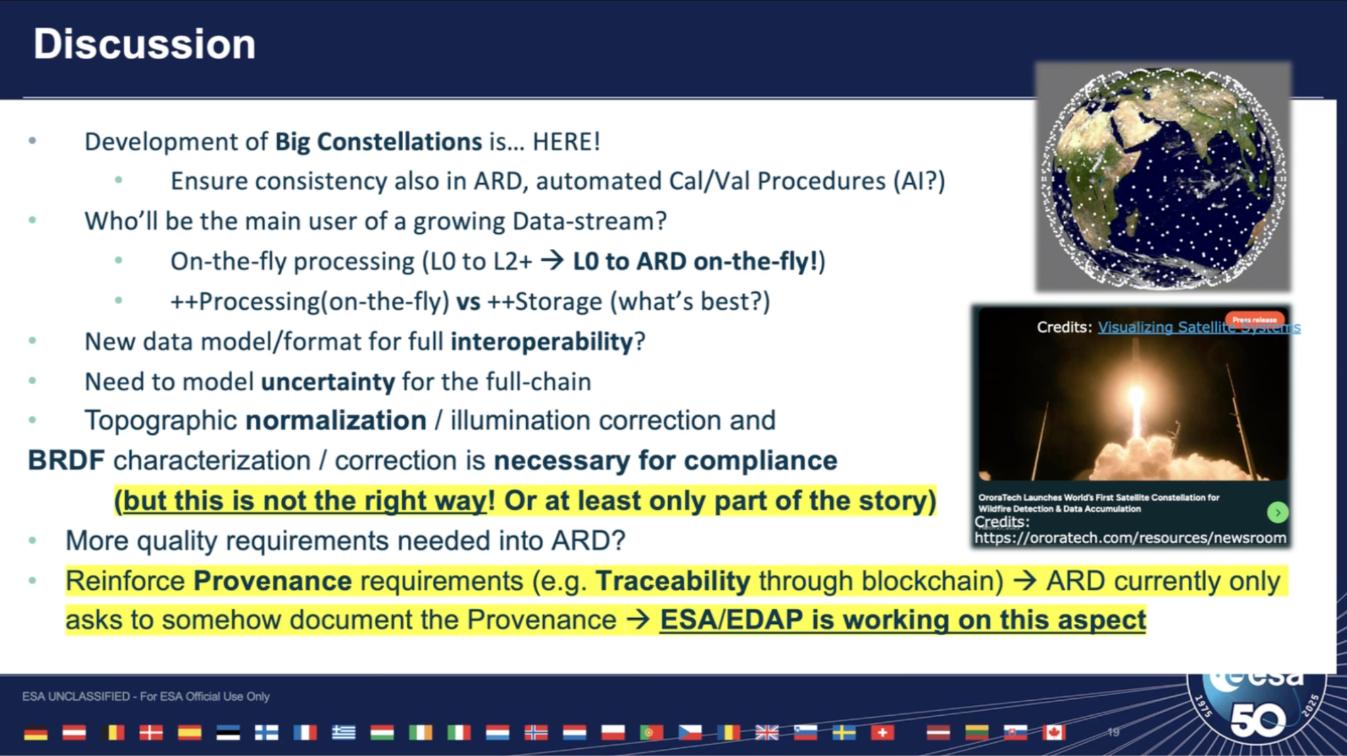

Slide 12
Initiatives under this pillar evolved during conversations - 1
Progress one or more of the CalVal recommendation from Interoperability Handbook.
Adopt the relevant recommendations of the quality chapter of the Interoperability Handbook
EDAP - used by ESA and agreed as a framework by NASA and USGS for optical at JACIE
  EDAP SAR guidelines agreed by NASA and ESA in 2024
  EDAP+ expanding into ATM domain and moving into higher level products (eg. L4) and user scenarios (eg. NDVI)
Engage the OPT-MPC of the Copernicus Ground Segment

Slide 13
Initiatives under this pillar evolved during conversations - 2
Seek how to adopt the grading used in the Maturity Matrix approach to align CEOS-ARD and other maturity matrices used throughout WGCV work
  Reduce assessment duplication, increase interoperability through equivalent criteria
Can we explore how other agencies could adopt the CSDA-EDAP framework for consistency across CEOS?
Accuracy, consistency, alignment to standards, traceable and verifiable provenance
Provision of reference data - guidelines and requirement to use specific calibration sites and networks - build into the CEOS-ARD specs/framework
  Enable access to reference datasets, shared global networks. Build distributed collaborative cal/val networks
Connect with JACIE assessments, review JACIE best practices for awareness - map JACIE assessments to EDAP

Slide 14
Initiatives under this pillar evolved during conversations - 3
Tool implementation vs. theoretical intent - context of “equivalence” of methods
Continuous requirements are seen by USGS as a way forward. Some work in CSDA on continuous assessment.
Write RadCalNet use specifically into CEOS-ARD ?
Noting challenges of maintaining funding for SAR cal/val infrastructure after a mission’s cal/val campaign, perhaps writing into quality framework/CEOS-ARD provides a means for ongoing justification?
Sample data for CEOS-ARD self assessments should be over PVP sites and submitted to that platform regularly

Slide 15
Initiatives under this pillar could include
Defining quantitative specifications thresholds for uncertainty/accuracy/precision and completeness across CEOS-ARD product families (e.g. building off of EDAP+).
Developing provenance and lineage specifications to capture version history, processing steps, and chain-of-custody information to build trust and reproducibility.
Integration with WGCV validation platforms and Cal/Val networks (such as RadCalNet and Hypernets) to support quality assurance and continuous verification.
WGCV Surface Reflectance Quality and Consistency project to contribute in refining the specifications.
Continuous integrity monitoring replacing one-off ARD assessments, leveraging automated pipelines and dashboards to track compliance and performance over time.

