Slide 1
UNC: Uncertainty metadata Naming Conventions
Machine-Readable & Actionable Uncertainty Information

Slide 2
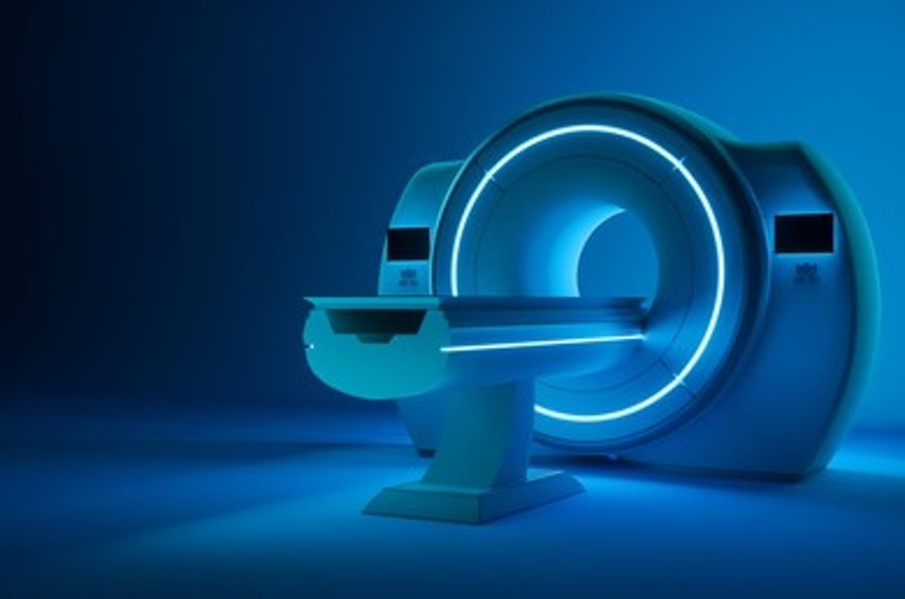
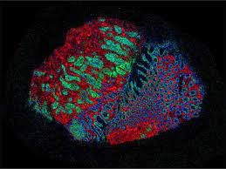
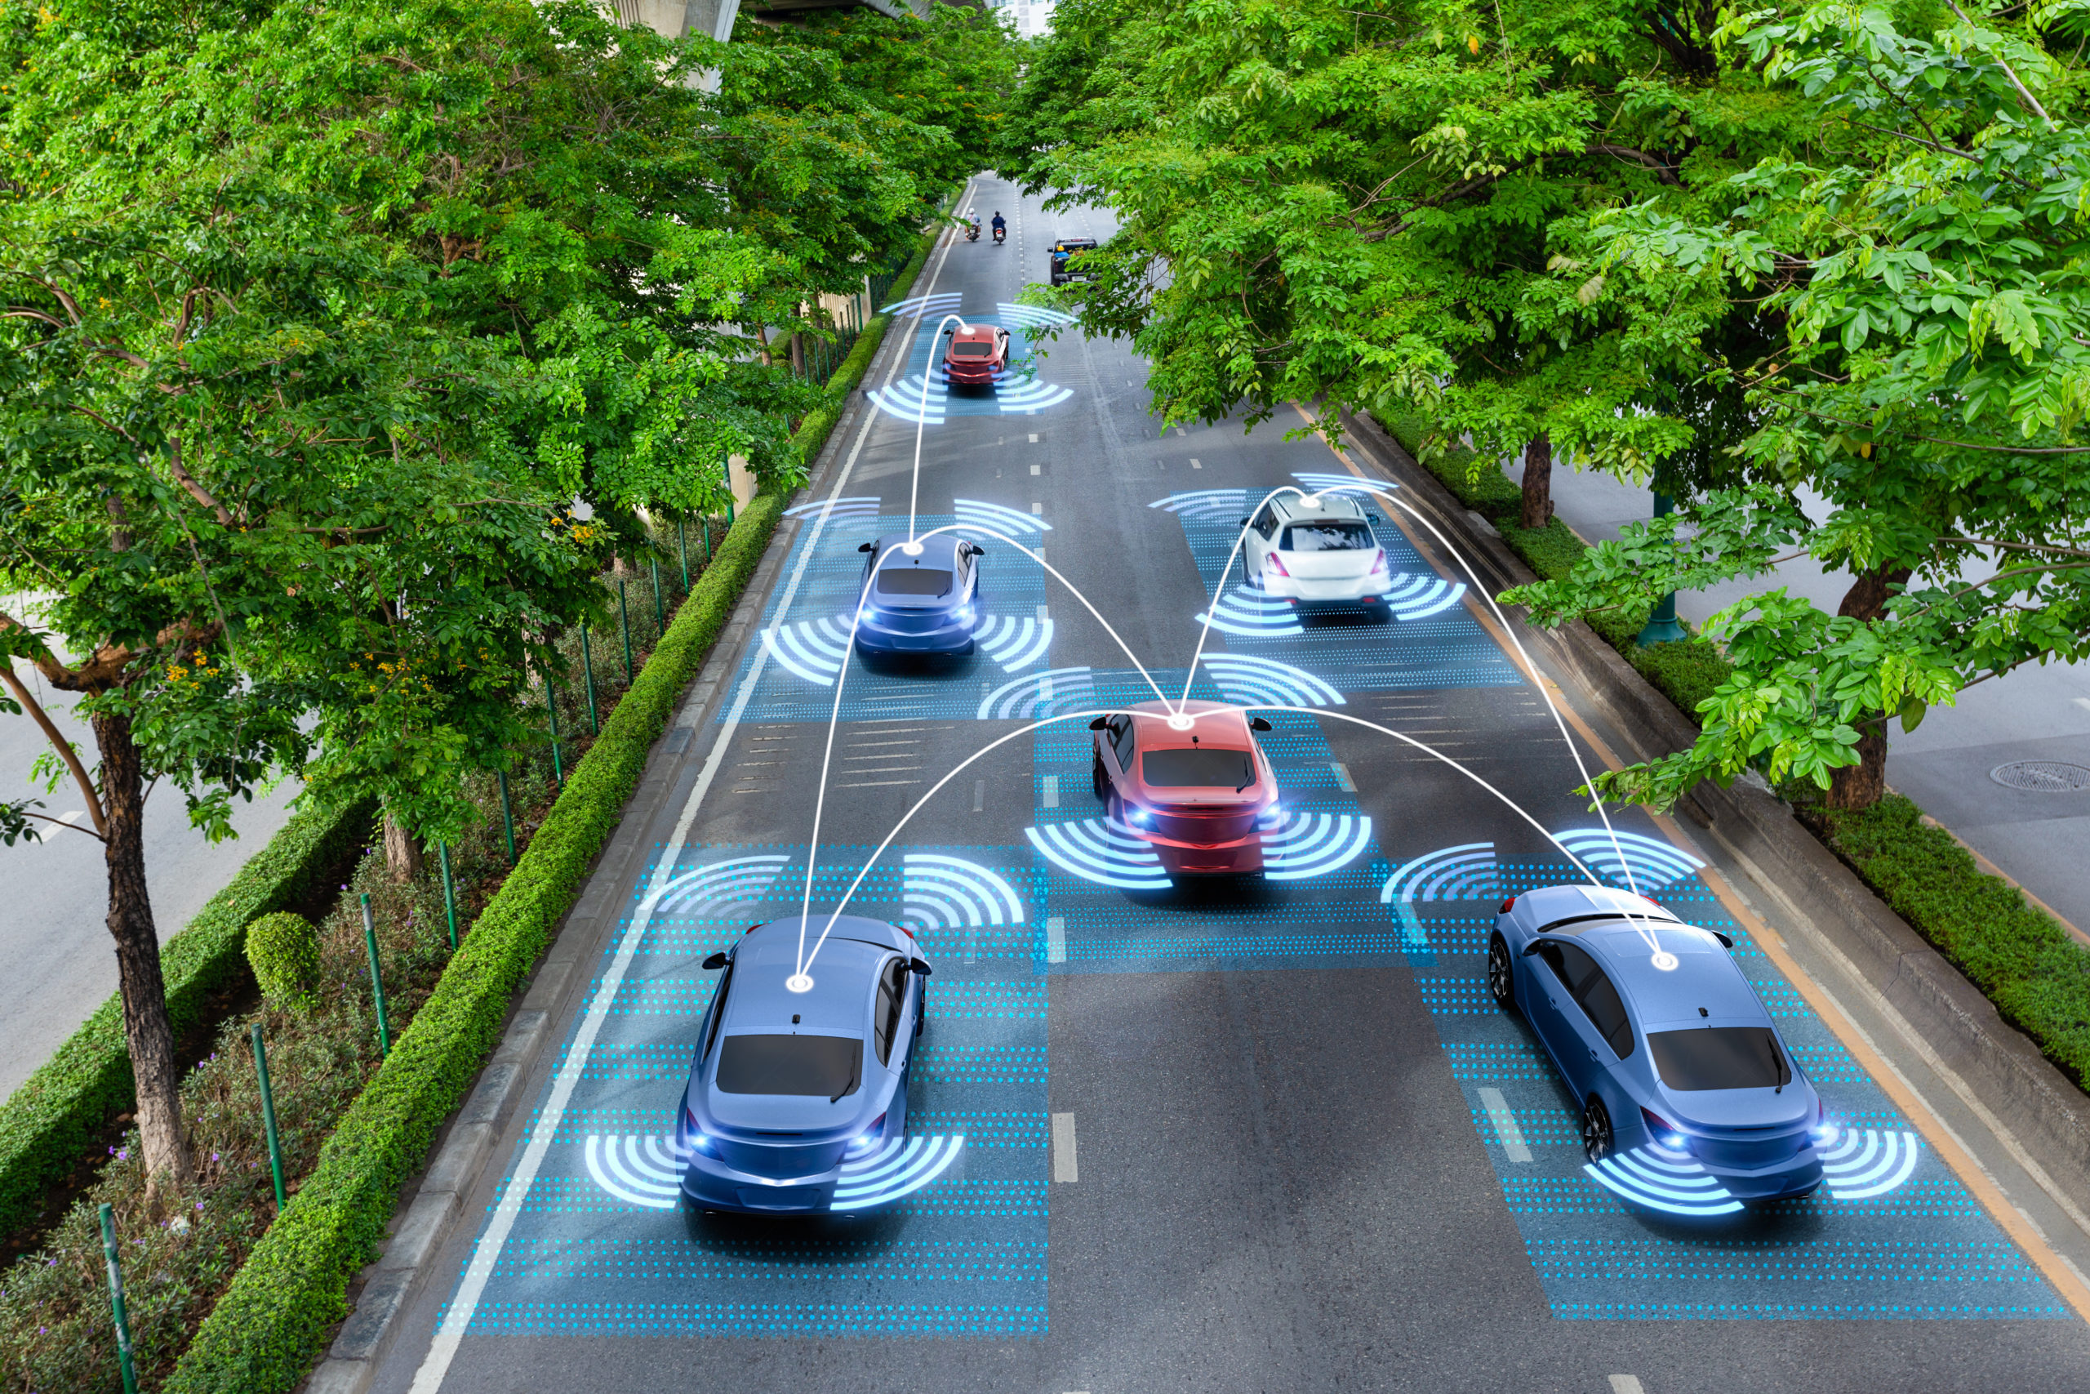

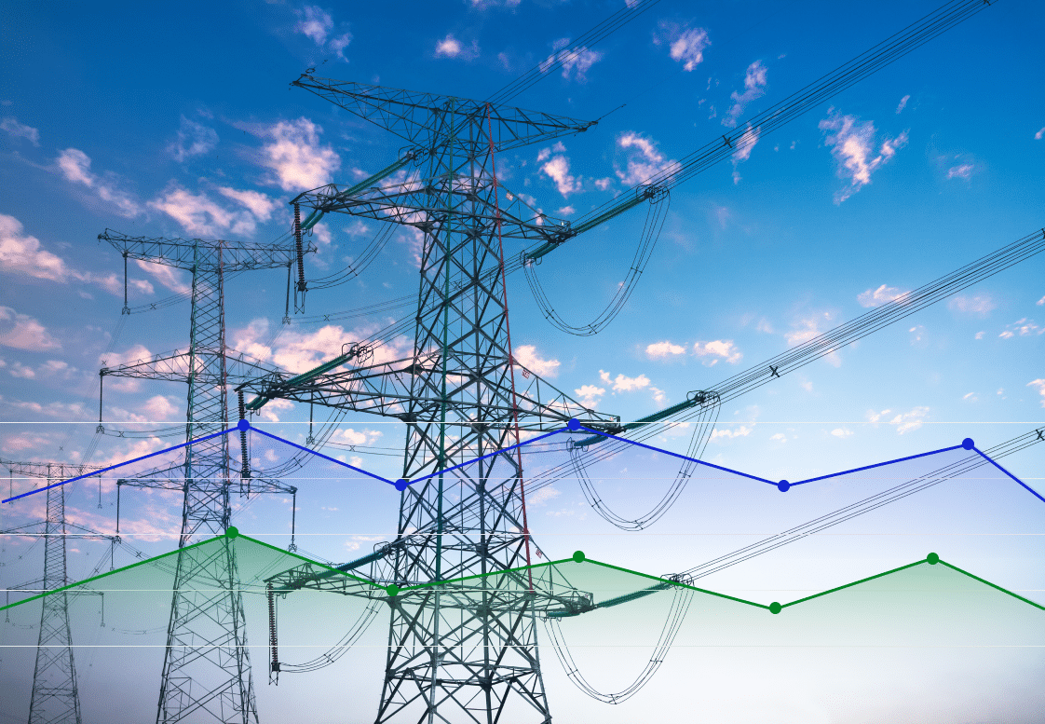
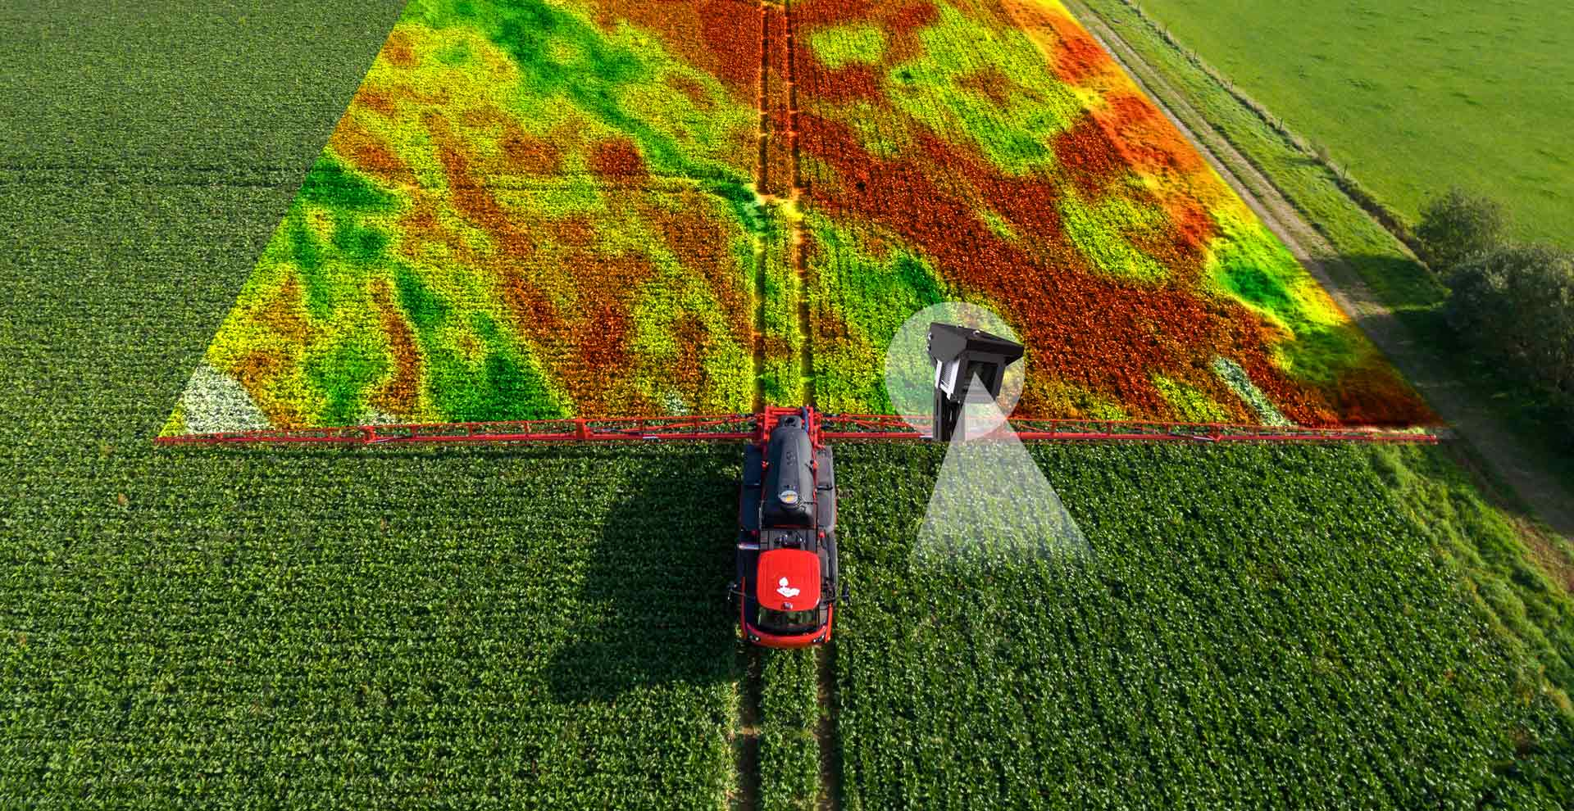
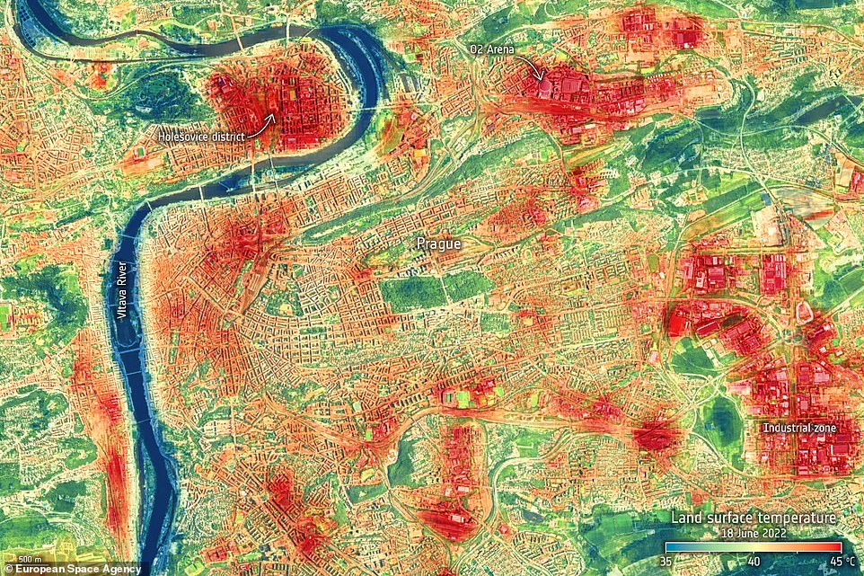
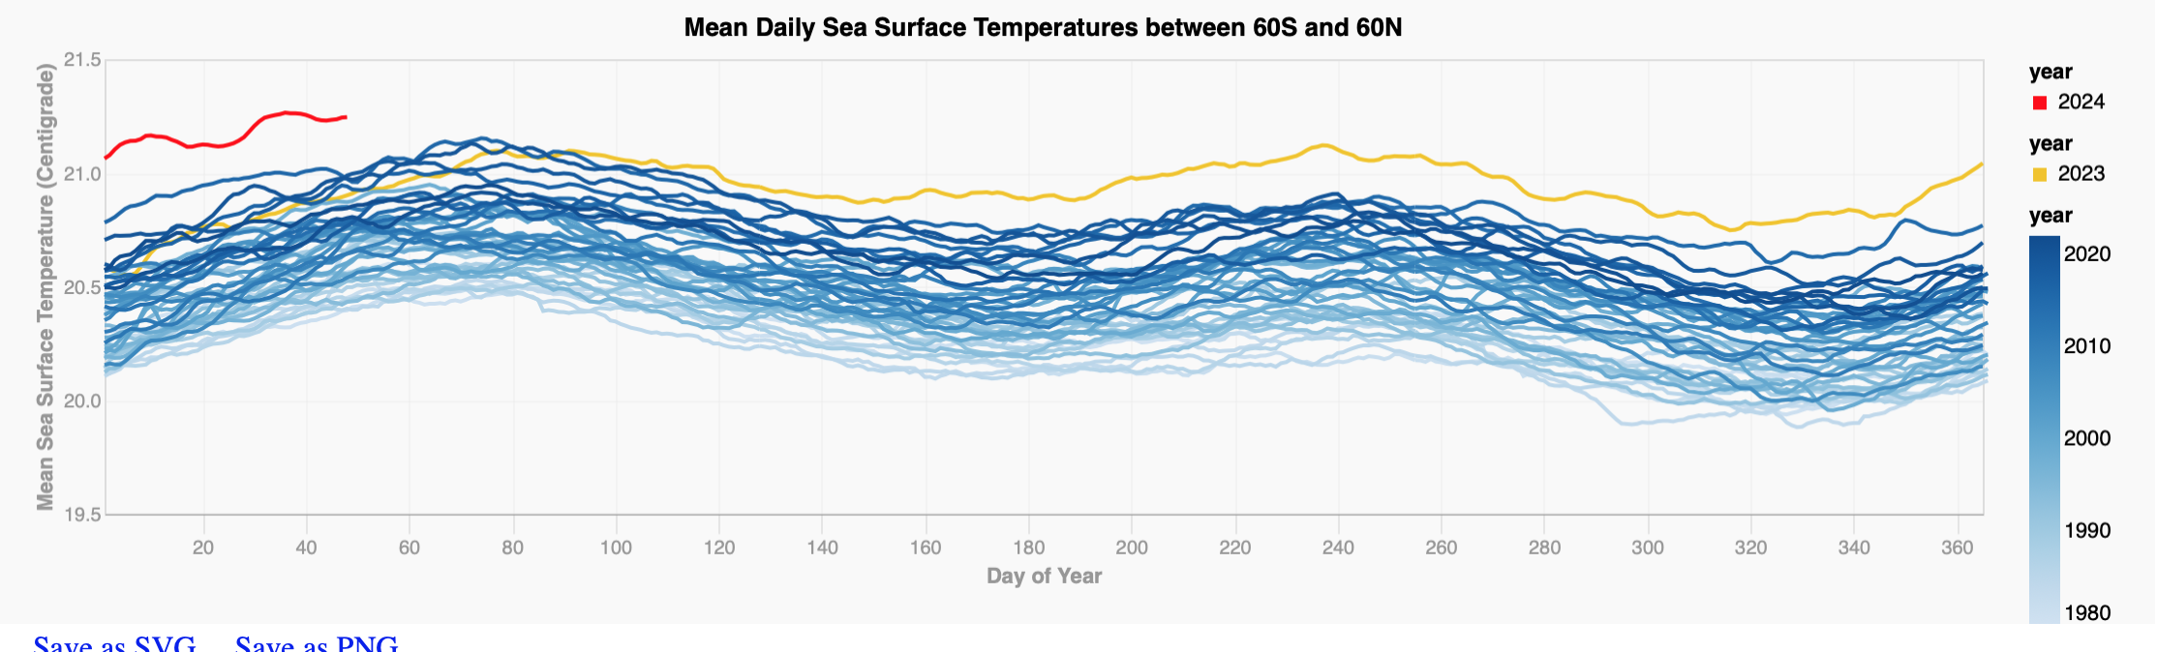
Measurements in Society
Critical for health, manufacturing, and environmental monitoring.
Growing in size and complexity.
Reliable interpretation requires uncertainty and error-covariance information, often overlooked or non-standardised.

Slide 3
Approach to Storing Uncertainties

Slide 4
Encoded Observations
Geospatial data is encoded with complex metadata, though users typically never have to interact with it.

Slide 5
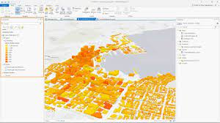


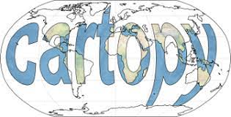
Encoded Observations
Geospatial data is encoded with complex metadata, though users typically never have to interact with it.
Example: Geocoding
Data is accompanied with standardised metadata
Tools provide means to
  Interface with this information
  Interpret and make use of this information
WKT

Slide 6
Encoded Observations
Geospatial data is encoded with complex metadata, though users typically never have to interact with it.
Why not take the same approach for error-covariance information for observations?

Slide 7


Encoded Observations
Measurement data encoded with uncertainty metadata, that users typically never have to interact with.
Digital Effects Table
Interface for Handling Information
e.g. Uncertainty propagation
Parallel: Error-covariance encoding
Data is accompanied with standardised metadata
Tools provide means to
  Interface with this information
  Interpret and make use of this information

Slide 8
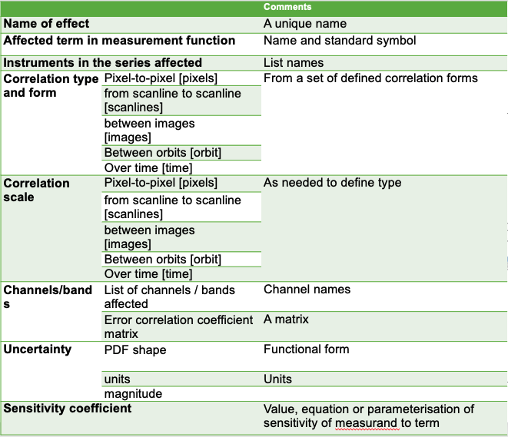
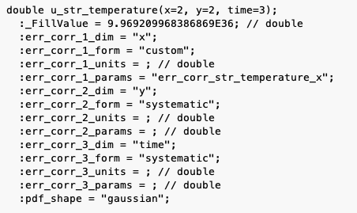
Standardised Error-Covariance Metadata: Digital Effects Tables
Print out of uncertainty variable attributes for netCDF file
Effects Table
Digital Effects Table

Slide 9
UNC Specification

Slide 10
Uncertainty metadata Naming Convention (UNC)
UNC Specification
Provide a standardised metadata format for uncertainty/error-covariance information.
Enable compact representation of error-covariance matrices using parameterised metadata.

Slide 11
Design Principles
UNC Specification
Scalability of Complexity
The complexity of the metadata should align with the use case:
  Simple use cases should be achievable with a simple implementation.
  Complex use cases should be possible without unnecessary restrictions.
Minimisation of Redundancy
The metadata specification should avoid duplication of information to prevent potential inconsistencies.
Human and Machine Readability
Metadata must be comprehensible for humans and parsable by machines.

Slide 12
Interaction with Other Standards
UNC Specification
The specification is intended to contribute to and build upon an existing ecosystem of standards and best practices. In particular, the following are adhered to, to the extent possible:
The understanding of uncertainty concepts defined in the JCGM GUM (Guide to the expression of uncertainty in measurement) suite of documents.
The definition of uncertainty-related terminology defined in the JGCM VIM(International Vocabulary for Metrology).
The NetCDF data model for creating self-describing, array-oriented scientific datasets.
The Climate and Forecast (CF) conventions on metadata for weather and climate data.

Slide 13
Uncertainty Variable Metadata
UNC Specification
Observation Variables
Uncertainty Variables
Metadata:
• PDF Shape (gaussian, …)
• Units (abs. or rel.)
• Error-Correlation…
associated with
Metadata:
• Uncertainty Components
…

Slide 14
Error-Covariance Metadata
UNC Specification
Error-covariance matrices grow quadratically with the size (N) of observation variables, making storage impractical for large datasets.
Instead, compact parameterisation of error-correlation matrices by defining specific structure, e.g.:
Identity
Effects:
• Random noise
Banded
Effects:
• Averaging
Banded
Effects:
• Systematic
Bloc Diagonal
Effects:
• Local systematics

Slide 15
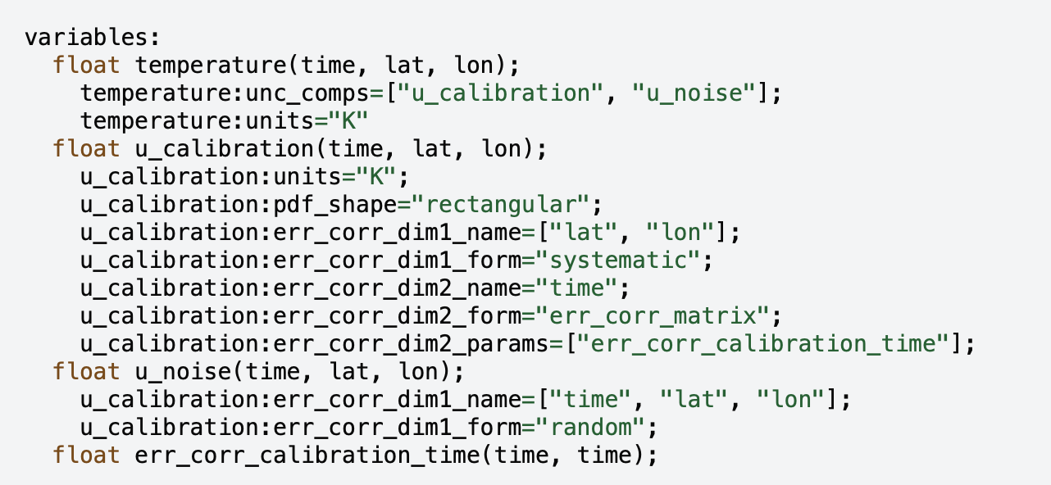
UNC Progress – Towards CF Integration
variables:
float sst(time, lat, lon) ;
sst:standard_name = "sea_surface_temperature" ;
sst:units = "K" ;
sst:units_metadata = "temperature: on_scale" ;
sst:uncertainty_variables = "unc" ;
float unc(lat, lon) ;
unc:error_correlation = "
lat: correlations
time: uncorrelated
lon: bell_shaped_relative (n: 15 sigma: sigma)" ;
float correlations(lat, lat1) ;
float sigma ;
sigma:standard_name = "sea_surface_temperature" ;
sigma:units = "K" ;
sigma:units_metadata = "temperature: difference" ;
UNC Spec v0.1
Towards CF-UNC Spec v1.0
Original proposal ~2023
Implemented in e.g., Hypernets
Update with support from Reading, NCAS
More idiomatic CF-style syntax
Notes:
Significant effort

Slide 16
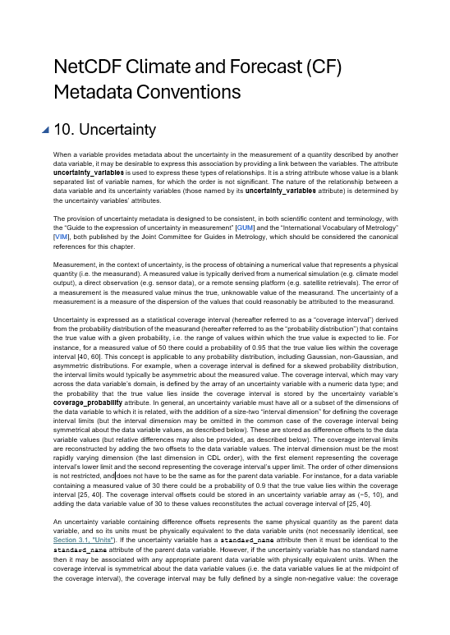
Next Steps
Prepared as a draft chapter to CF Conventions
About to begin Beta Phase testing – see here for details
Following Beta Phase we will propose to CF and summarise in a publication

Slide 17
Backup Slides

Slide 18
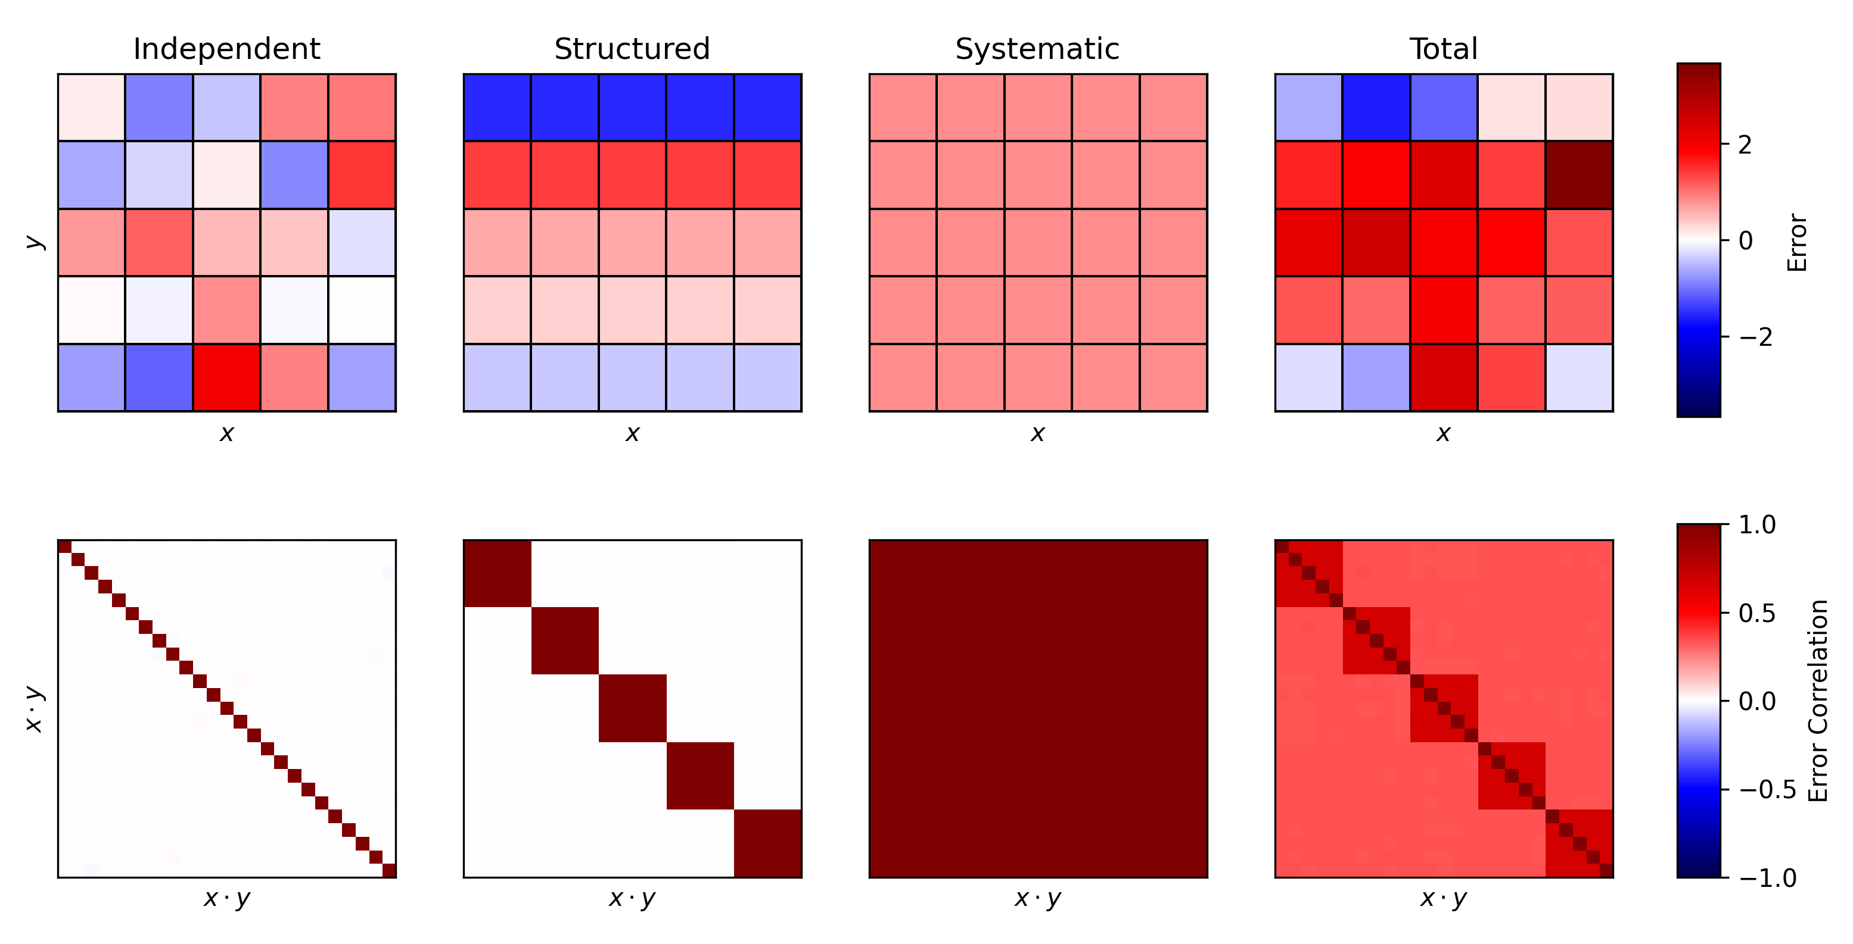
ND Datasets & Error-Correlation
+
+
=

Slide 19


ND Datasets & Error-Correlation
$N$ Pixels
+
+
=
$N^{2}$ Pixels!

Slide 20
ND Datasets & Error-Correlation
+
+
=
Sub-matrices for systematic error-correlation within row
Block
Diagonal
Identity
Full
Combination…

Slide 21
ND Datasets & Error-Correlation
+
+
=
Simply parameterisable
Parameterisable via other terms

Slide 22
ND Datasets & Error-Correlation
+
+
=
Simply parameterisable
One term might dominate at different scales
Parameterisable via other terms
Same complexity at all scales

Slide 23
ND Datasets & Error-Correlation
+
+
=
Each of these effects has the same uncertainty (u=1) – but a very different behaviour in the overall dataset! This matters!

Slide 24
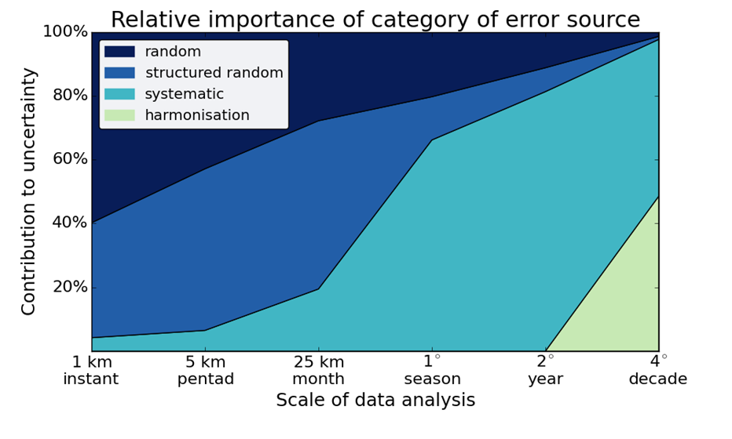
Why does error-correlation matter?
SST Example, C. Merchant (UoR)
Notes:
Mention why this shows one component of uncertainty isn’t enough

Slide 25
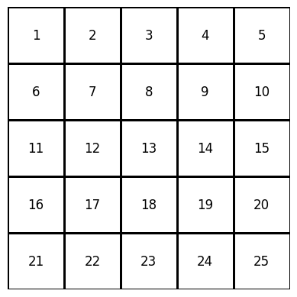
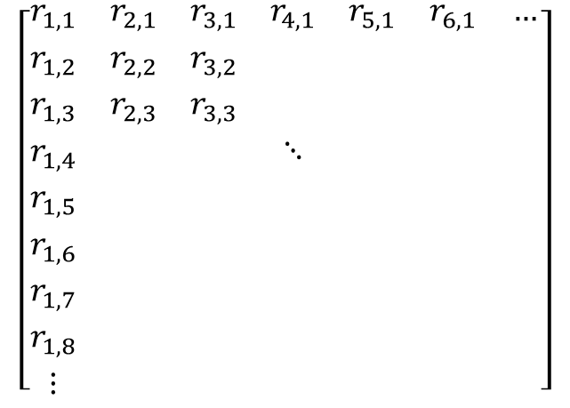
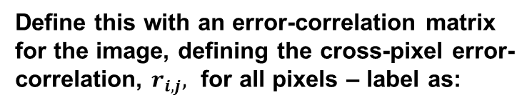
ND Datasets & Error-Correlation
Define this with an error-correlation matrix for the image, defining the cross-pixel error-correlation, $r_{i,j},$ for all pixels – label as:
$$\left[\begin{matrix}r_{1,1} & r_{2,1} & r_{3,1} & r_{4,1} & r_{5,1} & r_{6,1} & … \\ r_{1,2} & r_{2,2} & r_{3,2} & & & & \\ r_{1,3} & r_{2,3} & r_{3,3} & & & & \\ r_{1,4} & & & ⋱ & & & \\ r_{1,5} & & & & & & \\ r_{1,6} & & & & & & \\ r_{1,7} & & & & & & \\ r_{1,8} & & & & & & \\ ⋮ & & & & & & \end{matrix}\right]$$

