Slide 1
JACIE Data Quality Assessment Interoperability
20 April 2026
Jeffrey Clauson
USGS ECCOE Data Quality Lead
jclauson@usgs.gov
U.S. Geological Survey (USGS) Earth Resources Observation and Science (EROS) Center, Sioux Falls, SD 57198, USA.
CEOS WGCV - Sharing Perspectives and Approaches to Documenting and Assessing Data Quality (USGS)

Slide 2

Topics
USGS ECCOE Project Activity
JACIE Partner Analysis Collaboration
JACIE Partner Data Quality Assessment Collaboration
Toward an Initial Operational Configuration (IOC)

Slide 3
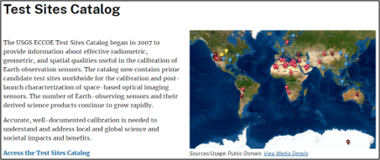

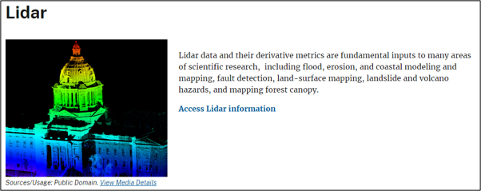
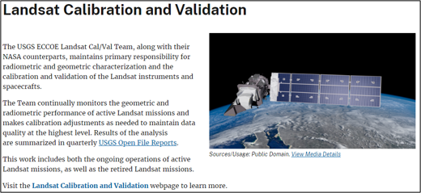

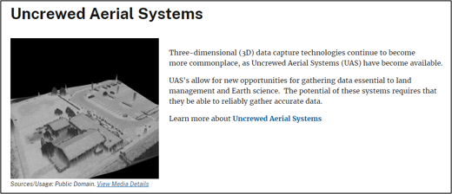
USGS ECCOE Project Activity
Background
USGS Earth Resources Observation and Science (EROS) Center
The EROS Cal/Val Center of Excellence (ECCOE) Project is a global leader in improving the accuracy, precision, and quality of remote sensing data​
https://www.usgs.gov/calval

Slide 4
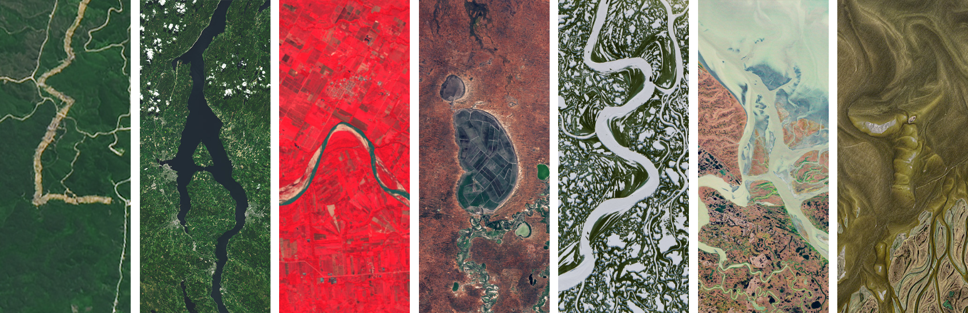
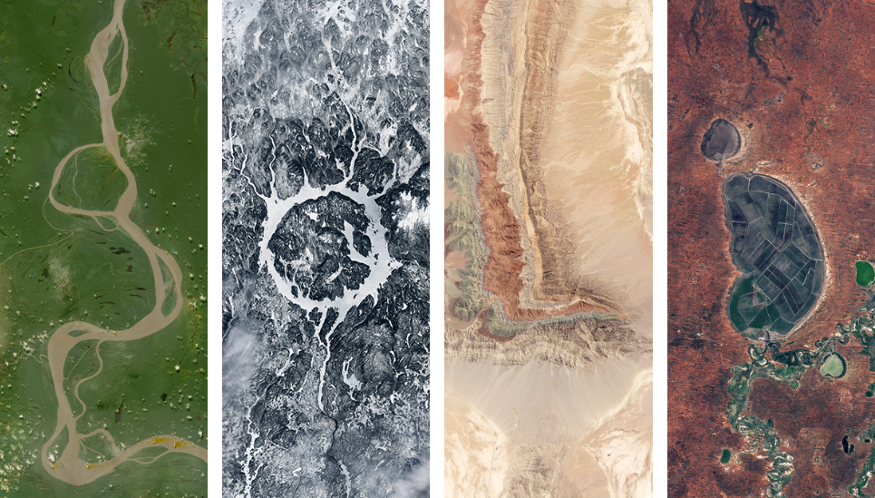
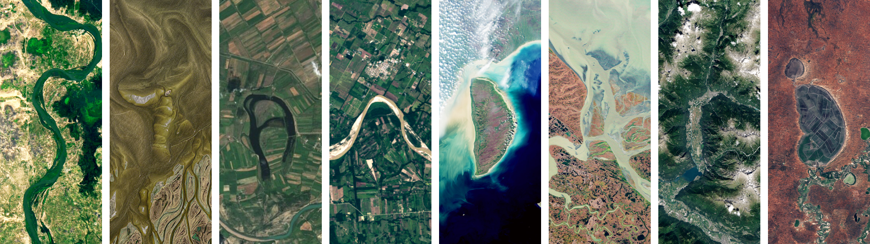
USGS ECCOE Project Activity
Responsibilities
Primarily responsible for assessing and reporting Landsat Calibration and Validation (Cal/Val) activities
Secondarily responsible for assessing and reporting data quality (civil and commercial) through relationships with data providers for the Earth observation

Slide 5
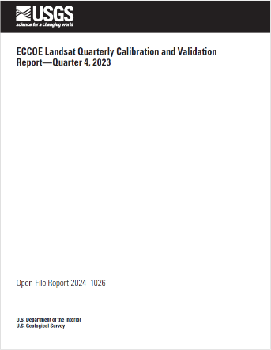
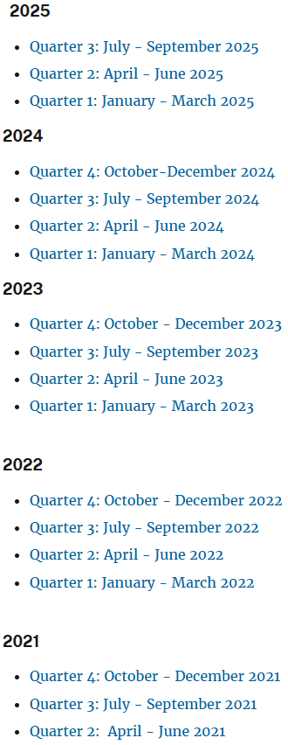
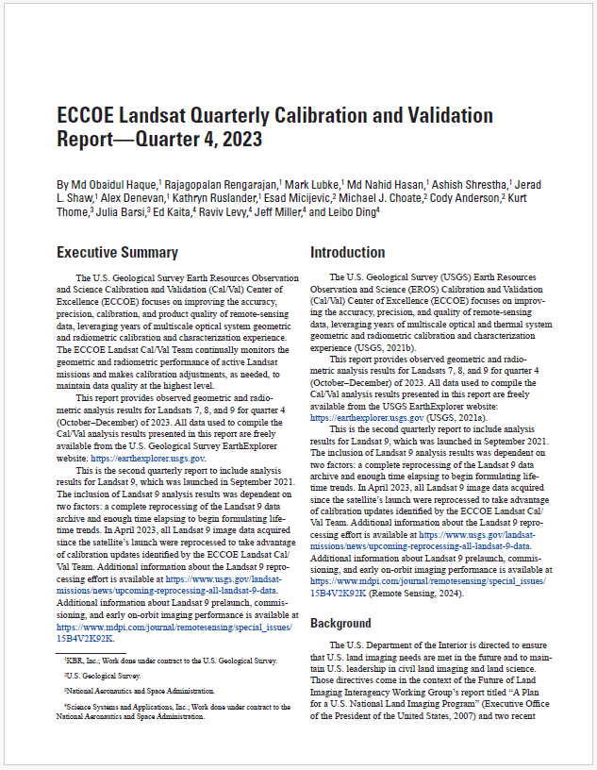
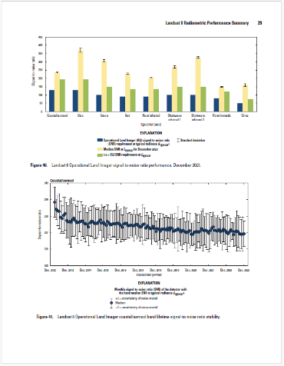
USGS ECCOE Project Activity
Data Quality Reporting - Landsat
Landsat Quarterly Cal/Val Reports
  The ECCOE Landsat Cal/Val Team continually monitors the geometric and radiometric performance of active Landsat missions and makes calibration adjustments as needed to maintain data quality at the highest level
  Performance evaluation is based on instrument specifications
  Results of the analysis are summarized in quarterly USGS Open File Reports
https://www.usgs.gov/calval/eccoe-landsat-quarterly-calibration-and-validation-reports

Slide 6
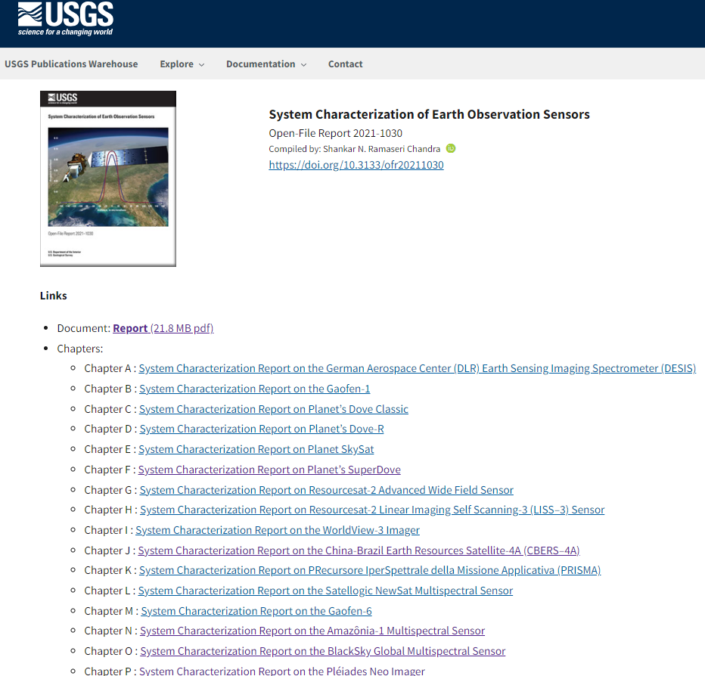
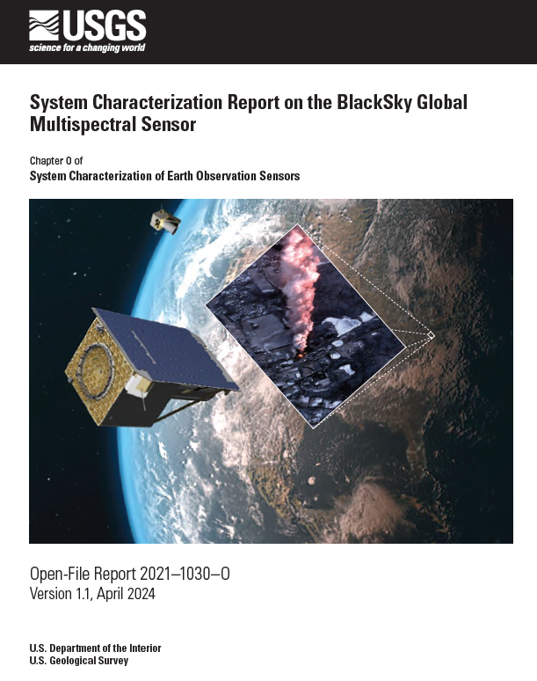
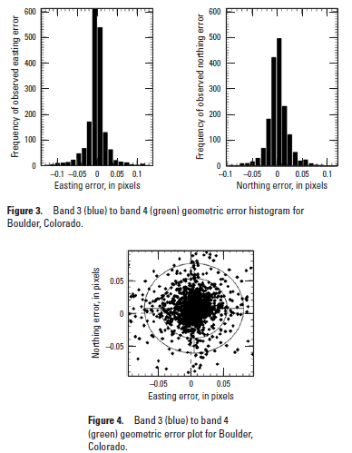
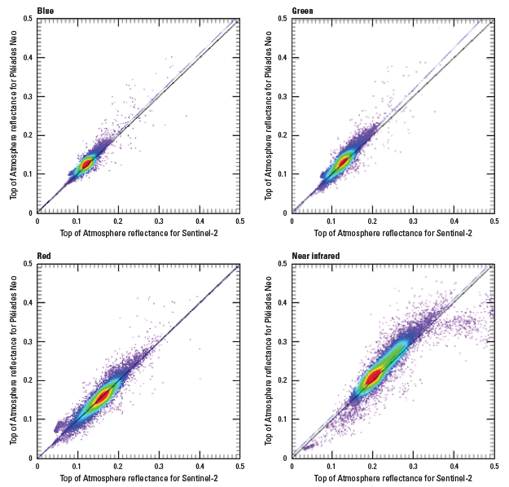
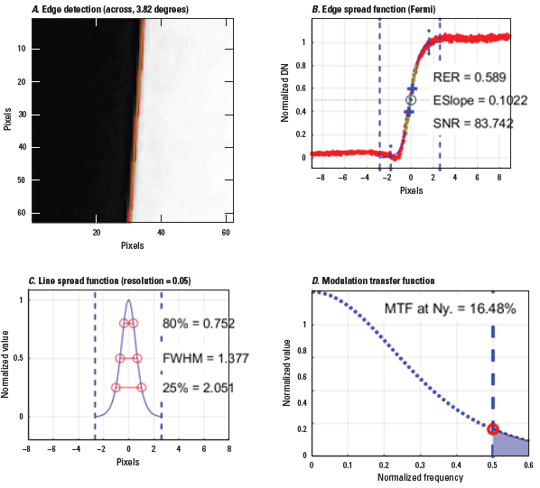
USGS ECCOE Project
Data Quality Reporting – System Characterization
USGS System Characterization Reports
  These are part of the USGS contribution to the JACIE partnership
  JACIE Data Quality Assessments and USGS System Characterizations are sometimes used interchangeably; however, that is changing as we move to data quality interoperability with the JACIE partners
  Performance evaluation is based on advertised instrument & product capabilities
  Data quality reporting includes radiometric, geometric (internal/external), and spatial accuracy assessments
https://pubs.usgs.gov/publication/ofr20211030

Slide 7
USGS ECCOE Project
Data Quality Reporting – EDAP+ Adoption
Earthnet Data Assessment Project (EDAP+) Reporting
  EO Mission Quality Assessment Framework – Optical Guidelines
    Issue: 2.1 31 October 2021
    Planning to migrate to the latest version
  EDAP+ Landsat TOA Product Evaluation Report (in-work)
    Completed the Summary Cal/Val Maturity Matrix
    Completed the Detailed Validation Cal/Val Maturity Matrix
    Applied the assessment component grading criteria … new experience for our analysts*
    Analysis paradigm shift from Landsat instrument performance specification evaluation to Landsat product specification evaluation*
*System Characterization and Evaluation of Remote Sensing Imagery- Lessons Learned from EDAP Evaluation [Quality & Accuracy Impacts to Data Fusion]
https://earth.esa.int/eogateway/activities/edap

Slide 8
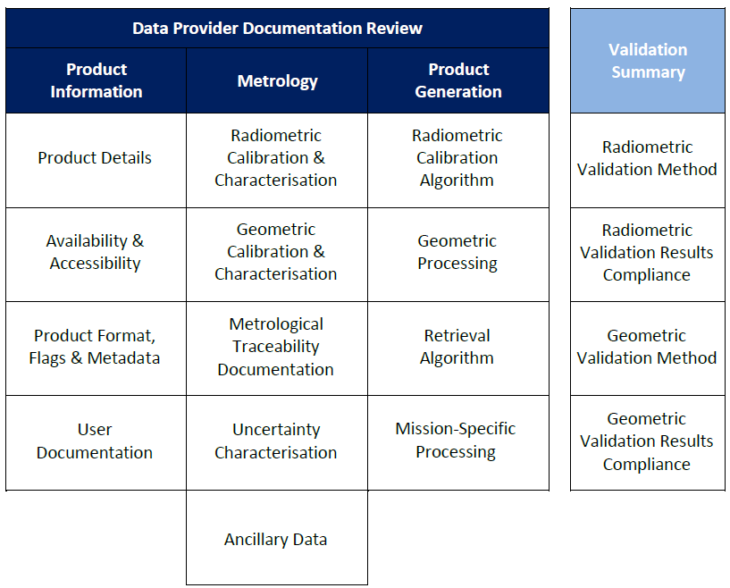
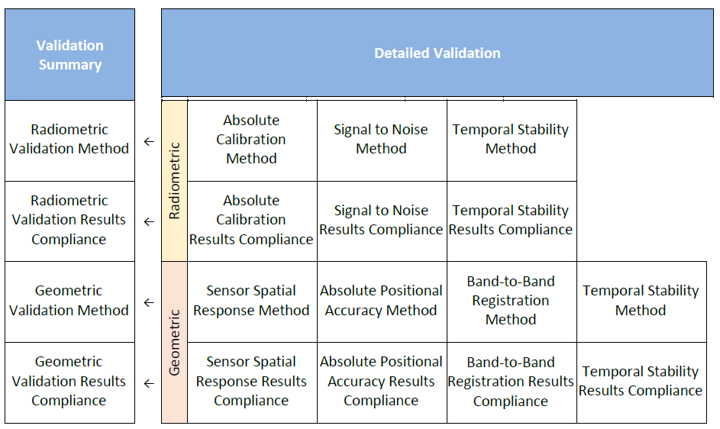
USGS ECCOE Project
Data Quality Reporting – EDAP+ Adoption
Summary Cal/Val Maturity Matrix
Documentation Review:
Mission quality as evidenced by its’ documentation
Detailed Validation Cal/Val Maturity Matrix
Detailed Validation:
Quantitative assessment of product compliance with stated performance

Slide 9
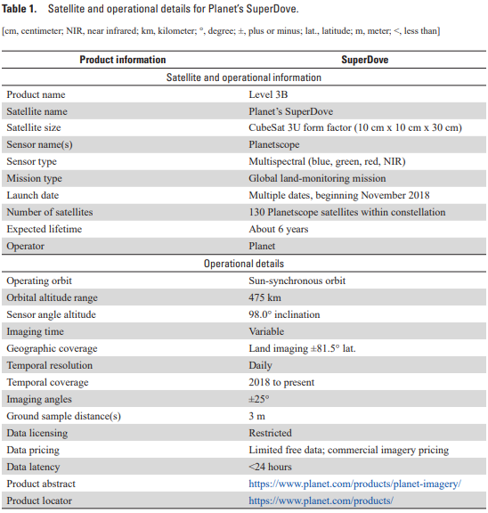
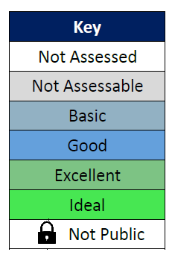
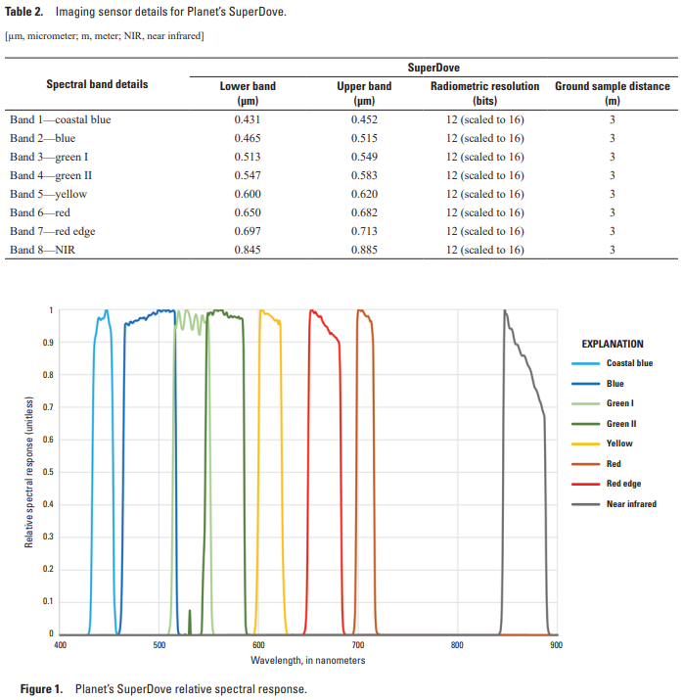
USGS ECCOE Project
Data Quality Reporting – EDAP+ USGS Interoperability
Common and Unique Data

Slide 10
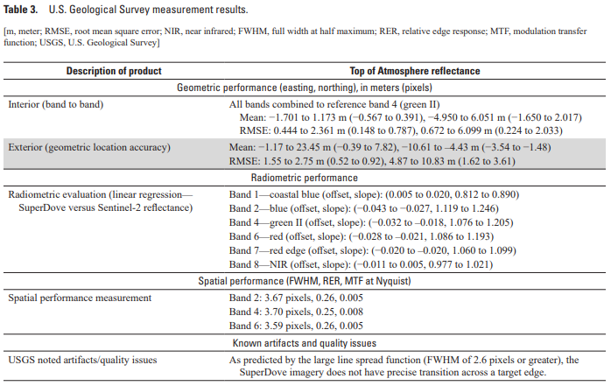
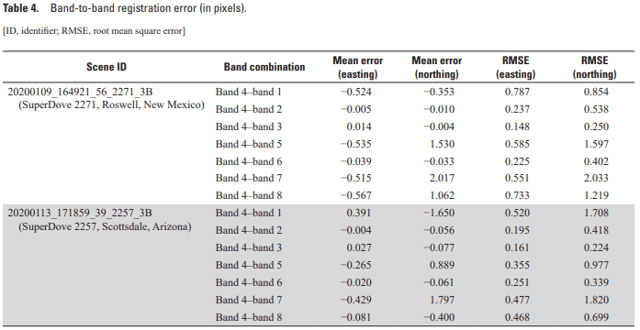
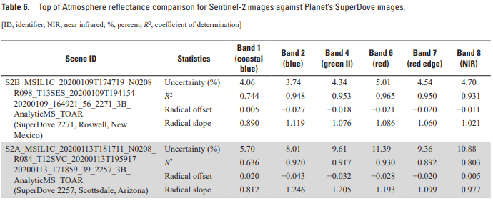
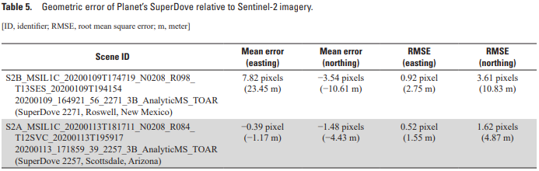
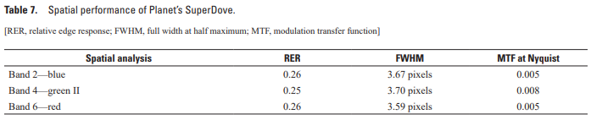
USGS ECCOE Project
Data Quality Reporting – EDAP+ USGS Interoperability
Common and Unique Analysis

Slide 11
JACIE Partner Analysis Collaboration
Summary
Taking a step back from reports and reporting to analysis …
  Methodologies
    Statistically Significant Number of Scenes, State of Algorithm Publication, Types of Analysis, etc.
  Tools
    COTS, Open-source, Combination, etc.
  Guidelines and Best Practices
    Foundational to Interoperability

Slide 12
JACIE Partner Analysis Collaboration
Methodologies
USGS Initial Look
  Analysis based on a very limited number of scenes (N < 20)
  Analysis algorithms published in peer review literature
  Radiometric Analysis
    In-situ and Cross Comparisons
  Geometric Analysis
    Exterior: I2I
    Interior: B2B
    GCPs
  Spatial Analysis
    Bridge Targets
    Checkerboard Targets
NASA CSDA Full Look and EDAP+
  Analysis based on a statistically significant number of scenes (N >> 20)
  Analysis algorithms published in peer review literature
  Radiometric Analysis
  Geometric Analysis
  Spatial Analysis
  SNR, Stability, etc.
  Documentation assessment
  Grading or Fit-for-Purpose

Slide 13
JACIE Partner Analysis Collaboration
Tools
USGS Tools
  Tools are typically lower volumes of data; however, scaling to be able to handle large volumes of data
  COTS: IDL
  Open-source: Python
  Latest Development: Moving all data quality analysis tools to USGS GitLab Open-source
    Enables sharing with partners and a pathway to public release/access
ESA / NASA Tools
  Tools are typically able to handle large volumes of data
  Karios … ESA geometric tool
  Catalyst … ESA match-up
  ISOFIT … NASA atmospheric correction package
  MSI, HSI, SAR, DEMs, Atmospherics, etc.

Slide 14
JACIE Partner Analysis Collaboration
Guidelines and Best Practices
JACIE Best Practices
  Provides some background and history about JACIE
  Addresses both pre and post launch aspects of data quality and reporting
  Analysis areas covered …
    Geometry
      Internal and External
    Radiometry
    Spatial
  Co-authored and reviewed by JACIE Partners
  JBPs moving toward interoperability with EDAP+ Guidelines and Best Practices
  USGS is moving Initial Look data quality analysis methods and techniques toward interoperability with the NASA CSDA Full Analysis and the broader EDAP+ analysis and reporting
EDAP+ Guidelines and Best Practices
  ESA/NASA SAR Guidelines (2024)
  ESA/NASA OPT Guidelines (2026)
  ESA/NASA ATM Guidelines (2026)
  ESA/NASA DEM Guidelines (2026)
  ESA/NASA Other Domains + Usability (2026)
https://pubs.usgs.gov/of/2024/1023/ofr20241023.pdf

Slide 15
JACIE Partner Data Quality Assessment Collaboration
JACIE Data Quality Assessment Dashboard – Why?
Taking another step back from analysis to JACIE partner collaboration …
  Who are the data providers of interest to the JACIE partners for data quality assessment?
  What data quality assessment analysis needs to be performed?
    Radiometry?, Geometry?, Spatial?, All?, Some?, Initial Look?, Full Look?, EDAP+? …
  What is the data quality assessment reporting mechanism?
    Formal Report?, Internal PPT?, Initial Look Results?, Full Look Results?, EDAP+?
  When will JACIE partners have resources available to perform the data quality assessment?
  How do the JACIE partners not duplicate effort?
    Interoperable data quality assessment analysis and reporting that enable …
      distributing data quality analysis within the JACIE partners
      sharing known equivalent data quality assessment results.

Slide 16
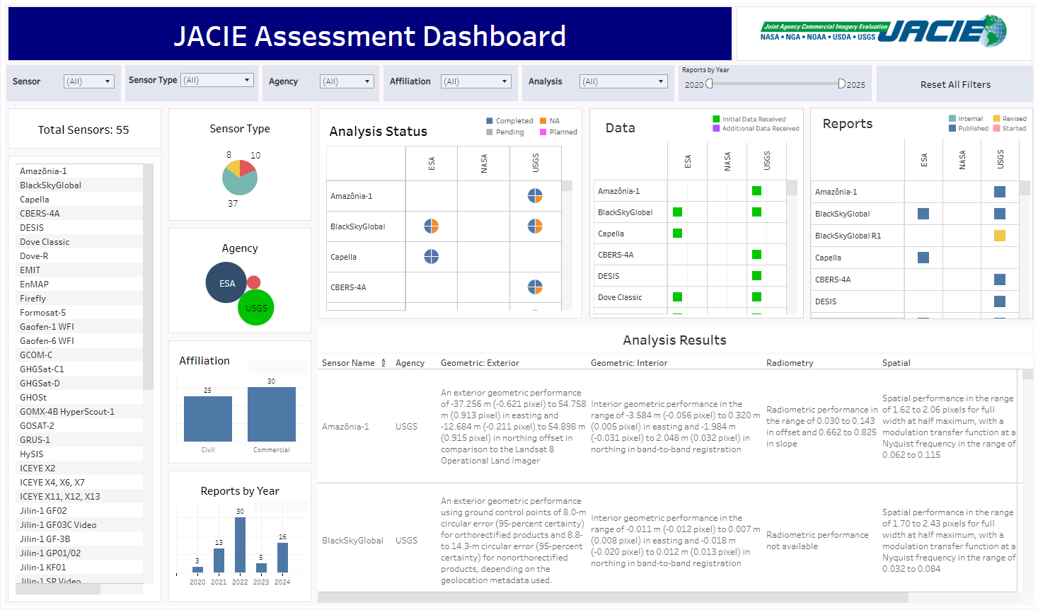
JACIE Partner Data Quality Assessment Collaboration
JACIE Data Quality Assessment Dashboard - Background
Continue to request JACIE Data Quality Assessment Dashboard joint development input from JACIE partners
  Data quality analysis summaries
  Leveraging the Optical base, expanding to appropriate fields for SAR, LiDAR, atmospherics, DEMs, etc.

Slide 17
JACIE Partner Data Quality Assessment Collaboration
JACIE Data Quality Assessment Dashboard - Functionality
Filtering by List
  Sensor
  Sensor Type
  Agency
  Affiliation
  Analysis
  Report by Year (slider)
  Reset All Filters
Filtering by Icon
  Selectable

Slide 18


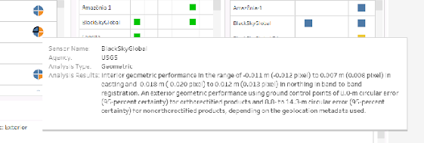
JACIE Partner Data Quality Assessment Collaboration
JACIE Data Quality Assessment Dashboard - Functionality
Analysis Status
Geometry
Radiometry
TBD (EDAP?)
Spatial

Slide 19


JACIE Partner Data Quality Assessment Collaboration
JACIE Data Quality Assessment Dashboard - Functionality
Data
Reports
  Complete reports are linked for access.
    OFRs
    Citable web reports
    JACIE historical presentations

Slide 20



JACIE Partner Data Quality Assessment Collaboration
JACIE Data Quality Assessment Dashboard – New Development
Public Facing
JACIE Partner
Data Quality Results
No Internal Only Reports
USGS Internal
Sensor Name, Sensor Type, Agency, Analysis Status, Initial Data Received, Additional Data Received, Geometric: Exterior Results, Geometric: Interior Results, Geometric: Absolute Results, Radiometry Results, Spatial Results, Other Results, Internal or External Report, Report Status, External Report Link, Revisions (Y/N), and Revision Date.

Slide 21
Toward an Initial Operational Configuration (IOC)
JACIE Joint Data Quality Evaluations - Commercial
JACIE Joint Airbus Data Quality Evaluation
  Participants: ESA, NASA CSDA, and USGS
  Capabilities: Pleiades (VNIR), Pleiades Neo (VNIR), and SPOT (VNIR & SWIR)
  Activities
    Provided input the joint data acquisition plan over Cal/Val test sites
    Analysis is underway
    Planning a results intercomparison to evaluate impact of methodologies and/or tools
    Planning participant and a combined joint report
JACIE Joint Muon Space Data Quality Evaluation
  Participants: NASA CSDA and USGS
  Capabilities: MuSat-4 (MWIR and LWIR)
  Activities
    Provided input the joint data acquisition plan over Cal/Val test sites
    Analysis is planned
    Planning a results intercomparison to evaluate impact of methodologies and/or tools
    Planning participant and a combined joint report

Slide 22
Toward an Initial Operational Configuration (IOC)
EDAP+ Landsat Evaluation - Civil
Landsat 8 and Landsat 9
  If the remote sensing community is expecting Commercial missions to be able to perform EDAP+ analysis and reporting, then the reference Civil missions should also be able to complete a full EDAP+ analysis and report.

Slide 23
Toward an Initial Operational Configuration (IOC)
EDAP+ Landsat Evaluation – High-level Results
Landsat 8 and Landsat 9
  Documentation Maturity and Transparency
    Mission documentation (e.g., Product User Guides, Algorithm Theoretical Basis Documents, and calibration reports) provides clear traceability from pre-launch characterization to on-orbit calibration and monitoring
    Calibration and geometric performance metrics are well defined, consistently reported, and aligned with community standards (e.g., CEOS, QA4EO)
    Sufficient detail is provided to support independent validation and reproducibility, meeting EDAP expectations for documentation completeness
    Overall documentation maturity is assessed as Excellent
  Geometric Accuracy and Stability
    Absolute geolocation accuracy is consistently sub-pixel, with RMSE typically ~0.1–0.15 pixels
    Multi-temporal analysis spanning 2013–2026 shows no detectable geolocation drift
    Temporal stability of geolocation meets the Ideal performance grade under the ESA-NASA Joint Earth Observation Mission Quality Assessment Framework - Optical Guidelines

Slide 24
Toward an Initial Operational Configuration (IOC)
EDAP+ Landsat Evaluation – High-level Results
Landsat 8 and Landsat 9
  Radiometric Absolute Calibration
    Comparison with RadCalNet indicates Excellent absolute radiometric agreement, with band-dependent differences generally within ~1–3%
    Systematic biases are small, stable, and consistent across RadCalNet sites and spectral bands.
  Radiometric Temporal Stability
    Time-series analysis over CEOS PICS sites shows no monotonic trends or step changes in TOA reflectance.
    Inter-sensor reflectance ratios (Sentinel-2A / Landsat-8) remain stable over nearly a decade, supporting long-term data record continuity.
  Overall Performance Context
    Observed geometric and radiometric performance is consistent with or exceeds stated mission specifications.
    Performance is comparable to other state-of-the-art optical EO missions used for land, environmental, and climate applications.

Slide 25
Toward an Initial Operational Configuration (IOC)
EDAP+ Landsat Evaluation – Detailed Results and Lessons Learned
Landsat 8 and Landsat 9
  For EDAP+ Evaluation of Landsat detailed analysis results and for a summary of lessons learned, please attend the following talk …
    System Characterization and Evaluation of Remote Sensing Imagery- Lessons Learned from EDAP Evaluation (Dr. Sampath)
    Quality & Accuracy Impacts to Data Fusion @ 3:30 - 3:45

Slide 26
Thank you!
Questions? Suggestions?
Email: eccoe@usgs.gov

Slide 27
Backup

Slide 28
Abstract
JACIE Data Quality Assessment Interoperability with EDAP+ and Progress Toward a Landsat EDAP+ Evaluation
  Wednesday, 2026 April 15
  11:15 – 11:30
Abstract
  The ESA-NASA "Earth Observation Mission Quality Assessment Framework - Optical Guidelines" establishes a standardized approach to evaluate the quality of commercial Earth Observation (EO) data. The framework consists of a two-part assessment: 1) Documentation Review: Examines mission documents to assess data quality. and 2) Detailed Validation: Quantitatively assesses data products against stated performance metrics. The results are compiled into a Quality Assessment Report and a color-coded Cal/Val maturity matrix, which visually summarizes the assessment results. The JACIE Data Quality Assessment process aligns with the ESA-NASA EDAP+ framework in several ways, especially in the areas of geometric, radiometric, and spatial validation. However, there are also differences. This talk provides an update to the steps being taken to align the JACIE Data Quality Assessment and EDAP+ processes to enable a Data Provider to use a JACIE Data Quality Assessment Report information in the fulfillment of the independent system evaluation requirement for the EDAP+ validation component. Also, to better understand the EDAP+ processes, the USGS ECCOE Project System Characterization Team and Landsat Cal/Val Team have been performing an EDAP+ evaluation for Landsat.

