Slide 1
JAXA SAR Quality Assessments
Takeo Tadono, JAXA
Agenda Item J3.4
WGCV-56 / LSI-VC-19 Joint Meeting
Sioux Falls, SD, USA

Slide 2
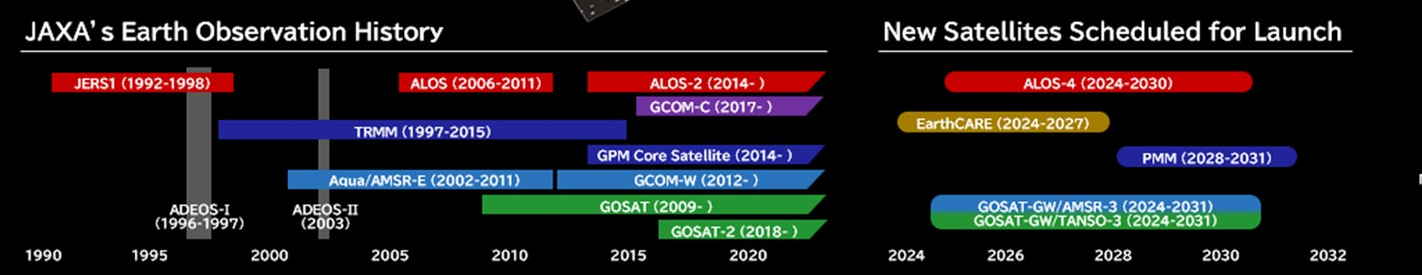
Launch History
March 2023: ALOS-3 (Optical) was lost due to H3 Test Flight #1 (TF1) rocket failure.
Feb. 17, 2024: H3 TF2 rocket launched with CE-SAT-IE, commercial small opt. satellite successfully.
May 29, 2024: EarthCARE “Hakuryu” launched by Space X Falcon 9, JAXA provides Cloud Profiling Radar (CPR).
July 1, 2024: ALOS-4 “Daichi-4” (SAR) by H3 F3.
June 29, 2025: GOSAT-GW (GHG spectrometers and microwave radiometer) launched by H-IIA.
December 22, 2025: H3 F8 was failure with QZSS-5, GNSS satellite.

Slide 3
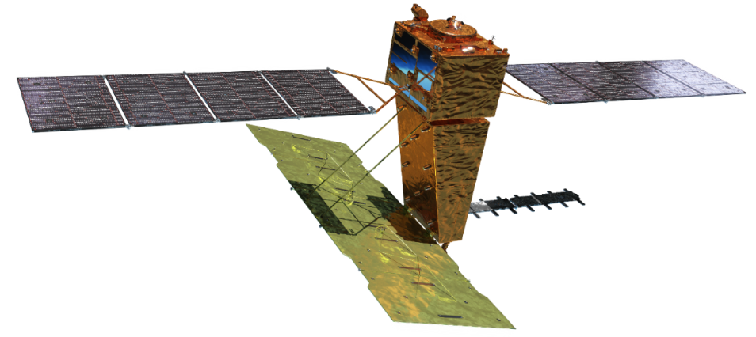

ALOS-4 “DAICHI-4” & PALSAR-3
Mission objectives:
  Ground deformation monitoring,
  Disaster monitoring,
  Continuation and enhancement of the ALOS-2 applications, and
  Maritime monitoring with SAR and AIS.
Launch | H3 launch vehicle F3 on July 1, 2024
Orbit | Same orbit as ALOS-2 Sun-synchronous sub-recurrent orbit Altitude: 628 km Inclination angle: 97.9 degree Local sun time: 12 a.m. and 12 p.m. Revisit time: 14 day (15-3/14 rev/day)
Lifetime | 7 years
Size | X 10.0 m x Y 20.0 m x Z 6.4 m
Satellite Mass | 2,990 kg
Downlink | ~3.6 Gbps (Ka-band direct transmission) ~1.8 Gbps (Optical data relay satellite)
Mission Instruments | PALSAR-3 (Phased Array type L-band Synthetic Aperture Radar-3) SPAISE3 (SPace based AIS Experiment 3)
Prime contractor | Mitsubishi Electric Corporation
SPAISE3
PALSAR-3

Slide 4
ALOS-4 “DAICHI-4” & PALSAR-3
Observation characteristics
SAR mode | Spotlight | Stripmap |  |  |  |  |  |  | ScanSAR
Code name | SB | UW |  | UB | HW | HB | FW | FB | XB
Resolution [m] | 3 x 1 (Rg x Az) | 3 |  |  | 6 |  | 10 |  | 25 (1 look)
Swath width [km] | 35 x 35 | 200 | 100 |  | 200 | 100 | 200 | 100 | 700 (4 scan)
Center freq. [MHz] | 1257.5 | 1257.5 |  |  | 1236.5 (or 1257.5/1278.5)
Bandwidth [MHz] | 84 | 84 |  |  | 42 |  | 28 |  | 28
Polarization* | S, D | S, D | S, D, Q |  | S, D | S, D, Q | S, D | S, D, Q | S, D
Available Incidence angle range | 8-70 | 30-56 | 8-70 |  | 30-56 | 8-70 | 29-56 | 8-70 | 8-70
NESZ | < -20 dB | < -20 dB |  |  | < -24 dB |  | < -28 dB |  | < -20 dB
Rg. S/A | > 15 dB | > 15 dB |  |  | > 15 dB |  | > 20 dB |  | > 15 dB
Az. S/A | > 15 dB | > 15 dB |  |  | > 15 dB |  | > 20 dB |  | > 15 dB
Pol. X-talk | < -30 dB
Split-band option | N/A | N/A | N/A |  | N/A | N/A | 28+10 MHz | N/A | N/A
*Polarization: S = HH or HV or VV or VH, D = HH+HV or VV+VH, Q = HH+HV+VH+VV

Slide 5
SAR Calibration and Evaluation Items at JAXA
No | Item | Evaluation Item | Calibration parameter | Evaluation criteria | Method
1 | Geometric Cal | Geometric accuracy (L1.1) | Signal delay in Range Azimuth time offset | Fine beam 3 m: (a) Precision orbit determination: Within 10 m (1σ) (b) On-board orbit det.: Within 50 m (1σ) Other observation modes: Equivalent to ALOS-2 | CR/ARC evaluation Cross Cal with ALOS-2
2 |  | Geometric accuracy (L2.1) | - | Same as above | CR/ARC evaluation
3 | Antenna Pattern Cal | Range antenna pattern | Amplitude | Radiometric accuracy (relative) | Assessment using tropical forests
4 |  | Azimuth antenna pattern | Amplitude | Radiometric accuracy (relative) | Assessment using tropical forests
5 |  | Radiometric accuracy (relative) | Amplitude in range and azimuth Adjustment between Scans | Within 1.0 dB (1σ) | Assessment using tropical forests
6 | Radiometric Cal | Radiometric accuracy (absolute) | Calibration factor | Within 1.0 dB (RMSE) | CR/ARC evaluation Assessment using tropical forests
7 | Polarimetric Cal | Polarimetric accuracy | Pol cal coefficient | Polarimetric separation (Cross talk): Less than -30 dB H/V amplitude ratio: Less than ±0.2 dB H/V phase differences: Less than ±5 degrees | CR/ARC evaluation Assessment using tropical forests
8 | Image Quality Evaluation | Point target (Resolution, Peak-to-Sidelobe Ratio (PSLR), Integrated Sidelobe Ratio (ISLR)) | - | Resolution: Depends on Obs. mode and beam PSLR: -13.26 + 2.00 dB ISLR: -10.16 + 2.00 dB | CR/ARC evaluation
9 |  | Noise Equivalent Sigma-Zero (NESZ) | - | Depends on Obs. mode and beam | Noise evaluation using low wind speed ocean images
10 |  | Range / Azimuth ambiguity (S/A) | - | Depends on Obs. mode and beam | Noise evaluation in coastal waters
11 |  | Removal of external interference (RFI) | Interference removal parameters | No noise or blurring should be observed. RFI must be appropriately removed in the frequency domain | Visual inspection of images and RFI evaluation
12 |  | Detection of ionospheric disturbances | Ionospheric disturbance detection parameters | No obvious errors are observed in the ionospheric disturbance detection flags. | Checking the ionosphere flag for images from various locations.
13 |  | Other image quality anomalies | - | No abnormalities of noise and blurring. | Visual inspection of images from various locations.
14 |  | Interferometry | Range antenna pattern (phase) | No abnormalities of interferometric fringes should be observed between ALOS-4, and ALOS-2 and ALOS-4. | InSAR analysis in urban and bare lands.
15 |  | Ionospheric correction mode | - | Correction of ionosphere using ionospheric correction mode. | InSAR analysis in urban and bare lands.
16 | Ortho-rectification | Ortho-rectified image from L2.1 | - | Ortho-rectified image comparison between ALOS-2 and ALOS-4. | Visual inspection of images from various mountainous regions.

Slide 6
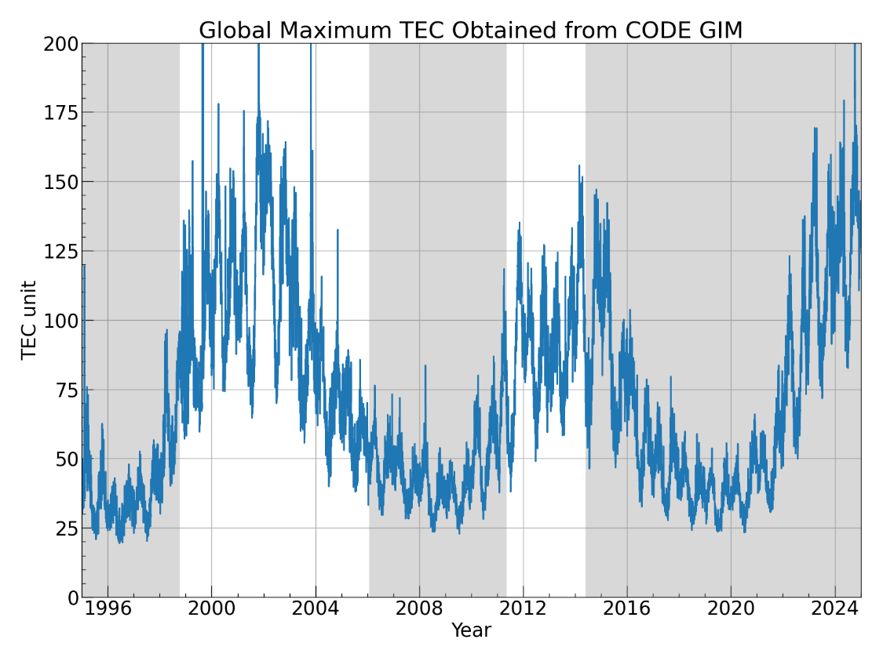
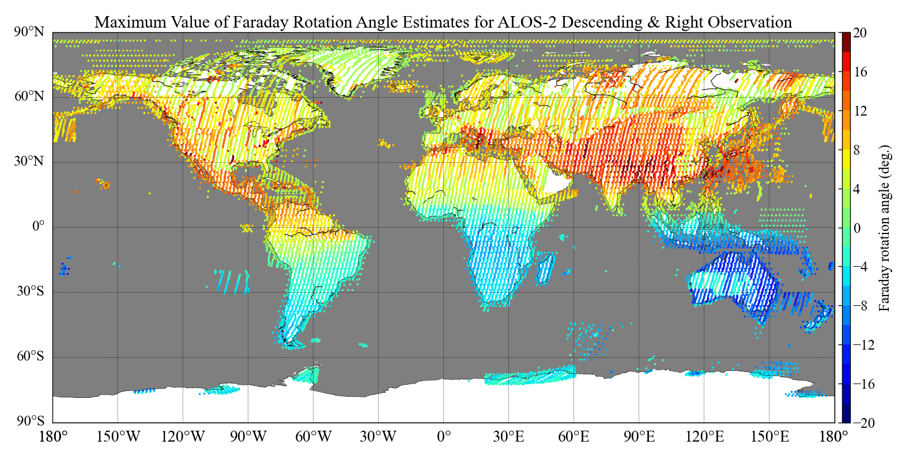
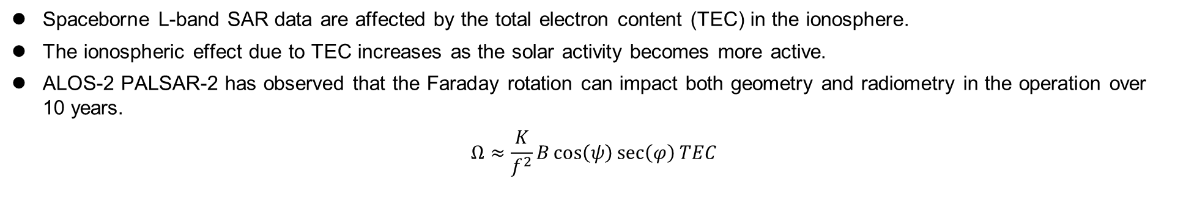
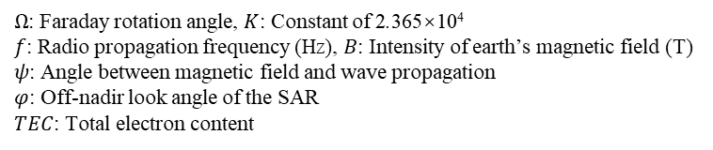
Effect of Faraday Rotation on L-band Spaceborne SAR Data
Spaceborne L-band SAR data are affected by the total electron content (TEC) in the ionosphere.
The ionospheric effect due to TEC increases as the solar activity becomes more active.
ALOS-2 PALSAR-2 has observed that the Faraday rotation can impact both geometry and radiometry in the operation over 10 years.
$$Ω≈\frac{K}{f^{2}}B\cos\left(ψ\right)\sec\left(φ\right){TEC}$$
$Ω$: Faraday rotation angle, $K$: Constant of 2.365×10⁴
$f$: Radio propagation frequency (Hz), $B$: Intensity of earth’s magnetic field (T)
$ψ$: Angle between magnetic field and wave propagation
$φ$: Off-nadir look angle of the SAR
$TEC$: Total electron content
JERS-1
ALOS
ALOS-2
Global daily maximum TEC from the Center for Orbit Determination in Europe (CODE) at the University of Bern, Germany.
Simulation of maximum Faraday rotation observed by PALSAR-2
Descending orbit and right observation with mode off-nadir angle
August 20th, 2014 to November 20, 2023.

Slide 7
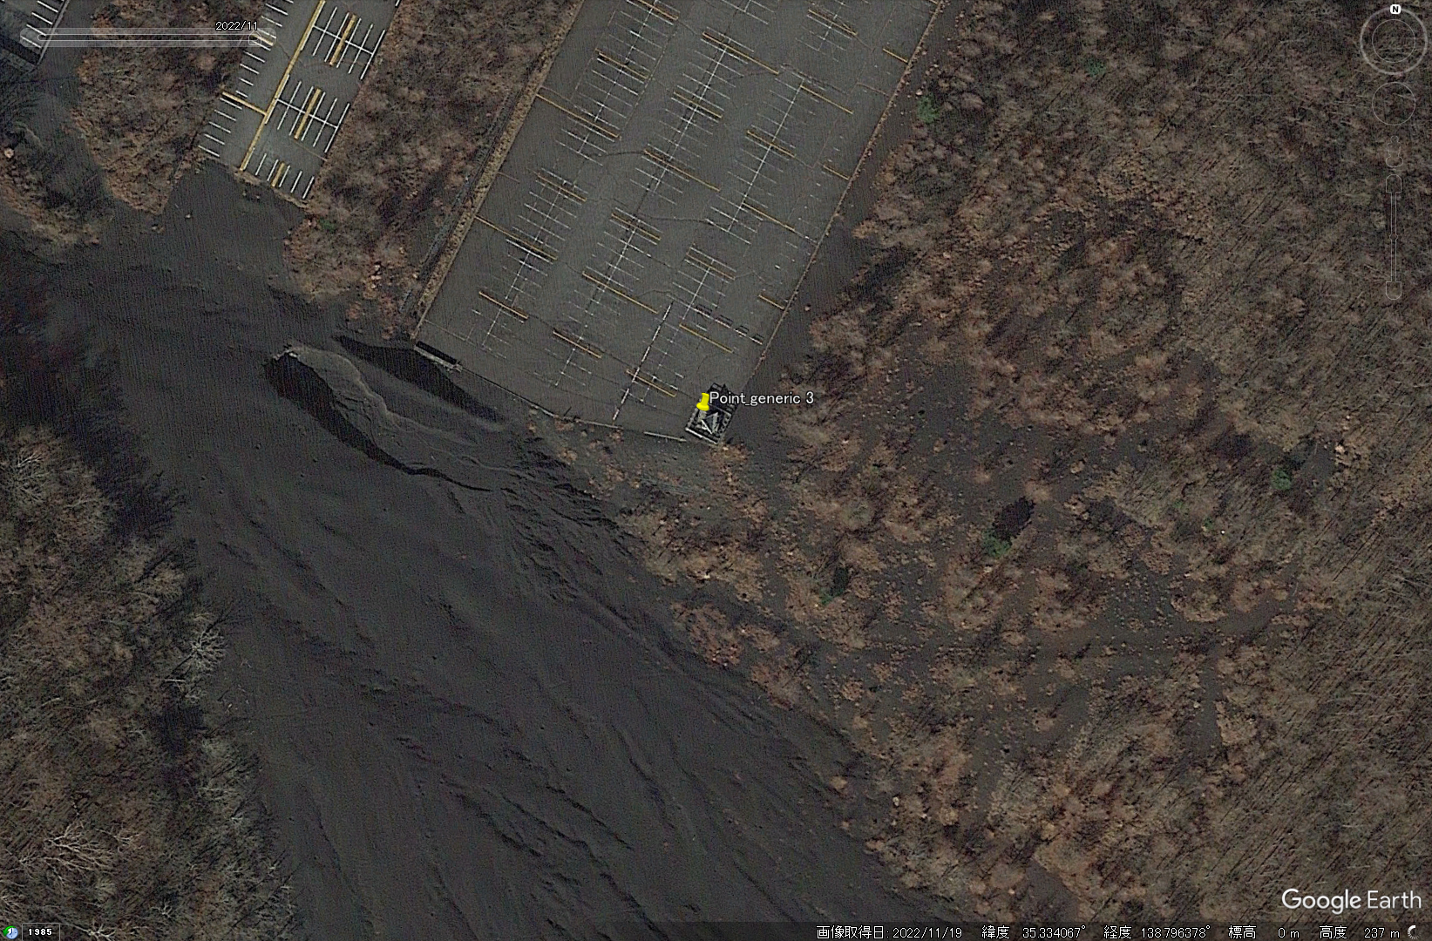
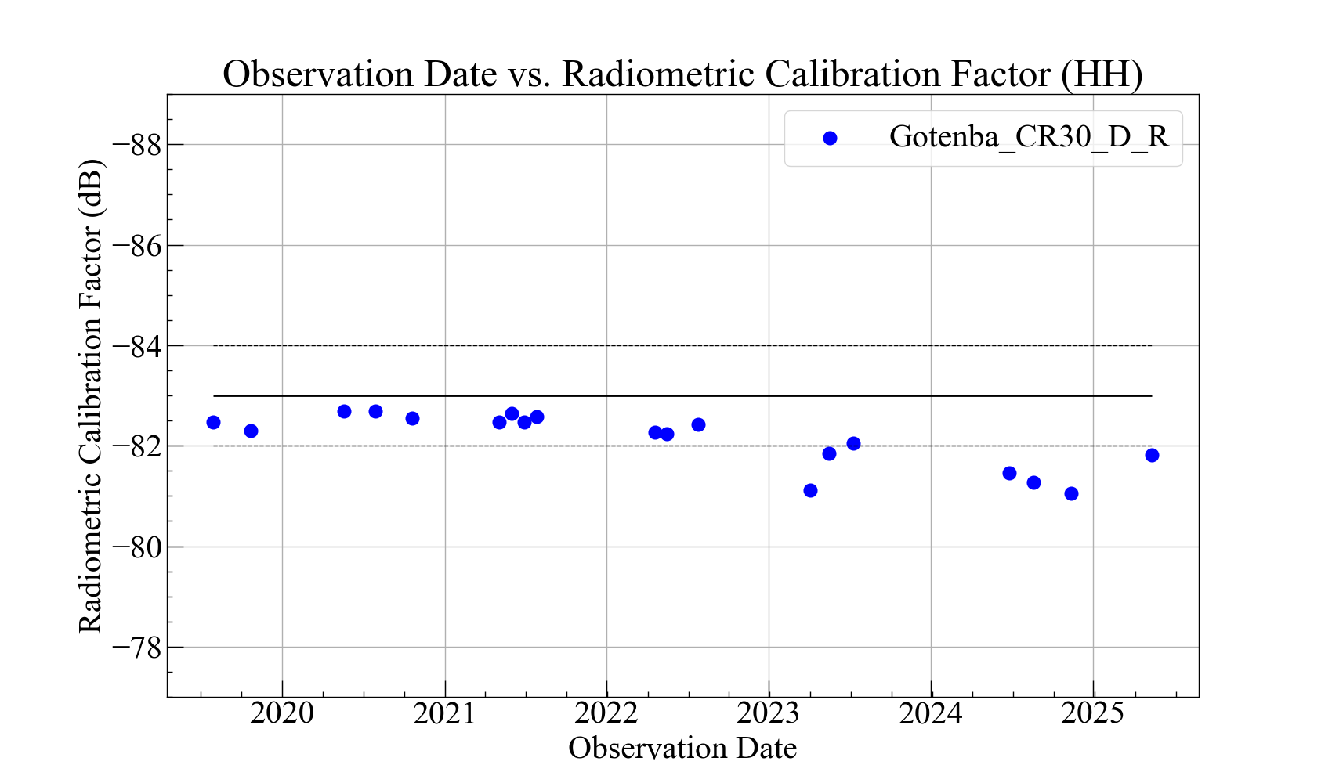
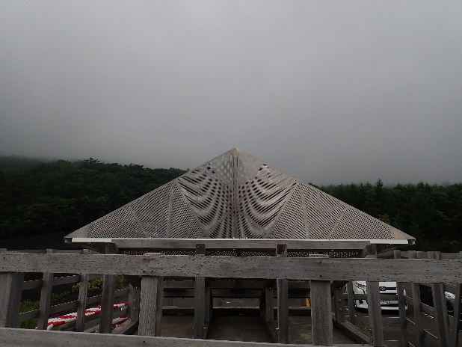
Radiometric Cal by the Point Target
A temporal variation has been observed in the determination of the radiometric calibration factor for PALSAR-2.
  The backscatter from point targets also affected by the Faraday rotation.
Copyright: Google
Target area: Gotemba, Shizuoka Pref., Japan
3 m trihedral corner reflector (CR).
PALSAR-2 Radiometric Calibration Factor in time-series
determined by the trihedral corner reflector deployed in Gotemba, Shizuoka Pref., Japan.

Slide 8
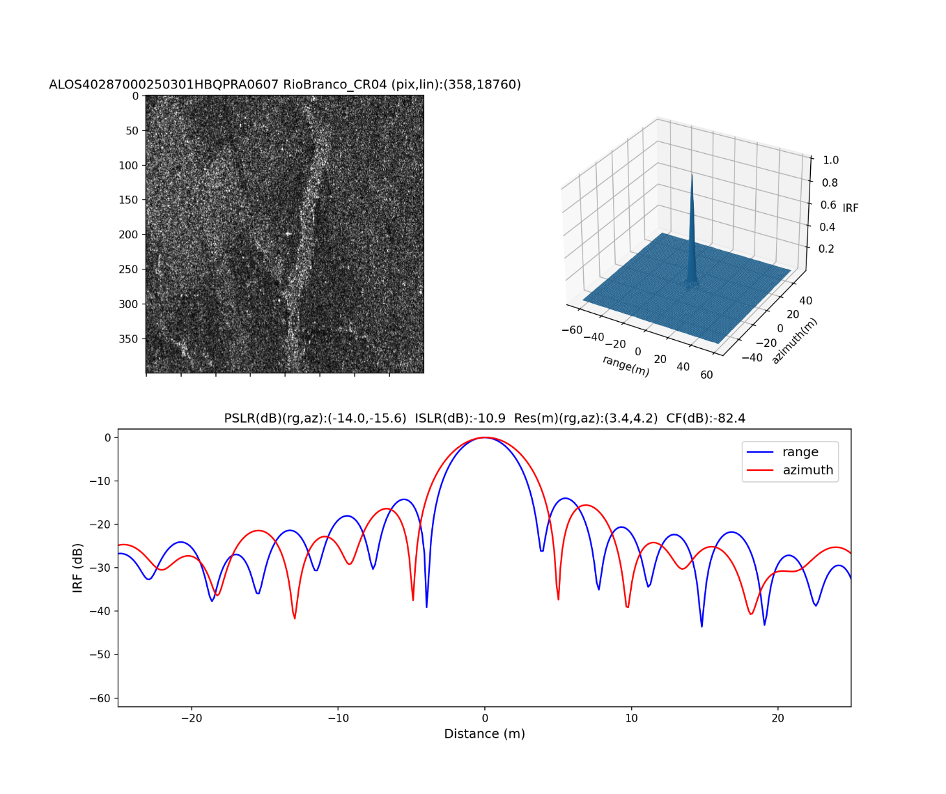
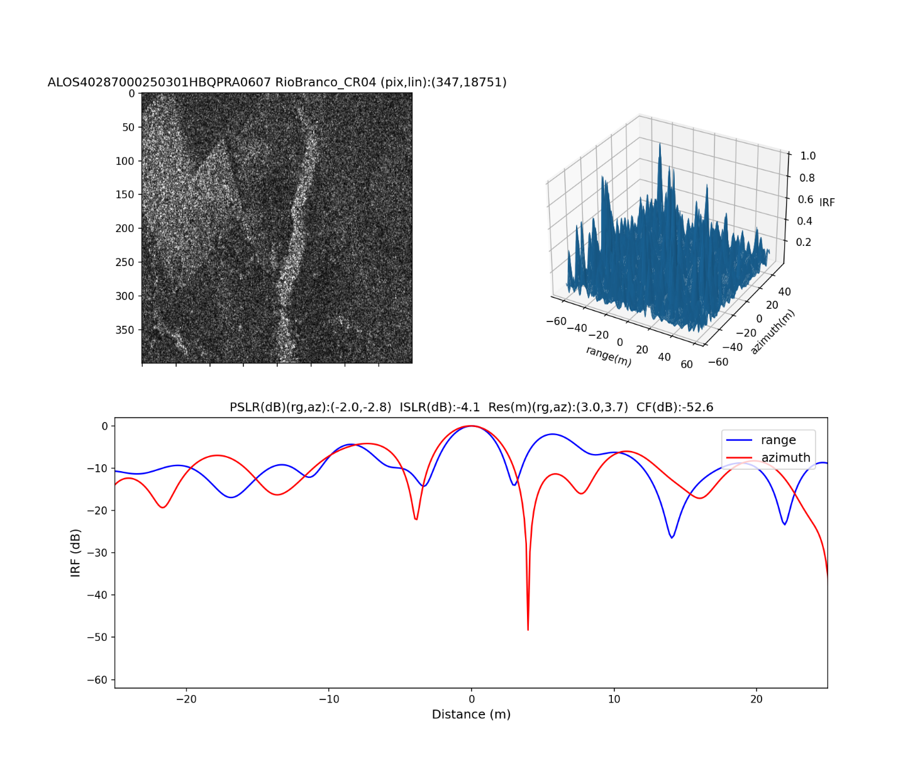
Radiometric Cal by the Point Target
In the case of the CR deployed in the Amazon rainforest, Brazil, the point target is invisible in the HV pol. image after the polarimetric calibration, when the Faraday rotation angle is approximately zero degrees.
ALOS40287000250301HBQPRA0607 (HH pol.)
Faraday rotation angle estimate: approx. zero deg.
ALOS-4 PALSAR-3 HBQ (6 m, quad-pol.) mode
ALOS40287000250301HBQPRA0607 (HV pol.)
Faraday rotation angle estimate: approx. zero deg.
ALOS-4 PALSAR-3 HBQ (6 m, quad-pol.) mode

Slide 9
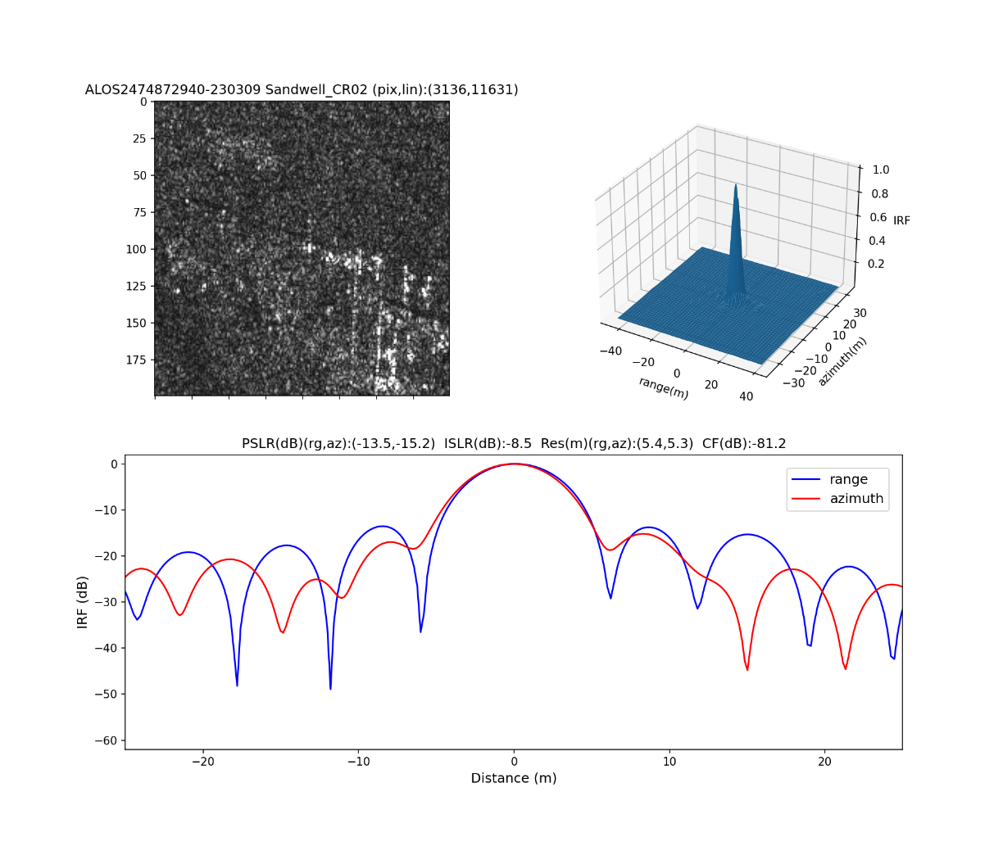
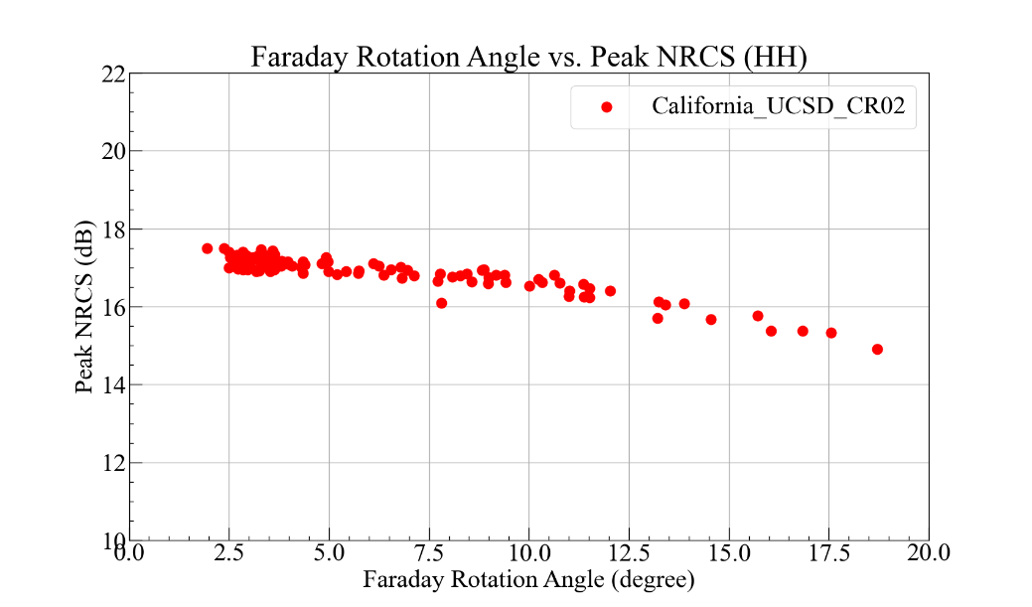
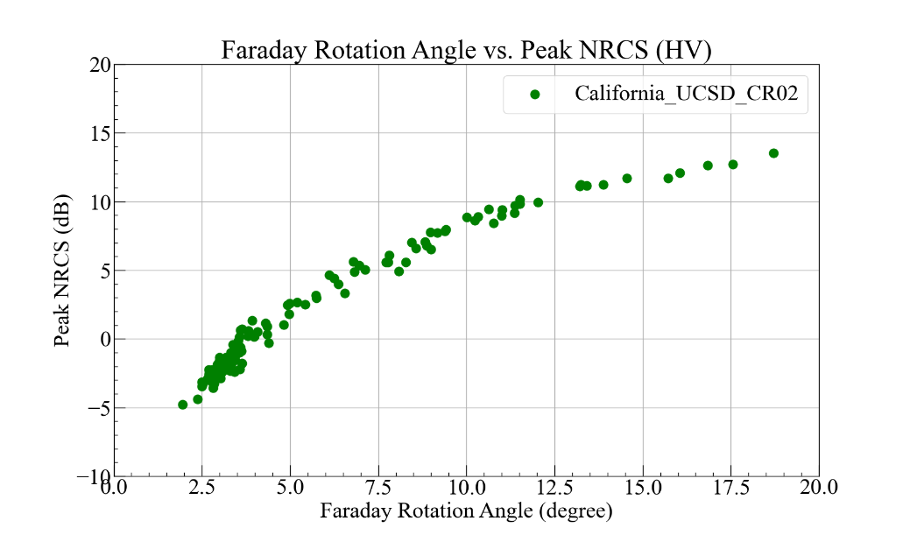
Radiometric Cal by the Point Target
This study compared the peak backscatter intensity from the point target of a trihedral CR with and without the correction using the derived parameters.
The experiment used 120 scenes of the PALSAR-2 dual-pol. data (FBD) over a trihedral CR in California, US.
HH pol.
HV pol.
Example of a point target of a trihedral CR in California
ALOS-2 PALSAR-2 FBD (10m, dual-pol.) mode, HH pol.
RSP165, descending orbit, and right observation
Faraday rotation angle estimate: 19 deg.
Peak backscatter intensity from a trihedral CR in California, US
vs.
Faraday rotation angle.

Slide 10

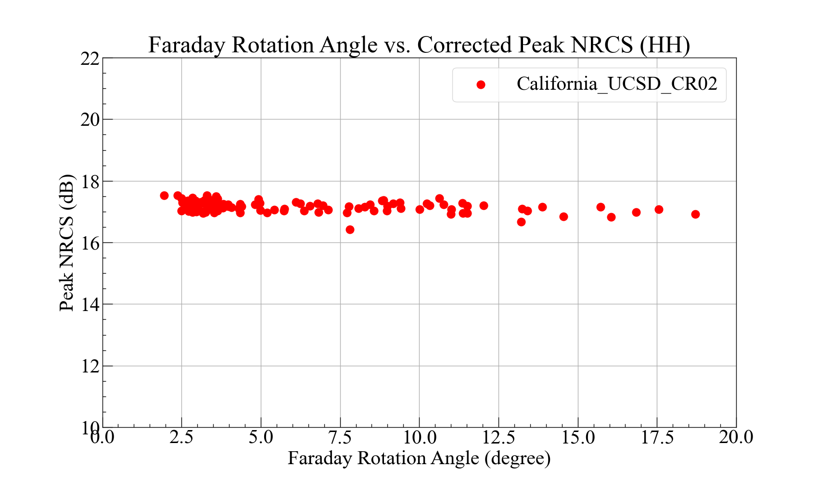
Radiometric Cal by the Point Target
The HH pol. backscatter intensity from the point targets decreases as the Faraday rotation angle increases.
The correction improved the dependence of the backscatter intensity on the Faraday rotation angle.
 | Mean (dB) | S.T.D. (dB) | Range (dB) max-min | Points
Without correction | 16.88 | 0.47 | 2.59 | 120
 | Mean (dB) | S.T.D. (dB) | Range (dB) max-min | Points
With correction | 17.16 | 0.17 | 1.10 | 120
$$\begin{aligned}\begin{aligned}\left\langle M_{hh}M_{hh}^{∗}\right\rangle =\left\langle S_{hh}S_{hh}^{∗}\right\rangle \left(\cos^{4}Ω−2C_{hhvv}\cos{φ_{hhvv}}\sqrt{PR}\sin^{2}Ω\cos^{2}Ω+PR\sin^{4}Ω\right)\end{aligned}\#\left(9a\right)\end{aligned}$$
One scene ALOS2164372940-170608 was excluded for outlier.

Slide 11
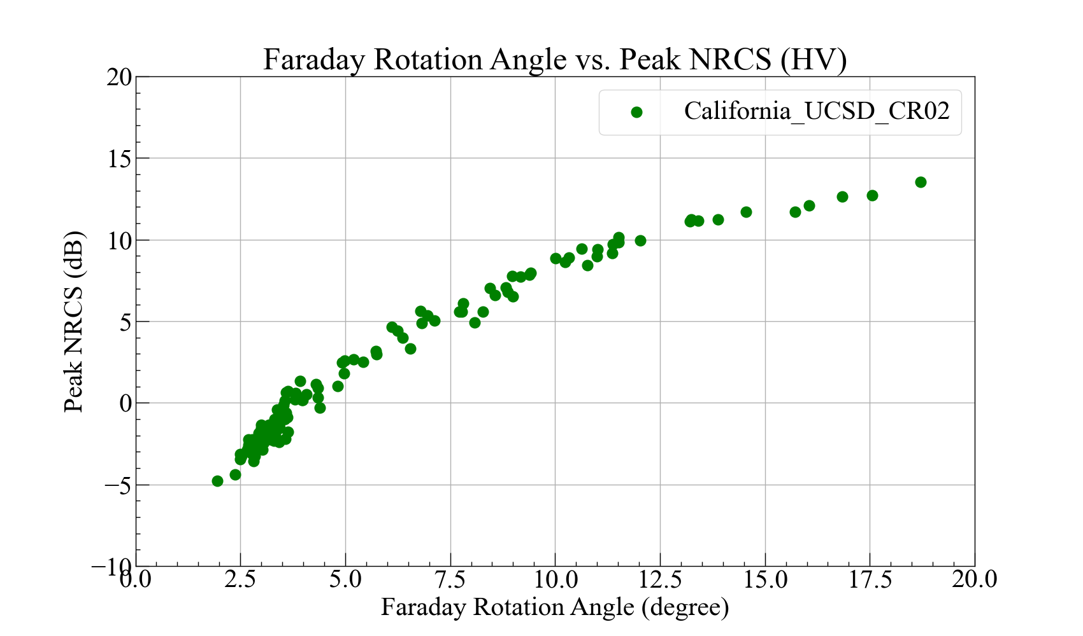
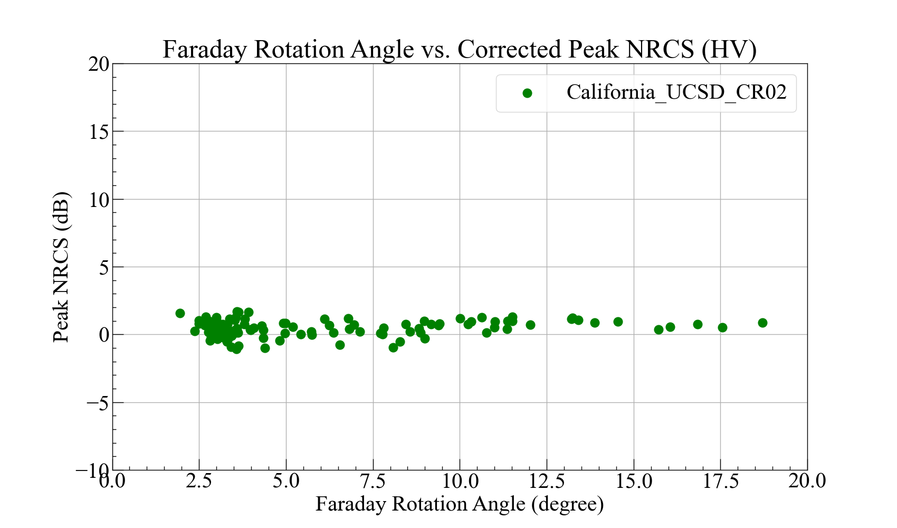
Radiometric Cal by the Point Target
The correction also improved the dependence of the HV pol. backscatter intensity on the Faraday rotation.
The results in a low Faraday rotation condition may be inaccurate because the HV pol. point targets will be invisible.
 | Mean (dB) | S.T.D. (dB) | Range (dB) max-min | Points
Without correction | 2.22 | 5.05 | 18.33 | 120
 | Mean (dB) | S.T.D. (dB) | Range (dB) max-min | Points
With correction | 0.50 | 0.59 | 2.78 | 120
$$\begin{aligned}\begin{aligned}\left\langle M_{hv}M_{hv}^{∗}\right\rangle =\left\langle S_{hv}S_{hv}^{∗}\right\rangle +\left\langle S_{hh}S_{hh}^{∗}\right\rangle \left(1+PR+2C_{hhvv}\cos{φ_{hhvv}}\sqrt{PR}\right)\sin^{2}Ω\cos^{2}Ω\end{aligned}\#\left(9c\right)\end{aligned}$$
One scene ALOS2164372940-170608 was excluded for outlier.
$\left\langle S_{hh}S_{hh}^{∗}\right\rangle$ was set to 17 dB (see, previous slide).

Slide 12
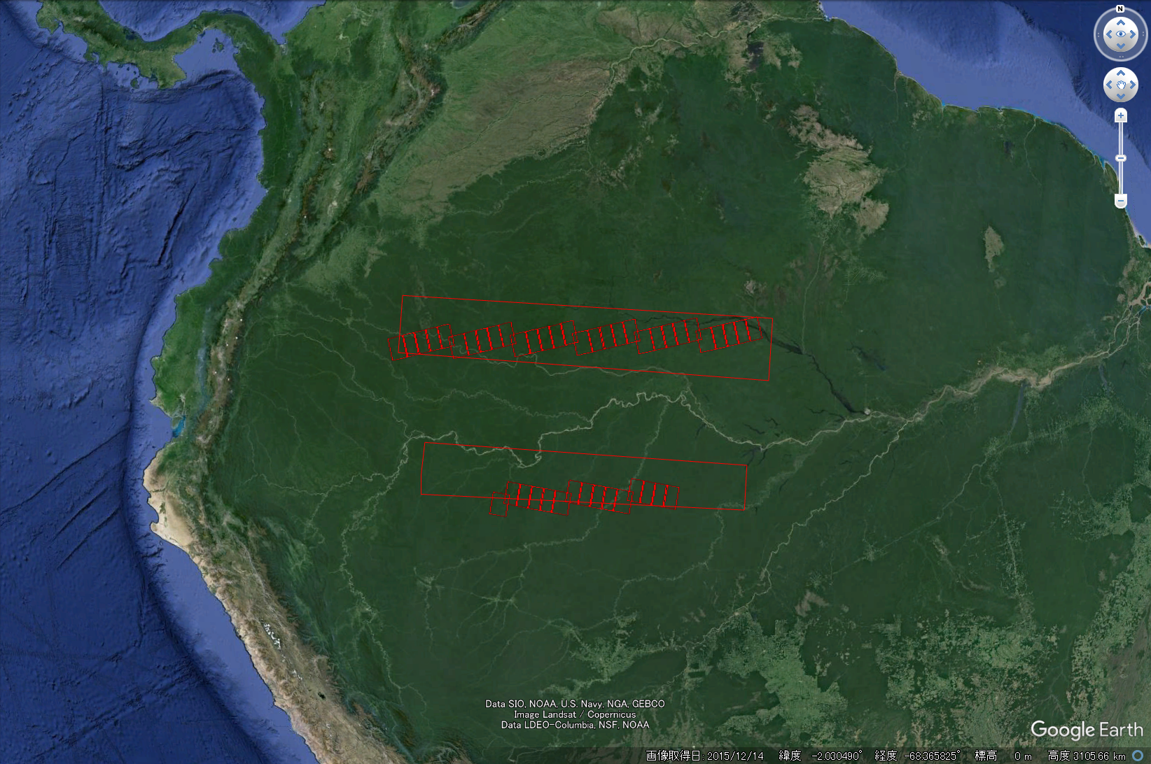
Polarimetric Cal using Tropical Forests
To apply the model to the forest, the polarization ratio and the complex correlation were derived.
The derivation used 41 scenes of the ALOS-2 PALSAR-2 quad-pol. (HBQ) data over the Amazon rainforest.
Scene IDs used in this study
The maximum Faraday rotation angle estimate was 4 degrees in these scenes.
This study excluded outlier scenes:
ALOS2037193720-150130
ALOS2039263720-150213
ALOS2106317170-160512
ALOS2108387170-160526
ALOS2099667170-160328 | ALOS2107797170-160522
ALOS2100107170-160331 | ALOS2107947170-160523
ALOS2100257170-160401 | ALOS2108387170-160526
ALOS2100847170-160405 | ALOS2108537170-160527
ALOS2100997170-160406 | ALOS2109127170-160531
ALOS2101587170-160410 | ALOS2109277170-160601
ALOS2101737170-160411 | ALOS2109867170-160605
ALOS2102177170-160414 | ALOS2035863720-150121
ALOS2102327170-160415 | ALOS2036603720-150126
ALOS2102917170-160419 | ALOS2037193720-150130
ALOS2103067170-160420 | ALOS2037933720-150204
ALOS2103657170-160424 | ALOS2038523720-150208
ALOS2103807170-160425 | ALOS2039263720-150213
ALOS2104247170-160428 | ALOS2060703720-150708
ALOS2104397170-160429 | ALOS2061293720-150712
ALOS2104987170-160503 | ALOS2062033720-150717
ALOS2105137170-160504 | ALOS2077263720-151028
ALOS2105727170-160508 | ALOS2077853720-151101
ALOS2105877170-160509 | ALOS2078593720-151106
ALOS2106317170-160512 | ALOS2079333720-151111
ALOS2106467170-160513 | ALOS2079923720-151115
ALOS2107057170-160517 | ALOS2080663720-151120
ALOS2107207170-160518 | 45 scenes in total
Copyright: Google
Large red outlines represent the antenna pattern sites.
Small red outlines represent the observation scenes.

Slide 13
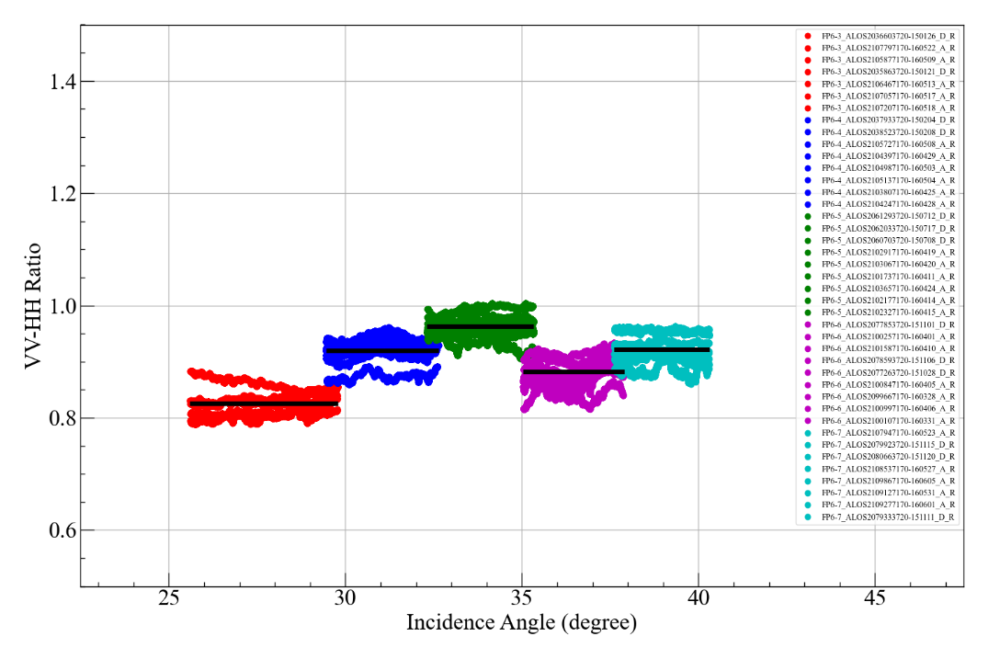
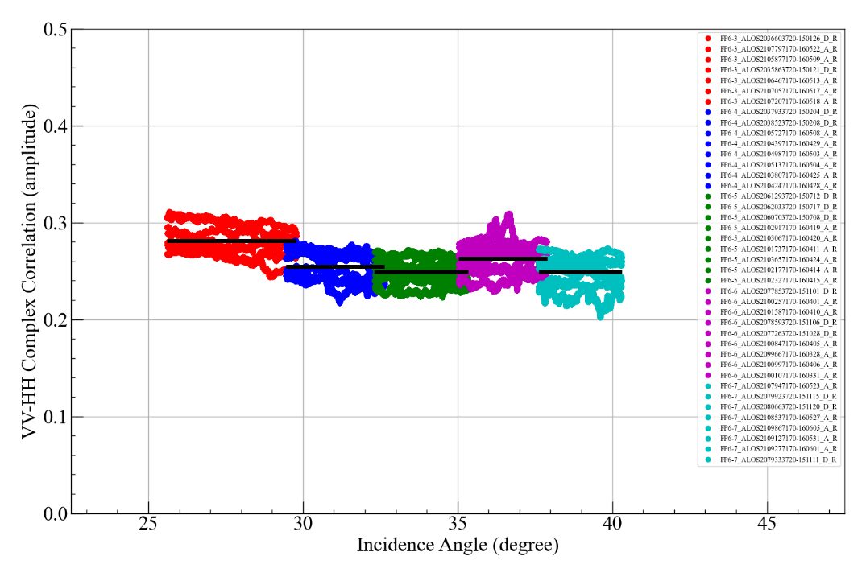
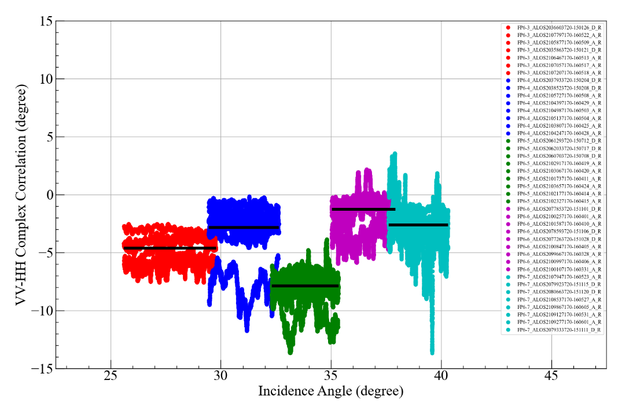

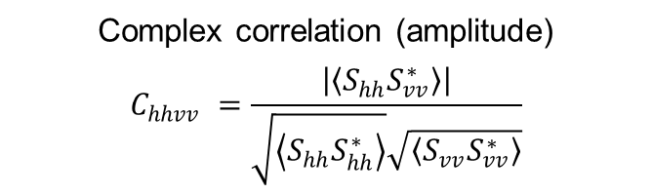
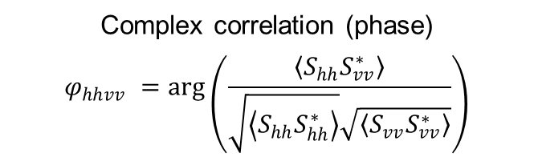
Polarimetric Cal using Tropical Forests
Each beam has different parameters (polarization ratio and complex correlation) depending on the incidence angle.
This study used the mean values of all beams without considering the incidence angle dependency.
Mean value
0.90
Mean value
0.26
Mean value
-3.82
Polarization ratio
$$PR=\frac{\left\langle {S_{vv}S}_{vv}^{∗}\right\rangle }{\left\langle {S_{hh}S}_{hh}^{∗}\right\rangle }$$
Complex correlation (amplitude)
$$C_{hhvv} =\frac{\left|\left\langle {S_{hh}S}_{vv}^{∗}\right\rangle \right|}{\sqrt{\left\langle {S_{hh}S}_{hh}^{∗}\right\rangle }\sqrt{\left\langle {S_{vv}S}_{vv}^{∗}\right\rangle }}$$
Complex correlation (phase)
$$φ_{hhvv} =\arg\left(\frac{\left\langle {S_{hh}S}_{vv}^{∗}\right\rangle }{\sqrt{\left\langle {S_{hh}S}_{hh}^{∗}\right\rangle }\sqrt{\left\langle {S_{vv}S}_{vv}^{∗}\right\rangle }}\right)$$
Mean value
FP6-3: 0.83
FP6-4: 0.92
FP6-5: 0.96
FP6-6: 0.88
FP6-7: 0.92
Mean value
FP6-3: 0.28
FP6-4: 0.25
FP6-5: 0.25
FP6-6: 0.26
FP6-7: 0.25
Mean value
FP6-3: -4.61°
FP6-4: -2.82°
FP6-5: -7.88°
FP6-6: -1.28°
FP6-7: -2.64°

Slide 14
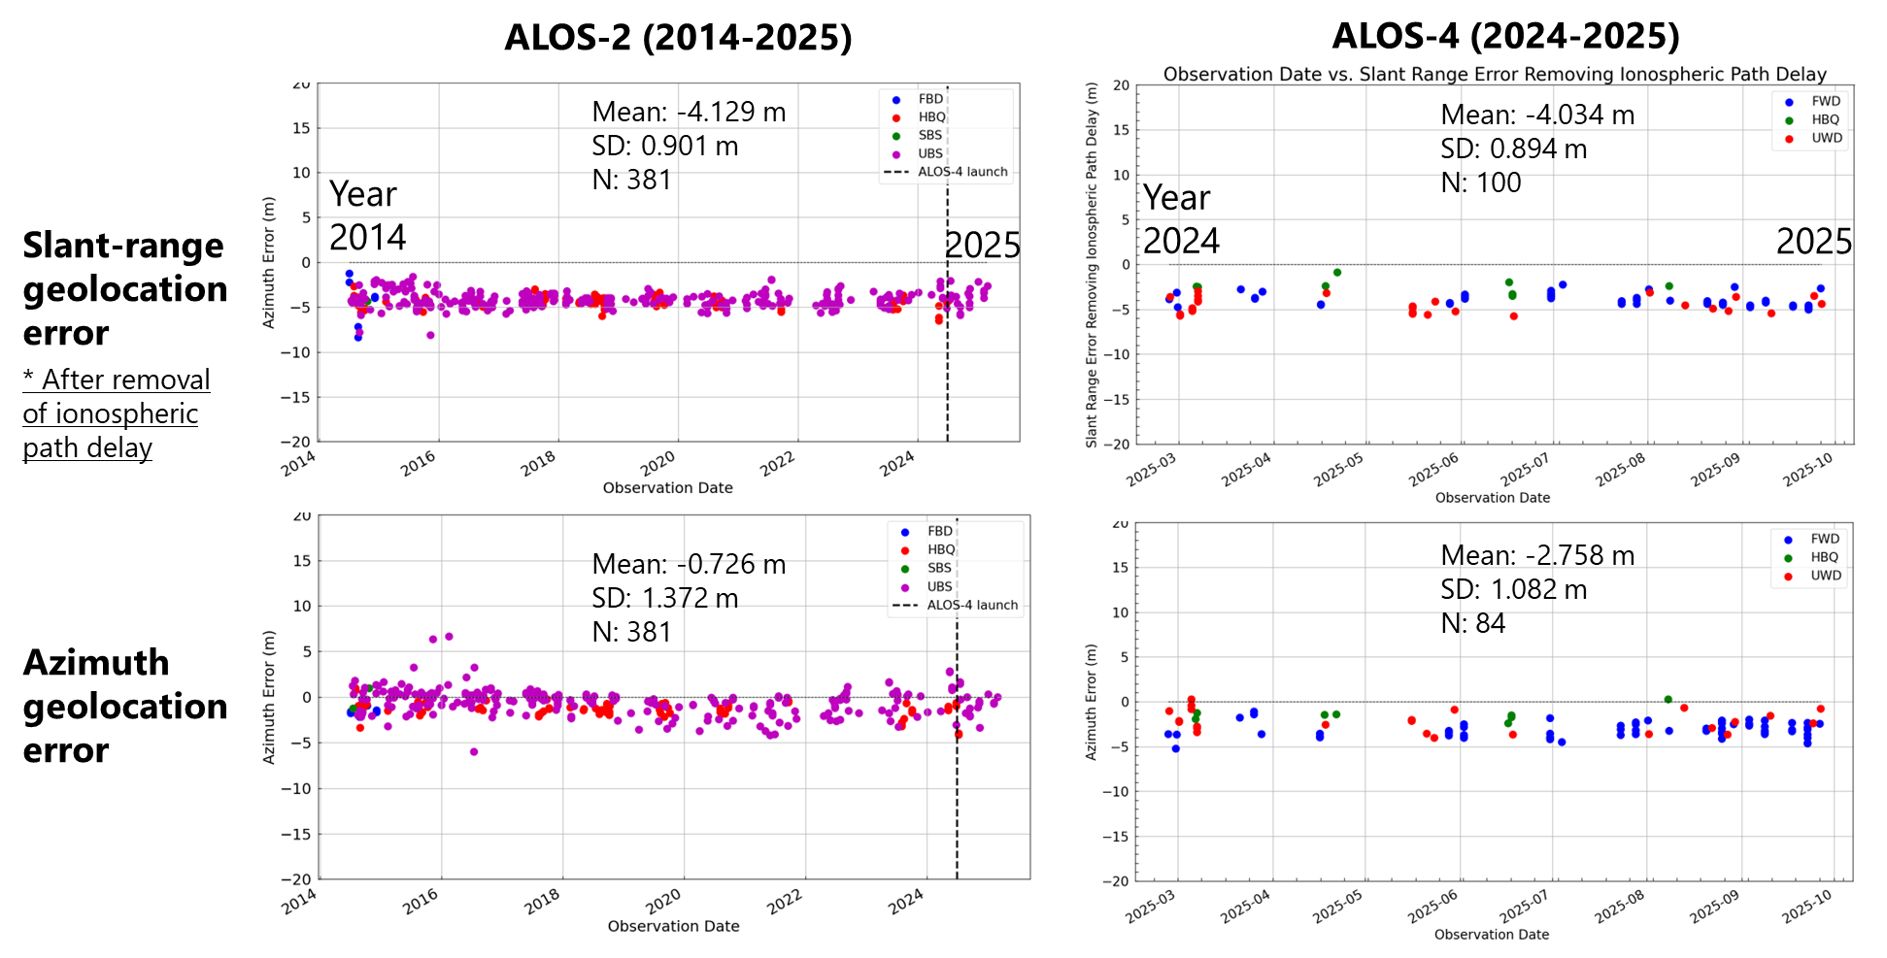
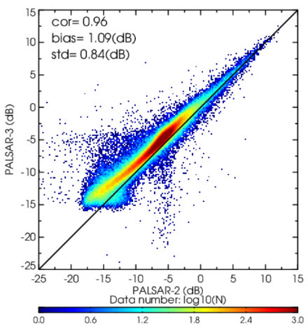
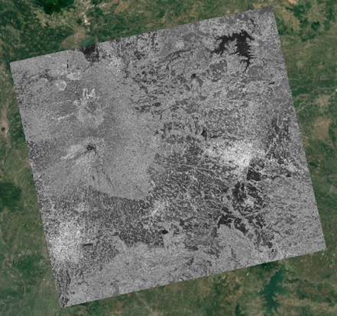
Calibration Consistency between ALOS-2 and ALOS-4
Advanced Land Observing Satellite-4 “DAICHI-4” (ALOS-4) / Phased Array type L-band Synthetic Aperture Radar-3 (PALSAR-3) launched in July 2024 and completed initial calibration and validation operation in March 2025. Data releases began in April 2025.
  After cross calibration between ALOS-2 and ALOS-4, good agreement was confirmed for geometric, radiometric, and polarimetric accuracy.
ALOS-4
ALOS-2
Geometric accuracy
Radiometric (backscatter)
Comparison of ALOS-2 and ALOS-4 products

Slide 15
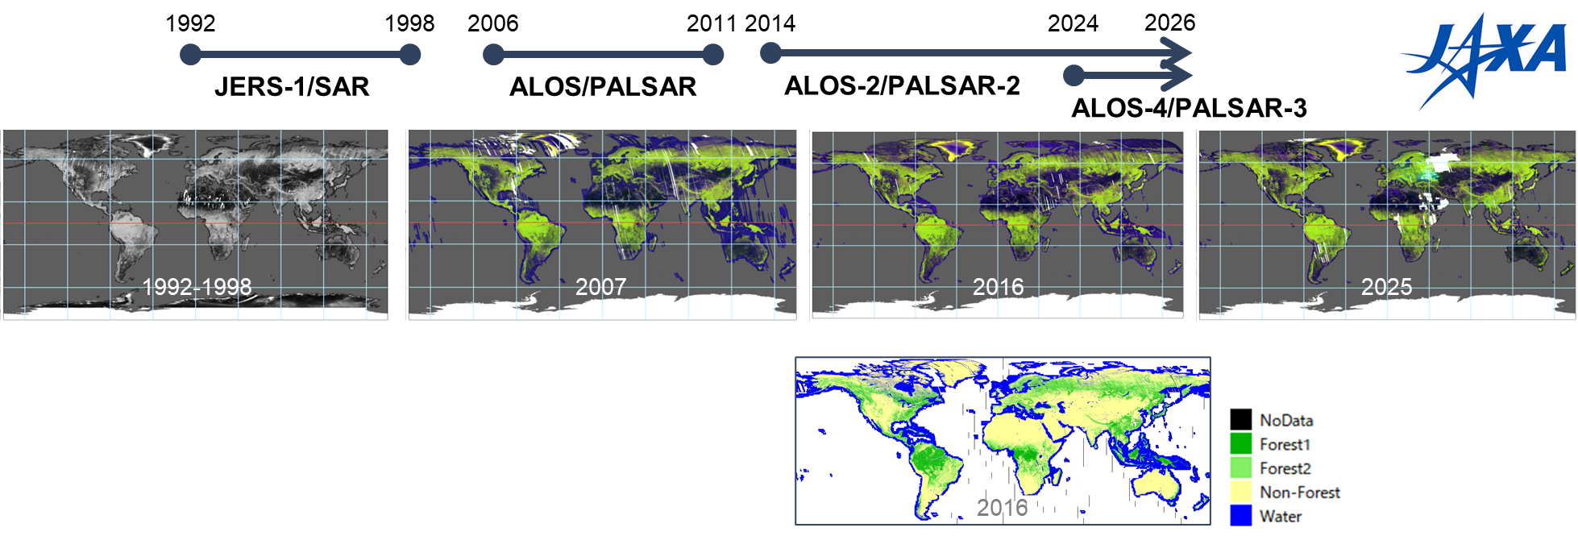
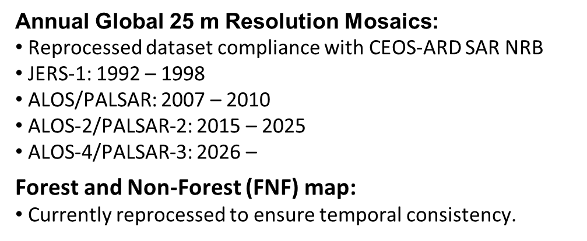
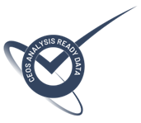

L-band SAR Annual Global Mosaics and Forest/Non-Forest Maps
“For our Global Mangrove Watch (GMW) data workflow where we process thousands of images, the CEOS-ARD standard used for the JERS-1/ALOS/ALOS-2 SAR data from JAXA has simplified our processing chains with data now provided as GeoTIFFs and with standardised metadata. The specified pre-processing, including geometric rectification and radiometric terrain correction, has also been a significant help and reduced our internal data processing effort.”
Dr Pete Bunting,
Global Mangrove Watch Product Lead,
Aberystwyth University, UK

Slide 16
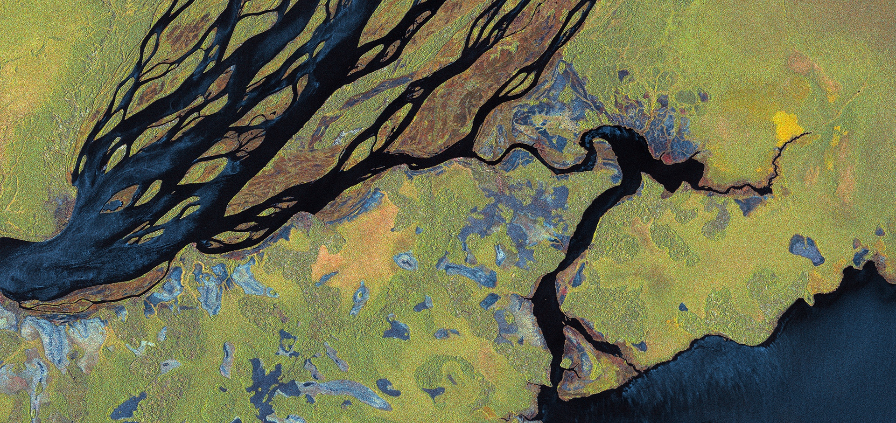
Thanks for your attention.
Any questions or comments?
Polarimetric backscatter
ALOS-2 © JAXA
16

