Slide 1


GSCN TOA Reflectance Comparison to Sentinel-2 and Landsat-8/9
RadCalNet ACTION5
2nd February 2026
Ashley Ramsay, Morven Sinclair, Agnieszka Bialek

Slide 2
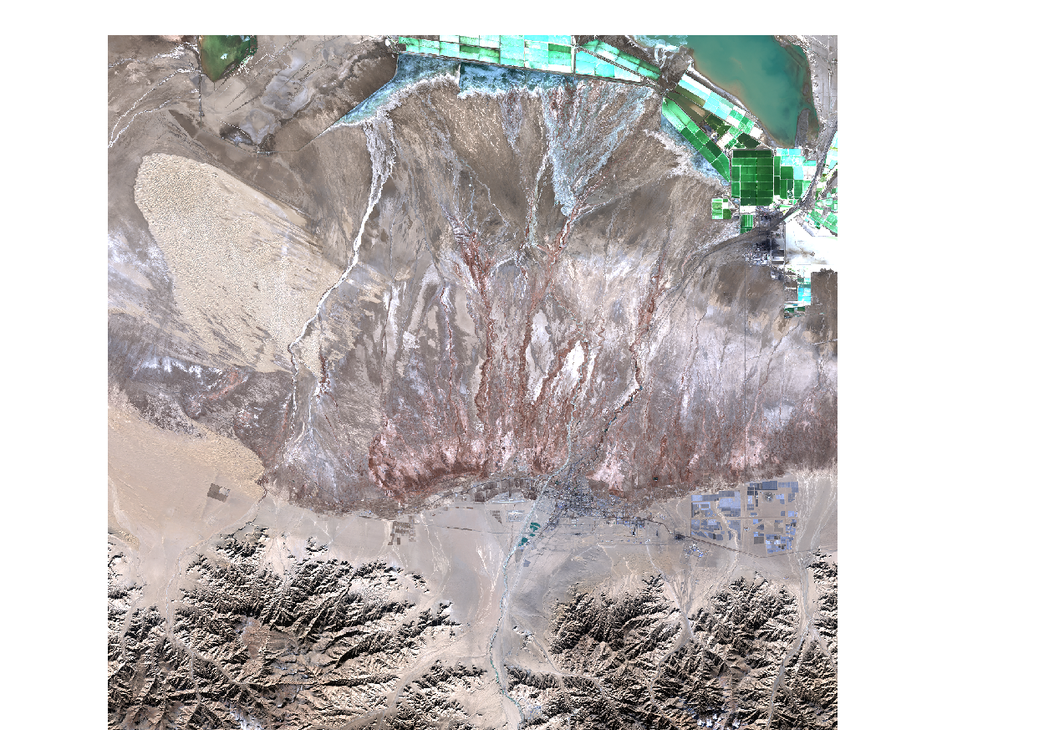
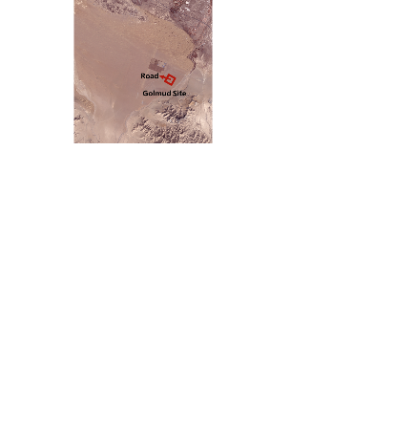
GSCN site description
Site Code: | GSCN
Site Name: | Golmud Gobi site
Site centre location: | Lat: 36.3977 E Lon: 94.3286 N
Site official extent: | 1000 × 1000 m² See also site description document for information about homogeneity of site and surroundings
Altitude: | 2824 m
Site local time zone: | GMT+8
Provided wavelength range: | CR (Colorimetry Research) series spectroradiometers - 380 nm to 1080 nm, with a spectral resolution of 2 nm.
Site owner/operator | Aerospace Information Research Institute, Chinese Academy of Science (Lingling Ma)
Sentinel-2 tile (ref=46SFF) used in matchups

Slide 3
Comparison Overview S2A / S2B
TOA reflectance interpolated to 0.1nm and convolved to S2A and S2B SRF
S2 TOA reflectance averaged over region of interest for each site
S2 L1C data screened for cloud and invalid pixels
Further screening on statistical analysis of pixels over each ROI (mean, std deviation, skew, kurtosis)
Bias between S2 TOA and RCN TOA calculated
Fixed bug causing S2-data to not be unzipped correctly (affected 2025 images)

Slide 4
Comparison Overview Landsat-8/9
TOA reflectance interpolated to 0.1nm and convolved to LC08 and LC09 SRF
LC08 and LC09 TOA reflectance averaged over region of interest for each site
Screening using statistical analysis of pixels over each ROI (mean, std deviation)
Bias between LC08/LC09 TOA and RCN TOA calculated
GHNA specific L8 extractions are now available

Slide 5
Comparison Results
RadCalNet Site | First Available Product | Matchups (B4) (S2A/S2B) Dec 2025 | Latest RadCalNet data version used
GSCN | 20/07/2023 | 9/11 | v04.05
161 Days of data are available from the 20th of July 2023 until 30th November 2025.
13 days worth of data was removed due to > 60% cloud coverage of the Sentinel-2 tile.
RadCalNet Site | First Available Product | Matchups (B4) (L8+L9) Dec 2025 | Latest RadCalNet data version used
GSCN | 20/07/2023 | 17 | v04.05
3 outliers were manually removed 1 and 2 for S2A and S2B respectively. These are being investigated further.
Percentage of GSCN ‘non-cloudy’ data which resulted in valid matchups:
Landsat 11.49%
S2A 6.76%
S2B 8.78%
For 148 total ‘non-cloudy’ days

Slide 6
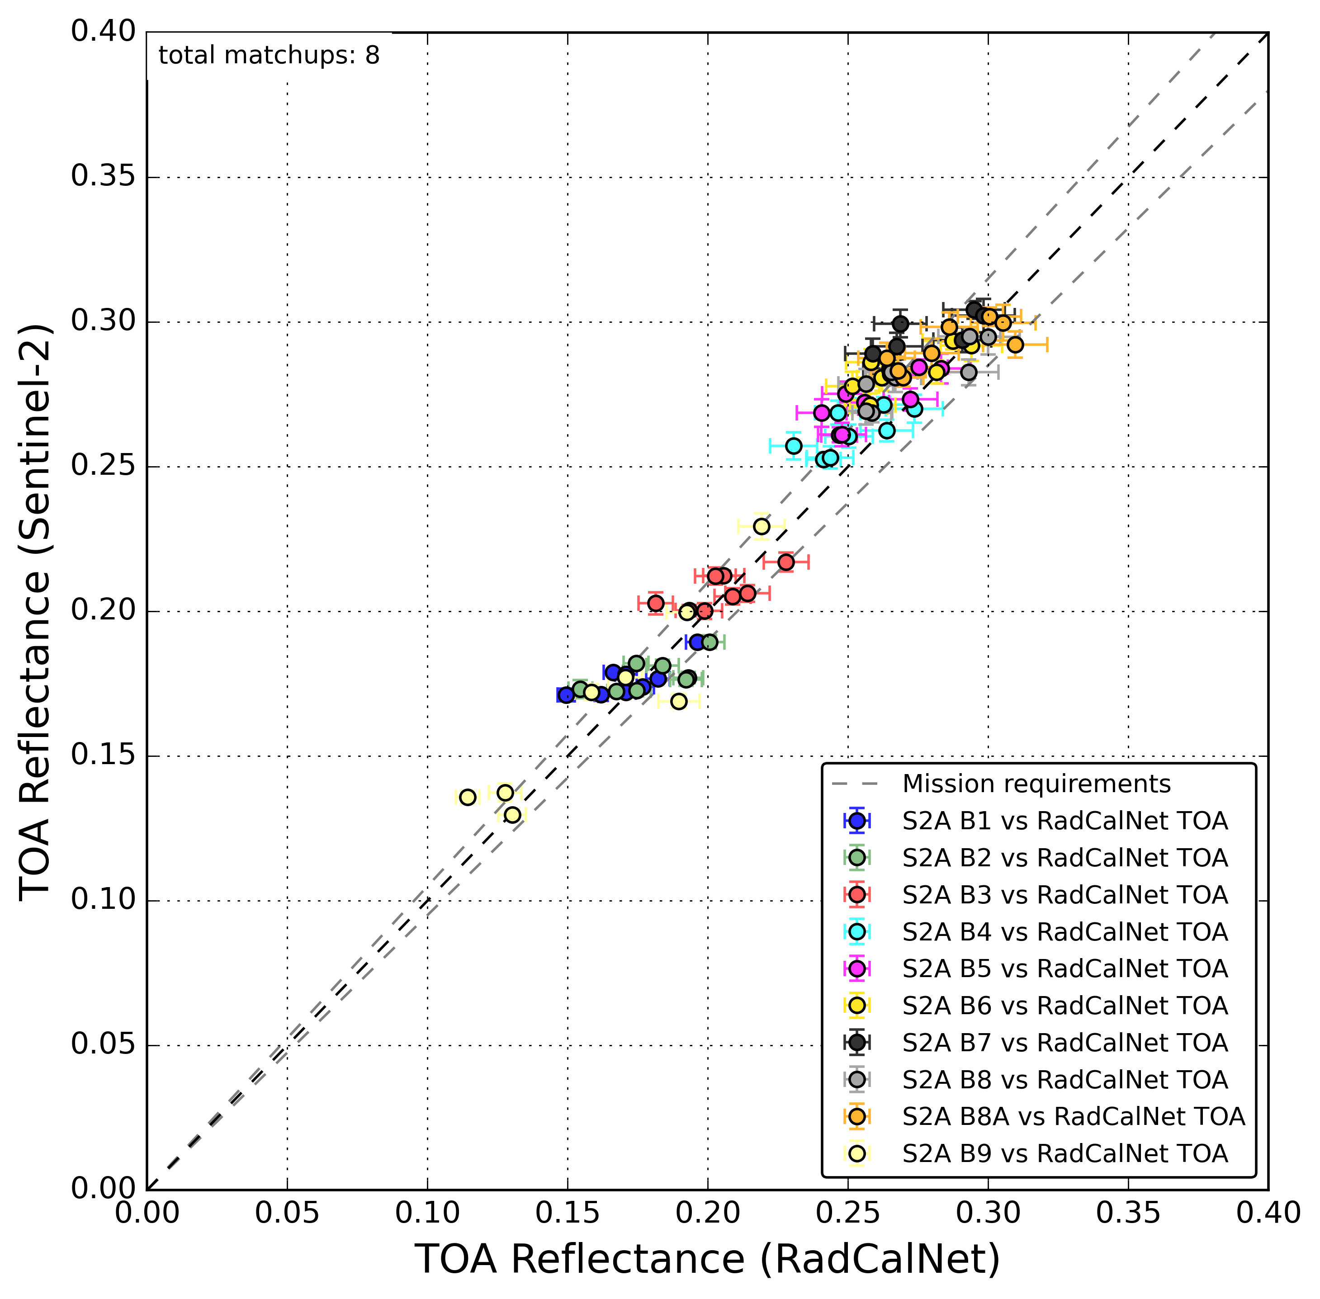
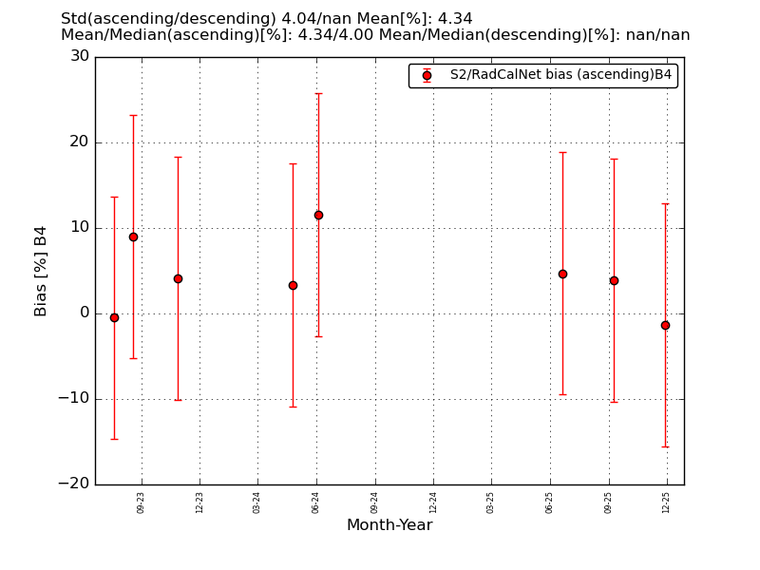
GSCN matchups with S2A
Error bars represent the reported RadCalNet uncertainties combined with estimated S2A uncertainties (right plot).

Slide 7
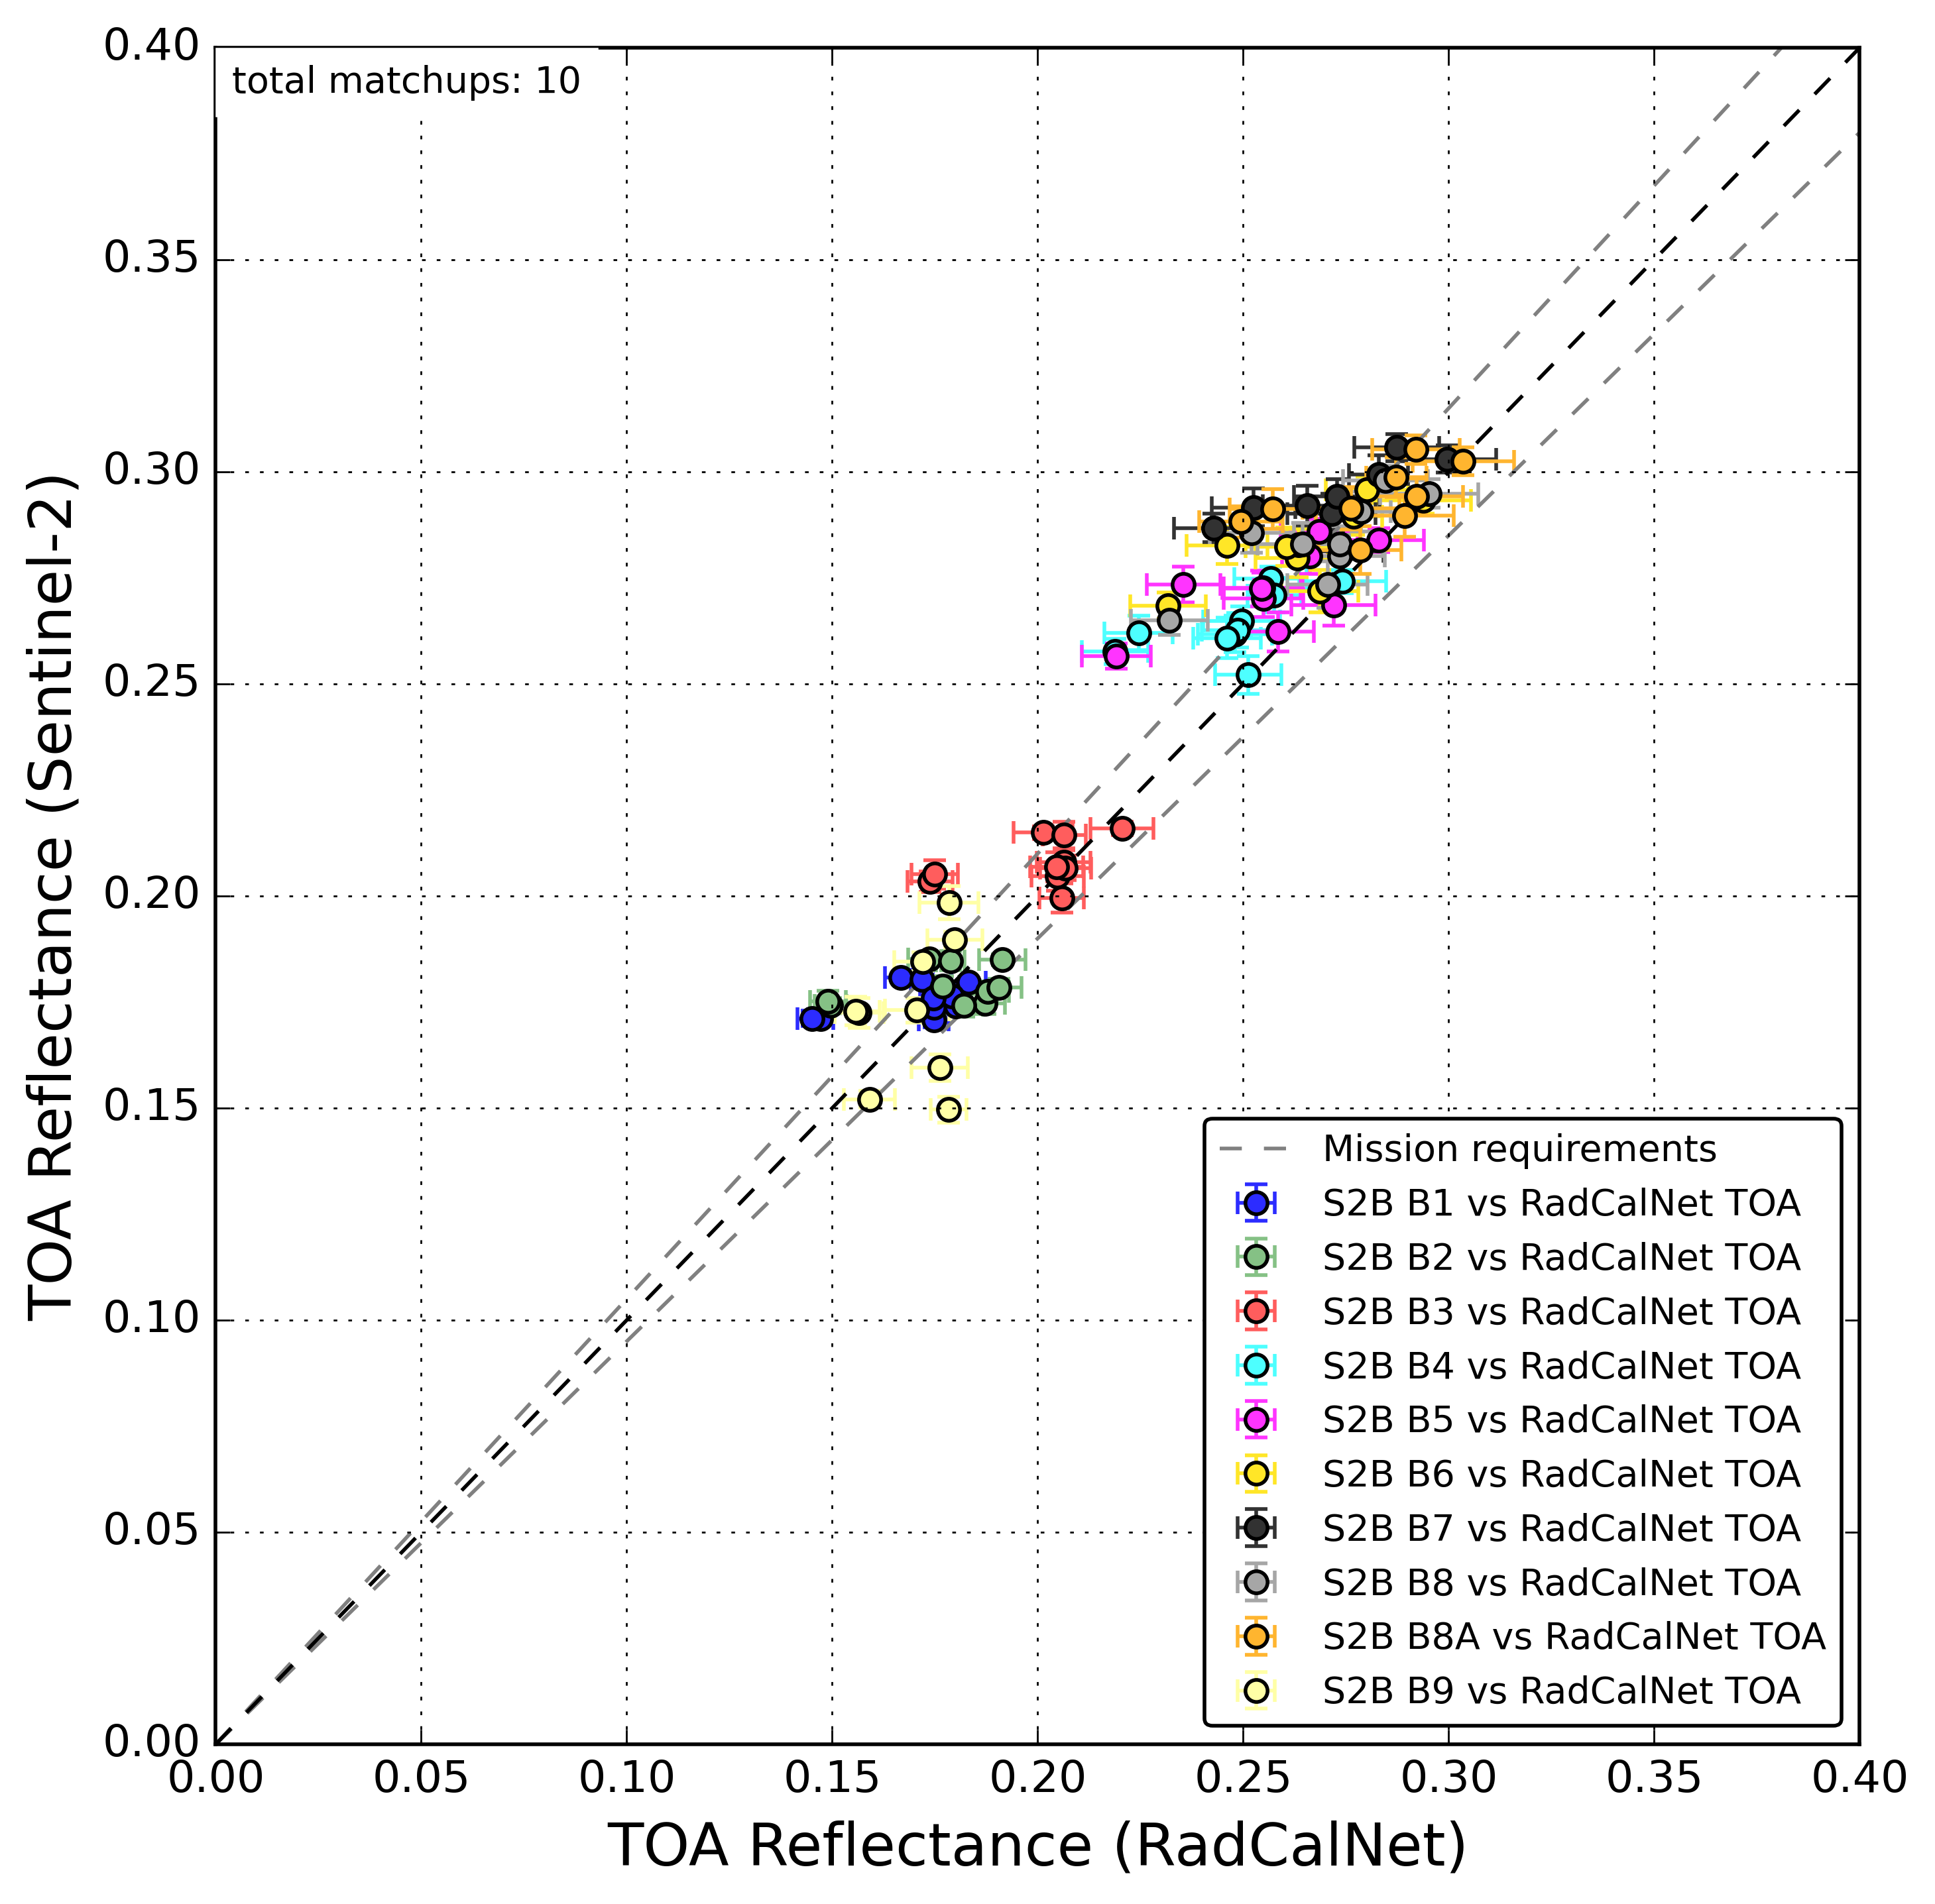
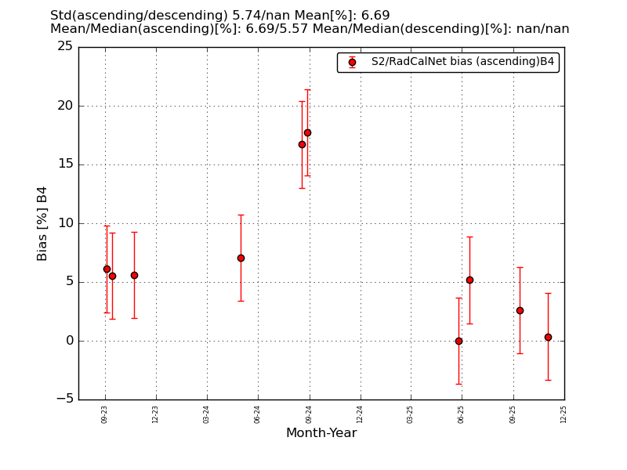
GSCN matchups with S2B
Error bars represent the reported RadCalNet uncertainties combined with estimated S2B uncertainties (right plot).

Slide 8
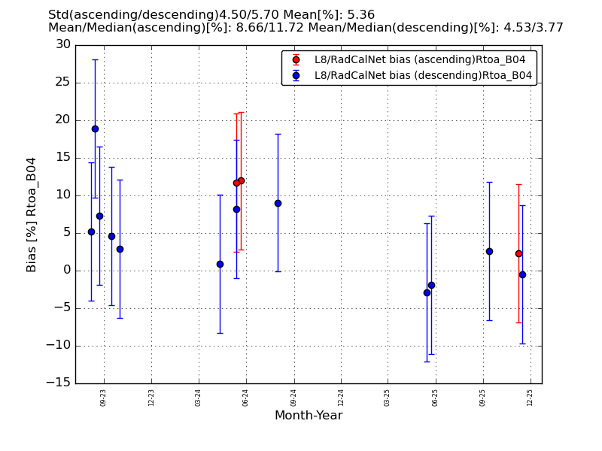
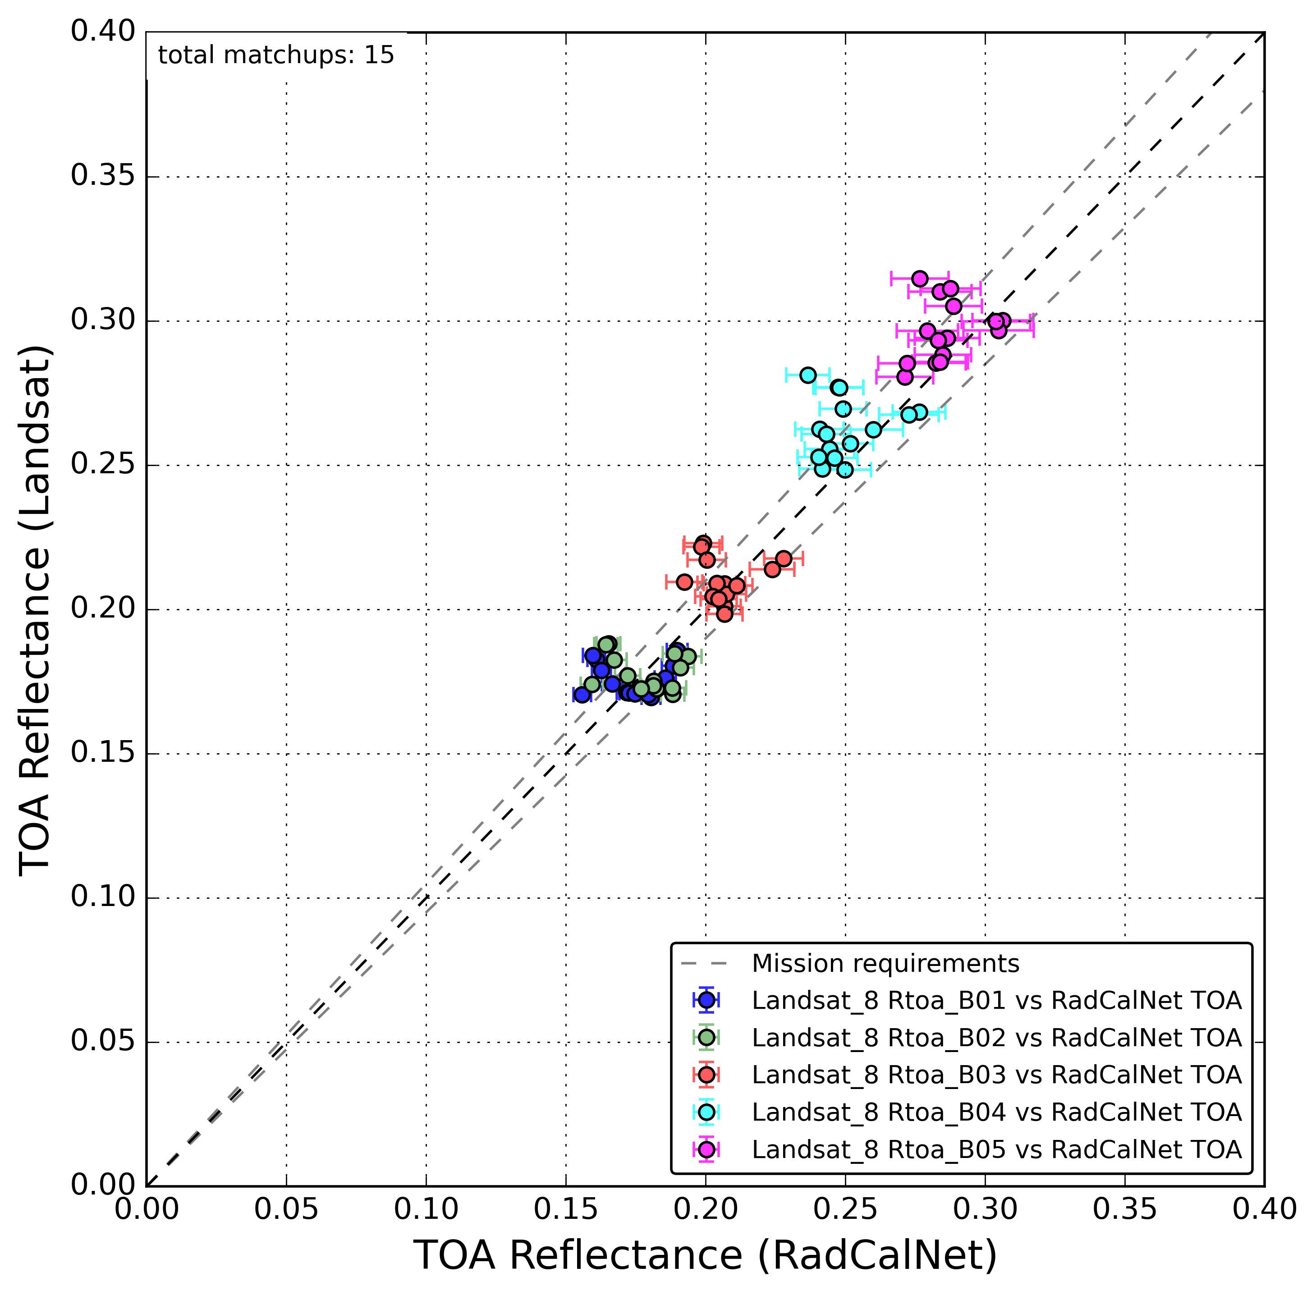
GSCN matchups with Landsat
Error bars represent the reported RadCalNet uncertainties combined with standard deviation within the Landsat ROI (right plot).

