Slide 1







TIRCalNet: Towards a Global Network for Thermal Infrared Calibration
Steffen Dransfeld², Morgane Chapelier¹, Sébastien Marcq¹, Emilie Delogu¹, Arthur Dick¹, Aimé Meygret¹, Simon J. Hook³, Jasdeep S. Anand⁴,
Darren Ghent⁴, Frank Göttsche⁵, Dave Smith⁶
¹ CNES, ² ESA, ³ JPL, ⁴ UoL, ⁵ KIT, ⁶ RAL

Slide 2
TIRCalNet context
Many TIR missions
OPERATIONAL MISSIONS
ECOSTRESS, ASTER, TIRS/TIRS-2, MODIS, VIIRS, SLSTR, SEVIRI, AVHRR, FCI…
FUTURE HI-RES MISSIONS
TRISHNA, LSTM, SBG, …
NEW SPACE MISSIONS
Need
Vicarious calibration and validation of on-board reference sources (black bodies) and sensors
L2
Products (temperature & emissivity) validation
L1
More and more demanding LST accuracy requirements better than 0.1 K for climate studies
CEOS has identified the lack of a thermal calibration network and wants to address this as a high priority. The activity is followed by the CEOS/WGCV/IVOS subgroup with the support of CEOS/WGCV/LPV.
TIRCalNet: Towards a Global Network for Thermal Infrared Calibration

Slide 3
TIRCalNet objectives
To collect surface temperature and emissivity, and atmospheric data necessary for the simulation of observations by TIR optical sensors and thus verify their radiometric calibration
To increase the number of matchups between in-situ measurements and space sensor observations and reduce the overall uncertainties, and reduce the efforts of individual agencies
To ensure traceability of the space sensor radiometry to the “Système International” (SI)
To support the establishment of the Global Earth Observation System of Systems by providing measurements to verify the radiometric consistency between EO space sensors
To transpose to TIR the success and experience return from RadCalNet network dedicated to VNIR-SWIR optical sensors cal/val
TIRCalNet: Towards a Global Network for Thermal Infrared Calibration

Slide 4
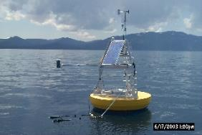
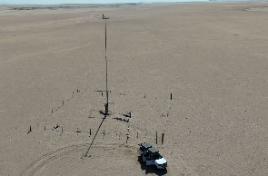
Existing TIR instrumented sites
Existing sites for LST validation (JPL, KIT, GCU, SURFRAD…)
Current limitations of LST sites:
Lack of emissivity measurements
Data access
Data harmonization
Do not provide TOA radiances
Data quality assurance (error budget traceable to SI)
In situ instruments calibration quality and traceability
Needs for the development of denser ground-based reference Network
Lake Tahoe JPL-NASA
Gobabeb KIT
TIRCalNet: Towards a Global Network for Thermal Infrared Calibration

Slide 5
TIRCalNet Working group preparation activities
ESA and CNES defined after discussions with domain and agency experts that TIRCALNet should be able to provide TOA Brightness Temperature signals propagated from BOA measurements of ~0.5K uncertainty.
1
3
5
Identification of uncertainty contributors to TOA-derived BT
Definition of site characteristics, instrumentation and forward propagation scheme
Interaction with Working Groups and network roadmap
2
4
Sensitivity analysis of uncertainties on TOA BT estimation
Selection of potential candidate sites
CNES uncertainty budget and instrumentation tests in La Crau
ESA and UoL consolidation of main contributors and application to Lake Tahoe, Salton Sea and La Crau
Discussions, feedback and data sharing from NASA, KIT, RAL, UoL, ESA, CNES, CSIRO, …
TIRCalNet: Towards a Global Network for Thermal Infrared Calibration

Slide 6







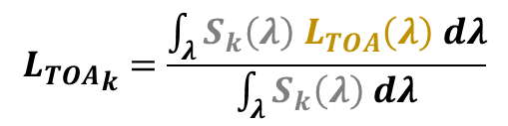



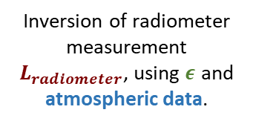


Emissivity-method-based preliminary model – CNES
$${L_{TOA}}_{k}=\frac{\int_{λ}{S_{k}\left(λ\right) L_{TOA}\left(λ\right) dλ}}{\int_{λ}{S_{k}\left(λ\right) dλ}}$$
with
$$L_{TOA}\left(λ\right)=L_{atm}^{↑}+τ^{↑} \left( ε L_{BB}\left(T_{S}\right)+\left(1 −ε\right) L_{atm}^{↓} \right)$$
$$S_{k}\left(λ\right)$$
Atmospheric profiles + RT (Modtran, RTTOV, …)
Emissivity spectrum
(in situ measurement)
Inversion of radiometer measurement $L_{radiometer}$, using $ε$ and atmospheric data.
$$S_{radiometer}$$
TIRCALNET
$$L_{atm}^{↑}\left(λ\right) \\ τ^{↑}\left(λ\right)$$
Radiometer pre-processing
$${L_{radiometer}}_{ }$$
$$T_{s}$$
$$L_{atm}^{↓}\left(λ\right)$$
Emissivity method
$$L_{radiometer}$$
$$L_{TOA}\left(λ\right)$$
$$ε$$
$L_{atm}^{↑},$ $L_{atm}^{↓}, τ^{↑}$
$T_{s}$ , $ε\left(λ\right)$
TIRCalNet: Towards a Global Network for Thermal Infrared Calibration
Notes:
Slide with animations
TIRCalNet will provide TOA radiance with a fine spectral resolution so it can be used for a large variety of spaceborne instruments with variatious thermal spectral bands. The convolution with the instrument spectral response is the user’s responsibility.

Slide 7
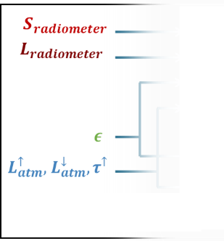
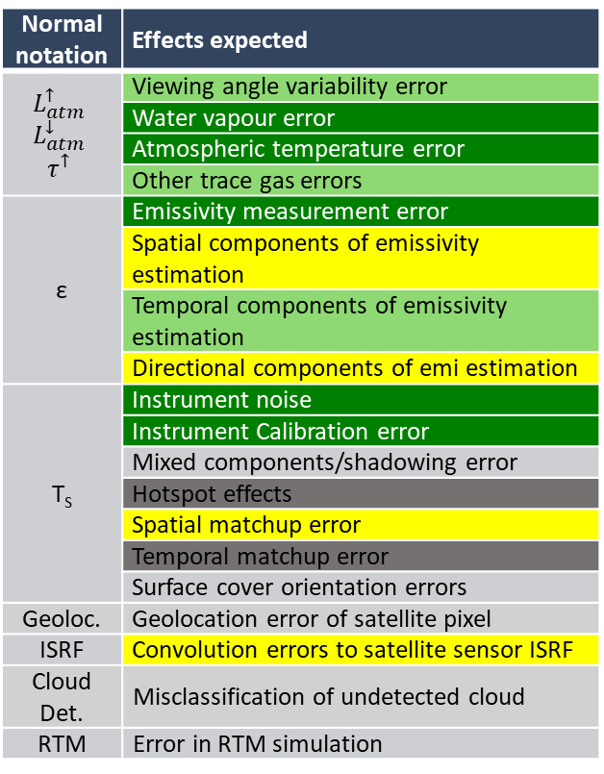
Identification of main uncertainty sources – ESA
Normal notation | Effects expected
$$L_{atm}^{↑}$$ $$L_{atm}^{↓}$$ $$τ^{↑}$$ | Viewing angle variability error
 | Water vapour error
 | Atmospheric temperature error
 | Other trace gas errors
ε | Emissivity measurement error
 | Spatial components of emissivity estimation
 | Temporal components of emissivity estimation
 | Directional components of emi estimation
T_{S} | Instrument noise
 | Instrument Calibration error
 | Mixed components/shadowing error
 | Hotspot effects
 | Spatial matchup error
 | Temporal matchup error
 | Surface cover orientation errors
Geoloc. | Geolocation error of satellite pixel
ISRF | Convolution errors to satellite sensor ISRF
Cloud Det. | Misclassification of undetected cloud
RTM | Error in RTM simulation
Dark Green: taken into account in CNES study (considered as main contributors).
Light Green: partially taken into account.
Yellow: work in progress.
Dark grey: not applicable to La Crau site.
1st quantification of uncertainty sources – CNES
Global radiometer uncertainty ~0.1K
Emissivity uncertainty
Over land : 0.02 on each value, 0.01 on mean value
Over water : 0.015 on each value, 0.01 on mean value
On La Crau : seasonality with NDVI and JPL measurement of soil/rock/vegetation samples
Atmospheric uncertainties
On each of 37 pressure levels :
WV : 10%
O3 : 20%
T : 0.8K
Jasdeep S. Anand, Darren Ghent (UoL)
TIRCalNet: Towards a Global Network for Thermal Infrared Calibration
Notes:
Slide with animations
Choice 0.8K
Barsi, J.A.; Barker, J.L.; Schott, J.R. An atmospheric correction parameter calculator for a single thermal band earth-sensing instrument. In Proceedings of the IGARSS 2003. 2003 IEEE International Geoscience and Remote Sensing Symposium. Proceedings (IEEE Cat. No.03CH37477), Toulouse, France, 21–25 July 2003; pp. 3014–3016.
Choice 10% 20%
Palluconi, F.; Hoover, G.; Alley, R.; Jentoft-Nilsen, M.; Thompson, T. An Atmospheric Correction Method for ASTER Thermal Radiometry Over Land, Algorithm Theoretical Basis Document. 1999. Available online: https://lpdaac.usgs.gov/documents/11 53/AST_09T_User_Guide_V4.pdf (accessed on 1 June 2022)
+ verification of order of magnitude with a few ERA5 and Ensemble Members profiles that give an uncertainty estimate with a 10-profile set.
Emissivity uncertainty
Over Land
Göttsche, F. M., Olesen, F., Poutier, L., Langlois, S., Wimmer, W., Santos, V. G., ... & Monchau, J. P. (2018). Report from the field inter-comparison experiment (FICE) for land surface temperature. Identity, 9, 0929b3d2a06f1e6010.
Over water (taking into account outliers)
Langsdale, M.; Wooster, M.; Harrison, J.; Koehl, M.; Hecker, C.; Hook, S.; Abbott, E.; Johnson, W.; Maturilli, A.; Poutier, L.; Lau, I.; Brucker, F. Spectral Emissivity (SE) Measurement Uncertainties across 2.5–14 Μm Derived from a Round-Robin Study Made across International Laboratories. Remote Sensing 2020, 13 (1), 102. https://doi.org/10.3390/rs13010102.
Radiometer uncertainty
Hook, S. J.; Vaughan, R. G.; Tonooka, H.; Schladow, S. G. Absolute Radiometric In-Flight Validation of Mid Infrared and Thermal Infrared Data From ASTER and MODIS on the Terra Spacecraft Using the Lake Tahoe, CA/NV, USA, Automated Validation Site. IEEE Trans. Geosci. Remote Sensing 2007, 45 (6), 1798–1807. https://doi.org/10.1109/TGRS.2007.894564.

Slide 8
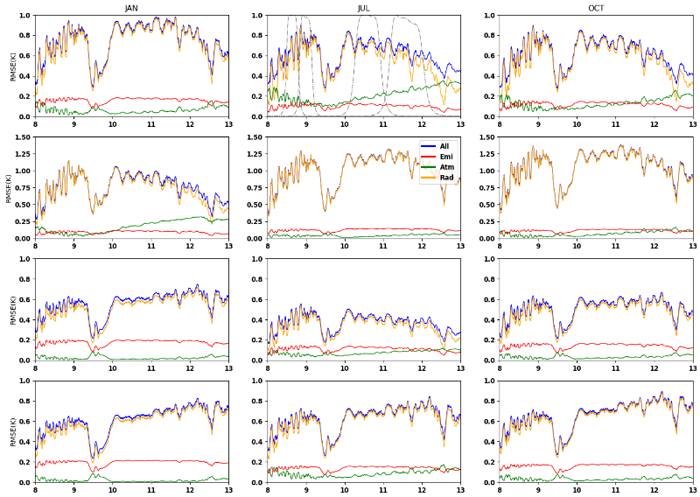
Results : uncertainty budget – CNES
La Crau
(CNES)
Preliminary results:
With considered sources, the emissivity uncertainties drive the overall TOA uncertainty.
Therefore, TOA uncertainty is lower for wetter atmospheres.
Questions raised:
Emissivity uncertainty value for water sites ?
Representativity of atmospheric uncertainties ?
Gobabeb
(KIT)
Lake Constance
(KIT)
Lake Tahoe
(NASA/JPL)
Paolo Dandini, CS group for CNES
TIRCalNet: Towards a Global Network for Thermal Infrared Calibration

Slide 9
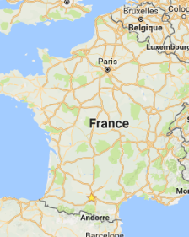
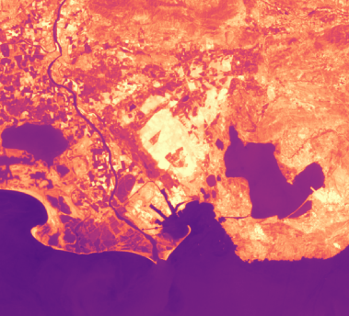
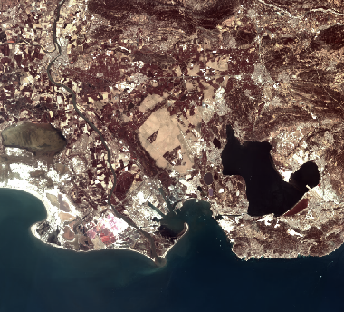
La Crau pilot site for TIRCalNet –CNES
La Crau site (CNES)
(TOA BT ~315K)
High spatial homogeneity
Few clouds
Accessible
RadCalNet mast 30m away from the TIR mast
Landsat 9 2025/08/08
TIRCalNet: Towards a Global Network for Thermal Infrared Calibration

Slide 10
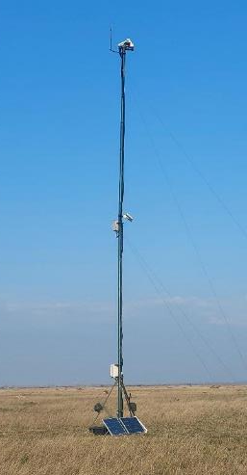
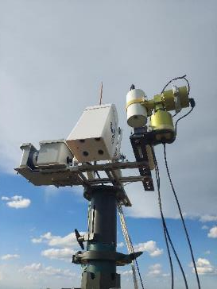
La Crau instrumentation – CNES, JPL
TIR instrumentation on the mast
JPL Radiometer - provided by NASA/JPL
First installation in December 2022
Broadband, very high radiometric accuracy
HEITRONICS KT15.99
Installation in March 2025
“TRISHNA-like” filters (8.65, 9, 10.6, 11.3 µm)
CIMEL CE312
Installation in June 2024
1 large band (8-14µm) and 5 narrow bands (8.1-8.5, 8.5-8.9, 8.9-9.3, 10.3-11, 11-11.7 µm)
Passive black body
Field instrumentation
Emissivity box
FTIR
TIRCalNet: Towards a Global Network for Thermal Infrared Calibration

Slide 11
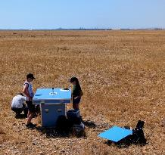
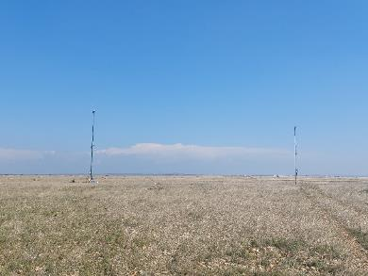
Emissivity measurement – Feedback from La Crau (CNES)
Emissivity box
Preliminary measurements → to be continued
Multiband radiometer
Temperature/Emissivity separation
Continuous monitoring of the surface emissivity
JPL lab measurements of surface samples emissivity spectra (soil, rocks, vegetation)
NDVI method
NDVI measured thanks to the nearby RadCalNet mast
NDVI → vegetation fraction → weights for weighted mean of samples emissivities
TIRCalNet: Towards a Global Network for Thermal Infrared Calibration

Slide 12
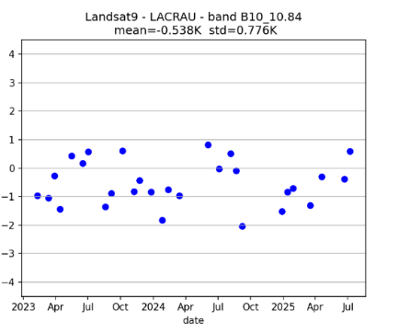
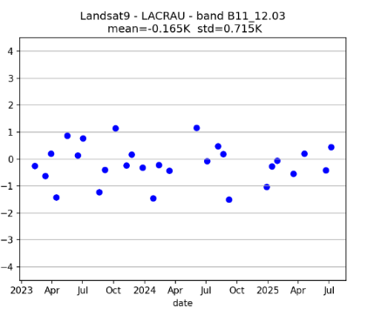
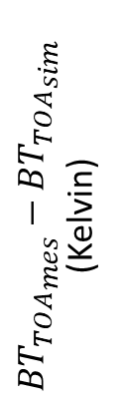
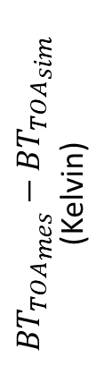
Landsat9 calibration results at La Crau (CNES site)
Calibration results are performed using JPL radiometer + NDVI method to estimate emissivity
$${{BT}_{TOA}}_{mes}−{BT_{TOA}}_{sim}$$
(Kelvin)
$${{BT}_{TOA}}_{mes}−{BT_{TOA}}_{sim}$$
(Kelvin)
Matchups since JPL radiometer installation in Dec 2022
→Consistency over time
-0.5° for band 10 (in the SW region), limited bias for band 11. Standard Deviations 0.7 K
TIRCalNet: Towards a Global Network for Thermal Infrared Calibration

Slide 13
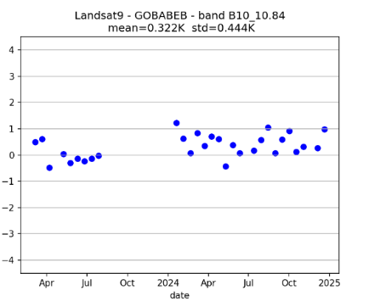
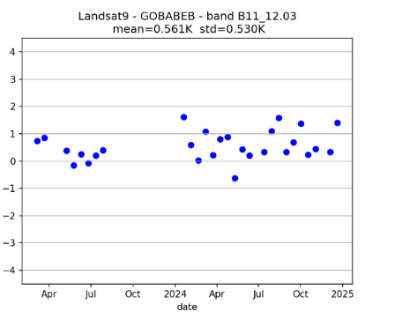
Landsat9 calibration results at Gobabeb (KIT site)
Two years of in situ Skin Temperature data are provided by KIT and surface emissivity spectrum by ONERA
$${{BT}_{TOA}}_{mes}−{BT_{TOA}}_{sim}$$
(Kelvin)
$${{BT}_{TOA}}_{mes}−{BT_{TOA}}_{sim}$$
(Kelvin)
Significant bias between Gobabeb and La Crau (not the case for similar ECOSTRESS bands)
Small Standard Deviations
TIRCalNet: Towards a Global Network for Thermal Infrared Calibration

Slide 14
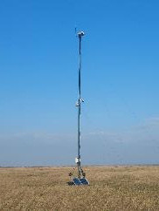
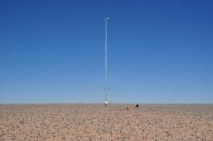
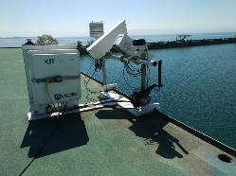
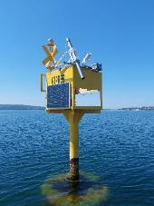
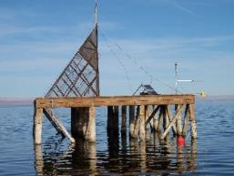
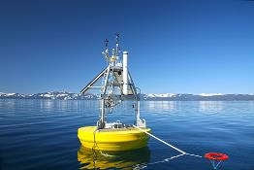
First criteria for sites selection
Site characteristics
Homogeneity on satellite footprint
Water sites with well-known emissivity, and land sites for their wide radiometry range
Numerous clear-sky days
Other criteria to come (emissivity temporal/spatial variation and directionality, atmospheric WV content, etc.)
Instrumentation
Time-dense observations
Autonomous instrumentation (minimal intervention, autonomous delivery of routine measurements)
Minimal and quantified uncertainty
La Crau
Gobabeb
Etang de Berre
Lake Constance
Salton Sea
Lake Tahoe
TIRCalNet: Towards a Global Network for Thermal Infrared Calibration

Slide 15
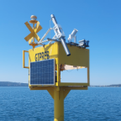
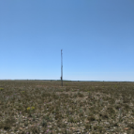
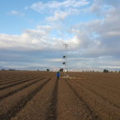
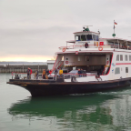
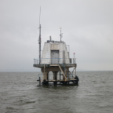
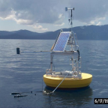
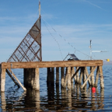
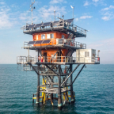
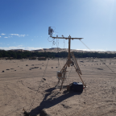
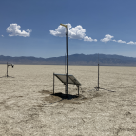
Common instrumentation – JPL radiometers
Currently 10 sites online.
Each site has JPL calibrated near nulling radiometer.
Data are transferred back to JPL for processing to ensure consistent approach.
5 other sites in development:
Lageren (Switzerland),
Myall Vale A (Australia),
Oklahoma (USA),
Santarem (Brazil),
Gobabeb (Namibia).
Etang de Berre | La Crau | Russell Ranch | L. Constance | L. Kasumigaura
France | France | USA | Switzerland | Japan
Water | Gravel Plain | Agriculture | Water | Water
Online | Online | Online | Online | Online
L. Tahoe | Salton Sea | Venice Lagoon | Pinnacles | Railroad Valley
USA | USA | Italy | Australia | USA
Water | Water | Water | Sand Dunes | Playa
Online | Online | Online | Online | Online
TIRCalNet: Towards a Global Network for Thermal Infrared Calibration

Slide 16
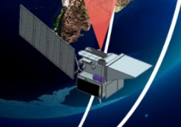
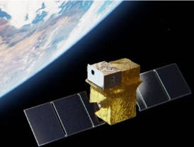
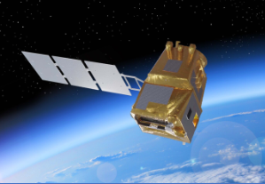
International Working Group
JPL-NASA
Operating Lake Tahoe and Salton Sea Calibration sites
Long data record since 1998
Providing operational Cal/Val for several TIR missions and preparing for SBG-TIR
CNES
Operating La Crau calibration site
Ramping up Cal/Val facility for TRISHNA mission
ESA
Sentinel-3 LST operator, CCI-LST, FRM4STS
LSTM Cal/Val preparation
Support to new space companies
CSIRO
Interest to assess and set up a site at Pinnacles Desert
INGV
Operating a radiometer at Acqua-Alta platform in Venice lagoon
Preparations for SBG-TIR mission Cal/Val
TIRCalNet: Towards a Global Network for Thermal Infrared Calibration

Slide 17
Next steps
TIRCalNet working group
Consolidation of TIR TOA uncertainty budget
In situ data sharing
Definition of the datasets that would be distributed through the webportal (common to all TIRCalNet sites).
Converge on a common RT model
Definition of the data processing (for L_TOA and L_TOA uncertainties)
Development of TIR sites (Berre – CNES, Pinnacles – CSIRO, Gobabeb – KIT/ESA/CNES…)
+ CNES
Thorough characterization of La Crau site (emissivity box)
Exploitation of multiband radiometers for continuous monitoring of the emissivity
+ ESA
Development of a site prototype design and a roadmap towards an operational network that provides TIR TOA for radiometry cal/val (current study ongoing since November 2023)
Procurement of Cimel CE312 to be deployed at Gobabeb at the KIT run station for aiding emissivity characterisation, with CNES support (planned for 2026)
Development of a webportal similar to the RCN Portal for a centralised processing repository and access point for data users
+ JPL
Loan and support in the deployment of JPL radiometers on various TIR sites
TIRCalNet: Towards a Global Network for Thermal Infrared Calibration

Slide 18
Thank you

