Slide 1


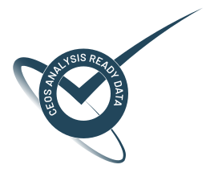
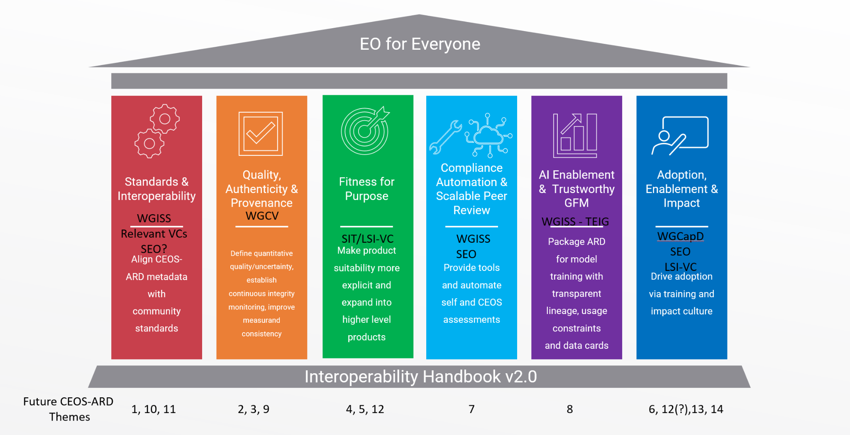
CEOS-ARD Strategy Pillars
Underpinned by CEOS Interoperability Handbook conventions

Slide 2
Fitness for Purpose
CEOS-ARD products are clearly classified for their suitability across different applications, supporting both non-expert users and scientific communities.
Success Criteria:
Users can clearly identify what each CEOS-ARD product is fit for, including limitations, uncertainty bounds, and appropriate application types.
CEOS-ARD supports long-term, stable, bias-aware data records suitable for long-term scientific applications.
Fitness-for-purpose distinctions help non-expert users avoid misuse, while giving providers clear pathways to improve product maturity.
CEOS-ARD products are increasingly cited as authoritative inputs to global frameworks, indicators, and assessments.
Outcome Signal: Users can select CEOS-ARD products with confidence.

Slide 3
Fitness for Purpose
“Provide a means to distinguish high-stability, science-grade observations from observations that are, e.g., only suitable for visual analysis, while still encouraging data providers to uphold the other principles of CEOS-ARD around metadata completeness, pre-processing, and documentation” . This group is the one that is best placed to “provide the means to distinguish”.

Slide 4
Initiatives under this pillar could include
“quality”/”fitness” classification to categorize products based on use cases, uncertainty ranges, and performance metrics derived from the EDAP and JACIE system characterization frameworks/systems (eg. Exploratory, Research, Operational, Science).
Application-specific guidance to help users select appropriate datasets for tasks such as agriculture monitoring or disaster response.
Introduction of Long-term sensor stability measurement and accuracy as metrics to support environment-quality records and adaptation strategies.
WGCV LPV protocols

Slide 5
What do we need from Agencies and CEOS to help develop these areas?
Headline: Engagement of agency and CEOS experts
Fitness for Purpose
Application area experts to assess suitability of CEOS-ARD specifications and products
Engagement of thematic CEOS groups in areas such as biodiversity, forests and biomass, agriculture, disasters, etc.
Alignment with WGCV LPV protocols

Slide 6
Matt’s Strawman
Switch to the other laptop

Slide 7
Discussion
Discussion objective: Fitness for Purpose initiatives and activities we can add to CEOS-ARD Strategy work plan for 2027-2031
GA strawman visual representation of “means to distinguish” utilising the existing PFS (Matt Adams, GA)
“Provide a means to distinguish high-stability, science-grade observations from observations that are, e.g., only suitable for visual analysis, while still encouraging data providers to uphold the other principles of CEOS-ARD around metadata completeness, pre-processing, and documentation” . This group is the one that is best placed to “provide the means to distinguish”.
Perspectives from WGCV:
Maturity Matrix
CEOS-FRM Assessment Framework
2026-2029 LPV Work Plan (Definition of higher level land products specification, and the associated data and metadata quality)

Slide 8
Discussion
What are the important fundamental metrics for assigning fitness for purpose?
Correct level of granularity? E.g. Exploratory, Research, Operational, Science
What is an initial set of applications we are going to focus on and who in CEOS or otherwise helps define the levels and assess applicability?
Consider application-specific guidance to help users select appropriate datasets?
How does it look in practice? How is fitness for purpose communicated to users?
Confirm: Fitness for Purpose initiatives and activities we can add to CEOS-ARD Strategy work plan for 2027-2031

