Slide 1
CEOS-ARD Stability Parameter
Mark Dowell, EC-JRC
Libby Rose, WGClimate Sec
Agenda Item J4.2
WGCV-56 / LSI-VC-19 Joint Meeting
Sioux Falls, SD, USA
20-24 April, 2026

Slide 2
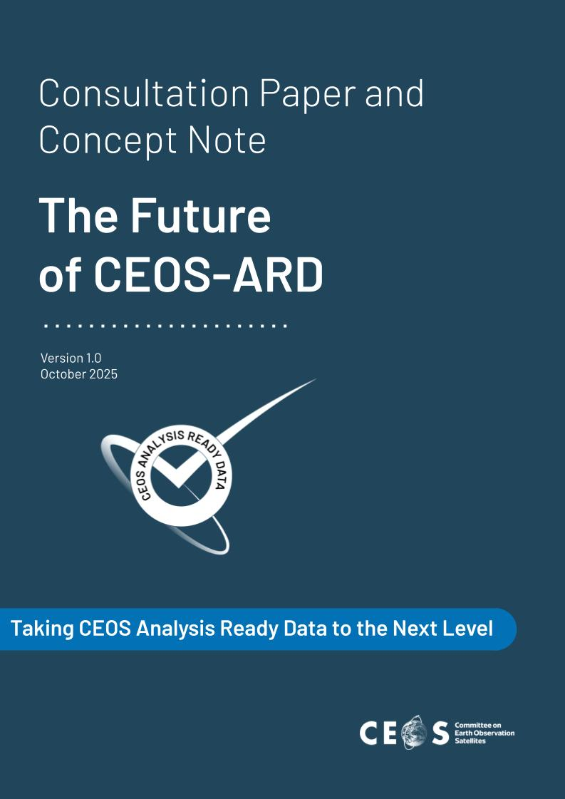
CEOS-ARD 2025 Consultation Paper & Concept Note
Item 4.5 from the 2025 Concept Note:
Increased Support to Scientific Applications and Environmental Adaptation and Resilience Issues
Include requirements for dataset stability
Something to help users evaluate ‘fitness for purpose’

Slide 3
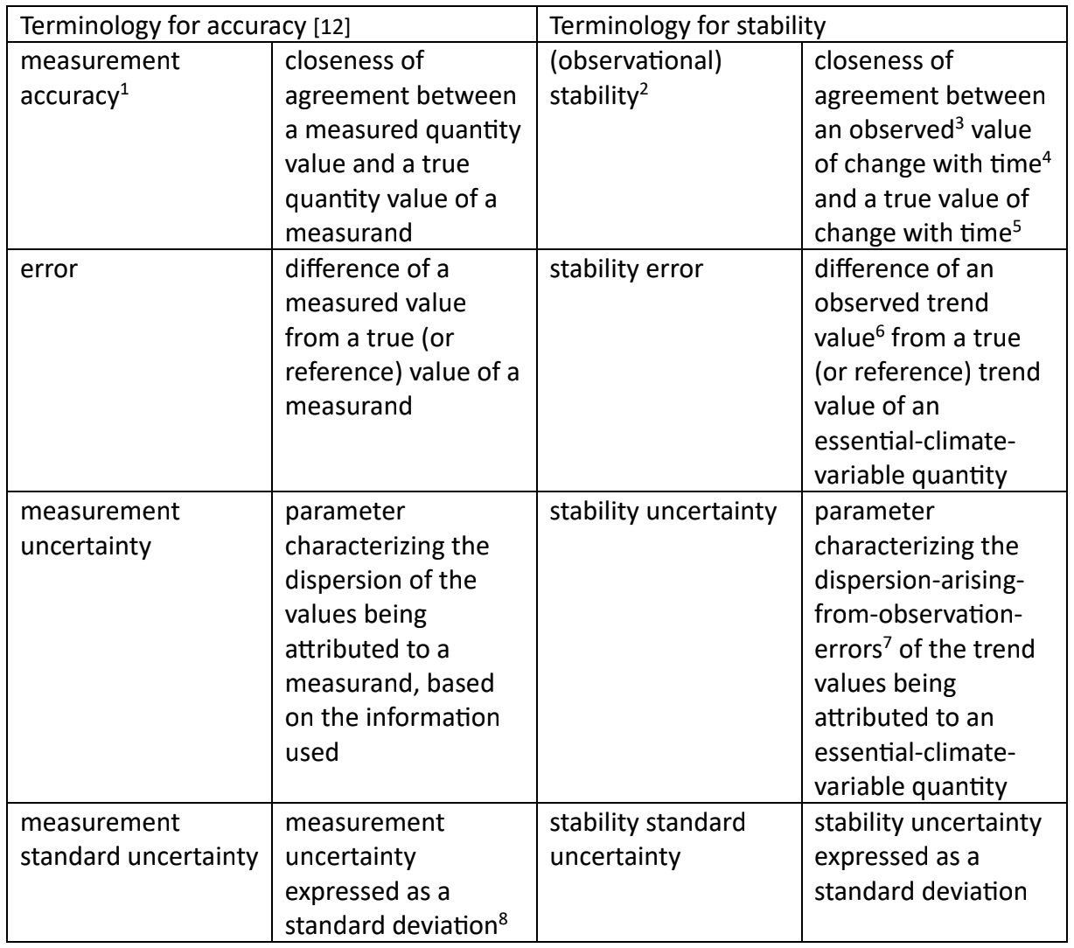
Stability: What does it mean?
Chris Merchant & Emma Woolliams draft paper:
We want providers to provide the ‘stability uncertainty’

Slide 4
What is ‘stability’
CEOS EO Glossary:
The maximum acceptable change in Uncertainty per decade
Not a great definition (would be an instability)
Proposal & comments:
closeness of agreement between an observed value of change with time and a true value of change with time.
Observed vs Measured?
the 'value of change' is not observed, it must read 'between the change in the observed values and the change in the true values' -> but 'true' values by definition are unknown
Should we be even trying to define stability? The applicable concept to define the fidelity of measurements is uncertainty - which can be provided by the producers and should be used for specifications like ARD.

Slide 5
Stability Uncertainty
Stability Uncertainty: parameter characterizing the dispersion of change (or trend) values arising from observation uncertainties (over a defined period)
Stability Standard Uncertainty: Stability Uncertainty expressed as a standard deviation

Slide 6
Draft Requirement
# | Item | Threshold | Goal
1.17 | Stability | Not required. | Provide indicative metrics on stability, via stability uncertainty expressed as a stability standard uncertainty (with a 66% confidence level) or stability expanded uncertainty (with a 95% confidence level), alongside the time scale and space scale the stability uncertainty is evaluated against. Include considerations of: (a) temporal drift of individual sensors, (b) inter-sensor biases as instruments are replaced, and (c) changes in the spatial and/or temporal sampling regime, and the impacts on aliasing with, e.g., diurnal and seasonal cycles and spatial patterns.
Goal level requirement only
Provided for the dataset as whole (general metadata)

Slide 7
Next Steps
Refine and finalise the definitions.
Develop 2-3 test Climate Data Records which meet the proposed requirement.
Refine the requirement as needed.
Include requirement in all PFS.
Encourage CDR providers to include this metric via the CDR Inventory.

Slide 8
Questions for discussion
How does the draft requirement look?
What would be the process to incorporate into all PFS?
How can we encourage data providers to meet the requirement - noting it is proposed to be goal level only?
# | Item | Threshold | Goal
1.17 | Stability | Not required. | Provide indicative metrics on stability, via stability uncertainty expressed as a stability standard uncertainty (with a 66% confidence level) or stability expanded uncertainty (with a 95% confidence level), alongside the time scale and space scale the stability uncertainty is evaluated against. Include considerations of: (a) temporal drift of individual sensors, (b) inter-sensor biases as instruments are replaced, and (c) changes in the spatial and/or temporal sampling regime, and the impacts on aliasing with, e.g., diurnal and seasonal cycles and spatial patterns.

