Slide 1

Title slide
Status and Progress in the Cal/Val activities
and Data Quality of the thermal and VNIR
Constellation HiVE
Andreas Brunn, Christian Köppl,
Alexandre Delahaye, Tianran Zhang,
Christophe Lerot, Daniel Spengler

Slide 2

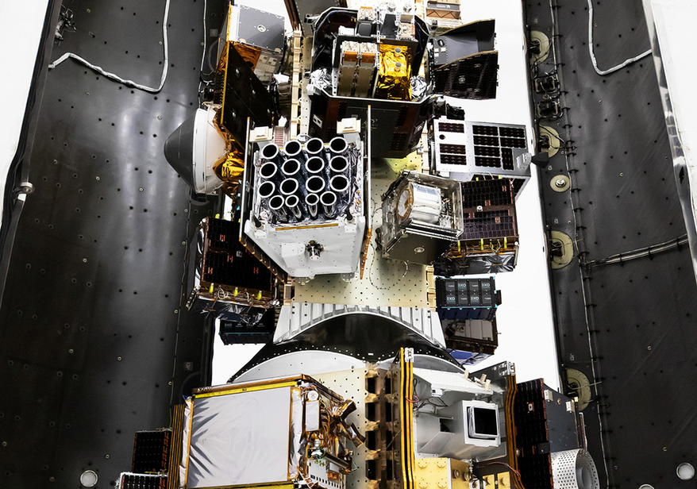

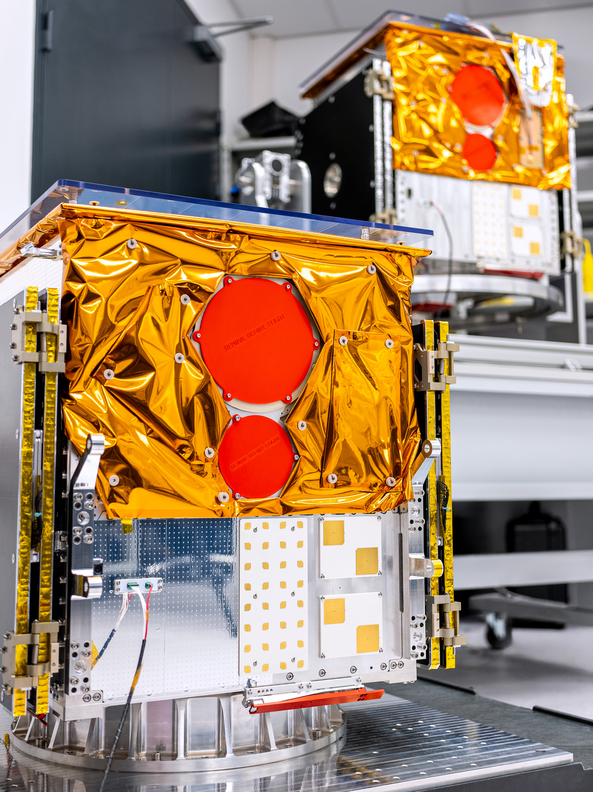
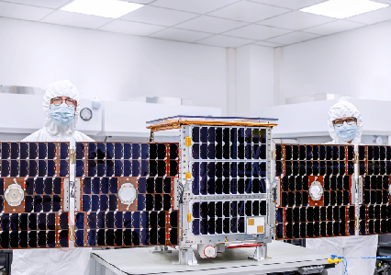
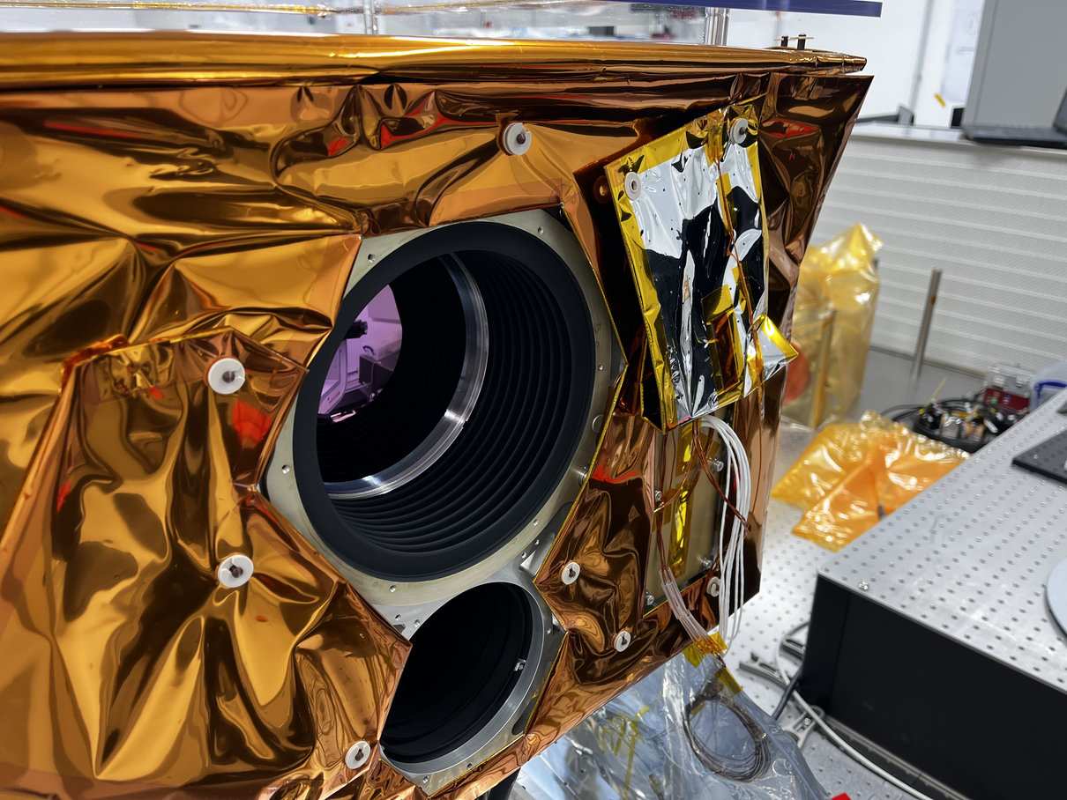
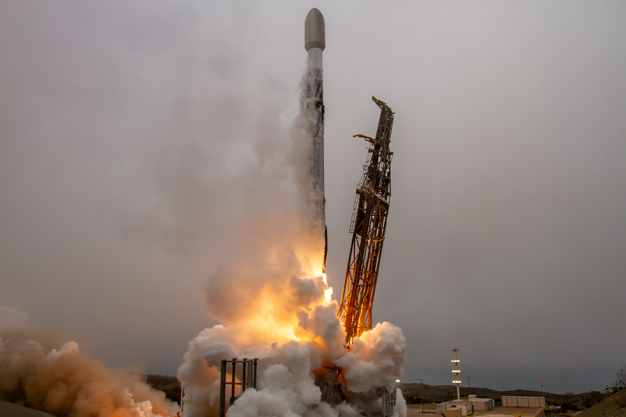
constellr – Who we are
Europe’s highest-accuracy thermal constellation
Company snapshot:
Founded 2020
€75m+ raised
100+ employees
2 operational satellites
Munich HQ
Offices in DE, FR, BE, US
Execution proven. Scaling underway.

Slide 3

Cal/Val Calendar HiVE Gen 1 Constellation
Pre-launch ground calibration
Commissioning phase calibration
Regular operations
Validation
Geometric
Geometric
Geometric
Monitoring :
Geometric
Radiometric
Radiometric:
MTF
LST & LSE
Surface reflectance
Water vapor
AOT
Radiometric
Radiometric:
Dead detectors
Self-emission
Flat fielding
Absolute
Spectral
SkyBee-1
2025
Launch 01/2025
Q2/Q3 2025
Since sept. 2025
ongoing
SkyBee-2
2025
Launch 06/2025
Q4 2025 / Q1 2026
Q1/2026
From Q1 2026
SkyBee-3
2027
Launch Q1/2027
HiVE performance evaluated by

Slide 4

Performance roadmap
Strategic
Tactical
Available From | Today | NextGen1 2028/2029 | NextGen2* 2030/2031 | NextGen3* 2032/2033
Native Resolution (GSD) | VNIR: 10m SWIR: - MWIR: - LWIR: 30m | VNIR: ≤1.5m* SWIR: - MWIR: ≤5m LWIR: ≤10m | VNIR: ≤1m SWIR: - MWIR: ≤3.5m LWIR: ≤7m | VNIR: ≤0.7m SWIR: ≤1.5m MWIR: ≤2.5m LWIR: ≤5m
Swath | 17.5km | >18km
Derived Thermal Product | 10m | 5m | 3.5m | 2.5m
Latency Standard NRT** | 24hr | <6hr <30min (2029) | <3h <20min | <2h <10min
ISL | no | 2029 | yes | yes
Satellites in service | 2 | 2-3 1ST GEN 6 NG1 | 1-2 1st Gen 15 NG1 2-4 NG2 | 20 NG1 20 NG2 2-4 NG3
Revisit time | <24hr | <12hr | <4hr | <15min (specific targets)
Relative radiometric accuracy (sensitivity) | <0,1K within a scene | <0,1K within a scene
From operational capability to sovereign infrastructure
Aligned with ESA Earth Observation and security timelines
* = design target, subject to final payload configuration, **Near Real Time data product

Slide 5
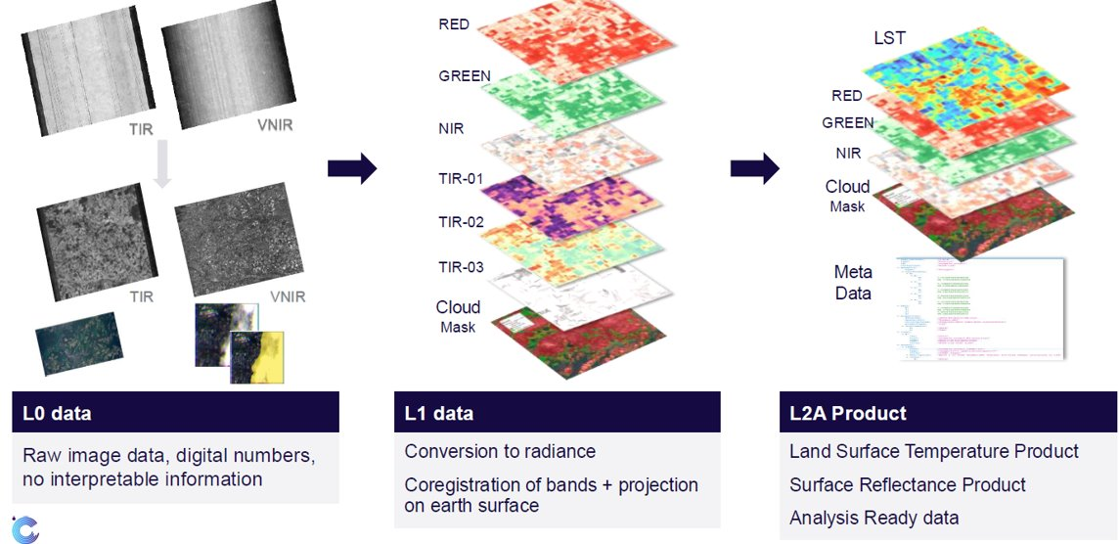
HiVE Processing Pipeline

Slide 6
Ruwais Refinery, UAE
Oil Refinery
Verifying activity
Pre-strike 16/01/2026
Post-strike 14/03/2026
Independent verification of increasing gas flaring post strike indicates significantly lower refinery output levels
Thermal measures infrastructure activity

Slide 7
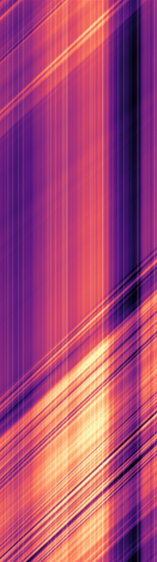
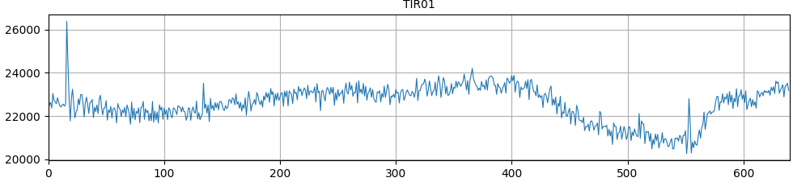
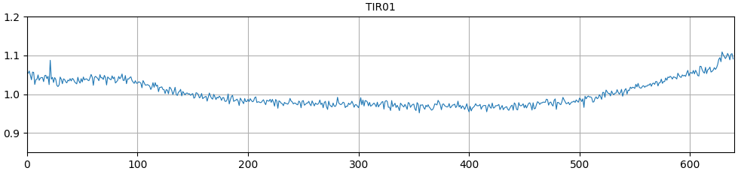
CalVal – PRNU Correction
Side-slither maneuver
Computing detectors gains and offsets from a pair of warm/cold images
Warm targets: deserts
Cold targets: Arctic/Antarctic
Update required every 5 days approx. and after Payload cryocooler restarts
Side-slither image example – SBA01

Slide 8
TIR On Orbit Cross-Calibration
To tackle a system without onboard blackbody
But not limited by the hardware band specification
Procedure
Simultaneously, collect imagery of uniform area with HiVE and Geostationary high revisit sensors (e.g. SEVIRI) Co-register areas on the ground and consolidate to same pixel sizes
Use low resolution ground temperature as ground truth for HiVE
Use external atmospheric profile (ERA5/CAMS)

Slide 9
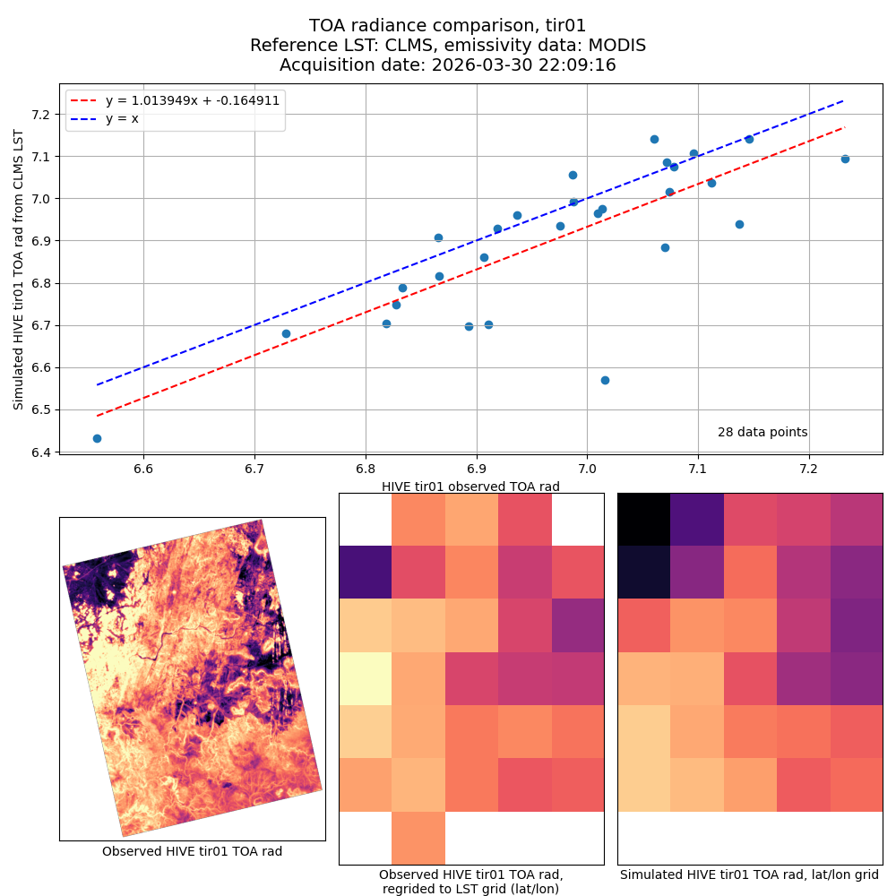
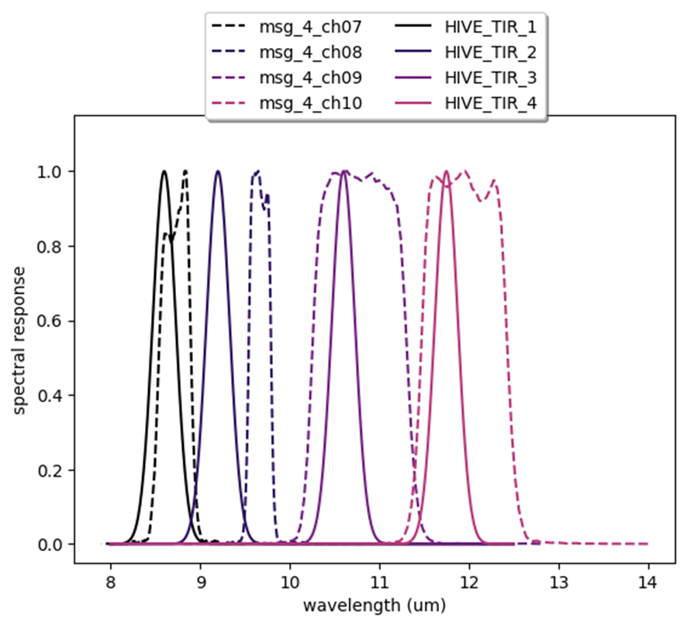
TIR On Orbit Cross-Calibration ctd

Slide 10
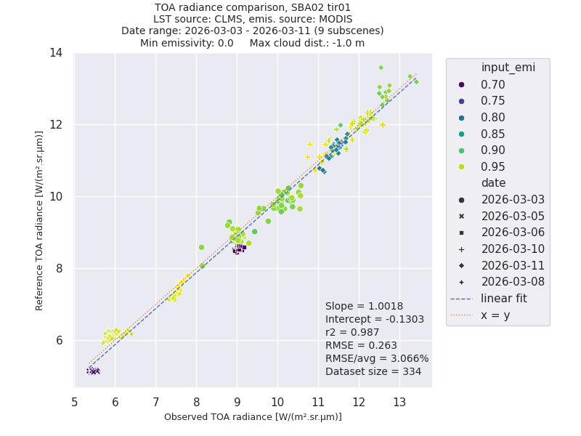
TIR On Orbit Cross-Calibration ctd 2
Cross-calibration on multiple acquisitions: allows a large radiance range and increase linear fit accuracy
Notes:
2

Slide 11
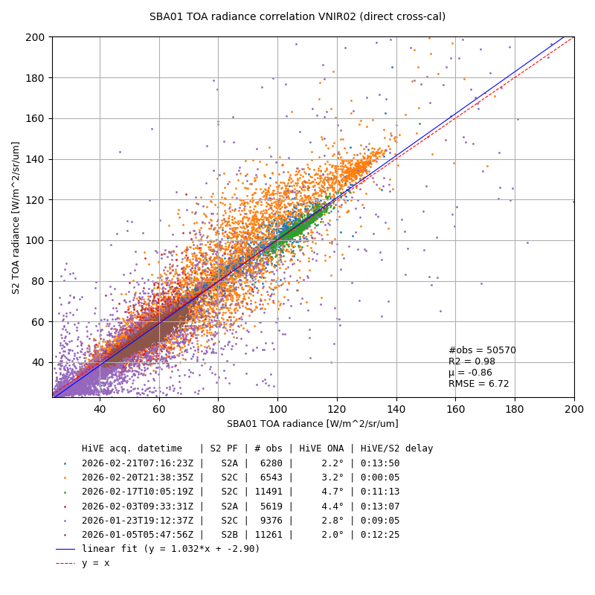
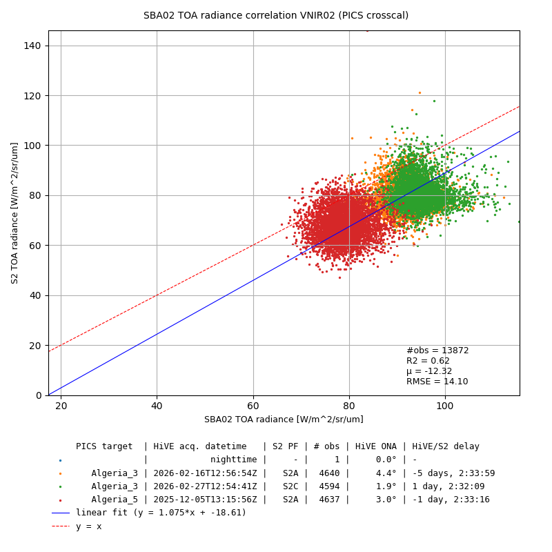
VNIR On Orbit Cross-Calibration
Direct cross-calibration with Sentinel-2, any target (SBA01):
Cross-calibration with Sentinel-2, PICS targets (SBA02):

Slide 12
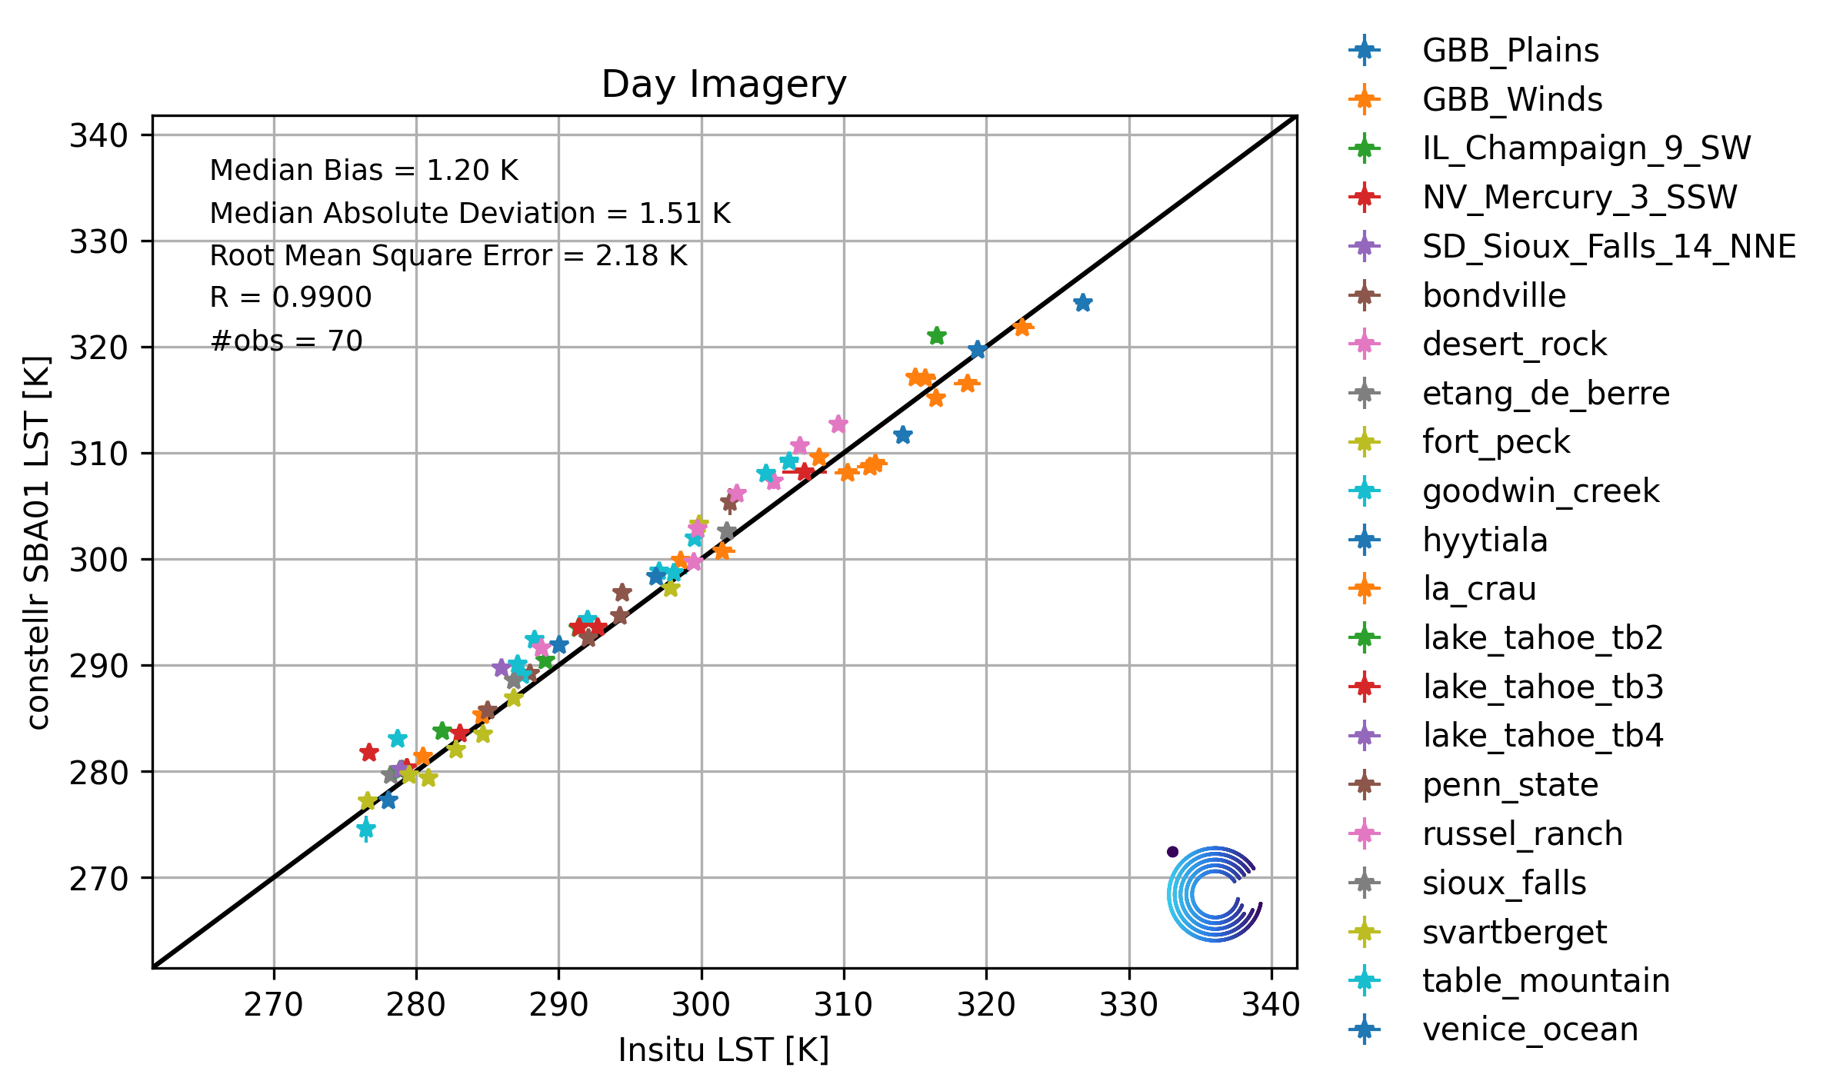
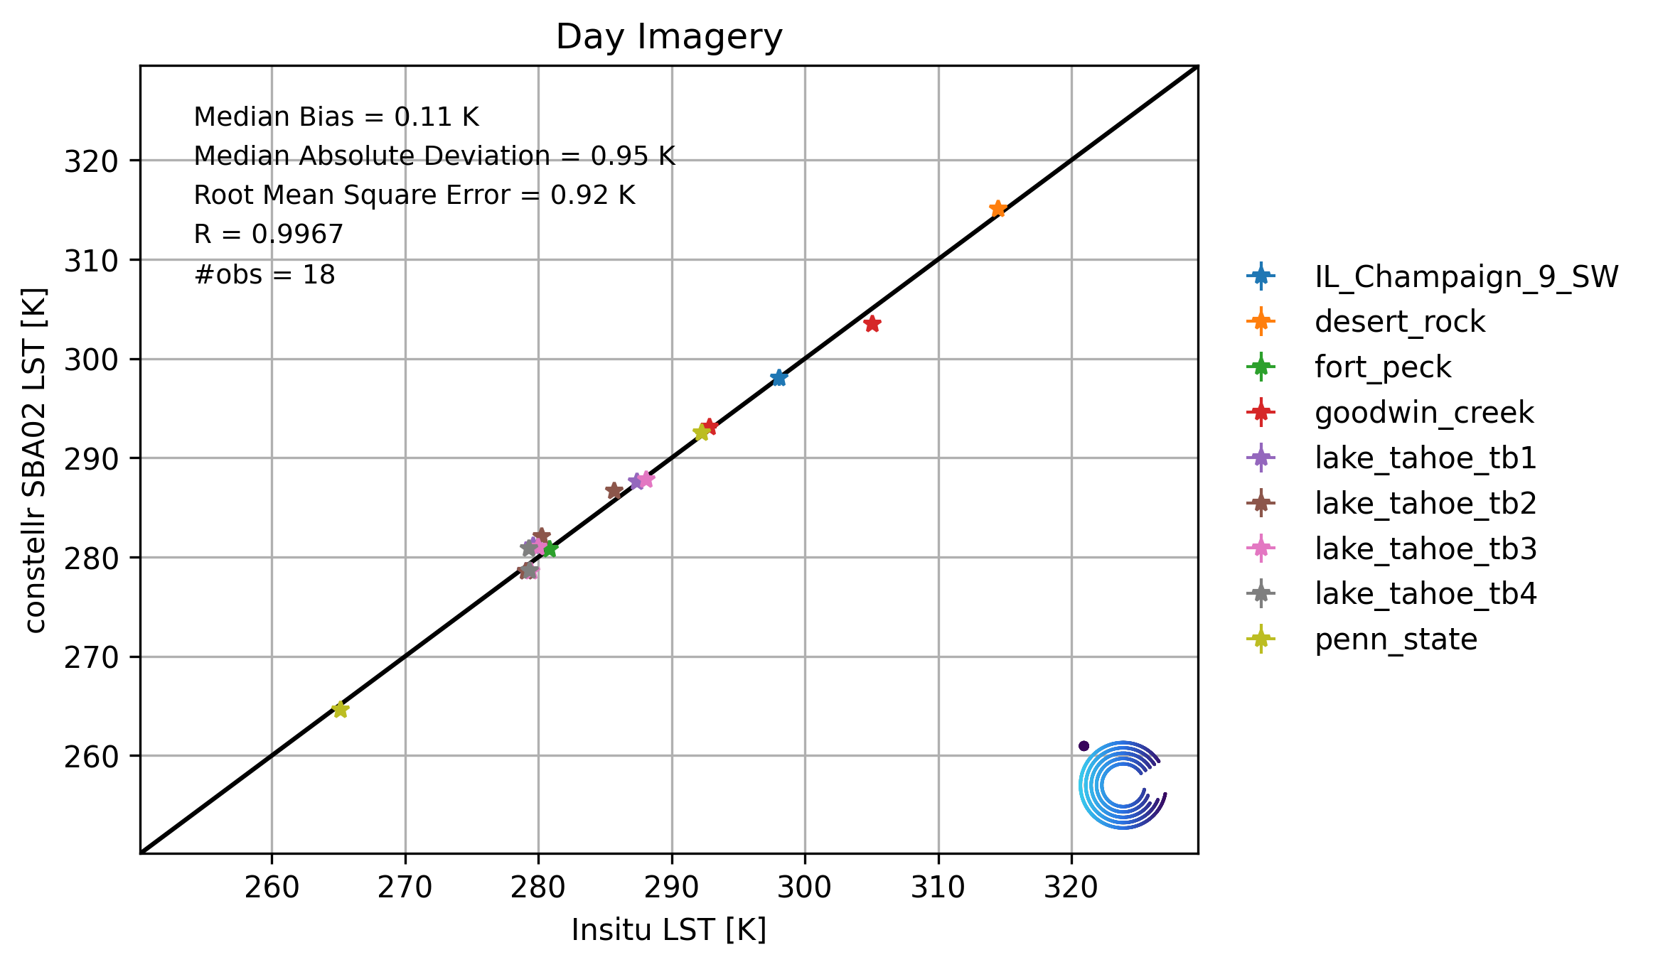
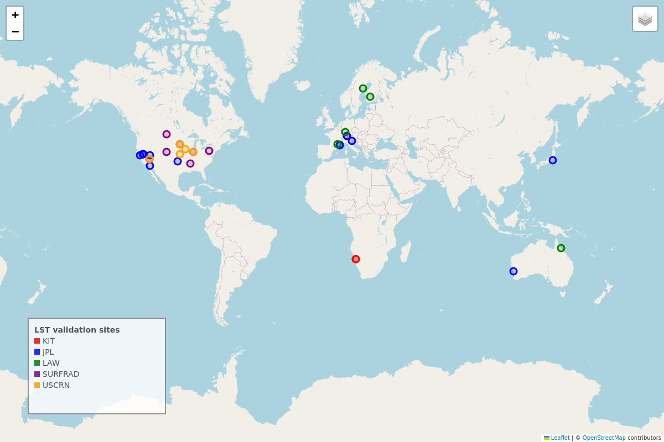
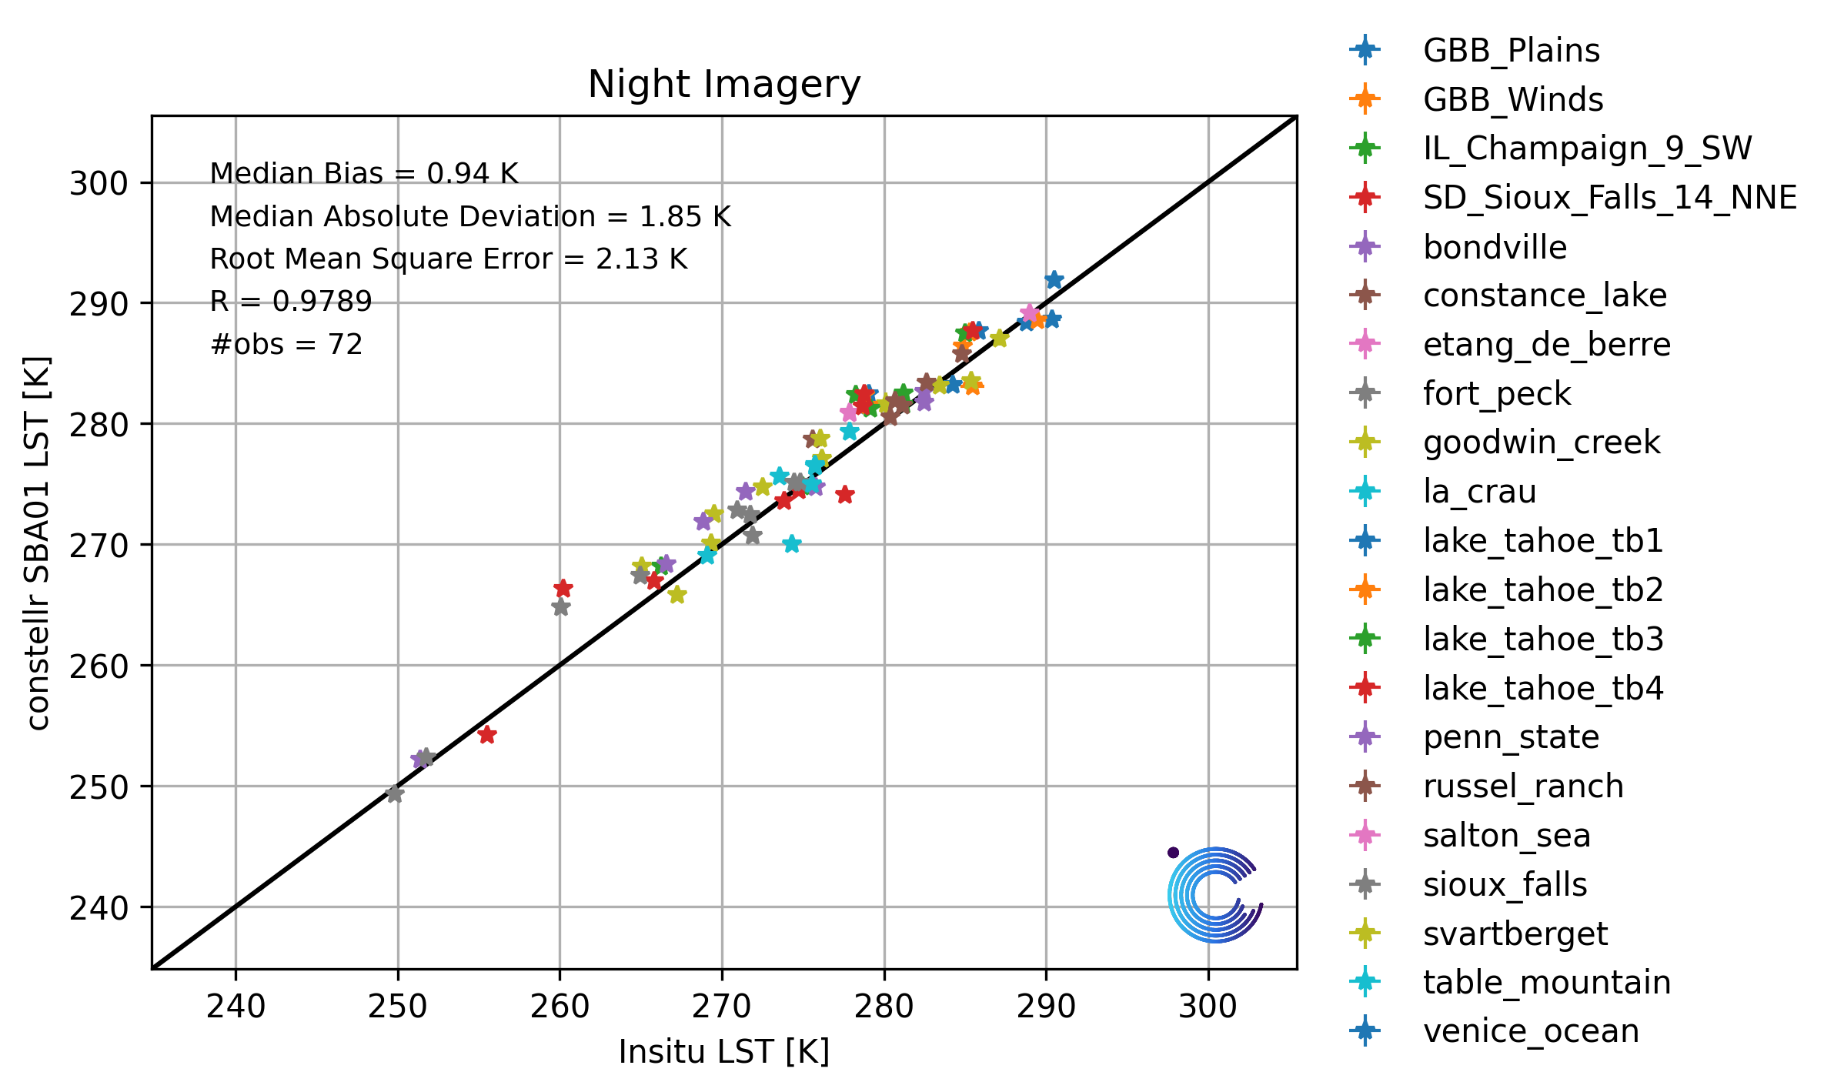
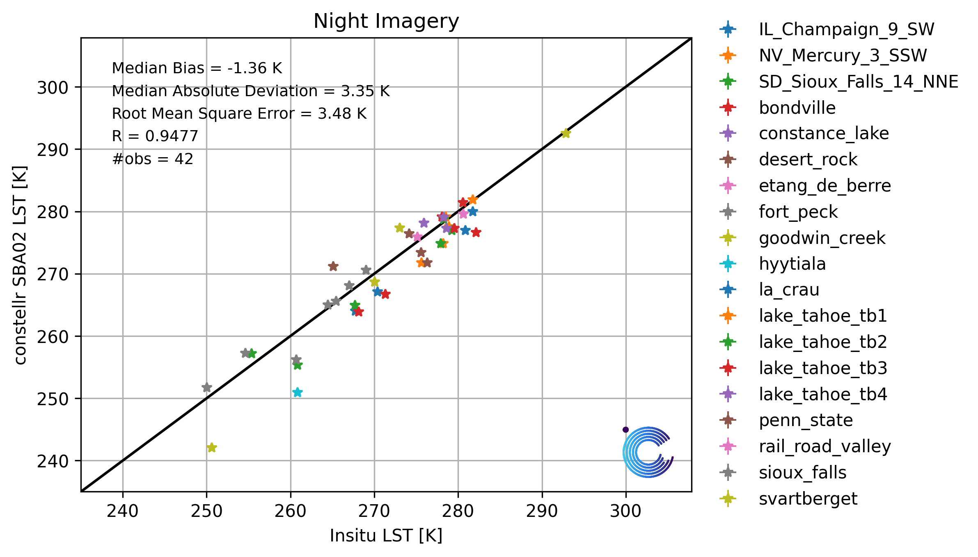
In-situ Validation of SkyBee LST data
Skybee-1
Skybee-2
Day
Day
LST ground-based data networks
Night
Night

Slide 13
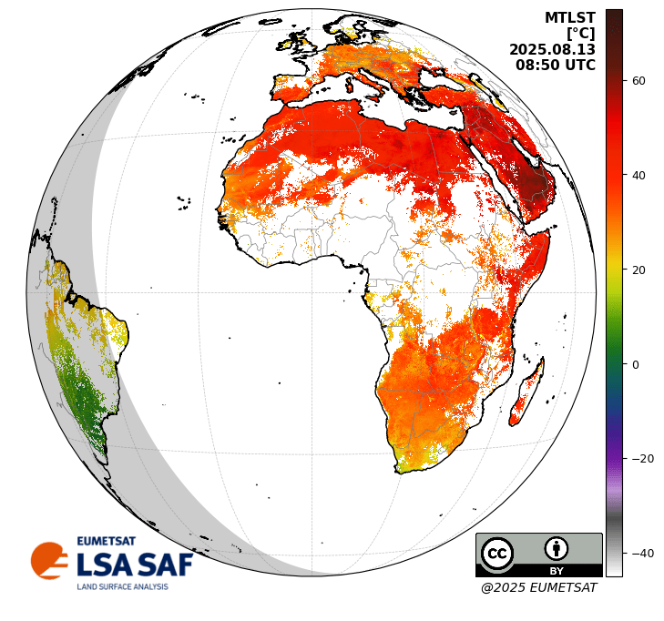
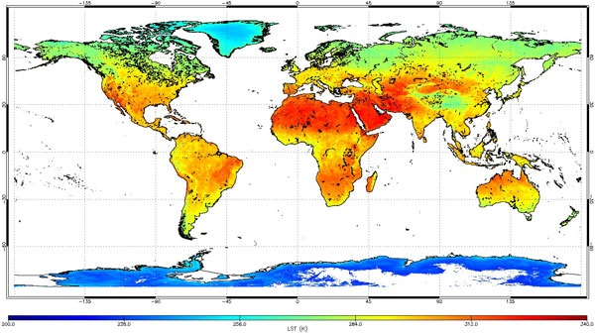
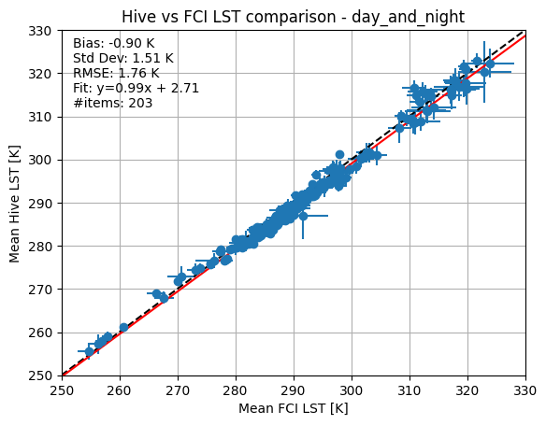
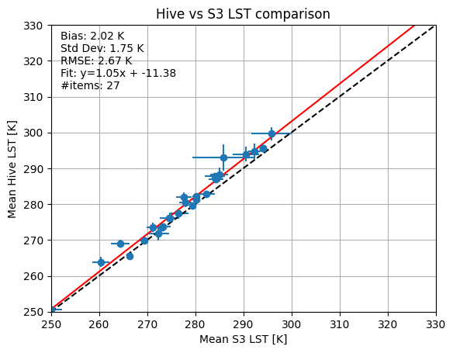
SkyBee-1 LST data: Inter-satellite comparison
MTG/FCI
Sentinel-3/SLSTR
Copernicus MeteoSat Third Generation/Flexible Combined Imager, successor of SEVIRI, launched late 2022.
Geostationnary Instrument
Revisit time: 10 minutes
Spatial resolution : ~ 2x2 km² in LWIR
Data available since January 2025
Copernicus Sentinel-3 Sea and Land Surface Temperature Radiometer
LEO orbit, Local Solar Time: 10AM.
Two satellites launched in 2016 and 2018.
Revisit time: 4 days
Spatial resolution : ~ 1x1 km² in LWIR
Global LST map (September 2016) derived from Sentinel-3A/SLSTR daytime data.
[Credits: University of Leicester]

Slide 14
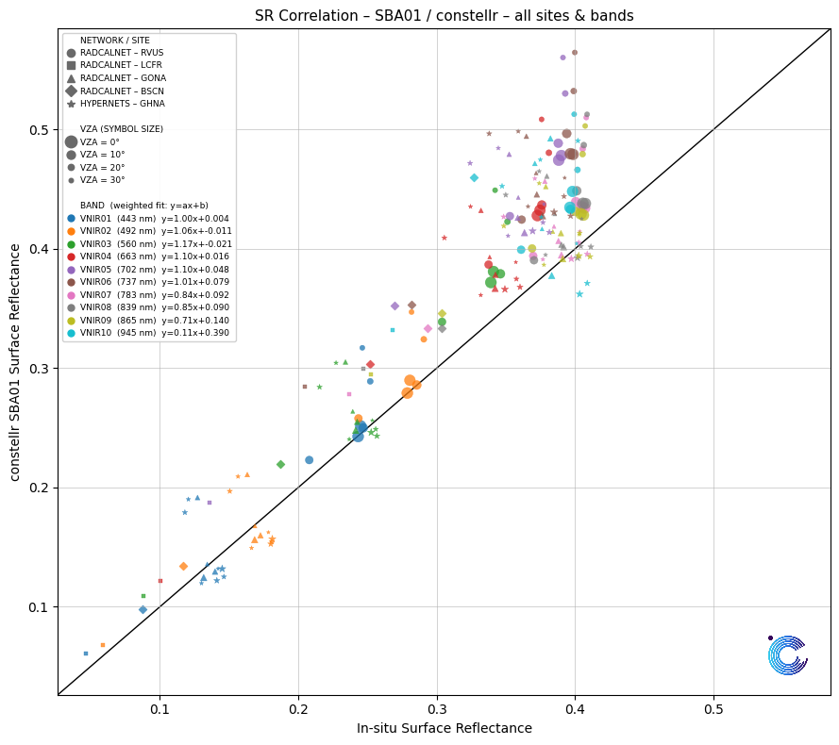
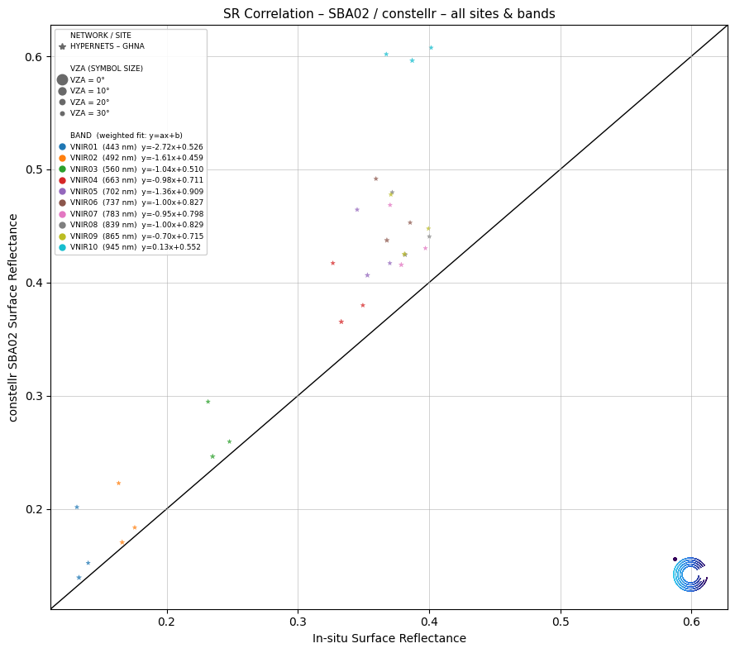
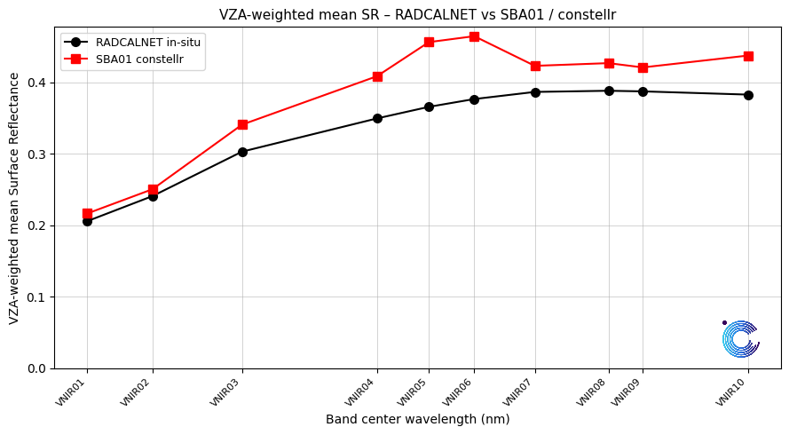
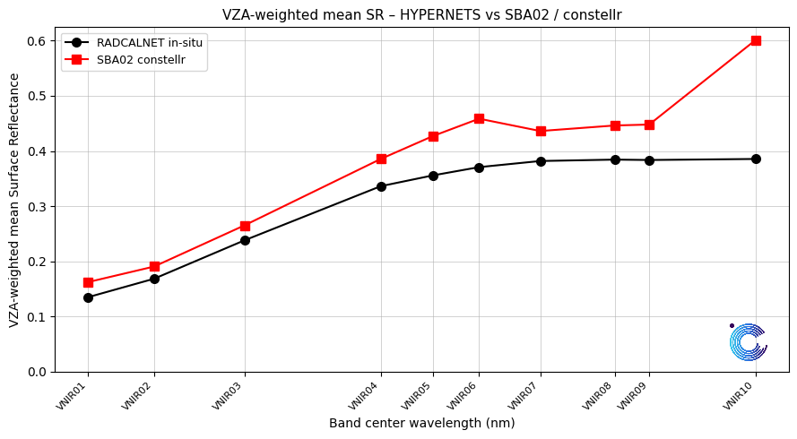
Validation of SkyBee-1/2 Surface Reflectance data
RADCALNET + HYPERNETS
Water-dominated scene

Slide 15
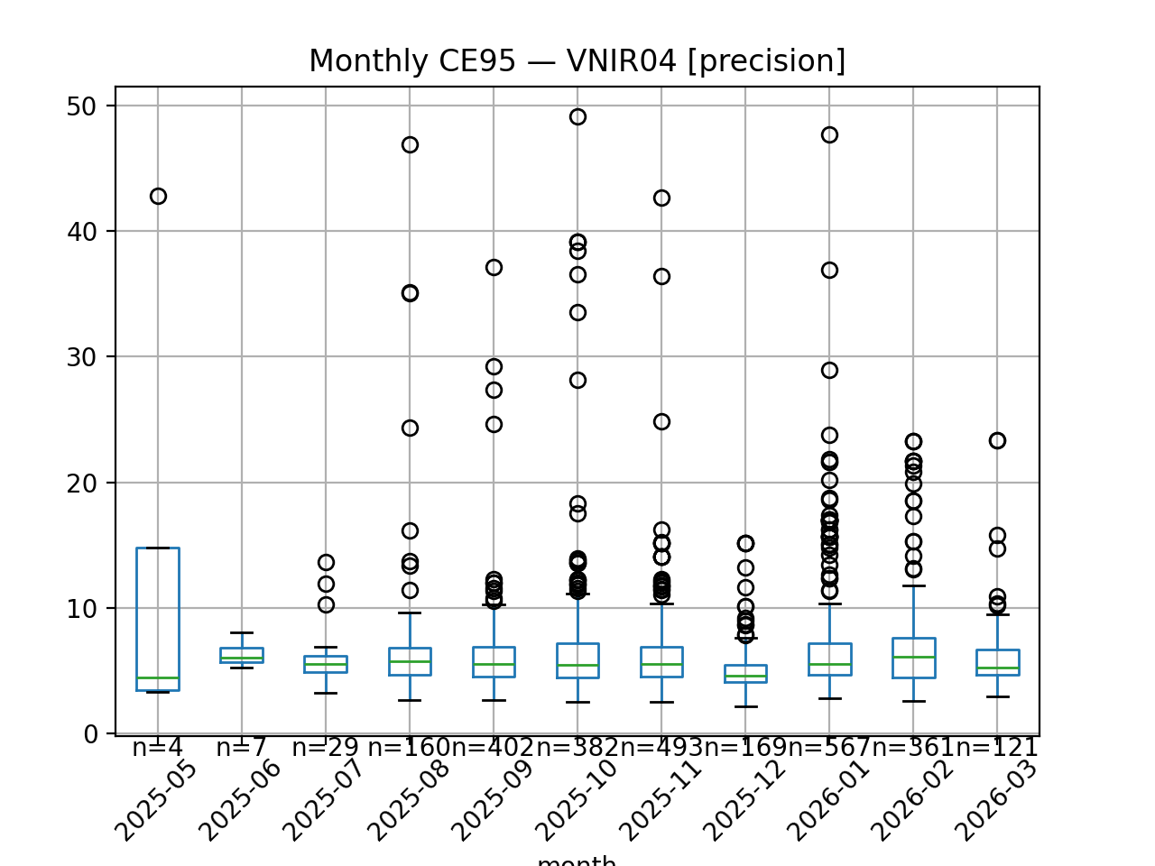
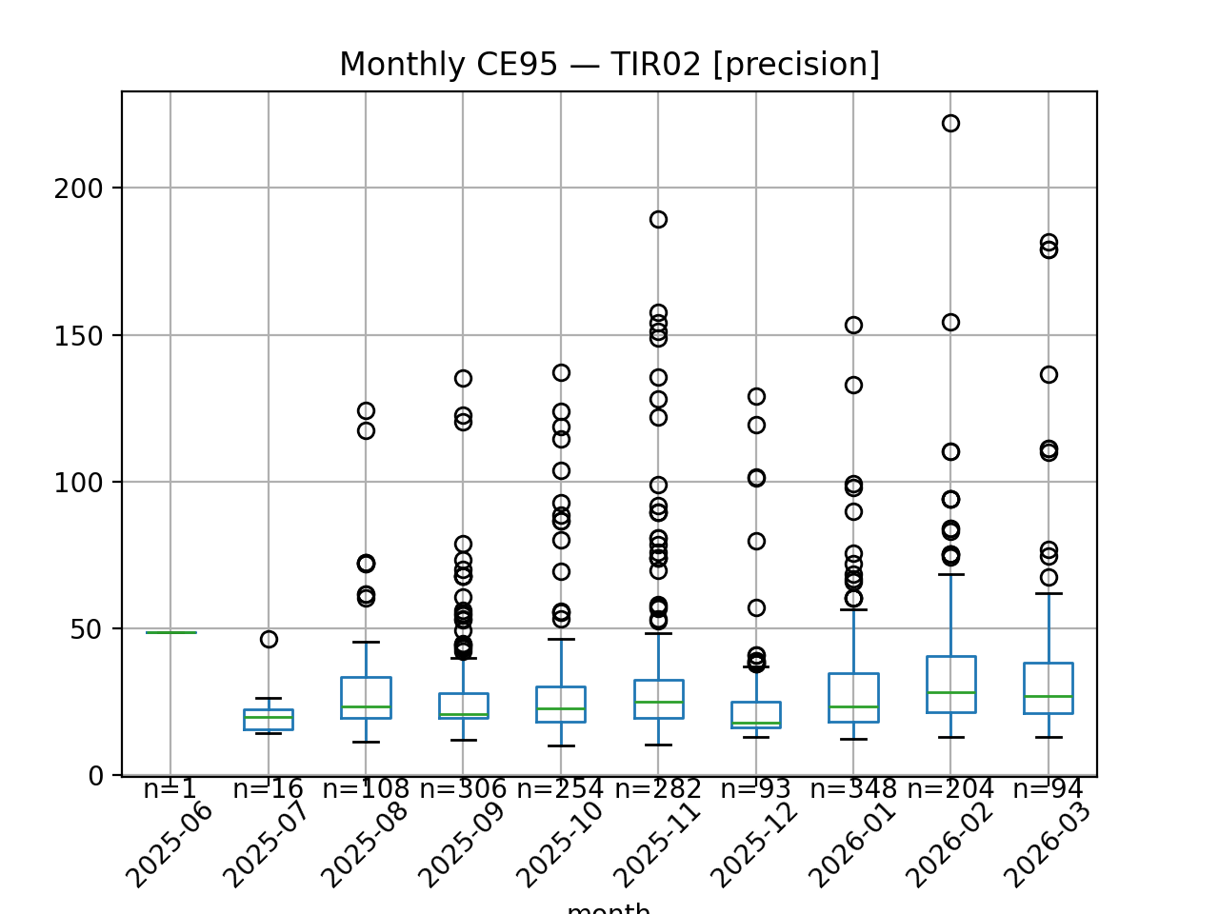
Geometric Accuracy Analysis
Error in [m]
Error in [m]

Slide 16
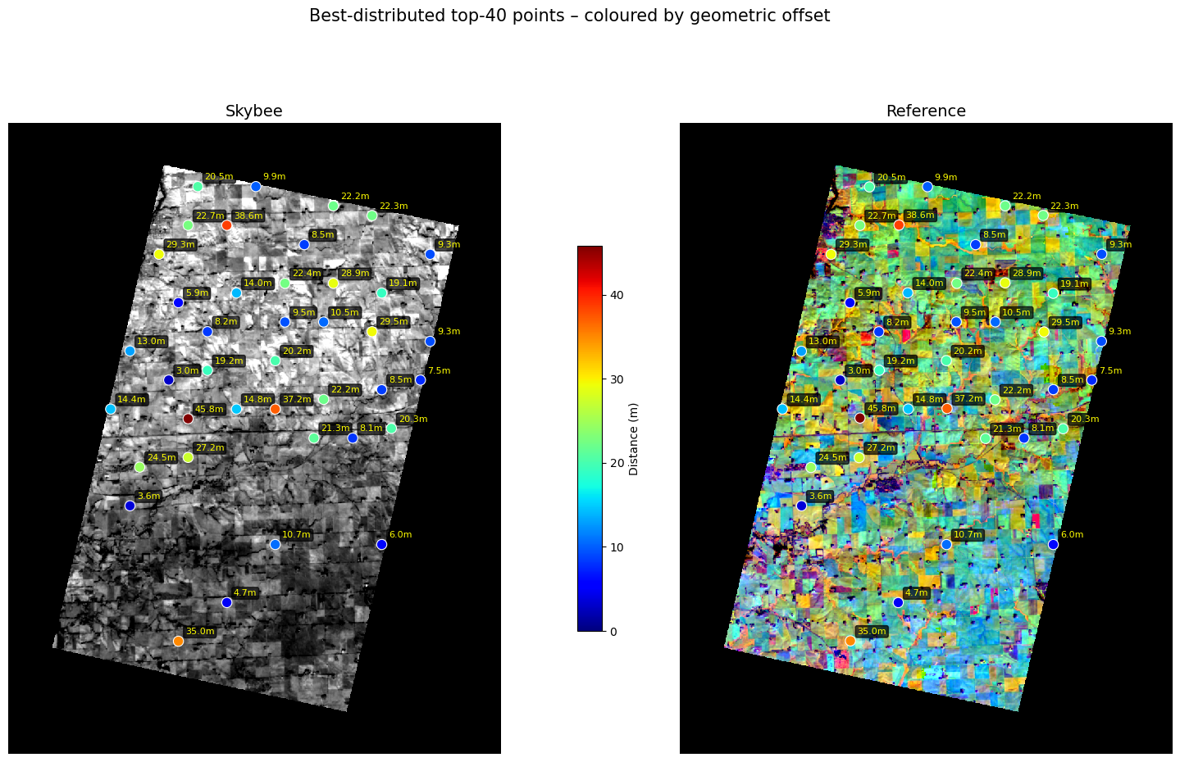
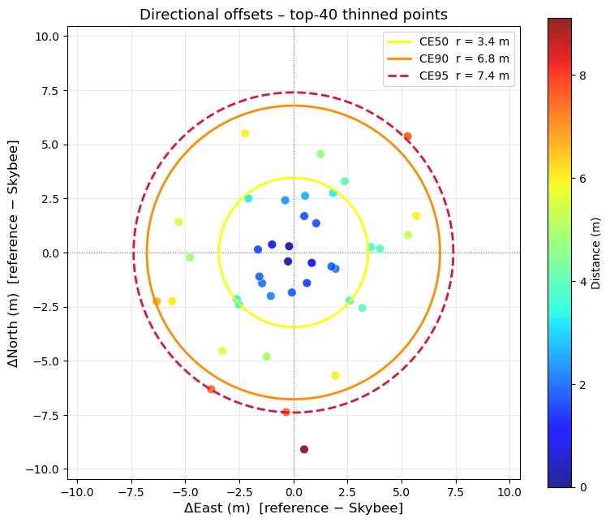
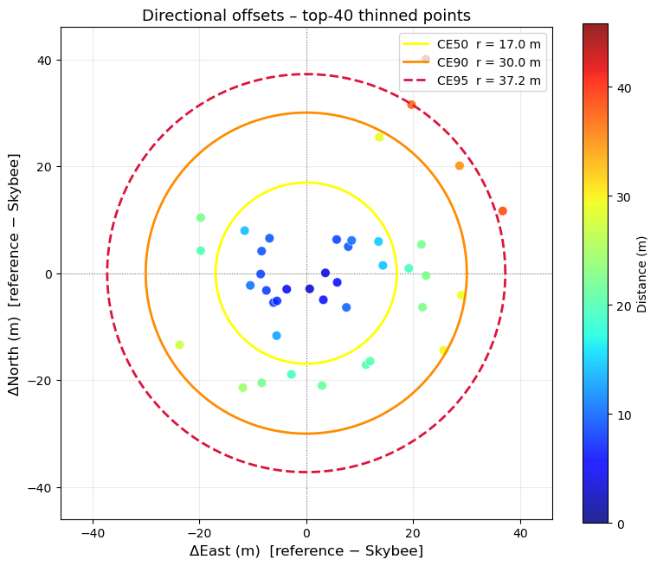
Geometric Accuracy Analysis – Typical Image Example
VNIR Bands
TIR Bands

Slide 17
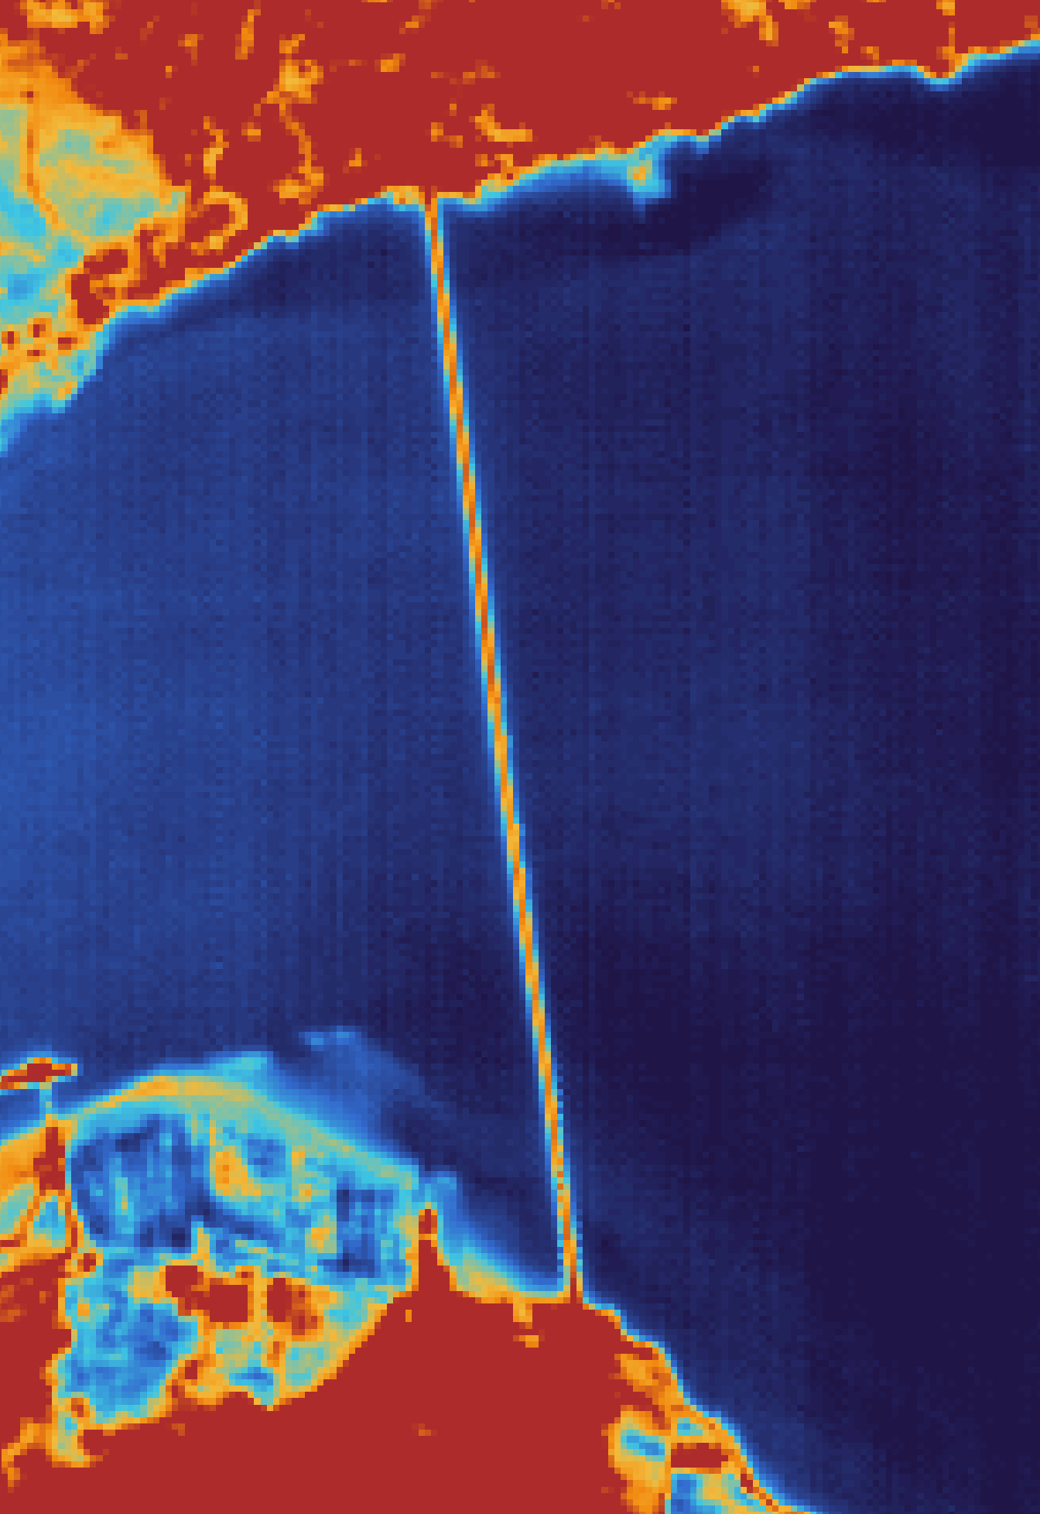
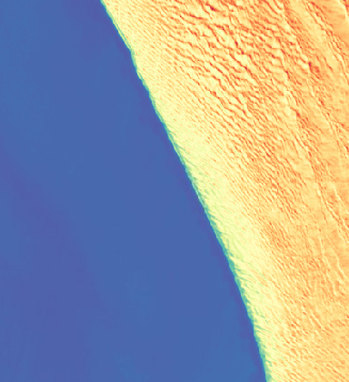
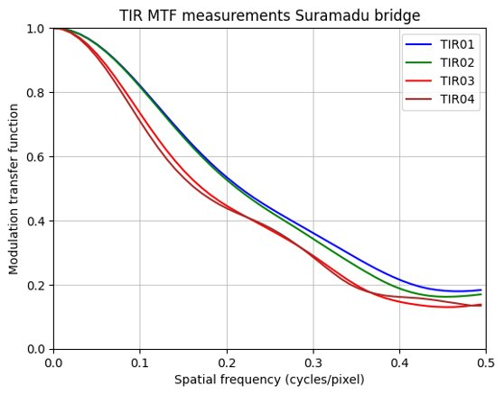
TIR Initial Validation Results
Measurements on bridges and coastlines
MTF close to expected values
Suramadu bridge 08-15-2025, TIR02
Namibia coast 23-09-2025, TIR01

Slide 18
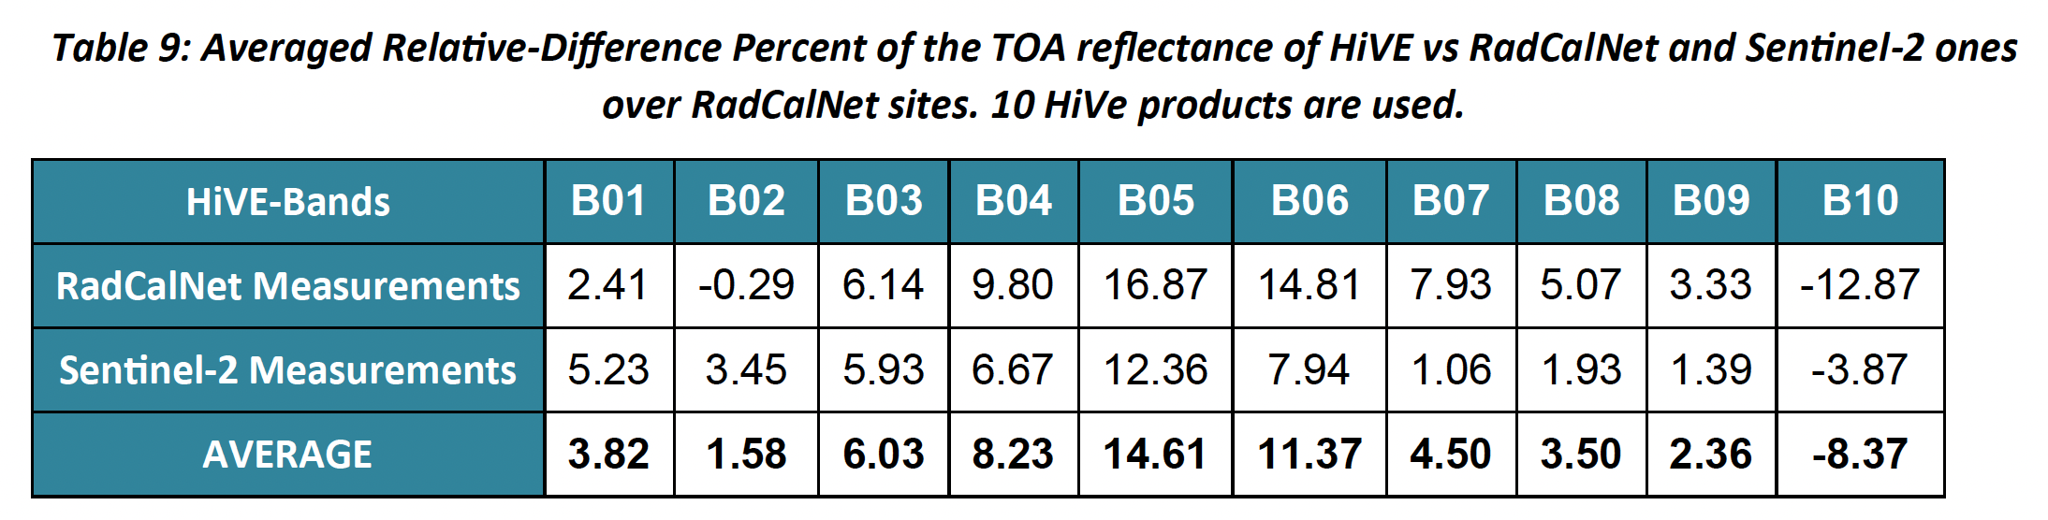
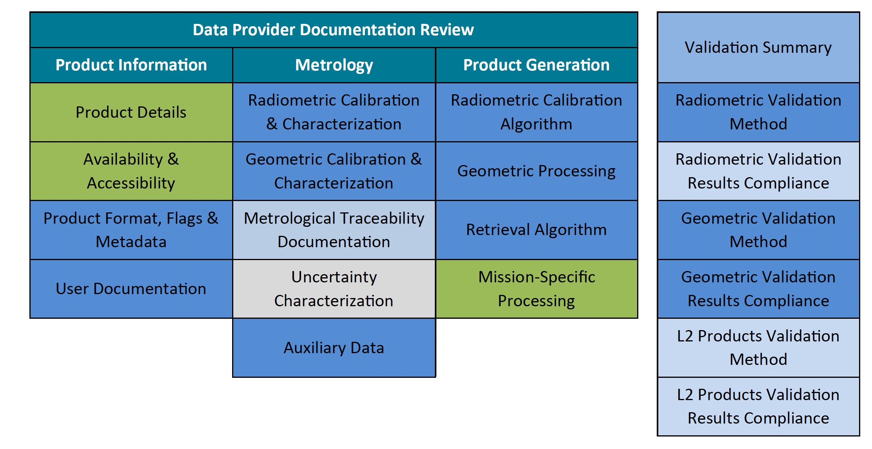
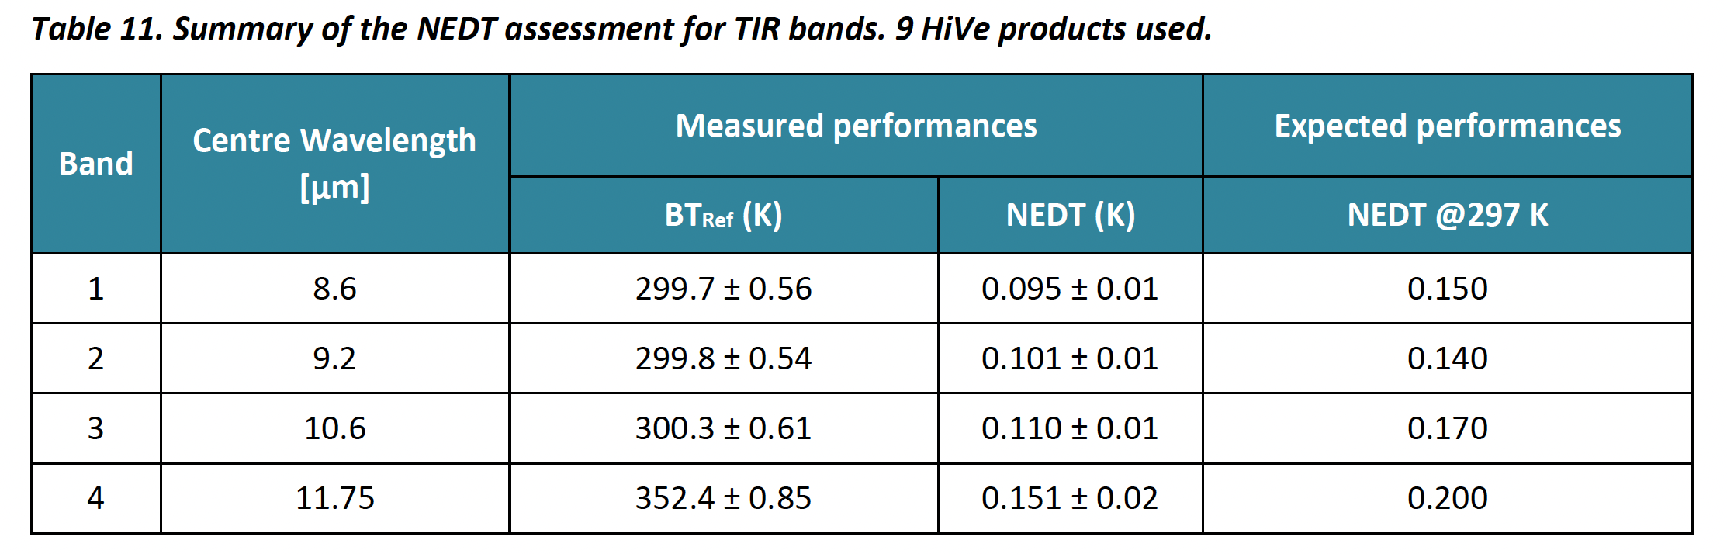
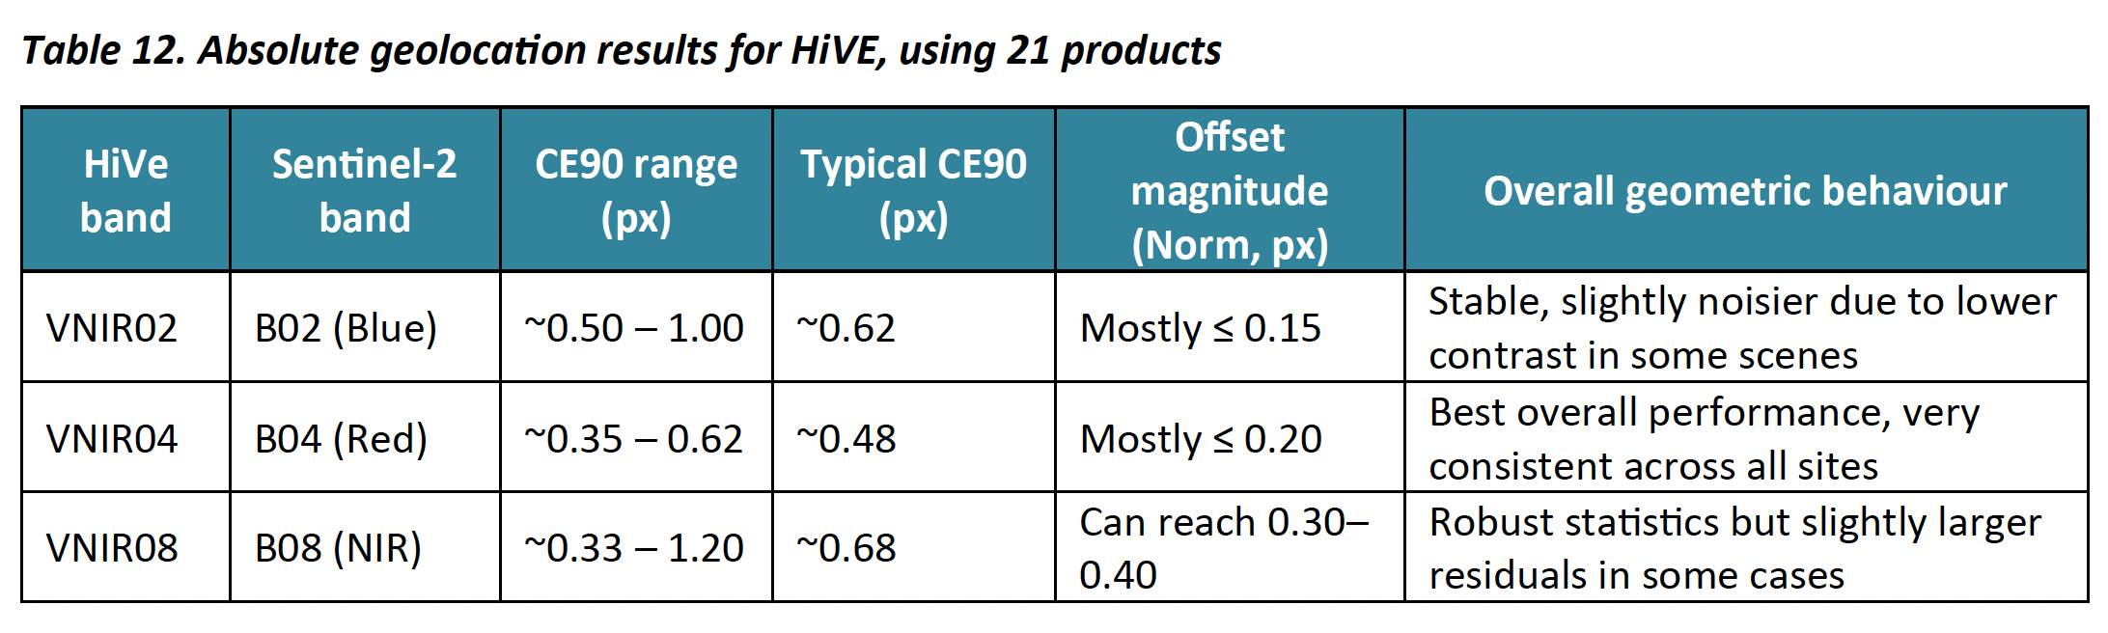


OPT - MPC Performance Analysis
Summary Cal/Val Maturity Matrix.

Slide 19
Farewell slide
Andreas Brunn, engineering manager image processing and calval
andreas.brunn@constellr.com

