Slide 1
LSI-VC-19
April 2026
SIT Chair Water Planet Activities
Item 6.1

Slide 2
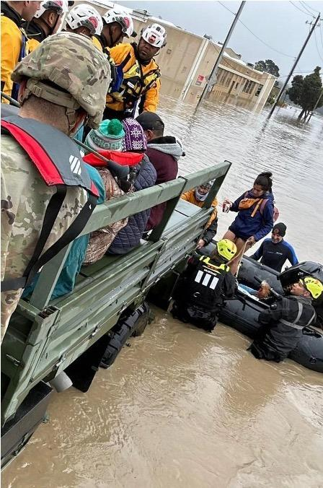

NASA SIT Chair Priorities
Priority 1: Water Planet- Seeing Earth's Water from Space
Advance understanding of Earth's water cycle by monitoring terrestrial waters, coastal regions, and oceans from space. Transform this knowledge to actionable insights to enhance water use efficiency, improve water quality, and enhance resilience to water-related hazards such as droughts, floods, and storms.

Slide 3
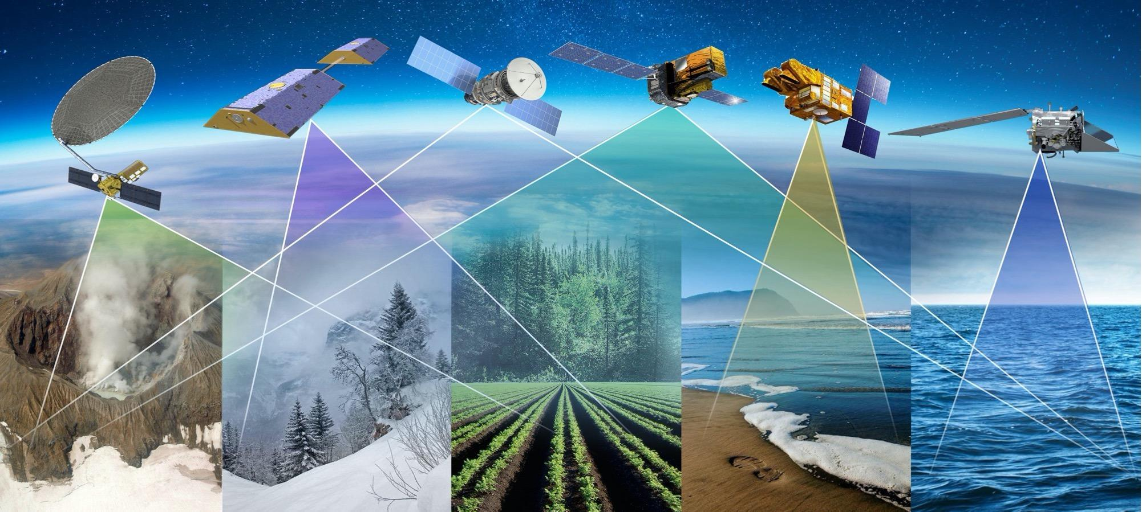
Priority 1: Key Objectives
Coordinated Water Observations
Accessible and Interoperable Water Data Products
User-Center Solutions for Water Challenges
Assessment of Benefits & Impact

Slide 4
Priority 1: Deliverables Timeline
Seeing Earth’s Water from Space
Plenary
2025
SIT-41
SIT TW
2026
Plenary
2026
SIT-42
SIT TW
2027
Plenary
2027
Objectives
Coordinated Water Observations
Gap analysis of water variables
Best practice guidance for integrating multispectral (optical + SAR) data for water
Coordinate and promote multisource integrated water products
Accessible & Interoperable Water Data Products
Define application specific requirements for water variables
CEOS-ARD Self Assessments
CEOS-ARD for Water
Encourage and contribute CEOS ARD Water products related to water resources & quality
Align and promote user-driven tools for water management and resilience
User-centered Solutions for Water Challenges
Water Quality Workshop Series
Advancing EO data for water resources solutions (TBD)
Assess data needs for water resources / water quality management
Assess Impact & Benefits
Impact assessment of existing CEOS activities related to water/resilience (w/ Priority 2)
Use cases on the benefits of EO for water

Slide 5
Table of Contents
Best Practice Guidance for Integrating Multiplatform and Multispectral Data for Water Science & Applications
Executive Summary
Introduction
Overview of Satellite Data for Water
Societal Challenges and Multi-Sensor Integration Opportunities
Integration & Best Practices
In-situ Network and Cal/Val Adequacy
Summary Gap Table
Way Forward & References

Slide 6

Use Cases
Each use case asks: Why does this water challenge require multiple sensors? What impact does integrated SAR + Optical provide? What are the pitfalls?
Post-Storm Water Supply & Quality
Drought Impact on Agriculture & Water Quality
River Floods & Coastal Water Quality
SAR + NISAR + PACE + SWOT
2024 Gulf Coast hurricanes Helene & Milton
GRACE-FO + SMAP + OPERA DSWx + PACE/CyAN
Drought-driven HAB intensification in reservoirs
SAR + SWOT discharge + PACE turbidity
Mississippi River flood pulses & Gulf hypoxia
Crop Health Monitoring & Food Security
Snow Water Supply & Security
Wildfire Impact Assessment
Sentinel-1 SAR + Sentinel-2/Landsat optical
Multi-freq SAR fusion: Sentinel-1 + NISAR + Airbus
Iowa, Michigan, Florida
NISAR + AMSR2 SWE validated at ASO sites
Sierra Nevada → Hindu Kush-Himalaya
Sentinel-1 SAR + Sentinel-2/Landsat optical
Canada

Slide 7
CEOS SIT-41
CEOS-ARD Water Thematic
David Borges, NASA
Agenda Item 5.2
CEOS SIT-41 2026
Irvine, California, USA
14-16 April 2026

Slide 8
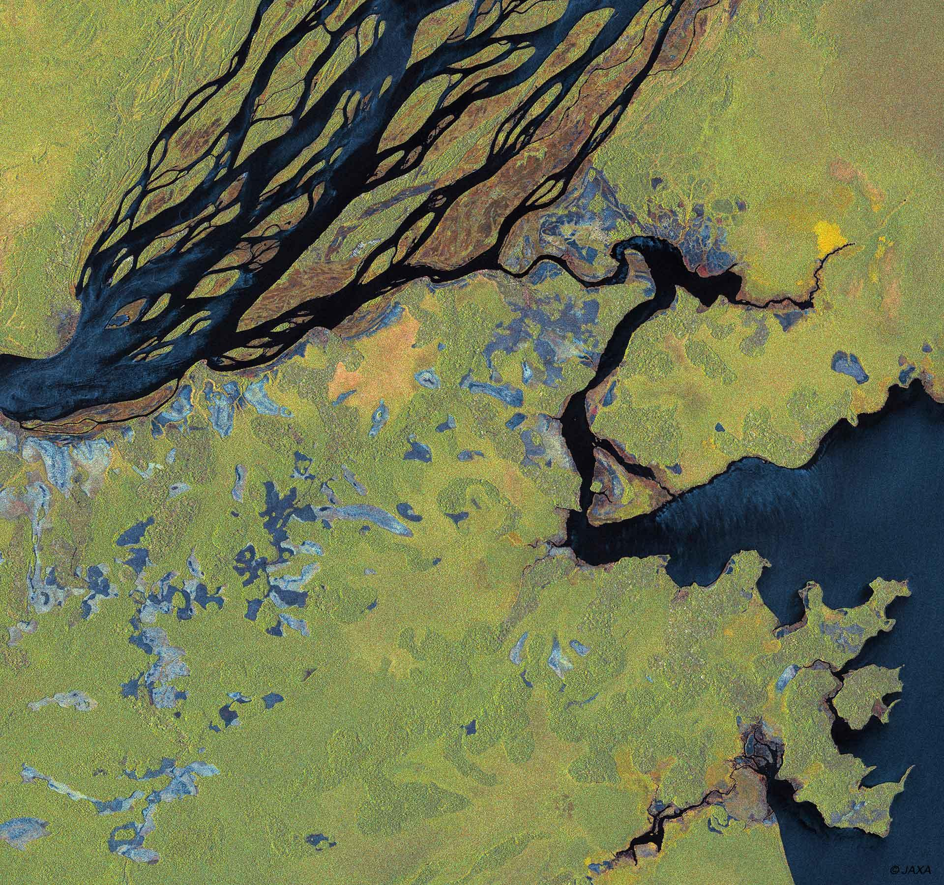


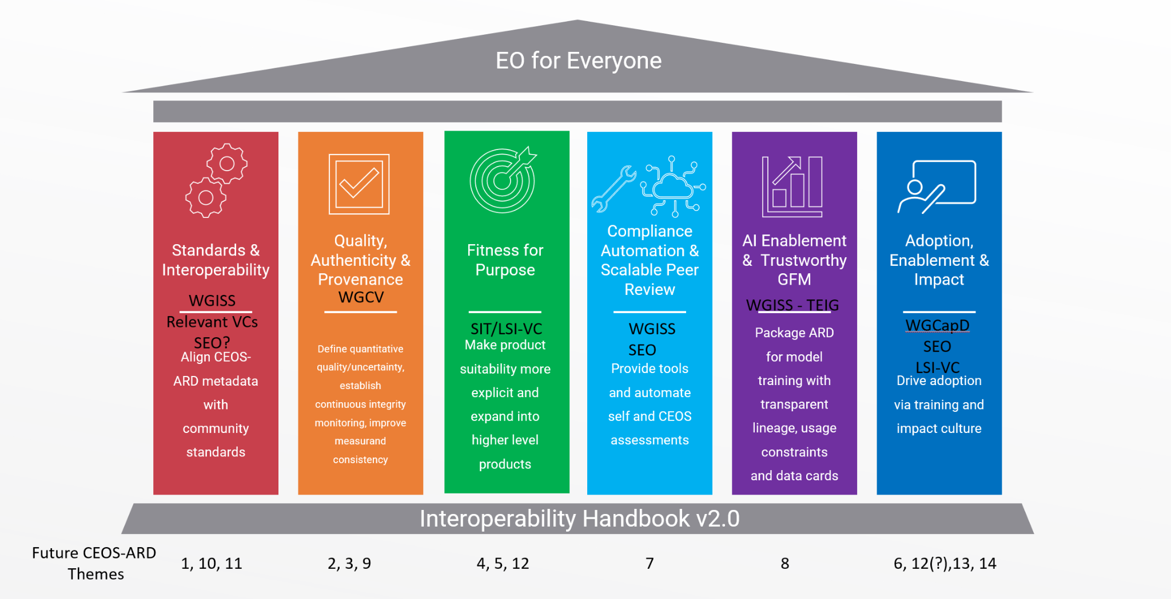
CEOS-ARD Strategy Pillars
Underpinned by CEOS Interoperability Handbook conventions

Slide 9
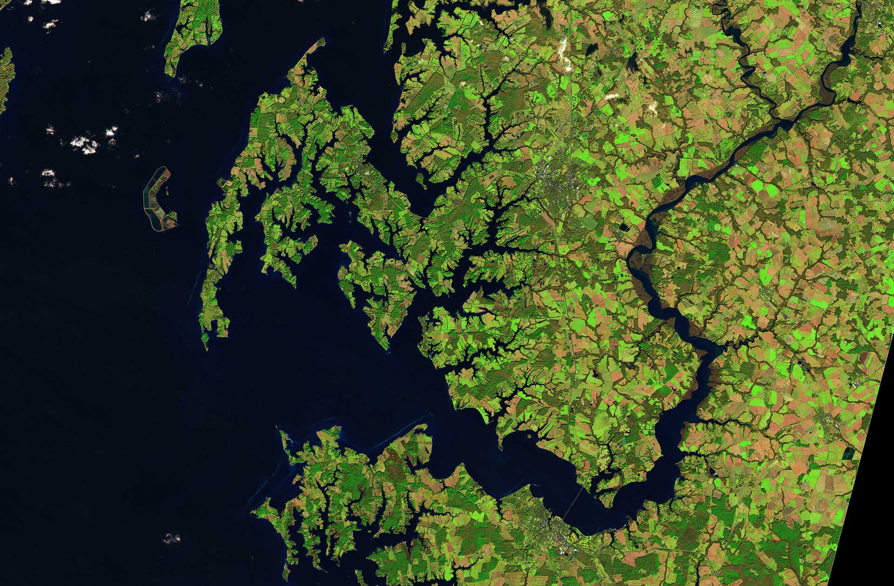

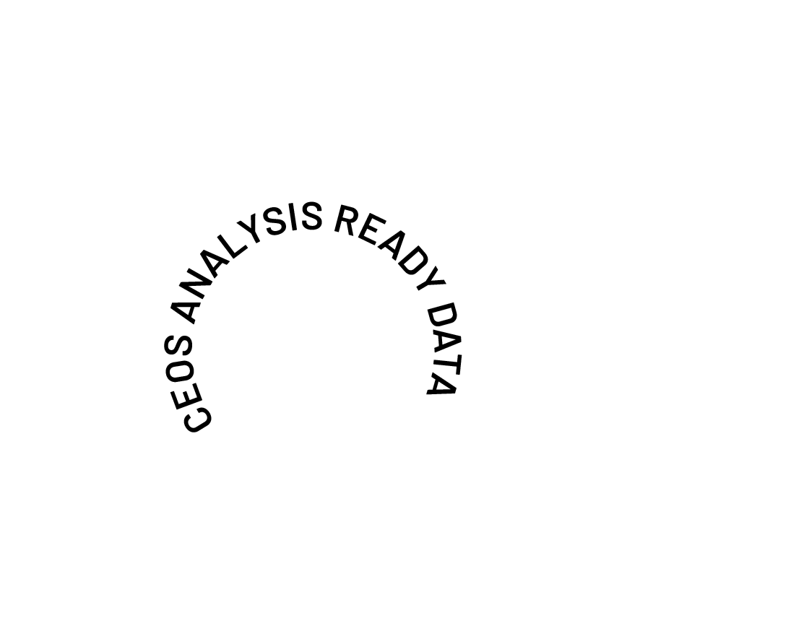
CEOS-ARD for Water
SIT Chair Priority #1: Water Planet- Seeing Earth's Water from Space has CEOS-ARD as a focus.
Deliverable: Contribute a water thematic section to updated CEOS-ARD strategy (in collaboration with CEOS Chair) by 2026 SIT-TW.
Where do we want to be in 5 years time to ensure CEOS-ARD is serving the needs of the water community?
Can we prepare a holistic vision for CEOS-ARD for water?
What do we need to cover the whole water cycle system?
What are the analysis-ready products needed by the water community?
  Essential Water Variables, or an expanded list of products?
What Product Family Specs do we need to meet those requirements?
  Are they derivatives of Aquatic Reflectance and/or SAR PFS?
  Who will develop those specs?
What is the appropriate ‘Level’ of CEOS-ARD product?
Can we use the CEOS WQ workshop series to elicit requirements and determine a development roadmap?

Slide 10
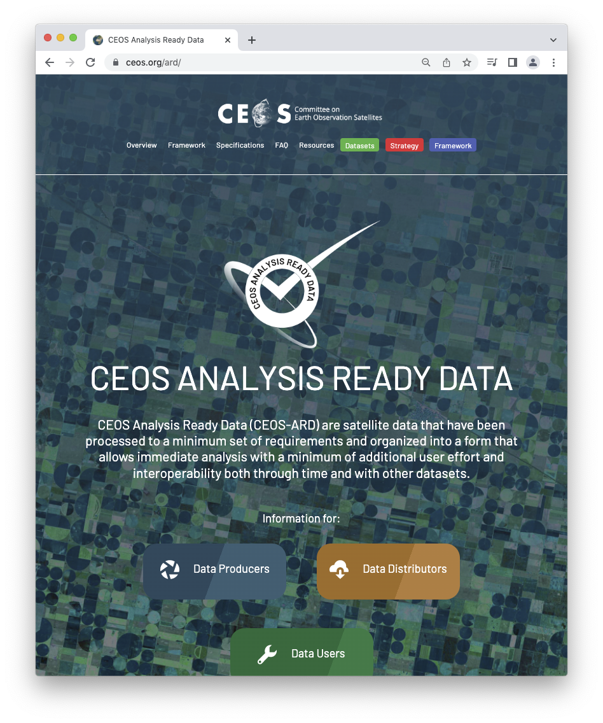
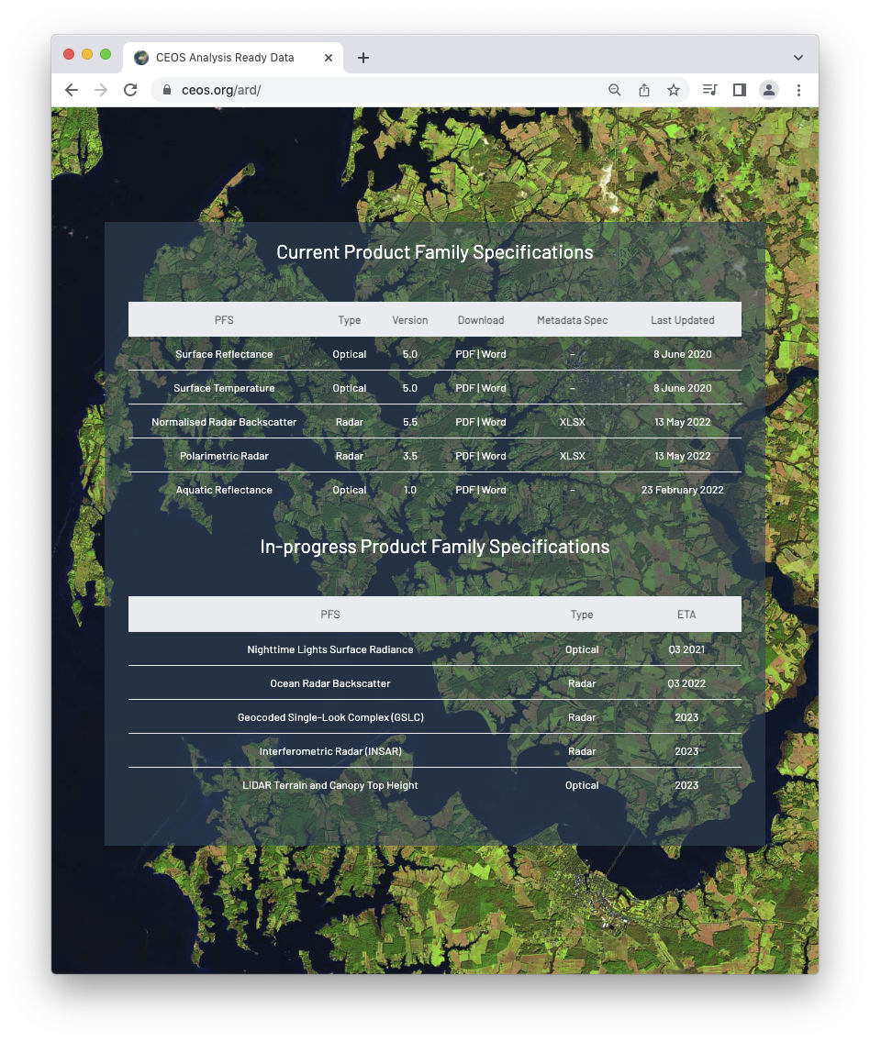
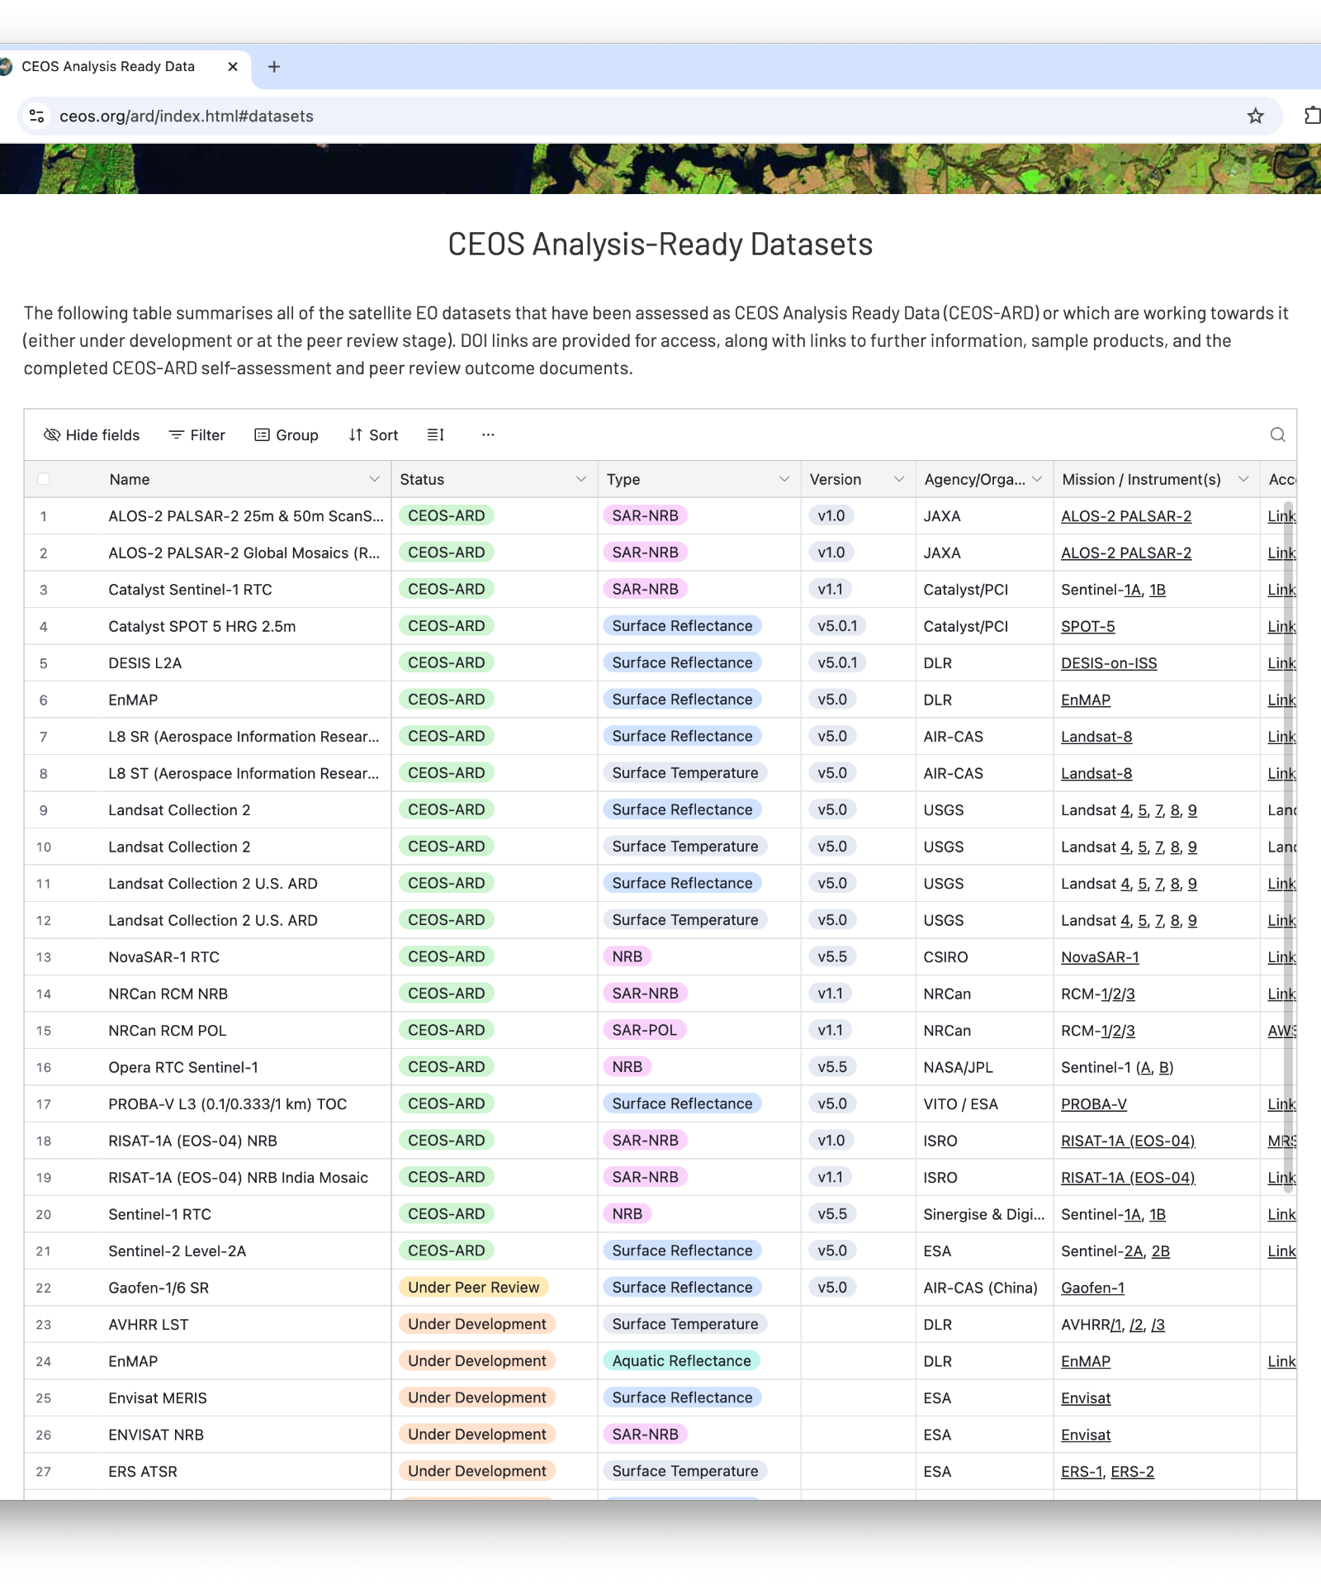
CEOS-ARD for Water
Self-Assessments have been initiated under NASA SIT Chair Priority #1
PACE (Aquatic Reflectance PFS)
SWOT (SAR PFS)
Compliance findings expected to be mutually beneficial to potential future NASA data practices as well as evolving ARD specifications.
Higher level water products review following initial Self-Assessments, to support “Fitness for Purpose” Pillar

Slide 11
LSI-VC-19
April 2026
SIT Chair Water Planet Activities
Item 6.7: Discussion

Slide 12
Discussion (1/2)
Parallels between the Best Practice Guidance for Integrating Multiplatform/Multisensor Data for Water Science and Applications and the Surface Reflectance Quality and Consistency Project
Representation of the aquatic domain in WGCV – is more needed?
Separate CEOS-ARD Strategy annex
or just part of the fitness for purpose initiatives?

Slide 13
Discussion (2/2)
Where do you want CEOS to be in 5 years time to ensure CEOS-ARD is serving the needs of the water community?
What are the analysis-ready data, and products needed by the water community?
  Essential Water Variables, or an expanded list of products?
What Product Family Specs do we need to meet those requirements?
  Are they derivatives of Aquatic Reflectance and/or SAR PFS?
What is the appropriate ‘Level’ of CEOS-ARD product?

