Slide 1

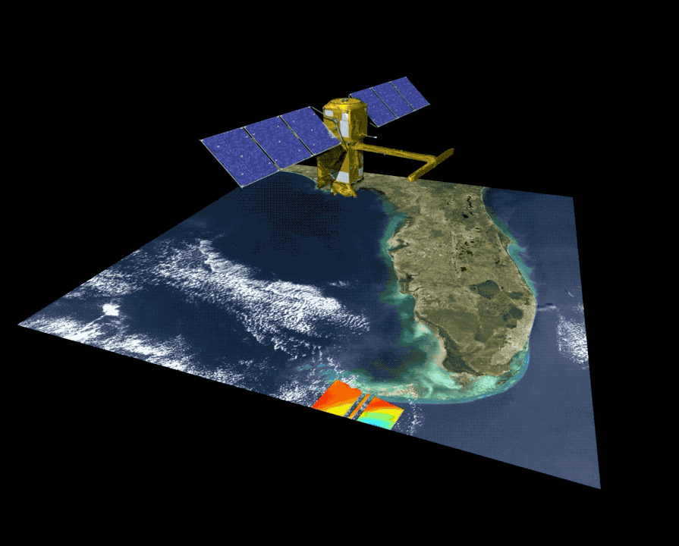
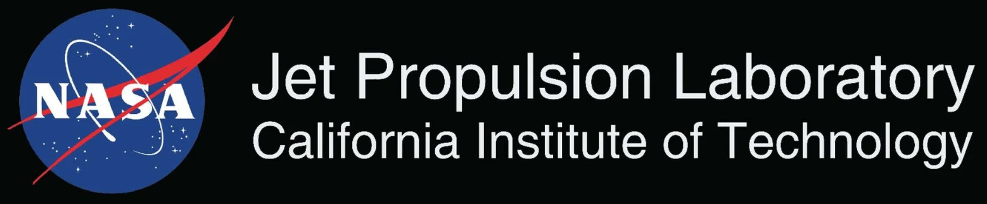
Surface Water and Ocean Topography Mission Provides heights of the world’s oceans and inland waters
Data Information
Observations of:
Coastal sea level and ocean heights at unprecedented resolution over a swath
Heights, widths, and slopes of rivers wider than 30m
Heights, extents, and storage changes of all lakes larger than 1 hectare
Global coverage below 78 degrees latitude
21-day orbit cycle yielding observations of any given location every 10 days on average
Applications Areas
Water resource management and reservoir monitoring
Coastal and inland flooding
Maritime and river operations and commerce
Coastal zone management
Matthew Bonnema, NASA JPL
WGCV-56 / LSI-VC-19 Joint Meeting
April 23rd 2026

Slide 2
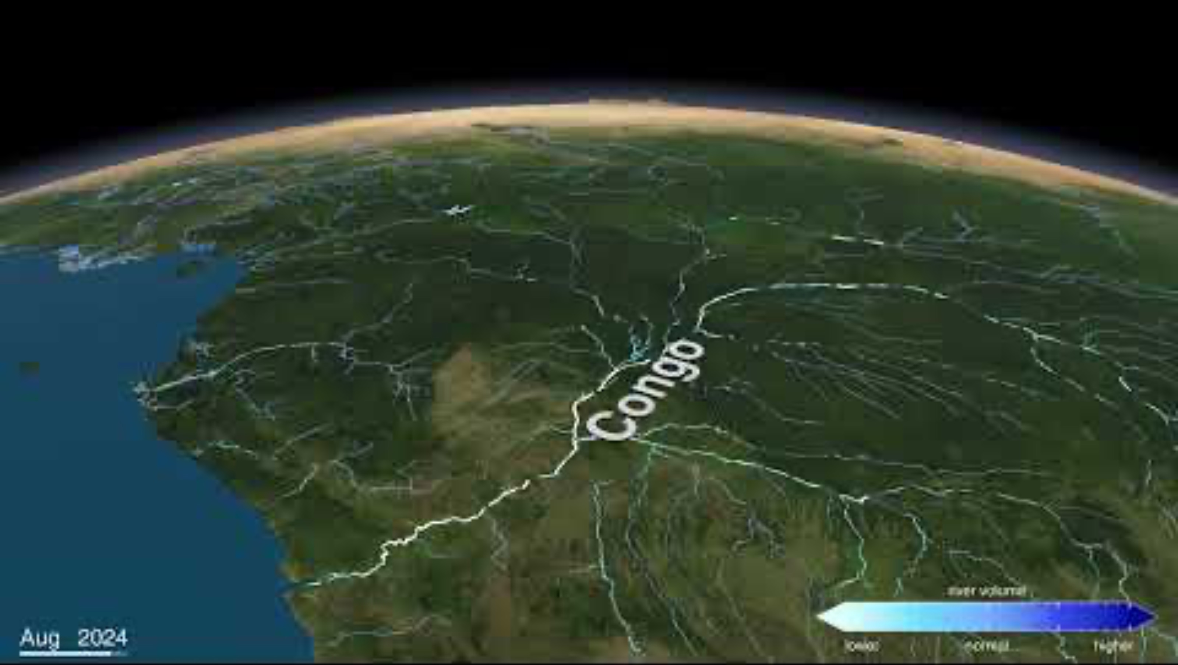
SWOT - Global River Measurements

Slide 3
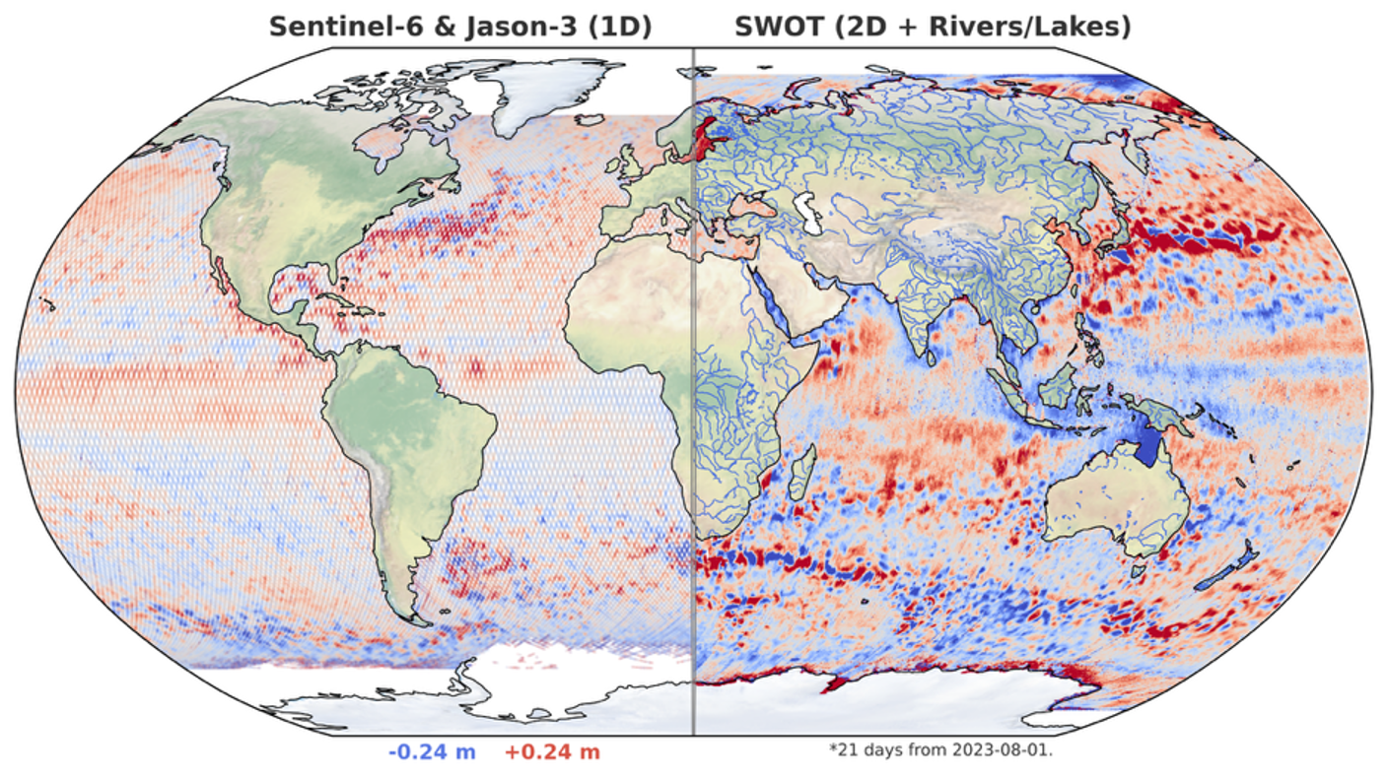
SWOT - Global Measurements of Ocean

Slide 4
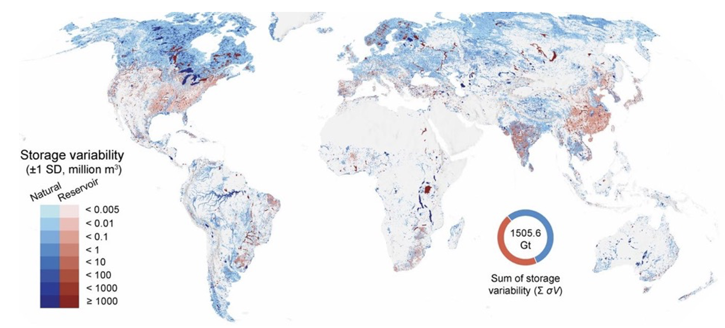
SWOT - Global Measurements of Lakes

Slide 5
SWOT - Data Products
Data Product Short Name | Data Product Description
L1B_LR_INTF | Low rate interferogram
L1B_HR_SLC | High rate single-look complex (SLC)
L2_LR_SSH | Low rate sea surface height (SSH), significant wave height, and wind speed
L2_HR_PIXC | High rate pixel cloud (PIXC) geolocated heights and backscatter
L2_HR_RiverSP | High rate river single pass product providing water surface elevation, slope, width, and derived discharge
L2_HR_LakeSP | High rate lake single pass product providing water surface elevation, area, and derived storage change
L2_HR_Raster | High rate raster product providing rasterized water surface elevation and inundation extent
Level 1 Radar Products
Level 2 Ocean Product
Level 2 Surface Water Products

Slide 6

SWOT - Data Products - ARD
Data Product Short Name | Data Product Description
L1B_LR_INTF | Low rate interferogram
L1B_HR_SLC | High rate single-look complex (SLC)
L2_LR_SSH | Low rate sea surface height (SSH), significant wave height, and wind speed
L2_HR_PIXC | High rate pixel cloud (PIXC) geolocated heights and backscatter
L2_HR_RiverSP | High rate river single pass product providing water surface elevation, slope, width, and derived discharge
L2_HR_LakeSP | High rate lake single pass product providing water surface elevation, area, and derived storage change
L2_HR_Raster | High rate raster product providing rasterized water surface elevation and inundation extent
Level 1 Radar Products
Level 2 Ocean Product
Level 2 Surface Water Products

Slide 7
SWOT - Data Products - ARD
Data Product Short Name | Data Product Description
L1B_LR_INTF | Low rate interferogram
L1B_HR_SLC | High rate single-look complex (SLC)
SWOT ARD Self Assessmnet (Preliminary):
Focused on Interferometric Radar [InSAR]
Potential for Ocean Radar Backscatter [ORB]
Not meeting requirements, but working to determine delta
Interested in discussing ARD for higher level water products

Slide 8
SWOT - Data Products - Water ARD
Data Product Short Name | Data Product Description
L1B_LR_INTF | Low rate interferogram
L1B_HR_SLC | High rate single-look complex (SLC)
L2_LR_SSH | Low rate sea surface height (SSH), significant wave height, and wind speed
L2_HR_PIXC | High rate pixel cloud (PIXC) geolocated heights and backscatter
L2_HR_RiverSP | High rate river single pass product providing water surface elevation, slope, width, and derived discharge
L2_HR_LakeSP | High rate lake single pass product providing water surface elevation, area, and derived storage change
L2_HR_Raster | High rate raster product providing rasterized water surface elevation and inundation extent
Level 1 Radar Products
Level 2 Ocean Product
Level 2 Surface Water Products
Potential water ARD products?

Slide 9
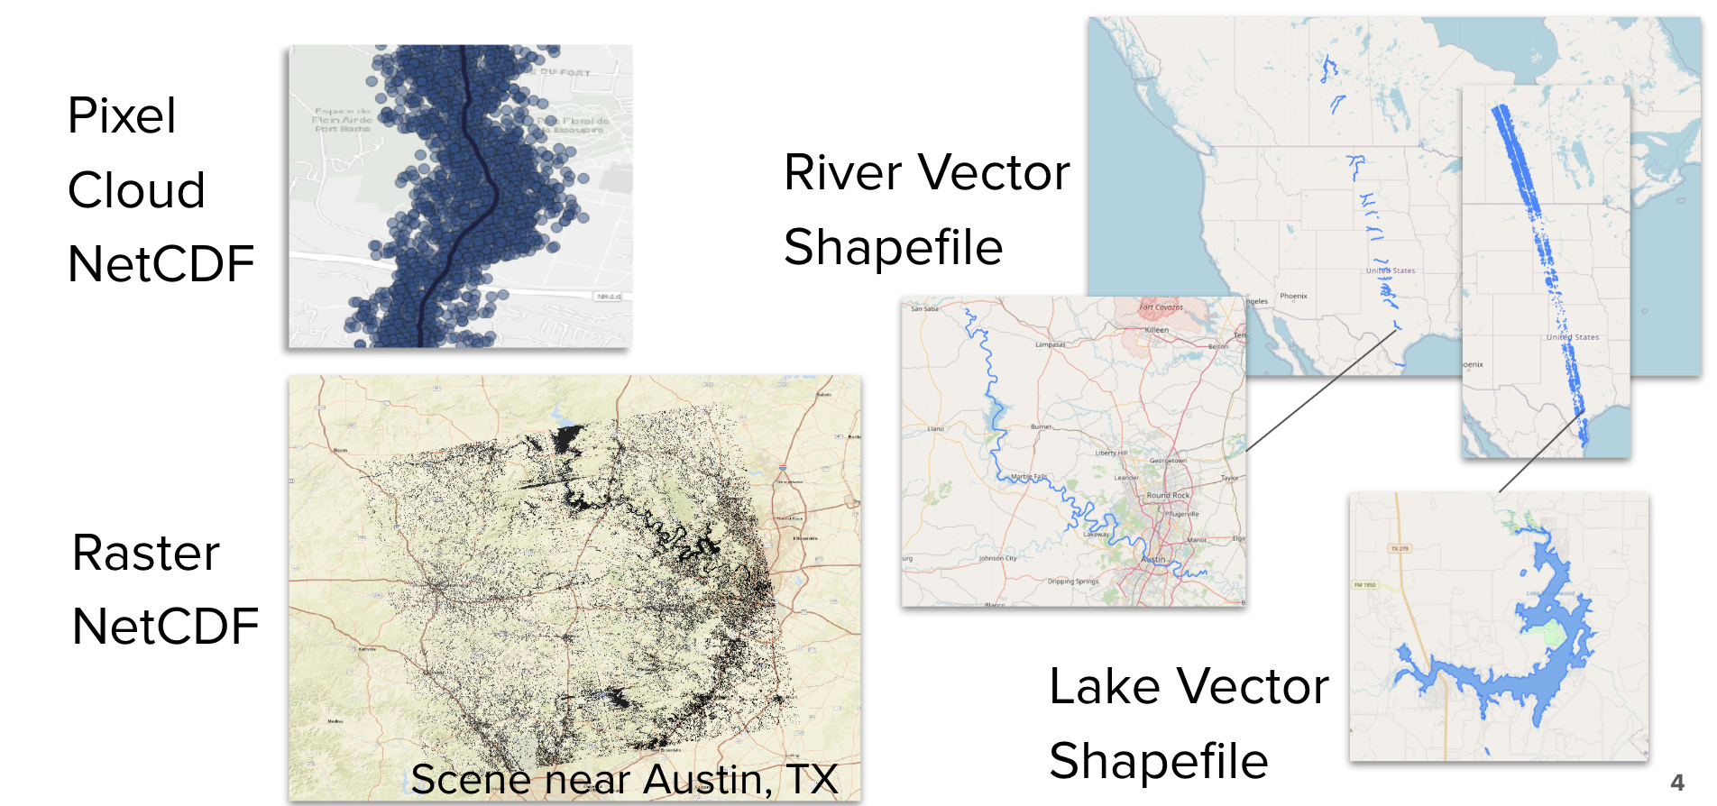
SWOT - Data Products - Water ARD

Slide 10


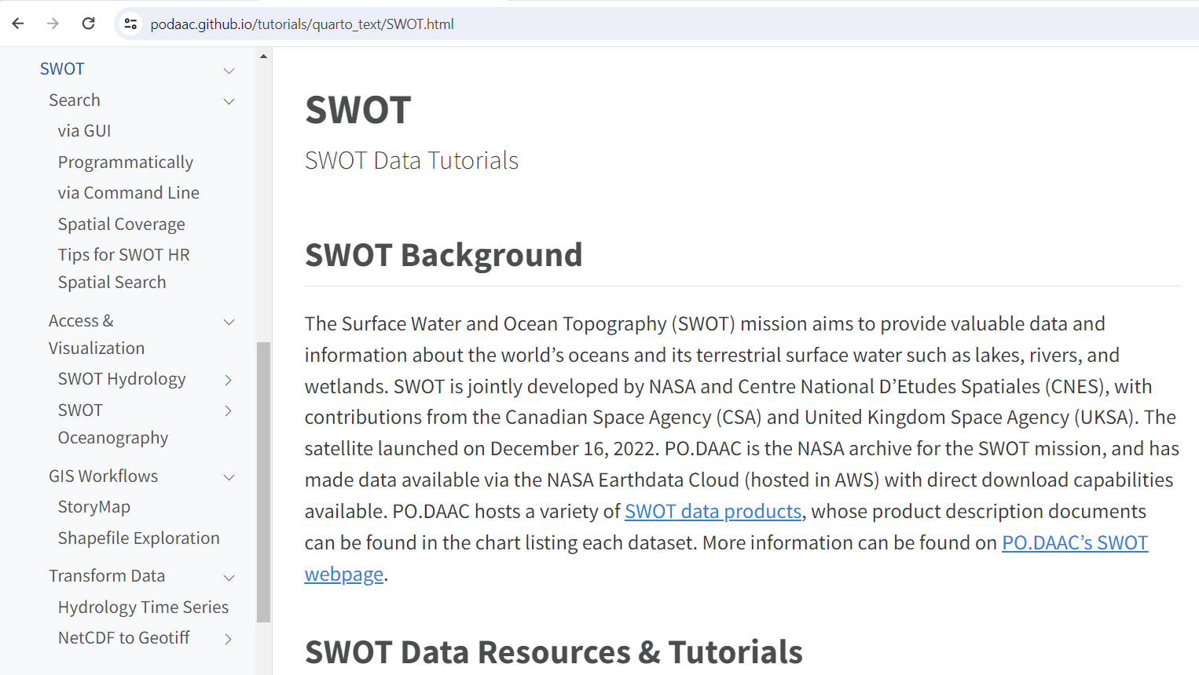


Resources, Tips, & Tutorials!
PO.DAAC Cookbook: SWOT Chapter
https://podaac.github.io/tutorials/quarto_text/SWOT.html
© 2024 California Institute of Technology. Government sponsorship acknowledged.
© 2024 California Institute of Technology. Government sponsorship acknowledged.

Slide 11
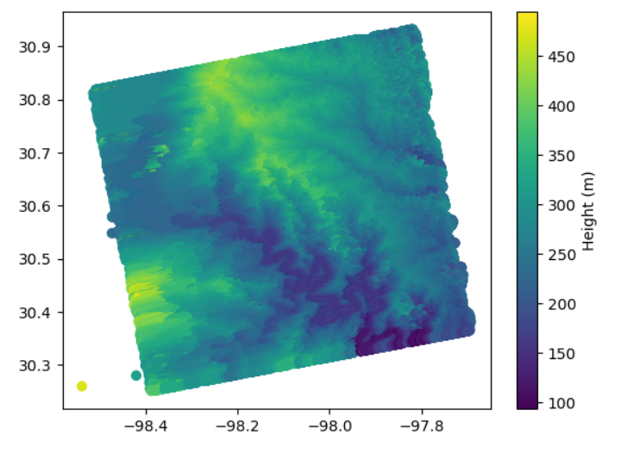
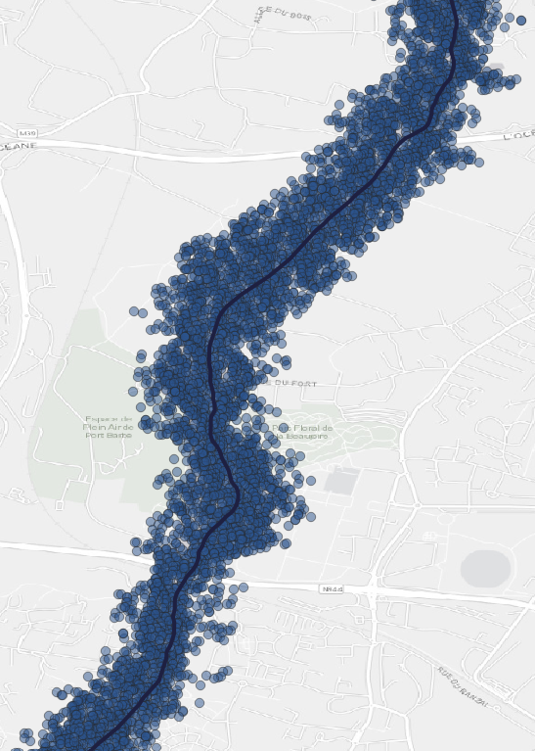
SWOT_L2_HR_PIXC (netCDF)
Description: Point cloud of water mask pixels (“pixel cloud”)
Spatial Extent Format: Tile (64x64 km²)
Select Variables: geolocated heights, backscatter, geophysical fields, and flags
Subcollections: N/A
Example river pixels
Colorado River near Austin, TX
© 2024 California Institute of Technology. Government sponsorship acknowledged.

Slide 12
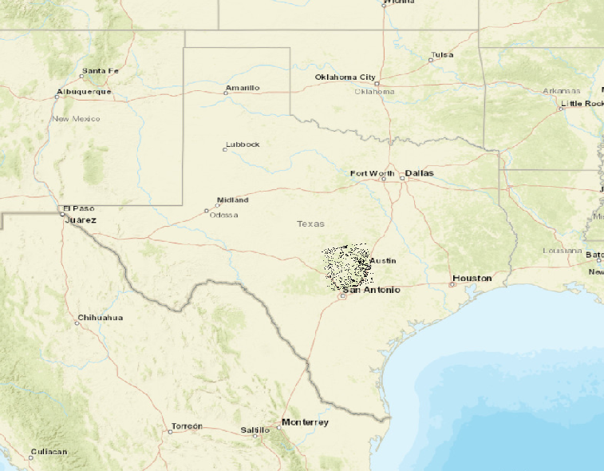
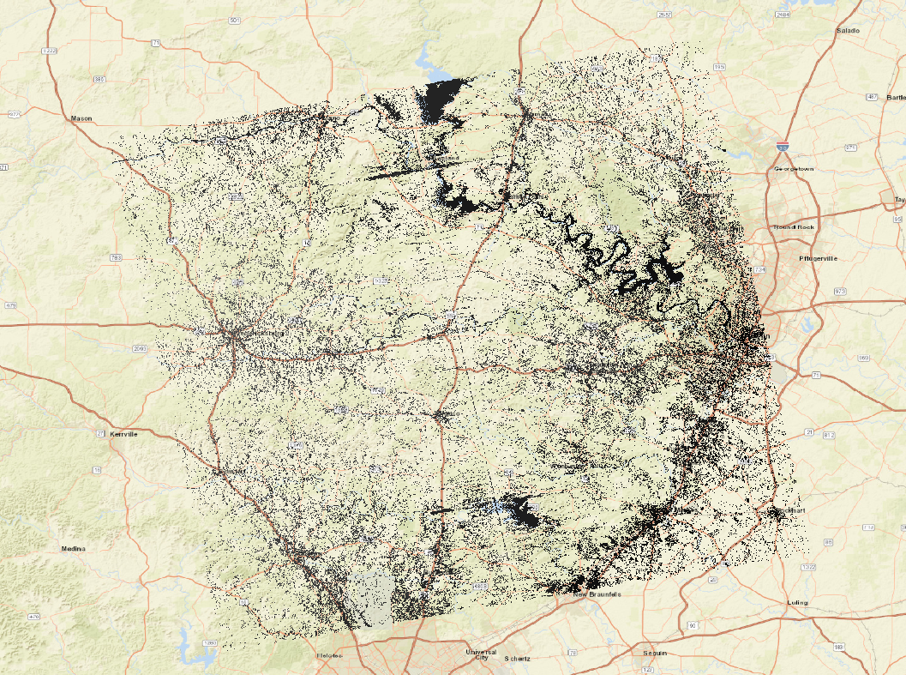
SWOT_L2_Raster (netCDF)
Description: Geographically fixed rasterized water surface elevation and inundation extent.
Spatial Extent Format: Scene (128x128 km²)
Select Variables: water surface elevation, area, water fraction, backscatter, geophysical information
Subcollections:
SWOT_L2_Raster_100m
SWOT_L2_Raster_250m
Scene near Austin, TX
© 2024 California Institute of Technology. Government sponsorship acknowledged.

Slide 13
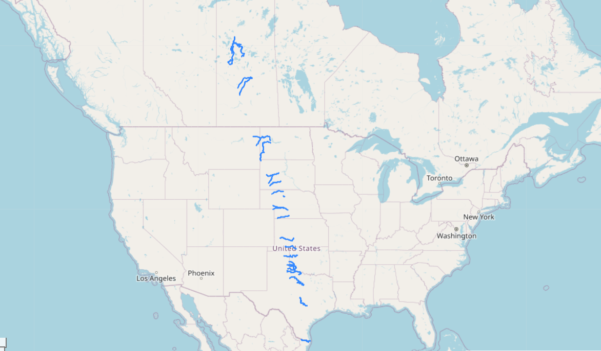
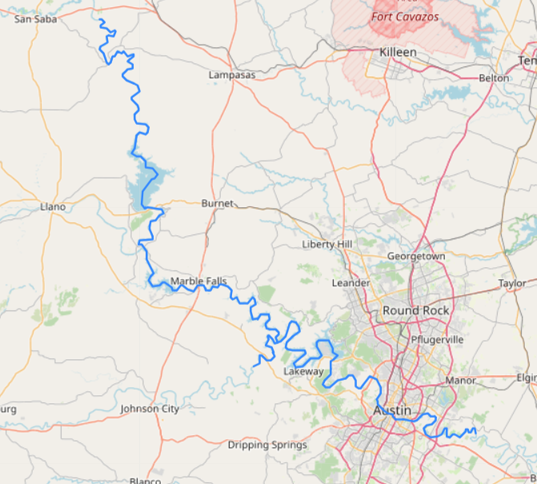
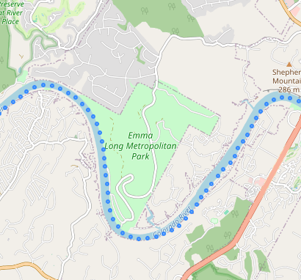
SWOT_L2_RiverSP (shapefile)
Description: Vectors of river reaches (~10 km long) and nodes (~200 m spacing) in prior river database.
Extent Format: continent-scale swath
Variables: water surface elevation, slope, width, derived discharge*
Subcollections:
SWOT_L2_RiverSP_reach
SWOT_L2_RiverSP_node
*included ~2 years after launch
Colorado River near Austin, TX
Reach file
Node file
© 2024 California Institute of Technology. Government sponsorship acknowledged.

Slide 14
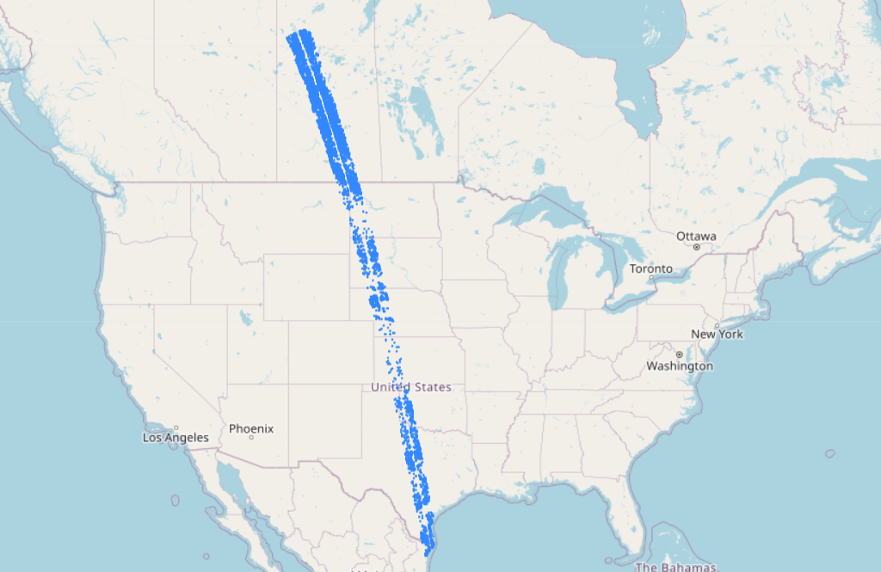
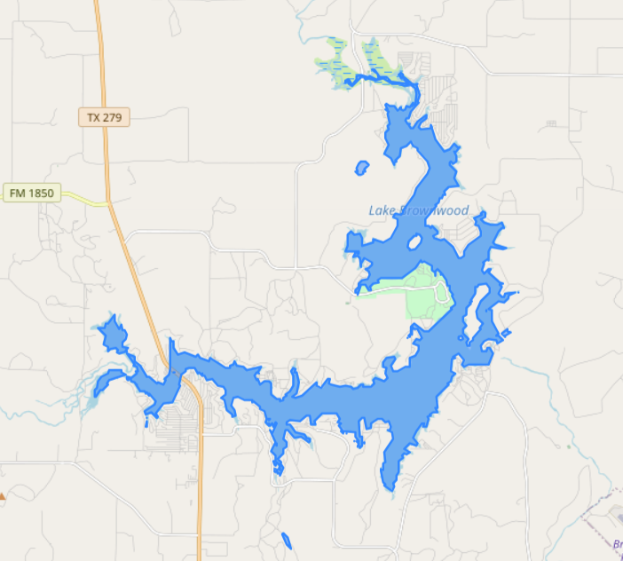
SWOT_L2_LakeSP (shapefile)
Description: Vectors of lakes in prior lake database and detected features not in the prior river or lake databases.
Extent Format: continent-scale swath
Select Variables: water surface elevation, area, derived storage change
Subcollections:
SWOT_L2_LakeSP_obs
SWOT_L2_LakeSP_prior
SWOT_L2_LakeSP_unassigned
Lake Brownwood, TX
© 2024 California Institute of Technology. Government sponsorship acknowledged.

Slide 15
Surface Water and Ocean Topography Mission Provides heights of the world’s oceans and inland waters
Data Information
Observations of:
Coastal sea level and ocean heights at unprecedented resolution over a swath
Heights, widths, and slopes of rivers wider than 30m
Heights, extents, and storage changes of all lakes larger than 1 hectare
Global coverage below 78 degrees latitude
21-day orbit cycle yielding observations of any given location every 10 days on average
Applications Areas
Water resource management and reservoir monitoring
Coastal and inland flooding
Maritime and river operations and commerce
Coastal zone management
Matthew Bonnema, NASA JPL
CEOS SIT-41 WQ Workshop
April 13th 2026

Slide 16
SWOT - Catchment to Coast Products
Data Product Short Name | Data Product Description
L1B_LR_INTF | Low rate interferogram
L1B_HR_SLC | High rate single-look complex (SLC)
L2_LR_SSH | Low rate sea surface height (SSH), significant wave height, and wind speed
L2_HR_PIXC | High rate pixel cloud (PIXC) geolocated heights and backscatter
L2_HR_RiverSP | High rate river single pass product providing water surface elevation, slope, width, and derived discharge
L2_HR_LakeSP | High rate lake single pass product providing water surface elevation, area, and derived storage change
L2_HR_Raster | High rate raster product providing rasterized water surface elevation and inundation extent
SWOT measures the elevation and extent of water surfaces, providing information about the movement of Earth’s water
Coastal pressure gradients, currents
Surface water fluxes and stores
River and lake bathymetry
Presence and depth* of inundation

Slide 17
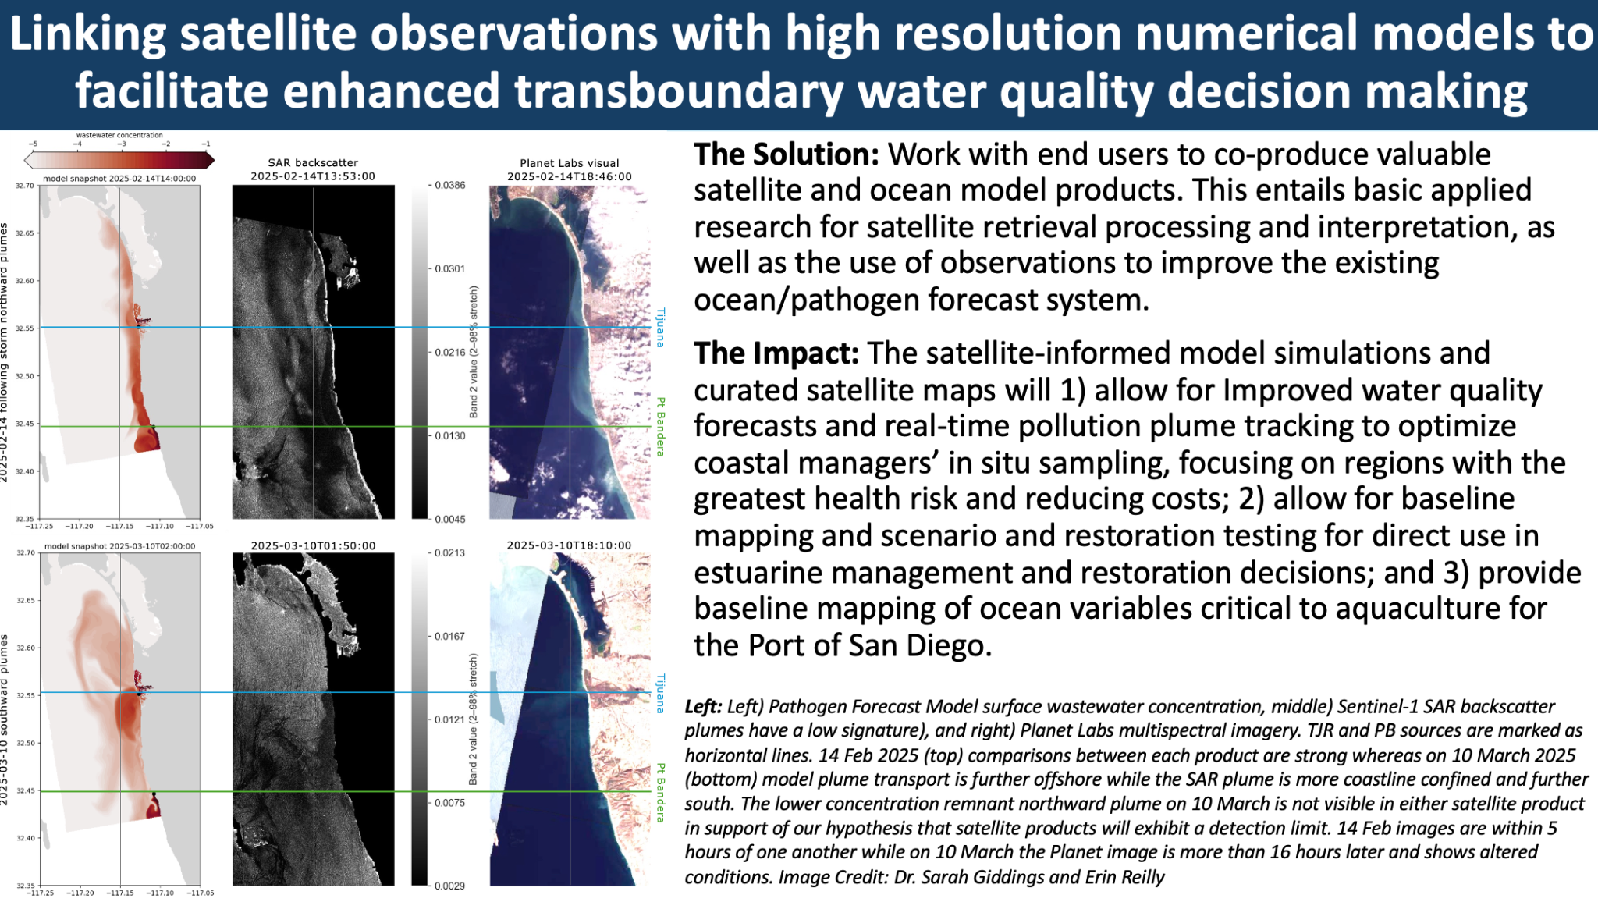
SWOT - Coastal Zone Applications
Recently funded project using SWOT to improve coastal water quality models and forecasts

