Slide 1
SIT Chair Water Planet Activities
Best Practice Guidance for Integrating Multiplatform/Multisensor Data for Water Science and Applications
John Bolten, NASA
Agenda Item J6.6
WGCV-56 / LSI-VC-19
Irvine, California, USA
April 23, 2026

Slide 2


Background & Context
2015 Strategy for Water Observations from Space
The Observation Landscape Changed
Strategy Recommendations:
Provided 22 recommendations covering satellite acquisition, in-situ networks, research, data sharing, and capacity development
Focus:
Strong on data acquisition, sharing, and standards with a primary audience of CEOS member organizations
Gap:
No unified, user/practitioner-facing guidance on how to combine optical and SAR data for water applications nor the increased operational value of integration for decision-making purposes and impact.
Sentinel-1/2 Global SAR + optical baseline (2014–)
SMAP Global soil moisture, operational (2015)
GRACE-FO Groundwater/storage monitoring (2018)
IceSat-2 Ice sheet height changes (2018)
SWOT Global surface water elevation (2022)
PACE Hyperspectral ocean color & water quality (2024)
OPERA DSWx Operational SAR water product (2024)
ALOS-4 L-band SAR; land deformation/subsidence (2024)
NISAR L-band SAR; soil moisture, SWE (2025)
Commercial/Smallsat Various
Examples of new water-relevant missions since 2015 from across the Earth observing system (list not exhaustive)
Opportunity: There has been an explosion in water-relevant Earth observations across the intergovernmental and private space since 2015. The resulting data is larger than ever and spans multiple formats and specifications. Therefore, there's a critical need for updated guidance on combining, processing, and applying these data to water management needs. This document aims to fill that gap—providing practitioners with use cases and best practices for optimally combining these sensors to significantly advance water science and decision-making impact.

Slide 3

Purpose & Scope
What This Document Is
What It Is Not
Who It Serves
A community-driven best practice guide for combining optical, SAR, passive microwave, and gravity satellite data to derive water variables, with a strong emphasis on decision-making impact, not just methods.
A living document hosted on GitHub which can be updated as missions evolve, contributable by all CEOS agencies.
This document reflects established data frameworks but is not prescriptive of any specific methodology.
Not a comprehensive review of every possible sensor or application.
Not intended to be a rewrite of the 2015 CEOS Strategy for Water Observations from Space. Instead, it builds on it with an integration and decision-making first lens.
Scientists and practitioners already working with satellite data who need step-by-step guidance on multi-sensor/ spectral integration.
CEOS entities seeking a shared integration guidance for science innovation and applications impact.
Researchers writing proposals who need to know what best practice looks like.

Slide 4

Audience
Scientists and practitioners
Researchers who are experienced in working with satellite data for water but need guidance on best practices for combining optical and SAR datasets for applications.
CEOS member agency scientists and programme managers
Seeking a shared guidance for how the community integrates water data across missions — especially relevant for agencies assessing CEOS-ARD compliance and planning future mission contributions.
Operational water managers and decision makers
The document is technical but use cases are framed to demonstrate actionable societal value: flood response, drought early warning, drinking water safety, food security.
Proposal writers and early-career researchers
Writing proposals for multi-mission water work — need to cite community-endorsed best practices and understand what the right approach looks like before designing a study.

Slide 5
Table of Contents
Best Practice Guidance for Integrating Multiplatform and Multispectral Data for Water Science & Applications
Executive Summary
Introduction
Overview of Satellite Data for Water
Societal Challenges and Multi-Sensor Integration Opportunities
Integration & Best Practices
In-situ Network and Cal/Val Adequacy
Summary Gap Table
Way Forward & References

Slide 6
Table of Contents
Executive Summary
Introduction
2. Overview of Satellite Data for Water
1.1 Background and context
1.2 Purpose and objectives
1.3 Scope — catchment-to-coast continuum
1.4 Audience
1.5 How to navigate this document
1.6 Relationship to CEOS-ARD 2026, 2015 CEOS Water Strategy, and other related efforts
1.7 CEOS-ARD standards and interoperability
2.1 Optical multispectral
2.2 Ocean color and hyperspectral
2.3 Thermal infrared
2.4 Synthetic Aperture Radar (SAR)
2.5 Passive microwave
2.6 Surface water and altimetry
2.7 Gravity and groundwater
2.8 CEOS-ARD standards and interoperability

Slide 7
Table of Contents
3. Societal Challenges and Multi-Sensor Integration Opportunities ​
Thematic Area A — Water Availability
Thematic Area B — Water Use
River Height, Lake and Reservoir Storage
Groundwater Dynamics / Water Table Height
Seasonal Water Supply from Mountain Snowpack
Water Availability for Agriculture, Irrigation Management, and Flood Forecasting
Industrial and Residential Use Crop Water Consumption and Agricultural Water Demand at Field Scale
Thematic Area C — Water Quality
Thematic Area D — Water Extremes
Harmful Algal Blooms in Inland and Coastal Waters
Sargassum Inundation Events Disrupting Fisheries and Coastal Economies
Water Quality Monitoring in Optically Complex Coastal Environments
Drinking Water Utilities
Wastewater plume monitoring/management
Drought—Multi-Variable Impact on Water Supply and Demand
Flood - Flood Inundation and Surface Water Mapping
Landslides
Wildland Fires

Slide 8

Use Cases
Each use case asks: Why does this water challenge require multiple sensors? What impact does integrated SAR + Optical provide? What are the pitfalls?
Post-Storm Water Supply & Quality
Drought Impact on Agriculture & Water Quality
River Floods & Coastal Water Quality
SAR + NISAR + PACE + SWOT
2024 Gulf Coast hurricanes Helene & Milton
GRACE-FO + SMAP + OPERA DSWx + PACE/CyAN
Drought-driven HAB intensification in reservoirs
SAR + SWOT discharge + PACE turbidity
Mississippi River flood pulses & Gulf hypoxia
Crop Health Monitoring & Food Security
Snow Water Supply & Security
Wildfire Impact Assessment
Sentinel-1 SAR + Sentinel-2/Landsat optical
Multi-freq SAR fusion: Sentinel-1 + NISAR + Airbus
Iowa, Michigan, Florida
NISAR + AMSR2 SWE validated at ASO sites
Sierra Nevada → Hindu Kush-Himalaya
Sentinel-1 SAR + Sentinel-2/Landsat optical
Canada

Slide 9
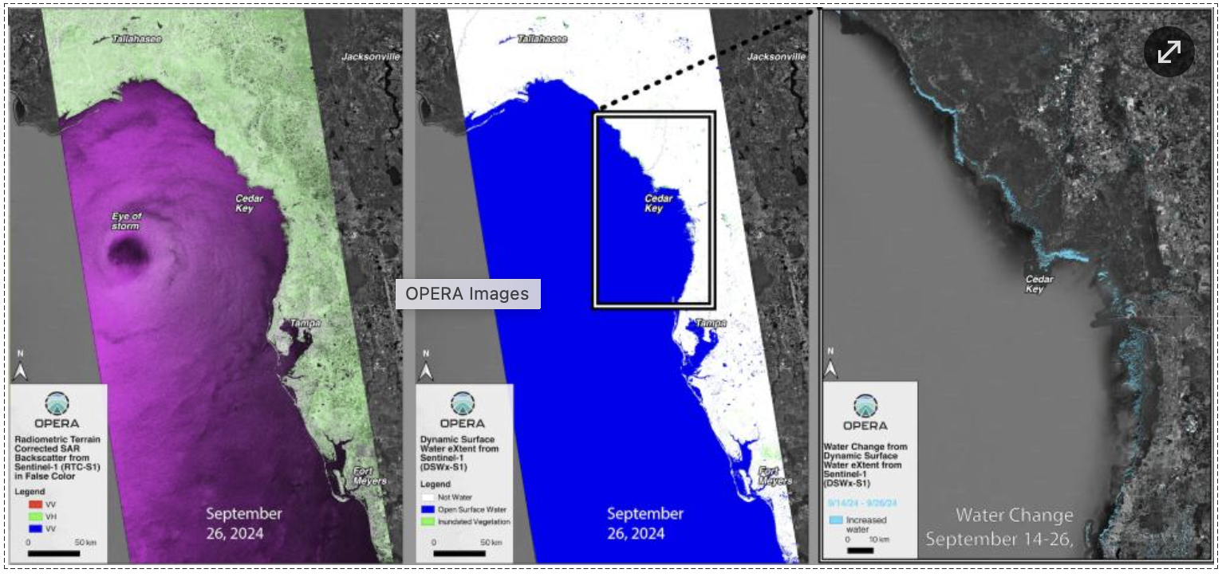
Use Cases: Post-Storm Water Supply & Quality
CHALLENGE
After major storms, decision-makers need to assess flood extent, water supply status, and contamination risk
Cloud cover blocks optical satellites for days and no single sensor provides all three
SAR sees through clouds but revisits only every 6–12 days — potentially missing peak flooding
Water quality assessment must wait until skies clear — no all-weather solution exists
SOLUTION
NISAR tracks soil saturation at high resolution to identify areas at risk of continued flooding
Commercial SAR (ICEYE, Capella) can improve temporal coverage but interoperability guidance is needed
SWOT monitors reservoir and river water levels to assess whether drinking water supply and flood control capacity have been compromised
PACE assesses water quality (sediment plumes, contamination, algal blooms) once clouds clear
Source: NASA JPL OPERA, PO.DAAC (podaac.jpl.nasa.gov). Credit: Alexander Handwerger
IMPACT
Complete post-storm water assessment — from flood extent to water supply to contamination — across the full disaster timeline
Enables faster, better-informed emergency response and recovery decisions

Slide 10
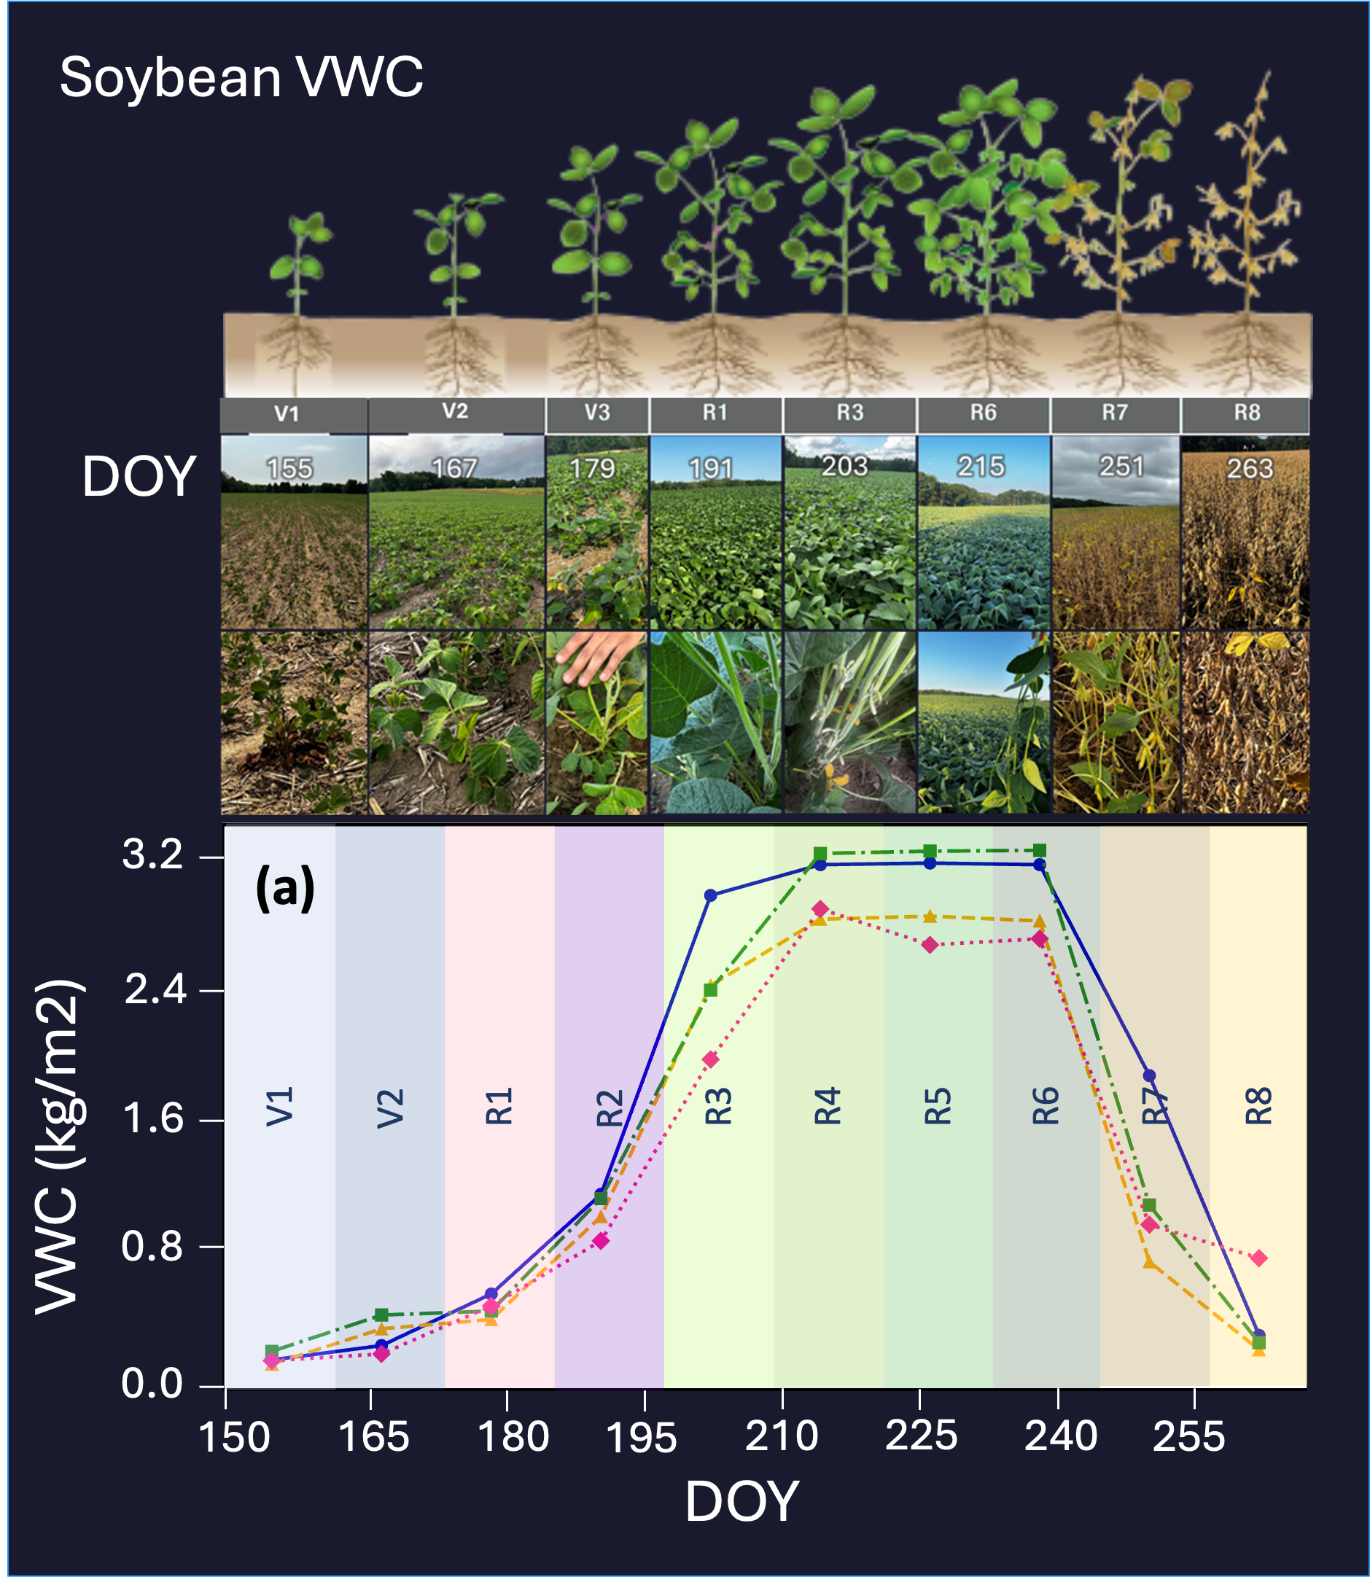
Use Cases: High-resolution Vegetation Water Content Estimation for Food Security
CHALLENGE
Farmers and food security agencies need timely crop water stress information for irrigation, harvest, and drought decisions
Optical sensors can't see through clouds
Optical lose accuracy in dense crops
Radar satellites pass over too infrequently to track rapid changes during the growing season
Without continuous monitoring, water stress goes undetected until yield losses are already locked in
Sentinel-1 revisit = 12 days — one observation per growth stage
SOLUTION
Multi-freq SAR fusion: Sentinel-1 (C-band) + NISAR (L-band) + Commercial SAR (X-band)
+ Sentinel-2/Landsat optical
Generative AI to synthesize intermediate imagery and fill SAR and optical temporal gaps
VWC time series: field measurements vs. AI model predictions across soybean growth stages (V1–R8)
IMPACT
All-weather, high-res (10-30 meter) and high-temporal (2-3 days) VWC maps across full crop growth cycle
Scalable to unseen regions with minimal field labels
Actionable crop monitoring for food security at continental scale

Slide 11
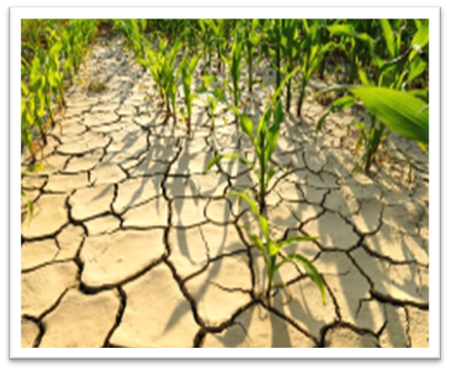
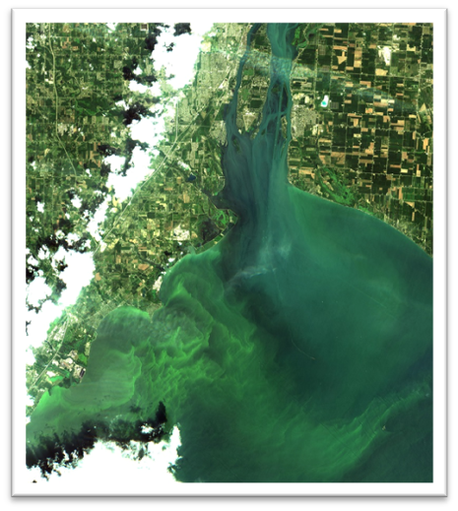
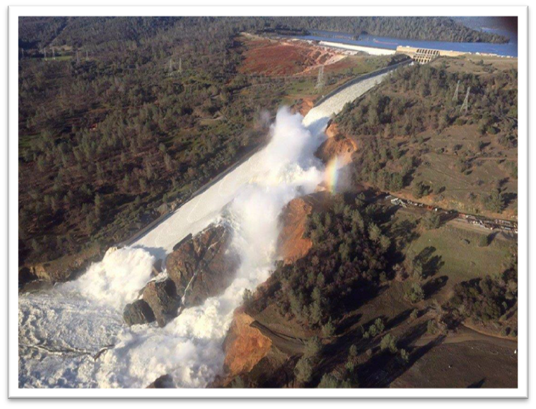
Table of Contents
4. Integration Protocols and Best Practices
Common best practice table (cross-variable)
CEOS-ARD interoperability
Inter-mission calibration
Machine learning and foundation models— when and how to use them
Uncertainty quantification and reporting
5. In-Situ Network and Cal/Val Adequacy
6. Summary Gap Table
7. Way Forward and References

Slide 12

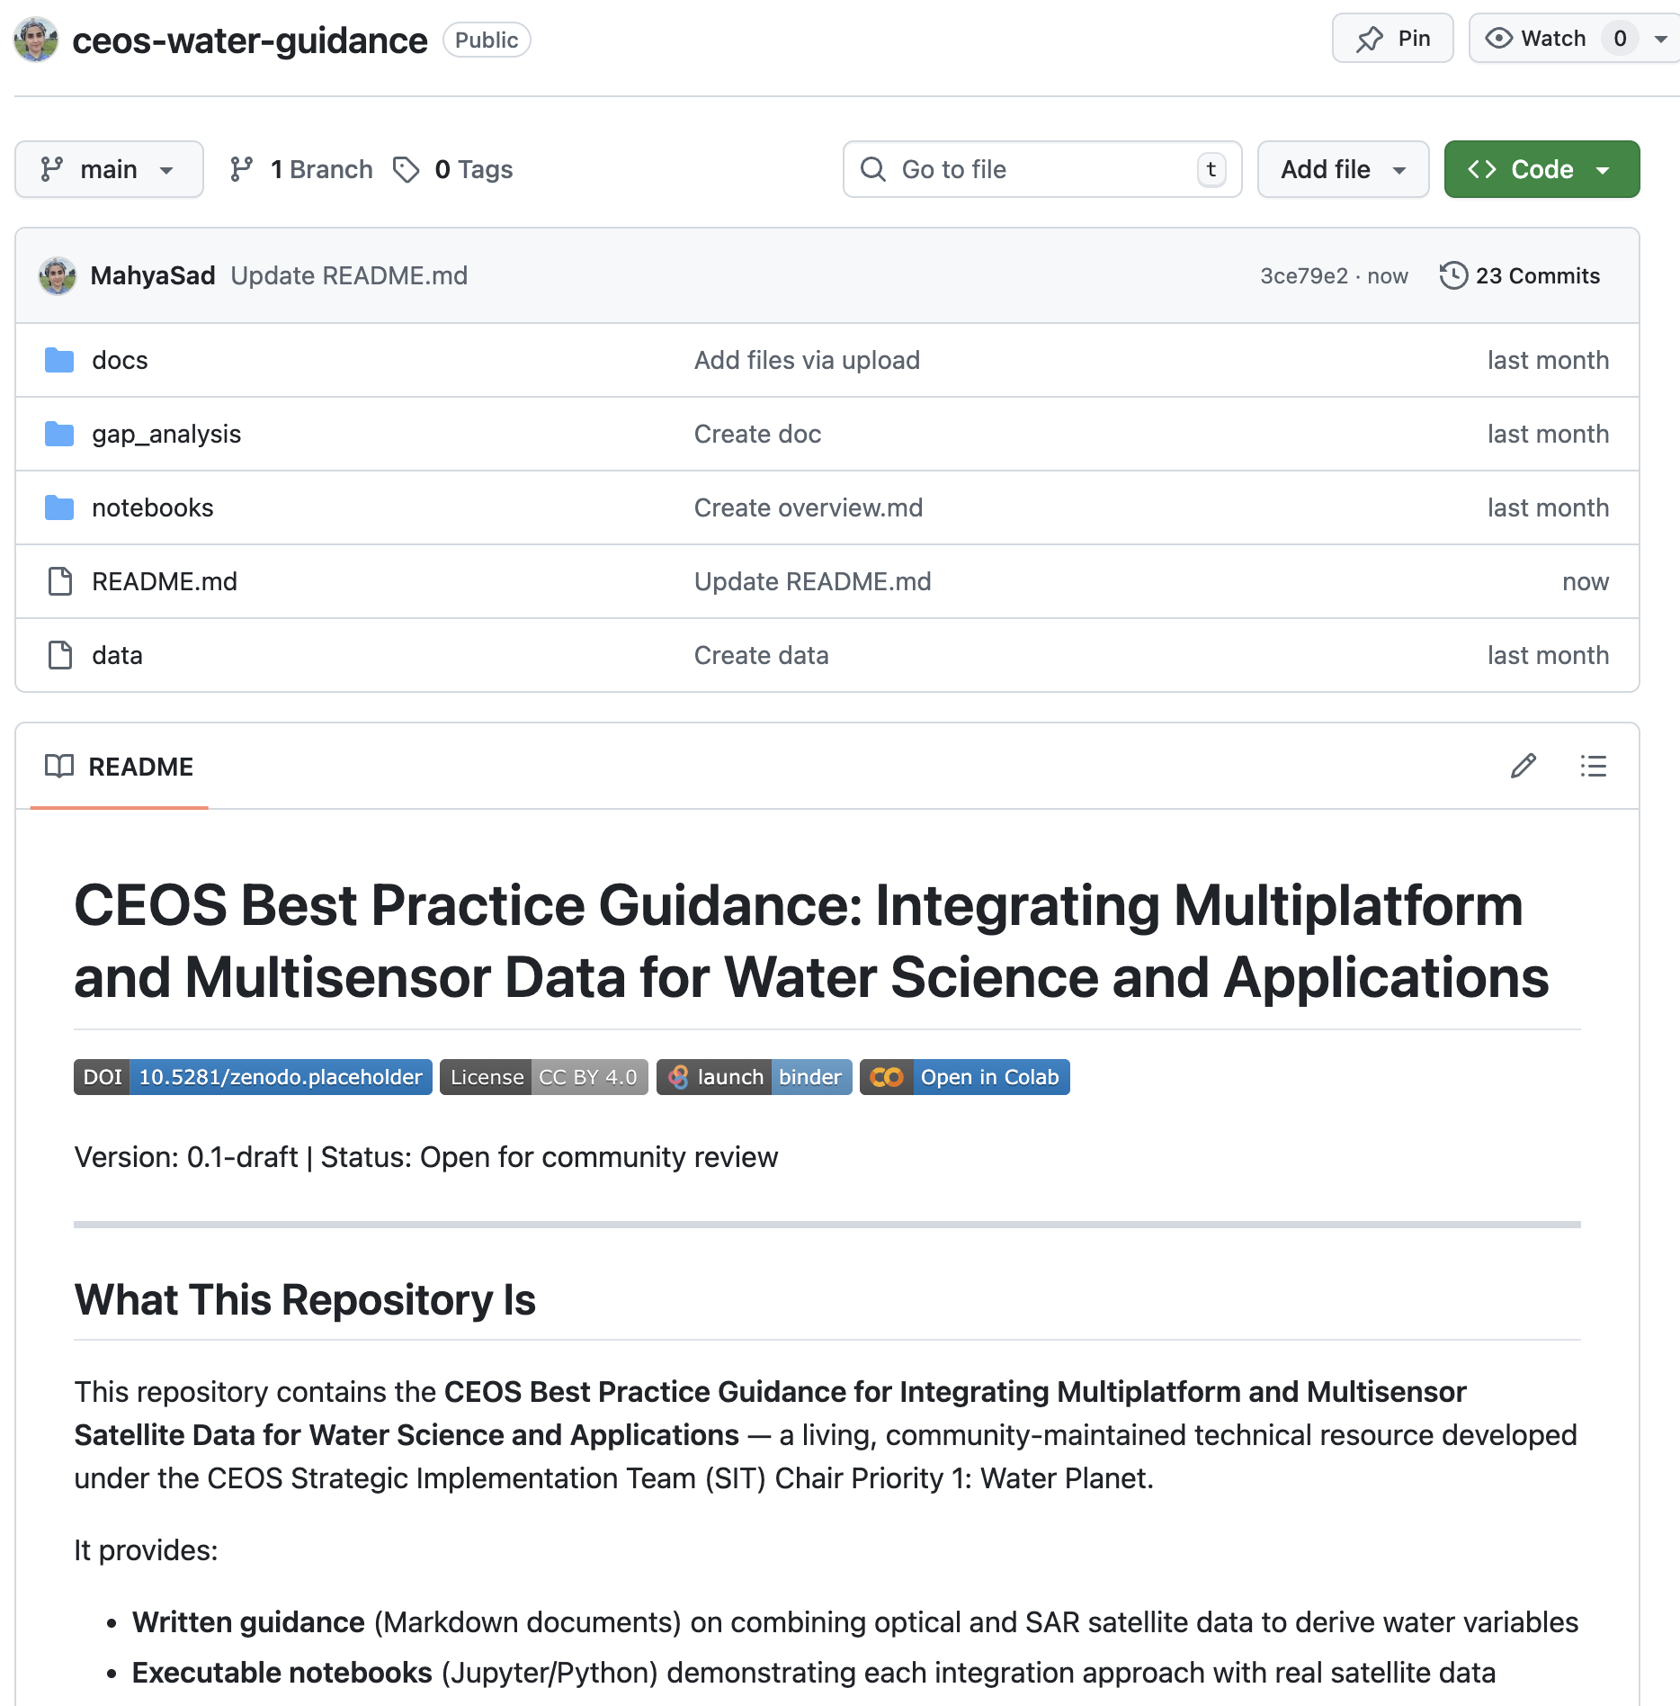

A Living, Open Resource
Our Best Practices Document will not just be a PDF — resources will be hosted on the CEOS GitHub with open-source code, reproducible notebooks, and community contributions welcome!

Slide 13
Next Steps
Next Steps
Finalize scope and table of contents based on CEOS SIT-41 feedback
Coordinate with CEOS-ARD for Water Thematic to ensure alignment
Target draft for review at 2026 SIT TW (September) and again at Plenary (November);
Final deliverable will be shared for endorsement at SIT-42
The CEOS ask…
Do CEOS principals agree with the strategic direction of guidance document (scope, audience, and objectives)?
We welcome CEOS entities to provide feedback and contribute to sections relevant to their missions and expertise
Contribution sought: use cases, datasets, code and/or successful integration examples

