Slide 1
LSI-VC-19
Discrete Global Grid System (DGGS)
Ferran Gascon (ESA)
Agenda Item L8.1
LSI-VC-19
Sioux Falls, USA
22 April 2026

Slide 2
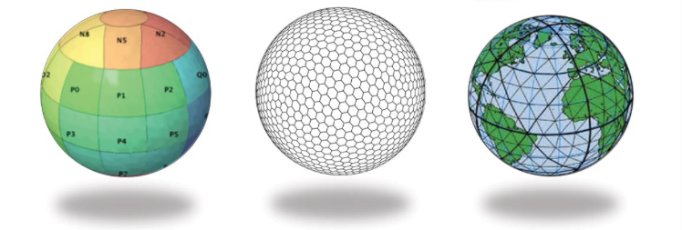
WHAT ?
“Discrete Global Grid System is a spatial reference system that uses a hierarchical sequence of equal area discrete global grids to model, partition and address the globe.” [OGC definition (Purss, 2015)]
Examples of DGGS tessellations based on platonic solids: (1) cube – cube, (2) hexagon – dodecahedron, and (3) triangle – icosahedron (Peterson, 2016)

Slide 3
WHY ?
Globally consistent framework | Combination of raster, vector and point cloud data into a common, globally consistent framework / Combination of multiscale EO data
Big data | DGGS cells an efficient type of granularity for big data analysis, i.e. cloud computing and parallelisation to visualization and data sharing
Common spatial reference | Integration and analysis of multiple data sources in one workflow, no need to convert/change spatial reference systems
Less distortions | While the data obtained by projection have serious deformation problems, especially in polar or high latitudes, DGGS cells are multiple, continuous, and have the same geometry and the “same area”

Slide 4
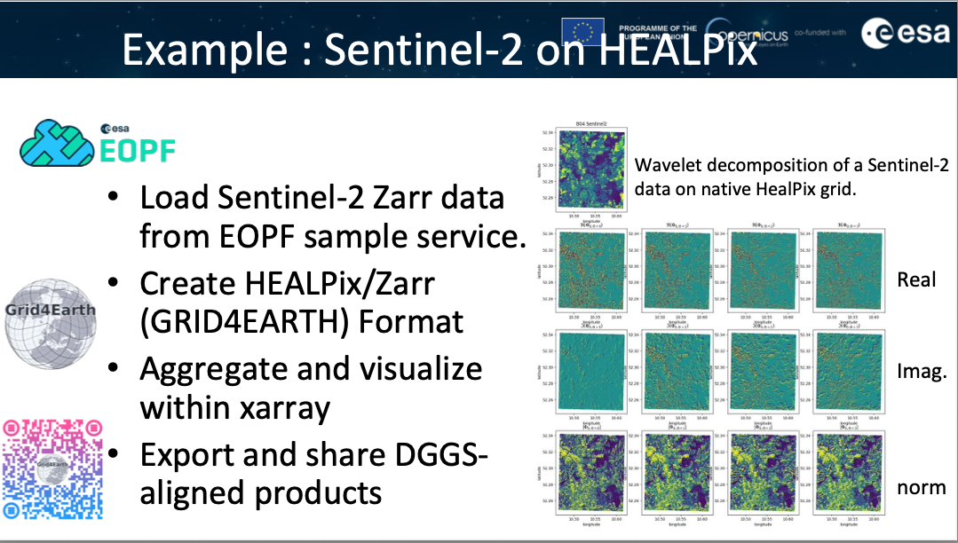
DGGS within DestinE
The HEALPix (Hierarchical, Equal Area, and isoLatitude Pixelisation) representation of the sphere offers a hierarchical tree structure for multi-resolution applications and has been adopted by DestinE for the Climate Digital Twin representation.

Slide 5

GRID4EARTH
The growing volume and diversity of Earth Observation (EO) and climate data from Copernicus and Destination Earth (DestinE) create major interoperability and large-scale analysis challenges.
Current global datasets use heterogeneous spatial grids, forcing users to apply repeated, ad-hoc regridding that is costly, error-prone, and hard to reproduce.
The GRID4EARTH project promotes a common Discrete Global Grid System (DGGS) to improve ARD interoperablity.
HEALPix is identified as a strong DGGS candidate due to its equal-area property, hierarchical structure, and widespread use in global modelling and large-scale analysis.
These properties support efficient multi-resolution workflows, scalable data access, and compatibility with cloud-native formats such as Zarr.
A key limitation of HEALPix is that it is defined on the sphere, while EO data are referenced to the WGS84 ellipsoid.

Slide 6

GRID4EARTH
For Copernicus resolutions, the sphere–ellipsoid mismatch leads to non-negligible area distortions and potential biases in zonal or regional analyses.
GRID4EARTH addresses this by extending HEALPix to the WGS84 ellipsoid using the associated authalic sphere.
This approach preserves equal-area properties on the ellipsoid and bridges spherical climate models with ellipsoidal EO data.
It enables a unified spatial framework for DestinE model outputs and Copernicus satellite data.
The solution remains compatible with existing HEALPix tools and workflows.
The contribution outlines the motivation, principles, and benefits of ellipsoidal HEALPix as a practical, scalable DGGS for next-generation Earth system data infrastructures.
healpix-geo supports reference ellipsoids such as WGS84 for optimal geodetic accuracy https://github.com/EOPF-DGGS/healpix-geo

Slide 7
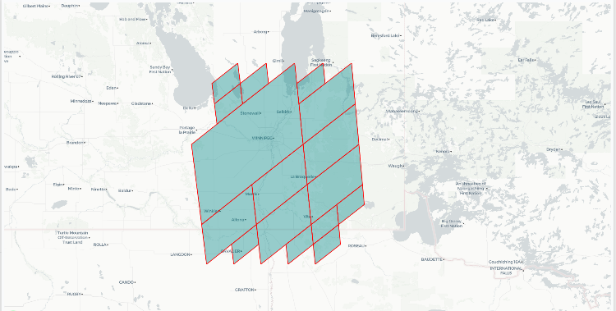
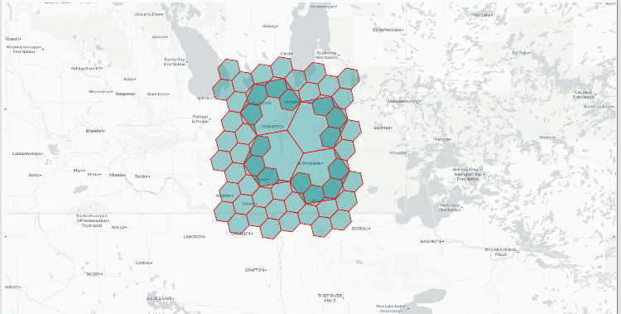
DGGS in 2026: Current Insights & Emerging Use Cases
What’s new in DGGS lately?
DGGS momentum acceleration in the past months.
New tools have emerged during the past months simplifying the use of different DGGS flavours (DGGAL library, new DGGS API implementations, etc.).
New DGGS reference systems: A5
OGC API DGGS standard is evolving, and the different grids are being standardized, and a registry is in development.
Convergence of DGGS and GeoAI : discrete grids can solve interoperability and cross collections analysis.
Strong institutional interest, e.g. OGC, CNES, ESA.

Slide 8
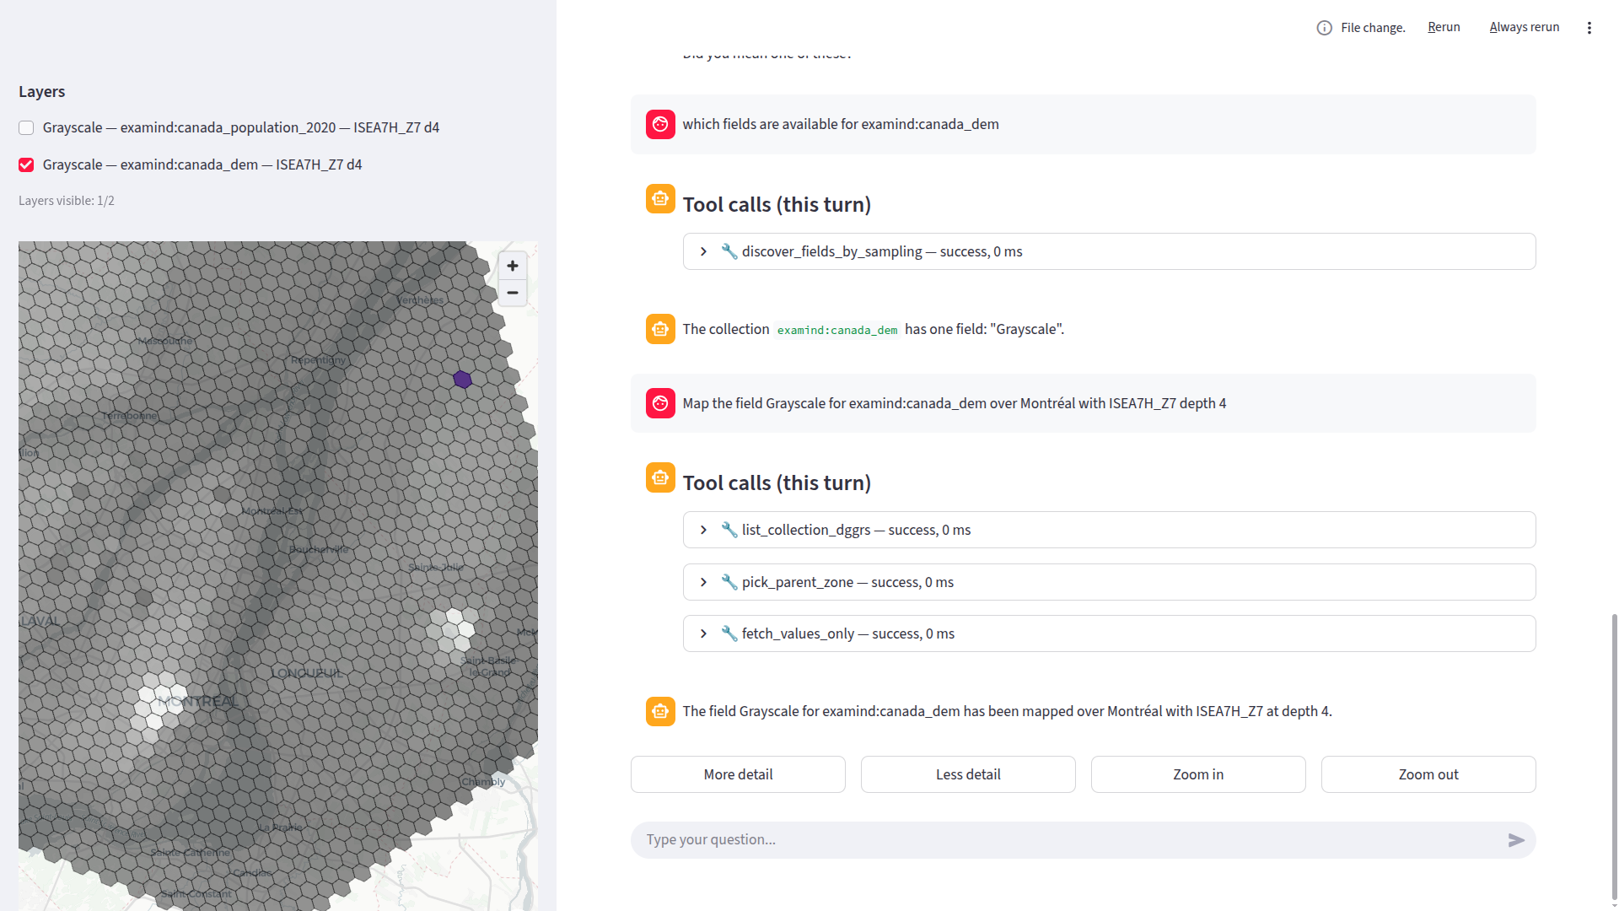
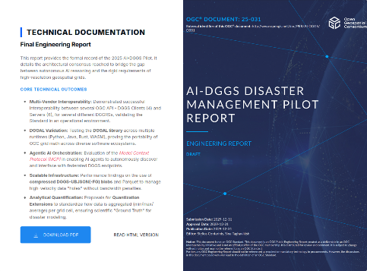





DGGS in 2026: Current Insights & Emerging Use Cases
AI-DGGS (Open Geospatial Consortium)
Objectives of the demonstrator:​ Why DGGS ?
How DGGS and AI technologies can work together to improve disaster management and respond to non expert users’ needs.
Test OGC API DGGS standard interoperability in real conditions.
Leverage AI/LLM for data query and analysis.
Test how well current OGC standards support this kind of integration,
Identify any gaps and showcase working tools and platforms.
Test data exploration using multiple DGGRS implementations (Healpix, ISEA4R, ISEA7H, H3, etc.) and multiple data sources
Develop a “generic client” able to connect to tie with many API providers

Slide 9
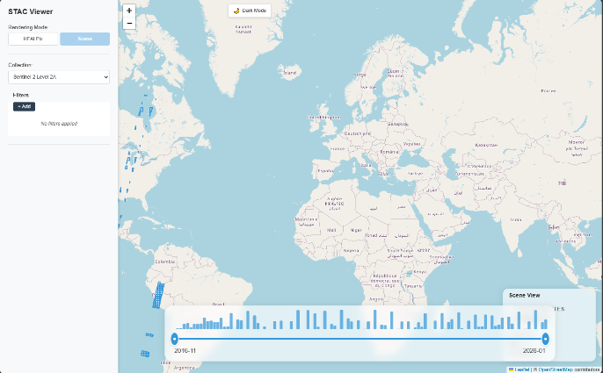
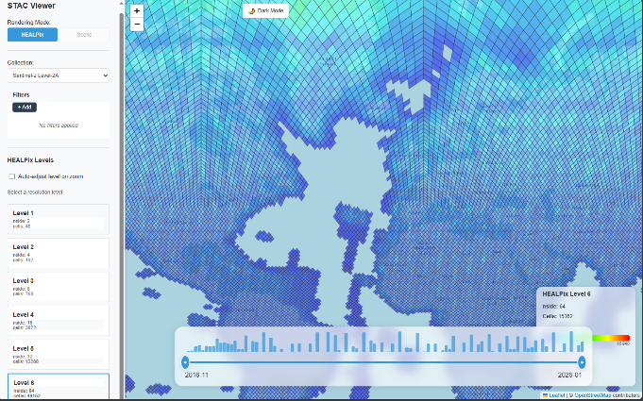
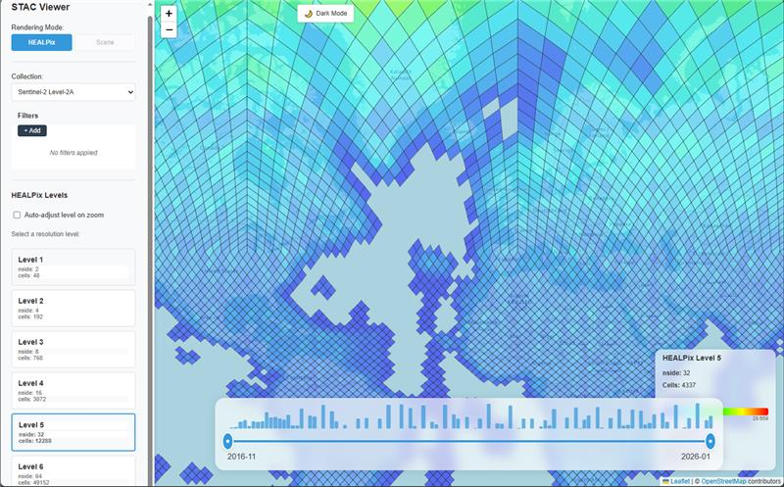
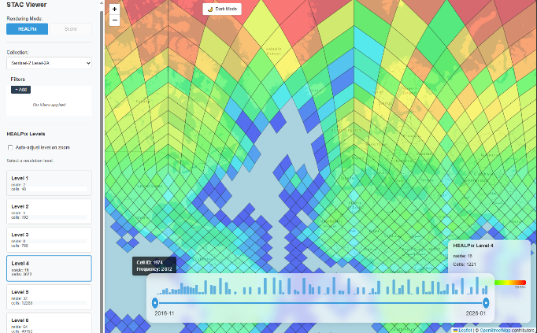
DGGS in 2026: Current Insights & Emerging Use Cases
GEODES (CNES)
DGGS-enabled STAC Viewer:
Multiple DGGS-based (Healpix, H3, S2 tiles) STAC catalog viewer.
Instant search of massive catalogs with DGGS aggregated results

Slide 10
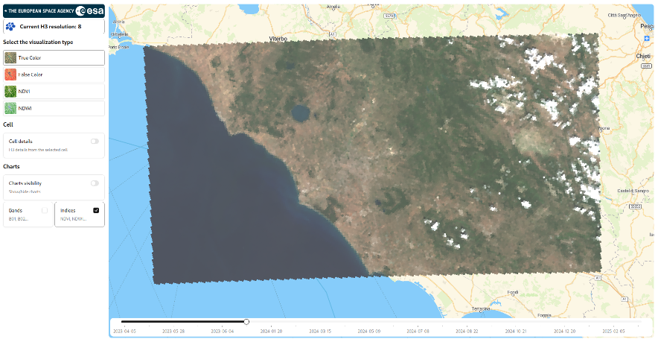
ESA Demonstrator / Early Access
Demonstrator preview
  Only development dataset available
    resolutions up to 60m over Toulouse (S2)
    Resolution up to 20m over Roma, Belgium and SW of France (S2)
    Resolution up to 30m for DEM dataset
  URL: https://s2mpc-dggs.csgroup.space/demo/

Slide 11
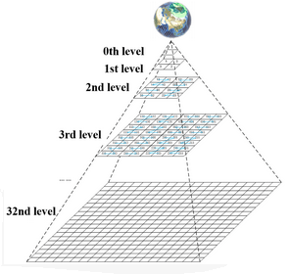
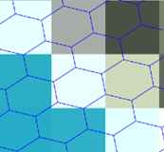
ESA Demonstrator / Data Quality
Schema of the Image Quality (IQ) evaluation
- Begin from L1C directly, although from L1B would be more operational (and with better quality).
- Different resampling solutions from input to DGGS (Bicubic resampling preferred)
- Different resampling solutions from DGGS to output (own method preferred, bad results from off the shelf solutions)
IQ evaluation
- Dense correlation : geometric shifts
- Comparison of PSF (possible blurring)
- Radiometric shift (in uniform sites)
S2 L1C tile
(ortho UTM square pixel 10:20:60m)
S2 output in same geometry of the tile
DGGS pyramid
Rasterizing from DGGS
On the same output geometry
With off the shelf solutions
With our own algorithm :
linear interpolation inside triangle, at the center of the output pixel.
Load in DGGS
resampling with NN,
and BICUBIC
considering lat,lon of centroid of DGGS cell
Center of output pixel
Triangle with the DGGS centroids the closest to the output pixel center

Slide 12
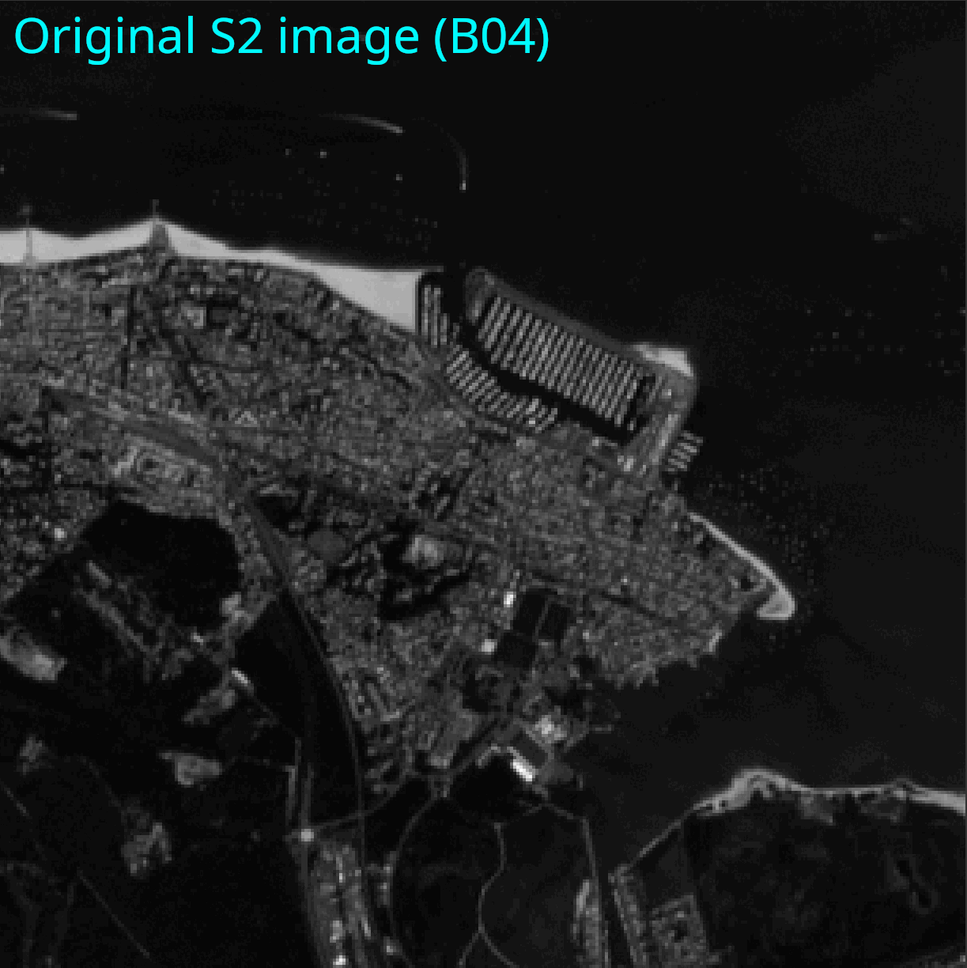
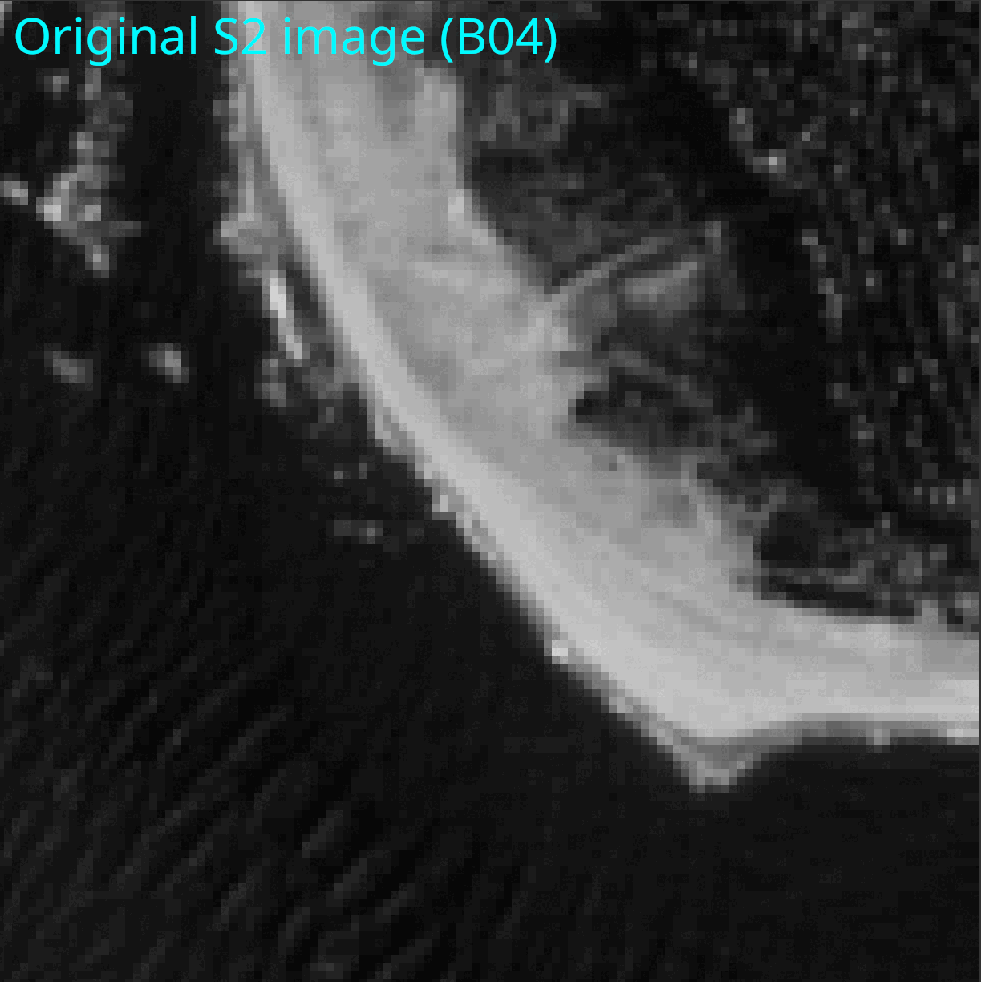
ESA Demonstrator / Data Quality
Image comparison (Sentinel-2 band 04, 10m resolution)

Slide 13
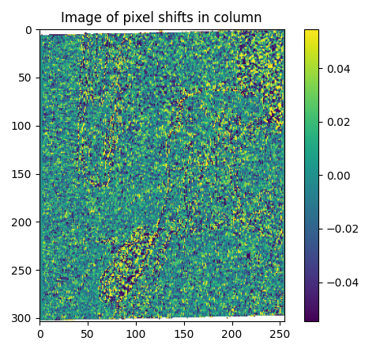
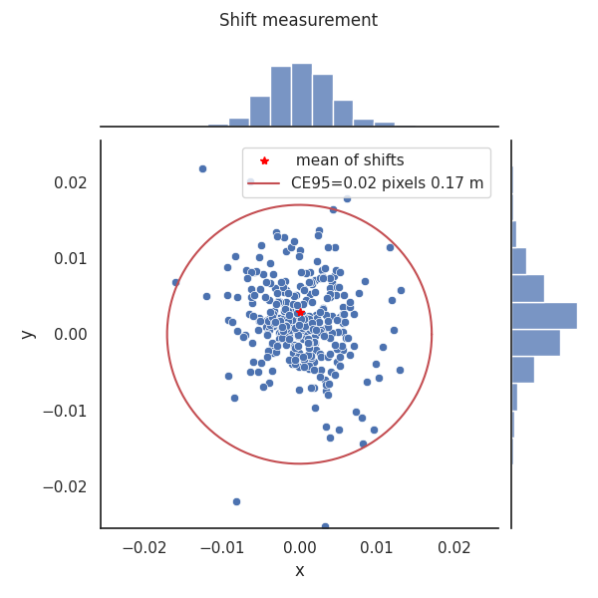
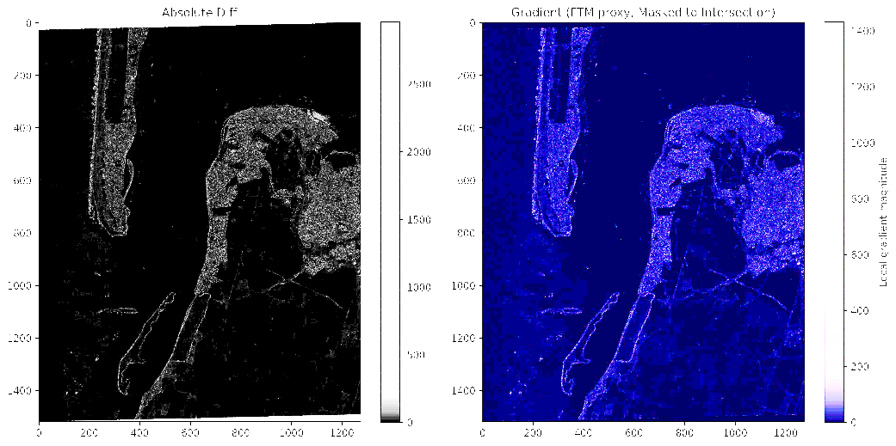
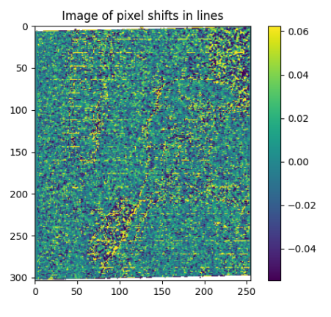
ESA Demonstrator / Data Quality
Study of images of differences (input / output),
comparison with gradient,
No radiometric shift in uniform zones.
Variations in high gradient zones due to small blurring
Geometric study using dense correlation.
- 0 shift measured,
- no trend inside the images,
- only correlation noise visible.

Slide 14


