Slide 1
Wildfire Subgroup
Mark de Jong
Natural Resources Canada
Agenda Item 4.1
WGCV-56 / LSI-VC-19 Joint Meeting
Sioux Falls, SD, USA
20-24 April 2026

Slide 2
Contents
Wildfire subgroup: formation / membership / purpose (10 min)
Active fire monitoring products (10 min)
Wildfire Subgroup: fire product endorsement process (10 min + discission)

Slide 3
Wildfire subgroup

Slide 4
CEOS WG Disasters Wildfire Pilot (1)
Gap analysis of LEO civil space agency missions for active fire Earth observation
Pilot co-leads:
NRCan, CSA, NASA, FAO
Initiated 2021, finished 2025
“Supply”-side
analysis
Orbital modelling of current & future active fire monitoring system coverage
“Demand”-side analysis
Survey, bibliometric, & web traffic data analysis to understand
who is using active fire products for management?

Slide 5
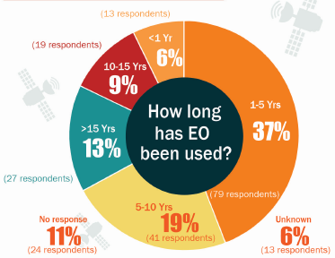
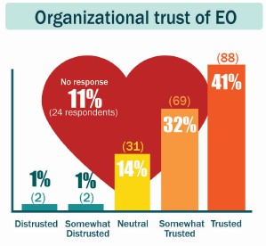
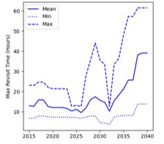
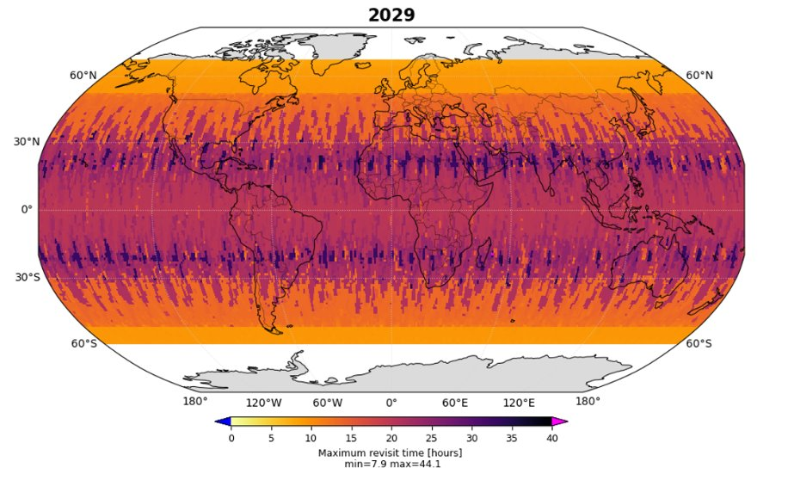
CEOS WG Disasters Wildfire Pilot (2)
Recent large increase in use of active fire EO and high user trust
EO active fire monitoring capabilities from LEO systems are unstable and may decline in future periods
Reduced capabilities -> less user trust -> negative consequences for fire management
Recommendation: need for increased international coordination and governance of global active fire monitoring satellites
Figure 1. Global end user survey outcomes (M^{c}Fayden et al., 2024)
Figure 2. Maximum revisit time (global)
baseline scenario for fire monitoring/detection
Figure 3. Maximum revisit time in 2029
baseline scenario for fire monitoring

Slide 6
LSI-VC Wildfire Subgroup - Process
The concept of a new CEOS initiative on the coordination of wildfire monitoring was supported by participants of a CEOS Plenary 2025 side meeting
~12 agencies in attendance
After further discussion and options analysis, the Chairs of the LSI-VC and the SIT Chair supported the formation of a new Wildfire subgroup under LSI-VC
SEC-344 action: requested expression of interest for membership and leadership of this new group from CEOS members and associates

Slide 7
Purpose & potential activities
Purpose: to provide a venue to support coordination between agencies producing EO data used to generate wildfire monitoring products and the downstream community, to enhance reliability and support wildfire management with current and future satellite missions.
Initial scope is active fire and potentially recent burned area, could expand to other areas e.g., pre-fire, in the future
Potential activities (to be refined):
Assess the existing & planned implicit virtual constellation of fire monitoring satellites
Document the case for sustained, refined & improved fire EO products
Support development of harmonized user & mission requirements for wildfire monitoring
Support interoperability of fire EO data and missions for wildfire monitoring
Support development of EO fire product best practices/endorsement process

Slide 8
LSI-VC Wildfire Subgroup - Membership
Organization | Point of Contact
CEOS Agency Co-leads
ESA | Steffen Dransfeld
SANSA | Cecilia Masemola
CSA | Yann Denis
NRCan | Mark de Jong Catriona Armstrong
CEOS Agency Members
EC | Fernando Sedano
HSC | Dimitris Bliziotis
INPE | Fabiano Morelli
NASA | Ian Brosnan
UKSA | Gareth Roberts
Wider Community
GOFC-GOLD FireIT | David Roy Martin Wooster
New Space organizations | TBD
Initial “meet-and-greet” kick-off meeting for members held 2 weeks ago
Near future:
Develop priorities to inform objectives & activities
Develop Terms of Reference and work plan
additional membership interest from other agencies is welcome

Slide 9
EO based active fire monitoring

Slide 10
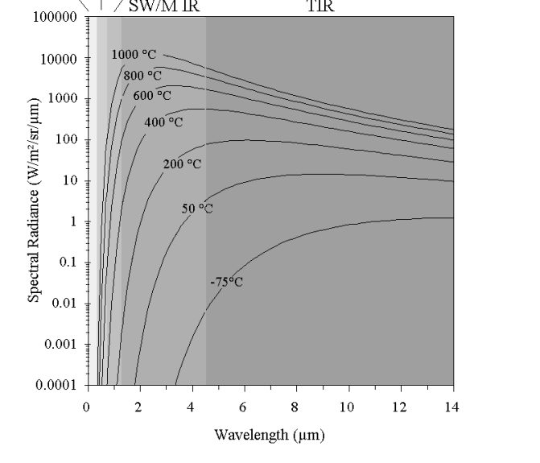
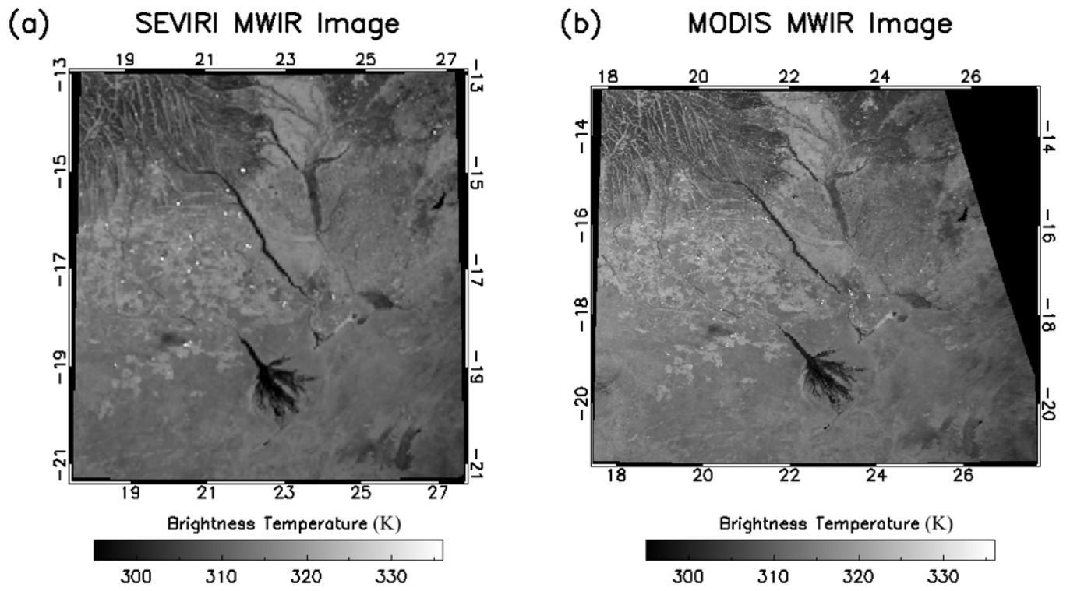
EO based active fire monitoring
Fires (600-1200 K) emit strongly in the mid & short-wave infrared
Fires are easily identifiable against an ambient temperature background (~300 K)
Algorithms typically identify thermal signatures in L1B imagery by contrasting suspected fire pixels to a local window of non-fire pixels
Possible to detect extremely subpixel fire events (< 0.01 % pixel area)
Detection and monitoring feasible with relatively coarse (1-4km) resolution instruments (e.g. AVHRR, MODIS, GOES, SEVIRI)
Planck curves for a range of temperatures (Wooster & Rothery, 2000)
Actively burning fires observed in near simultaneous MWIR imagery from (a) MSG SEVIRI and (b) MODIS over Southern Africa, 17th August 2007 (Wooster et al. 2015)

Slide 11
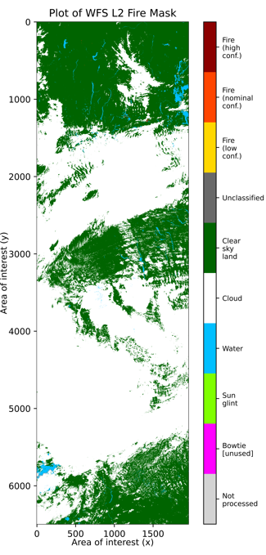
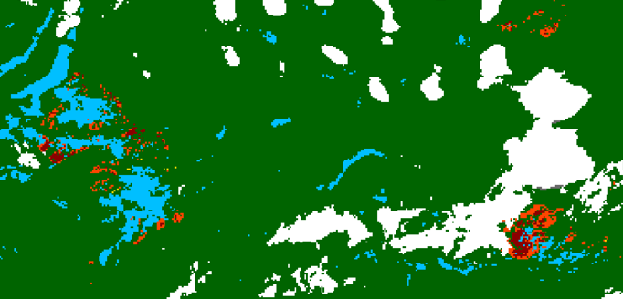
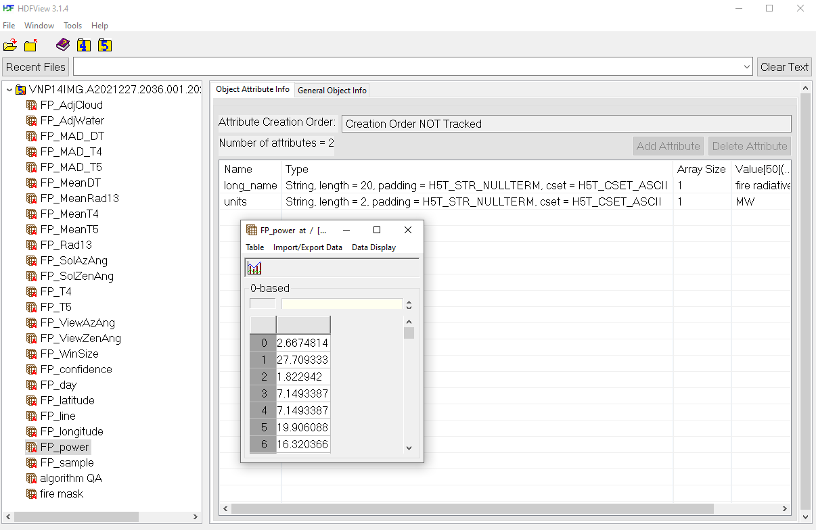
AF Product example: VIIRS
VIIRS (V<XX>14IMG) Active Fire Product
Core product is a classified 2D ‘fire mask’ generated in NRT from L1B swath product (Schroeder et al. 2014)
Pixels identified as fire have additional information extracted:
Latitude, longitude, timestamp
‘Confidence’ (e.g. high, nominal, low) of being a ‘true’ fire pixel
radiant energy release (FRP; MW)
Metadata/statistics from detection algorithm
Example of a SNPP VIIRS VNP14IMG L2 fire product [modified for visualisation]. Classified 2D swath product ‘fire mask’ (left) and a close-up of a fire affected area (top right). Example data structure of a VIIRS L2 fire product netCDF file (bottom right), with 1D sparse arrays containing fire pixel characteristics and metadata. File: VNP14IMG.A2021227.2036.001.2021280074047.nc
Schroeder et al. 2014: http://dx.doi.org/10.1016/j.rse.2013.12.008

Slide 12
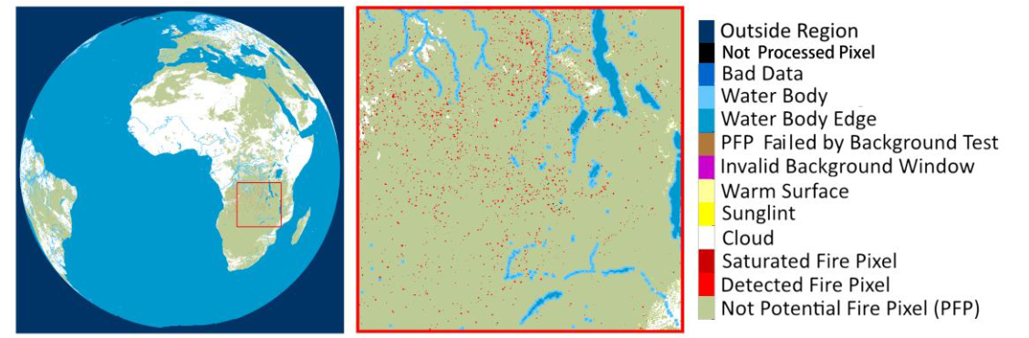
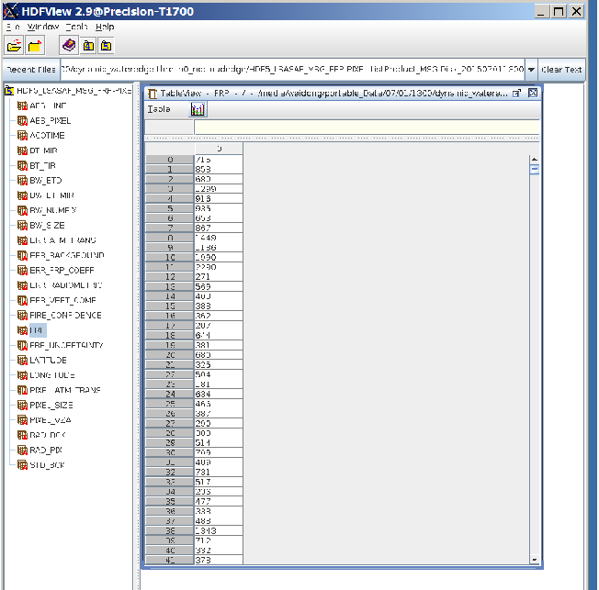
AF Product example: GEO
Geostationary FRP-PIXEL Products
‘Quality’ (2D classified scene) and ‘List’ products available in NRT from EUMETSAT LSA SAF for:
MSG SEVIRI (Wooster et al., 2015) & MTG
GOES-R ABI (Xu et al., 2017)
Himawari-8/9 (Xu et al., 2021)
Pixels identified as fire have additional information extracted:
Latitude, longitude, timestamp
‘Confidence’ (e.g. high, nominal, low) of being a ‘true’ fire pixel
radiant energy release (FRP; MW)
Uncertainty estimates
Metadata/statistics from detection algorithm
Example of an MSG SEVIRI FRP-PIXEL fire product.
Classified 2D full disk ‘Quality’ product (top left) and a close-up of a fire affected area (top right). Example data structure of an MSG SEVIRI FRP-PIXEL fire product netCDF file (bottom left), with 1D sparse arrays containing fire pixel characteristics and metadata.
Figures compiled from the MSG SEVIRI FRP-PIXEL fire product Product User Guide: https://landsaf.ipma.pt/en/data/products/fire-products/
Wooster et al. 2015: https://doi.org/10.5194/acp-15-13217-2015
Xu et al. 2017: https://doi.org/10.1016/j.rse.2017.02.024
Xu et al. 2021: https://doi.org/10.1016/j.srs.2021.100016

Slide 13
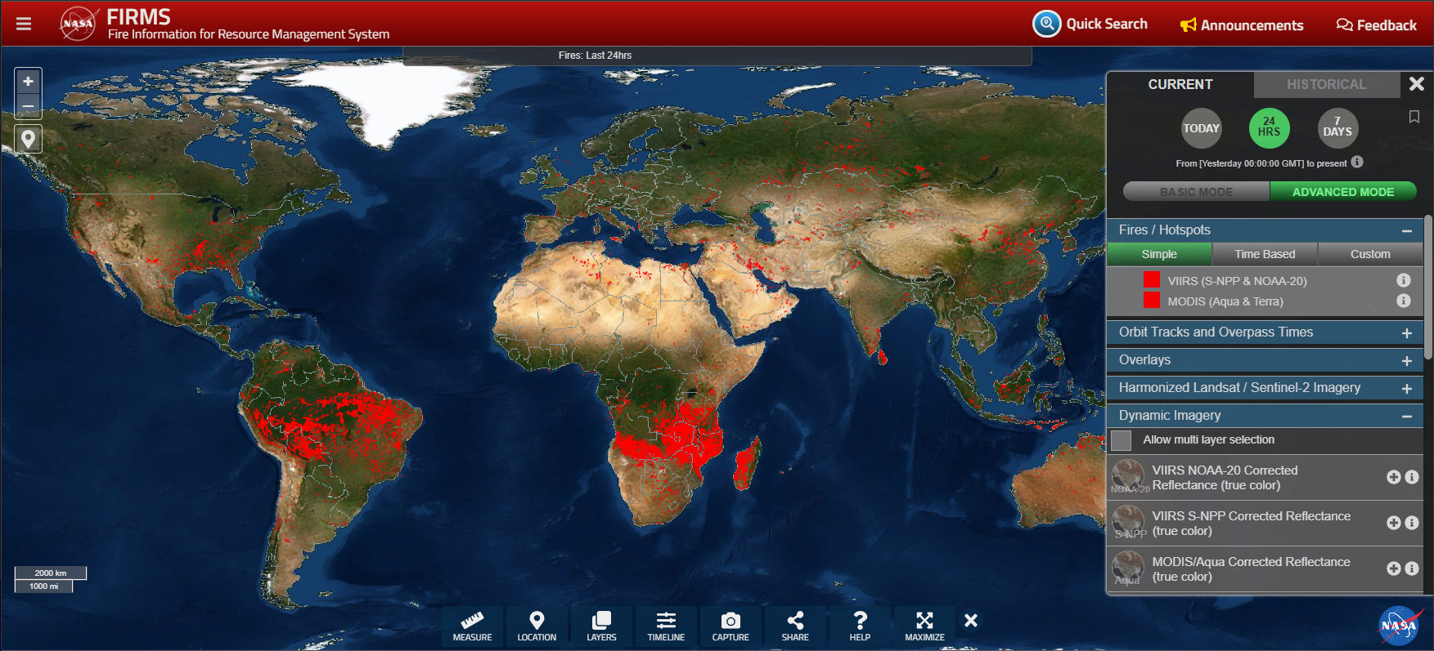
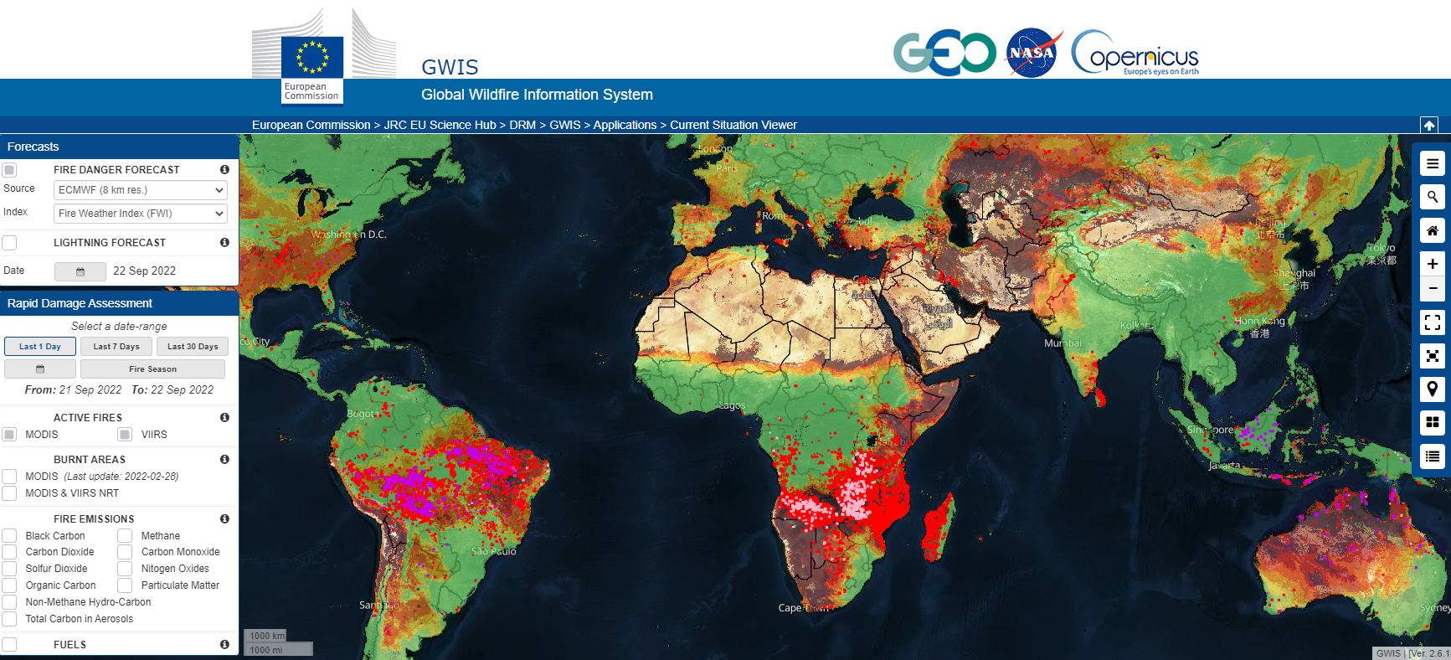
Active Fire Hotspot Products
Most users just make use of ‘hotspot’ products
Fire pixel data available as point data though web portals, downloadable .csv files and .shp files
NASA FIRMS is the most visited provider with NRT hotspots for MODIS, VIIRS, Landsat (N. America), and geostationary satellites
Similar data available through other global and regional re-hosting sites e.g. GWIS (global), AFIS (global), M3 hotspot system (Canada)
MODIS, VIIRS, Landsat, GOES, Meteosat-SEVIRI, Himawari NRT (<24h) and historic ‘Fire & Thermal Anomalies Data’ available from NASA FIRMS
GWIS - a joint GEO/Copernicus initiative provides NRT and historic hotspot and fire environment data https://gwis.jrc.ec.europa.eu/

Slide 14
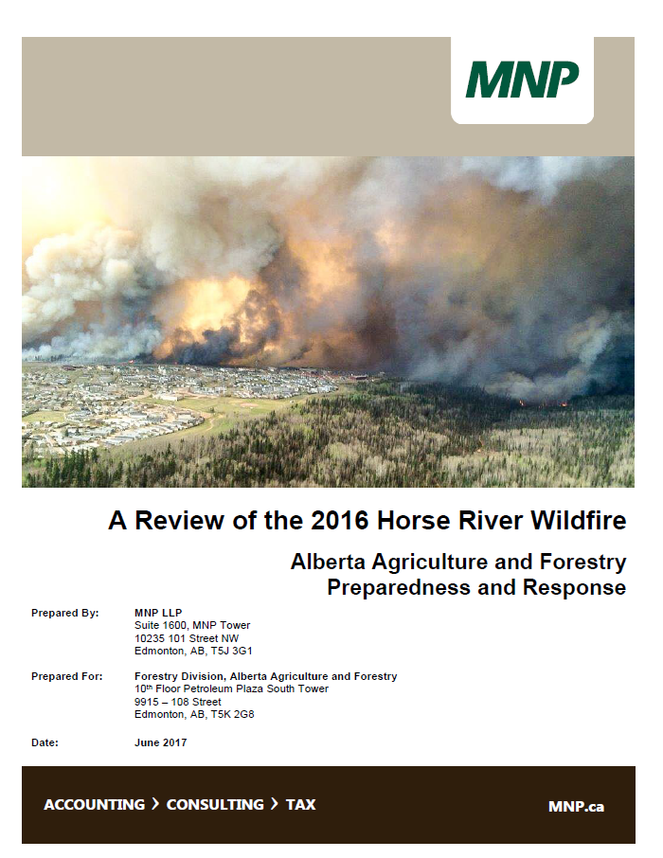
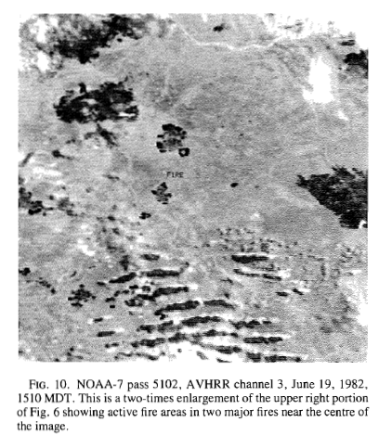
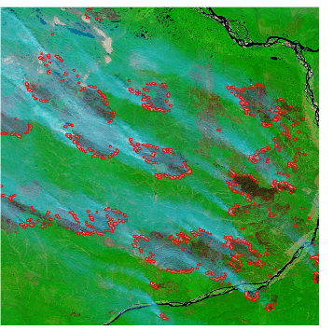
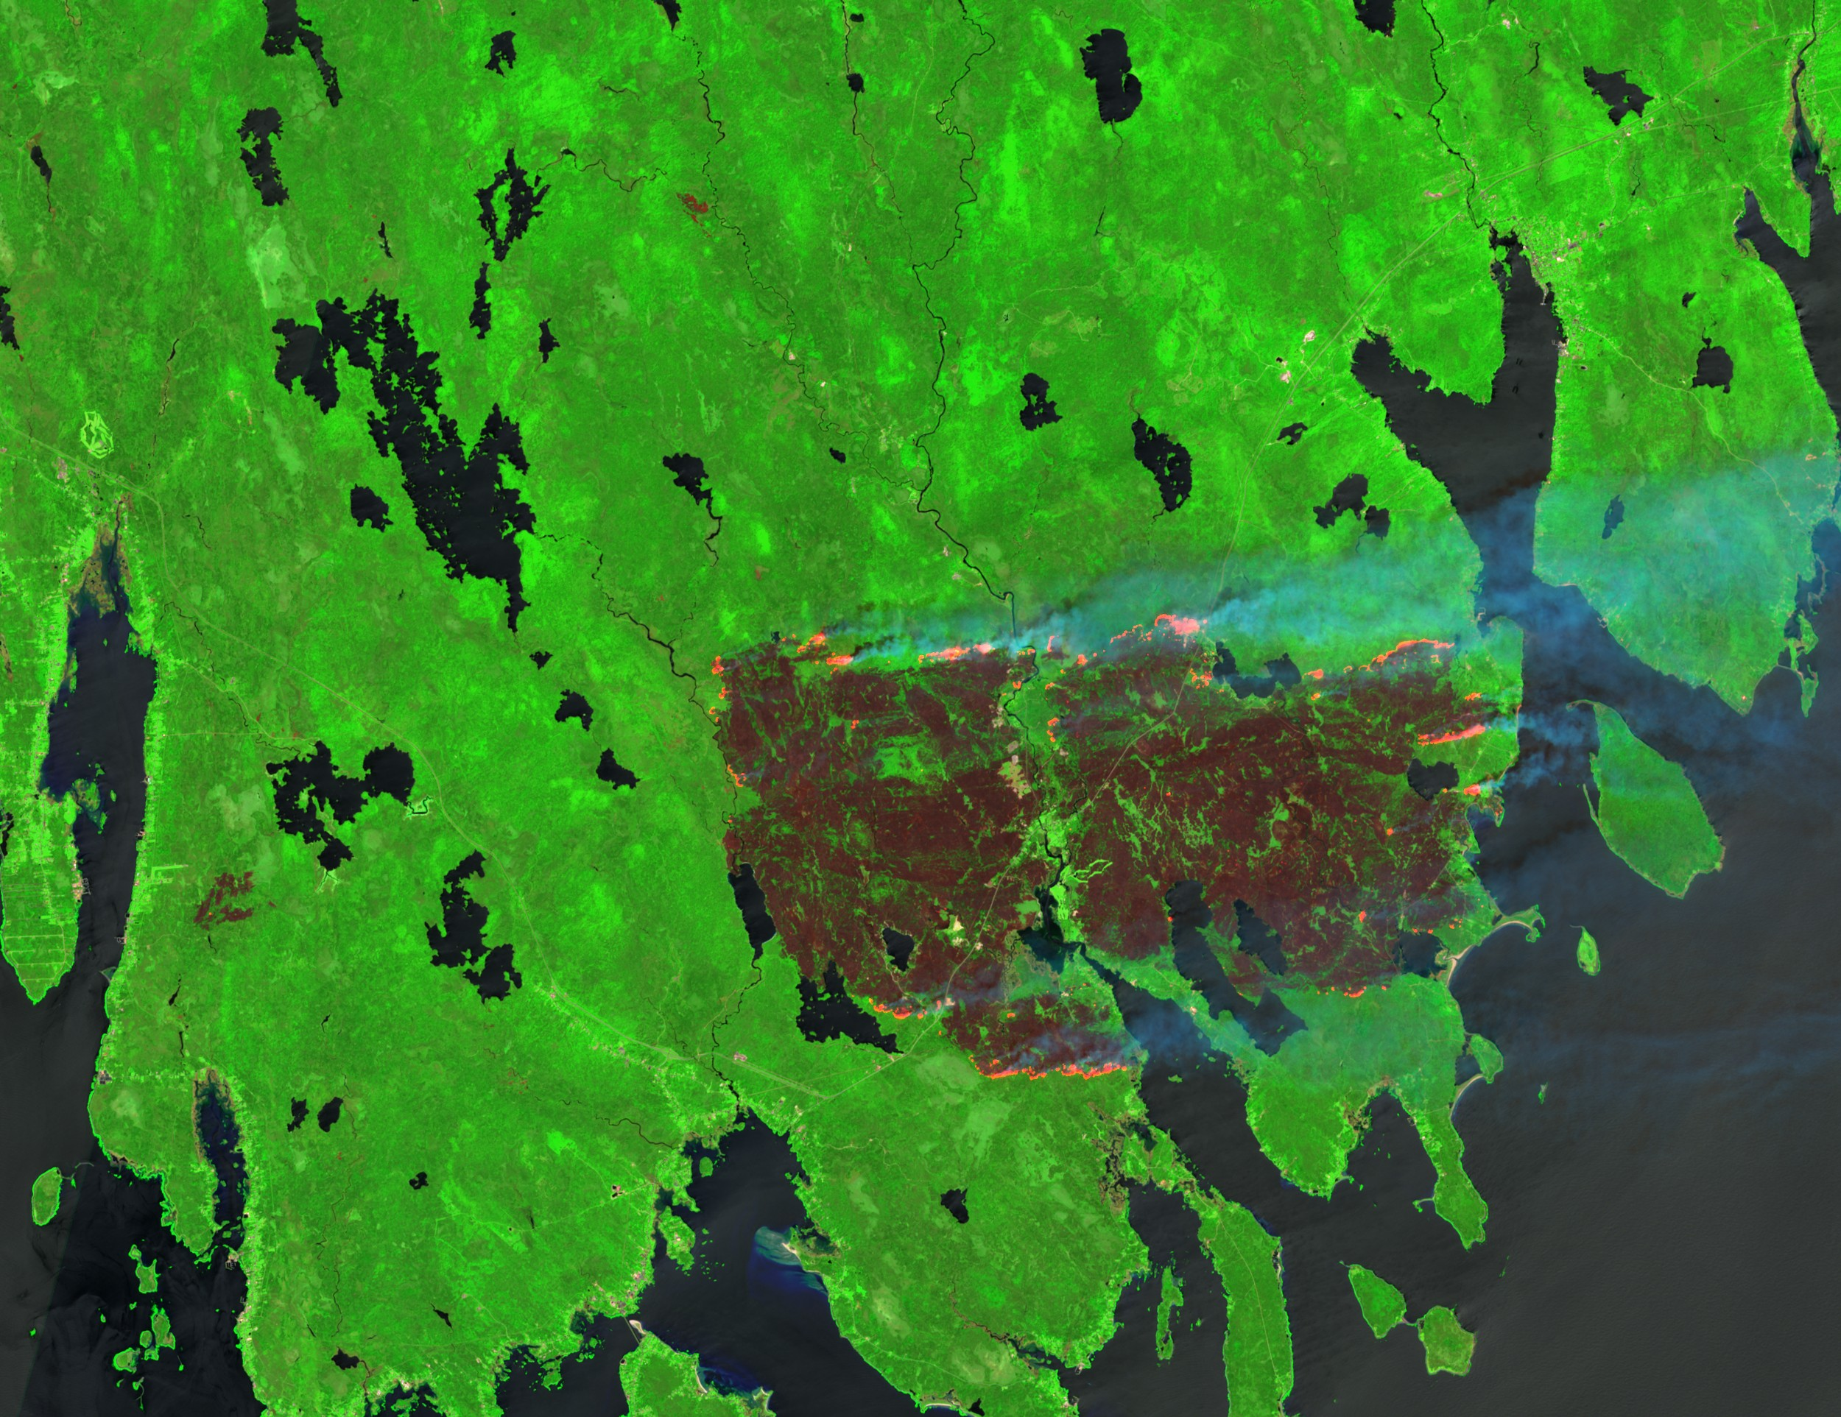
Active Fire EO
Long history (>30 years) of EO for active fire monitoring using MWIR (and SWIR). Historically, missions not designed for oper. fire monitoring; community developed around ‘opportunistic use’ e.g. AVHRR, MODIS, GOES
Operational tools are built on the back of these missions, but no guaranteed long term mission continuation leads to vulnerabilities (e.g. MODIS)
Existing products are often not optimal for tactical operational use by fire agencies
“Satellite images are not available in real time and are not generally used to support ongoing suppression activities; rather they are available for single points in time and are useful for strategy and planning”
Fire burn scars (black) overlain with hotspot data (red) in MODIS imagery, Russia 2002 (Giglio et al 2006)
Sentinel-2 imagery of the Barringtom Lake Fire, NS, Canada May 2023. Processed by M. Crowley
AVHRR, Flannigan & Vonder Haar, 1986

Slide 15
Wildfire Subgroup: product endorsement
Input from Prof. David Roy, MSU

Slide 16
Wildfire Subgroup: product endorsement
Community identified need for independent fire product endorsement process
Active fire and burned area
Increasing no. of systems being used for AF/BA fire monitoring, especially considering non-profit / commercial sector initiatives
Increasingly easy to make new products with ARD and cloud computing
Limited agreement between products, and some products have quality issues

Slide 17
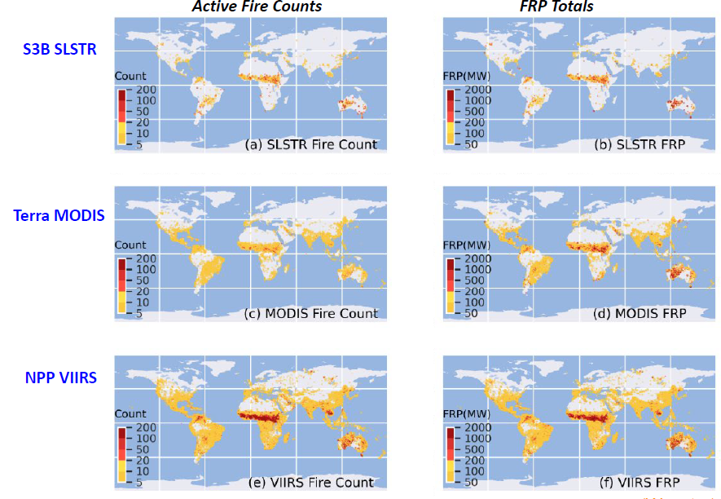
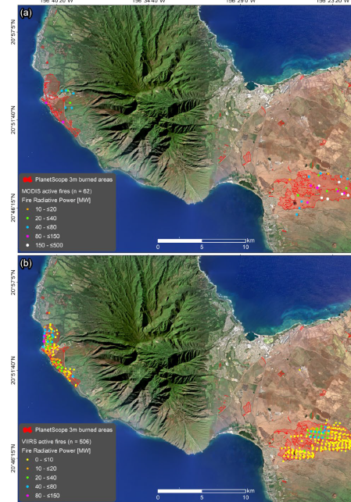
AF Product Differences
Wooster & Xu, personal communication
Roy et al., 2024

Slide 18
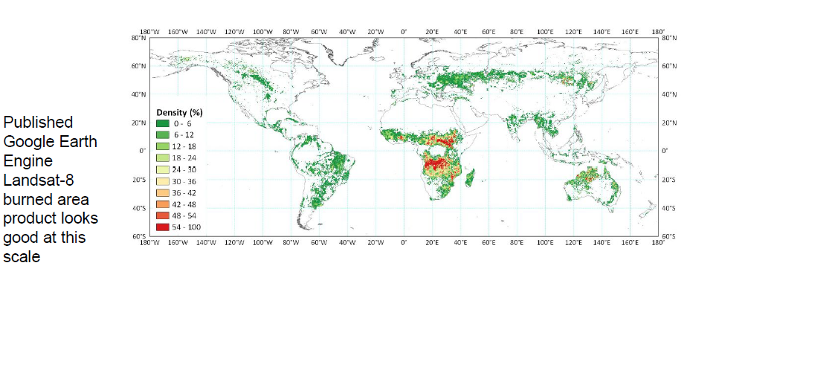
BA product artifacts

Slide 19
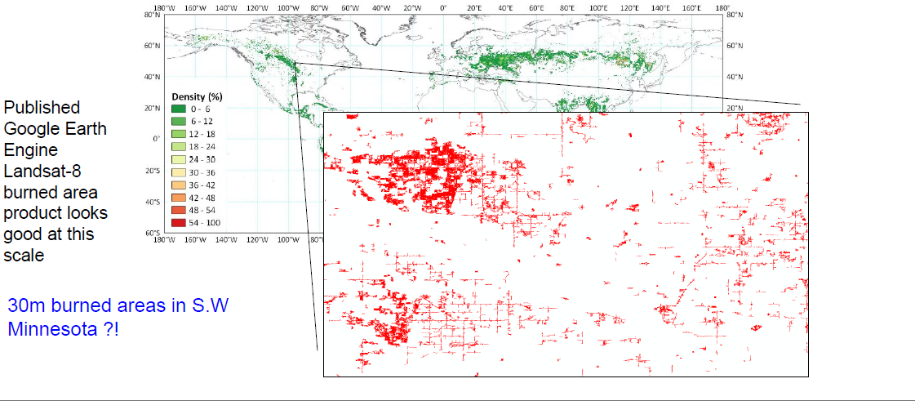
BA product artifacts

Slide 20
Product endorsement: discussion
CEOS backed fire product endorsement “clearing house”
Independent of producers
Authoritative
Traceable/reproducible evidence-based endorsement
Endorsement process considerations
More than a document review exercise
Product QA
Product validation (especially difficult for AF)
Ongoing periodic assessment (orbit/reprocessing/algorithm changes)
Tiered endorsement for different purposes (e.g. fit for science use, fit for fire detection & mapping)
How could/should this interact/build on existing CEOS (e.g. ARD) and adjacent (EDAP?) processes for lower-level products - minimize duplication of effort

