Slide 1
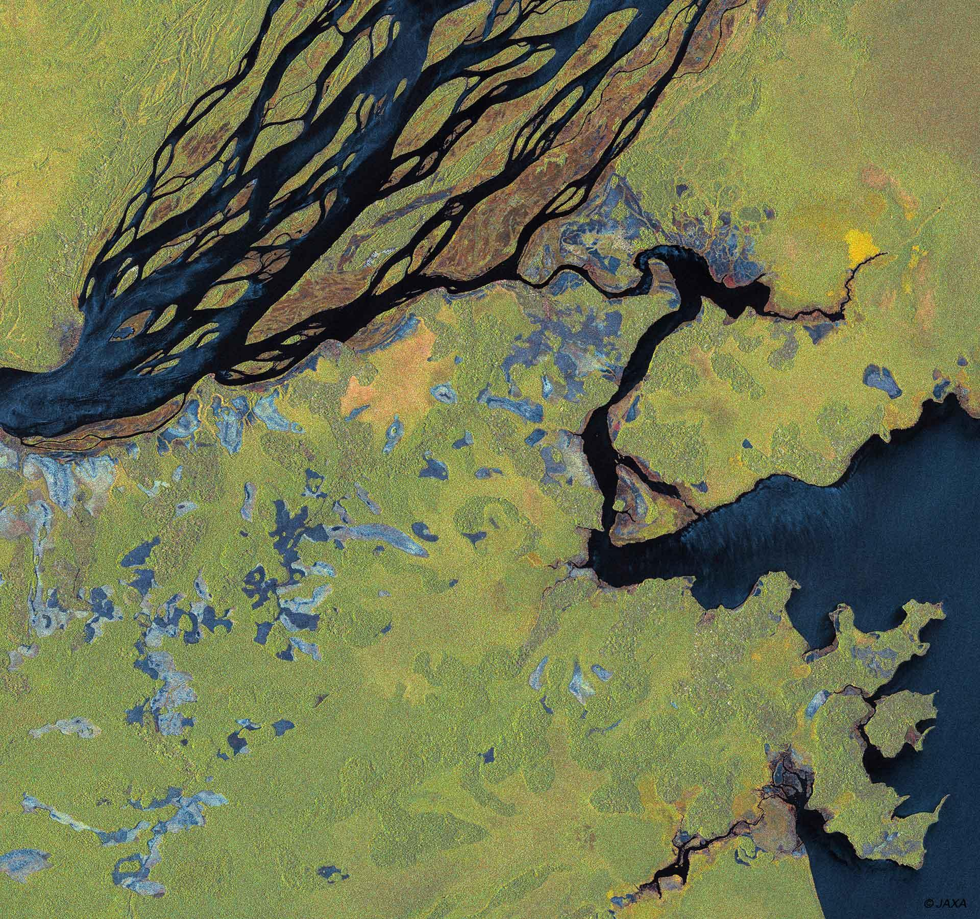


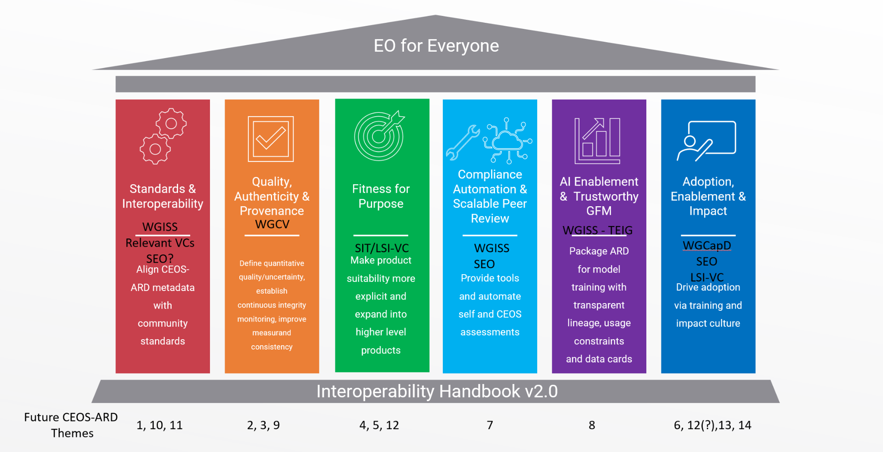
CEOS-ARD Strategy Pillars
Underpinned by CEOS Interoperability Handbook conventions

Slide 2
Standards and Interoperability
Focus on ensuring CEOS-ARD metadata and data structures are interoperable across existing global standards.
Success Criteria:
CEOS-ARD metadata is consistently implemented across all Product Family Specifications, with a STAC-first, machine-readable and human-interpretable specification supported by OGC/ISO crosswalks.
CEOS-ARD data and metadata are natively understood by mainstream software tools (e.g., GDAL, QGIS, ArcGIS, cloud catalogues) without custom adapters.
CEOS-ARD is recognised as the de facto global community standard for satellite Analysis Ready Data, with a clear, endorsed roadmap toward formal standardisation.
Agencies, commercial providers, and distributors treat CEOS-ARD requirements as default interoperability baselines, not bespoke CEOS artifacts.
Outcome Signal: CEOS ARD datasets work seamlessly across mainstream geospatial tools and cloud-based processing environments. This means:
CEOS-ARD metadata and data work out-of-the-box in mainstream tools and cloud workflows.
Users don’t need custom scripts or manual schema mappings to use CEOS-ARD.
CEOS-ARD is seen as ready-to-use.

Slide 3
Initiatives under this pillar could include
Developing CEOS-ARD Metadata (vNext or v2), which will align specifications with STAC and OGC/ISO standards, providing JSON and XML schemas for validation.
Optical metadata (SR, Aquatic, Nighttime Lights) harmonization is to match the maturity of SAR specifications, reducing inconsistencies across product families.
A formal roadmap to guide CEOS-ARD from a community-driven framework to a recognized standard, reassuring stakeholders of its stability and longevity.
Published reference implementations and conformance test suites to accelerate adoption and reduce integration friction.

Slide 4
What do we need from Agencies and CEOS to help develop these areas?
Headline: Engagement of agency and CEOS experts
Standards and Interoperability
Expertise in geospatial standards development
Engagement with national standards bodies
Experience with STAC implementation and discoverability and accessibility standards (WGISS)
Connection to agency staff responsible for archives, data processing, metadata definition, etc.
Connections to software and tool developers including in private sector
Adoption of CEOS-ARD as an interoperability baseline
Pilot studies to demonstrate CEOS-ARD facilitation of interoperability

Slide 5
Discussion
Discussion objective: Standards initiatives and activities we can add to CEOS-ARD Strategy work plan for 2027-2031
Call to action for LSI-VC to define a pilot study using endorsed products to demonstrate how CEOS-ARD enables interoperability (Barnes)
Software and tool dependencies, alignment
Confirm: Standards initiatives and activities we can add to CEOS-ARD Strategy work plan for 2027-2031

Slide 6
Ideas from LSI-VC-19 discussions
High level framework / hierarchy (Peter!)
Effort to have consistency in terminology across CEOS-ARD PFS
Building out the CEOS EO Glossary and growing adoption
Metadata mapping and implementation of references to ISO standards in the building blocks
UML model for CEOS-ARD
STAC for CEOS-ARD update
OGC Community standard for CEOS-ARD
Fostering a CEOS-ARD community that has a broad representation of users, producers, etc. through GitHub
URI framework for ceos.org/ard
WGISS CDA work next steps ?
Full compliance with GDAL libraries

