Slide 1
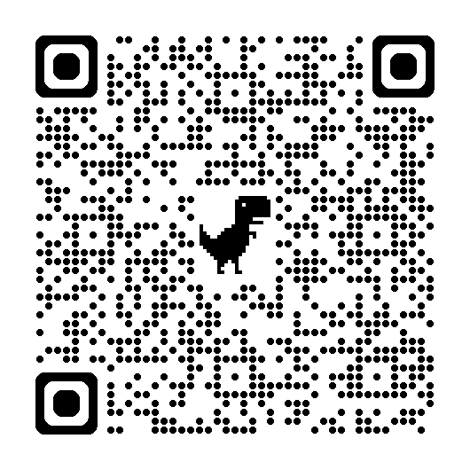
Geospatial Data Systems:
A Lossy and Destructive Journey from Data Production to Data Use
Simon ILYUSHCHENKO
Earth Engine Data Tech Lead simonf@google.com simonf.com
Tom WALKER
Head of Science, Cecil
tom@cecil.earth
AAG 2026-03-20
Notes:
Hello everyone! I'm Simon Ilyushchenko. I work on Google Earth Engine and Earth AI. This talk has had a few working titles — the program has the first one

Slide 2
a.k.a.
Governance Data Journeys
Notes:
but the other two are more honest about what we're doing.

Slide 3
a.k.a.
Geography:
A Lossy Power Trip through Time

Slide 4
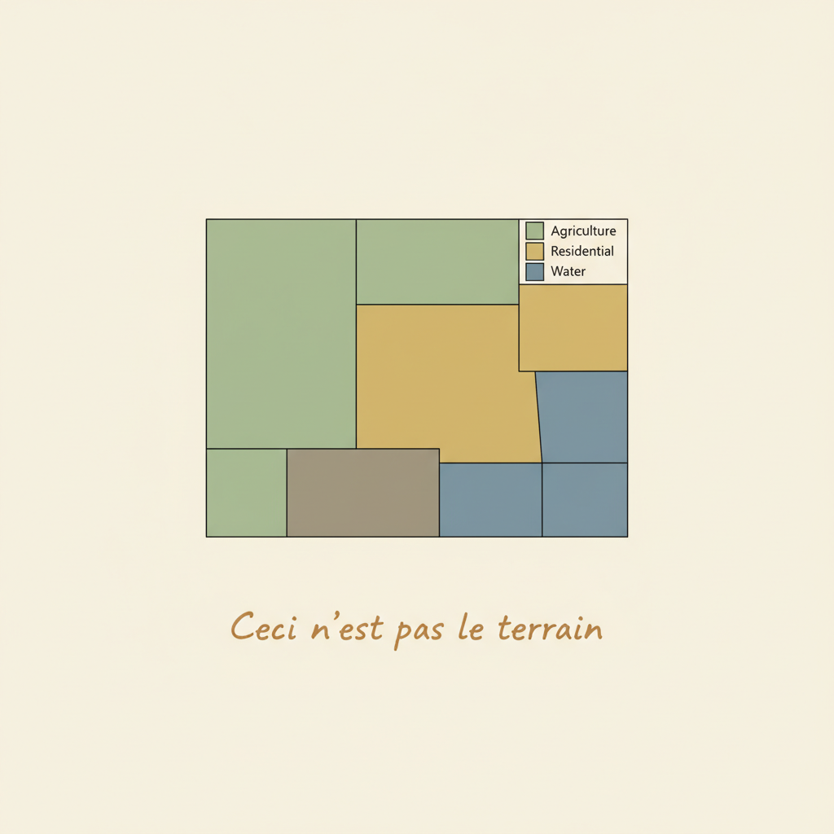
Yes, this is another of those
"the map isn't the territory" talks.
Notes:
This will be a very qualitative talk. And yes, this is another map-isn't-the-territory talk - which you already know.

Slide 5
The problem is, in governance maps are often treated as territory.
OFFICIAL
Notes:
But governance doesn't know this — or rather, governance can't afford to know this.

Slide 6
This talk is about what happens to uncertainty when maps become decisions — and who pays.
OFFICIAL
Notes:
Maps become decisions. The question is what happens to uncertainty in that case, and who pays when the map is wrong.

Slide 7
We selected about 100 documented cases of geospatial governance harm. Three cases are traced in detail.
OFFICIAL
Notes:
We looked at about a hundred documented cases where geospatial data caused governance harm. Three are going to be traced today.

Slide 8
This is the data journey for every talk in this session.
Measurements
Fusion/ML
Output
Notes:
This is the data journey for every other talk in this session. From measurements to fusion to output.

Slide 9
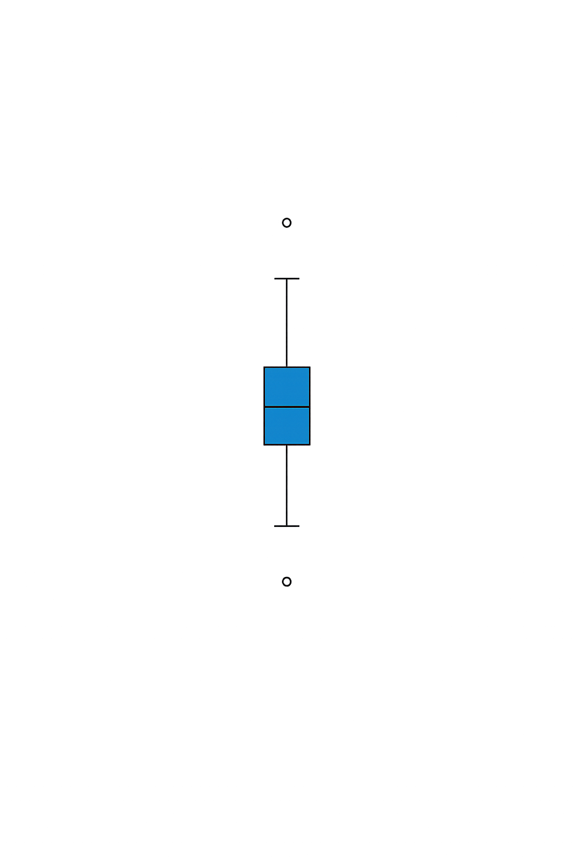
This is the data journey for every talk in this session.
Each data journey has to deal with uncertainty.
Measurements
Fusion/ML
Output
Notes:
Each step deals with uncertainty in rigorous ways.

Slide 10
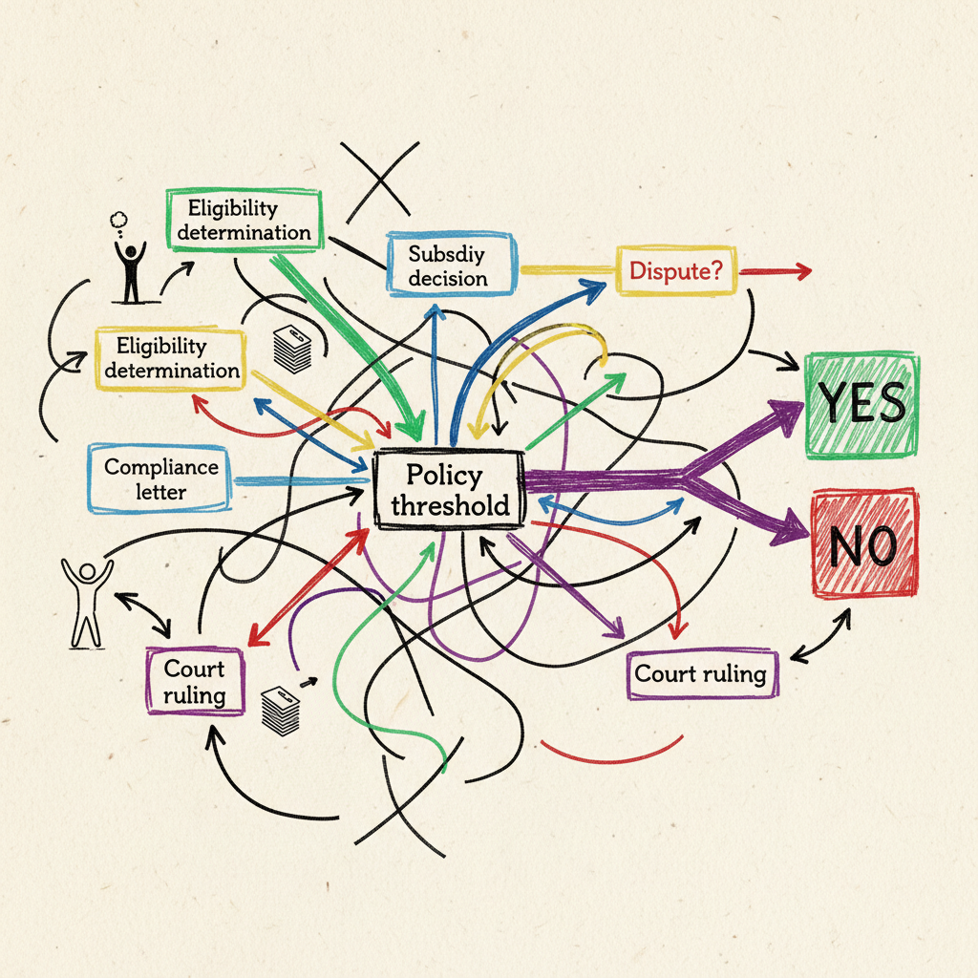
Measurements
Fusion/ML
Output
Measurements
Fusion/ML
Output
Measurements
Fusion/ML
Output
Notes:
Your scientific pipeline ends at "Output", but the governance pipeline is just getting started. Multiple outputs feed into a mess that is not very easy to make sense of. This is where uncertainty often becomes someone else's problem.

Slide 11
What happens when an uncertain output has to become a certain decision?
Notes:
But what happens when an uncertain output has to become a certain decision?

Slide 12
Case 1:
Malawi Drought, 2015-16
Notes:
See details at https://github.com/google/earthengine-community/blob/master/experimental/data_journeys/README.md

Slide 13
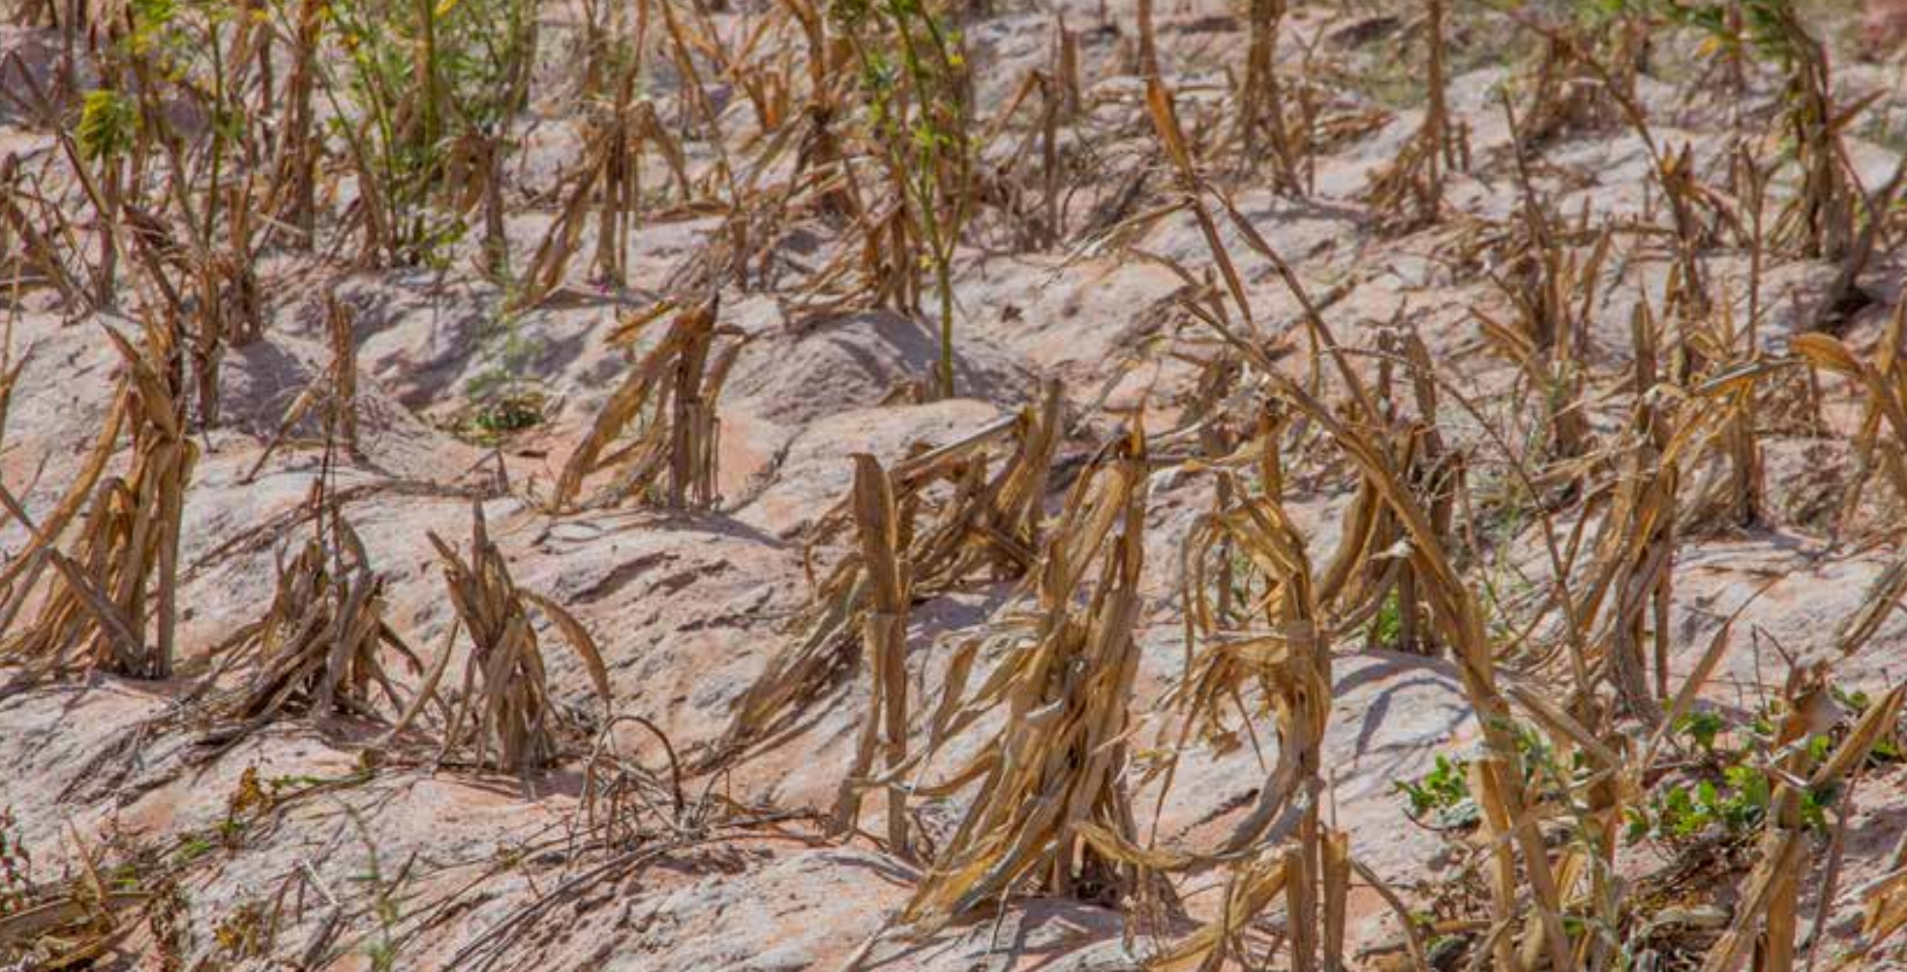
Malawi Drought, 2015-6
Notes:
Case one. Malawi, 2015-16. These images are from the post-disaster needs assessment.
Source: MALAWI DROUGHT 2015-2016 POST-DISASTER NEEDS ASSESSMENT (PDNA)
https://www.preventionweb.net/media/77813/download?startDownload=20260301

Slide 14
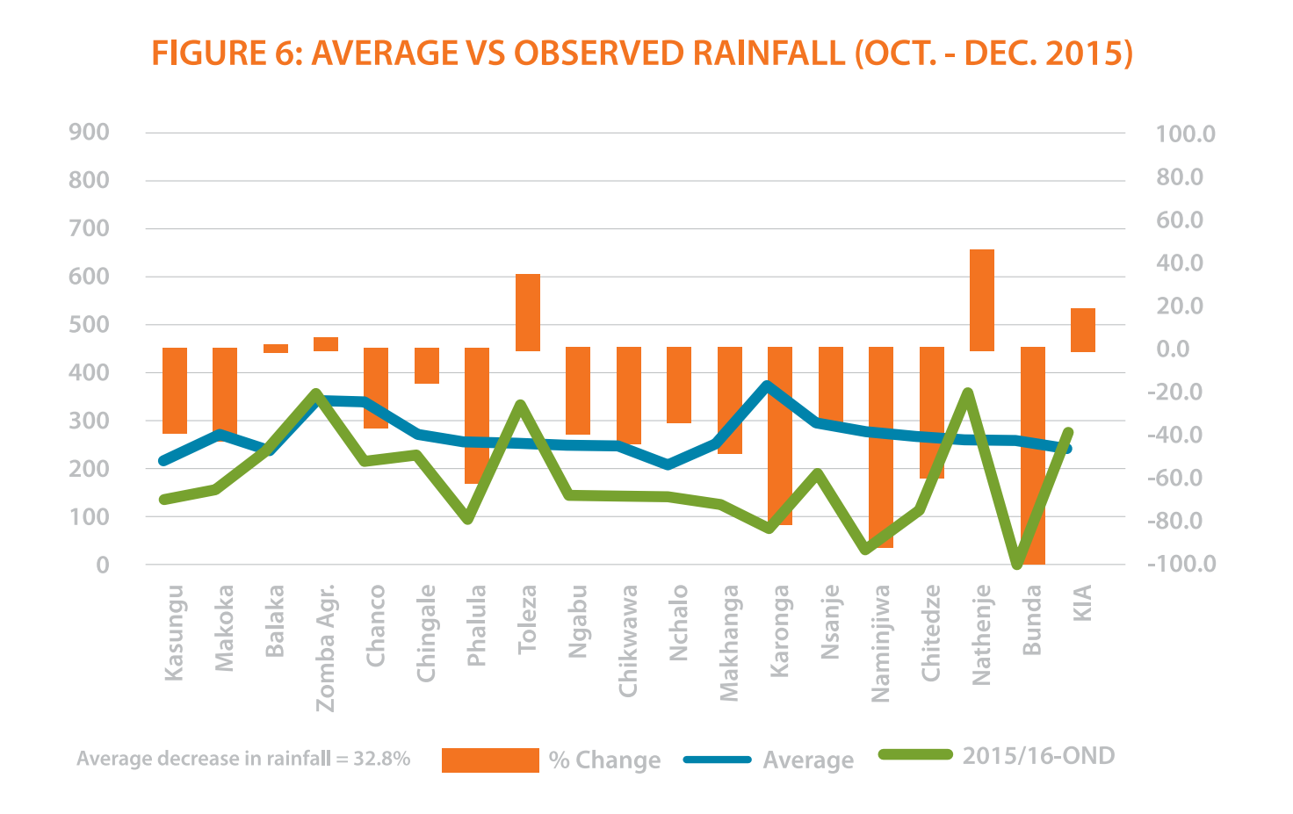
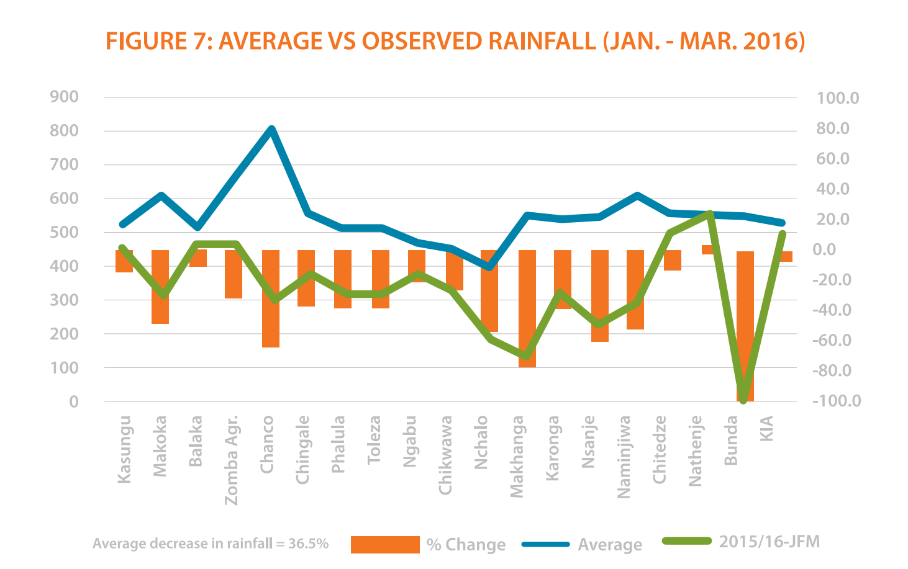
From the Post-Disaster Needs Assessment report
Case 1: Malawi Drought, 2015-16
Notes:
Rainfall was down 30-35 percent across the country.

Slide 15
Case 1: Malawi Drought, 2015-16
ARC parametric drought insurance calculates a vegetation stress index from satellite rainfall data. The index was calibrated to 120-day maize.
Notes:
The government had bought parametric drought insurance from ARC (insurance company named African Risk Capacity). "Parametric" insurance is one that pays off in case of a certain metric exceeding a threshold based on the event intensity (and not assessed loss). The insurance uses a vegetation stress index calibrated to a reference crop. The model assumed 120-day maize.

Slide 16
Case 1: Malawi Drought, 2015-16
ARC parametric drought insurance calculates a vegetation stress index from satellite rainfall data. The index was calibrated to 120-day maize.
Farmers had switched to 90-day varieties. The dry spell hit during the 90-day critical window but fell outside what the model considered critical for 120-day crops.
Notes:
Farmers had switched to 90-day varieties. The dry spell hit during the critical window for the short-cycle crop but looked passable for the long-cycle crop the model was tracking.

Slide 17
Case 1: Malawi Drought, 2015-16
ARC parametric drought insurance calculates a vegetation stress index from satellite rainfall data. The index was calibrated to 120-day maize.
Farmers had switched to 90-day varieties. The dry spell hit during the 90-day critical window but fell outside what the model considered critical for 120-day crops.
The index said: 20K people affected.
The government said: 6.7M people.
Notes:
The index showed only 20,000 people are affected. The government found 6.7 million.

Slide 18
Case 1: Malawi Drought, 2015-16
ARC parametric drought insurance calculates a vegetation stress index from satellite rainfall data. The index was calibrated to 120-day maize.
Farmers had switched to 90-day varieties. The dry spell hit during the 90-day critical window but fell outside what the model considered critical for 120-day crops.
The index said: 20K people affected.
The government said: 6.7M people.
The payout arrived, but nine months late.
Notes:
The payout eventually came — nine months late.

Slide 19
Case 2:
Delhi Informal Settlements

Slide 20
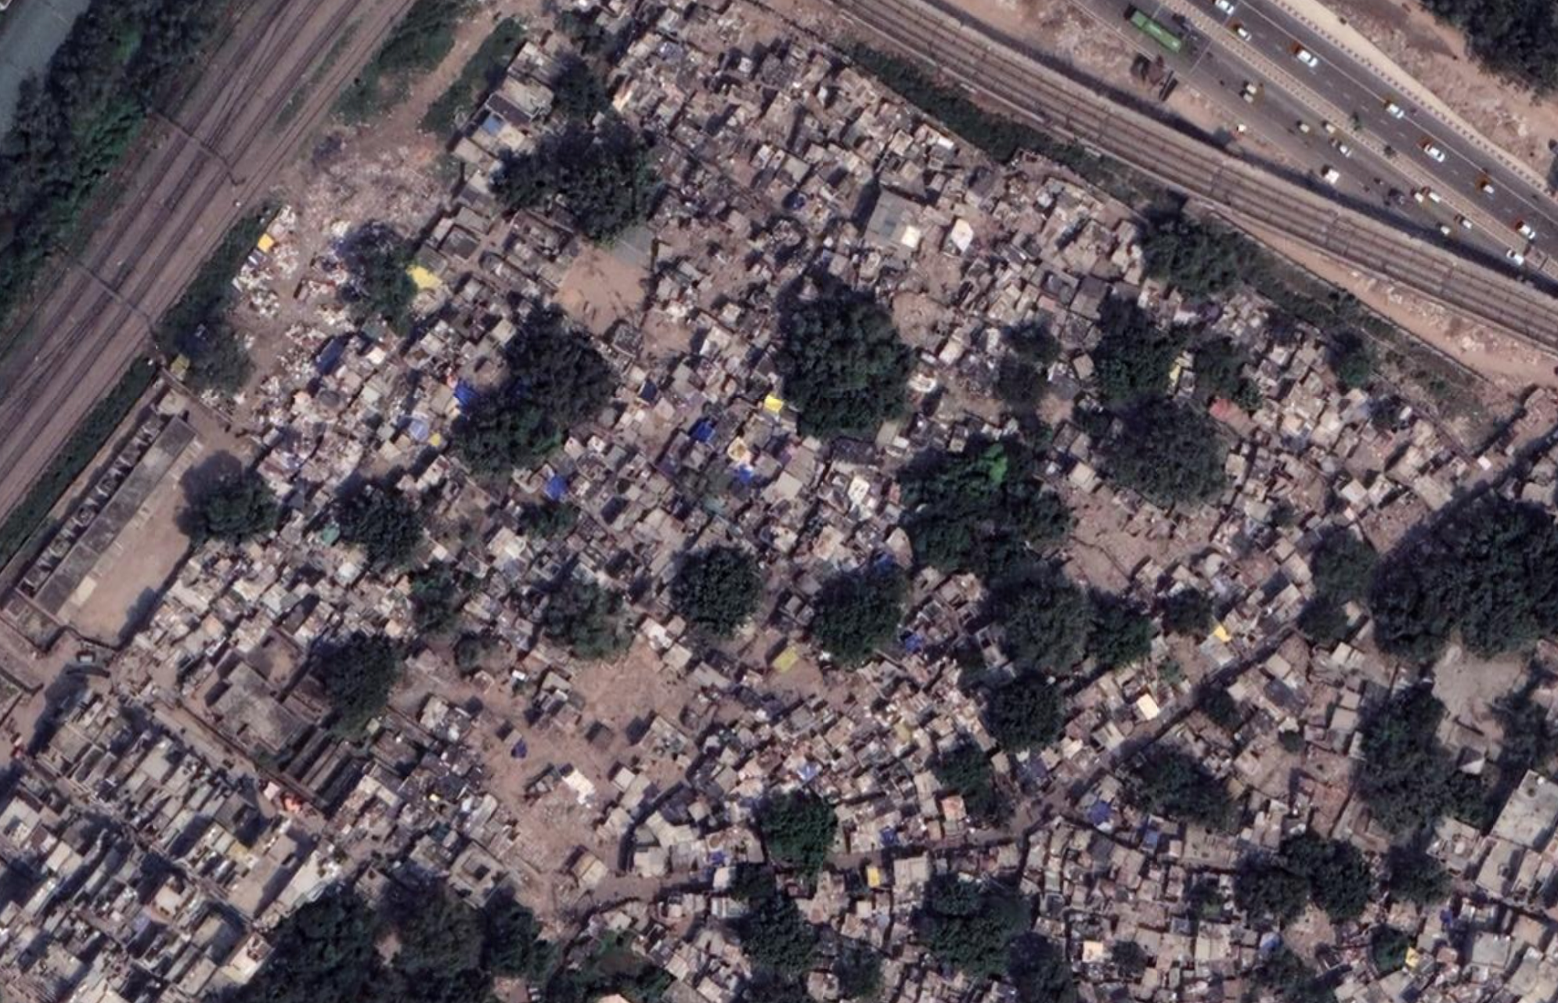
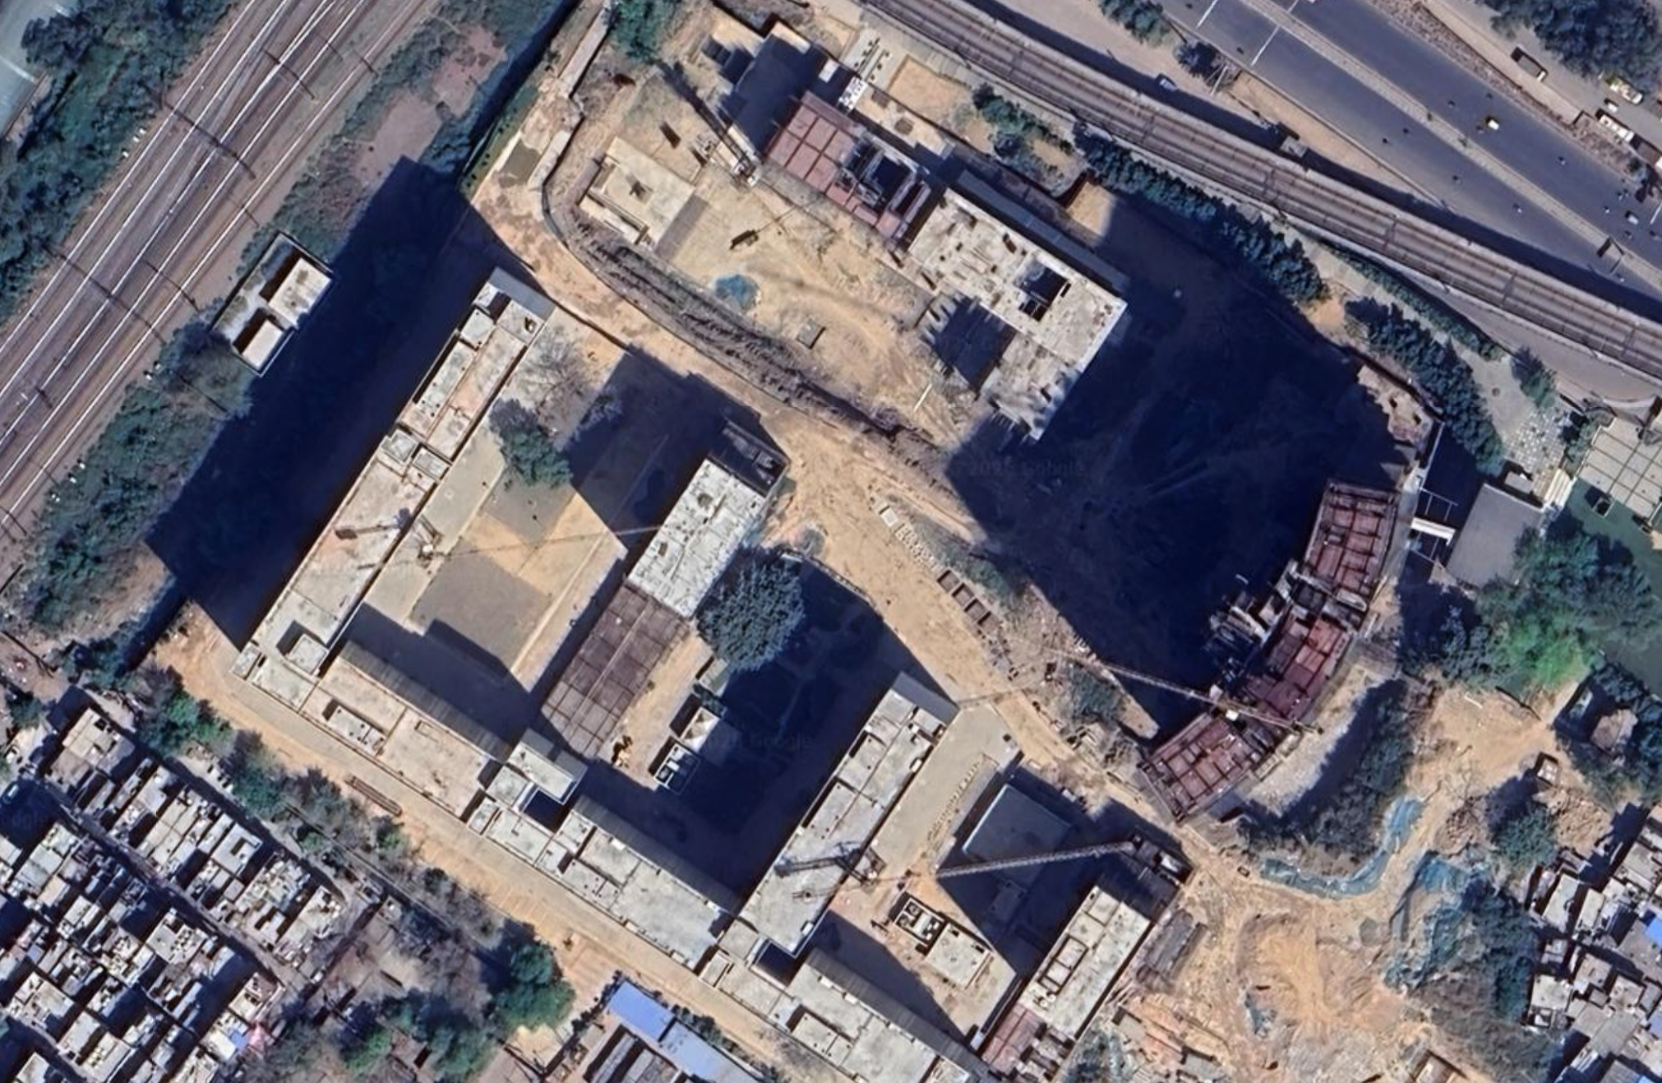
Kathputli Colony, 2017
Notes:
Case two. Delhi. This is Kathputli Colony — 2017 first.
(Imagery from Google Earth)

Slide 21
Kathputli Colony, 2025
Notes:
And 2025 next. The settlement is gone. Redevelopment is underway. Most residents from such settlements were never rehoused.
Imagery from Google Earth

Slide 22
Case 2: Delhi Informal Settlements
The state procures satellite imagery every three months to detect candidates for demolition.
Notes:
The state photographs every settlement from space every three months. That's the enforcement data journey.

Slide 23
Case 2: Delhi Informal Settlements
The state procures satellite imagery every three months to detect candidates for demolition.
To be rehoused after demolition, you must be on a list of the officially recognized JJ bastis (informal settlements) surveyed by 2006. The state has surveyed 675 of Delhi's 4,390 informal settlements.
Notes:
The help-with-resettlement journey is different. To be rehoused, you have to be on a list. The list comes from a survey. The state has surveyed only 675 of over 4,000 settlements.

Slide 24
Case 2: Delhi Informal Settlements
The state procures satellite imagery every three months to detect candidates for demolition.
To be rehoused after demolition, you must be on a list of the officially recognized JJ bastis (informal settlements) surveyed by 2006. The state has surveyed 675 of Delhi's 4,390 informal settlements.
In 2023, 280,000 people were evicted. Courts now treat absence from the survey as the resident's failure — not the state's refusal to count.
Notes:
In 2023, a quarter of a million people were evicted. The courts now treat absence from the survey as the resident's failure, not as the consequence of the state's refusal to count.

Slide 25
Case 3:
SIGPAC parcel classification, Spain

Slide 26
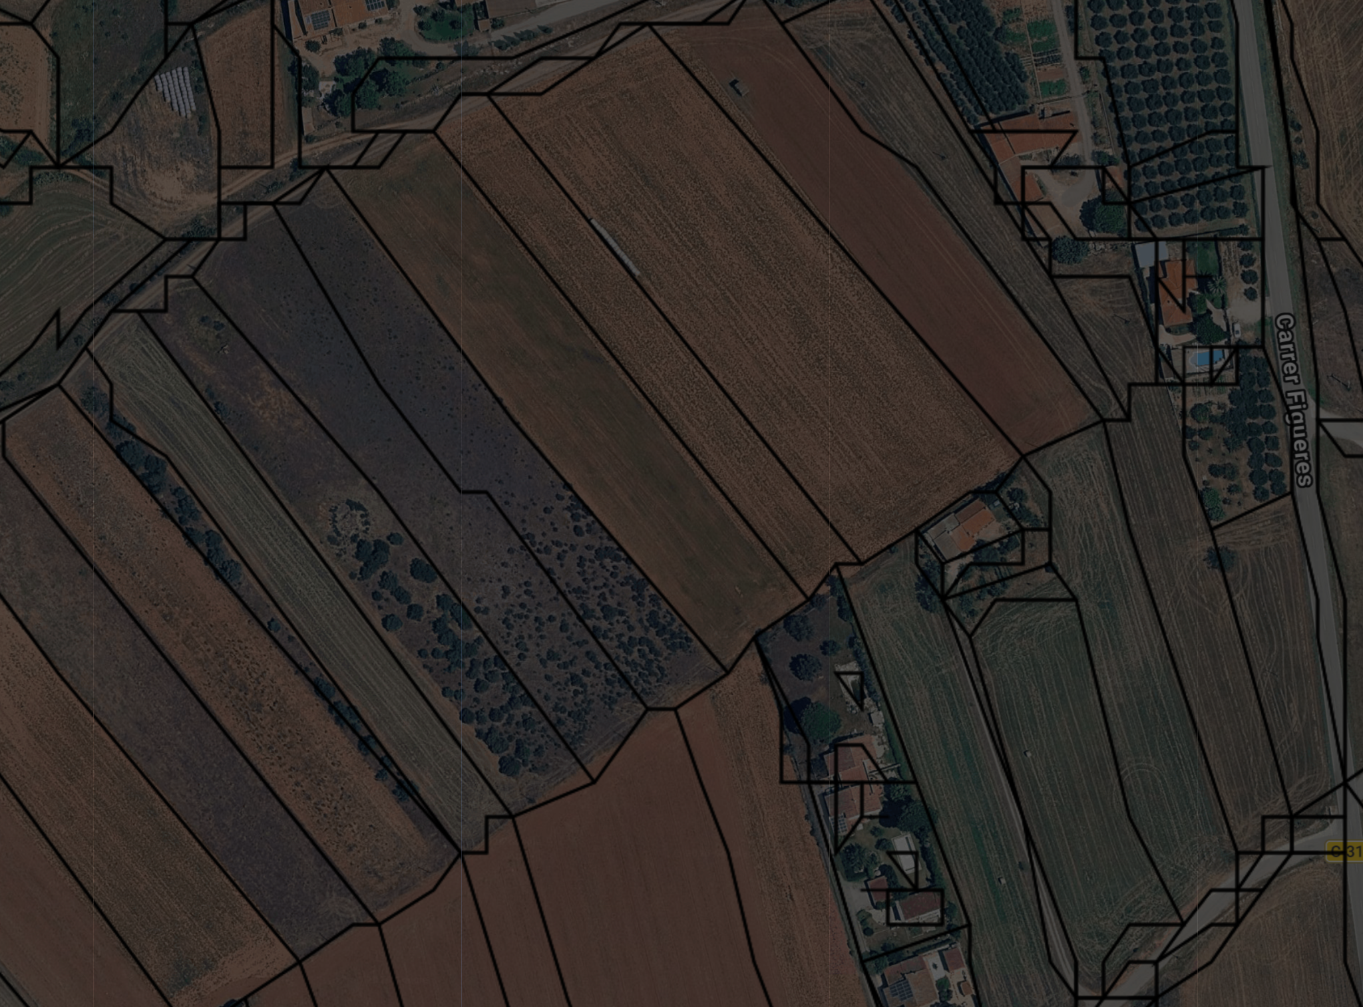
SIGPAC data over
Viladamac, Catalonia
Notes:
Case three. Spain. This is the SIGPAC data — the official parcel map that determines agricultural subsidy eligibility.
The location is 3.07N, 42.12E. Source

Slide 27
Case 3: SIGPAC parcel classification, Spain
In Spain, SIGPAC (an official register) classifies every agricultural parcel from orthoimagery and satellite data. The classification determines subsidy eligibility.
Notes:
The system classifies every parcel from orthoimagery.

Slide 28
Case 3: SIGPAC parcel classification, Spain
In Spain, SIGPAC (an official register) classifies every agricultural parcel from orthoimagery and satellite data. The classification determines subsidy eligibility.
When the algorithm is wrong, the farmer must identify the error, file a formal alegación with georeferenced photos and technical reports, and wait up to six months for a response. Silence counts as denial.
Notes:
When the algorithm gets it wrong, the farmer has to identify the error, file a formal alegación with georeferenced photos and technical reports, wait up to six months. Silence counts as denial.

Slide 29
Case 3: SIGPAC parcel classification, Spain
In Spain, SIGPAC (an official register) classifies every agricultural parcel from orthoimagery and satellite data. The classification determines subsidy eligibility.
When the algorithm is wrong, the farmer must identify the error, file a formal alegación with georeferenced photos and technical reports, and wait up to six months for a response. Silence counts as denial.
The High Court of Justice of Aragon ruled: "The farmer cannot be expected to have the technical means to verify the algorithm."
Notes:
The Aragon High Court saw the problem clearly. The farmer doesn't have the technical means to verify a coefficient computed in a complex process.

Slide 30
Case 3: SIGPAC parcel classification, Spain
In Spain, SIGPAC (an official register) classifies every agricultural parcel from orthoimagery and satellite data. The classification determines subsidy eligibility.
When the algorithm is wrong, the farmer must identify the error, file a formal alegación with georeferenced photos and technical reports, and wait up to six months for a response. Silence counts as denial.
The High Court of Justice of Aragon ruled: "The farmer cannot be expected to have the technical means to verify the algorithm".
The Spanish Supreme Court overruled it: the farmer bears ultimate responsibility for the state's map.
Notes:
The Supreme Court of Spain overruled the Aragon High Court. Now the farmer again bears ultimate responsibility for the state's map. Because of methodology changes, farmers might have to contest findings again next year. Or they can give up and accept the SIGPAC classification as "correct".

Slide 31
The institution is allowed to guess.
The governed pay when the guess is wrong.
Notes:
We see the overall pattern: the institution gets to guess. The governed pay when the guess is wrong.

Slide 32
Governance data journeys
Notes:
So: three cases, one pattern. How do we study this?

Slide 33

Governance data journeys
Inspired by Sabina Leonelli's notion of
data journeys in life sciences and other STS/critical GIS works.
Notes:
We build on Sabina Leonelli's data journeys framework from philosophy of biology. Her key insight: data have no fixed meaning independent of the communities that use them. Data change through transit. We extend this from just scientific communities to governance, where the receiving community often doesn't get to push back.

Slide 34
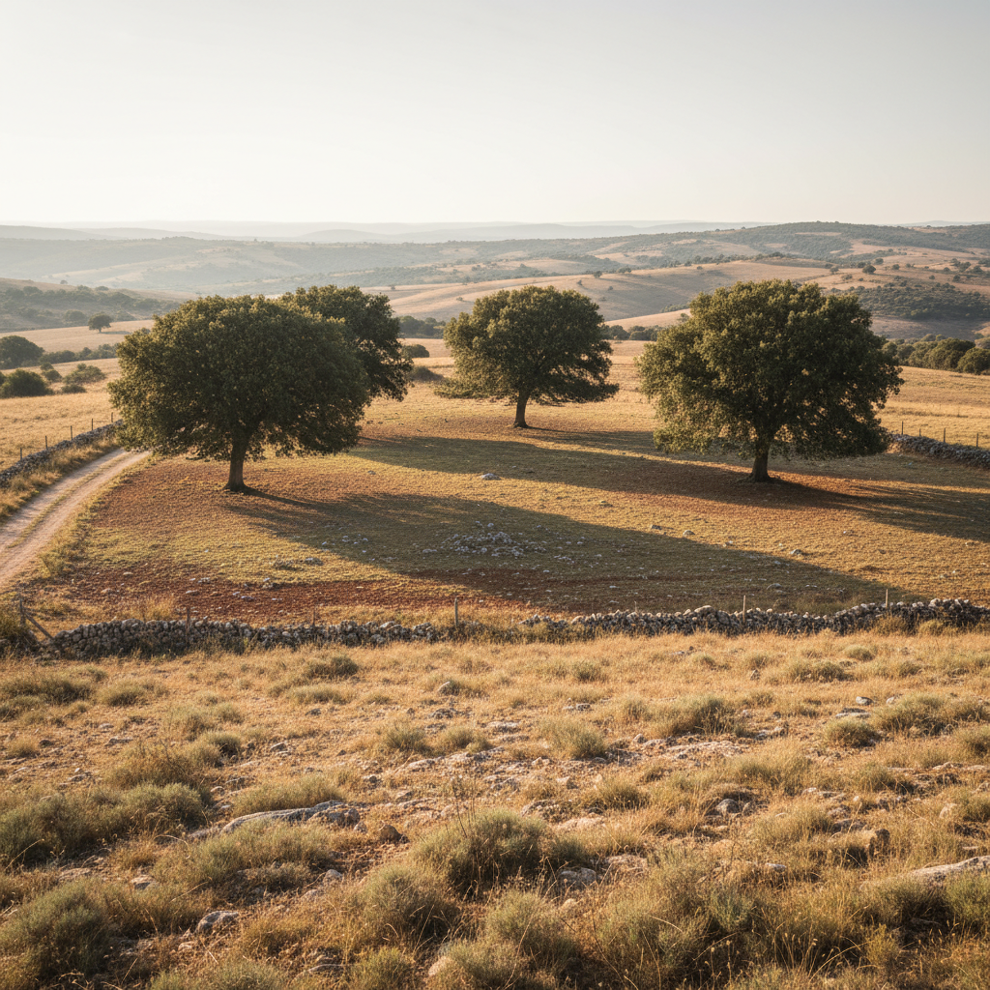
Governance data journeys
Situated Category
What exists on the ground
Notes:
I will introduce a few terms that are hopefully intuitive. We start with what exists on the ground: situated category. Here's a parcel - it's a complex, ambiguous, seasonal thing.

Slide 35
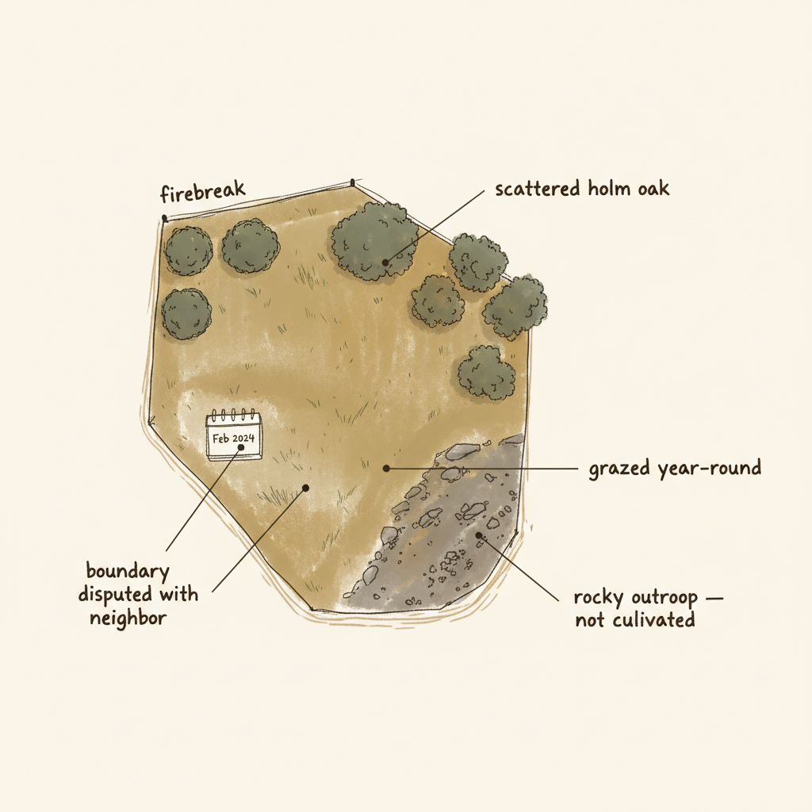
Governance data journeys
Situated Category
What exists on the ground
Inscription
What was recorded
Notes:
Inscription is what gets recorded. Already a reduction — but still rich.

Slide 36
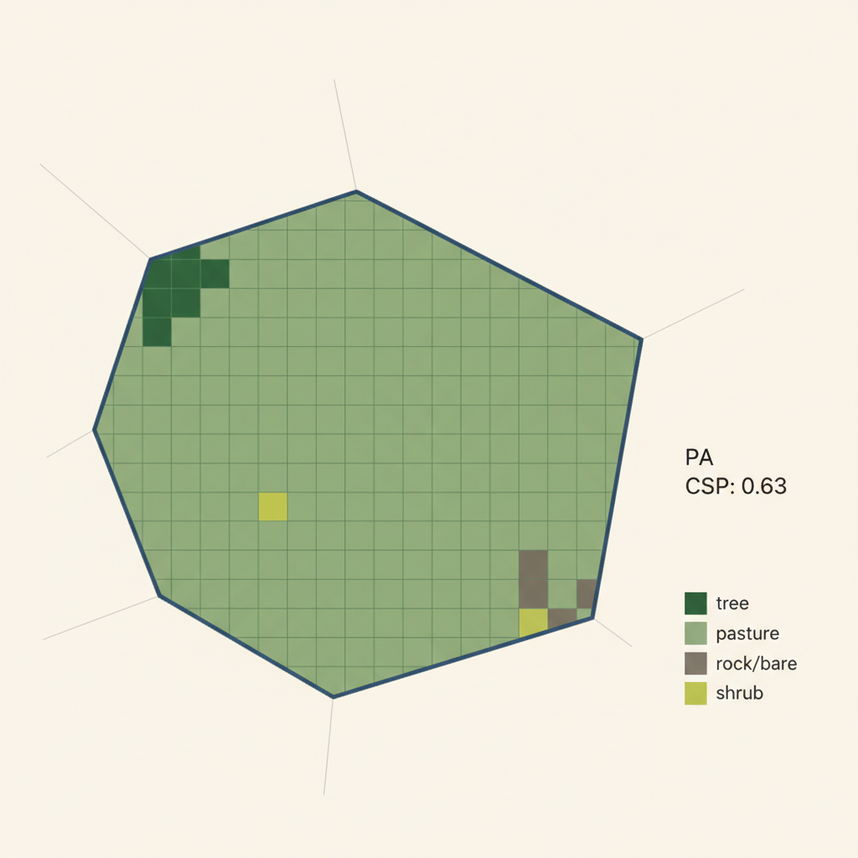
Governance data journeys
Situated Category
What exists on the ground
Inscription
What was recorded
Packaging
What survives the journey
Notes:
Packaging: what survives the journey. Now it's a grid of classified pixels and a coefficient.

Slide 37
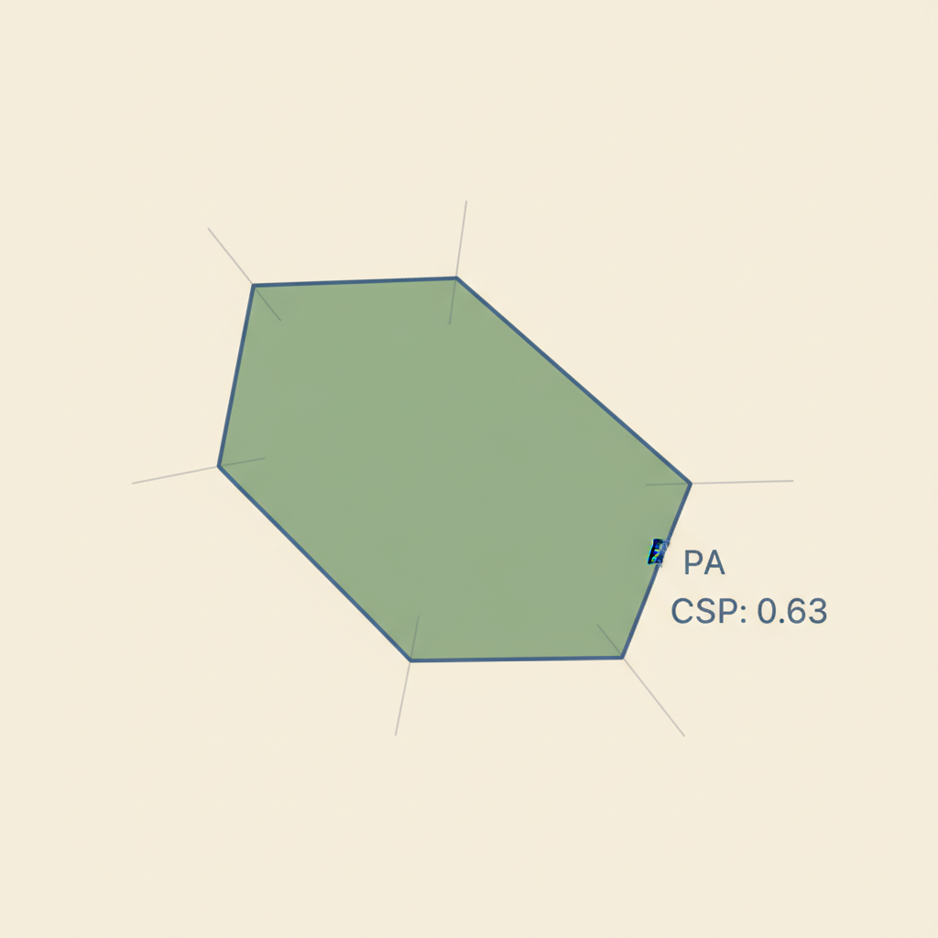
Governance data journeys
Situated Category
What exists on the ground
Inscription
What was recorded
Packaging
What survives the journey
Landing
What the institution sees
Notes:
Landing: what the institution sees. A polygon, a use code, a number.

Slide 38

Governance data journeys
Situated Category
What exists on the ground
Inscription
What was recorded
Packaging
What survives the journey
Landing
What the institution sees
Warrant
What the institution does
Notes:
Warrant: what the institution does. A verdict stamped on an abstraction.

Slide 39
Governance data journeys
As context drops, authority rises.
Situated Category
Inscription
Packaging
Landing
Warrant
Notes:
We see that in governance journeys authority rises as context drops.

Slide 40

Interlude: lossy compression
Notes:
Brief interlude to introduce a term: you must have seen digital images become very pixelated. This is called "lossy compression".

Slide 41
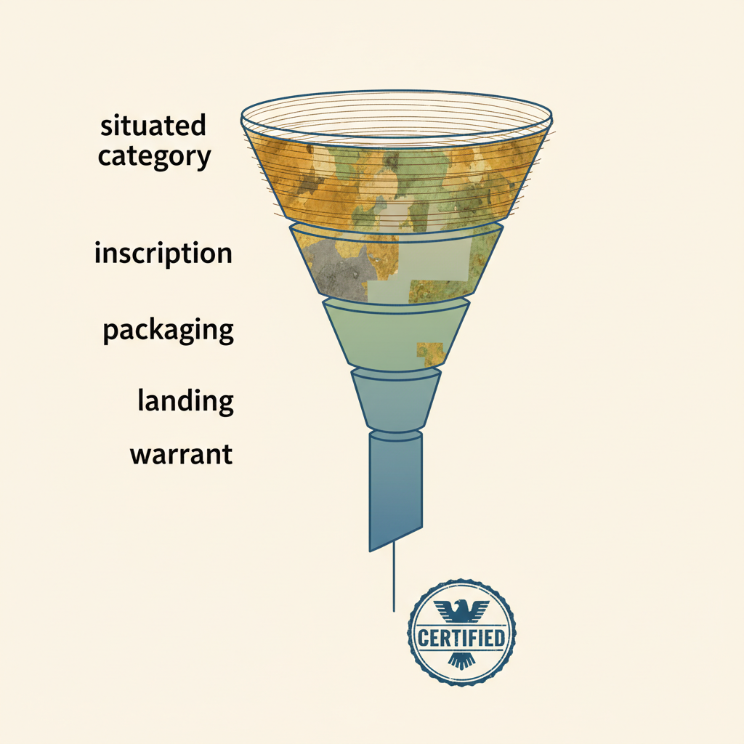
Governance data journeys
As context drops, authority rises.
The Lossy Warrant
Notes:
We call this the lossy warrant.

Slide 42
Governance data journeys
As context drops, authority rises.
The Lossy Warrant
This is inevitable in governance.
Notes:
This is inevitable in governance. The question isn't how to stop it — it's who bears the cost

Slide 43

Yes, maps are often treated as territory in governance.
How do we study this?
OFFICIAL
Notes:
Scott told us states simplify to govern. We're asking: what specific shapes does that simplification take, and what specific harms does each shape produce?

Slide 44
An attempt at classification

Slide 45
An attempt at classification
The cases seem to form three big groups based on this question:
What is the shape of the warrant?
Notes:
The cases seem to form three groups based on what the warrant does to the governed.

Slide 46
An attempt at classification
The cases seem to form three big groups based on this question:
What is the shape of the warrant?
1. Gate (Malawi): A threshold, trigger, or classification that becomes the decision. The subject must prove it wrong.
Notes:
Number 1: Gate. This is our Malawi case: the index either fires or it doesn't. A threshold or classification becomes the decision itself. The subject must prove it wrong.

Slide 47
An attempt at classification
The cases seem to form three big groups based on this question:
What is the shape of the warrant?
1. Gate (Malawi): A threshold, trigger, or classification that becomes the decision. The subject must prove it wrong.
2. Void (Delhi): Absence in the record treated as absence in the world. A single canonical record determines standing.
Notes:
Number 2. Void. This is our Delhi case: if you're not on the list, you don't exist. The absence in the record is treated as the absence in the world. The subject must prove they're real.

Slide 48
An attempt at classification
The cases seem to form three big groups based on this question:
What is the shape of the warrant?
1. Gate (Malawi): A threshold, trigger, or classification that becomes the decision. The subject must prove it wrong.
2. Void (Delhi): Absence in the record treated as absence in the world. A single canonical record determines standing.
3. Loop (Spain): The system's actions shape the governed subject's behavior, which the next cycle evaluates.
Notes:
Number 3. Loop. This is our Spain case: classify, contest or comply, reclassify. The system's outputs shape the behavior that the next cycle evaluates. The burden never ends.

Slide 49
An attempt at classification
The cases seem to form three big groups based on this question:
What is the shape of the warrant?
1. Gate (Malawi): A threshold, trigger, or classification that becomes the decision. The subject must prove it wrong.
2. Void (Delhi): Absence in the record treated as absence in the world. A single canonical record determines standing.
3. Loop (Spain): The system's actions shape the governed subject's behavior, which the next cycle evaluates, manufacturing compliance.
This needs further thought: predictive policing is also a loop, but one that manufactures evidence. The shape of the warrant is different.
Notes:
I want to flag — this needs further thought. Predictive policing has the same feedback structure as Spain, but it manufactures evidence rather than compliance. Same circulation shape, different harm at landing. We think that distinction matters but we haven't fully worked it out.

Slide 50
An attempt at recommendations

Slide 51
An attempt at recommendations
What should we do with this classification?
Notes:
What advice can we infer?

Slide 52
An attempt at recommendations
One solution is common
0. Uncertainty burden must follow authority.
Notes:
One principle is common to all three: uncertainty burden must follow authority.

Slide 53
An attempt at recommendations
0. Uncertainty burden must follow authority.
When institutions exercise power through probabilistic spatial proxies, they must internalize the costs of doubt rather than externalizing uncertainty resolution onto those they govern.
Notes:
When institutions act on probabilistic proxies, they must internalize the costs of doubt.

Slide 54
An attempt at recommendations
0. Uncertainty burden must follow authority.
Malawi:
Internalize doubt as maintenance
Fund annual crop calendar updates and sensitivity testing.
Delhi:
Internalize doubt as a precondition
Survey first, then demolish.
Spain:
Internalize doubt as funded contestation
Fund field verification for a proportion of parcels before the farmer bears liability.
Notes:
Concretely: In Malawi, internalize doubt as maintenance — fund the calibration that keeps the model honest. In Delhi, internalize doubt as a precondition — survey first, then demolish. In Spain, internalize doubt as funded contestation — the institution that classifies should bear a part of the cost of being wrong.

Slide 55
An attempt at recommendations
Other solutions depend on the journey type.
Notes:
But some solutions are journey-specific.

Slide 56
An attempt at recommendations
Other solutions depend on the journey type.
1. Gate.
Malawi: require the index to say it was calibrated to 120-day maize varieties.
Notes:
Malawi: require the index to declare it was calibrated to 120-day maize

Slide 57
An attempt at recommendations
Other solutions depend on the journey type.
1. Gate.
Malawi: require the index to say it was calibrated to 120-day maize varieties.
If a data journey triggers a decision, it must state its calibration assumptions and what would make it wrong.
Notes:
Gate: the trigger must declare its assumptions and what would make it wrong.

Slide 58
An attempt at recommendations
Other solutions depend on the journey type.
2. Void.
Delhi: allow to present other proofs of residence: electricity bills, school enrollment, voter registration, community testimony.
Notes:
Delhi: allow accepting electricity bills, school enrollment, community testimony as proof of residence

Slide 59
An attempt at recommendations
Other solutions depend on the journey type.
2. Void.
Delhi: allow to present other proofs of residence: electricity bills, school enrollment, voter registration, community testimony.
If only one record determines what exists, the institution must justify why it refuses other proof.
Notes:
Void: if only one type of record determines who exists, justify why other types are refused.

Slide 60
An attempt at recommendations
Other solutions depend on the journey type.
3. Loop.
Spain: farmer-supplied corrections should persist; independent verification should interrupt the cycle.
Notes:
Spain: corrections should persist across methodology changes, and independent field verification should interrupt the cycle.

Slide 61
An attempt at recommendations
Other solutions depend on the journey type.
3. Loop.
Spain: farmer-supplied corrections should persist; independent verification should interrupt the cycle.
If the system acts on data shaped by its own prior actions,
build friction into the cycle.
Notes:
Loop: build friction into the cycle — independent checks, persistent corrections.

Slide 62
Justice demands institutions that can bear the weight of their own uncertainty.
Do not force the governed to carry it.
Notes:
Justice demands institutions that can bear the weight of their own uncertainty. Do not force the governed to carry it.
Thank you.

Slide 63

Inspiration
Inspired by Bruno Latour. "The map IS a part of the territory"
Notes:
All of this in some sense is inspired by Bruno Latour.

Slide 64
Inspiration
Scott (1998): states simplify to govern
Latour (1999): data travel through chains of transformation
Edwards (2010): data friction — data change at every institutional boundary they cross
Leonelli (2016): data journeys — the unit of analysis for this work
Discussions with Erin Trochim, Samapriya Roy, Renee Johnston, and many others
Notes:
Intellectual debts on the slide. Leonelli is the scaffolding.

Slide 65

Next steps
Could you help curate more cases?
Notes:
We need to curate more than just three cases. If you work with a geospatial system that produces governance decisions, we'd love to hear from you. Especially cases where the system works well — we need to understand what journey-aware governance looks like in practice, not just what goes wrong.

