Slide 1
Using ISO 19115-2 to model CEOS ARD
Meta-data modeling with
Universal Modeling Language (UML)
Sumit Sen & Siri Jodha Khalsa
L7.4 Session L7:2026 CEOS-ARD Strategy
Pillar: Standards and Interoperability
WGCV-56 / LSI-VC-19 Joint Meeting
Sioux Falls, SD, USA -20-24 April, 2026

Slide 2
Why CEOS ARD needs grounding in ISO Standards
Building upon existing international standards increases acceptance and improves interoperability
ISO/TC211 has an established framework for the standardization of metadata describing geospatial data
  Based on decades of work by domain experts
The 191** series of standards created by ISO/TC211 are “abstract” standards
  They do not specify a particular technology, like a web service or file format
  Instead, they define a high-level, technology-independent conceptual model
  These conceptual models are portrayed using Universal Modeling Language (UML)
  These can be graphically represented using class diagrams
Notes:
Unified Modeling Language (UML) is an international standard for object oriented modeling

Slide 3
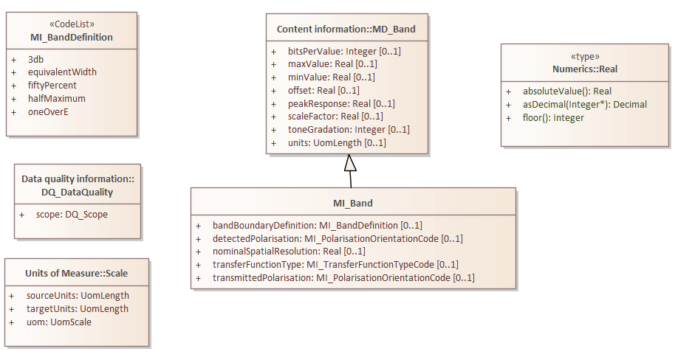
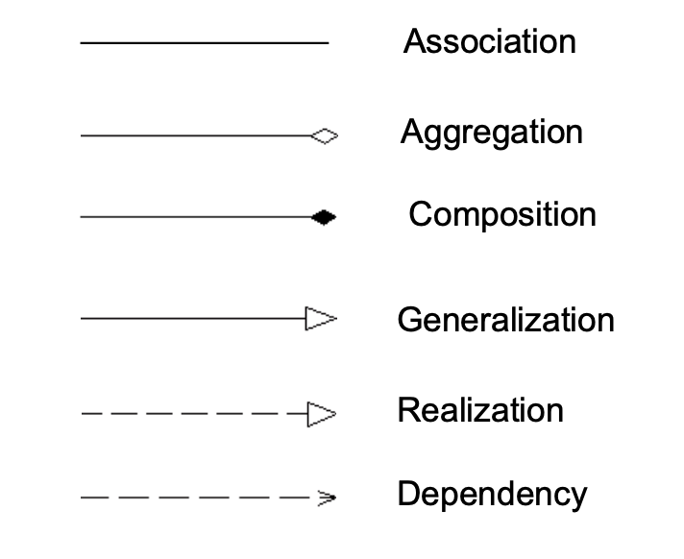
UML Example
Package-name::Class-name
<<stereotypes>>
CodeLists
Data Types
multiplicity
Class names are prefixed with a code indicating the originating standard, e.g.
MD = 19115-1, MI = 19115-2, DQ = 19157
Notes:
A UML Class Diagram defines object types and their attributes, (operations), and relationships
ISO/TC211 metadata models are displayed as Class & Package Diagrams
UML diagram and associated data dictionary are the formal specification which can be validated against (using XSD = XML schema definition)
This example is from 19115-2 Geographic information — Metadata — Part 2: Extensions for acquisition and processing

Slide 4
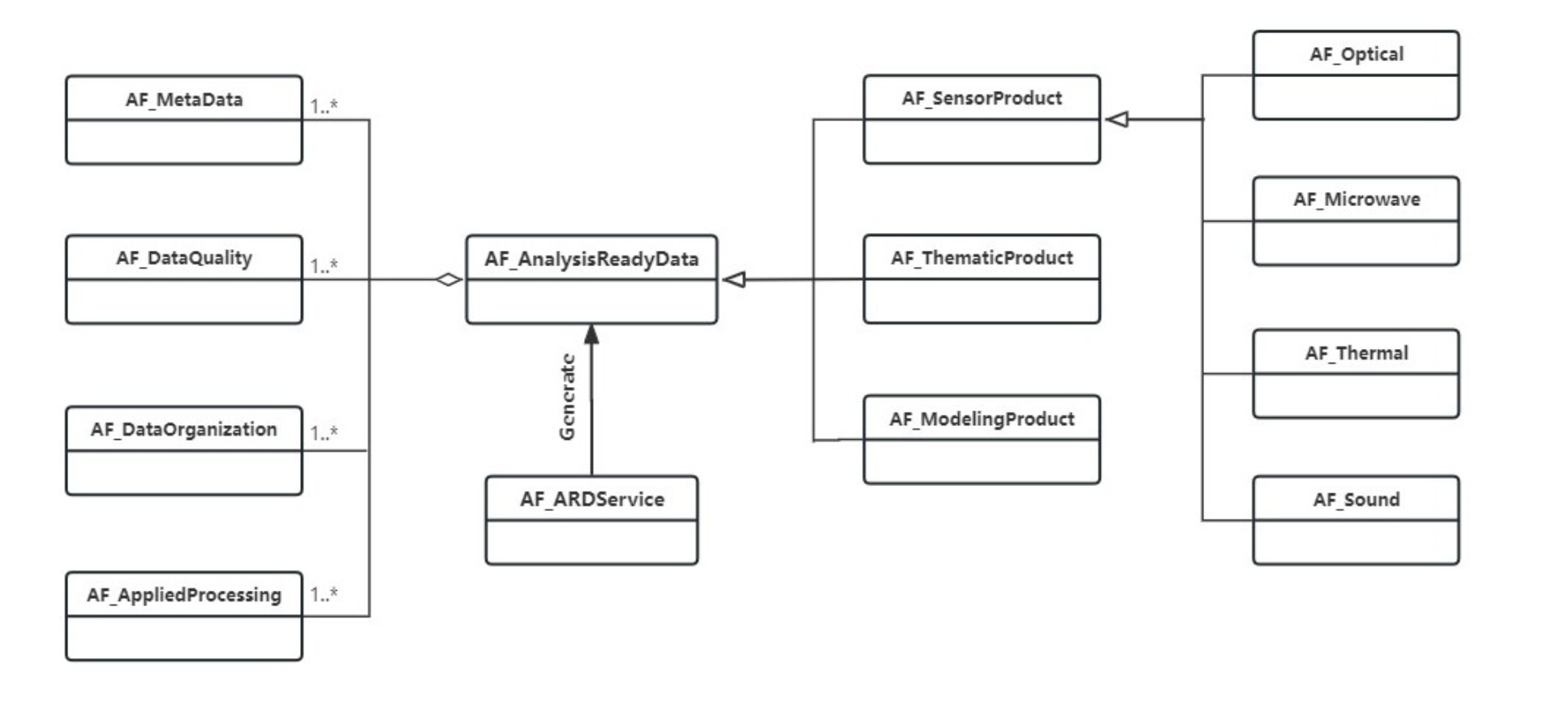
Representing CEOS ARD in UML
Proposed model with all elements of CEOS-ARD PFS (Quinn, 2014)
Proposed top-level UML from draft ISO 19176-1
Notes:
This is the top-level UML that was included in the initial draft of 19176-1
This is a preliminary modeling of the attributes in all the PFSs submitted by Patrick Quinn of NASA as a graphic only. Sumit has re-created it. I will show a detail of this graphic and Sumit will dive into details of the model he has re-created from this

Slide 5
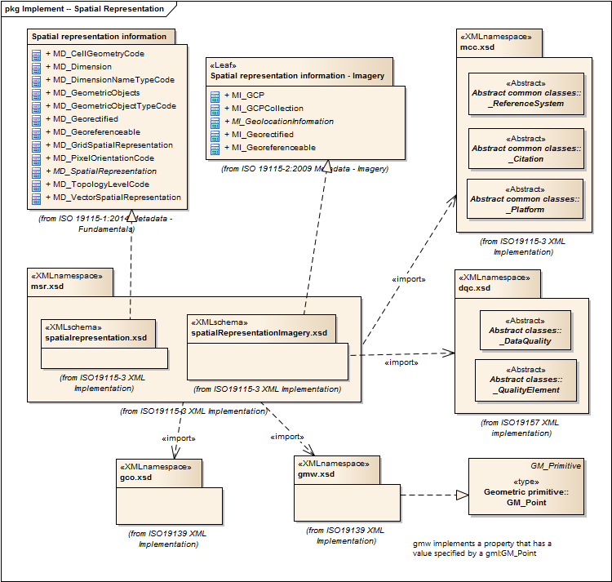
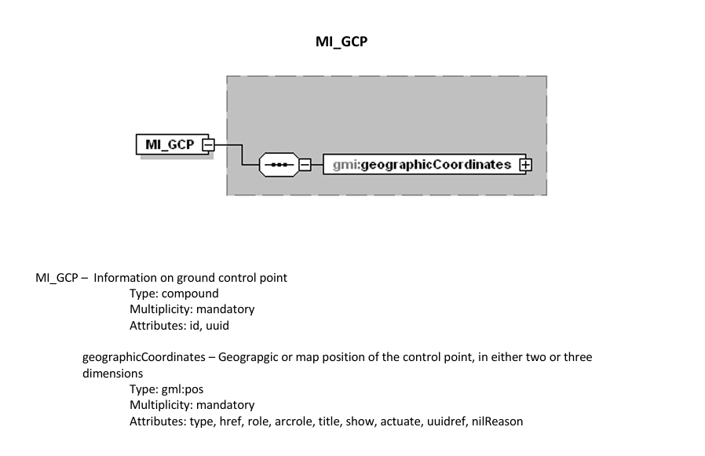
ISO 19115-2

Slide 6
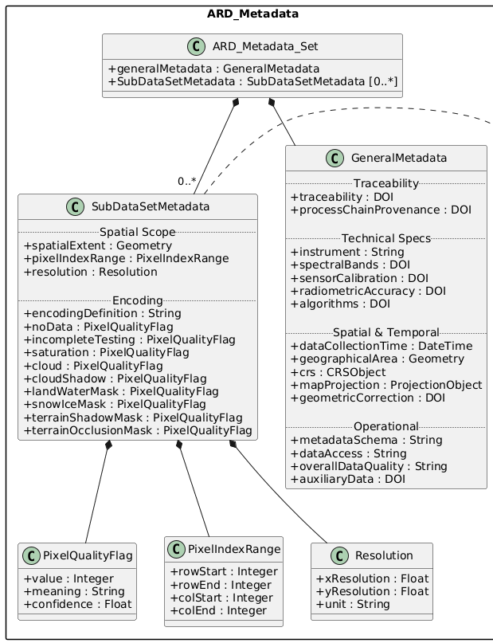
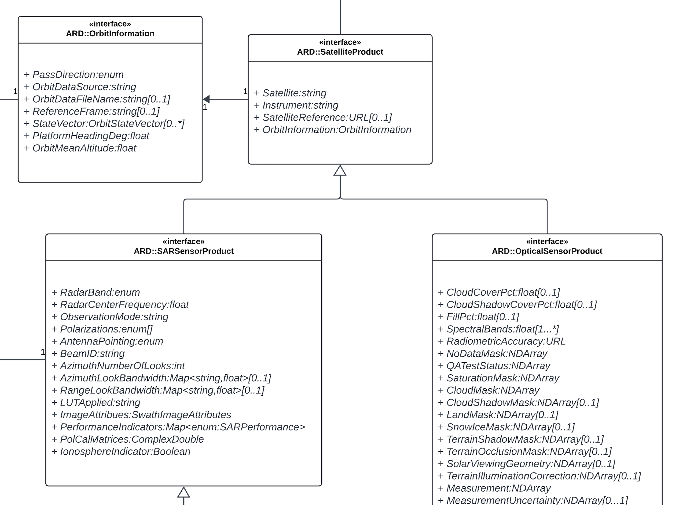
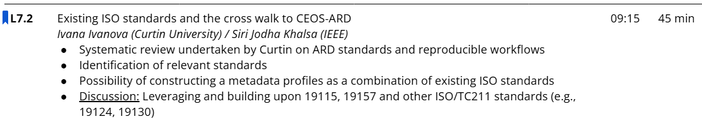
High Level ARD UML Model
Initial attempt to make a high-level UML model of CEOS ARD metadata (Patrick Quinn, NASA)

Slide 7
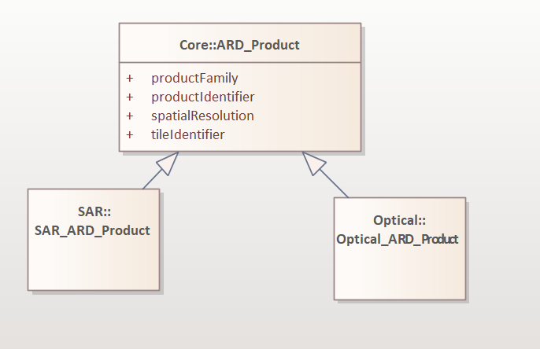
UML Models of CEOS ARD …

Slide 8
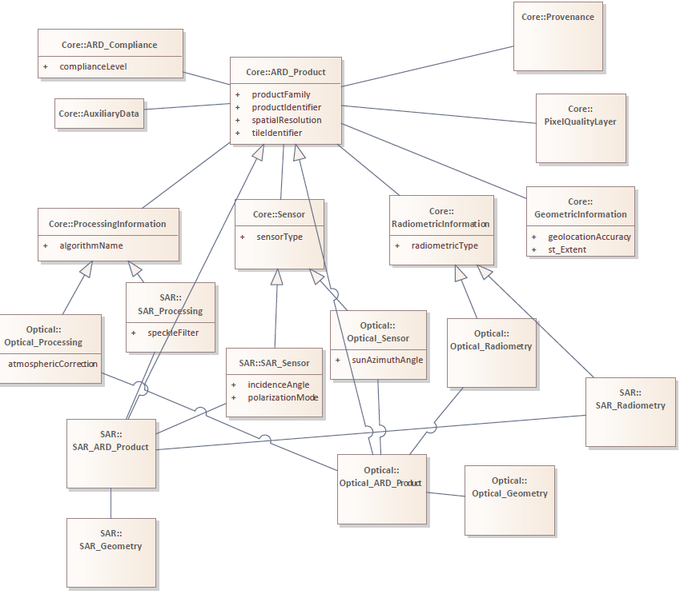
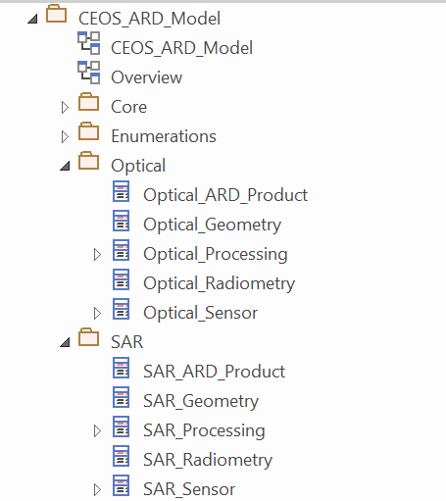
Classes and their associations

Slide 9
Core Metadata Crosswalk
CEOS ARD Class | Attribute | ISO 19115-2 Element | ISO Path | Notes
ARD_Product | productIdentifier | MD_Identifier | MD_Metadata.fileIdentifier | Primary ID
 | productFamily | MD_Keywords | MD_Metadata.identificationInfo.descriptiveKeywords | CARD4L type
 | acquisitionDate | EX_TemporalExtent | EX_Extent.temporalElement | Acquisition
 | processingDate | LI_ProcessStep.dateTime | LI_Lineage.processStep | Processing time
 | spatialResolution | MD_Resolution | MD_DataIdentification.spatialResolution | Required

Slide 10
Platform & Sensor Mapping
CEOS Class | Attribute | ISO Element | ISO Class
Platform | platformName | MI_Platform.identifier | MI_Platform
 | orbitType | MI_Platform.description | MI_Platform
Sensor | sensorType | MI_Sensor.type | MI_Sensor
SAR_Sensor | polarizationMode | MI_Sensor.description | MI_Sensor
 | incidenceAngle | MI_Instrument.description | MI_Instrument
Optical_Sensor | sunAzimuthAngle | MI_Instrument.description | MI_Instrument

Slide 11
Processing Metadata Crosswalk
CEOS Class | Attribute | ISO Element
ProcessingInformation | algorithmName | LI_ProcessStep.description
SAR_Processing | speckleFilter | LI_ProcessStep.processingInformation
Optical_Processing | atmosphericCorrection | LI_ProcessStep.processingInformation
MD_Metadata
└── dataQualityInfo
└── lineage
└── processStep

Slide 12
Geometry Metadata Crosswalk
CEOS Class | Attribute | ISO Element
GeometricInformation | geolocationAccuracy | DQ_AbsoluteExternalPositionalAccuracy
SpatialReference | CRS | MD_ReferenceSystem
Radiometric Metadata Crosswalk
CEOS Class | Attribute | ISO Element
RadiometricInformation | radiometricType | MI_ImageDescription.radiometricCalibrationDataAvailability
SAR_Radiometry | (type) | MI_ImageDescription
Optical_Radiometry | (type) | MI_ImageDescription

Slide 13
Quality Metadata Crosswalk
CEOS Class | Attribute | ISO Element
QualityInformation | — | DQ_DataQuality
PixelQualityLayer | qualityFlagName | DQ_ThematicAccuracy
Provenance Crosswalk
CEOS Class | Attribute | ISO Element
Provenance | processingCenter | CI_ResponsibleParty
 | — | LI_Lineage

Slide 14
Compliance Metadata Crosswalk
CEOS Class | Attribute | ISO Element
ARD_Compliance | complianceLevel | DQ_ConformanceResult
Auxiliary Data Crosswalk
CEOS Class | Subtype | ISO Element
AuxiliaryData | DEM_Data | CI_Citation
 | OrbitData | CI_Citation
 | AtmosphericData | CI_Citation
 | CalibrationData | CI_Citation

Slide 15
Stereotype mapping
CEOS Class | ISO Stereotype
ARD_Product | <<MD_Metadata>>
Platform | <<MI_Platform>>
Sensor | <<MI_Sensor>>
ProcessingInformation | <<LI_ProcessStep>>
Provenance | <<LI_Lineage>>
QualityInformation | <<DQ_DataQuality>>
SpatialReference | <<MD_ReferenceSystem>>
TemporalExtent | <<EX_Extent>>
RadiometricInformation | <<MI_ImageDescription>>
AuxiliaryData | <<CI_Citation>>

Slide 16
What is missing
ISO 19115-2 supports:
✔ Processing lineage
✔ Processing steps
But missing:
Standardized ARD processing stages
Algorithm parameter provenance
Correction-chain definitions
Processing dependency modeling
ISO 19115-2 supports:
✔ Dataset-level quality
✔ Positional accuracy
But lacks:
Pixel-level quality flags
Bitmask definitions
Confidence layer semantics
Multi-layer QA relationships
ISO 19115-2 includes:
✔ Conformance reporting
But lacks:
Threshold vs Target distinction
Requirement traceability
Product certification status
Validation rule metadata
ISO 19115-2 supports:
✔ General image metadata
But lacks:
SAR-specific radiometric models
Backscatter normalization metadata
Polarization-specific calibration metadata
Multi-incidence-angle relationships
ISO 19115-2 supports:
✔ Dataset citation
But lacks:
Explicit dependency graphs
Versioned auxiliary inputs
DEM lineage propagation
Orbit model precision metadata
ISO 19115-2 supports:
✔ Accuracy metrics
But lacks:
Uncertainty propagation chains
Confidence modeling
Multi-stage error accumulation
Pixel-to-product uncertainty linkage

Slide 17
Why not STAC?
Missing many ARD requirements not natively supported
  Even with STAC-ARD extension can’t add many quality parameters, provenance, …
  STAC does NOT natively support:
    multi-step lineage graphs
    detailed algorithm chains
    execution environments
For Validation → Need a formal model to test compliance (UML)
But need backward compatibility with STAC
LI_Lineage → LE_ProcessStep → LE_Algorithm → ProcessingEnvironment
"properties": {
"processing:level": "ARD",
"description": "processed using XYZ"
}
Notes:
LI = Lineage LE = Lineage Extended

Slide 18
Conclusions and Takeaways
ISO already gets us surprisingly far
  ISO 19115-2 provides a strong foundation for CEOS ARD
  Core capabilities like lineage, quality, and acquisition metadata are already supported
  A large portion of ARD can be modeled without introducing extensions
2. But ARD requirements go beyond ISO’s native scope
  Missing support for pixel-level quality and bitmasks
  Algorithm parameter provenance
  Multi-stage processing chains
3. UML is essential for formalization and validation
  Clear conceptual modeling, validation of schemas (possibly schema-less?)
  Standardized interpretation across agencies
  Ensure compatibility with STAC to ensure distribution (discoverability and access)

Slide 19
Questions & Discussion
Thanks to Conversations @ OGC, ISO TC211, …
Eager to carry forward the discussion – Sumit Sen (sumitssen@gmail.com)
– Siri Jodha Singh KHALSA (khalsa@colorado.edu)

