Slide 1
CEOS-ARD in the Cloud
Landsat, STAC,
and the Cloud
Megan Rush, KBR*
Tom Maiersperger, USGS
Agenda Item L7.7
WGCV-56 / LSI-VC-19 Joint Meeting
Sioux Falls, SD, USA
20-24 April, 2026
*KBR, contractor to the U.S. Geological Survey (USGS)
Earth Resources Observation and Science (EROS) Center, Sioux Falls, SD 57198, USA.
Work performed under USGS Contract 140G0121D0001.

Slide 2
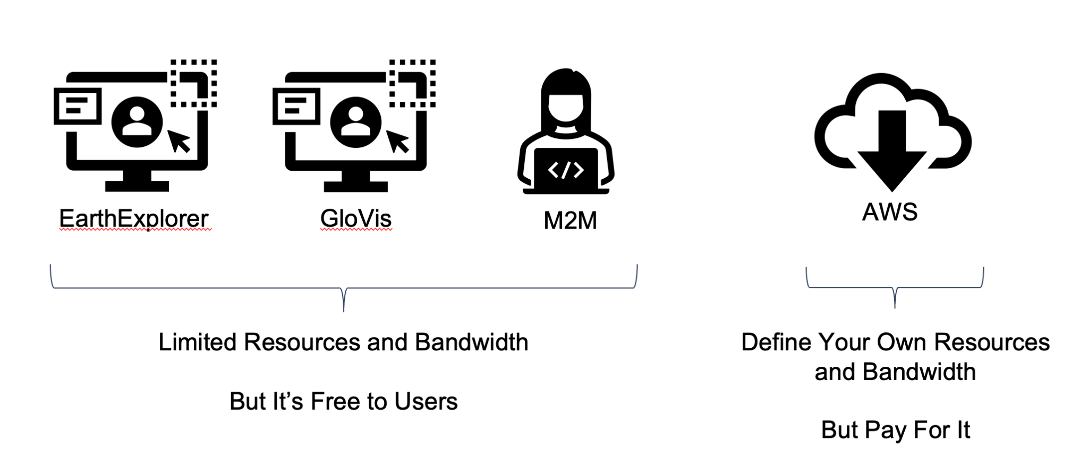
Data Access
EarthExplorer
GloVis
M2M
AWS
Limited Resources and Bandwidth
But It’s Free to Users
Define Your Own Resources and Bandwidth
But Pay For It

Slide 3
About Access Types
STAC supports both M2M and AWS direct access users
No cost access for all, but with limited resources
  Over 800,000 unique user accounts in Collection 2
Alternate access option for users who want more
  AWS direct access (user-pays)
Collection 2 moved to COG format to allow partial-file access for direct access users

Slide 4
Direct Access Popularity

Slide 5
Take a Chance on Me
Landsat took a chance on STAC in 2020
  Metadata catalog
  Browser interface
  Access and Discovery API

Slide 6
Other Metadata
Dataset metadata
  FGDC: Used in USGS and US Government catalogs
Granule catalogs
  FGDC: Unused
  MTL metadata file: Used for details on granules downloaded
  Bulk metadata export (CSV, Parquet, XML): Used for access and reconciliation

Slide 7
Interoperability
Which Landsat catalog best enables interoperability with other catalogs?
  STAC
Is it perfect?
  License
  Thumbnails
  Sparse dataset (collection) records
  Still using STAC 1.0
  Still using CARD4L

Slide 8
New Data for STAC
Made during Collection 2
  Checksums
Looking at for Collection 3
  Processing timestamp
  Quality indicators to aid in search
  Scale and offset per band
  Identifier for unique data collects

Slide 9
Pulling Back the Curtain
Supporting authoritative data means more transparency
  Granules processed, removed, revised
Transparency on
  Over 30 million granules
  Constantly growing datasets
  Corrections and revisions due to instrument anomalies
  “New” data from previous decades
Notes:
Not an easy task for Landsat, not an easy task for archive replicators and scientific reproducibility

Slide 10
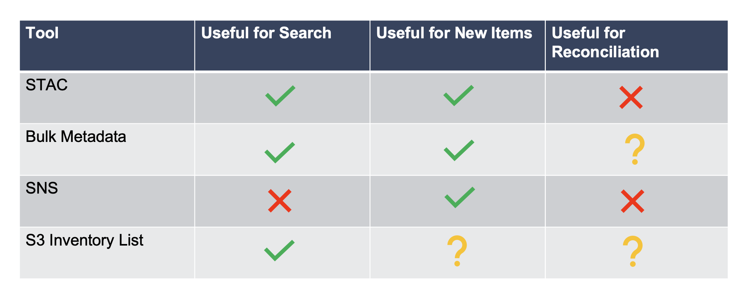
Transparency Tools
Tool | Useful for Search | Useful for New Items | Useful for Reconciliation
STAC
Bulk Metadata
SNS
S3 Inventory List

Slide 11
Reconciliation Tools
Collection 2 improvements
  Reprocessing GUI and CSV
    https://landsat.usgs.gov/landsat-reprocessing
    Updated monthly
Collection 3 Concepts Explored
  Similar GUI and export list of removed and reprocessed products
    But updated more often
  SNS subscription for removed products

