Slide 1
CEOS WGCV-56 / LSI-VC-19
Joint Meeting Atmospheric Composition Sub Group Updates
Jean-Christopher Lambert, BIRA-IASB
Agenda Item 2.3
WGCV-56 / LSI-VC-19 Joint Meeting
Sioux Falls, SD, USA
20-24 April 2026

Slide 2
Terms of Reference
Approved at the 15th CEOS Plenary in November 2001, the objectives of the Atmospheric Composition Sub Group (ACSG), beyond those of the Working Group on Calibration and Validation (WGCV), are to:
Promote international collaboration and technical exchange to ensure the efficient use and maintenance of calibration/validation resources required for atmospheric composition and other missions
Verify accurate scientific products by encouraging an end-to-end approach to the calibration and validation of Level 1 and Level 2 data products, and any subsequent re-calibration and reprocessing using established best practice procedures
Ensure that validation sensors are calibrated to traceable national standards, with documented statements of accuracy and repeatability
Encourage interaction between calibration scientists and data users to enable a better understanding of data uncertainties and user requirements
Recommend a network of validation sites and to encourage continuous observation and quality control of data through the use of standard procedures and inter-comparison
Develop comprehensive data validation methods that employ ground, aircraft, balloon, and satellite measurements and with models
Specify a comprehensive, consistent and quality-controlled multi-mission validation database in an accepted format and employing user-friendly tools

Slide 3
Atmospheric Composition Updates
Tropospheric ozone datasets harmonization and validation VC-20-01
GHG and AQ Constellations Cal/Val highlights CV-20-02/03/04
CEOS-FRM – Atmospheric composition CV-23-01
CINDI-3 campaign CV-24-01
Design and evolution of validation networks
AC-VC-22/ ACSG joint meeting 2026

Slide 4


Tropospheric Ozone Activity
VC-20-01
CEOS activity on Tropospheric ozone (satellite) datasets validation and harmonization (Lead DLR, Co-Leads BIRA-IASB & NASA)
Direct support to IGAC TOAR-II, responding to needs and questions highlighted by TOAR-I (2014-2019)
TOAR-II community papers in Copernicus Special Issue
TOAR-II assessment papers in Phil. Trans. A
TOAR-III SC selection and ideas being formulated, e.g.:
Impact of wildfires and wildland-urban interface fires to O₃
Policy-relevant outcomes, e.g. “what reductions in precursor emissions would achieve a 0.1 K reduction from O₃ radiative forcing?”
Geostationary sounders for diurnal observations of ozone
Expanded use of AI for predicting surface O₃
Phase II

Slide 5
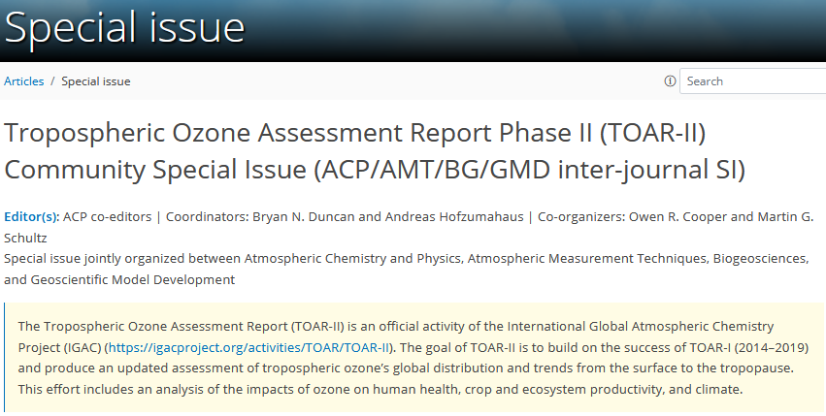
TOAR-II / Satellites
VC-20-01
TOAR-II Community Special Issue in Copernicus journals (closed)
(58 papers published)
https://acp.copernicus.org/articles/special_issue1256.html
Key satellite contribution: 21 papers in total
Intercomparison & harmonization papers (5 published) ⇨ VC-20-01
Satellite O₃ trend papers (8 published)
Reanalysis papers (2 published, 1 in review)
Satellite O₃ precursors trends (1 published)
Other analyses: CoViD-19 period, O₃ production rates, O₃ Radiative Forcing, model evaluation (4 published)
Phase II

Slide 6
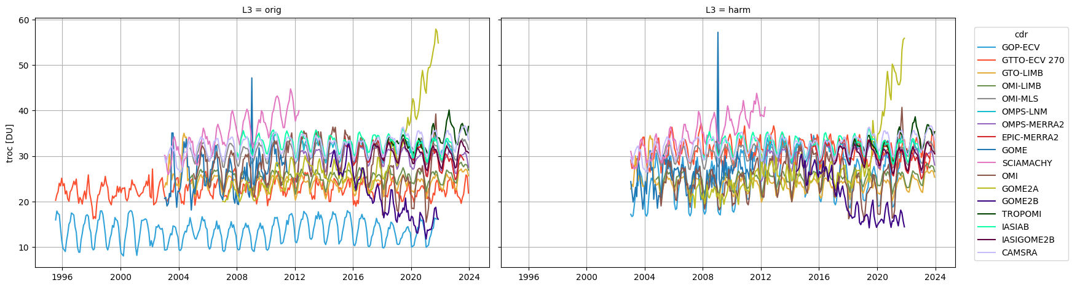
Harmonization of satellite tropospheric ozone data
Original data After harmonization(s)
Harmonization needs addressed: (i) Vertical representation & units, (ii) Tropospheric top levels, (iii) Surface pressure, (iv) Spatial sampling, (v) Temporal sampling, (vi) A-priori information sources, (vii) A-priori information (effective) contributions (vertical smoothing)
Satellite data harmonization reduces dispersion between datasets by about ~10-40 %.
Residual discrepancies between harmonized satellite data ⇨ other sources of uncertainty
Keppens et al., AMT 2025

Slide 7
TOAR-II / Satellites
VC-20-01
TOAR-II assessment papers in Philos. Trans. R. Soc. A
(lead authors)
Overview paper Helen Worden and Martin Schultz
Oceans Roberto Sommariva
Vegetation Lisa Emberson
Health Gaige Kerr
S. America Regional Rodrigo Seguel
Strat Trop Exchange James Keeble and Paul Griffiths
Climate Sophie Szopa and Owen Cooper
Satellite Data Daan Hubert (BIRA-IASB) and Kazuyuki Miyazaki (JPL)

Slide 8
TOAR-II / Satellites
VC-20-01
TOAR-II Satellite Assessment combines 15 harmonised records https://doi.org/10.18758/39zdhztg
Significant advances since TOAR-I Maps of present-day mean & seasonal cycle, long-term trend and episodic events are more finely resolved, more accurate and have more robust uncertainty estimates.

Slide 9
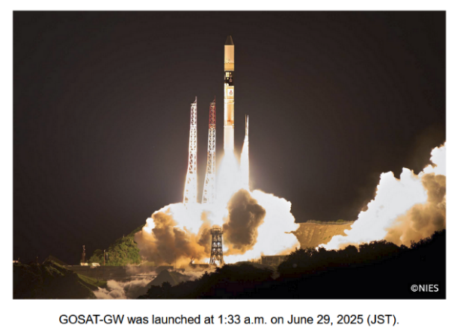
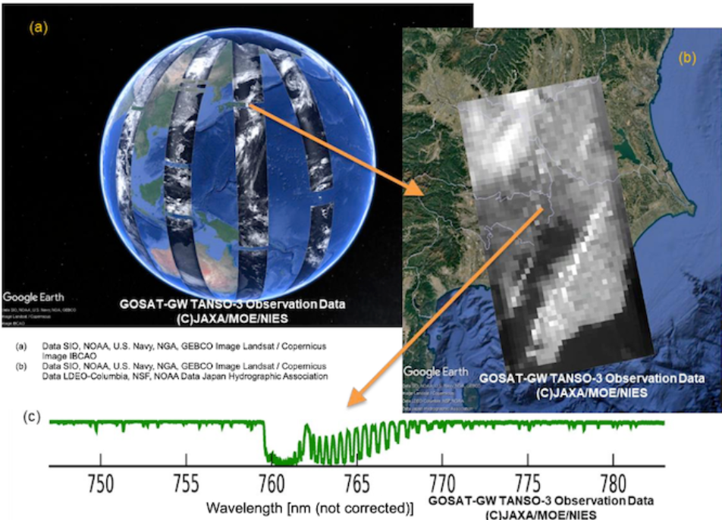


Recent Launches: GOSAT-GW
On 29 June 2025, GOSAT-GW was successfully launched from
Tanegashima with the last (the 50th!!) H-IIA Launch Vehicle.
The first light was conducted on 14 July. (Please see links below.)
- https://www.jaxa.jp/press/2025/08/20250808-1_j.html (Japanese)
- https://www.nies.go.jp/whatsnew/20250826/20250826-e.html
Useful links for TANSO-3
Data policy: https://www.nies.go.jp/soc/en/documents/datapolicy/
Observation request: https://gosat-gw.nies.go.jp/en/request.html
- Application form will be soon opened.
Product Archive: https://product.gosat-gw.nies.go.jp/
- User registration, download L1B/L2 data, request focus mode observations (authorized user only)
Sample L2 product: https://gosat-gw.nies.go.jp/request.html (Japanese (soon in English))
- For checking the file format
Schedule
L1B will be open to the public after Apr.-May 2026. (L2 will be open 1yr. after L1B open.)
see also, Tanimoto et al., 2025, Prog Earth Planet Sci, https://doi.org/10.1186/s40645-025-00684-9

Slide 10
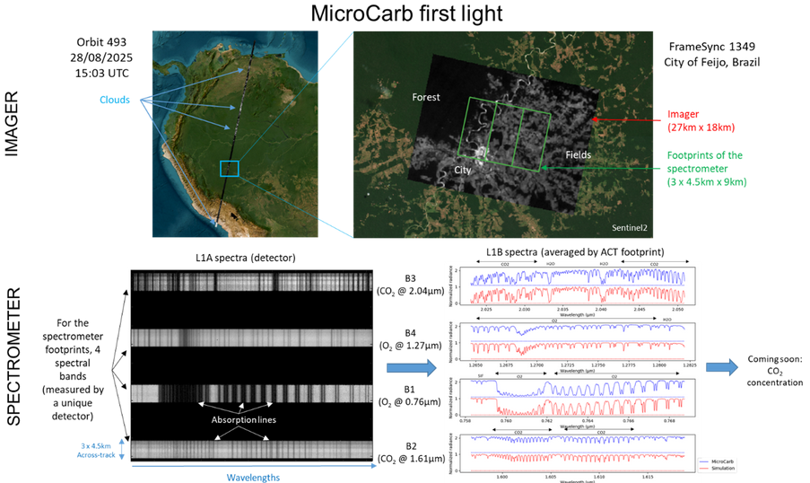

Recent Launches: MicroCarb
MicroCarb
July 25
Microcarb Portal
https://microcarb.aeris-data.fr/

Slide 11
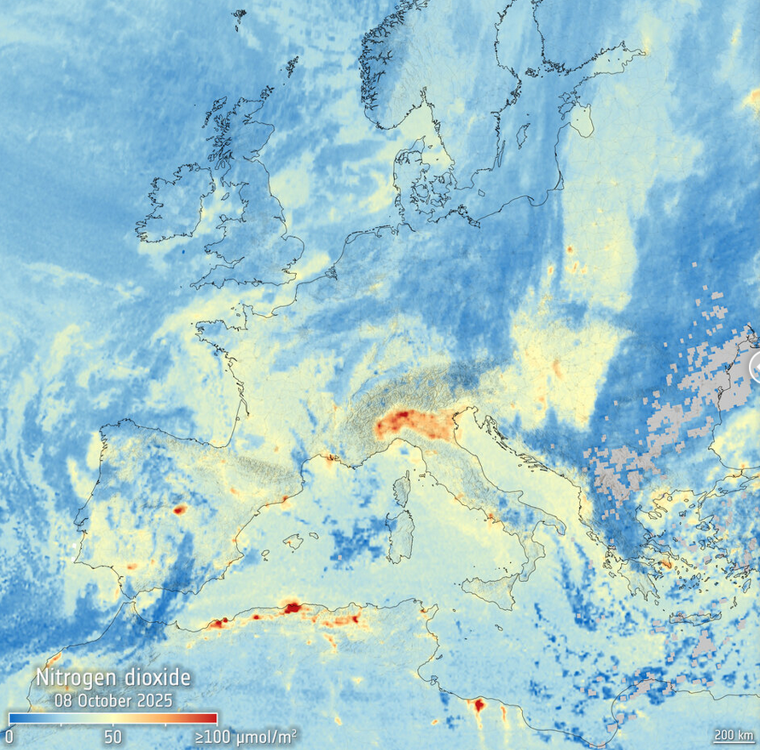
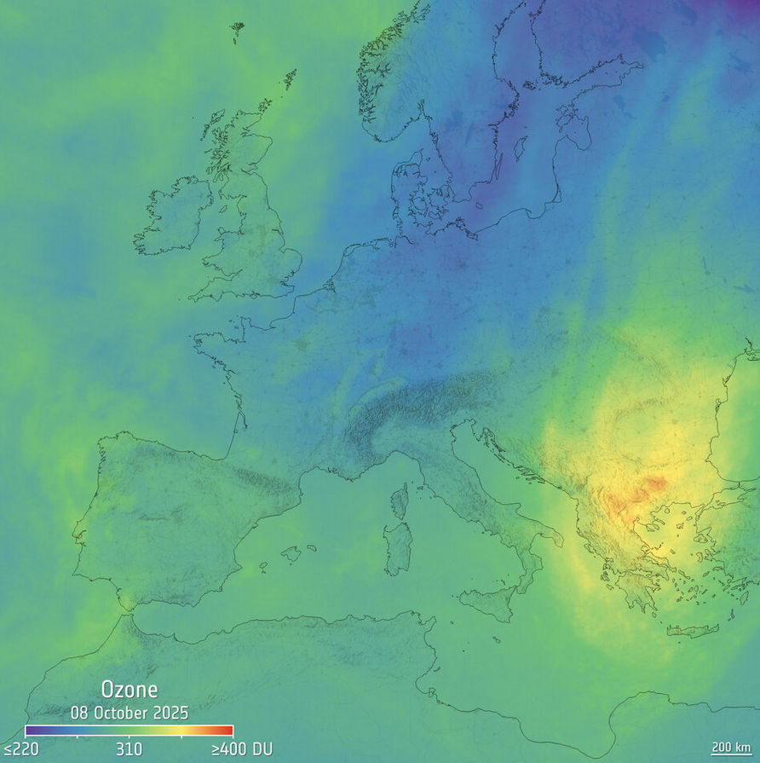
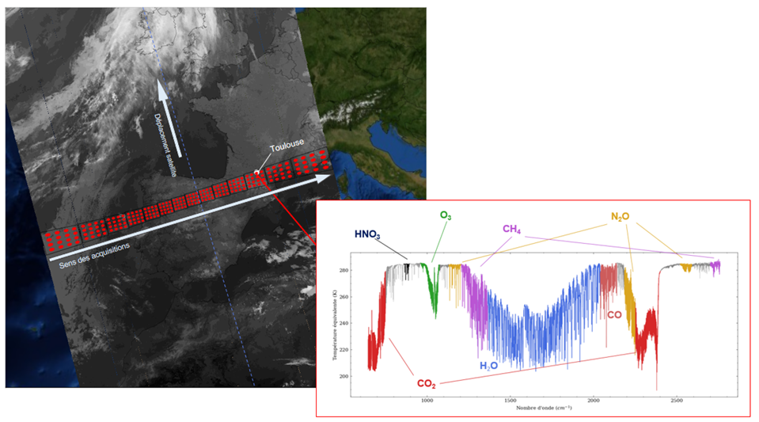
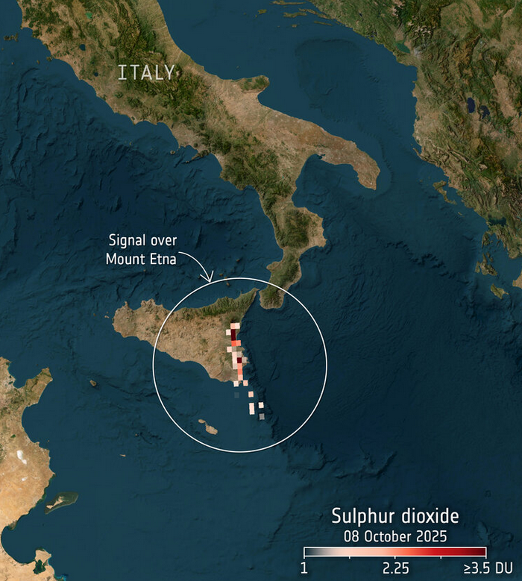
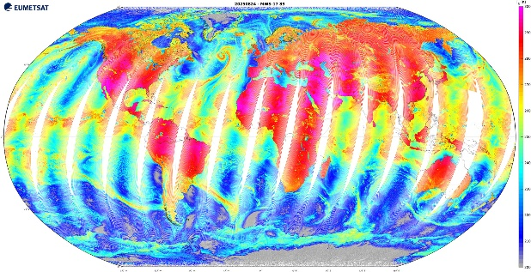


Recent Launches: MetOp & MTG
Sentinel-4 UVN
Tropospheric NO₂
Sentinel-4 UVN
Total O₃
MTG-SG1 (GEO) launched 1 July 2025
MetOp-SG-A1 (LEO) launched 13 August 2025
First IASI-NG Spectrum
MWS Brightness Temperature
Sentinel-4 UVN
Volcanic SO₂
More in ESA and EUMETSAT press releases
https://www.esa.int/Applications/Observing_the_Earth/Copernicus/Sentinel-4/Sentinel-4_offers_first_glimpses_of_air_pollutants https://www.eumetsat.int/news/press-releases with first data from IASI-NG, Sentinel-4, 3MI, METimage, MWS

Slide 12
GHG Constellation Cal/Val Highlights
Details: see GHG Cal/Val session W5 on Wednesday morning
L1 calibration (W5.1)
RRV Intercalibration campaigns
VICAL GHG Cal/Val website
Match-up database for SWIR and TIR sounders
L2 GHG networks (W5.2)
Instrument deployments and campaigns
Central processing, infrastructures, operational validation capacity
Evolving needs
Contribution to CEOS facility scale emissions/fluxes validation guidelines

Slide 13
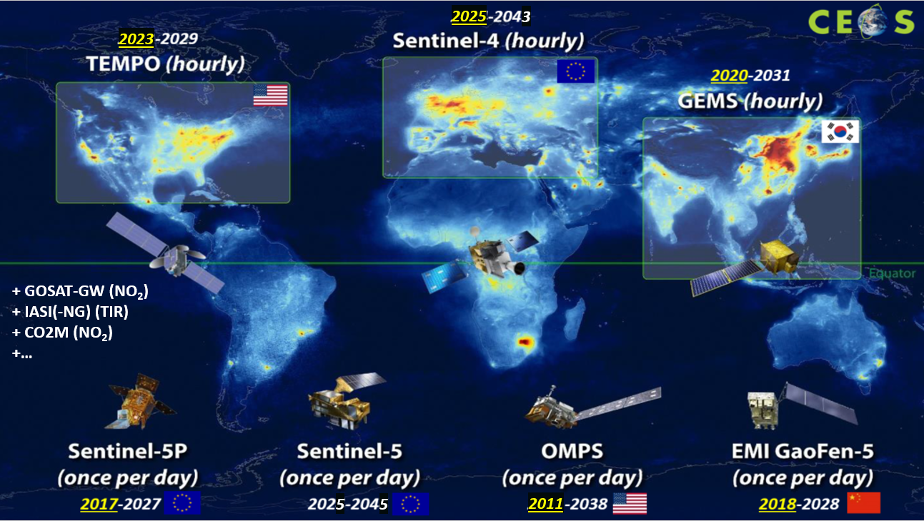
GEO-AQ Constellation
2025

Slide 14
GEO-AQ Constellation Validation
Cal/Val coordination, plans and joint activities VC-20-02/02/03
GEMS AO, TEMPO MVP, ESA/EUMETSAT joint AO for S-4/-5
L2 algorithm and product intercomparisons
International collaboration on FRMs and other validation data: collaborative airborne campaigns, Pandora network expansion, CINDI-3 MAX-DOAS campaign with participation of other networks
International collaboration on validation
Sentinel-5P MPC operational validation service (2017-2028)
ESA PEGASOS validation service for GEMS and TEMPO (2025-2027)
U. Yonsei Geo-Ring validation and research for GEMS and TEMPO (2025-2028)
Joint meetings/conversations of GEMS, TEMPO and Sentinel-5P validation teams

Slide 15
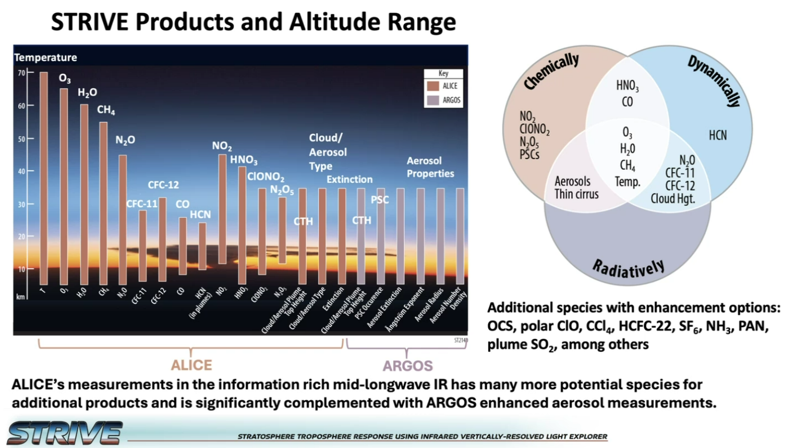
New Limb Capabilities: STRIVE
Selected by NASA 2026/02
PI Lyatt Jaeglé, University of Washington

Slide 16
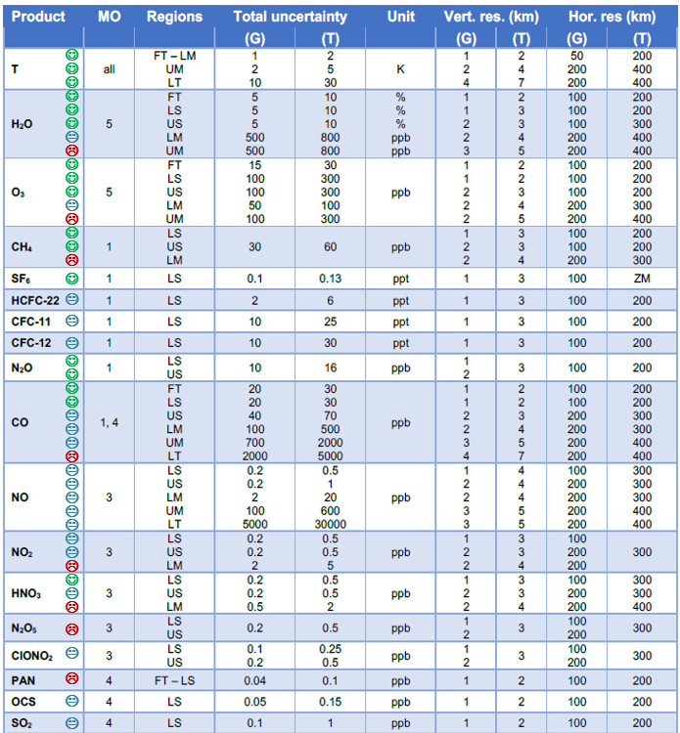
New Limb Capabilities
ESA EE-11 candidate mission CAIRT - Gap analysis of existing validation capabilities vs limb IR mission requirements
AirCore, GRUAN, NDACC, NDMC, AGAGE…
Satellites
Balloons & aircrafts
Cal/Val weaknesses/gaps in:
mesosphere & lower thermosphere, transport & waves, higher-level products (NO_{y}, AoA, GW), 3D/tomography
Lambert, Sheese and Walker, 2026
ESA CAIRT PerReC Study

Slide 17
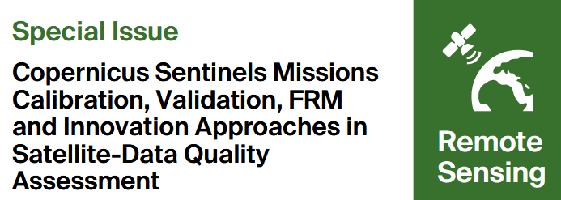

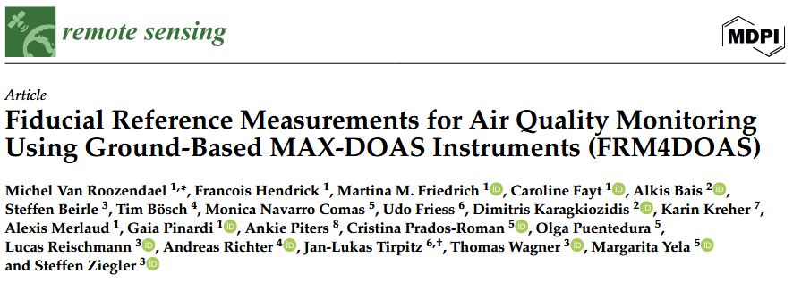
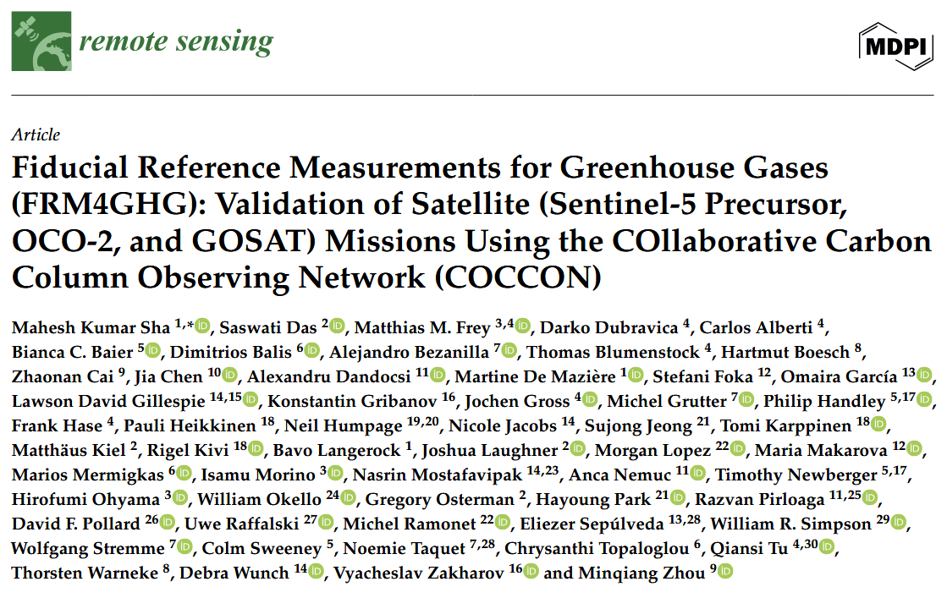
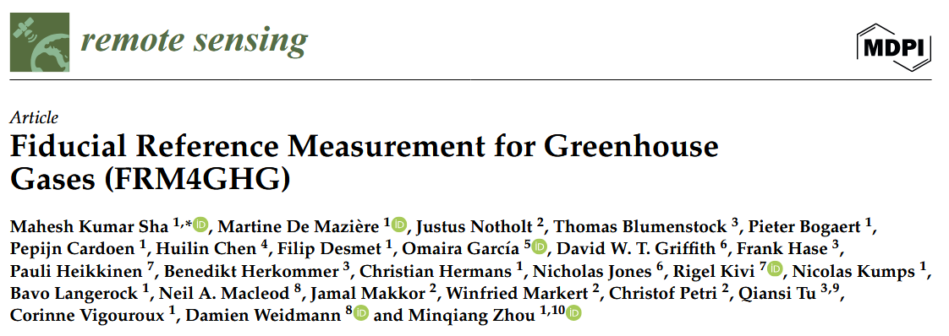
CEOS-FRM Maturity Assessment Framework v1
FRM4DOAS and FRM4GHG CEOS-FRM v1 self-assessments published

Slide 18
CEOS-FRM / Atmospheric Composition
Ongoing CEOS-FRM v2 assessment of ground-based networks
ACTRIS-CREGARS-FTIR (FTIR HCHO ⬄ NDACC FTIR HCHO)
COCCON & TCCON
NDACC ○ Brewer ⬄ EUBREWNET
FTIR CH₄
Lidar
MWR
Ozonesonde
UV-Vis ⬄ FRM4DOAS ⬄ ACTRIS-CREGARS-UVVIS
Pandora (PGN)
Further engagement
BTS (candidate 3rd generation O₃ monitoring developed by PMOD/WRC)
AC-VC-22/ACSG meeting, NDACC Newsletter

Slide 19
CEOS-FRM / Atmospheric Composition
First feedback on CEOS-FRM v2
“Class of instrument” (e.g., nadir UV-vis imaging spectrometer) is vague and does not refer to the measurand (e.g., tropospheric NO₂ column). “Class of product” is felt as more appropriate.
Several types of FRM may be needed to validate the measurand, its uncertainty estimates and its information content diagnostics (end-to-end approach to validation). Therefore, how to highlight the fitness-for-purpose of a FRM: FRM for bias estimation, FRM for stability assessment, FRM for validation of satellite uncertainty estimates, of information content…?
CEOS-FRM is appreciated as a guide to understanding and improvement. However, curiosity/fear about the result of the overall classification: Who does require this classification and for what purpose?

Slide 20
CEOS-FRM / Atmospheric Composition
First feedback on Maturity Matrix Tool
The MM is “a means to facilitate the provision and interpretation of the evidence”
“It is assumed that for each category in the matrix, the FRM owner provides a short text descriptor to justify their claim within the box together with any appropriate documentary evidence (or link to it)”
⇨ Evidence should not be assumed but requested explicitly in a separate box (currently, only optional in ‘Comments’)
Risk of confusion between User ID and FRM as more assessments come ⇨ catalogue adhering to metadata standards?
Self-assessors tend to assess multiple species in one round ⇨ clarification
Copy-and-paste option for assessments of multi-species FRM instruments?
How to further reduce subjectivity of the self-assessment? Systematic verification by the same verifier(s), followed by iteration with self-assessors?

Slide 21
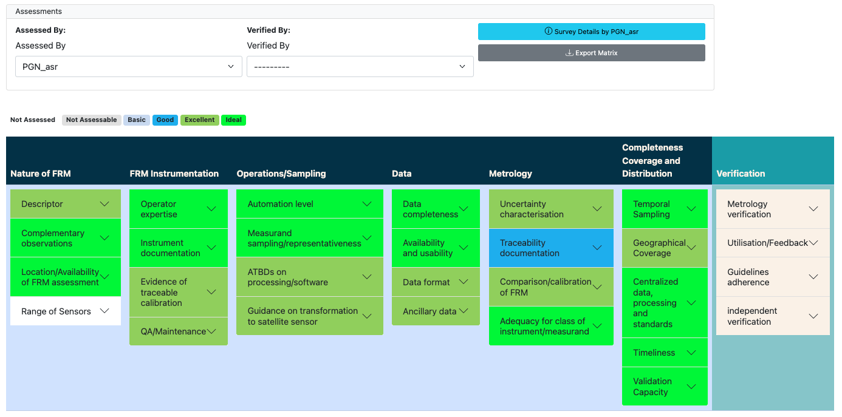
CEOS-FRM / Atmospheric Composition

Slide 22
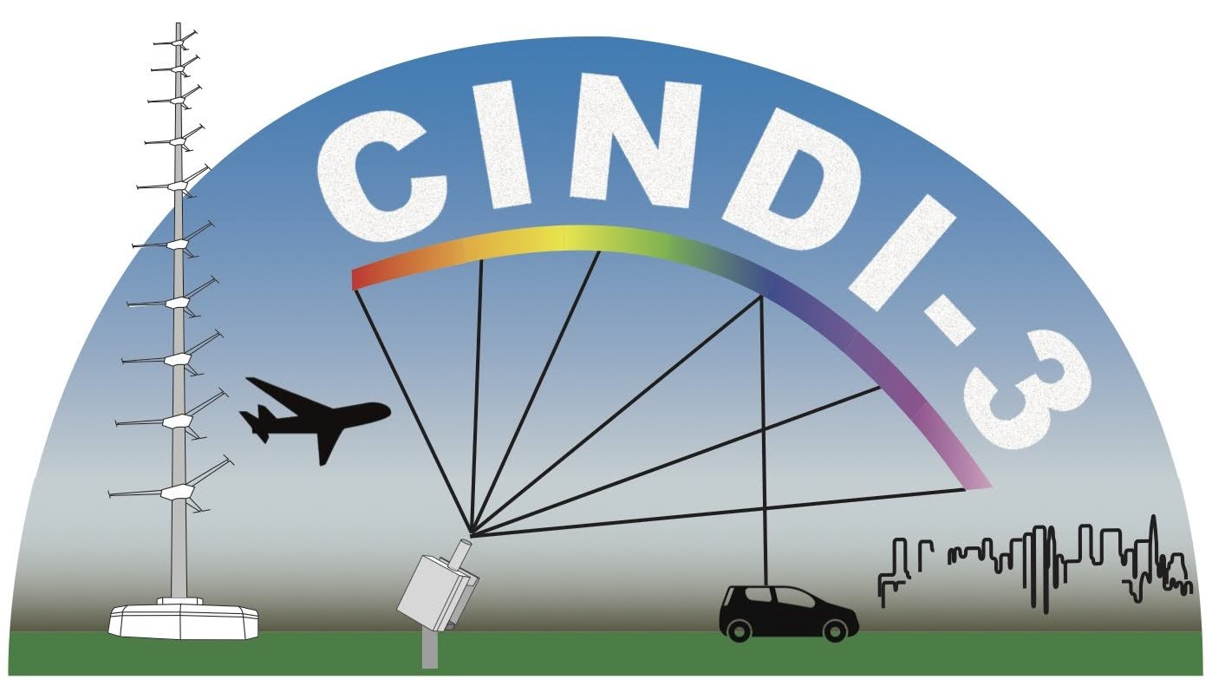

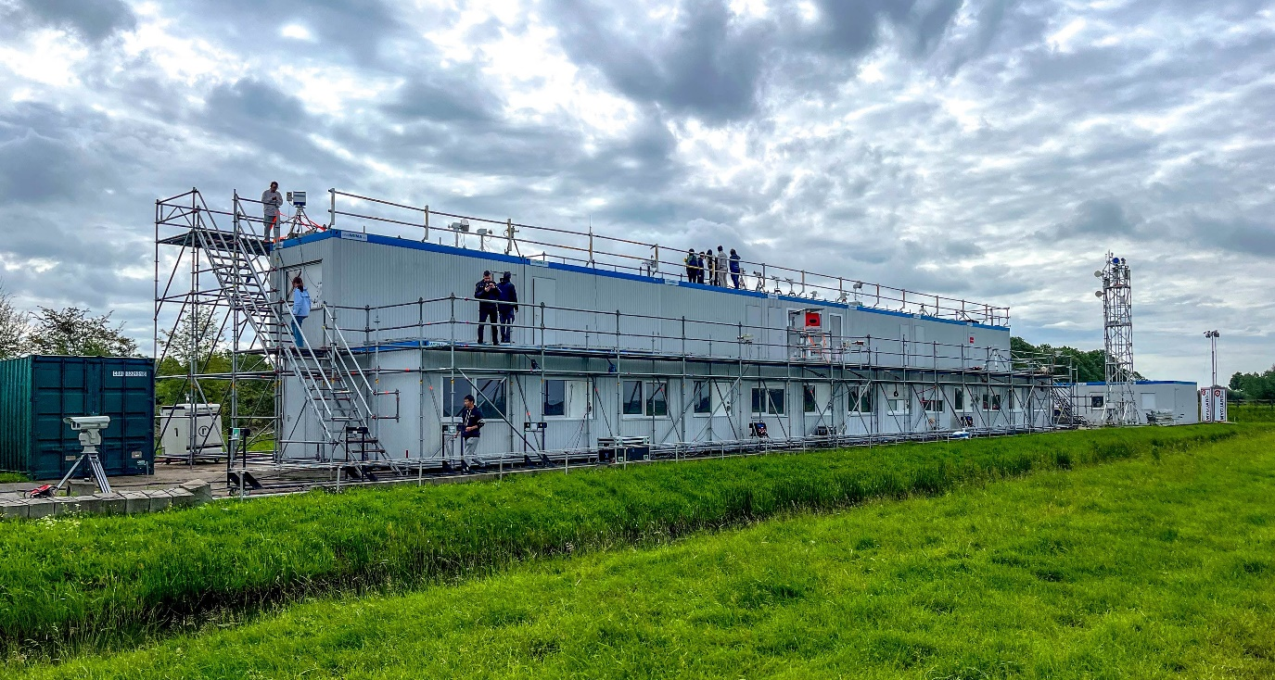
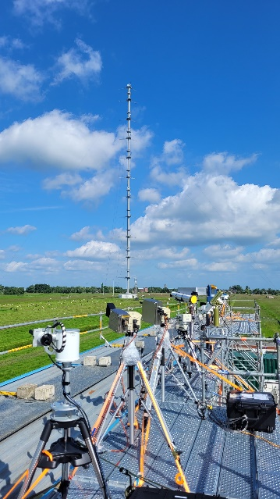



CINDI-3 (May 21 – June 21, 2024)
CV-24-01
Cabauw, The Netherlands
Overview
35+ UV-VIS MAX-DOAS instruments intercompared, from 16 countries
60+ instruments deployed
100+ participants
FRM4DOAS central processing applied to 50% of participating instruments
Airborne deployment for NO₂ mapping and profiling
Data analysis in progress
UV-Vis intercalibration campaign organized as part of NDACC and ACTRIS CREGARS topical center, with additional ESA support.

Slide 23
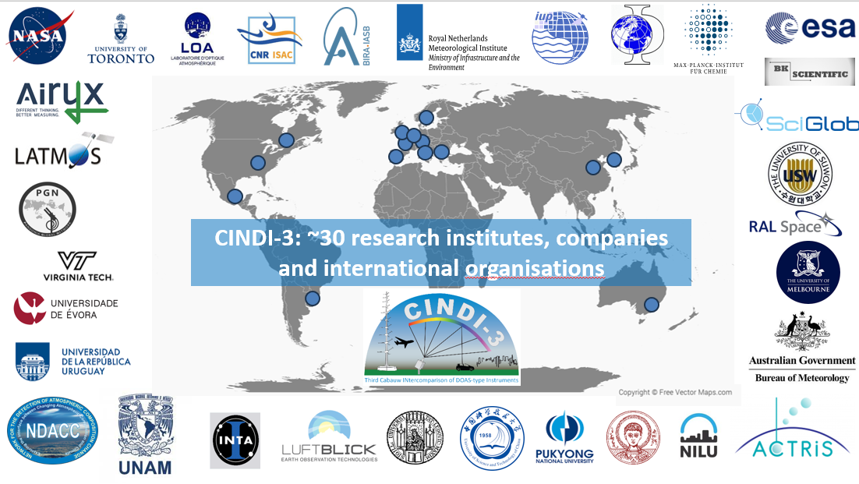

Slide 24
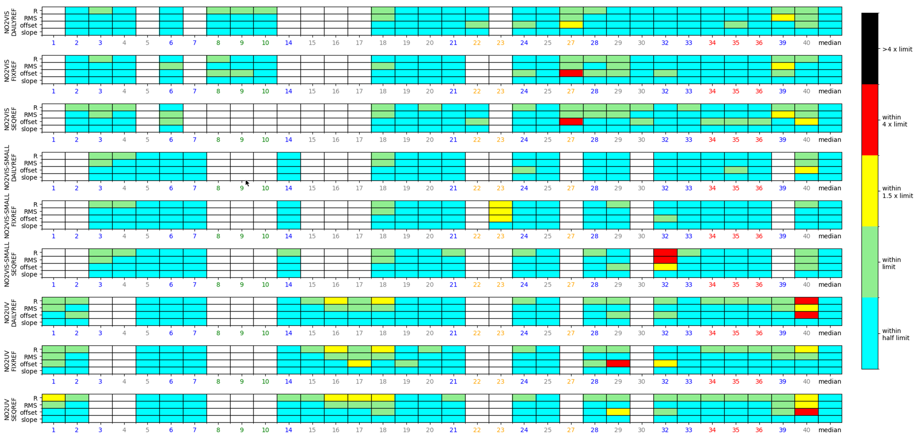
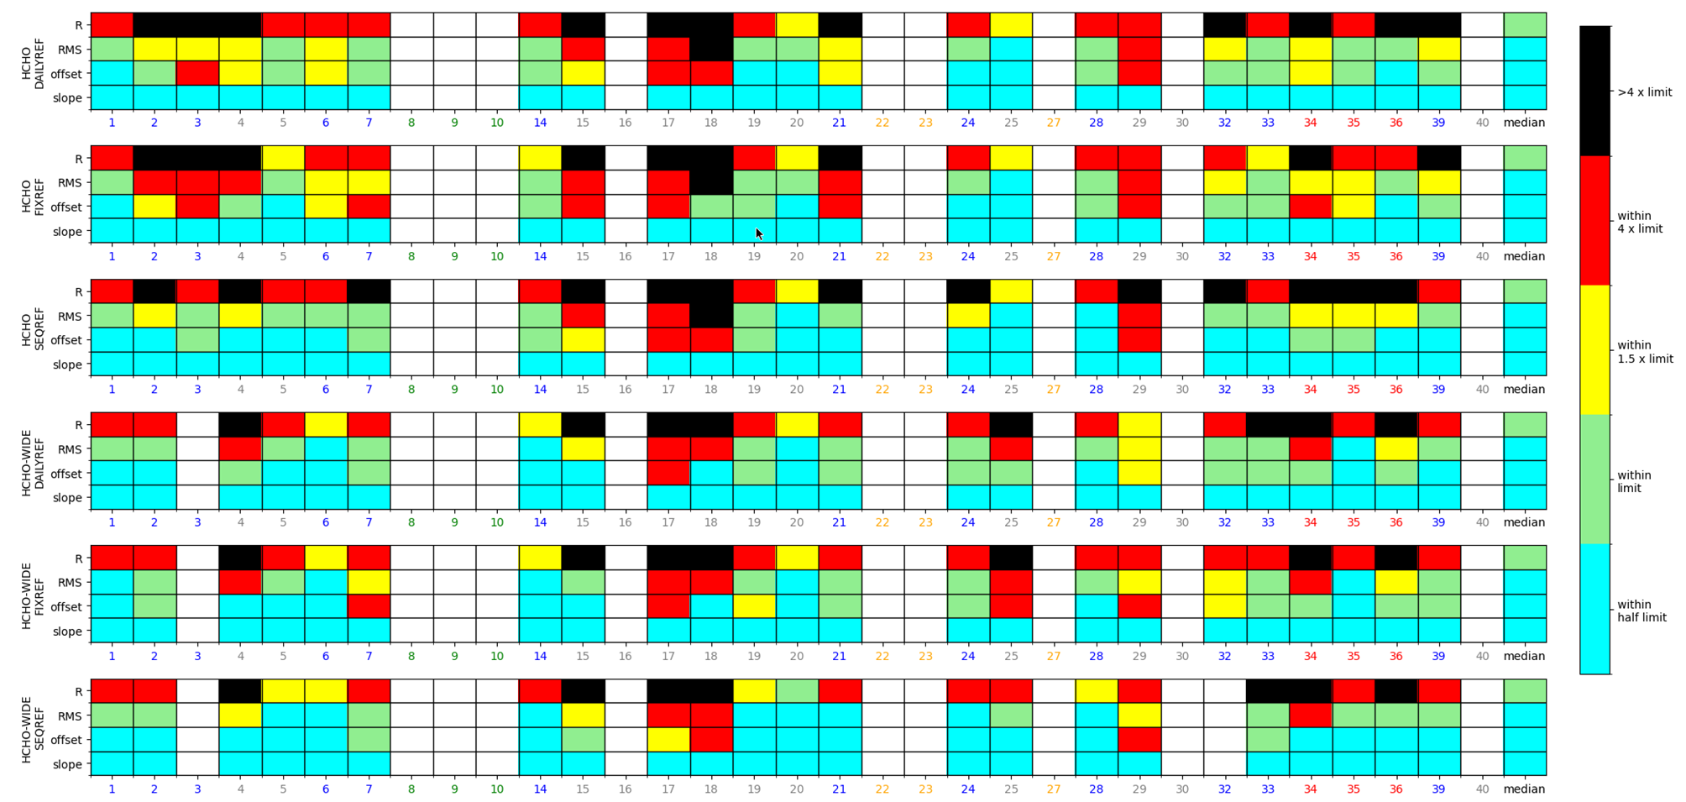
CINDI-3 – Progress in 2025
Analysis of semi-blind intercomparison completed → Friedrich et al, 2026
(ESA report available from FRM4DOAS website and paper in preparation for AMT)
MAX-DOAS evaluation for NO₂ (all products)
MAX-DOAS evaluation for HCHO (all products)

Slide 25
CINDI-3 – Publication plan
To appear in AMT/ ACP (thematic collection)
Subject | Lead Author | Planned date of submission
Campaign overview | Karin Kreher | Q4 2026
Semi-blind intercomparison of NO₂, HCHO, O₃ and O₄ slant columns | Martina Friedrich | Q4 2026
Intercomparison of glyoxal retrievals | Kai Krause | Q3 2026
Cloud bottom altitude retrieval from MAX-DOAS | Udo Friess | Q2 2027
Intercomparison of BrO retrievals | Michel van Roozendael | Q2 2027
Synergistic aerosol retrieval using Pandora and CIMEL sunphotometer | Elena Lind | Q3 2026
Imaging DOAS NO₂ measurements during CINDI-3 | Cedric Busschots | Q3 2026
Airborne NO₂ measurements during CINDI-3 | Frederik Tack | Q3 2027
O₃ retrieval intercomparison | Chengzhi Xing | Q4 2026
Tomographic reconstruction of NO₂ fields using CINDI-3 data | Manuel Henning | Q2 2026

Slide 26
Ground-based Cal/Val Network Design and Evolution
WMO GAW gap analysis and monitoring strategies
WMO GAW critical review of observing capabilities (GAW No 307, 2025)
GAW Global Ozone Monitoring Strategy in finalization as BAMS paper
Include satellite validation needs, CEOS-FRM concept…
NDACC network evolution strategy
Satellite session at “NDACC Symposium 2025 Celebrating 35th Anniversary of the Network”, Virginia Beach, VA, USA (2025/10)
Peer-reviewed strategy paper in final review, including satellite validation strategies and viewpoint of stakeholders (incl. ACSG and space agencies)
GHG Roadmap v2 Annex C – Tracking needs, gaps and issues (see W5.2 on Wednesday)
https://ndacc.cas.hamptonu.edu/?page_id=444

Slide 27
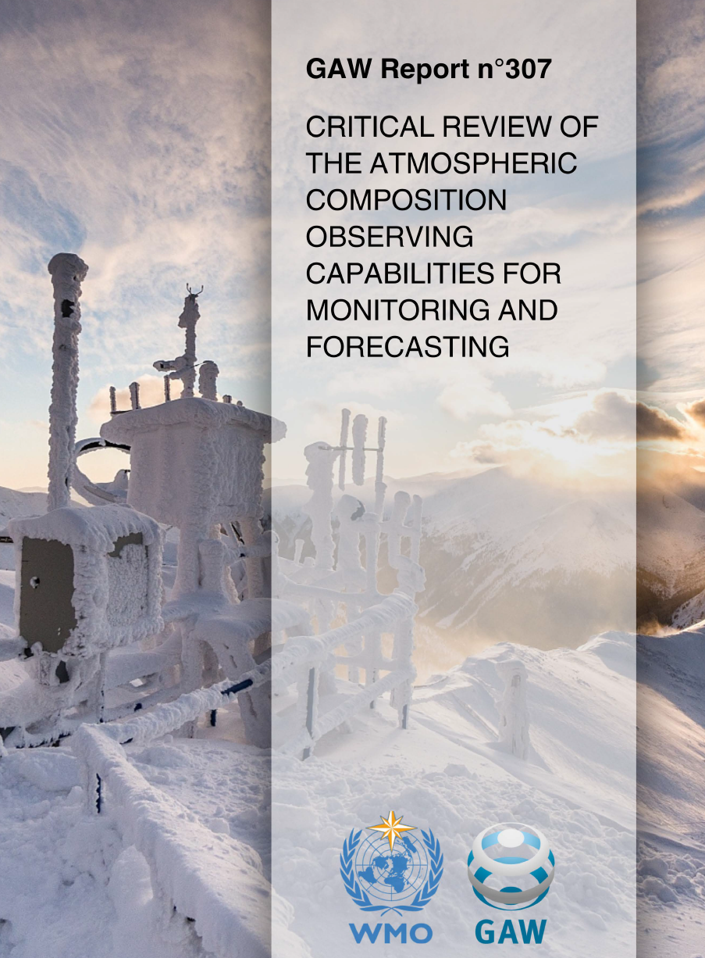
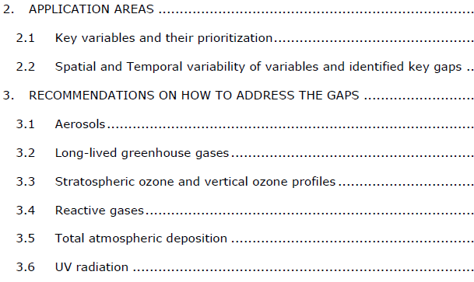
Ground-based Cal/Val Network Design and Evolution
WMO GAW Report No 307 (2025) prepared by Expert Team on Network Design and Evolution (ET-ACNDE, chairs R. Eckman, H. Tanimoto and S. Moreno)

Slide 28
WMO GAW Global Ozone Monitoring Strategy
WMO GAW O₃ monitoring strategy BAMS paper in finalization
Concerns with future of Dobson and Brewer monitoring (1st and 2nd generation O₃ column long-term validation standards)
Potential replacement under evaluation, incl. BTS and Pandora
Side-by-side intercomparison campaigns
Ideally, full suite of Dobson, Brewer, MAX-DOAS, BTS, Pandora
Davos (PMOD/WRC), Thessaloniki (AUTH)
Arctic (FMI Sodankylä), Antarctica (Princess Elisabeth)
Dobson/BTS in Nairobi and South Africa (Irene, Springbok, Cape Town)
More to come…

Slide 29
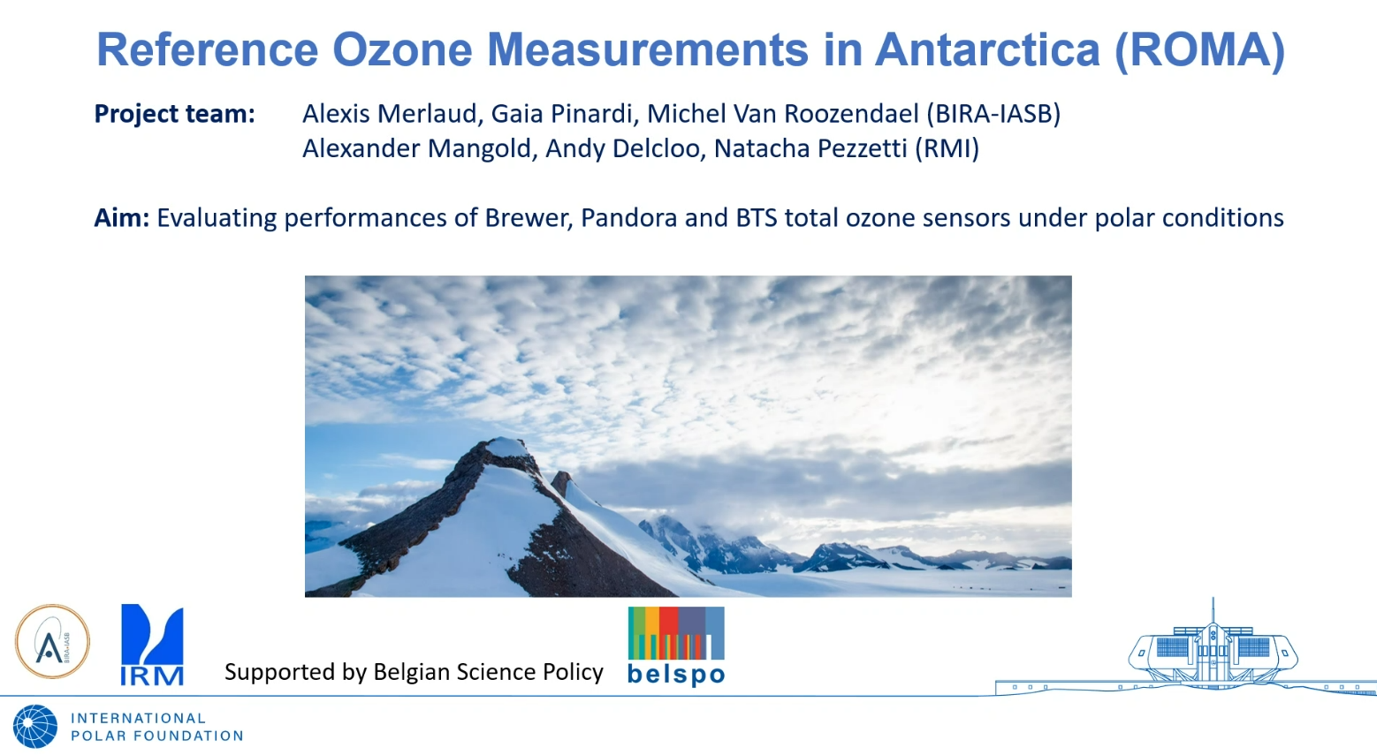

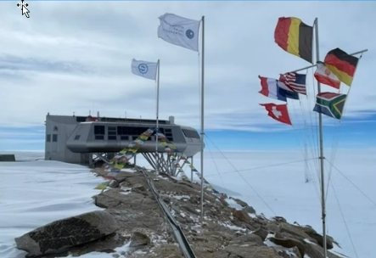
ROMA (Reference Ozone Measurements in Antarctica)

Slide 30
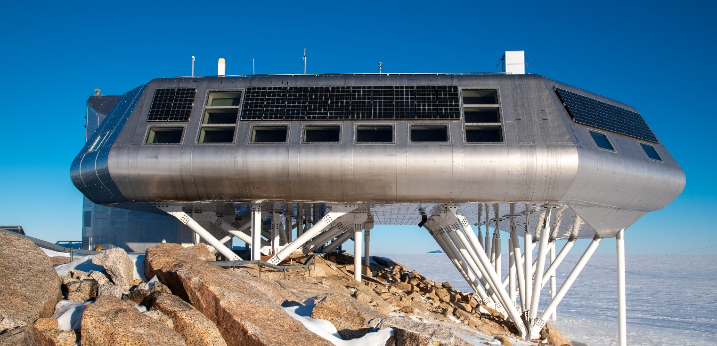
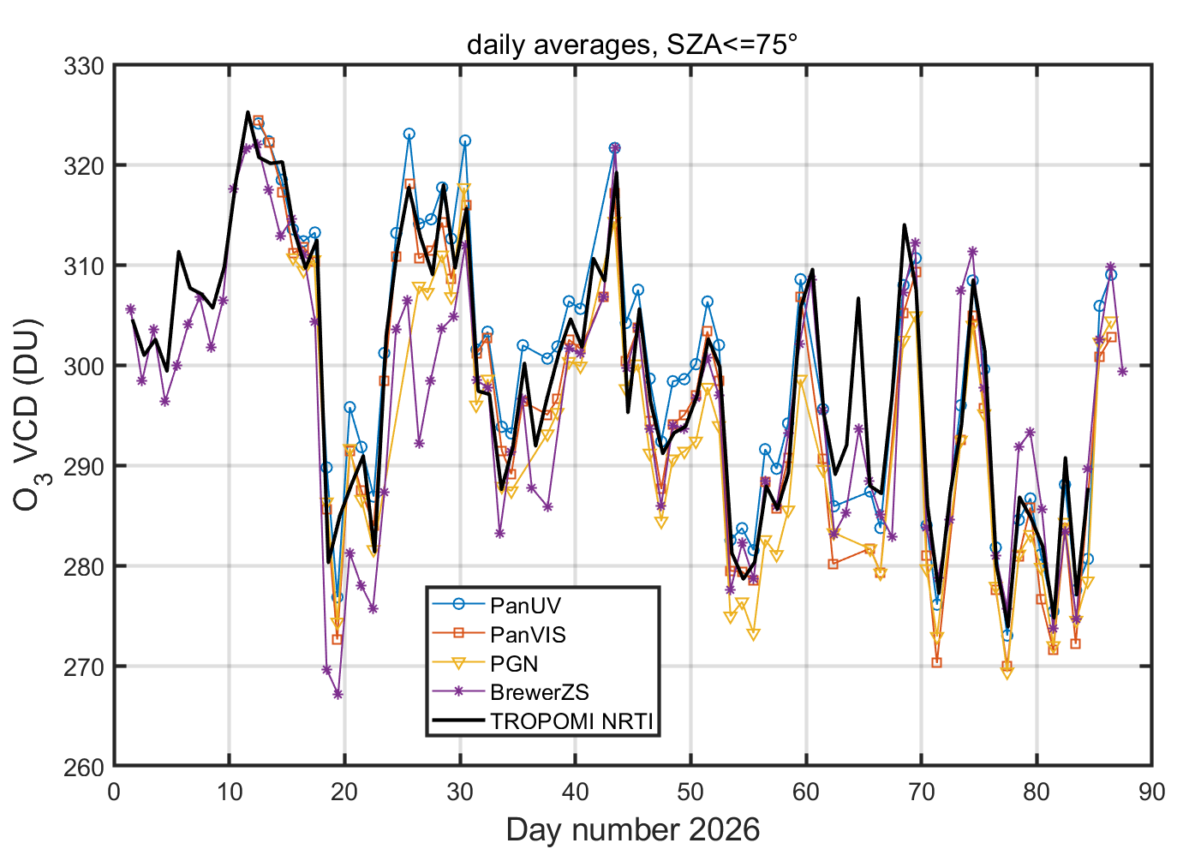

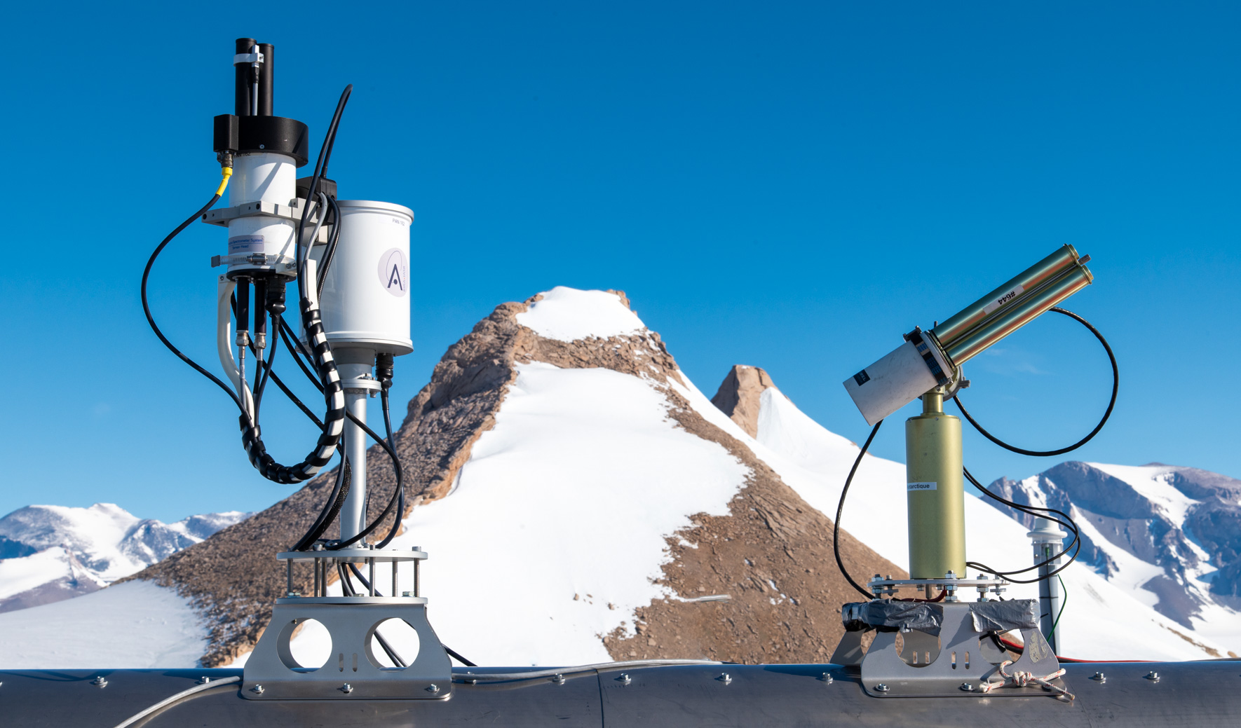
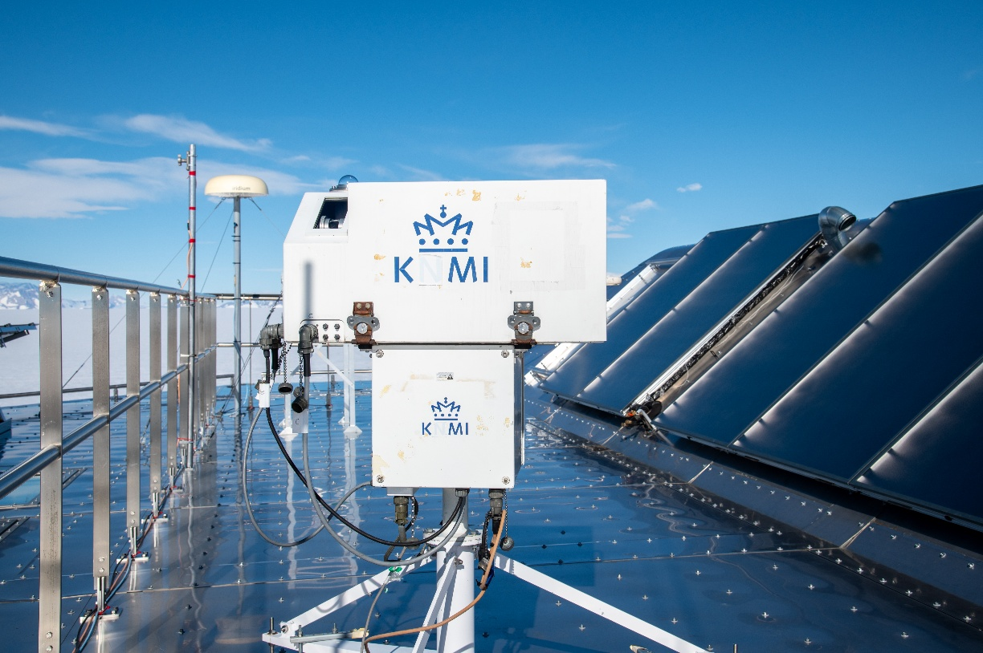


ROMA (Reference Ozone Measurements in Antarctica)
National Belgian project to deploy Brewer #100, Pandora #162 and BTS ozone spectrophotometers at the Princess Elisabeth Antarctic (PEA) Station
Pandora installed on 9 Jan 2026, next to KMI Brewer and CIMEL sunphotometer. Both instruments will be operated year-long (but without local support between March and November)
BTS instrument to be deployed next season (2026-2027)
Preliminary evaluation of the O₃ data in progress

Slide 31
“Cal/Val Supersite” concepts
General discussion at CEOS AC-VC-21 / WGCV-ACSG Joint Meeting 2025, Takamatsu, Japan (2025/06)
Principles presented to WMO GAW Scientific Advisory Groups on Ozone, UV and Greenhouse Gases (2025/07) and to NDACC Steering Committee (2025/10)
Staggered approach to satellite validation, from producer to user service
‘Traceability validation’: in-depth, end-to-end validation of L1-to-L2 retrieval diagram elements and associated uncertainties; R&D nature
‘End-product validation’: global, long-term production of L2 data quality indicators over entire domain of application; may have operational needs
‘Product-to-service validation’ connecting space, surface, modelling and user applications; multi-constituent/multi-theme; likely both R&D and operational
Tiered approach to Cal/Val network design and evolution
Tier 1: High CEOS-FRM classes; full suite of retrieval and influence quantities; may include L1 related data, e.g., from RadCalNet & HYPERNETS
Tier 2: High-to-mid CEOS-FRM classes; classical L2 product validation, L2/3/4 CDRs
Tier 3: Mid-to-low CEOS-FRM classes; global, first-order, statistical mass

Slide 32
Ground-based Cal/Val Network Design and Evolution
Operational/routine validation facilities
AERIS https://www.aeris-data.fr/en/aeris-icare-satellite-data-extraction-tool
CAMS Global Validation Server https://global-evaluation.atmosphere.copernicus.eu
EPA Remote Sensing Information Gateway https://www.epa.gov/hesc/remote-sensing-information-gateway
ESA/BIRA-IASB ALTIUS Validation Service in development
ESA/Copernicus ATM-MPC Sentinel-5P Validation Service https://mpc-vdaf-server.tropomi.eu
ESA Validation Data Centre (EVDC) https://evdc.esa.int
EUMETSAT AC SAF Validation & Quality Assessment https://acsaf.org
EUMETSAT UVN(S)-STAR L2 https://ceos.org/document_management/Virtual_Constellations/AC-VC/Meetings/AC-VC-21/Presentations/AC-VC_2.23_Ruethrich.pptx
NASA SAGE III/ISS Visualization / Comparisons https://sage.nasa.gov/sageiii-iss/browse_images/quicklook
NOAA Products Validation System (NPROVS) https://www.star.nesdis.noaa.gov/smcd/opdb/nprovs

Slide 33
AC-VC-22 / ACSG Joint Meeting 2026
AC-VC-22 / ACSG Joint Meeting 2026, Leiden (NL), June 1-5
Discussion topics
WGCV-ACSG session / Cal/Val for the constellations
WGCV updates, Cal/Val portal, best practices
CEOS-FRM assessment campaign for aerosols and trace gases
Tracking gaps and issues for validation systems and networks
Incl. completeness of validation and operational validation capacity
Validation needs for new research and applications
High resolution sounding, limb TIR, multi-source L2/L3, AI/ML
Connecting validation, research and users/services

Slide 34
Thank you for your attention !

