Slide 1
WGCV-56
Infrared Visible and Optical Sensors (IVOS) subgroup: #37
Nigel Fox, NPL/UKSA
Agenda Item:W2.4
WGCV-56,
Sioux Falls
20th - 24th Apr 2026

Slide 2
Mission Statement
Mission
“To ensure high quality calibration and validation of infrared and visible optical data from Earth observation satellites and validation of higher level products”

Slide 3
Terms of Reference
Promote international and national collaboration in the calibration and validation of all IVOS member sensors, Level 1.
Address all sensors (ground based, airborne, and satellite) for which there is a direct link to the calibration and validation of satellite sensors;
Identify and agree on calibration and validation requirements and standard specifications for IVOS members;
Identify test sites and encourage continuing observations and inter-comparison of data from these sites;
Encourage the preservation, unencumbered and timely release of data relating to calibration and validation activities including details of pre-launch and in flight parameters.
In the context of calibration and validation encourage the full consideration of “traceability” in all activities involved in the end-to-end development of an EO product including appropriate models and algorithms.

Slide 4
IVOS: Vision
To facilitate the provision of ‘fit for purpose’ information through enabling data interoperability and performance assessment through an ‘operational’ CEOS coordinated & internationally harmonised Cal/Val infrastructure consistent with QA4EO principles.
Pre-flight characterisation & calibration
Test – sites
Comparisons
Agreed methodologies
Community Good Practises
Interchangeable/readable formats
Results/metadata - databases
Shared learning
Recommendations as appropriate
Key Infrastructure to be established and maintained independent of sensor specific projects and/or agencies

Slide 5
Work plan
Structured into themes and led by ‘champions’ (Plus specific projects)
Land surface reflectance - Czapler Myers (U of Arizona USA)
Ocean colour (link to IOCCG, VC-OCR etc) - Murakami (JAXA JPN)
Water Surface Temperature (link to VC-SST, GHRSST) - Corlett (Eumetsat)
Geo spatial image quality! - +USGS to propose topics to explore interest
PROJECTS
PICSCAR TBA
RadCalNet M Bouvet (ESA)
SST & OC Comparisons N Fox (NPL)
Sensor pre-flight workshop N Fox (NPL)
Uncertainty/traceability S Hunt (NPL)

Slide 6
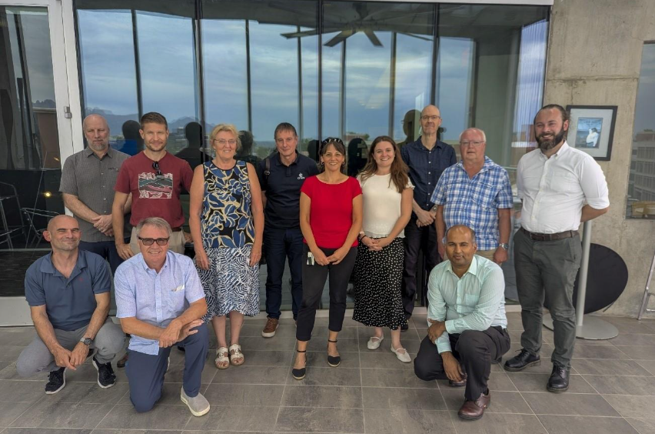
Summary of activities
IVOS 37 @ Tucson, USA
hosted by Un Arizona Sep 2025
(next ESAESRIN Frascati Italy WK 25 Sep 2026
25 agency/orgs represented
15 attendees + 38 on-line
Most themes and topics (work-plan
discussed or summarised)
mett
Special Projects/Activities:
FRM4…
VH-RHODA & JACIE interfaces
Newspace support (uncertainty)
Pre-flight Cal workshop
Lunar workshop (GSICS Led)
Special Projects/Activities:
RadCalNet team met Sep 25
Regular telecons
Support for Surface Reflectance QA
TIRCalNet

Slide 7
IVOS 37 Topics: Minutes & Presentations on CalVal Portal
Comparison tools
QA initiatives (VH-Rhoda & Jacie)
Cal/Val methods/Services (RadCalNet, Hypernets, Vicalops, RT-Code, global)
‘Test-sites’ + Moon
Sensor performance assessment and status
Hyperspectral sensors
Commercial sensors
Uncertainty, Traceability, interoperability: what and how
CEOS WGCV projects/Actions: - Interoperabilty, SITSats, FRM (QA), Pre-flight,
TIRCalNet
Communications

Slide 8
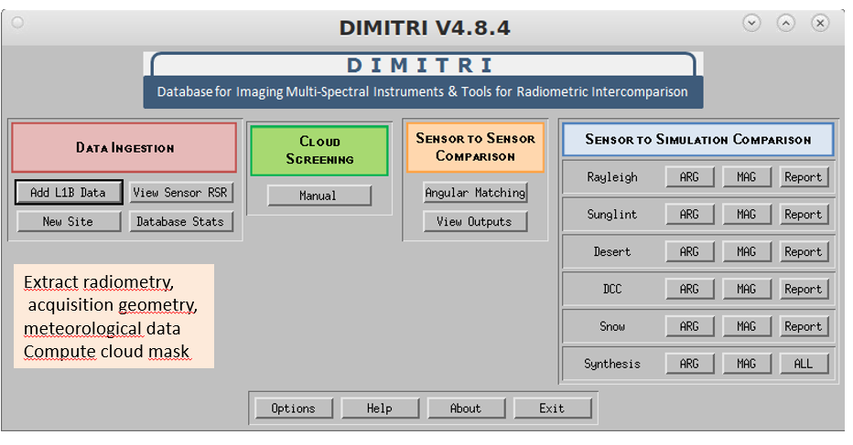
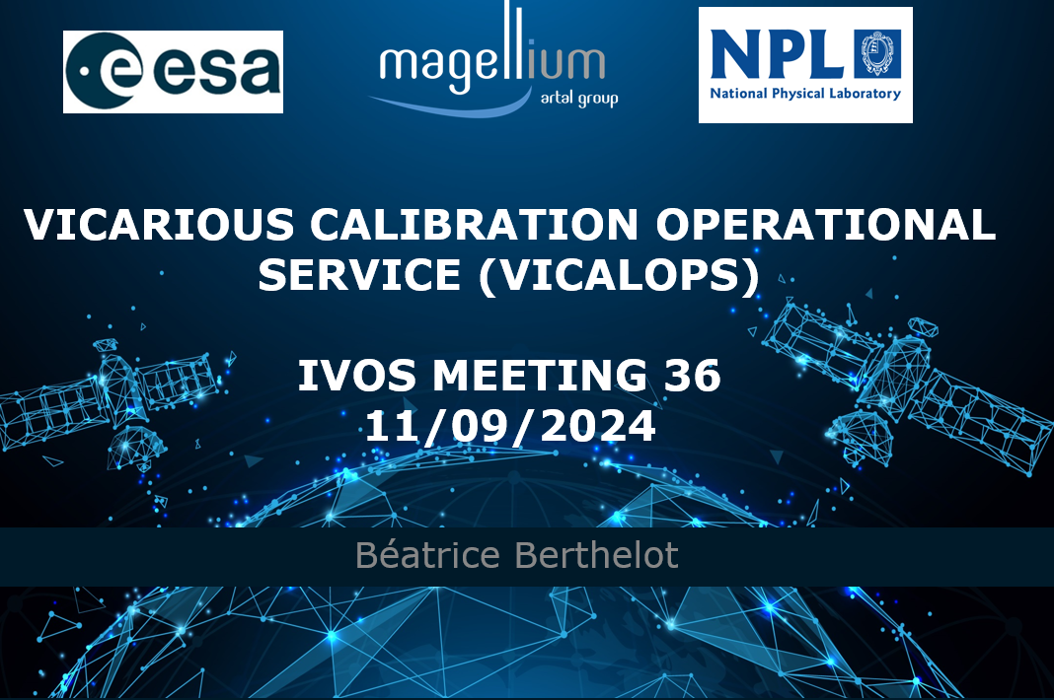
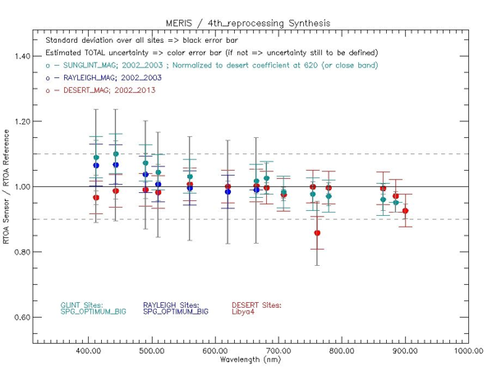
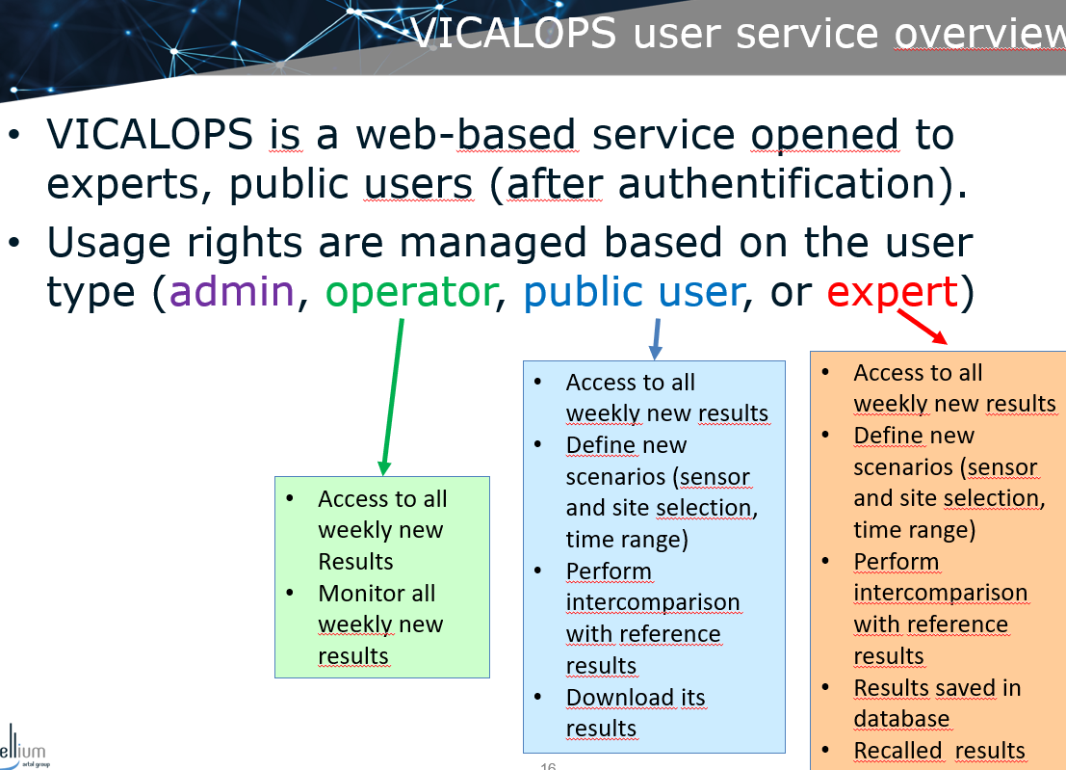
Comparison tools
VICALOPS – ESA provided free and open web service primarily for calval ‘experts’
Will be accessible via Cal/Val Portal
https://www.vicalops.org/overview from summer
Beta testers welcome please contact me.

Slide 9
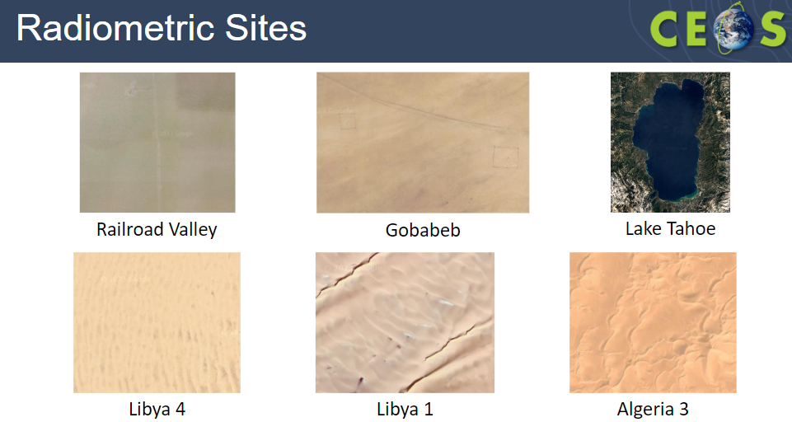
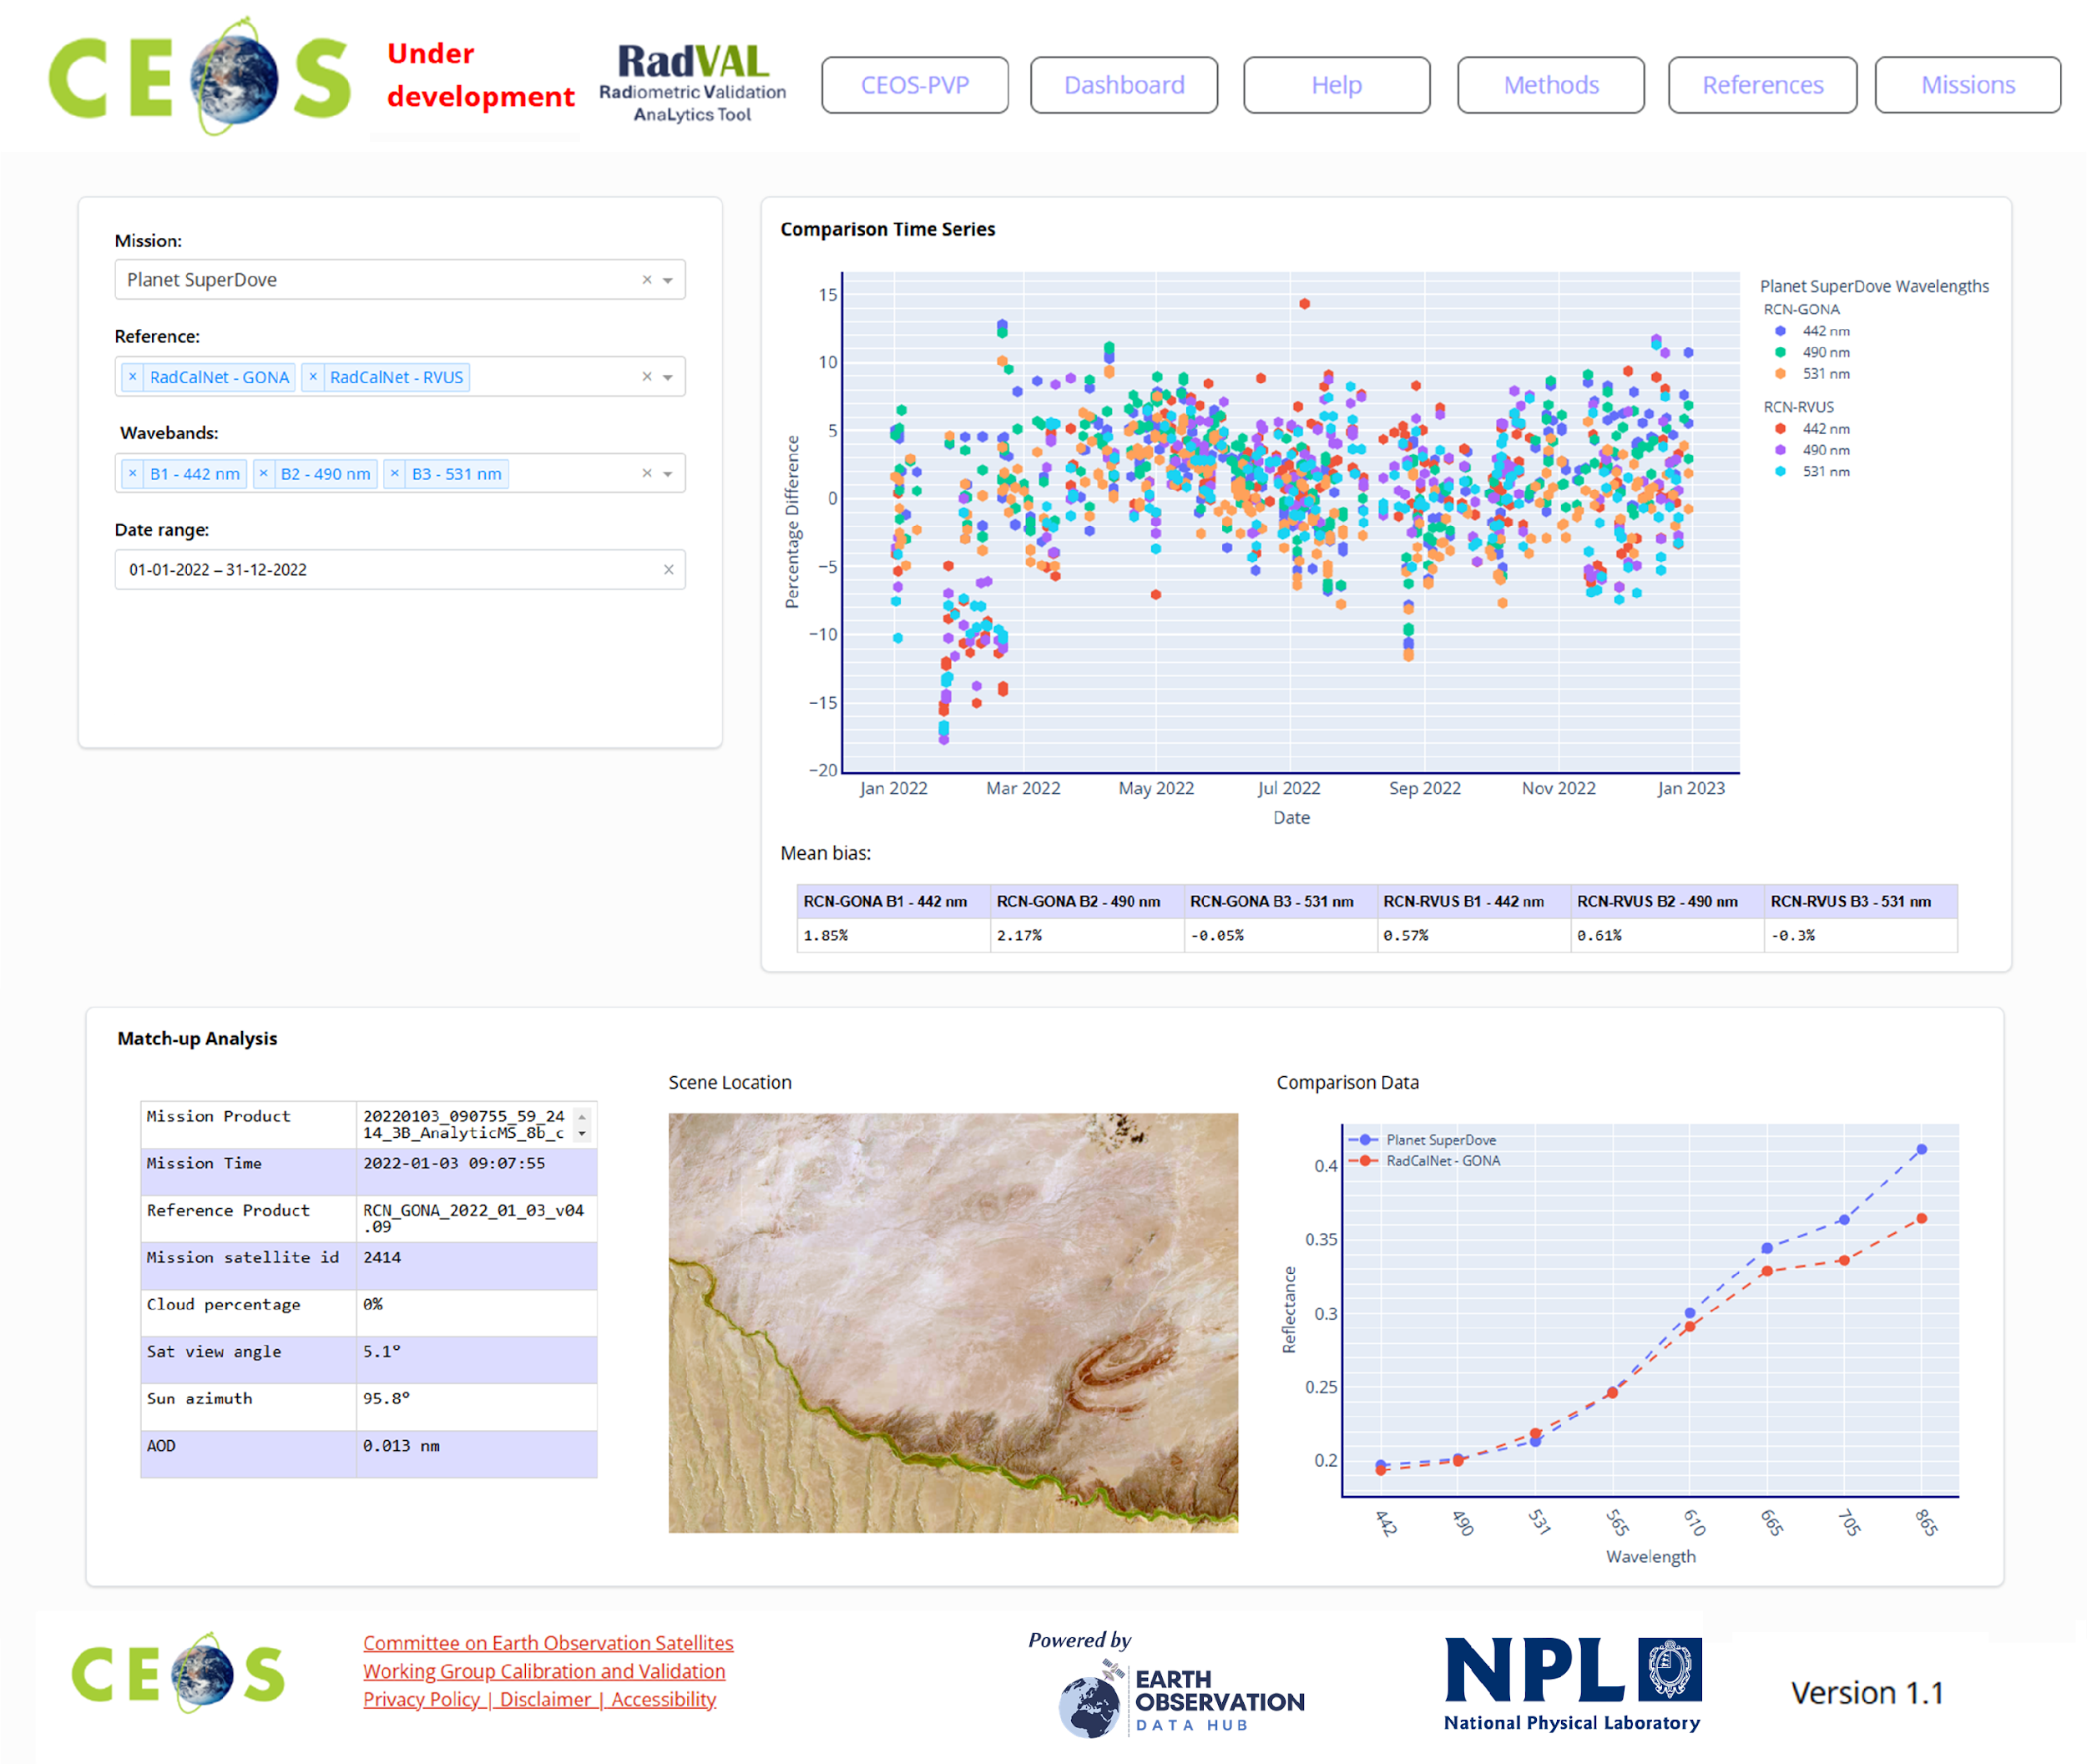
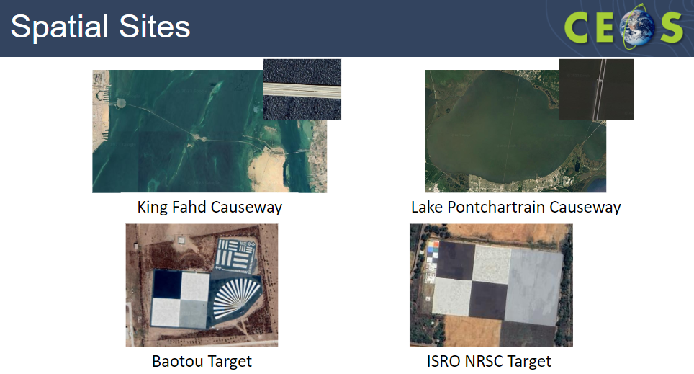
Comparison tools: Level 1 (now PVP)
Site now operational engagement slow!
See Pres on Monday J3.5

Slide 10

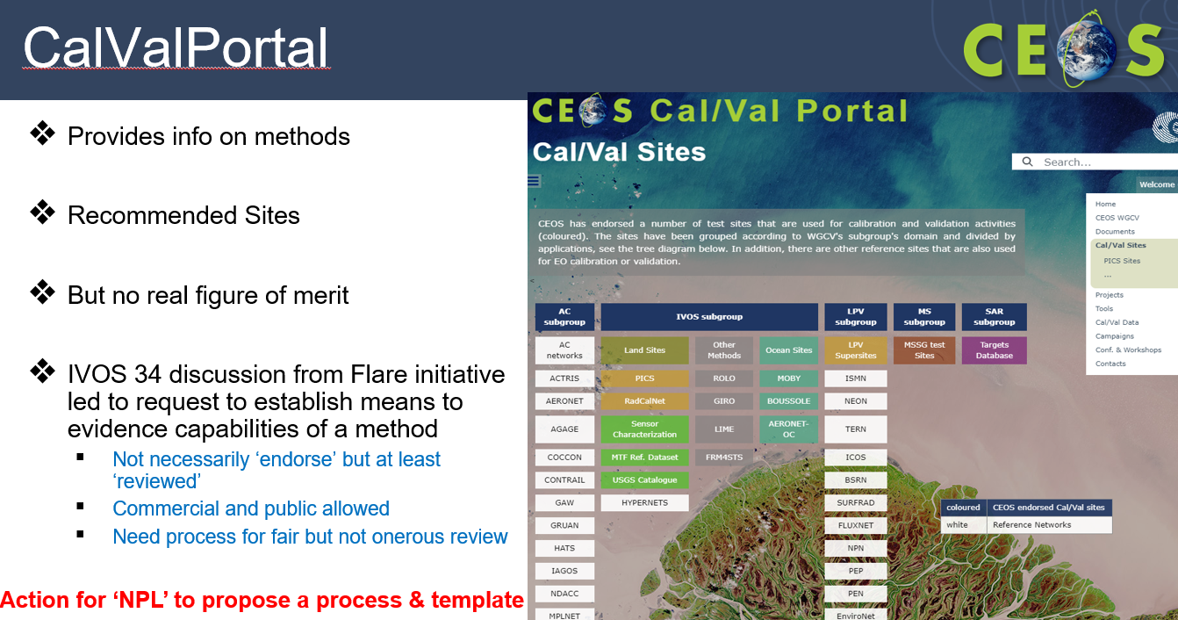
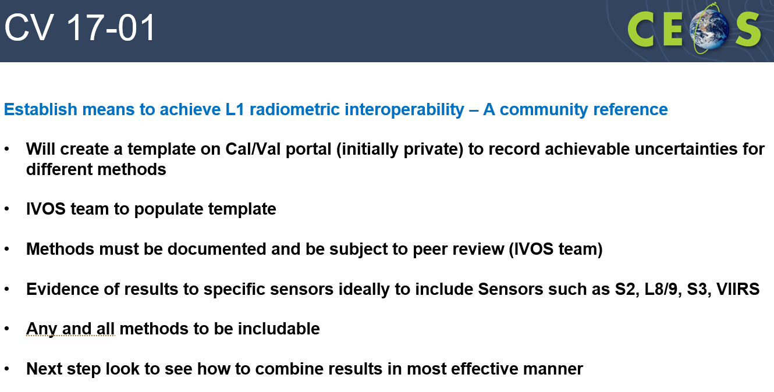
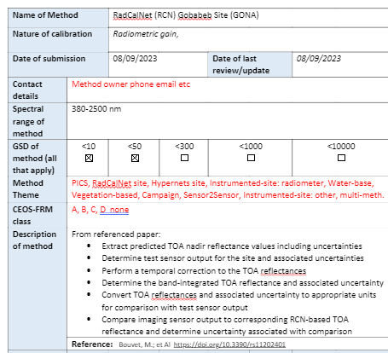
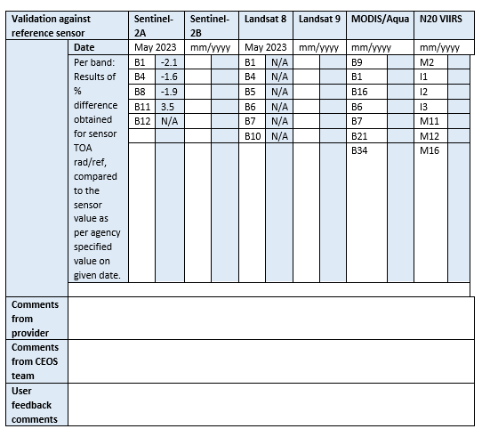
Database of Cal/Val infrastructure
Proposed last WGCV
Reconfirmed interest at IVOS 36
ACTION - Need to work with Paolo (ESA) to establish on Cal/Val portal

Slide 11
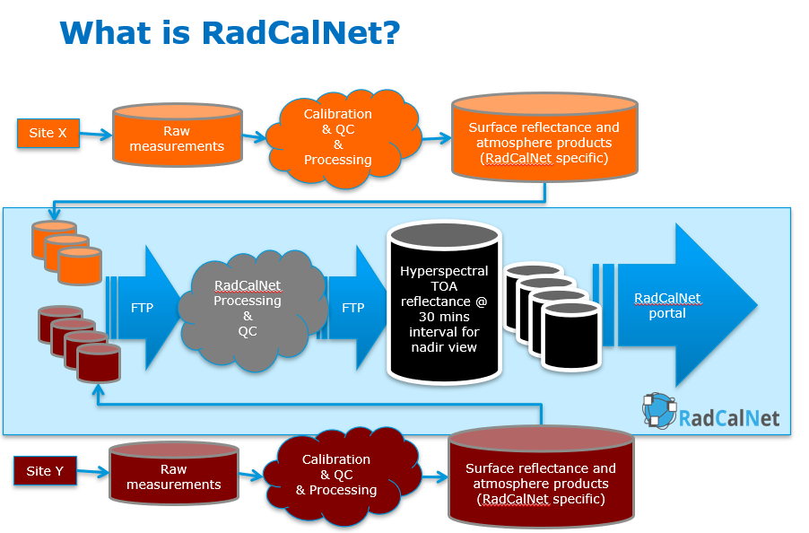
RadCalNet: See dedicated Presentation

Slide 12
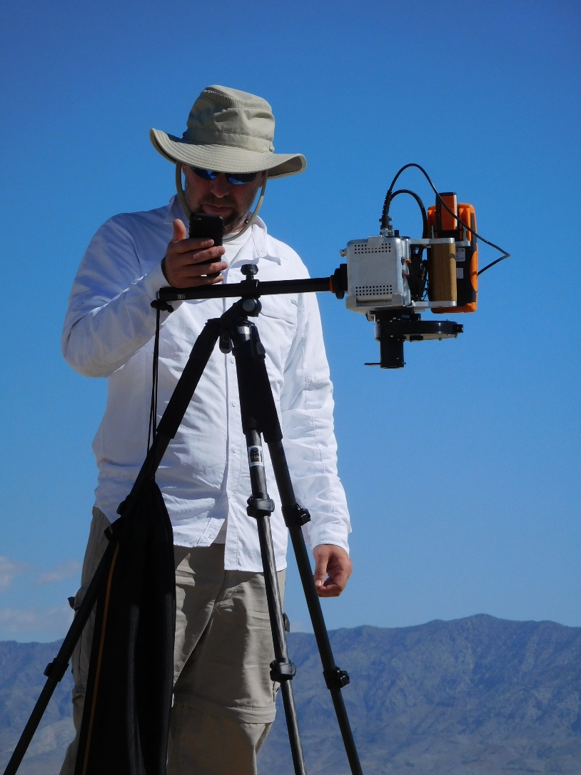
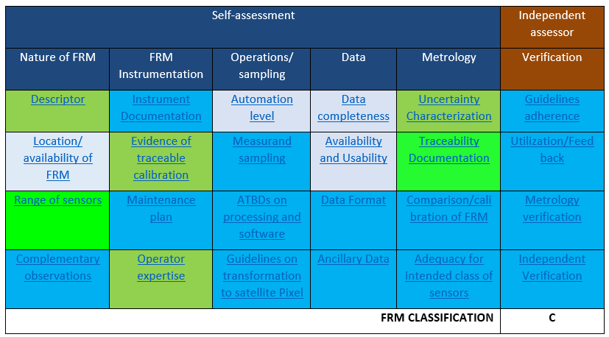
FRM QA framework
Lessons learnt from:
Calibration and Test Site SI-Traceable Transfer Radiometer (CaTSSITTR)
RadCalNet
Assessment can be subjective/pessimistic and make assumptions based on how the person thinks the context is
Should be done to reflect what is claimed to be done in descriptor
Ideally needs to be done early in a projects development cycle to get quick feedback into priorities of what needs to be done.
Assessing for a network and for other users can have different criteria some NA
New network category and NA do not necessarily
need to count to overall assessment (%)
Who does verification column? And their independence
Will be very valuable when number of assessed products increases
Valuable for mission managers to specify class of FRM they need

Slide 13
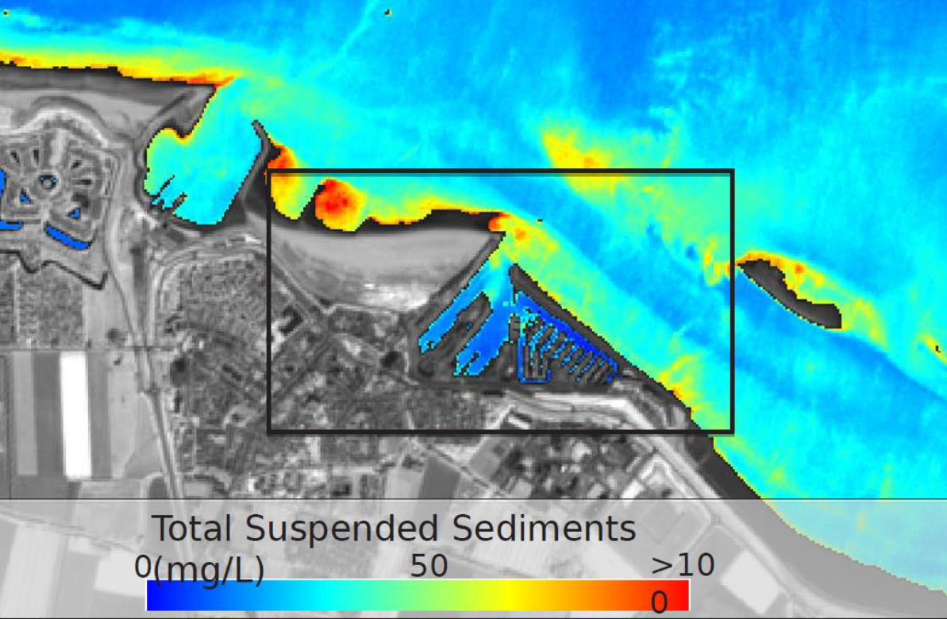
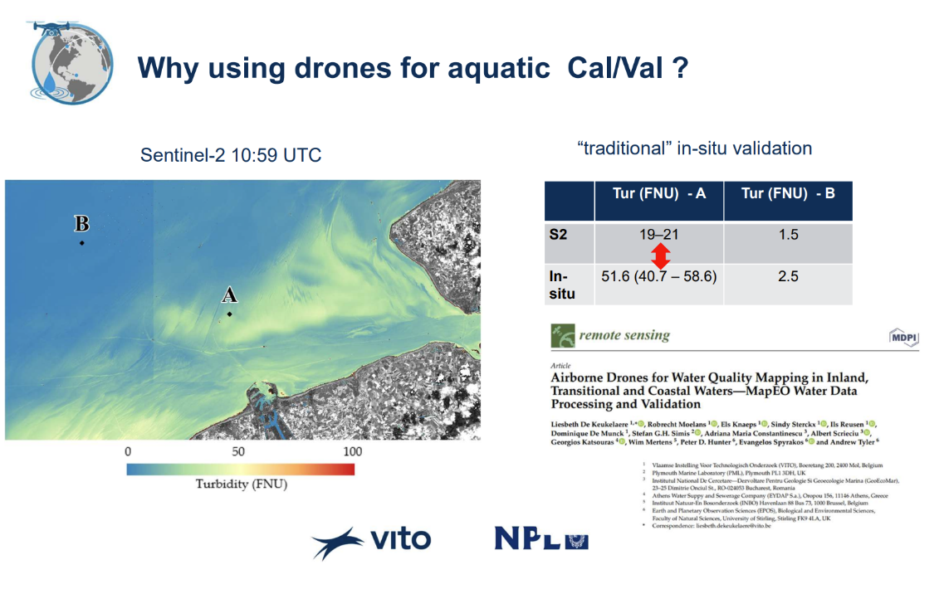
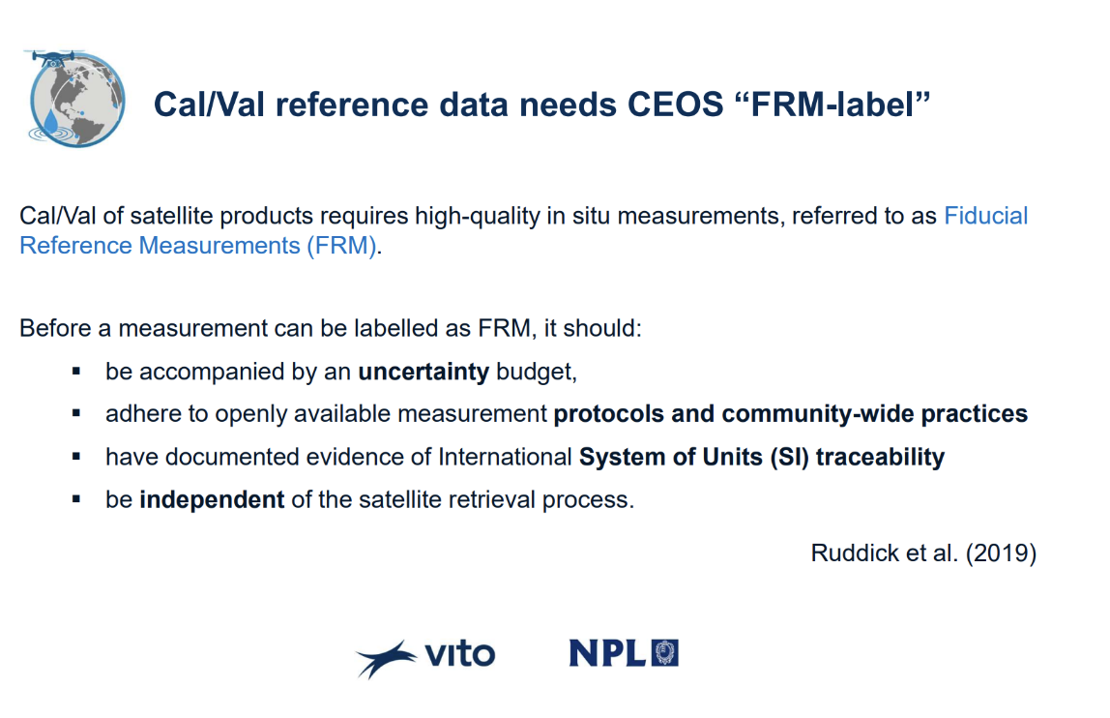
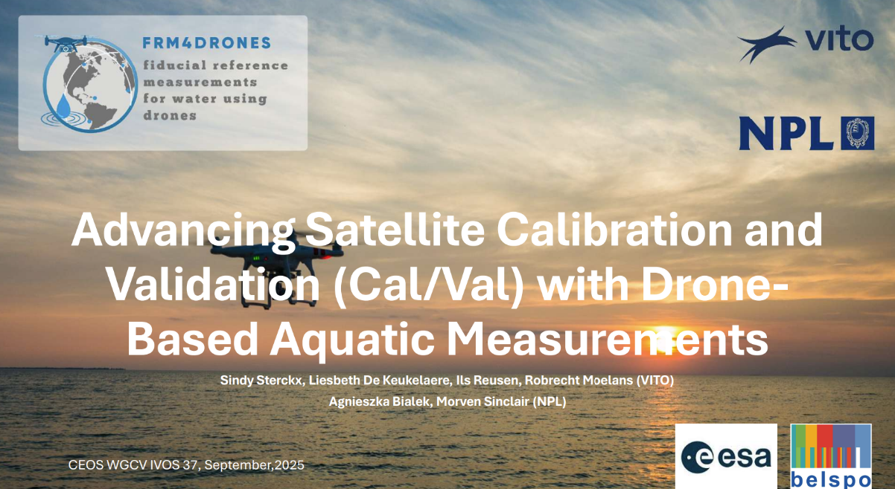
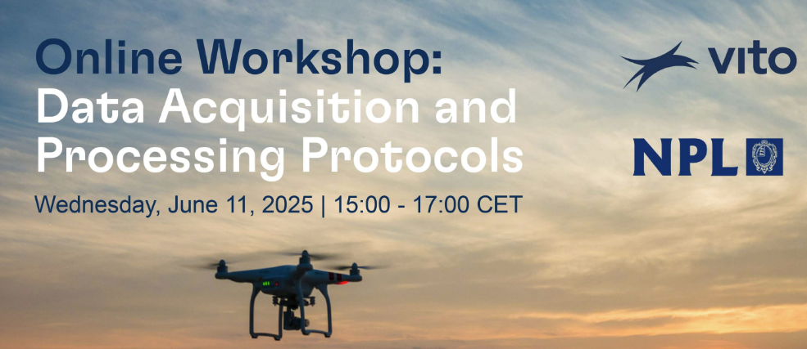
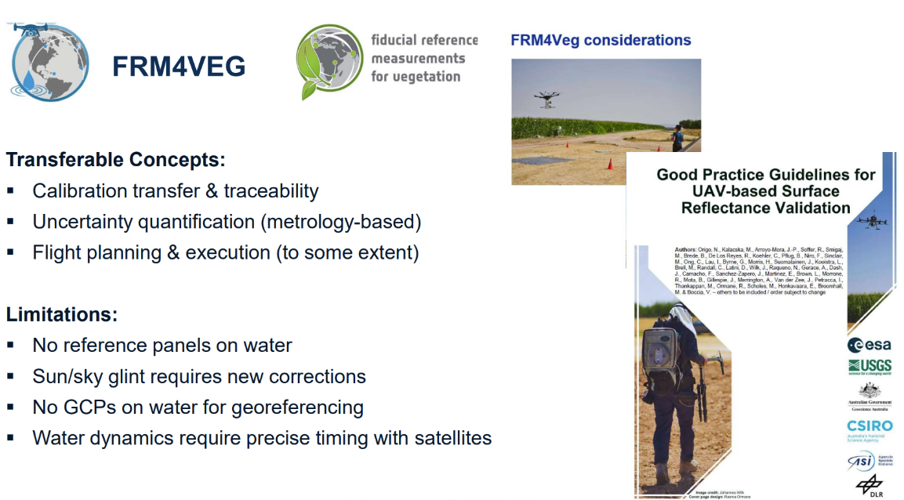
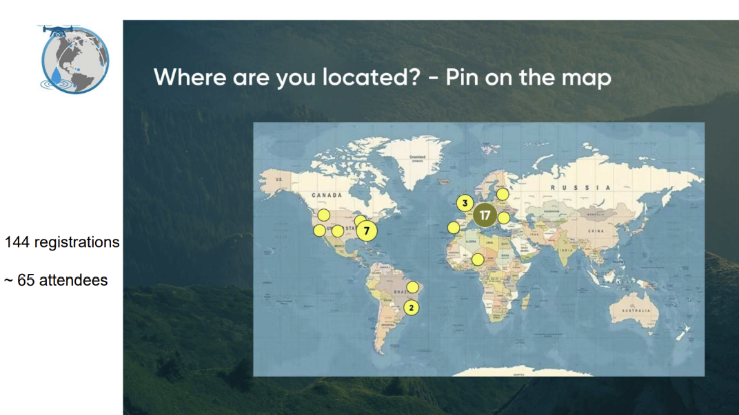
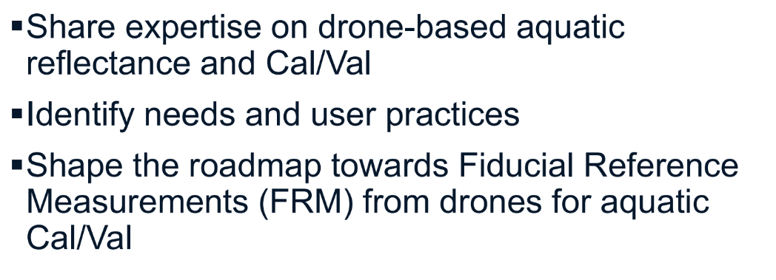

dDrones for water quality validation: FRM4Drones(water) Sterck (Vito)

Slide 14
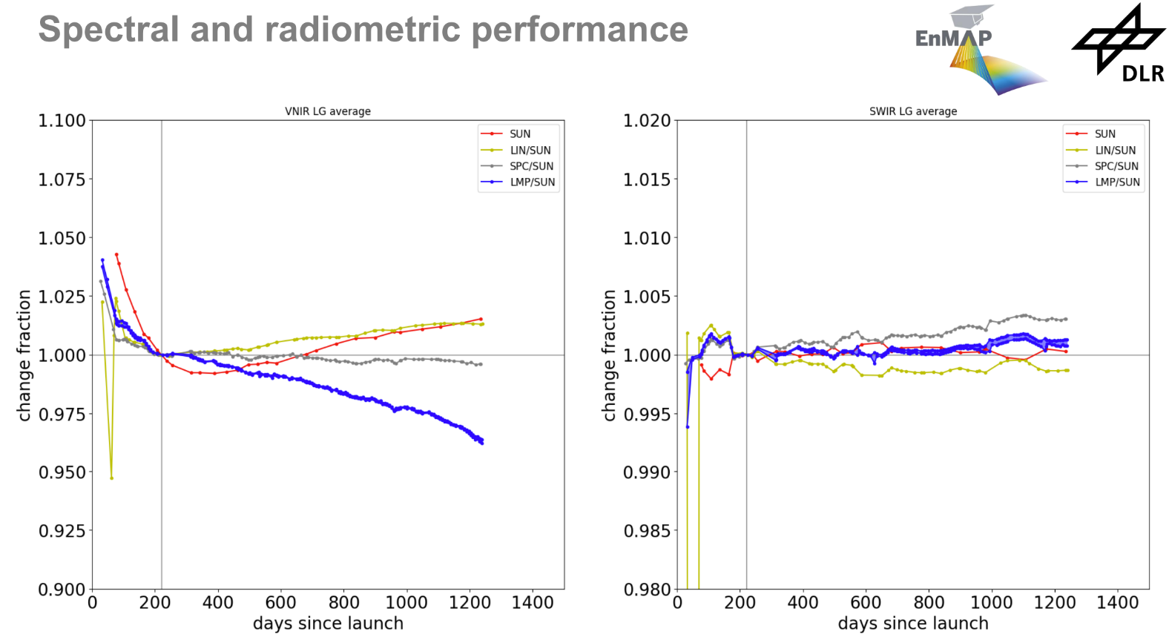
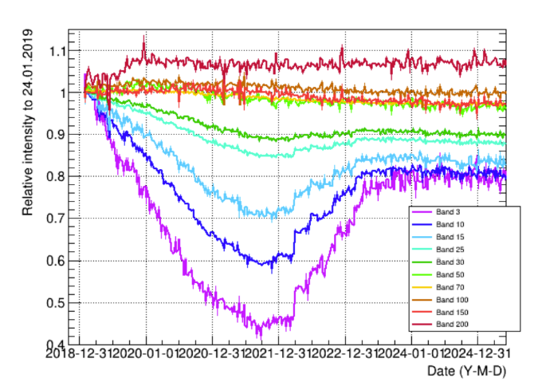
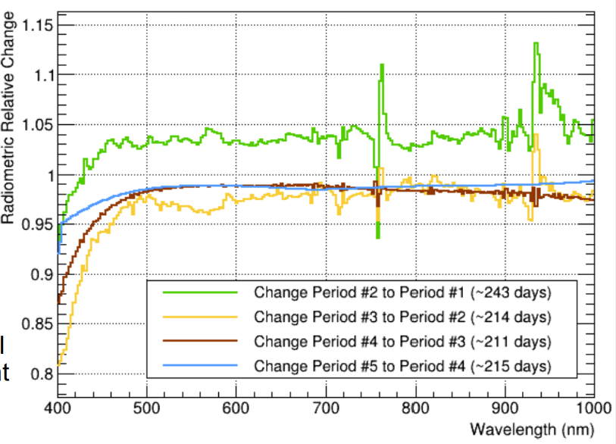
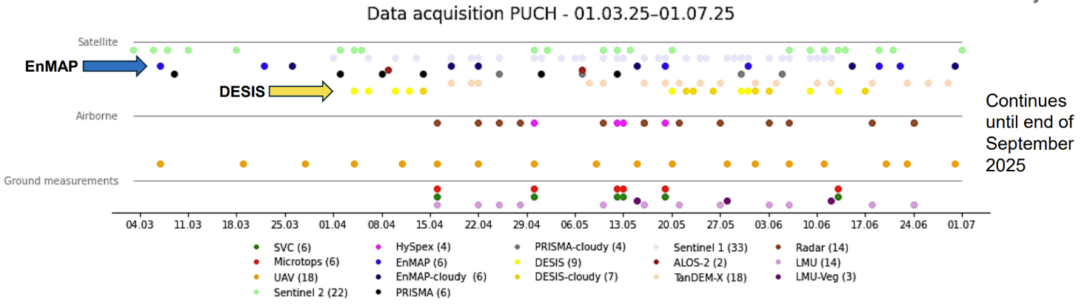
Sensor status and performance: Hyperspectral
Similar trends but different scales (on-board 40% vs 60% vicarious)
DESIS on-board
DESIS Vicarious
Multi-sensor comparison campaign – EnMap, DESIS, PRISMA, airborne, ground last year results awaited to IVOS 38!

Slide 15
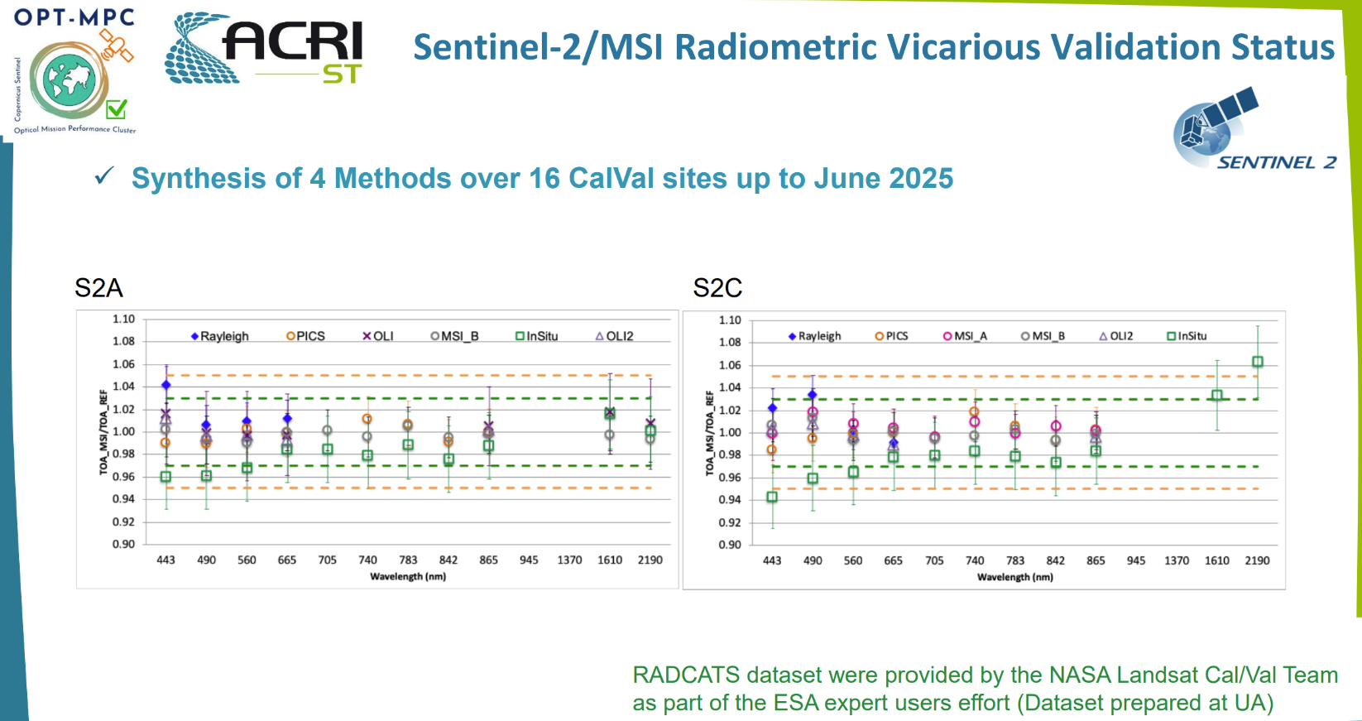
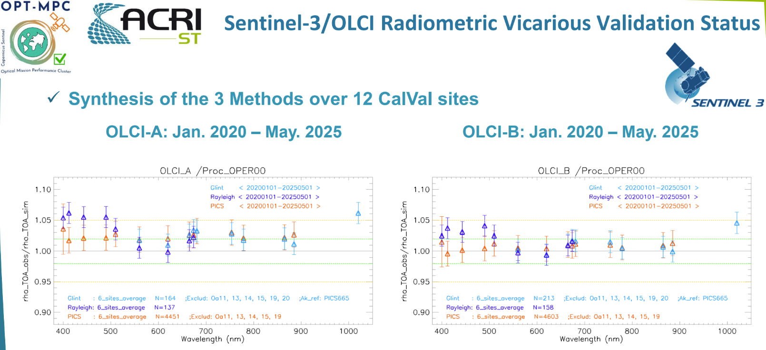
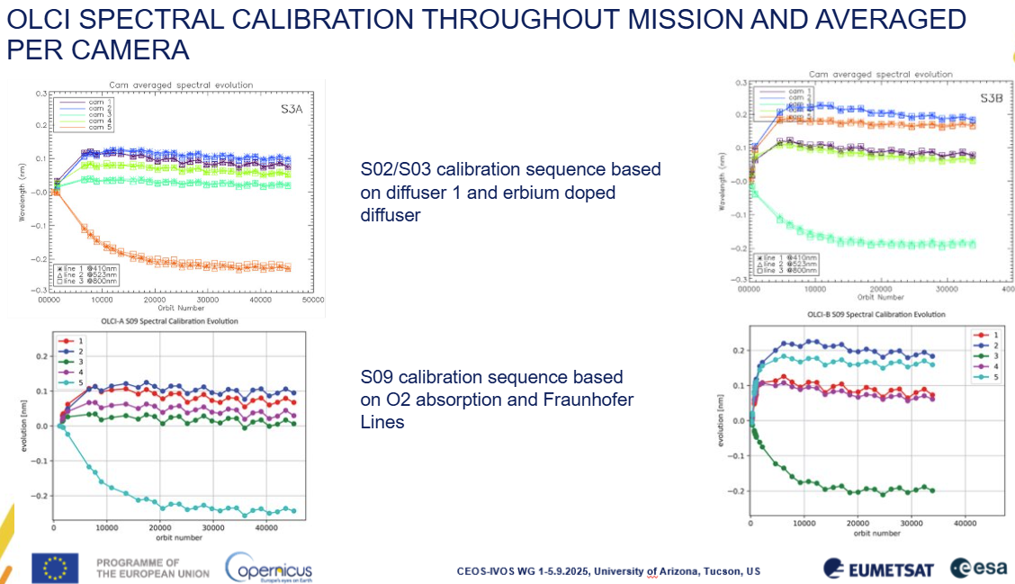
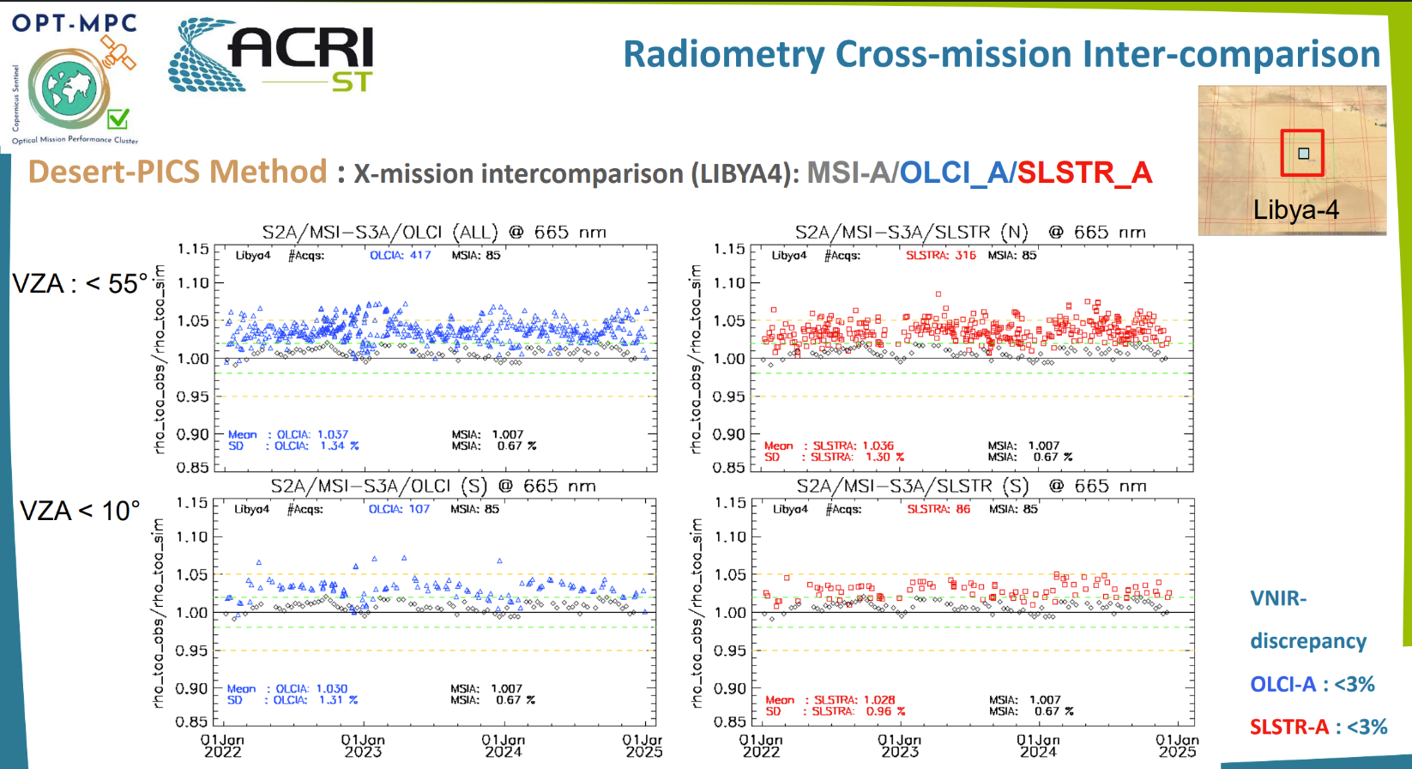
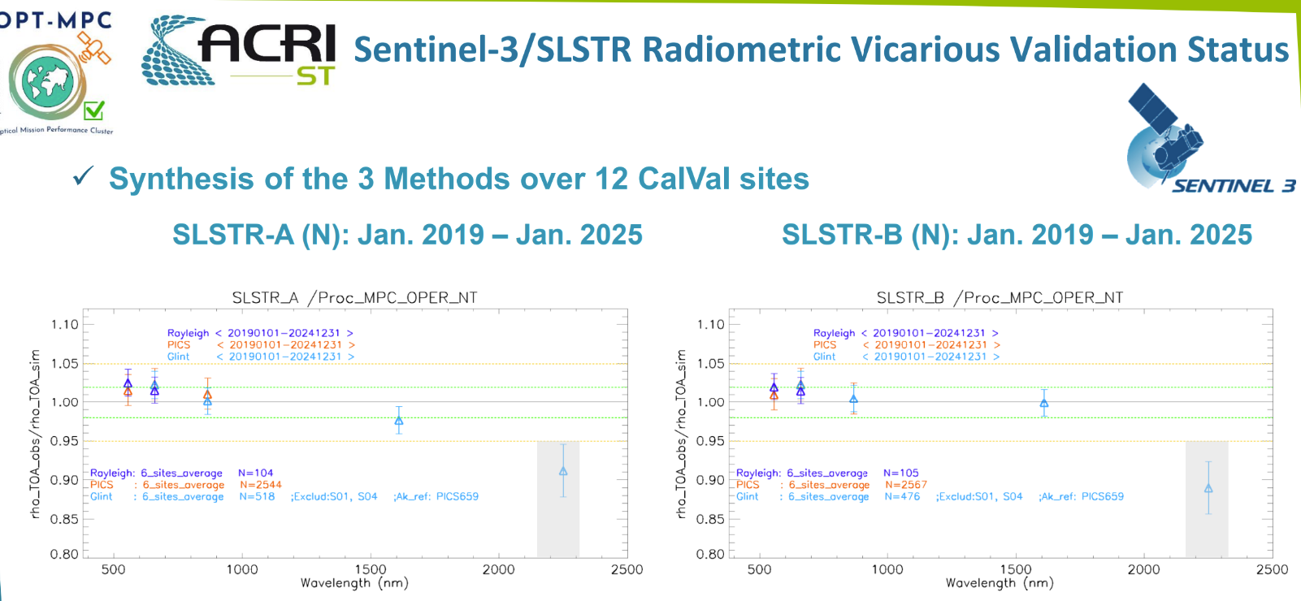
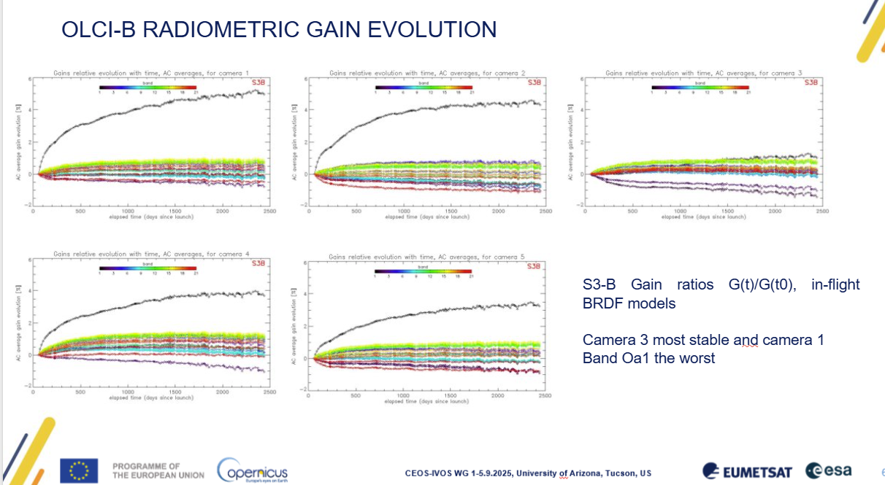
Sentinel Sensor status & performance

Slide 16
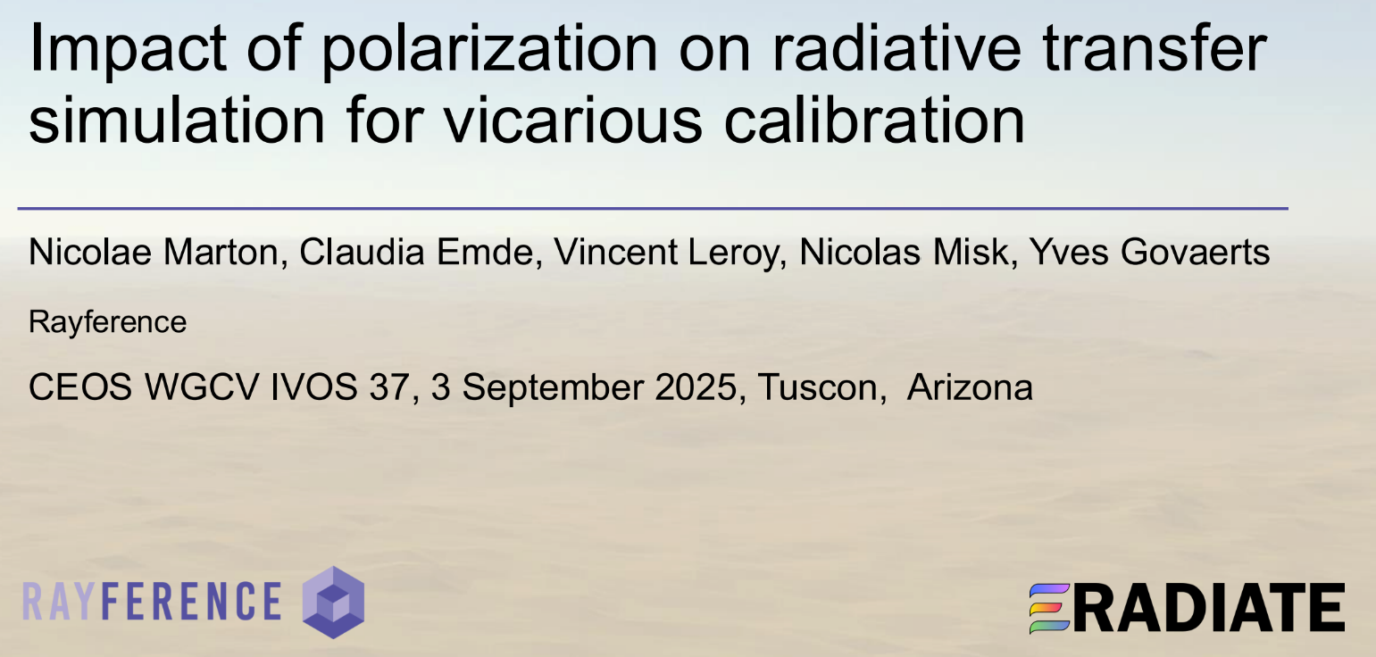
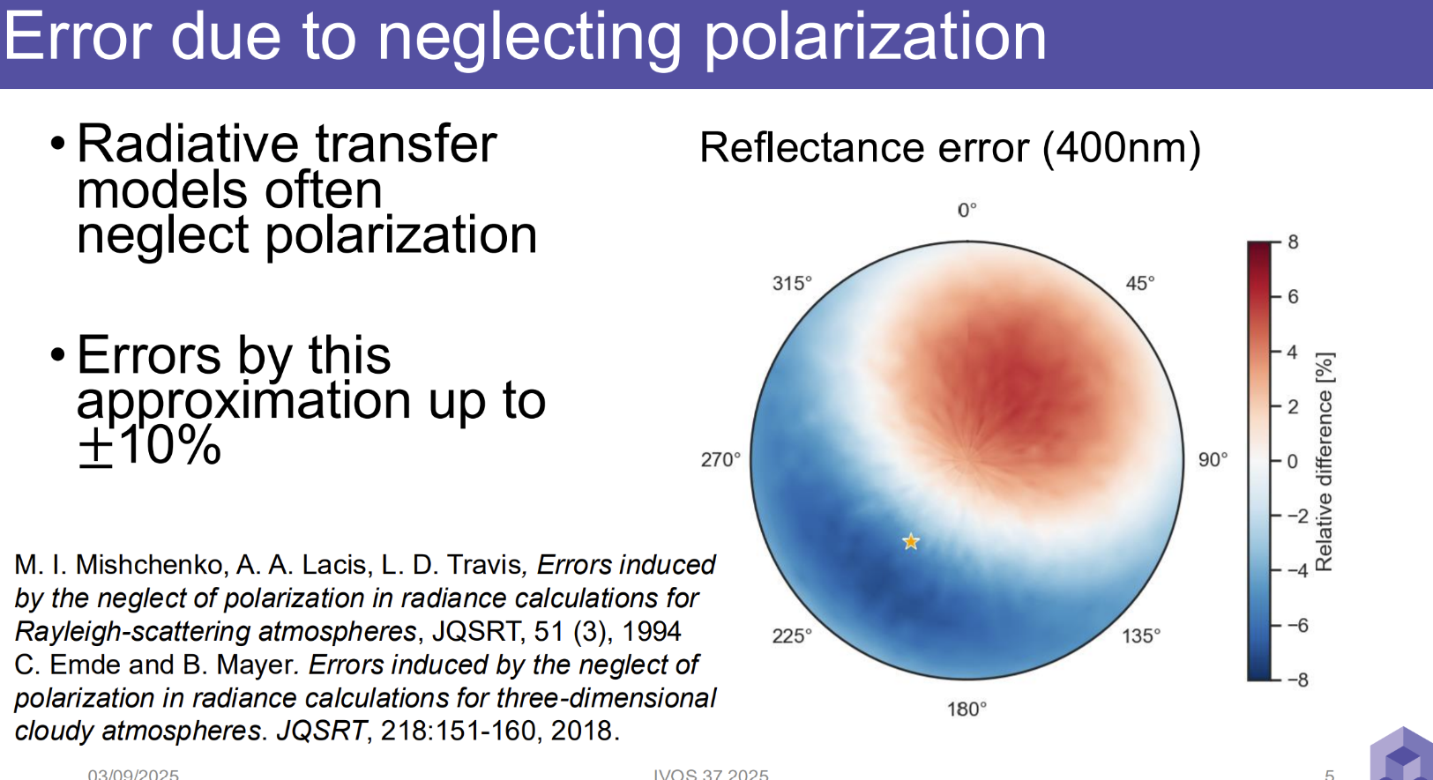
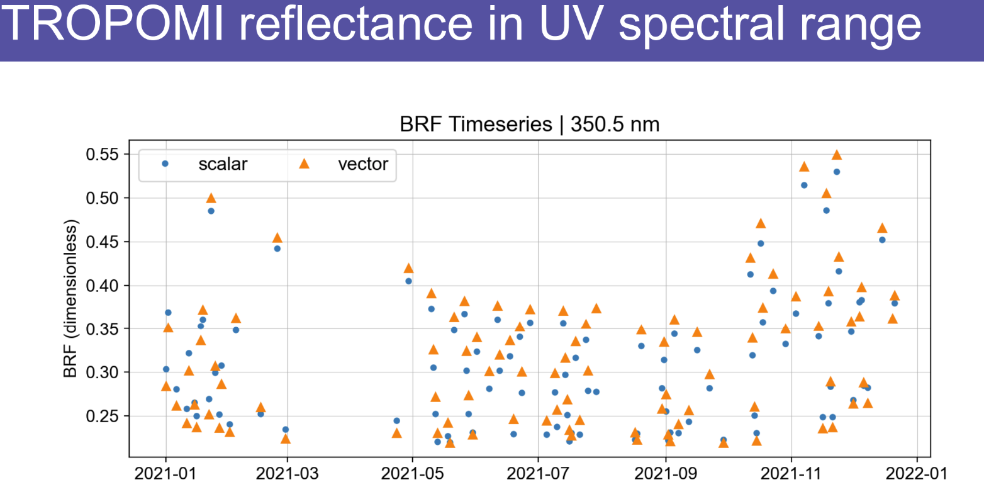
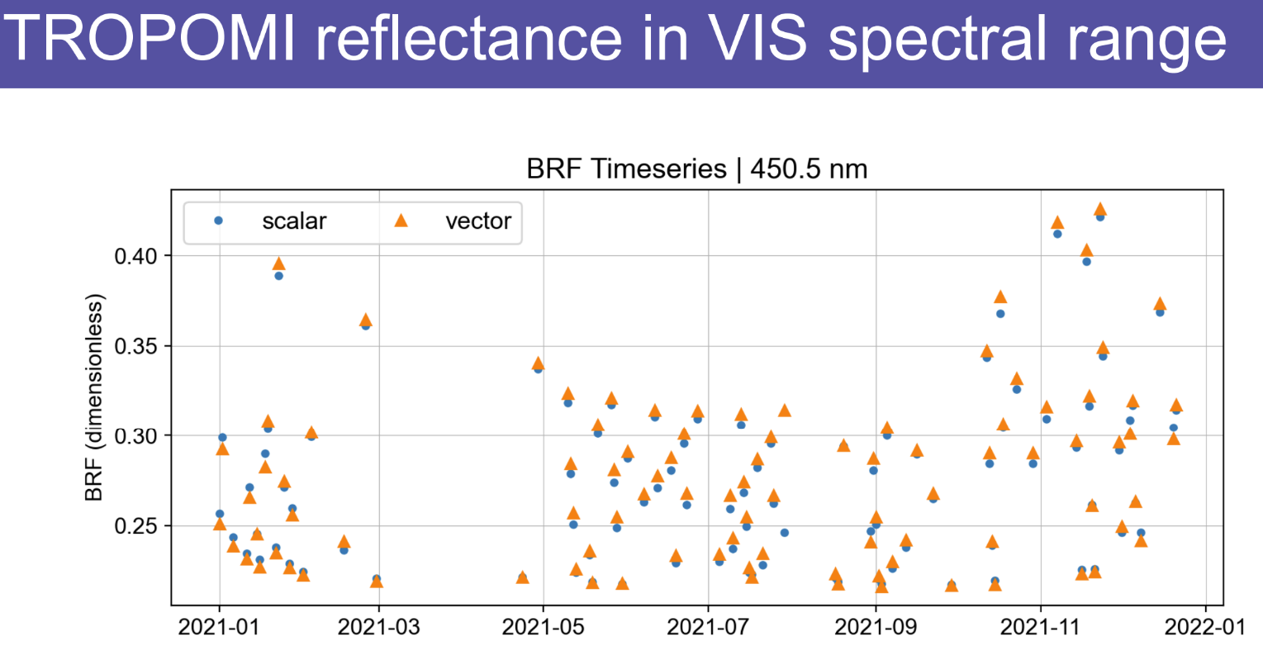
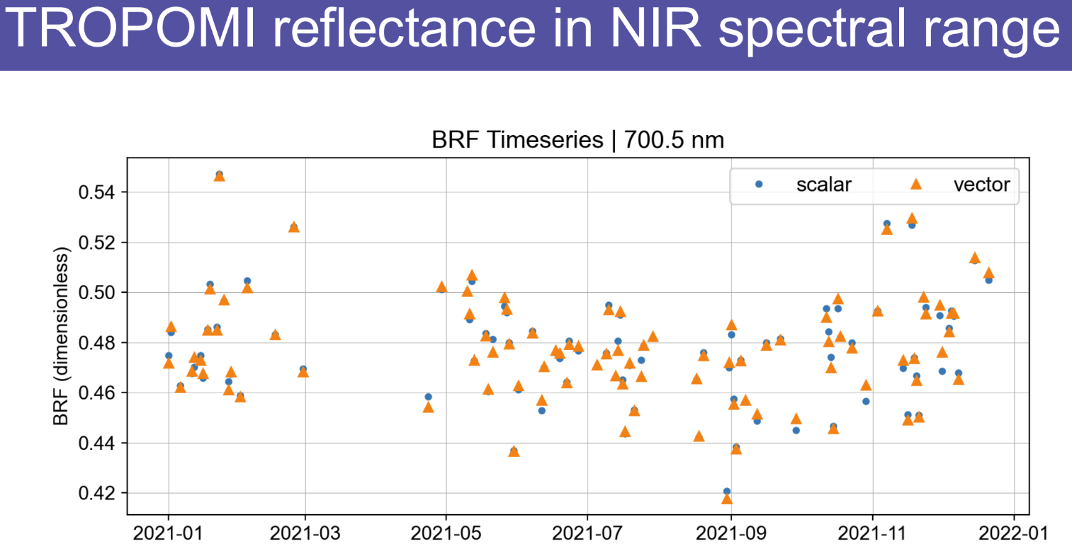
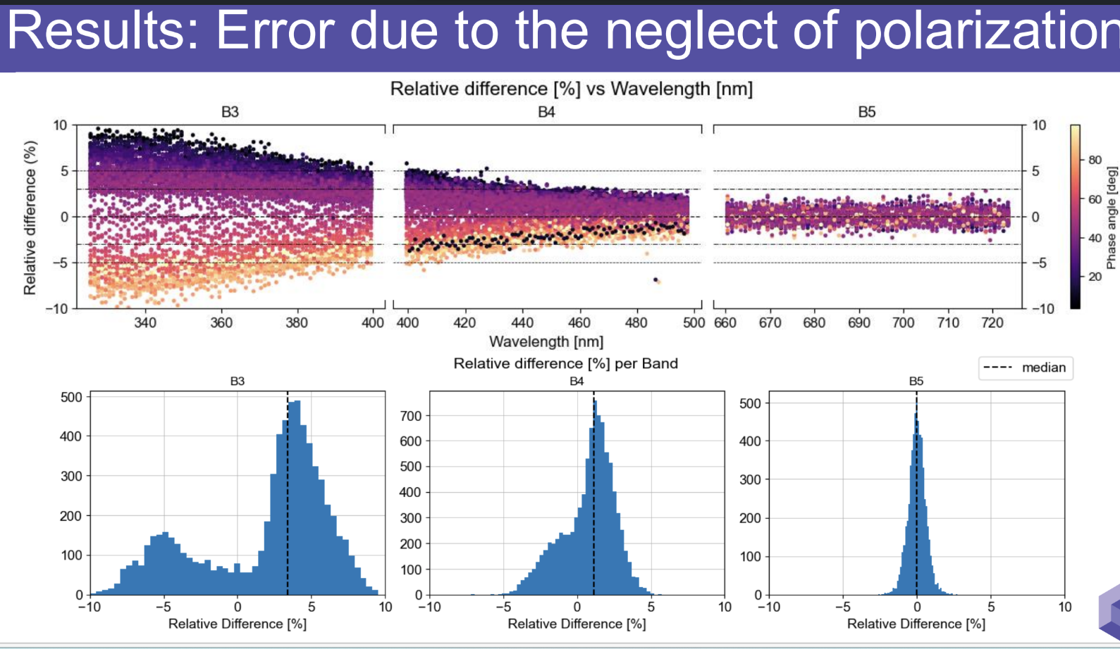
Impact of Polarisation in RT code

Slide 17
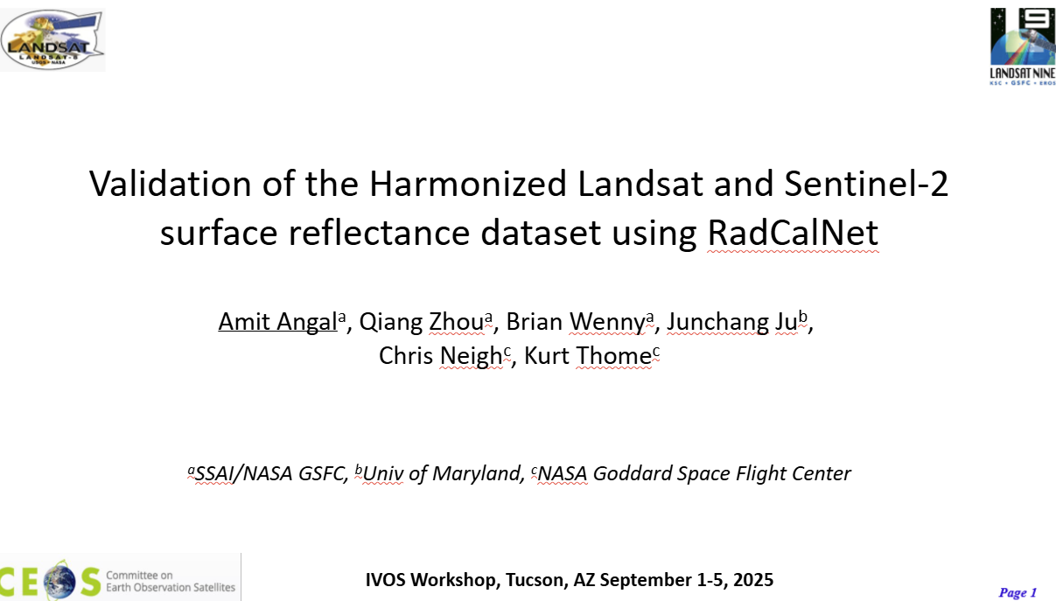
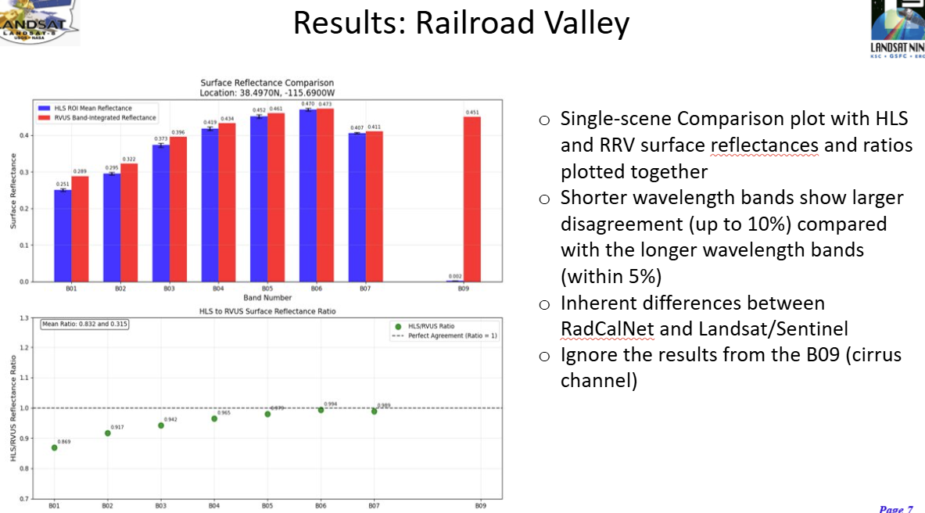
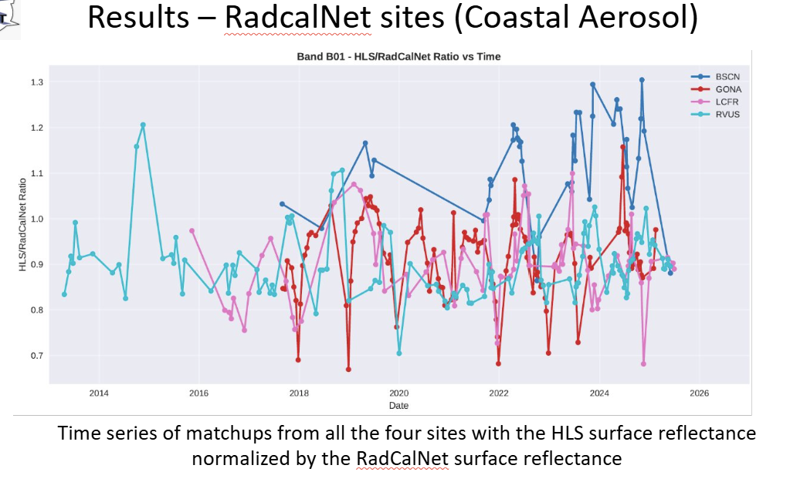
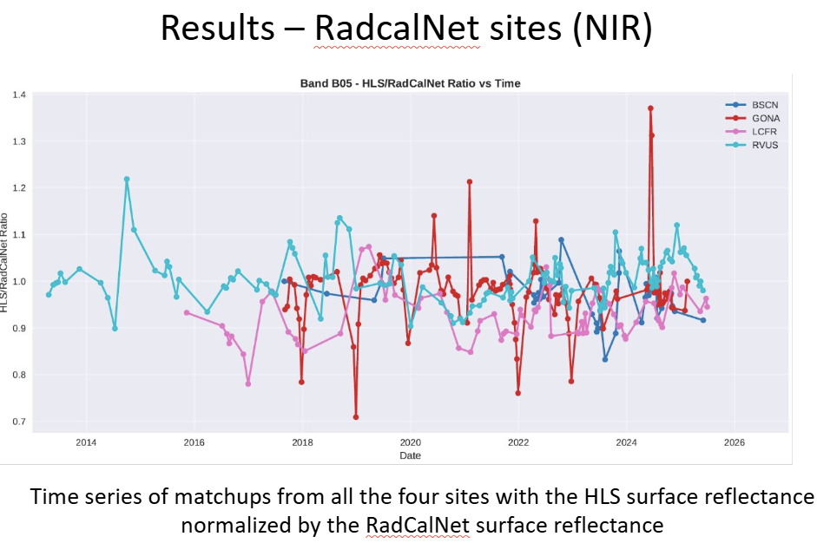
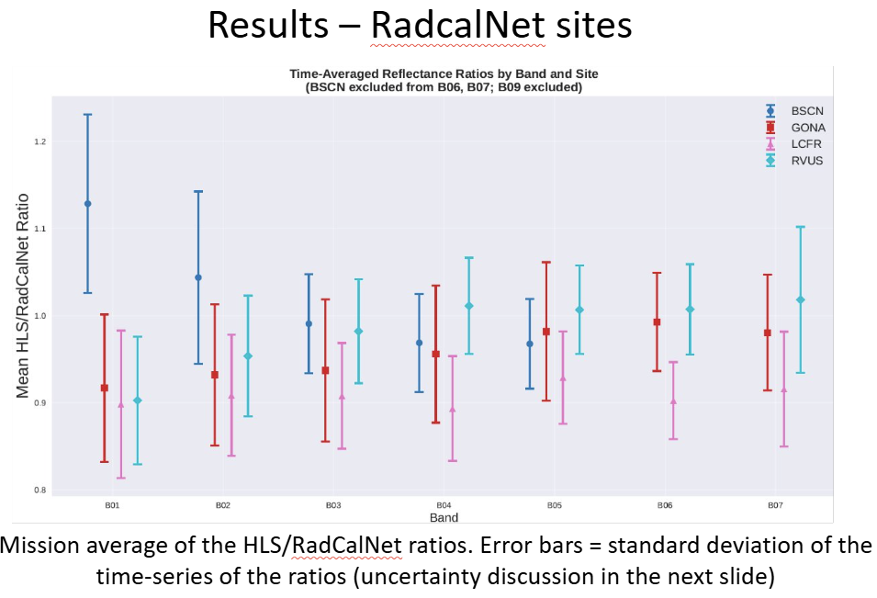
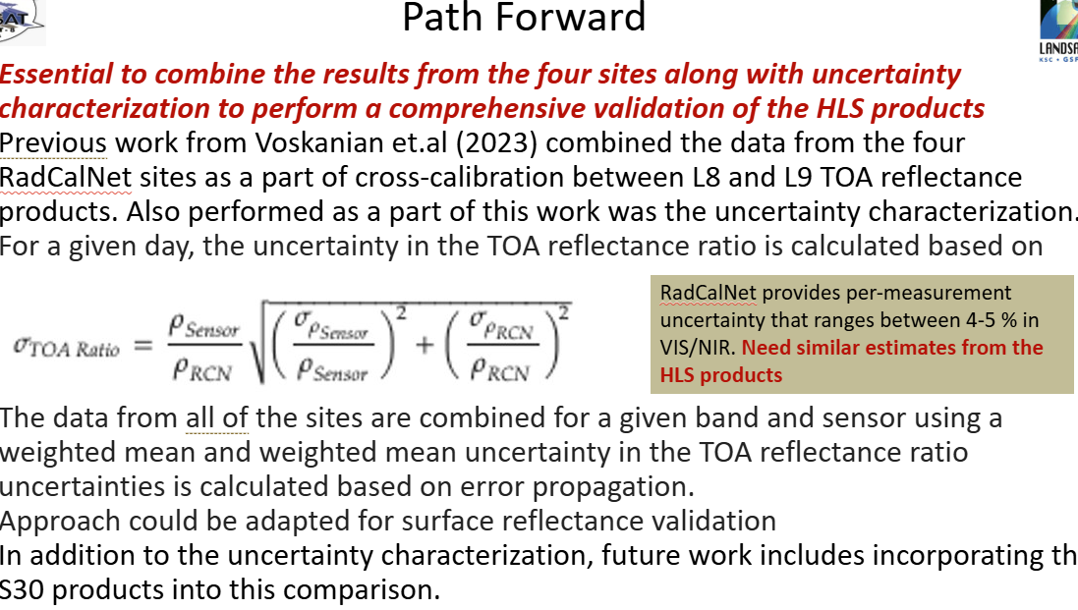
Validation of HLS product

Slide 18
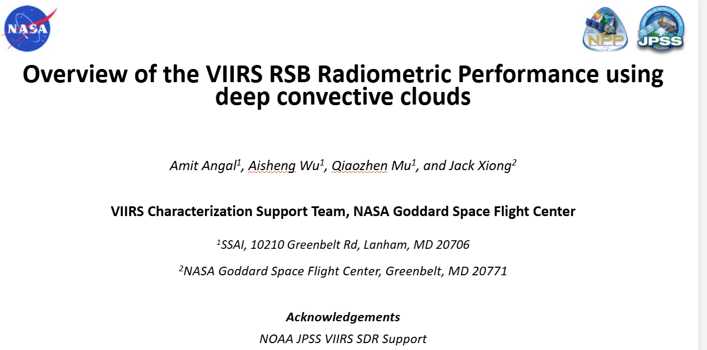
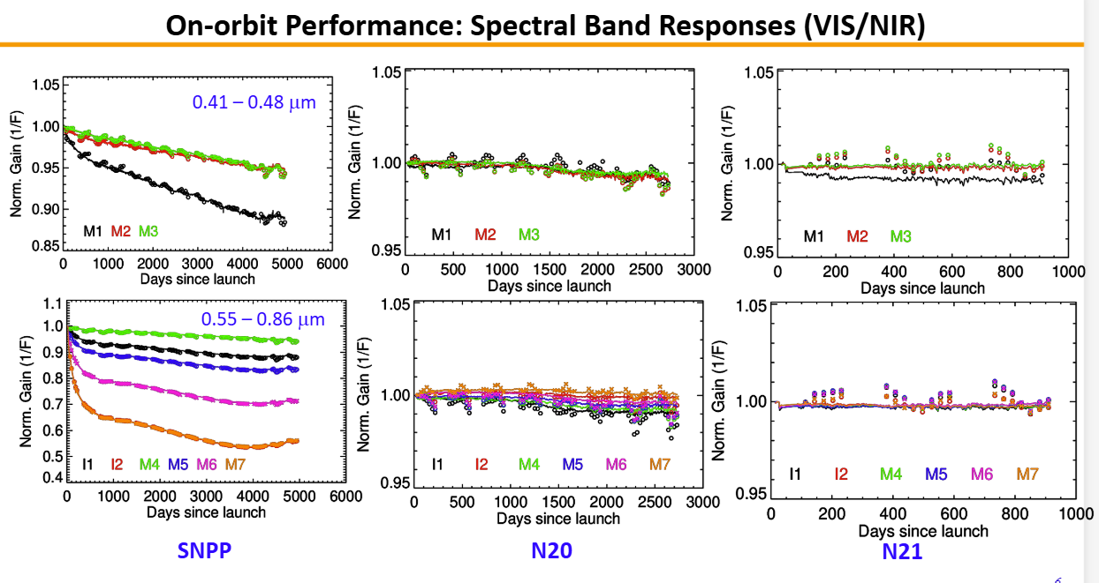
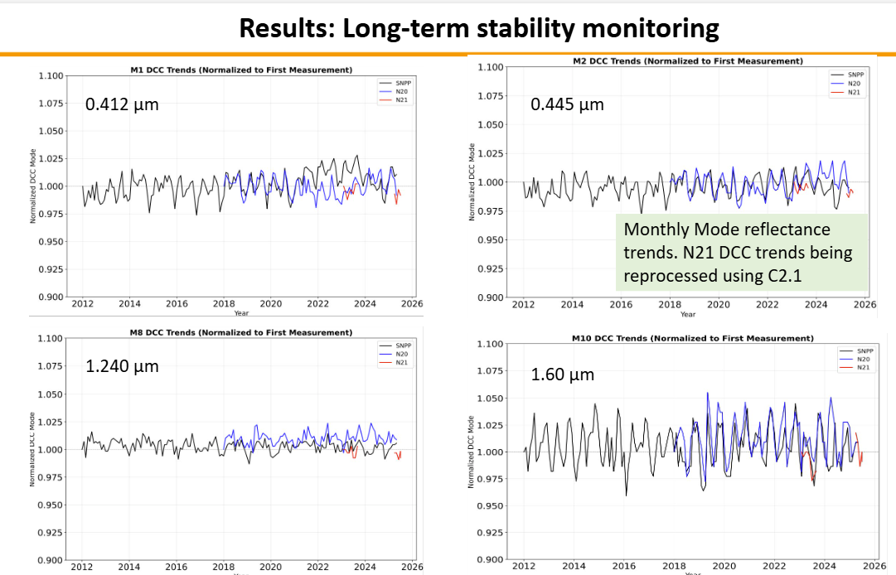
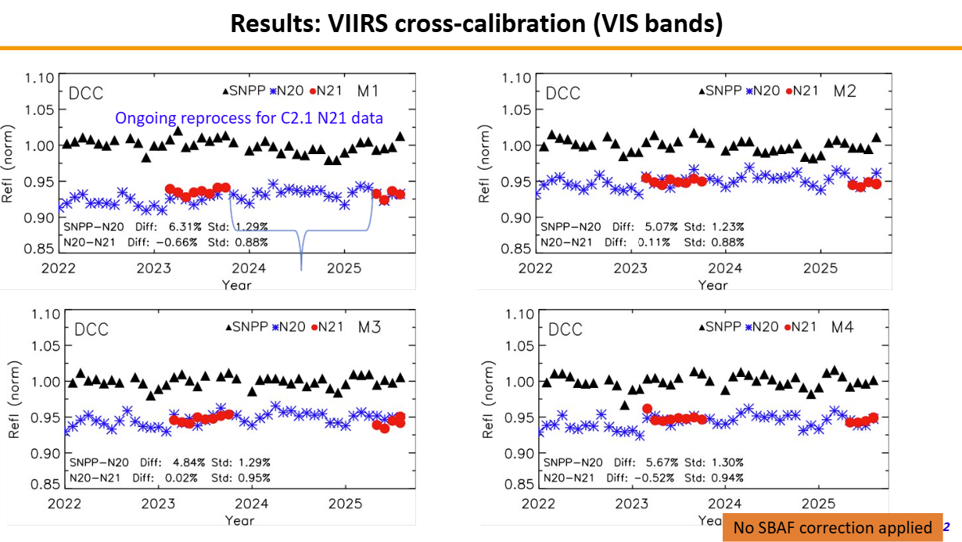
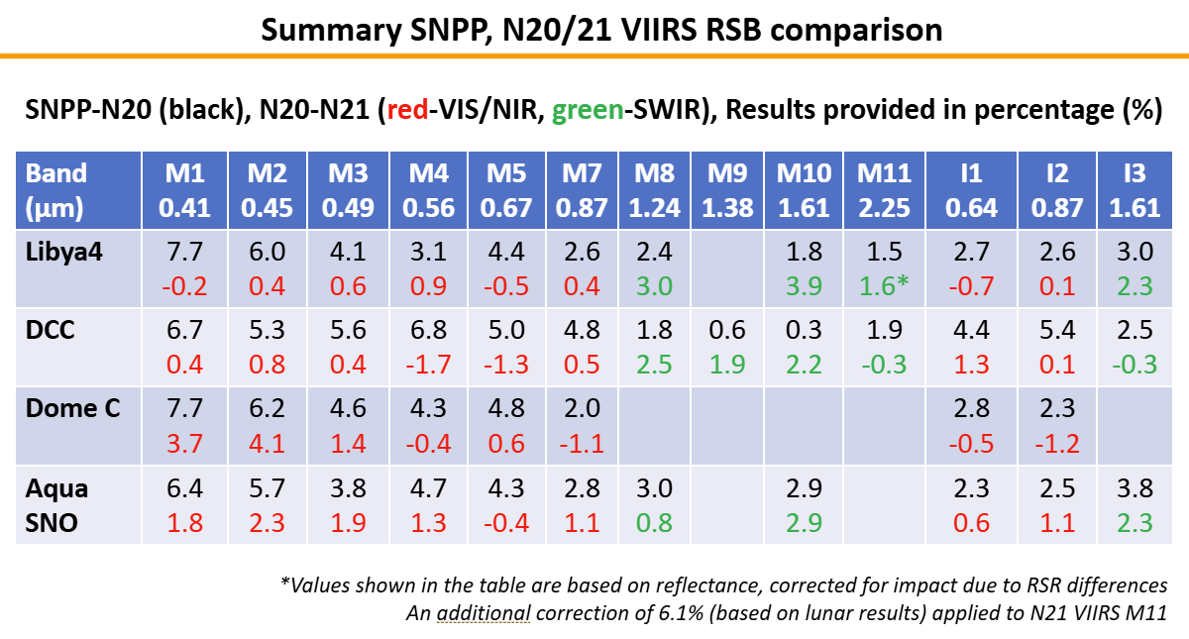
VIRS performance using DCC

Slide 19







Sensor 2 Sensor (SNO cal)
SZ < 60° Δt < 15 min
VZA < 10°
SZA < 60° Δt < 15 min
VZA < 5°

Slide 20


Uncertainty, Traceability and QA
Drivers: ARD, Per pixel Uc, Climate, New space -
What IS Traceability?
What do we have to evidence?
What is enough in terms of Uncertainty?
Started to scope a ‘minimum requirements for newspace’
What to do pre-flight ?
what to do post-launch ?
What information needs to be provided ?
Need to have evidence as to why it is needed?
Undertake studies to evidence need e.g spectral response ideally linked to applications
Comprehensive 2nd and now 3rd workshop at JACIE:
Starting point
Discussion at IVOS
On-line & in-person Training (May 26)
https://www.qa4eo.org/met4eo/

Slide 21




Toolkit
https://qa4eo.org/tools/
On-line & in-person Training (May 26)
https://www.qa4eo.org/met4eo/
Propagation UNcertainties in Python
Handling uncertainty and error-covariance in datasets
UNC Specification
CoMet mathematical algorithms and interpolation tools
Uncertainty metadata naming conventions

Slide 22



New space Cal/Val
Considered the minimum requirements that are needed to enable L1 product to be assessed by a user for a science application
Spectral Response Function (SRF)
Combined radiometric uncertainty
Radiometric gain uncertainty
Non-linearity over sensor specified
dynamic range
Noise characterisation (SNR) for a specified signal level typical of intended applications
Geometric location performance
Modulation Transfer Function (MTF)
Each characteristic needs to have supporting evidence
To Be Reviewed and then to potentially lead to a recommendation (note also proposal from others to be considered)

Slide 23
TIRCALNet
TIR Top-of-Atmosphere Calibration Network
See dedicated presentation
Steffen Dransfeld, ESA
Morgane Chapelier, Sébastien Marcq, Arthur Dick, Emilie Delogu, Aimé Meygret CNES
Darren Ghent, Jasdeep Anand, Mike Perry University of Leicester
Frank Goettsche, Lluis Perez-Planells KIT
Dave Smith RAL
Simon Hook JPL

Slide 24




New Missions + their Cal

Slide 25








The Moon
5th Lunar Cal workshop at Eumetsat Darmstadt, Germany
Nov 16-20 2026
ARCSTONE

Slide 26









CNES Activities

Slide 27
Summary
Looking for a volunteer (s) to take leadership of ‘image quality/geometric’ focus group
- USGS to provide a questionnaire to solicit interest and priority topics
Interoperability (radiometric) L1
- Sub-set of sites identified for ‘encouraged collect by Newspace and agencies
- Match-up platform to assess/report consistency with ‘CEOS reference’ CEOS-PVP NOW LIVE
– strategy to build a database for users to assess suitability for their application as first step!
Uncertainties, Traceability, QA – lot of interest further workshops include new space
- Develop guidance recommendations (agency buyers guide) of what needs to be done to evidence QA
- CEOS to establish case studies (Sensitivity) to demonstrate why we need information
- more workshops including in Europe, Tools created, & on-line training course about to be launched
LST ToA brightness temperature project (TIRCalNet) started with view to future operational network noting RadCalNet has Eight yrs of operation and >500 active users
- Metrological analysis to support TIRCalNet (JPL radiometer/Lake Tahoe)
RT codes (parameterisation/function) may need to improve as we move to higher performance

