Slide 1
WGCV-56 Land Product Validation (LPV) sub-group report
Fabrizio Niro (Serco/ESA)
WGCV-56
USGS-EROS, 20-24 April 2026

Slide 2

Outline
Overview
Mission and Objectives
Validation framework
Protocols, datasets and Tools
LPV Supersites
FA status report
Summary and Outlook
Recent updates on ACIX-IV Land

Slide 3

Mission and Objectives
The mission is to coordinate the quantitative validation of satellite-derived land products
The main objective is to develop standardized validation practices and a common validation framework to enhance comparability and interoperability across products
The sub-group consists of 12 Focus Areas, with 2-3 co-leads responsible for each land variable (ECVs, EBVs, EAVs,)
https://lpvs.gsfc.nasa.gov/

Slide 4
LPV team Ex-officio NEW
 | First Name | Last Name | Institution | Country | End of Term
Lead team | Fabrizio | Niro | ESA | Italy | Apr 2028
 | Vice-chair
 | Jaime | Nickeson | GSFC | USA
Land Cover | Alexandra | Tyukavina | University of Maryland | USA | Mar 2027 (2nd term)
 | Nandika | Tsendbazar | Wageningen University | Netherlands | April 2027 (1st term)
 | Sophie | Bontemps | Université Catholique de Louvain | Belgium | ex-officio
Biophysical | Richard | Fernandes | Natural Resources Canada | Canada | Apr 2027 (one term)
 | Hao | Teng | University of Maryland | USA | April 2027 (1st term)
 | Luke | Brown | University of Salford | UK | Jan 2026 (1st term)
Fire/Burn Area | Louis | Giglio | University of Maryland | USA | Sep 2026 (2nd term)
 | Bernardo | Mota | National Physical Laboratory | UK | Jan 2026 (1st term)
Surface Rad | Zhuosen | Wang | NASA GSFC | USA | ex-officio
 | Angela | Erb | Leidos | USA | Jan 2026 (1st term)
 | Jorge | Sanchez-Zapero | EOLab | Spain | Jan 2026 (1st term)
Soil Moisture | John | Bolten | NASA GSFC | USA | Apr 2026 (2nd term)
 | Alexander | Gruber | Technical University Wien (TUW) | Austria | Oct 2026 (1st term)
LST | Thomas | Holmes | NASA/GSFC | USA | Dec 2028 (1st term)
 | Lluis | Perez Planells | Karlsruhe Institute of Technology | Germany | Sept 2026 (1st term)
Phenology | Joshua | Gray | North Carolina State University | USA | Jan 2025 (2nd term)
 | Victor | Rodríguez-Galiano | University of Seville | Spain | Aug 2025 (2nd term)
 | Qiaoyun | Xie | The University Of Western Australia | Australia | Sep 2028 (1st term)
Snow Cover | Carrie | Vuyovich | NASA GSFC | USA | Jan 2026 (1st term)
 | Juha | Lemmetyinen | Finnish Meteorologial Inst. | Finland | Sep 2026 (1st term)
Veg Index | Tomoaki | Miura | University of Hawaii | USA | ex-officio
 | Simon | Kraatz | USDA | USA | Apr 2027 (1st term)
 | Sarah | Gebruers | VITO | Belgium | Sep 2028 (1st term)
Biomass | Laura | Duncanson | University of Maryland | USA | ex-officio
 | Mikhail | Urbazaev | GFZ | Germany | Jan 2029 (1st term)
 | KC | Cushman | ORNL | USA | Jan 2029 (1st term)
ET | Yun | Yang | Cornell University | USA | Jan 2027 (1st term)
 | Carmelo | Cammalleri | Polytechnic of Milano | Italy | Jan 2027 (1st term)
GPP/NPP | Arthur | Endsley | University of Montana | USA | Sept 2027 (1st term)
 | Álvaro | Moreno | University of Valencia | Spain | Nov 2027 (1st term)

Slide 5

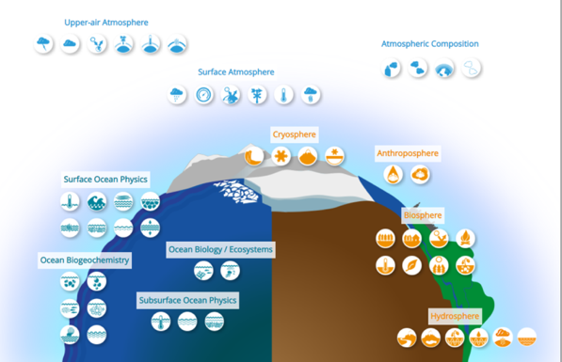
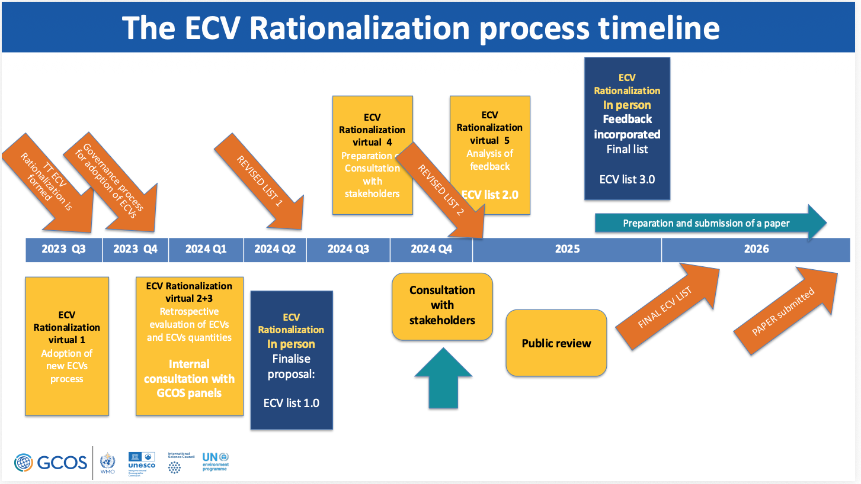
User requirements
GCOS ECVs requirements for climate applications have been historically the main driver for defining LPV validation framework
More recently, GEOBON, GEOGLAM started to formulate their needs for EBVs, EAVs, although their uncertainty requirements are not yet mature
Collaborations with user groups:
Active participation to the public review within the GCOS ECVs rationalization process (Jul-Sep 2025)
Future cooperation with GCOS is foreseen for defining updated ECVs uncertainty requirements (2028)
Close cooperation with GEOGLAM for crop mapping and LC protocol, now on-going for ET protocol

Slide 6
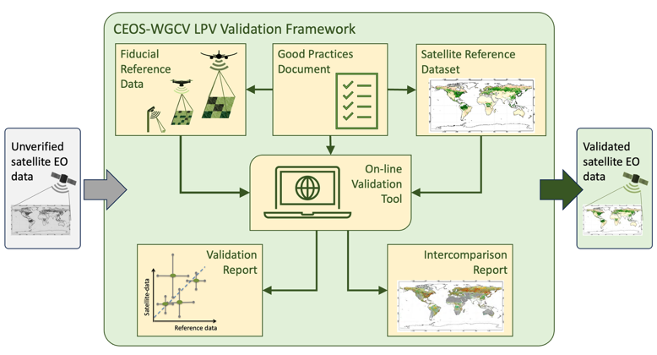
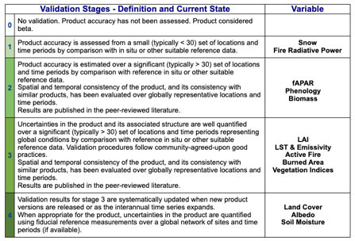
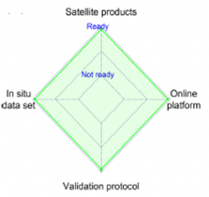
LPV Validation Framework
Core elements:
Fiducial Reference Measurements
Validation Good Practices Protocol
Reference satellite products
On-line validation tool
LPV Validation stage
Readiness of the four core elements essential to reach Stage 4
Maturity increases as reference data becomes more representative across biomes and ecoclimatic conditions
Validation methods and results should undergo rigorous peer-review
Niro et al. 2024
Bayat et al. 2020

Slide 7



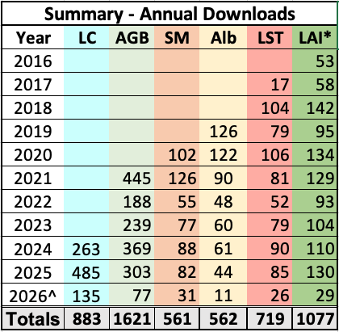



LPV Protocols
Key outcome of LPV sub-group:
Guidelines for measurements, comparison to satellite, uncertainty evaluation, metrics
Community-driven effort, lengthy process
Need regular update as requirements evolve, new sensors and methods emerge
2014 - LAI
2018 - LST
2019 - Albedo
Statistics of download from LPV web site demonstrate the strong uptake of the protocols within the community with the most recent LC protocol rapidly becoming one of the most popular
2020 - SM
2021 - AGB
2026 - LC

Slide 8
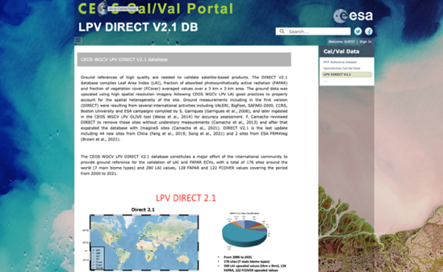
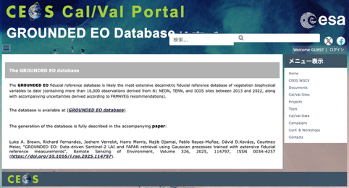
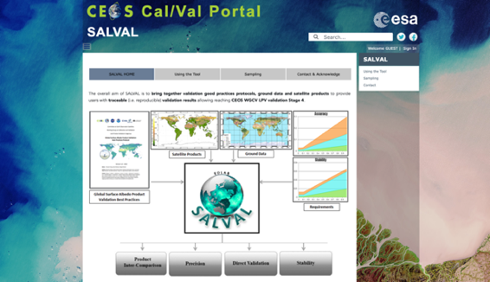

LPV Datasets and Tools
Available in CEOS Cal/Val portal:
LPV Direct 2.1 dataset for LAI, fAPAR, fCover coarse resolution
GROUNDED EO most extensive decametric resolution dataset for LAI/FAPAR following FRM4VEG
SALVAL Tool for broadband albedo coarse resolution using ground-based data and reference satellite products
OLIVE Tool for LAI/fAPAR outdated (long-standing action) → ESA project to update the tool, starting on April 2026

Slide 9
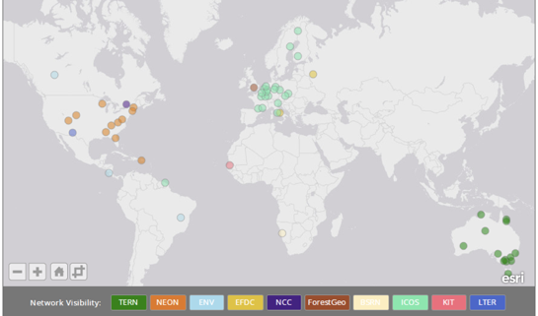
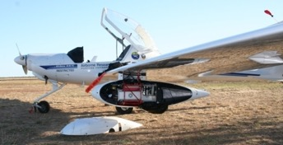
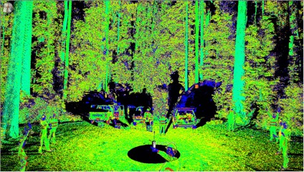
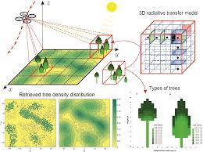
LPV Supersites V1
Objective: evaluate most suitable sites to support satellite land products validation
First defined in 2016 in response to CEOS action:
Well characterised site including 3D canopy structure and key land variables → Enabling RTM-based validation
Useful for validating 3+ ECVs → Cross ECVs physical consistency (GCOS IP 20222)
Long term sustained operations, part of established networks
Follow community-agreed protocols
Ideally supported by airborne acquisitions
GCOS 2022 IP: “Currently satellite-based products developed separately with different processing streams despite several ECVs being closely inter-related (e.g., albedo, Fire, FAPAR and LAI). Consistency between these products needs to be ensured so that data from multiple sources can be used together.”

Slide 10


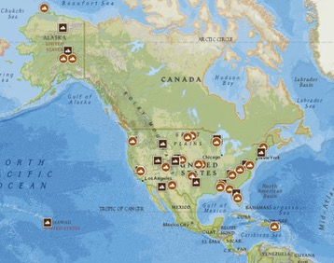



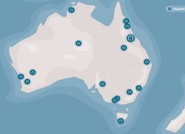
LPV Supersites V2 review
Since 2016 landscape has evolved: new networks, new sites and projects, new variables and missions
Review definition
Expand variables: ET, GPP/NPP, SIF, BRF (hyp)
For validation of 3+ family of ECVs (multi-themes, e.g., not only FAPAR/LAI/FCover, but also albedo, LST, SM)
Airborne + UAV Hyperspectral / Lidar (ideal)
Adherence (ideal) to CEOS-FRM principles
Review selection (220+ candidate)
Include recent networks /project/sites
Refine ranking: ancillary data, spatial homogeneity, biomes and geographical relevance

Slide 11
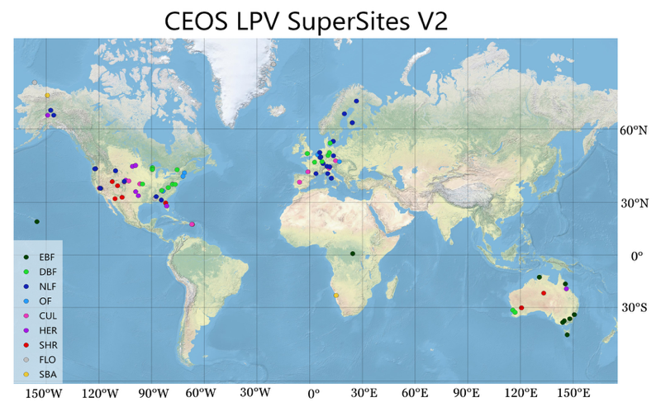
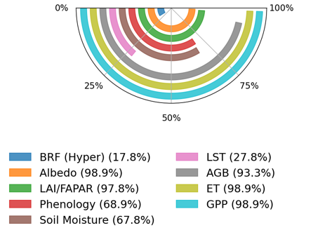
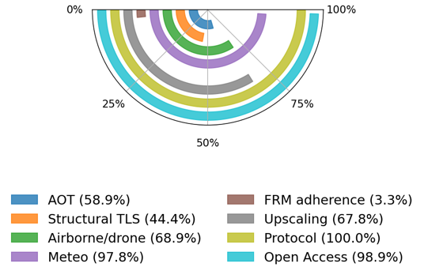
LPV Supersites 2.0
Status
Internal LPV review completed
Final version published in LPV website
90 sites + 64 candidate sites
Spreadsheet + TN delivered
It should be regularly updated (every 5 years)
Remaining gaps
Geographical gaps
Some biomes under sampled
Limited adherence to FRM
LST and Spectrally-resolved BRF

Slide 12
FA status report
Biophysical
Fires
Phenology
Vegetation Index
Land Cover
Snow
Surface Radiation
Soil Moisture
LST / LSE
Biomass
Evapotranspiration
GPP/NPP
Protocol Ready
Update on going
Draft ready
Draft on going

Slide 13
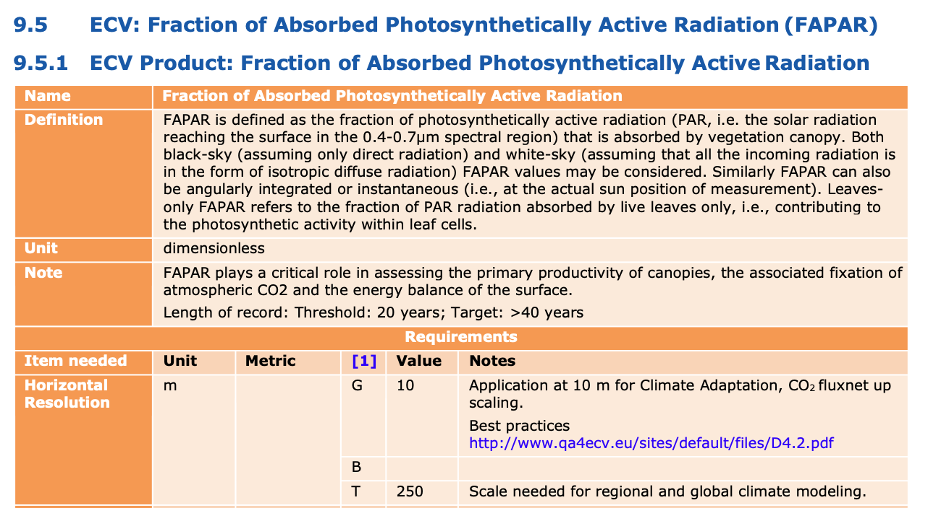


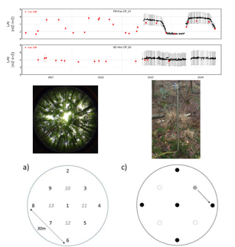

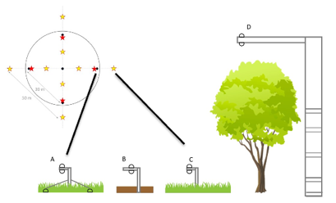
Biophysical
LAI 2014 protocol revision
Add new variable: FCover, FAPAR
More stringent GCOS 2022 requirements (FAPAR Res G=10m, U G=5%) for climate adaptation
Better align to CEOS-FRM principles
Recent technological advances (e.g., UAV, automated)
Draft paper sent to co-authors, 15+ comments
Submission in Q2 2026 to new EGU EO Journal
Better use of ICOS for Cal/Val (NUBICOS EU)
Long-standing action within LPV
Align protocol to FRM4VEG and LPV (e.g., understory)
Progressively updating across all ICOS sites

Slide 14

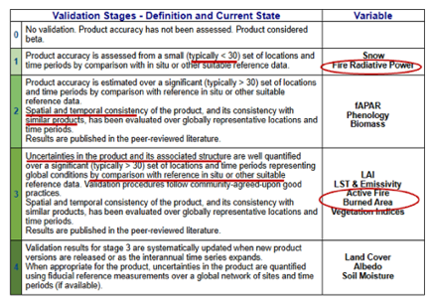
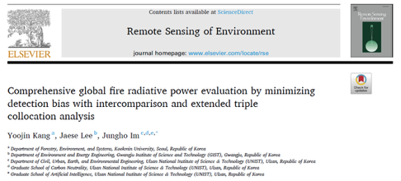
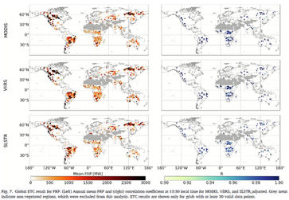
Fires
Burned Area (BA)
Updated GCOS requirements (Goal=10 m)
Consolidated draft UMD and NPL lead authors
Still some disagreement within the community regarding required sample sizes, metrics
Fire Radiative Power (FRP)
Still at validation stage 1
Scarcity of campaign data remain the main constraint
FRM4Fires aiming at enhancing maturity by developing FRP traceability / uncertainty tree
Recent use of triple collocation to assess FRP (MODIS, VIIRS, SLSTR) consistency

Slide 15
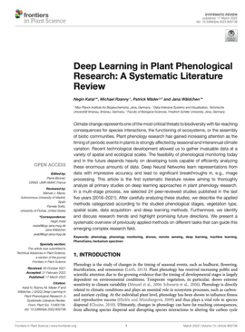
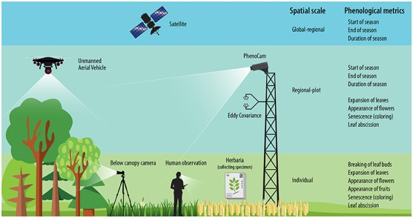
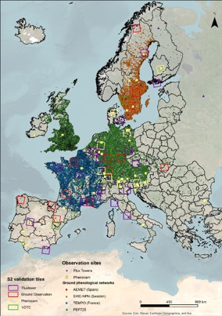
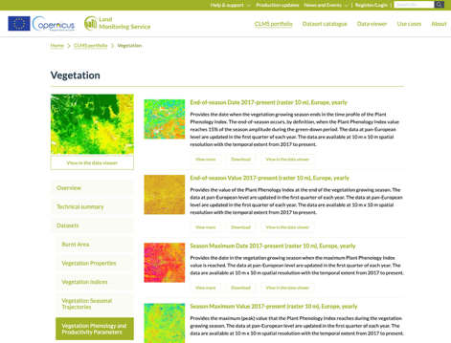
Phenology and VI
Land surface phenology (LSP)
Consolidated draft ready under review
Focus on HR, Copernicus HR-VPP (10m)
Large variety of Cal/Val sources and different spatiotemporal scale sampled
Emerging use of UAV: review paper being prepared
Systematic use of Ground-based networks (PhenoCam, Flux Towers)
Vegetation Indices
Q2 2026: release of consolidated draft V2 to the community for collecting feedback
Katal et al. 2022

Slide 16

Land Cover
Status and Challenge
Ever increasing number of HR (10m) maps
Large discrepancies in quality assessment methods still hampers the comparability across products
LC Protocol
Updating Straheler et al. 2006 guidelines
V1.1 published in Nov 2025 (WGCV comments)
Strong community effort
35 co-authors, 18 Institutions/agencies
~200 pages, 300+ references
GCOS and GEOGLAM requirements considered
Recently presented at CEOS SIT

Slide 17
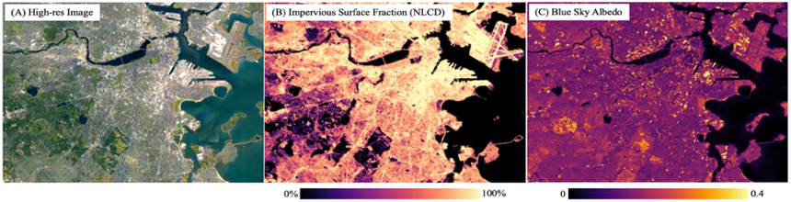
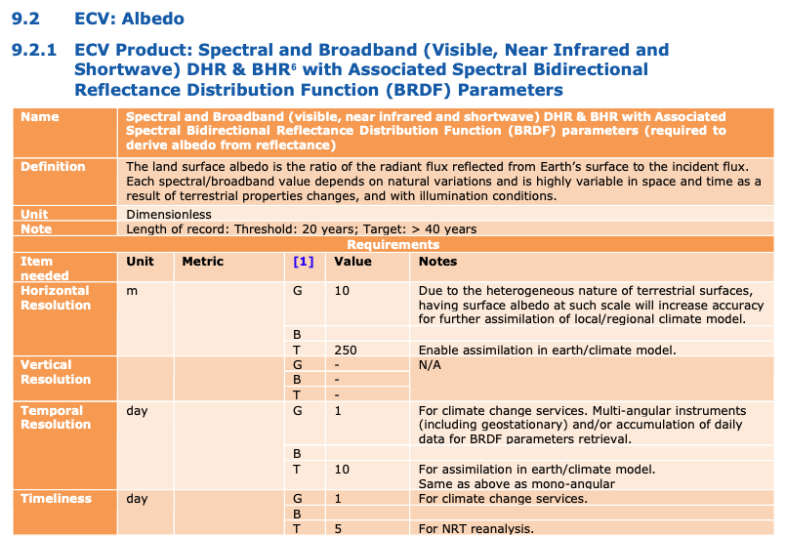
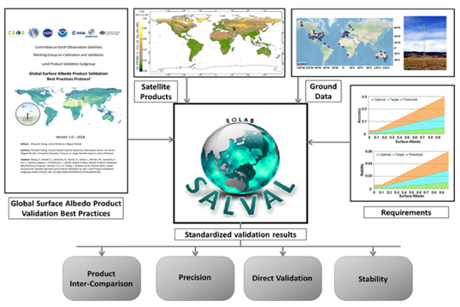
Surface Radiation
Status and Challenges
Emerging focus on HR (G=10m) products for urban monitoring (GCOS 2022)
Requirement for spectral + broadband DHR and BHR + BRDF parameters
Need to improve accuracy of albedo over ice/snowy surfaces (GCOS 2022 IP)
Status within LPV
Existing protocol (2019) and tool (SALVAL) focus on coarse resolution and broadband
Need to update to move to HR and include BRDF parameters and spectral albedo
Plan to have an initial draft in 2027
GCOS 2022 IP: “There is a need to improve the accuracy and consistency of observations of albedo for ice and snowy surfaces across domains (terrestrial snow, land ice, ..)”
https://eolab.es/salval/

Slide 18
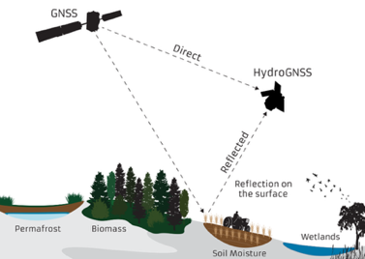

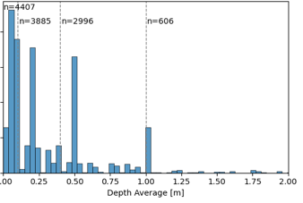
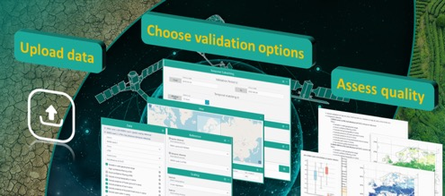
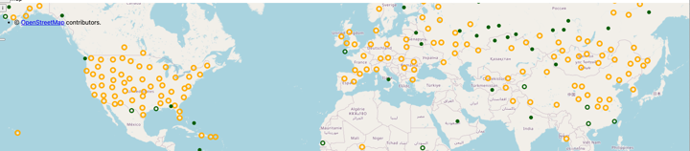
Soil Moisture
Evolving requirements
Moving towards HR products (<1km)
Need below-ground SM
New technology (GNSS), missions, e.g., CIMR
Need to update 2020 LPV protocol:
Maintain / improve ISMN + QA4SM
Higher spatial resolution and support to root zone soil moisture (RZSM) validation
Assess adherence to CEOS-FRM → FRM assessment of ISMN on-going
Aiming at first consolidated draft in Q2 2026, final update in 2027
https://ismn.earth/en/
ISMN measuring depths
https://qa4sm.eu/

Slide 19
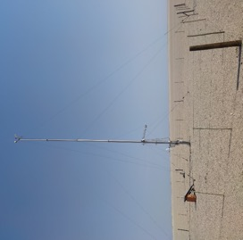
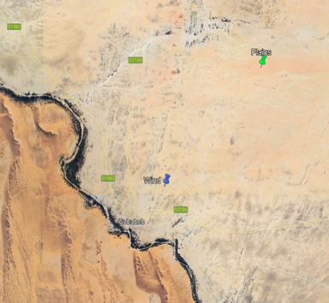
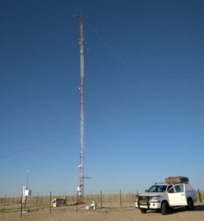
LST / LSE
Contribute to TIRCalNet
Intercomparison of 3 radiometers (JPL, KIT15, CIMEL) at La Crau
Since Nov 2024, long-term intercomparison between JPL and KT15 at Lake Constance
Field campaign
Planned in Oct 2026 in Gobabeb
Long-term dataset acquired by KIT including in-situ emissivity spectra
Plan to deploy two radiometers
Evaluate different RTM simulations at TOA to characterise uncertainties

Slide 20


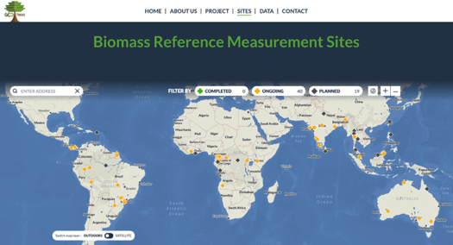
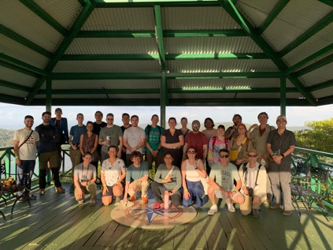
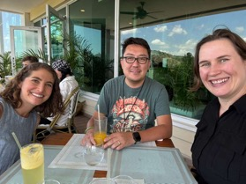
Biomass
GEO-TREES a Global Forest Biomass Reference System
Stems from LPV AGB protocol recommendations
100 core sites (60 Tropical, 40 Temperate)
Open data policy, long-term commitment
Updates
TLS field campaign in Ghana (Jan-Feb 2026) to support ESA-BIOMASS validation
GEO-TREES WS in Panama (March 2026), the new LPV FA leads present, maintaining LPV-GEO-TREES link
Integrate and harmonize the inventory, TLS, and ALS processing pipelines
https://geo-trees.org/

Slide 21
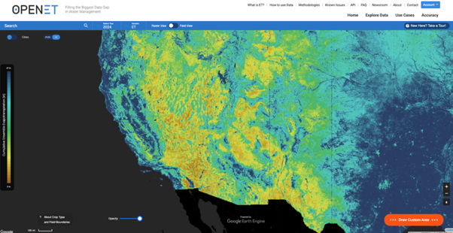
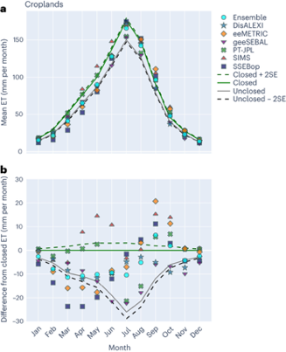

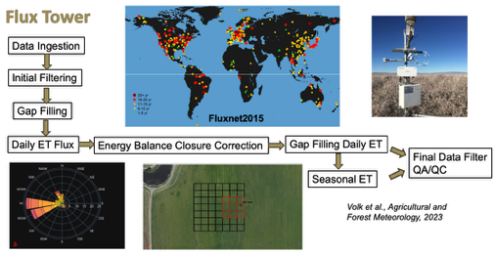
Evapotranspiration
Status and challenges (New FA)
Strong relevance for land applications: agriculture, water management, …
Growing number of ET products, also driven by upcoming HR TIR missions (TRISHNA, LSTM)
Discrepancies between models / validation methods
Urgent need for community protocol
First draft of outline LPV protocol being prepared
LPV-GEOGLAM WS (22-24 Jun 2026, FAO), draft protocol will be presented / discussed
Consolidated agenda for the WS agreed
https://etdata.org/

Slide 22
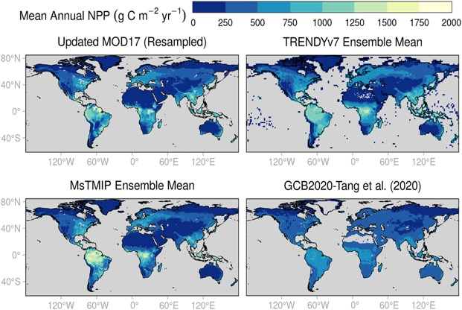
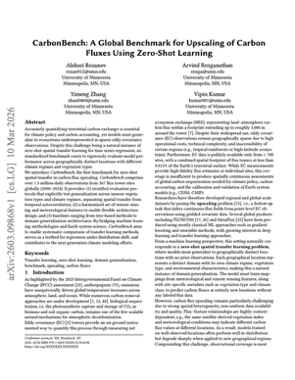
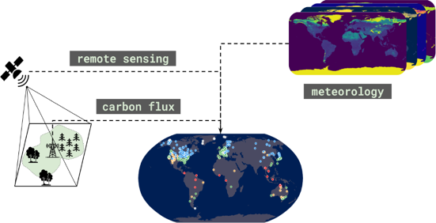
GPP / NPP
Status and challenges
GPP recently proposed as new ECV quantity in the “Vegetation properties and productivity” group
Growing interest and availability of GPP/NPP global satellite products, e.g., MODIS, VIIRS, Copernicus
Large Variety of models and input data, persistent inconsistencies across products / validation methods
Recent updates: CarbonBench
Benchmark exercise to systematically evaluate models that estimate GPP at global scale.
It compiles a large dataset from FLUXNET sites (567 sites, 2020-2024) allowing to test models’ ability to generalize to ecosystems and regions
Endsley et al. (JGR: Biogeosciences)

Slide 23
Summary and Outlook
Working along the lines of the LPV 2026-29 Action Plan
Develop and evolve validation practices and tools → LAI, FAPAR, albedo, SM, BA, LSP
Enhance representativeness and coverage of reference data → LPV Supersites V2
Strengthen collaboration with user community → GCOS, GEOGLAM, GEO-TREES
Reinforce focus on CEOS-FRM → FRM embedded in upcoming protocols: FAPAR, SM, FRP
Enhance awareness and communication → LC protocol at CEOS-SIT, LPV web site
Outlook
Work towards filling long-standing gaps: OLIVE, ICOS for Cal/Val
Further strengthen collaboration with GEOGLAM for ET protocol (WS in June)
Cooperate with GCOS in the definition of uncertainty requirements for new ECVs
Enhance readiness for upcoming missions (hyperspectral, HR TIR)

Slide 24
Recent updates on ACIX-III and ACIX-IV Land

Slide 25
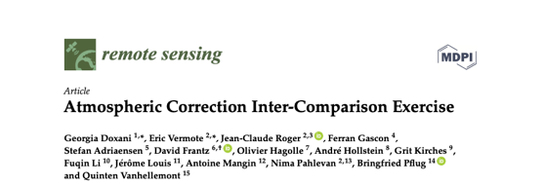
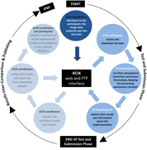
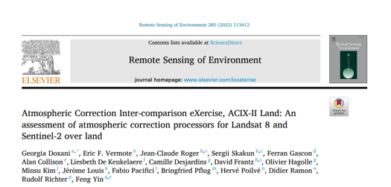


ACIX framework
Goal → Understand strengths/limitations and enhance harmonisation of AC algorithms
Generic “X” approach
Engage the community
Agree on protocol, references and metrics
Run the inter-comparison exercise
Review/discuss the results
Publish the paper
ACIX Started in 2016, 10 years coordinated by ESA-NASA under CEOS-WGCV auspices, initial focus on L8/S2 → 4 highly cited papers
Since ACIX-II, 3 groups focusing on Land, Water and Cloud Mask (CMIX)

Slide 26


ACIX-III Land and Aqua
Status
Focus on hyperspectral: EnMAP, PRISMA in preparation to CHIME
Validation of AOD and TCWV over a set of AERONET sites
Validation of SR using data from networks (RadCalNet, HYPERNETS, AERONET-OC) and field campaigns for CHIME/SBG
Use similar methods and metrics (APU) as in previous ACIX
2 papers published in 2025
 | ACIX-III Land | ACIX-III Aqua
# processor | 7 | 7
EO data | PRISMA, EnMAP | PRISMA
Reference | RadCalNet, HYPERNETS, ad-hoc campaigns, AERONET | AERONET-OC, HYPERNETS, ad-hoc campaigns
Gilardino et al. 2025
Cremer et al. 2025

Slide 27

ACIX-IV Land
ACIX-III shows strong impact of spatial heterogeneity and adjacency effects for field campaign data
Reliable results mostly obtained over RadCalNet and HYPERNETS Gobabeb bright and homogeneous sites
ACIX-IV will use data from networks, HYPERNETS, complemented with RTM simulations to better characterize uncertainty sources
ACIX-IV Land Proposal
Simulated realistic TOA scenes (S2, CHIME) over different land cover types, seasons (summer/winter) and atmospheric conditions (atmospheric vertical profile, aerosol properties) based on the ESA-Rayference Digital Twin Earth Synthetic Scene Generator (DTE-S2GOS) project
Simulations of satellite (L8, S2) SR using the 6SV RTM based on aerosol ground measurements.
Simulated MSI RGB image
Simulated CHIME RGB image
Image credit: Rayference
Image credit: Vermote et al., 2006

Slide 28


ACIX-IV Land
How
Who
The approach would be to maintain it under CEOS-WGCV auspices as in previous ACIX
Developer Teams from various Space Agencies, R&D Companies, Research Institutes and Universities (tentative list)
Processor/Model | Organisation/Affiliation
PACO | DLR
HYPER SIAC | University College London
MAGAC | MAGELLIUM
GeoNEX-AC | NASA Ames Research Center
ACOLITE DSF | RBINS
ImaACor | CNR IMAA
ATREM | Naval Research Lab, Washington DC USA
ATCOR | ReSe Applications
iCOR | VITO Remote Sensing
IsoFIT | NASA JPL
PRISMA | ASI
Processor/Model | Organisation/Affiliation
CHRIS/PROBA | University Valencia/Brockmann
COCHISE | ONERA
SIERRA | ONERA
ICARE | ONERA
HATCH | University of Colorado
FLAASH | Air Force Research Laboratory, Hanscom AFB and Spectral Sciences, Inc.
ACORN | Spectral Information Technology Applications Ctr.
HISUI | METI
QUAC | Spectral Sciences
ISDAS | Canada Center for Remote Sensing
When
1st WS in Autumn 2026

Slide 29



HARMONIX
New international initiative being defined on intercomparing different approaches for BRDF normalization and data fusion for S2/L8-9, such as:
HLS (NASA)
Sen2Like (ESA)
NN-based data fusion (CNES)
… Open call for others
Initial definition of a comparison protocol and associated quality metrics being explored, e.g., TSI

Slide 30
Thanks !

